Slide 1
Dual Link Image Coding for Earth Observation Satellites
Francesc Aulí-Llinàs
Dep. of Information and Communications Engineering,
Universitat Autònoma de Barcelona, Spain

Slide 2
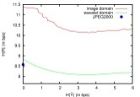
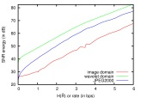
TABLE OF CONTENTS
INTRODUCTION
DUAL LINK IMAGE CODING
EXPERIMENTAL RESULTS
CONCLUSIONS
Motivation
Earth Obervation (EO) satellites in geosynchronous orbits have limited download capacity
Imaging sensors in EO satellites have increased their resolution
Need to trim down data before it is downloaded
Research purpose: increase the download capacity of EO satellites

Slide 3
TABLE OF CONTENTS
INTRODUCTION
DUAL LINK IMAGE CODING
EXPERIMENTAL RESULTS
CONCLUSIONS
Motivation
Earth Obervation (EO) satellites in geosynchronous orbits have limited download capacity
Imaging sensors in EO satellites have increased their resolution
Need to trim down data before it is downloaded
Research purpose: increase the download capacity of EO satellites

Slide 4
INTRODUCTION
SATELLITES’ ORBITS
1

Slide 5
INTRODUCTION
SATELLITES’ ORBITS
GEOSYNCHRONOUS
Located upon a stationary
point on the Earth’s equator
High altitudes: 22,000 miles
Ground stations with
uninterrupted line of sight
Employed for:
Communications
TV broadcast
Weather monitoring
…
1

Slide 6
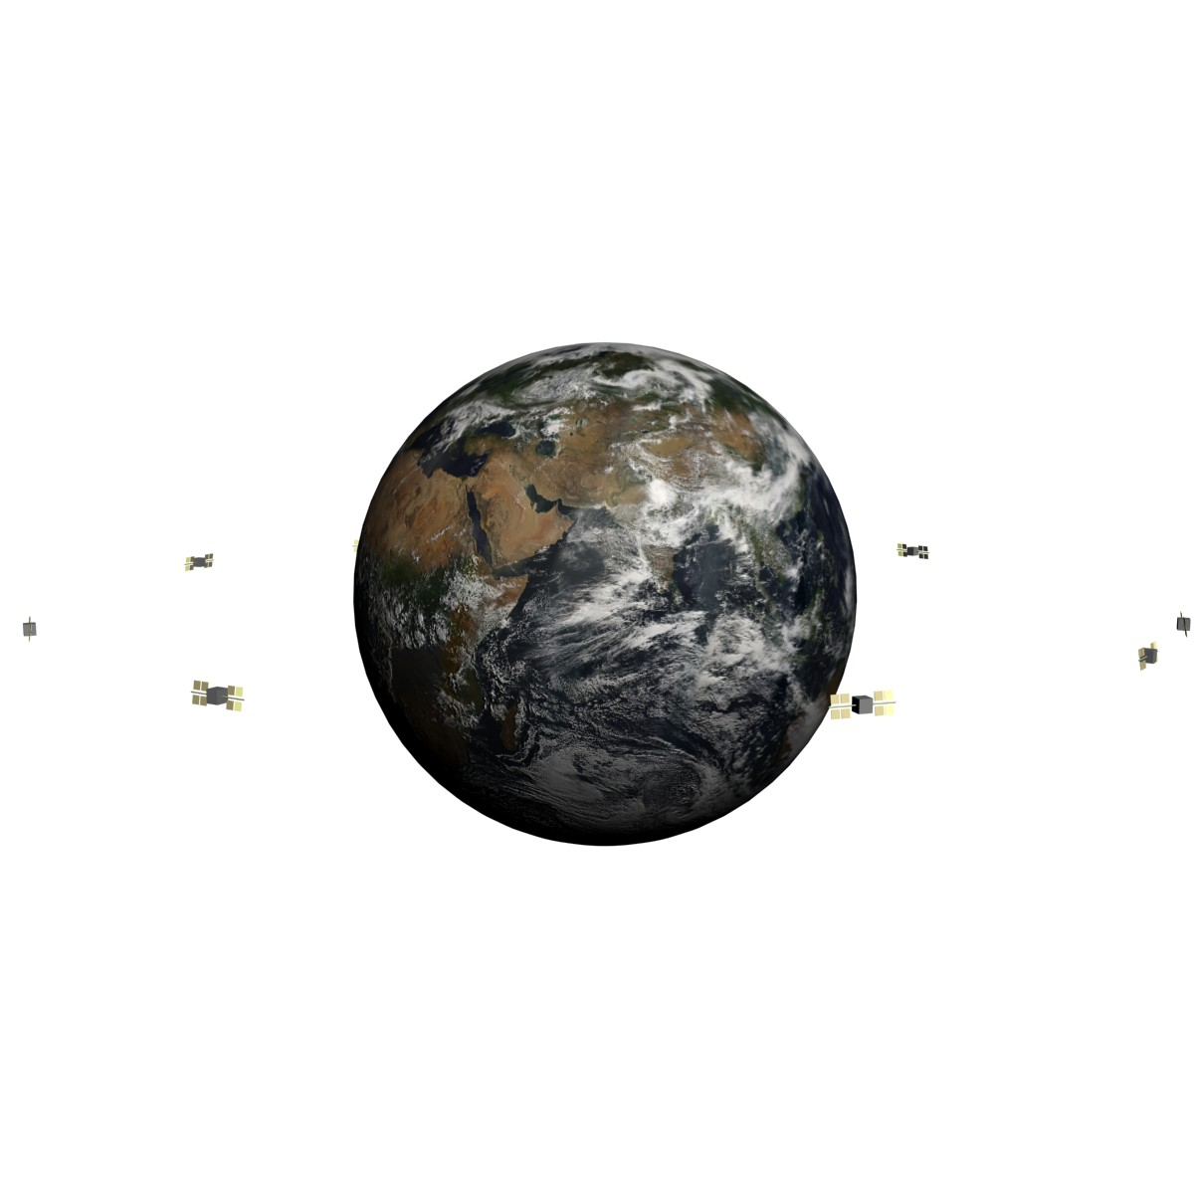
INTRODUCTION
SATELLITES’ ORBITS
GEOSYNCHRONOUS
Located upon a stationary
point on the Earth’s equator
High altitudes: 22,000 miles
Ground stations with
uninterrupted line of sight
Employed for:
Communications
TV broadcast
Weather monitoring
…
PERMANENT COMMUNICATION LINK
all acquired data can be downloaded
1

Slide 7
INTRODUCTION
SATELLITES’ ORBITS
GEOSYNCHRONOUS
Located upon a stationary
point on the Earth’s equator
High altitudes: 22,000 miles
Ground stations with
uninterrupted line of sight
Employed for:
Communications
TV broadcast
Weather monitoring
…
1

Slide 8
INTRODUCTION
SATELLITES’ ORBITS
POLAR
Revolutions from the North
to the South Pole
Low/medium altitudes:
100 to 10,000 miles
Ground stations at the poles
(10-20 minutes for data
downloading)
Employed for:
Earth Observation (EO)
Surface and atmosphere
monitoring
…
2

Slide 9
INTRODUCTION
SATELLITES’ ORBITS
POLAR
Revolutions from the North
to the South Pole
Low/medium altitudes:
100 to 10,000 miles
Ground stations at the poles
(10-20 minutes for data
downloading)
Employed for:
Earth Observation (EO)
Surface and atmosphere
monitoring
…
RESEARCH PURPOSE:
ENHANCE THE ABILITY OF EO SATELLITES
TO DOWNLOAD THE DATA ACQUIRED BY
THEIR IMAGING SENSORS
INTERMITENT COMMUNICATION LINK
data acquired by high resolution
imaging sensors may not be fully
downloaded
2

Slide 10
TABLE OF CONTENTS
INTRODUCTION
DUAL LINK IMAGE CODING
EXPERIMENTAL RESULTS
CONCLUSIONS
Motivation
Earth Obervation (EO) satellites in geosynchronous orbits have limited download capacity
Imaging sensors in EO satellites have increased their resolution
Need to trim down data before it is downloaded
Research purpose: increase the download capacity of EO satellites

Slide 11
DUAL LINK IMAGE CODING
TRADITIONAL APPROACH
3

Slide 12
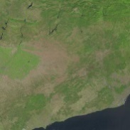
DUAL LINK IMAGE CODING
TRADITIONAL APPROACH
CODING STEPS
The sensor captures the image
3

Slide 13
DUAL LINK IMAGE CODING
TRADITIONAL APPROACH
CODING STEPS
The sensor captures the image
The satellite codes the image
3

Slide 14
DUAL LINK IMAGE CODING
TRADITIONAL APPROACH
CODING STEPS
The sensor captures the image
The satellite codes the image
The image is transmitted via the downlink
3

Slide 15
DUAL LINK IMAGE CODING
TRADITIONAL APPROACH
CODING STEPS
The sensor captures the image
The satellite codes the image
The image is transmitted via the downlink
3

Slide 16
DUAL LINK IMAGE CODING
TRADITIONAL APPROACH
CODING STEPS
The sensor captures the image
The satellite codes the image
The image is transmitted via the downlink
EMPLOYED CHANNEL: downlink only
(uplink idle most of the time)
4

Slide 17
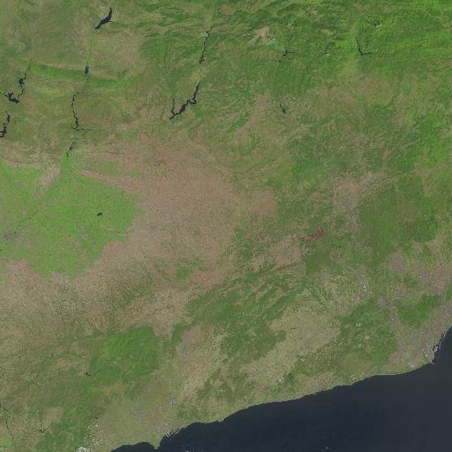
DUAL LINK IMAGE CODING
TRADITIONAL APPROACH
CODING STEPS
The sensor captures the image
The satellite codes the image
The image is transmitted via the downlink
EMPLOYED CHANNEL: uplink only
(downlink idle most of the time)
TYPES OF REDUNDANCY EXPLOITED
Spatial redundancy
4

Slide 18
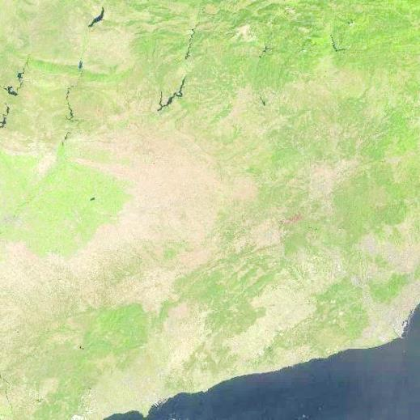
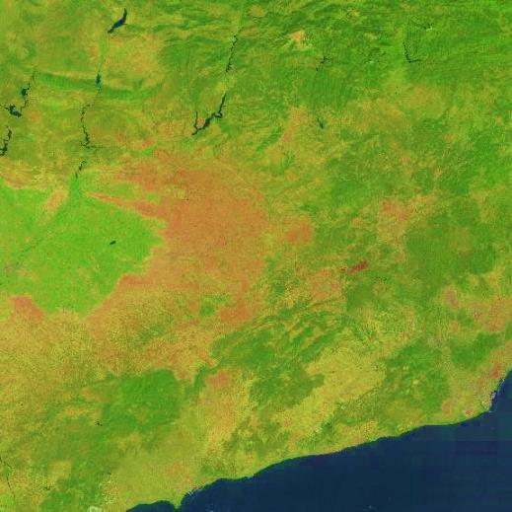
DUAL LINK IMAGE CODING
TRADITIONAL APPROACH
CODING STEPS
The sensor captures the image
The satellite codes the image
The image is transmitted via the downlink
EMPLOYED CHANNEL: uplink only
(downlink idle most of the time)
TYPES OF REDUNDANCY EXPLOITED
Spatial redundancy
Spectral redundancy
4

Slide 19
DUAL LINK IMAGE CODING
TRADITIONAL APPROACH
CODING STEPS
The sensor captures the image
The satellite codes the image
The image is transmitted via the downlink
EMPLOYED CHANNEL: uplink only
(downlink idle most of the time)
LANDSAT 8 SATELLITE
650 images per day
352 MB per image
Repeat cycle: 16 days
images of an area of
Barcelona over a period
of a year
TYPES OF REDUNDANCY EXPLOITED
Spatial redundancy
Spectral redundancy
4

Slide 20
DUAL LINK IMAGE CODING
TRADITIONAL APPROACH
CODING STEPS
The sensor captures the image
The satellite codes the image
The image is transmitted via the downlink
EMPLOYED CHANNEL: uplink only
(downlink idle most of the time)
LANDSAT 8 SATELLITE
650 images per day
352 MB per image
Repeat cycle: 16 days
images of an area of
Barcelona over a period
of a year
TYPES OF REDUNDANCY EXPLOITED
Spatial redundancy
Spectral redundancy
4

Slide 21
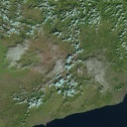
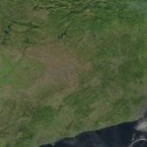
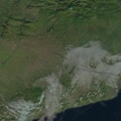
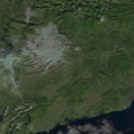
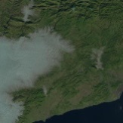
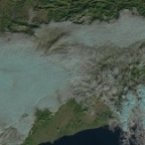
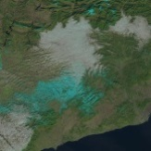
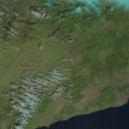
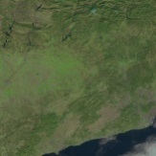
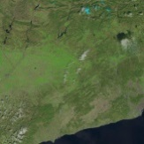
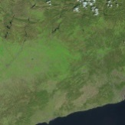
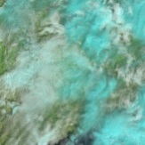
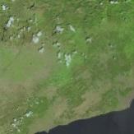
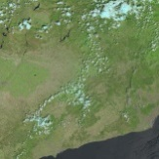
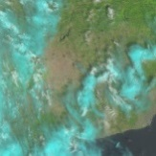
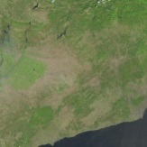
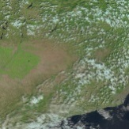
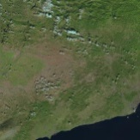
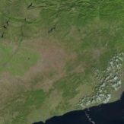
DUAL LINK IMAGE CODING
TRADITIONAL APPROACH
CODING STEPS
The sensor captures the image
The satellite codes the image
The image is transmitted via the downlink
EMPLOYED CHANNEL: uplink only
(downlink idle most of the time)
LANDSAT 8 SATELLITE
650 images per day
352 MB per image
Repeat cycle: 16 days
images of an area of
Barcelona over a period
of a year
TYPES OF REDUNDANCY EXPLOITED
Spatial redundancy
Spectral redundancy
5

Slide 22
DUAL LINK IMAGE CODING
TRADITIONAL APPROACH
CODING STEPS
The sensor captures the image
The satellite codes the image
The image is transmitted via the downlink
EMPLOYED CHANNEL: uplink only
(downlink idle most of the time)
LANDSAT 8 SATELLITE
650 images per day
352 MB per image
Repeat cycle: 16 days
images of an area of
Barcelona over a period
of a year
TYPES OF REDUNDANCY EXPLOITED
Spatial redundancy
Spectral redundancy
Temporal redundancy
satellite’s constraints
(space, computation & power)
5

Slide 23
DUAL LINK IMAGE CODING
TRADITIONAL APPROACH
CODING STEPS
The sensor captures the image
The satellite codes the image
The image is transmitted via the downlink
EMPLOYED CHANNEL: uplink only
(downlink idle most of the time)
INSIGHT OF DUAL LINK IMAGE CODING:
SEND REFERENCE INFORMATION VIA THE UPLINK SO THAT TEMPORAL REDUNDANCY
IS ALSO EXPLOITED IN THE SATELLITE
LANDSAT 8 SATELLITE
650 images per day
352 MB per image
Repeat cycle: 16 days
images of an area of
Barcelona over a period
of a year
TYPES OF REDUNDANCY EXPLOITED
Spatial redundancy
Spectral redundancy
Temporal redundancy
satellite’s constraints
(space, computation & power)
5

Slide 24
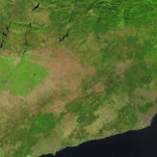
DUAL LINK IMAGE CODING
PROPOSED APPROACH
CODING STEPS
The ground station generates and codes
an estimate image
6

Slide 25
DUAL LINK IMAGE CODING
PROPOSED APPROACH
CODING STEPS
The ground station generates and codes
an estimate image
6

Slide 26
DUAL LINK IMAGE CODING
PROPOSED APPROACH
CODING STEPS
The ground station generates and codes
an estimate image
The estimate is transmitted via the uplink
and decoded by the satellite
6

Slide 27
DUAL LINK IMAGE CODING
PROPOSED APPROACH
CODING STEPS
The ground station generates and codes
an estimate image
The estimate is transmitted via the uplink
and decoded by the satellite
The satellite codes the captured image
using the estimate
6

Slide 28
DUAL LINK IMAGE CODING
PROPOSED APPROACH
CODING STEPS
The ground station generates and codes
an estimate image
The estimate is transmitted via the uplink
and decoded by the satellite
The satellite codes the captured image
using the estimate
The codestream is transmitted via the
downlink
6

Slide 29
DUAL LINK IMAGE CODING
PROPOSED APPROACH
CODING STEPS
The ground station generates and codes
an estimate image
The estimate is transmitted via the uplink
and decoded by the satellite
The satellite codes the captured image
using the estimate
The codestream is transmitted via the
downlink
The ground station decodes the codestream
and recovers the captured image
6

Slide 30
DUAL LINK IMAGE CODING
OTHER ASPECTS
CODING STEPS
The ground station generates and codes
an estimate image
The estimate is transmitted via the uplink
and decoded by the satellite
The satellite codes the captured image
using the estimate
The codestream is transmitted via the
downlink
The ground station decodes the codestream
and recovers the captured image
GENERATION OF THE ESTIMATE & RESIDUAL
The ground station has all captured data
and vast computational resources to
generate the estimate
The satellite must utilize simple techniques
to exploit the estimate (herein, Y – X = R)
7

Slide 31
DUAL LINK IMAGE CODING
OTHER ASPECTS
CODING STEPS
The ground station generates and codes
an estimate image
The estimate is transmitted via the uplink
and decoded by the satellite
The satellite codes the captured image
using the estimate
The codestream is transmitted via the
downlink
The ground station decodes the codestream
and recovers the captured image
GENERATION OF THE ESTIMATE & RESIDUAL
The ground station has all captured data
and vast computational resources to
generate the estimate
The satellite must utilize simple techniques
to exploit the estimate (herein, Y – X = R)
SYNCHRONIZATION
Up/down transmission occurs in parallel,
so the packets of data must be synchronized
7

Slide 32
DUAL LINK IMAGE CODING
OTHER ASPECTS
CODING STEPS
The ground station generates and codes
an estimate image
The estimate is transmitted via the uplink
and decoded by the satellite
The satellite codes the captured image
using the estimate
The codestream is transmitted via the
downlink
The ground station decodes the codestream
and recovers the captured image
GENERATION OF THE ESTIMATE & RESIDUAL
The ground station has all captured data
and vast computational resources to
generate the estimate
The satellite must utilize simple techniques
to exploit the estimate (herein, Y – X = R)
SYNCHRONIZATION
Up/down transmission occurs in parallel,
so the data packets must be synchronized
7

Slide 33
TABLE OF CONTENTS
INTRODUCTION
DUAL LINK IMAGE CODING
EXPERIMENTAL RESULTS
CONCLUSIONS
Motivation
Earth Obervation (EO) satellites in geosynchronous orbits have limited download capacity
Imaging sensors in EO satellites have increased their resolution
Need to trim down data before it is downloaded
Research purpose: increase the download capacity of EO satellites

Slide 34
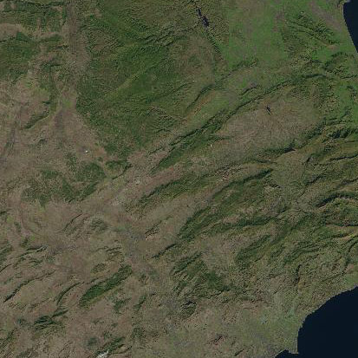
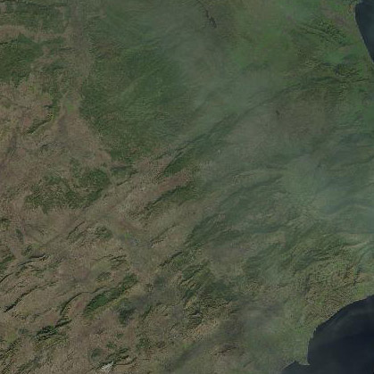
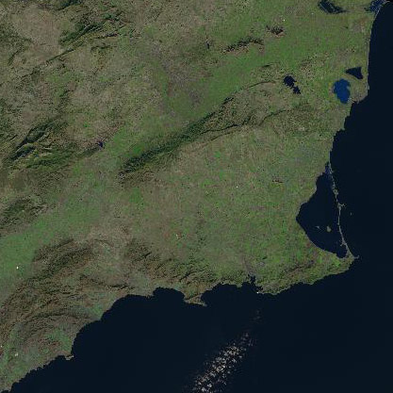
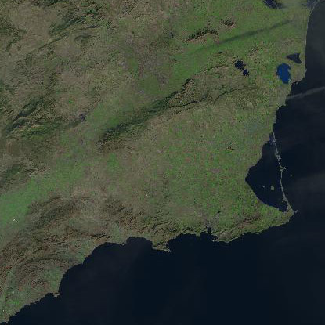
EXPERIMENTAL RESULTS
CORPORA OF IMAGES
LANDSAT 8
Alicante (Spain) - WRS-2 path 199, row 33
2048x2048, 11 components, 16 bps
LANDSAT 8
Cartagena (Spain) - WRS-2 path 199, row 34
2048x2048, 11 components, 16 bps
ESTIMATE
(previous image)
June 23, 2015
ESTIMATE
(previous image)
February 12, 2014
8

Slide 35
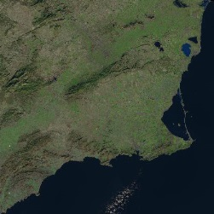
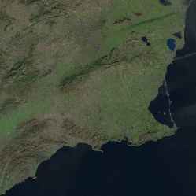
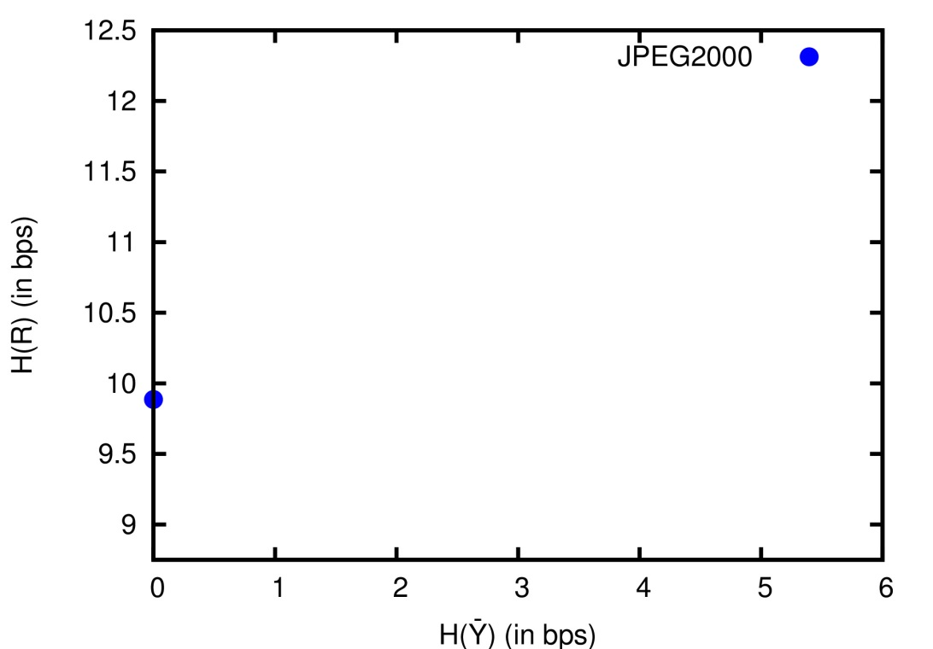
EXPERIMENTAL RESULTS
LOSSLESS COMPRESSION (entropy-based evaluation)
Alicante
Cartagena
9

Slide 36
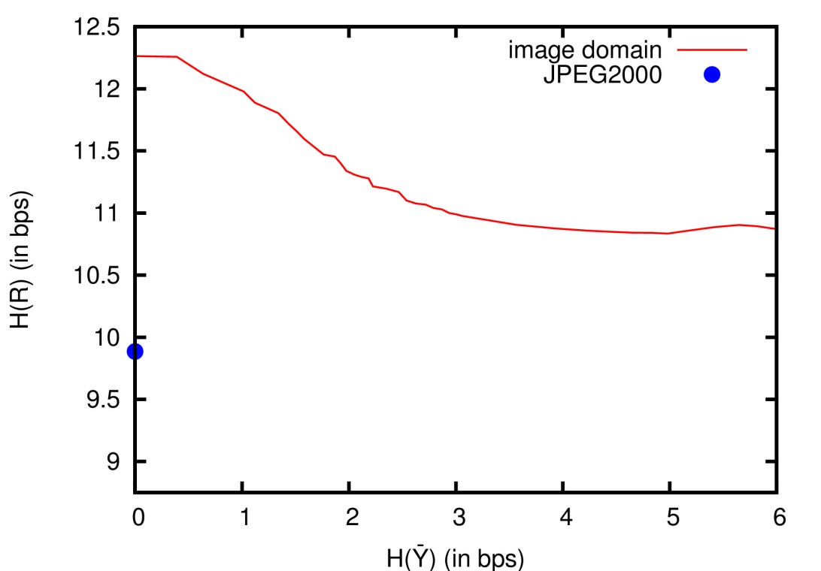
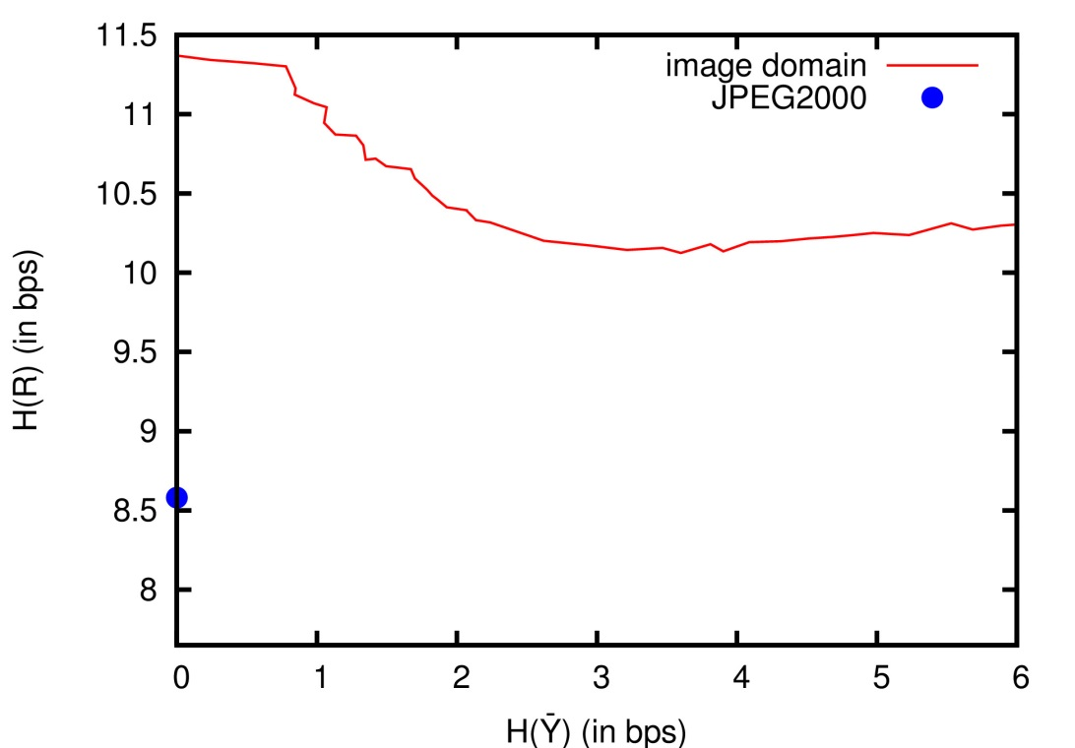
EXPERIMENTAL RESULTS
LOSSLESS COMPRESSION (entropy-based evaluation)
Alicante
Cartagena
9

Slide 37
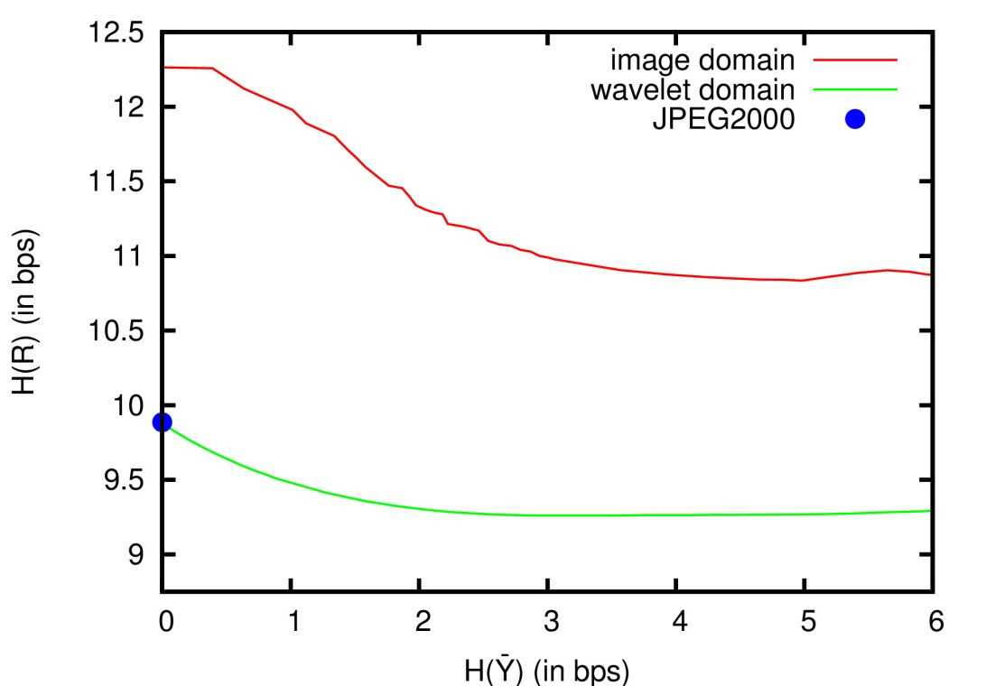
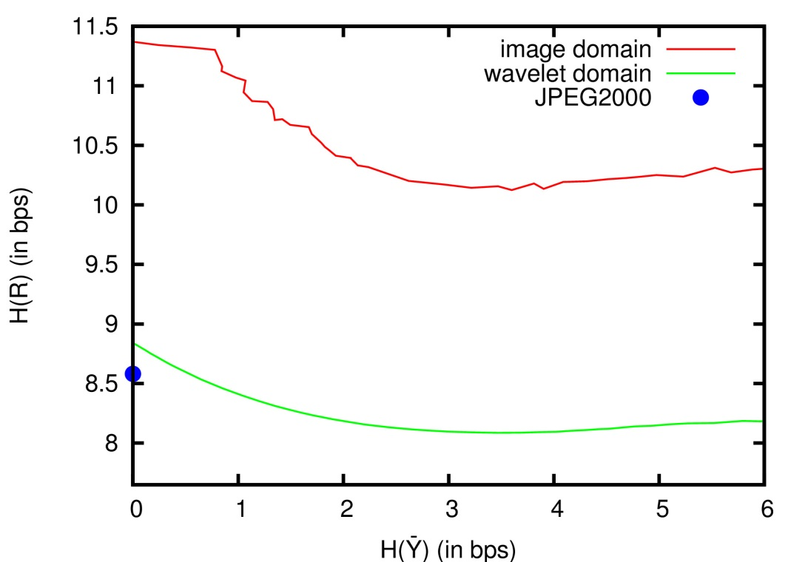
EXPERIMENTAL RESULTS
LOSSLESS COMPRESSION (entropy-based evaluation)
Alicante
Cartagena
9

Slide 38
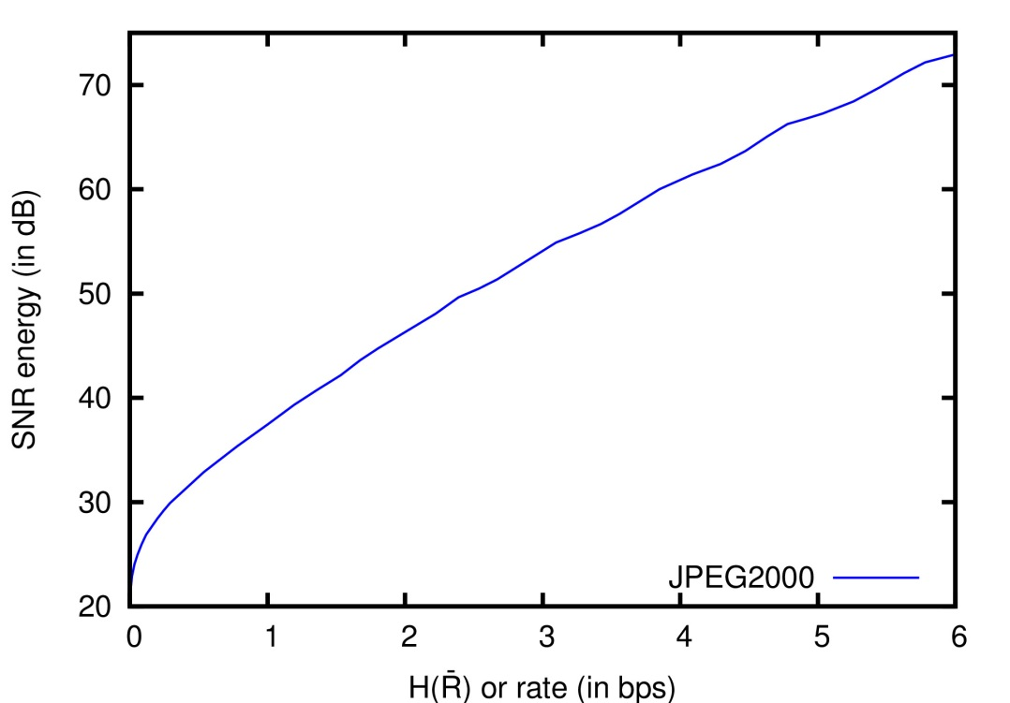
EXPERIMENTAL RESULTS
LOSSY COMPRESSION (entropy-based evaluation)
Alicante
Cartagena
UPLINK BIT BUDGET: 2 bps
UPLINK BIT BUDGET: 1 bps
10

Slide 39
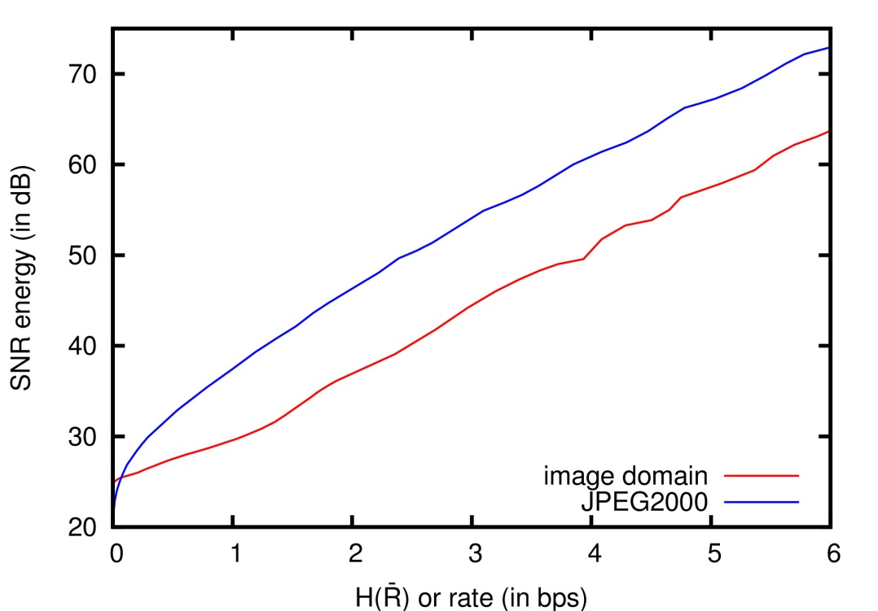
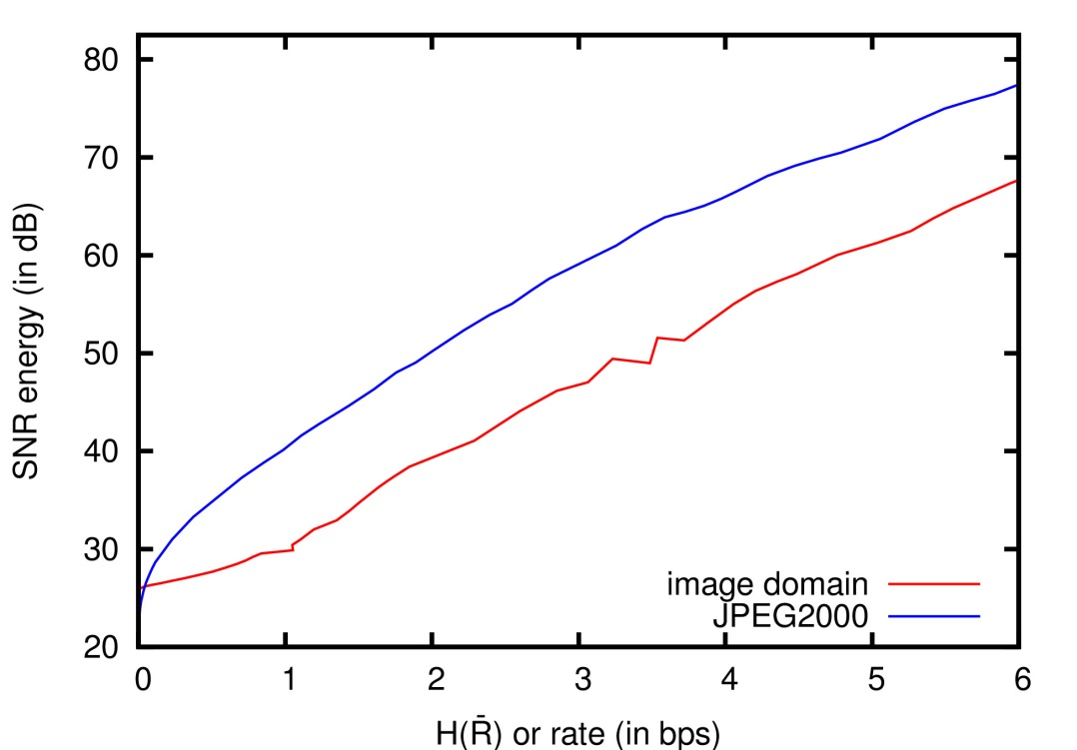
EXPERIMENTAL RESULTS
LOSSY COMPRESSION (entropy-based evaluation)
Alicante
Cartagena
UPLINK BIT BUDGET: 2 bps
UPLINK BIT BUDGET: 1 bps
10

Slide 40
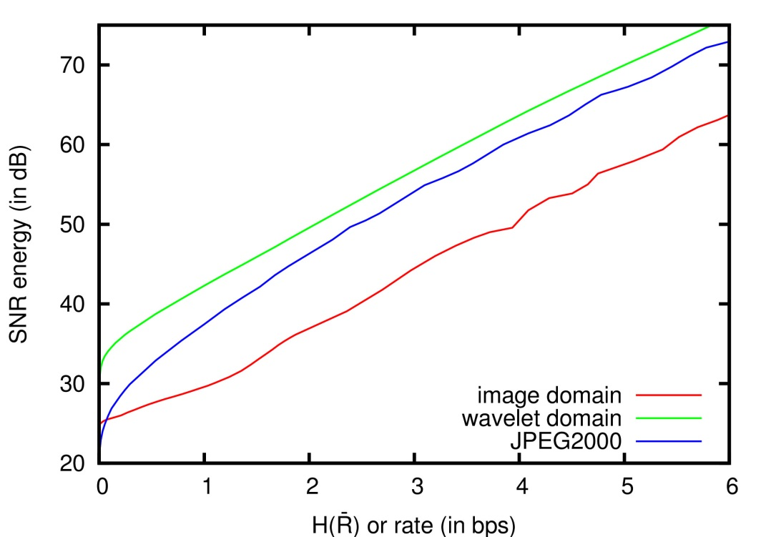
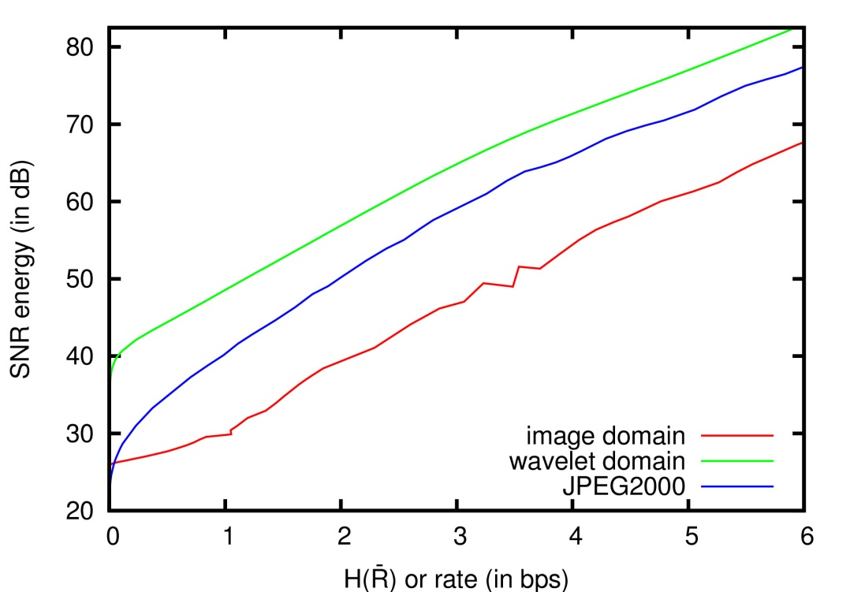
EXPERIMENTAL RESULTS
LOSSY COMPRESSION (entropy-based evaluation)
Alicante
Cartagena
UPLINK BIT BUDGET: 2 bps
UPLINK BIT BUDGET: 1 bps
10

Slide 41
TABLE OF CONTENTS
INTRODUCTION
DUAL LINK IMAGE CODING
EXPERIMENTAL RESULTS
CONCLUSIONS
Motivation
Earth Obervation (EO) satellites in geosynchronous orbits have limited download capacity
Imaging sensors in EO satellites have increased their resolution
Need to trim down data before it is downloaded
Research purpose: increase the download capacity of EO satellites

Slide 42
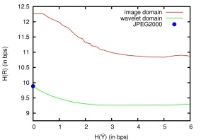
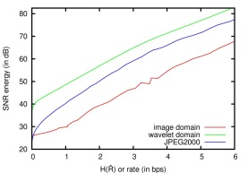
CONCLUSIONS
Motivation
Earth Obervation (EO) satellites in geosynchronous orbits have limited download capacity
Imaging sensors in EO satellites have increased their resolution
Need to trim down data before it is downloaded
Research purpose: increase the download capacity of EO satellites
Insights
Exploit the temporal redundancy of satellite data
Use the uplink of the satellite, which is otherwise idle during transmission time
Traditional approach
Dual link image coding
Experimental results (based on the data entropy)
Lossless coding performance: gains about 0.5 to 1 bits per sample (bps)
Lossy coding performance: gains about 5 to 10 dB at low rates
11

Slide 43
CONCLUSIONS
Motivation
Earth Obervation (EO) satellites in geosynchronous orbits have limited download capacity
Imaging sensors in EO satellites have increased their resolution
Need to trim down data before it is downloaded
Research purpose: increase the download capacity of EO satellites
Insights
Exploit the temporal redundancy of satellite data
Use the uplink of the satellite, which is otherwise idle during transmission time
Traditional approach
Dual link image coding
Experimental results (based on the data entropy)
Lossless coding performance: gains about 0.5 to 1 bits per sample (bps)
Lossy coding performance: gains about 5 to 10 dB at low rates
11

Slide 44
CONCLUSIONS
Motivation
Earth Obervation (EO) satellites in geosynchronous orbits have limited download capacity
Imaging sensors in EO satellites have increased their resolution
Need to trim down data before it is downloaded
Research purpose: increase the download capacity of EO satellites
Insights
Exploit the temporal redundancy of satellite data
Use the uplink of the satellite, which is otherwise idle during transmission time
Traditional approach
Dual link image coding
Experimental results (based on the data entropy)
Lossless coding performance: gains about 0.5 to 1 bits per sample (bps)
Lossy coding performance: gains about 5 to 10 dB at low rates
11

