Slide 1
BITPLANE IMAGE CODING WITH PARALLEL COEFFICIENT PROCESSING
Francesc Aulí-Llinàs
Department of Information and Communications Engineering,
Universitat Autònoma de Barcelona, Spain

Slide 2
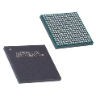
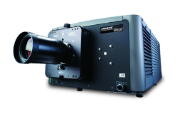
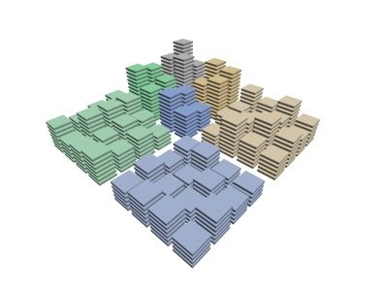
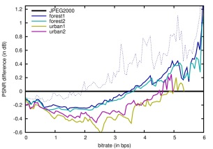
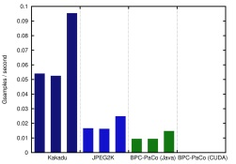
TABLE OF CONTENTS
INTRODUCTION
TRADITIONAL SCHEMES
PROPOSED METHOD
EXPERIMENTAL RESULTS
CONCLUSIONS
Proposed method
Redevise mechanisms to allow SIMD computing
Scanning order: multiple stripes coded in parallel
Context formation: simplification without sacrifice in performance
Probability model: use of a stationary model via LUTs
Arithmetic coder: multiple coders and sorting technique

Slide 3
TABLE OF CONTENTS
INTRODUCTION
TRADITIONAL SCHEMES
PROPOSED METHOD
EXPERIMENTAL RESULTS
CONCLUSIONS
Proposed method
Redevise mechanisms to allow SIMD computing
Scanning order: multiple stripes coded in parallel
Context formation: simplification without sacrifice in performance
Probability model: use of a stationary model via LUTs
Arithmetic coder: multiple coders and sorting technique

Slide 4
INTRODUCTION
EVOLUTION OF LOSSY IMAGE CODING SCHEMES
Discrete Cosine Transform (DCT): JPEG, JPEG XT
Discrete Wavelet Transform (DWT): SPIHT, JPEG2000
Lapped Biorthogonal Transform (LBT): JPEG XR
Vector quantization, Huffman coding,…
Prediction techniques: H.264, HEVC
198X
1994
2000
2008
2014
Coding performance
Scalability (in terms of quality, spatial resolution,…)
Interactive transmission
Security (fingerprinting & watermarking)
Computational complexity
1

Slide 5
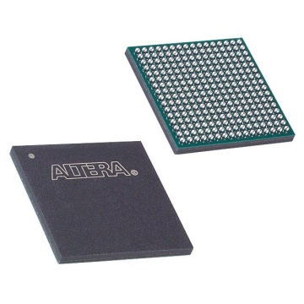
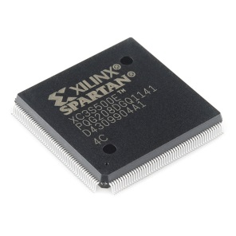
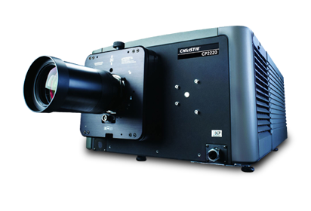
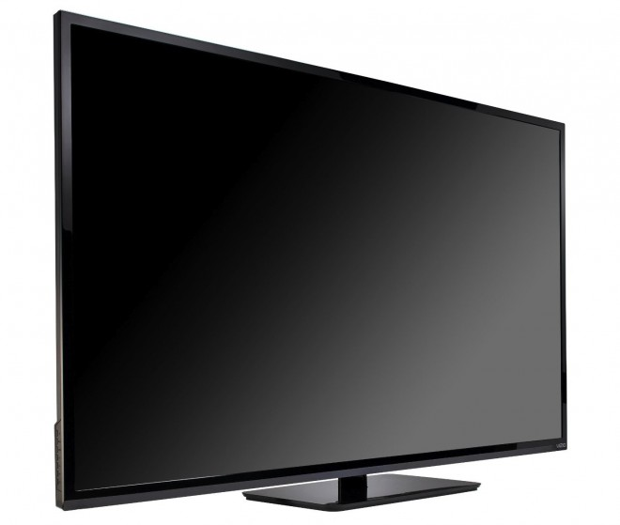
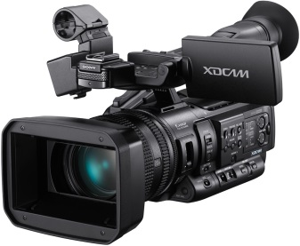
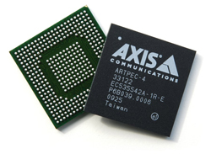
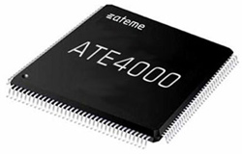
INTRODUCTION
HOW TO TACKLE THE COMPUTATIONAL COMPLEXITY
DIGITAL CINEMA (JPEG2000)
Field-Programable Gate Array (FPGA)
HARDWARE SOLUTIONS:
FAST but EXPENSIVE
VIDEO PRODUCTION
(H.264, HEVC)
Application-Specific Integrated Circuit (ASIC)
2

Slide 6
INTRODUCTION
EVOLUTION OF GENERAL-PURPOSE PROCESSORS
Multiple Instruction, Multiple Data (MIMD)
instructions
CPUs with multiples cores
data
CPUs with single core
4 GHz
Increase clock frequency
Refine set of instructions
Embed more cores
197X
2005
2006
Refine architecture
Increase clock frequency
CUDA: GPUs for general-purpose computing
data
instructions
data
Single Instruction, Multiple Data (SIMD)
3

Slide 7
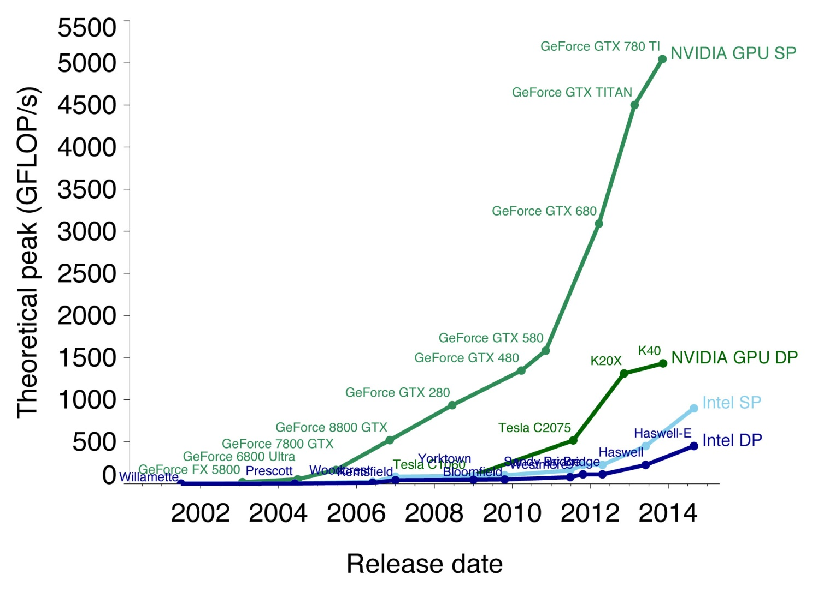
INTRODUCTION
EVOLUTION OF GENERAL-PURPOSE PROCESSORS
Multiple Instruction, Multiple Data (MIMD)
instructions
CPUs with multiples cores
data
CPUs with single core
4 GHz
Increase clock frequency
Refine set of instructions
Embed more cores
197X
2005
2006
Refine architecture
Increase clock frequency
CUDA: GPUs for general-purpose computing
data
instructions
data
source: Michael Galloy
Single Instruction, Multiple Data (SIMD)
3

Slide 8
INTRODUCTION
2+2 =
image coding systems may benefit from the computational power of GPUs
Current approach: implement already developed coding systems in GPUs
S. Datla and N. S. Gidijala, “Parallelizing motion JPEG 2000 with CUDA,” in Proc. IEEE International Conference on Computer and Electrical Engineering, Dec. 2009, pp. 630–634.
J. Matela, V. Rusnak, and P. Holub, “Efficient JPEG2000 EBCOT context modeling for massively parallel architectures,” in Proc. IEEE Data Compression Conference, Mar. 2011, pp. 423–432.
M. Ciznicki, K. Kurowski, and A. Plaza, “Graphics processing unit implementation of JPEG2000 for hyperspectral image compression,” SPIE Journal of Applied Remote Sensing, vol. 6, pp. 1–14, Jan. 2012.
B. Pieters, J. D. Cock, C. Hollemeersch, J. Wielandt, P. Lambert, and R. V. de Walle, “Ultra high definition video decoding with motion JPEG XR using the GPU,” in Proc. IEEE International Conference on Image Processing, Sep. 2011, pp. 377–380.
N.-M. Cheung, O. C. Au, M.-C. Kung, P. H. Wong, and C. H. Liu, “Highly parallel rate-distortion optimized intra-mode decision on multicore graphics processors,” IEEE Trans. Circuits Syst. Video Technol., vol. 19, no. 11, pp. 1692–1703, Nov. 2009.
N.-M. Cheung, X. Fan, O. C. Au, and M.-C. Kung, “Video coding on multicore graphics processors,” IEEE Signal Process. Mag., vol. 27, no. 2, pp. 79–89, Mar. 2010.
…
Issue: current coding systems are inherently sequential
r₁
r₂
r₃
r₄
r₅
r₆
r₇
r₈
r₉
4

Slide 9
INTRODUCTION
2+2 =
image coding systems may benefit from the computational power of GPUs
Current approach: implement already developed coding systems in GPUs
S. Datla and N. S. Gidijala, “Parallelizing motion JPEG 2000 with CUDA,” in Proc. IEEE International Conference on Computer and Electrical Engineering, Dec. 2009, pp. 630–634.
J. Matela, V. Rusnak, and P. Holub, “Efficient JPEG2000 EBCOT context modeling for massively parallel architectures,” in Proc. IEEE Data Compression Conference, Mar. 2011, pp. 423–432.
M. Ciznicki, K. Kurowski, and A. Plaza, “Graphics processing unit implementation of JPEG2000 for hyperspectral image compression,” SPIE Journal of Applied Remote Sensing, vol. 6, pp. 1–14, Jan. 2012.
B. Pieters, J. D. Cock, C. Hollemeersch, J. Wielandt, P. Lambert, and R. V. de Walle, “Ultra high definition video decoding with motion JPEG XR using the GPU,” in Proc. IEEE International Conference on Image Processing, Sep. 2011, pp. 377–380.
N.-M. Cheung, O. C. Au, M.-C. Kung, P. H. Wong, and C. H. Liu, “Highly parallel rate-distortion optimized intra-mode decision on multicore graphics processors,” IEEE Trans. Circuits Syst. Video Technol., vol. 19, no. 11, pp. 1692–1703, Nov. 2009.
N.-M. Cheung, X. Fan, O. C. Au, and M.-C. Kung, “Video coding on multicore graphics processors,” IEEE Signal Process. Mag., vol. 27, no. 2, pp. 79–89, Mar. 2010.
…
Issue: current coding systems are inherently sequential
r₁
r₂
r₃
r₄
r₅
r₆
r₇
r₈
r₉
GPUs mainly use SIMD computing (vectorial instructions)
4

Slide 10
INTRODUCTION
2+2 =
image coding systems may benefit from the computational power of GPUs
Current approach: implement already developed coding systems in GPUs
S. Datla and N. S. Gidijala, “Parallelizing motion JPEG 2000 with CUDA,” in Proc. IEEE International Conference on Computer and Electrical Engineering, Dec. 2009, pp. 630–634.
J. Matela, V. Rusnak, and P. Holub, “Efficient JPEG2000 EBCOT context modeling for massively parallel architectures,” in Proc. IEEE Data Compression Conference, Mar. 2011, pp. 423–432.
M. Ciznicki, K. Kurowski, and A. Plaza, “Graphics processing unit implementation of JPEG2000 for hyperspectral image compression,” SPIE Journal of Applied Remote Sensing, vol. 6, pp. 1–14, Jan. 2012.
B. Pieters, J. D. Cock, C. Hollemeersch, J. Wielandt, P. Lambert, and R. V. de Walle, “Ultra high definition video decoding with motion JPEG XR using the GPU,” in Proc. IEEE International Conference on Image Processing, Sep. 2011, pp. 377–380.
N.-M. Cheung, O. C. Au, M.-C. Kung, P. H. Wong, and C. H. Liu, “Highly parallel rate-distortion optimized intra-mode decision on multicore graphics processors,” IEEE Trans. Circuits Syst. Video Technol., vol. 19, no. 11, pp. 1692–1703, Nov. 2009.
N.-M. Cheung, X. Fan, O. C. Au, and M.-C. Kung, “Video coding on multicore graphics processors,” IEEE Signal Process. Mag., vol. 27, no. 2, pp. 79–89, Mar. 2010.
…
RESEARCH PURPOSE:
DEVELOP AN IMAGE CODING SYSTEM
TAILORED TO SIMD COMPUTING
Issue: current coding systems are inherently sequential
r₁
r₂
r₃
r₄
r₅
r₆
r₇
r₈
r₉
GPUs mainly use SIMD computing (vectorial instructions)
4

Slide 11
TABLE OF CONTENTS
INTRODUCTION
TRADITIONAL SCHEMES
PROPOSED METHOD
EXPERIMENTAL RESULTS
CONCLUSIONS
Proposed method
Redevise mechanisms to allow SIMD computing
Scanning order: multiple stripes coded in parallel
Context formation: simplification without sacrifice in performance
Probability model: use of a stationary model via LUTs
Arithmetic coder: multiple coders and sorting technique

Slide 12
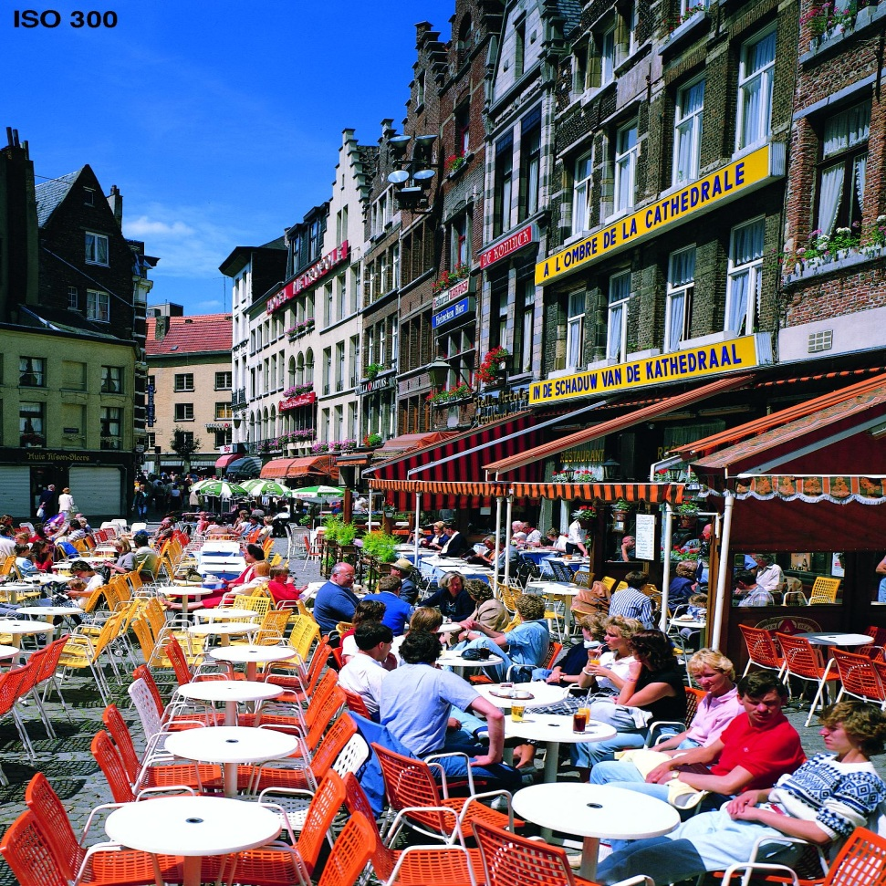
OVERVIEW OF TRADITIONAL CODING SCHEMES
STAGES OF A WAVELET-BASED CODING SYSTEM (JPEG2000)
ORIGINAL IMAGE
5

Slide 13
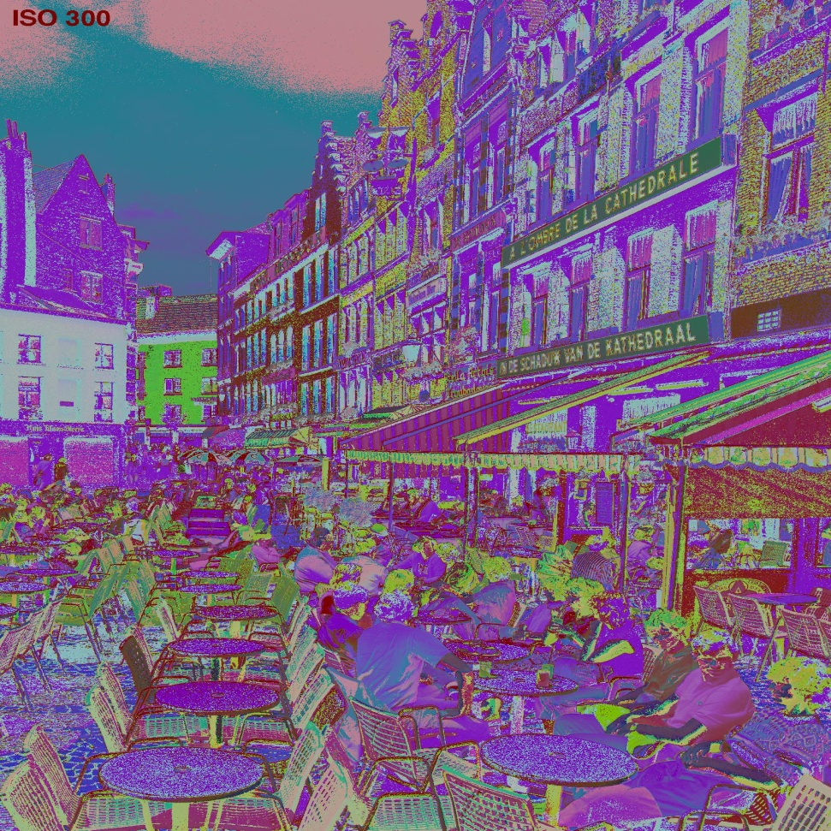
OVERVIEW OF TRADITIONAL CODING SCHEMES
STAGES OF A WAVELET-BASED CODING SYSTEM (JPEG2000)
ORIGINAL IMAGE
MULTI-COMPONENT
TRANSFORM
5

Slide 14
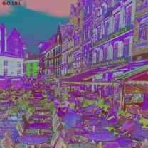
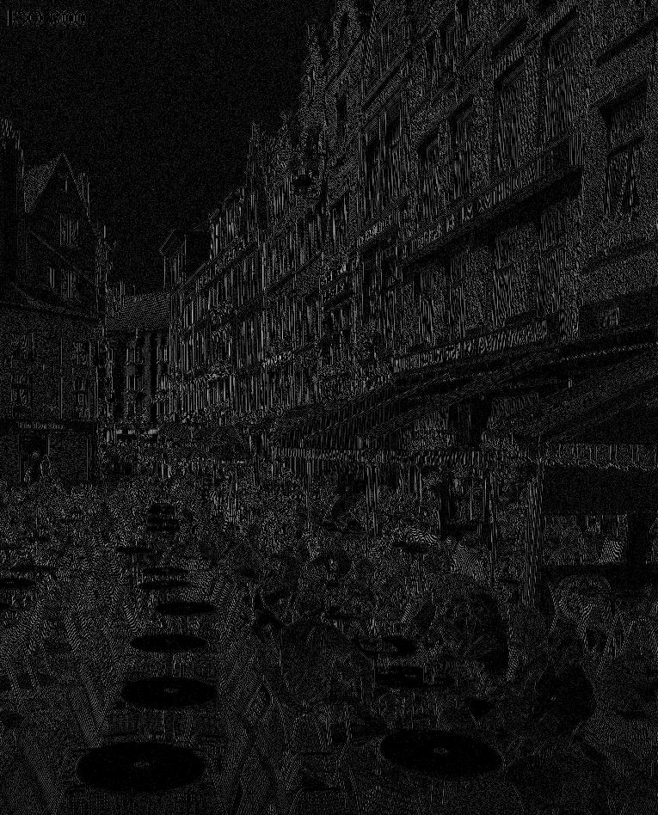
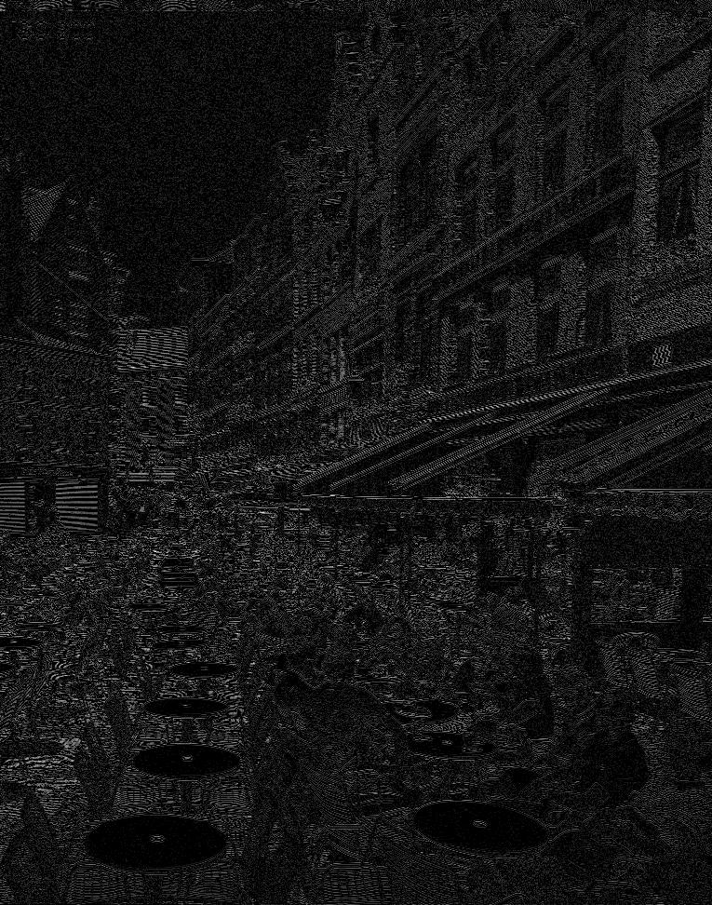
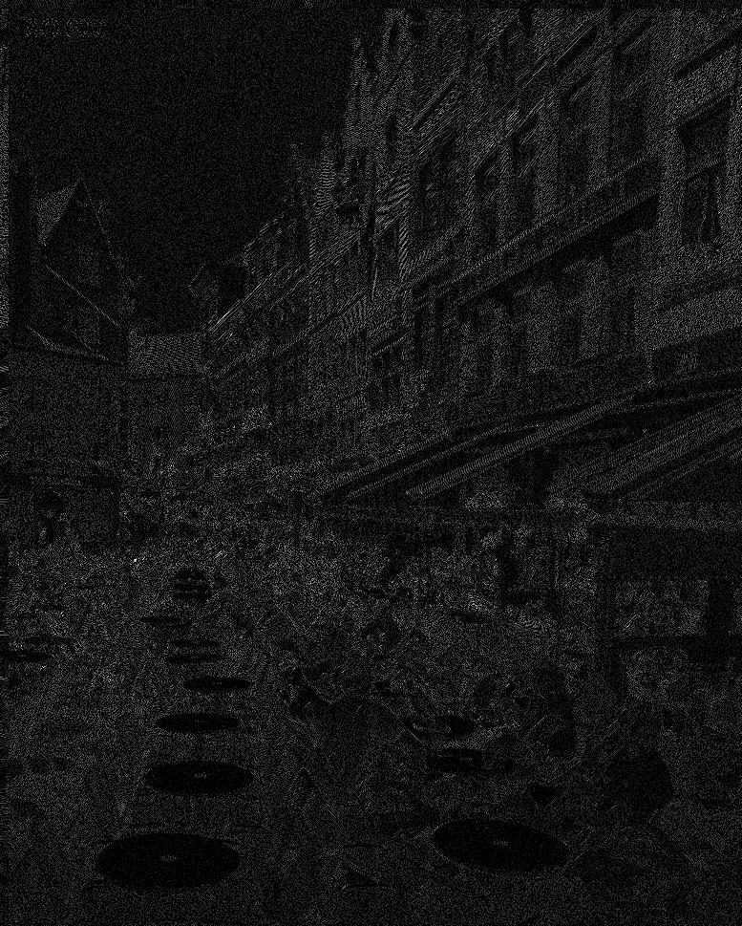
OVERVIEW OF TRADITIONAL CODING SCHEMES
STAGES OF A WAVELET-BASED CODING SYSTEM (JPEG2000)
ORIGINAL IMAGE
MULTI-COMPONENT
TRANSFORM
WAVELET
TRANSFORM
QUANTIZATION
5

Slide 15
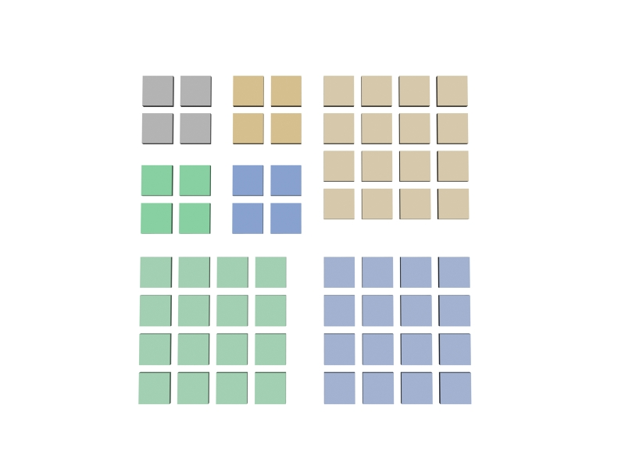
OVERVIEW OF TRADITIONAL CODING SCHEMES
STAGES OF A WAVELET-BASED CODING SYSTEM (JPEG2000)
ORIGINAL IMAGE
MULTI-COMPONENT
TRANSFORM
WAVELET
TRANSFORM
QUANTIZATION
6

Slide 16
OVERVIEW OF TRADITIONAL CODING SCHEMES
STAGES OF A WAVELET-BASED CODING SYSTEM (JPEG2000)
ORIGINAL IMAGE
MULTI-COMPONENT
TRANSFORM
WAVELET
TRANSFORM
QUANTIZATION
6

Slide 17
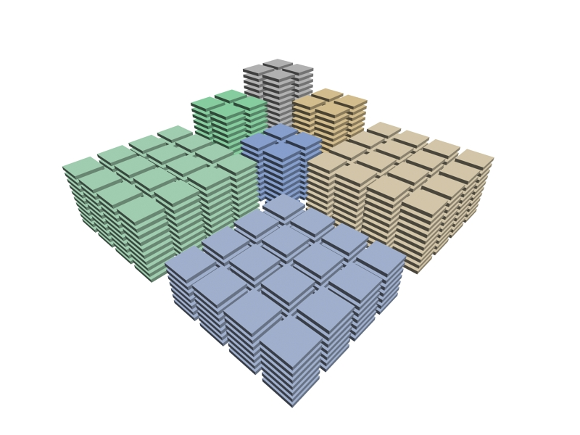
OVERVIEW OF TRADITIONAL CODING SCHEMES
STAGES OF A WAVELET-BASED CODING SYSTEM (JPEG2000)
ORIGINAL IMAGE
MULTI-COMPONENT
TRANSFORM
WAVELET
TRANSFORM
QUANTIZATION
7

Slide 18
OVERVIEW OF TRADITIONAL CODING SCHEMES
STAGES OF A WAVELET-BASED CODING SYSTEM (JPEG2000)
ORIGINAL IMAGE
MULTI-COMPONENT
TRANSFORM
WAVELET
TRANSFORM
QUANTIZATION
TIER-1
CODING
7

Slide 19
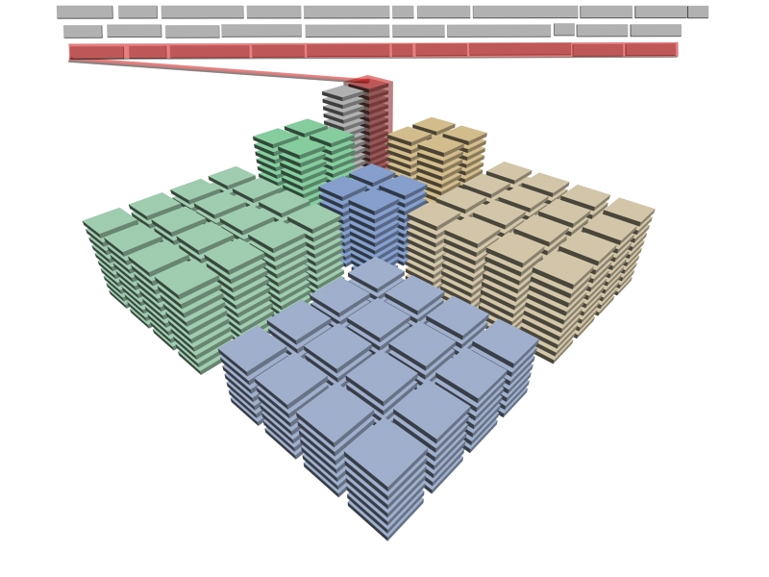
OVERVIEW OF TRADITIONAL CODING SCHEMES
STAGES OF A WAVELET-BASED CODING SYSTEM (JPEG2000)
ORIGINAL IMAGE
MULTI-COMPONENT
TRANSFORM
WAVELET
TRANSFORM
QUANTIZATION
TIER-1
CODING
RD OPTIMIZATION
TIER-2
CODING
CODESTREAM
7

Slide 20
OVERVIEW OF TRADITIONAL CODING SCHEMES
STAGES OF A WAVELET-BASED CODING SYSTEM (JPEG2000)
ORIGINAL IMAGE
20%
MULTI-COMPONENT
TRANSFORM
75%
WAVELET
TRANSFORM
QUANTIZATION
TIER-1
CODING
TIER-2
CODING
5%
CODESTREAM
coding time
8

Slide 21
OVERVIEW OF TRADITIONAL CODING SCHEMES
STAGES OF A WAVELET-BASED CODING SYSTEM (JPEG2000)
ORIGINAL IMAGE
20%
MULTI-COMPONENT
TRANSFORM
75%
WAVELET
TRANSFORM
QUANTIZATION
TIER-1
CODING
TIER-2
CODING
5%
CODESTREAM
coding time
8

Slide 22
OVERVIEW OF TRADITIONAL CODING SCHEMES
BITPLANE CODING STAGE (TIER-1)
9

Slide 23
OVERVIEW OF TRADITIONAL CODING SCHEMES
BITPLANE CODING STAGE (TIER-1)
9

Slide 24
OVERVIEW OF TRADITIONAL CODING SCHEMES
BITPLANE CODING STAGE (TIER-1)
10

Slide 25
OVERVIEW OF TRADITIONAL CODING SCHEMES
BITPLANE CODING STAGE (TIER-1)
Scanning order
current
bitplane
10

Slide 26
OVERVIEW OF TRADITIONAL CODING SCHEMES
BITPLANE CODING STAGE (TIER-1)
Scanning order
current
bitplane
10

Slide 27
OVERVIEW OF TRADITIONAL CODING SCHEMES
BITPLANE CODING STAGE (TIER-1)
Scanning order
Coding passes
current
bitplane
11

Slide 28
OVERVIEW OF TRADITIONAL CODING SCHEMES
BITPLANE CODING STAGE (TIER-1)
Scanning order
Coding passes
current
bitplane
11

Slide 29
OVERVIEW OF TRADITIONAL CODING SCHEMES
BITPLANE CODING STAGE (TIER-1)
Scanning order
Coding passes
Context formation
current
bitplane
12

Slide 30
OVERVIEW OF TRADITIONAL CODING SCHEMES
BITPLANE CODING STAGE (TIER-1)
Scanning order
Coding passes
Context formation
Probability model
current
bitplane
13

Slide 31
OVERVIEW OF TRADITIONAL CODING SCHEMES
BITPLANE CODING STAGE (TIER-1)
001011111101001010101
Scanning order
Coding passes
Context formation
Probability model
current
bitplane
13

Slide 32
OVERVIEW OF TRADITIONAL CODING SCHEMES
BITPLANE CODING STAGE (TIER-1)
Scanning order
Coding passes
Context formation
Probability model
Arithmetic coder
current
bitplane
ARITHMETIC
CODER
14

Slide 33
TABLE OF CONTENTS
INTRODUCTION
TRADITIONAL SCHEMES
PROPOSED METHOD
EXPERIMENTAL RESULTS
CONCLUSIONS
Proposed method
Redevise mechanisms to allow SIMD computing
Scanning order: multiple stripes coded in parallel
Context formation: simplification without sacrifice in performance
Probability model: use of a stationary model via LUTs
Arithmetic coder: multiple coders and sorting technique

Slide 34
PROPOSED METHOD
MECHANISMS THAT PREVENT PARALLELISM
Scanning order
Coding passes
Context formation
Probability model
Arithmetic coder
ARITHMETIC
CODER
15

Slide 35
PROPOSED METHOD
MECHANISMS THAT PREVENT PARALLELISM
✗
Scanning order
Coding passes
Context formation
Probability model
Arithmetic coder
✓
✗
✗
✗
ARITHMETIC
CODER
15

Slide 36
PROPOSED METHOD
REDEVISED MECHANISMS
✗
Scanning order
Coding passes
Context formation
Probability model
Arithmetic coder
✓
✗
✗
✗
16

Slide 37
PROPOSED METHOD
REDEVISED MECHANISMS
Scanning order
Coding passes
Context formation
Probability model
Arithmetic coder
✓
✗
✗
✗
16

Slide 38
PROPOSED METHOD
REDEVISED MECHANISMS
✓
Scanning order
Coding passes
Context formation
Probability model
Arithmetic coder
✗
✗
✗
17

Slide 39
PROPOSED METHOD
REDEVISED MECHANISMS
✓
Scanning order
Coding passes
Context formation
Probability model
Arithmetic coder
✗
✗
✗
17

Slide 40
PROPOSED METHOD
REDEVISED MECHANISMS
✓
Scanning order
Coding passes
Context formation
Probability model
Arithmetic coder
✗
✗
✗
17

Slide 41
PROPOSED METHOD
REDEVISED MECHANISMS
✓
Scanning order
Coding passes
Context formation
Probability model
Arithmetic coder
✓
✗
✗
18

Slide 42
PROPOSED METHOD
REDEVISED MECHANISMS
✓
Scanning order
Coding passes
Context formation
Probability model
Arithmetic coder
✓
✗
✗
18

Slide 43
PROPOSED METHOD
REDEVISED MECHANISMS
✓
Scanning order
Coding passes
Context formation
Probability model
Arithmetic coder
✓
✗
✗
18

Slide 44
PROPOSED METHOD
REDEVISED MECHANISMS
✓
Scanning order
Coding passes
Context formation
Probability model
Arithmetic coder
✓
✗
✗
= 2
18

Slide 45
PROPOSED METHOD
REDEVISED MECHANISMS
✓
Scanning order
Coding passes
Context formation
Probability model
Arithmetic coder
✓
✓
✗
= 2
19

Slide 46
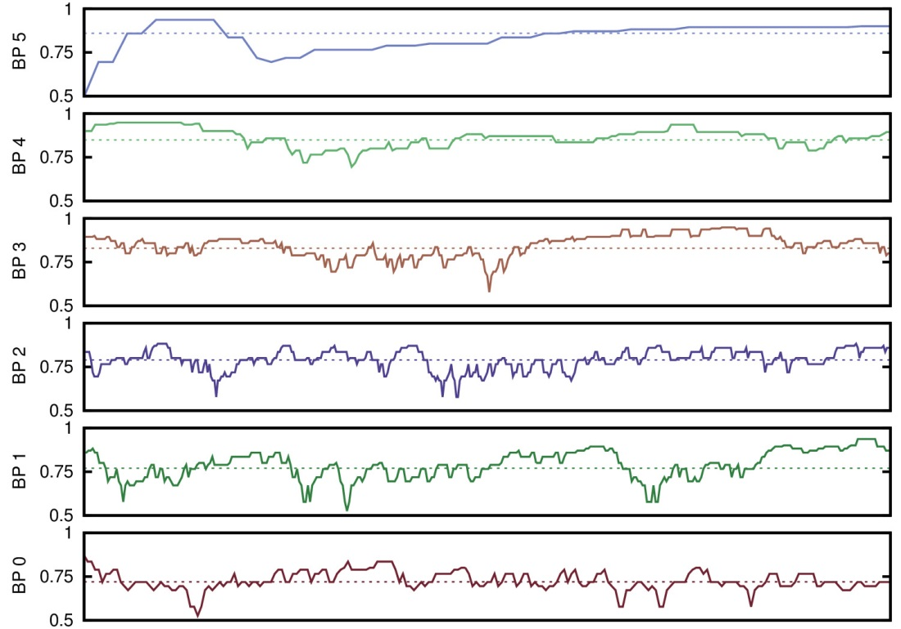
PROPOSED METHOD
REDEVISED MECHANISMS
✓
Scanning order
Coding passes
Context formation
Probability model
Arithmetic coder
✓
✓
✗
= 2
19

Slide 47
PROPOSED METHOD
REDEVISED MECHANISMS
✓
Scanning order
Coding passes
Context formation
Probability model
Arithmetic coder
✓
✓
✗
= 2
LUT with pre-computed probabilities
19

Slide 48
PROPOSED METHOD
REDEVISED MECHANISMS
✓
Scanning order
Coding passes
Context formation
Probability model
Arithmetic coder
✓
✓
✓
AC
AC
AC
AC
AC
AC
AC
AC
20

Slide 49
PROPOSED METHOD
REDEVISED MECHANISMS
✓
Scanning order
Coding passes
Context formation
Probability model
Arithmetic coder
✓
✓
✓
AC
AC
AC
AC
AC
AC
AC
AC
20

Slide 50
PROPOSED METHOD
REDEVISED MECHANISMS
✓
Scanning order
Coding passes
Context formation
Probability model
Arithmetic coder
✓
✓
✓
✓
AC
AC
AC
AC
AC
AC
AC
AC
20

Slide 51
TABLE OF CONTENTS
INTRODUCTION
TRADITIONAL SCHEMES
PROPOSED METHOD
EXPERIMENTAL RESULTS
CONCLUSIONS
Proposed method
Redevise mechanisms to allow SIMD computing
Scanning order: multiple stripes coded in parallel
Context formation: simplification without sacrifice in performance
Probability model: use of a stationary model via LUTs
Arithmetic coder: multiple coders and sorting technique

Slide 52
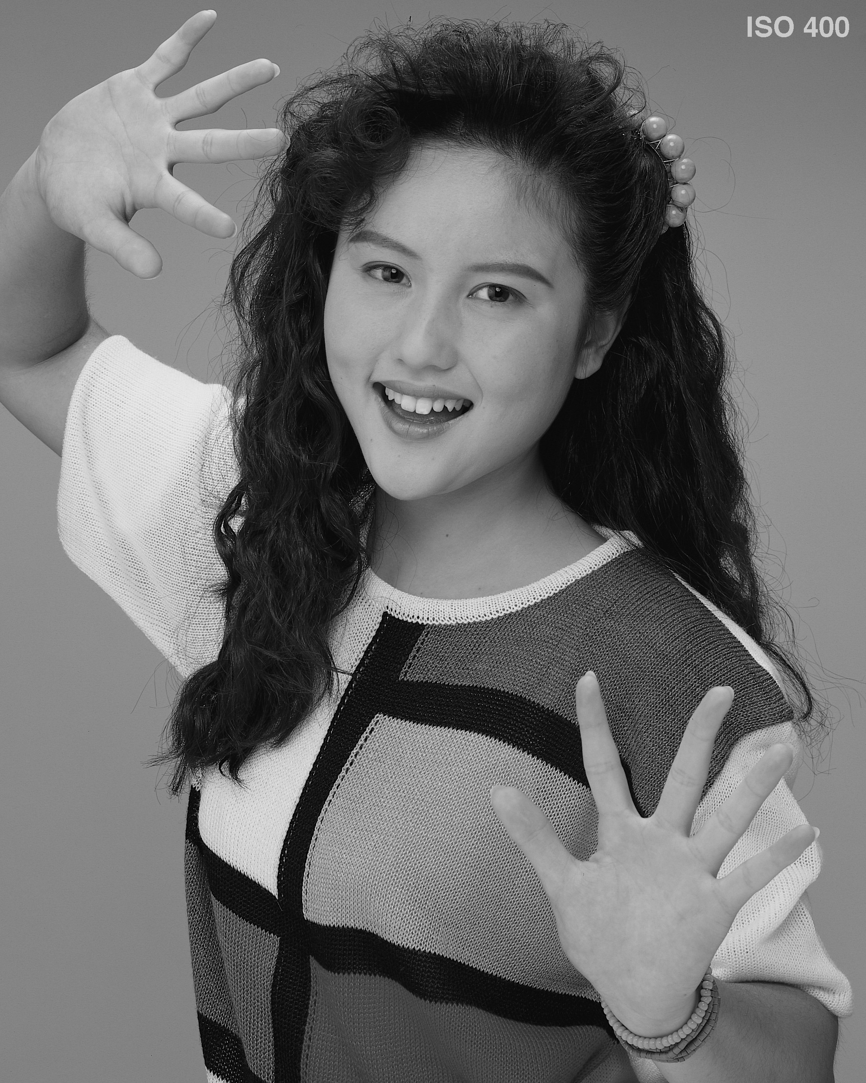
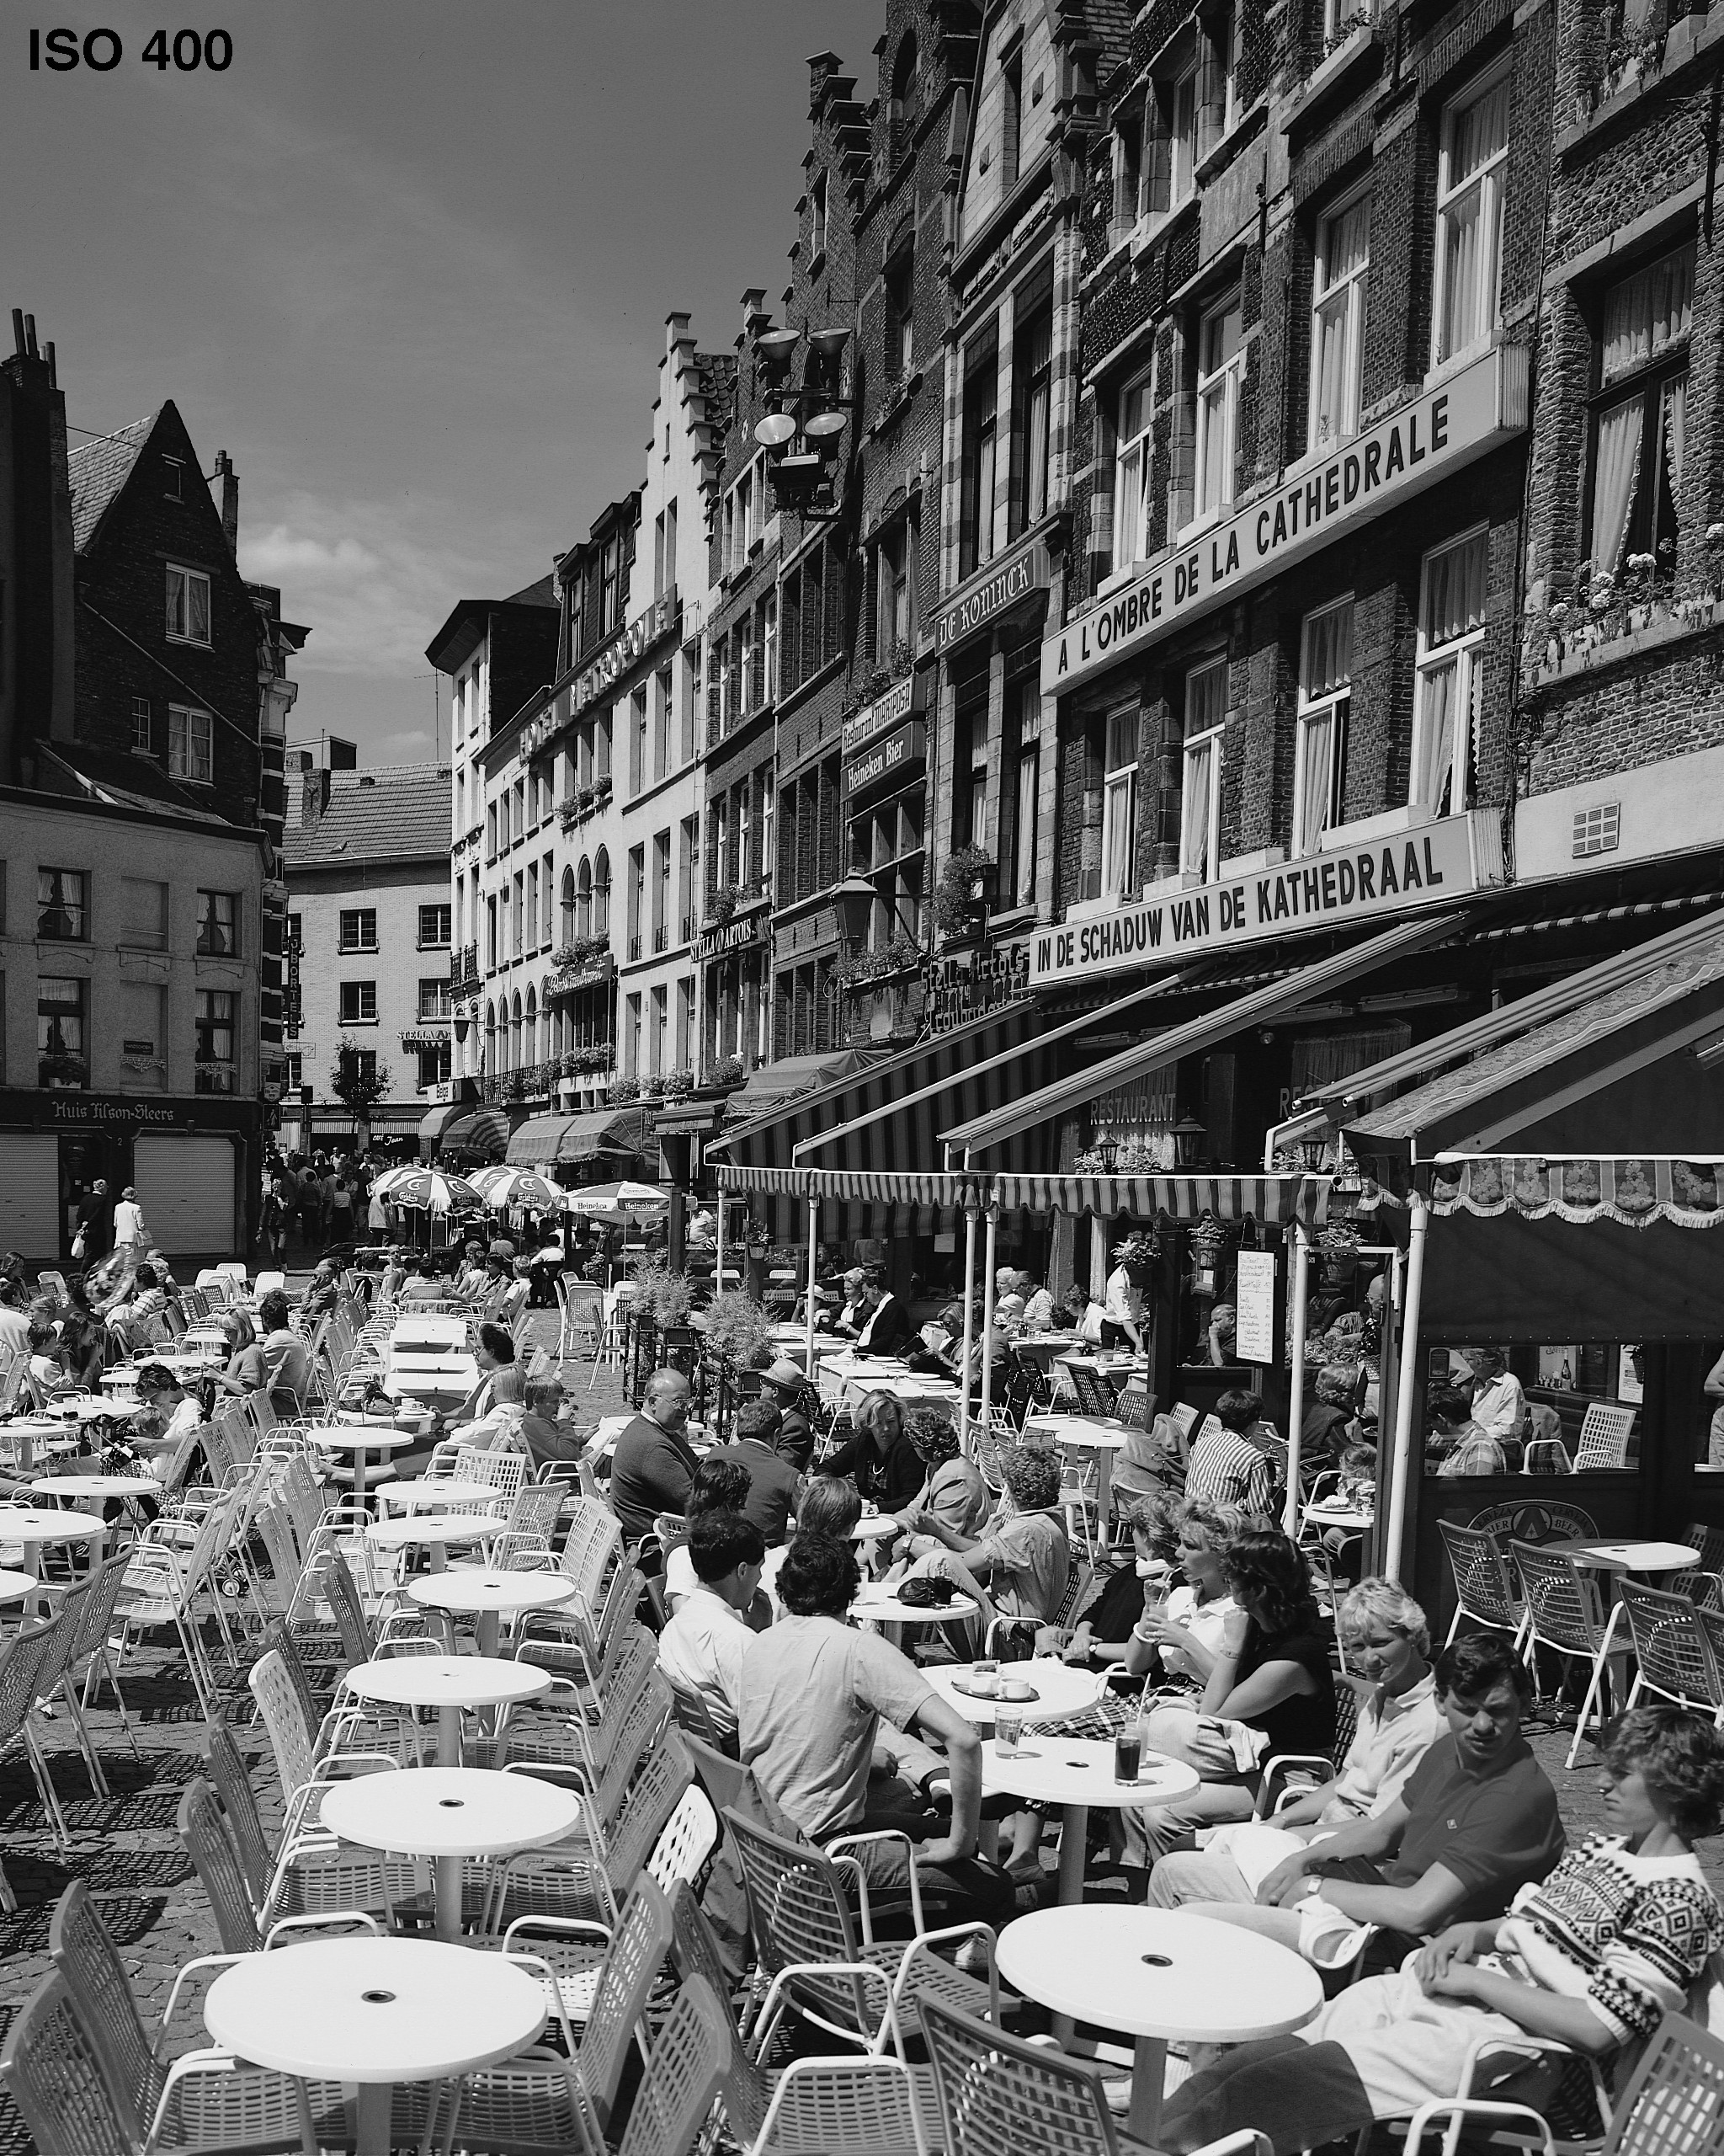
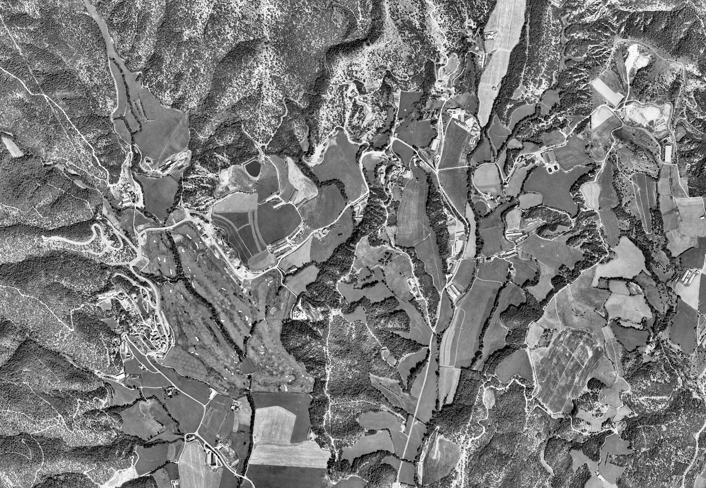
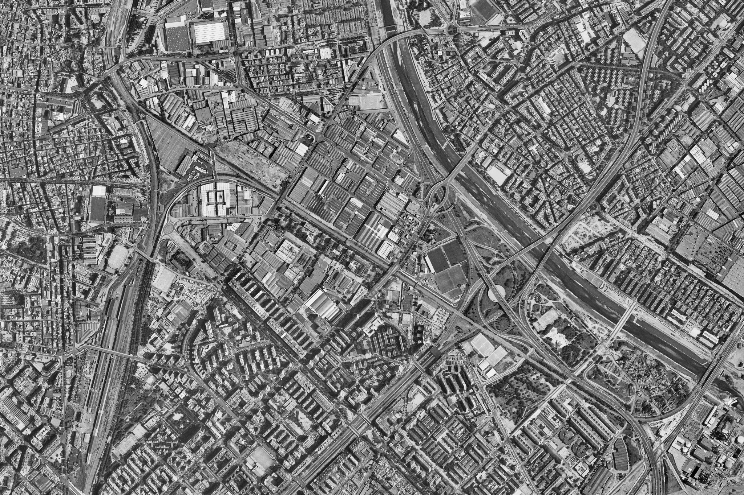
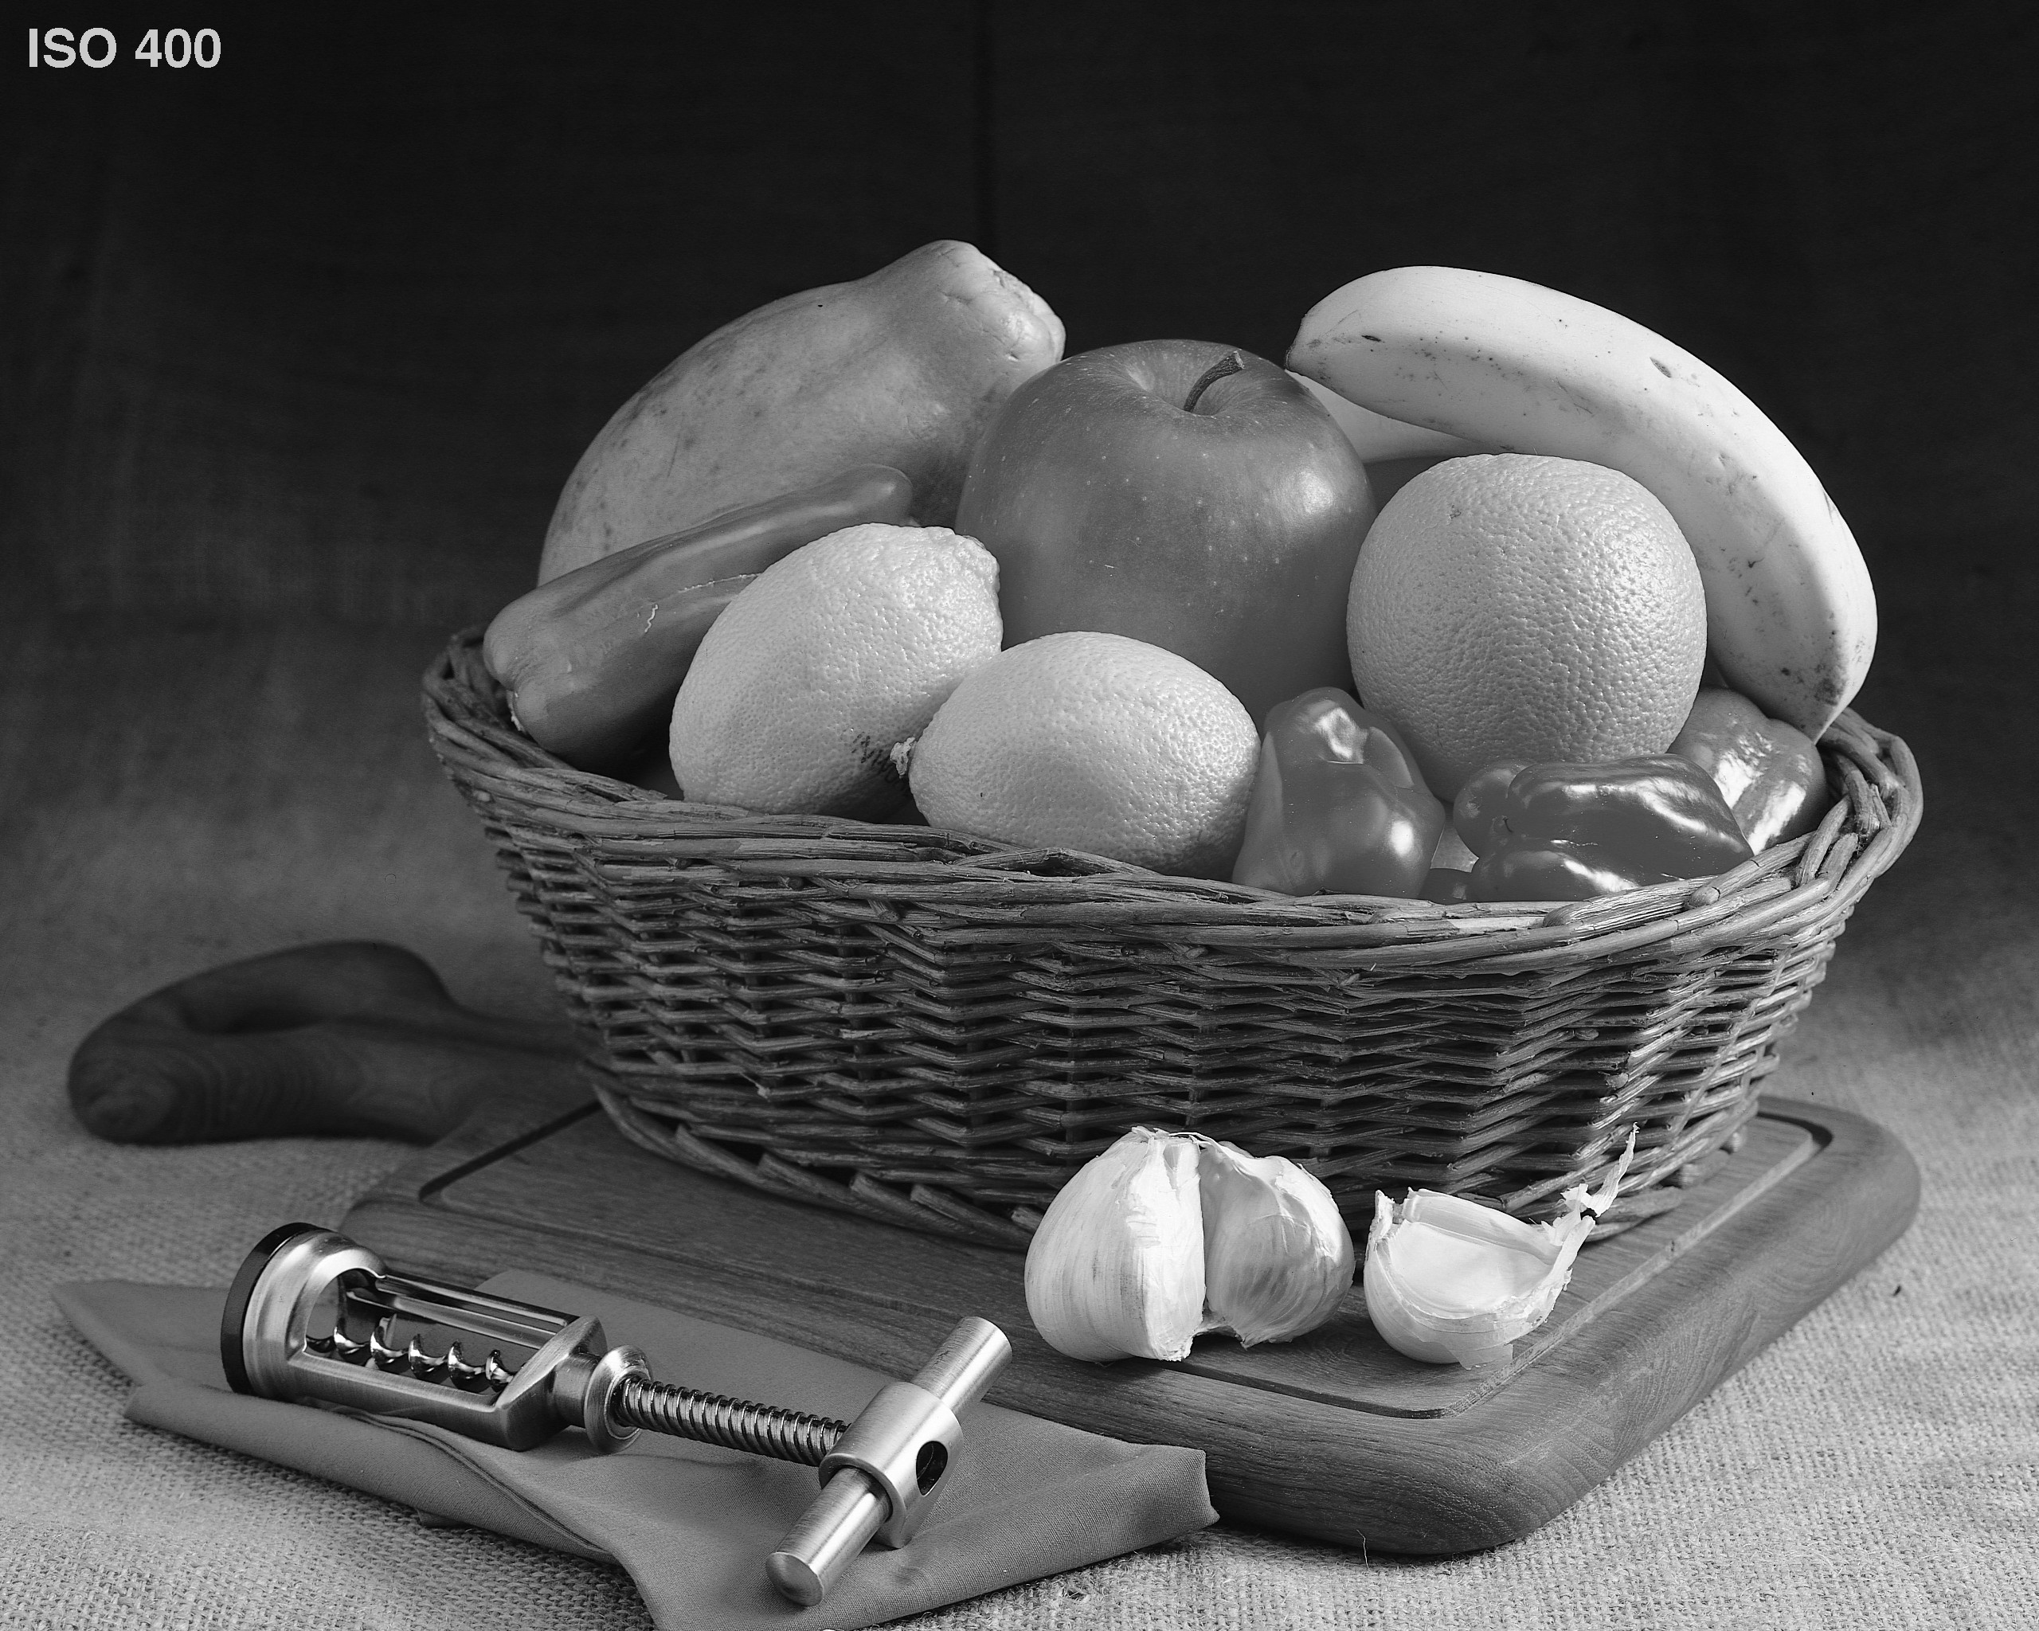
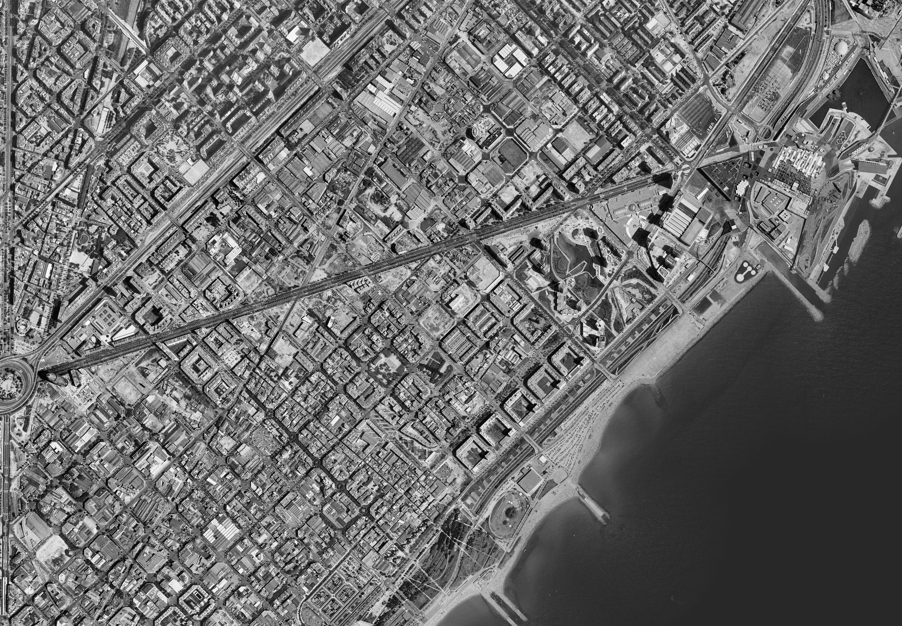
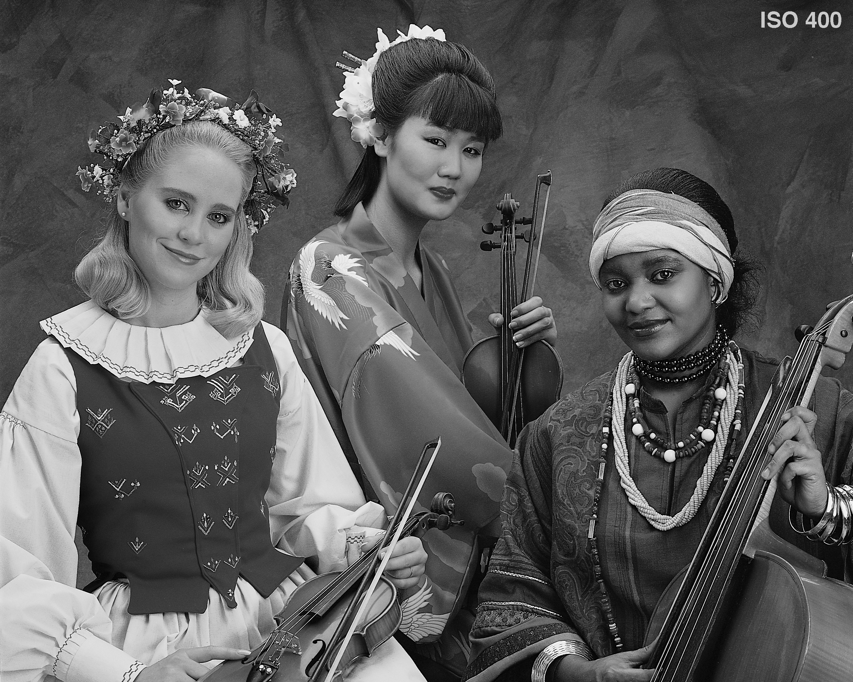
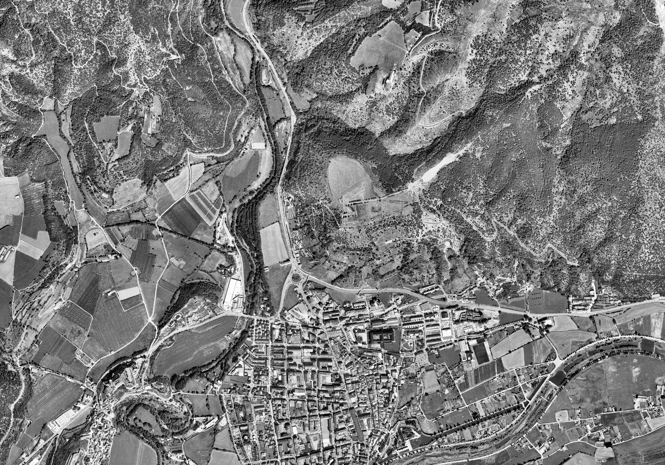
EXPERIMENTAL RESULTS
CODING PERFORMANCE EVALUATION
natural images
(2048x2560, 8 bps)
aerial images
(7200x4950, 8 bps)
21

Slide 53
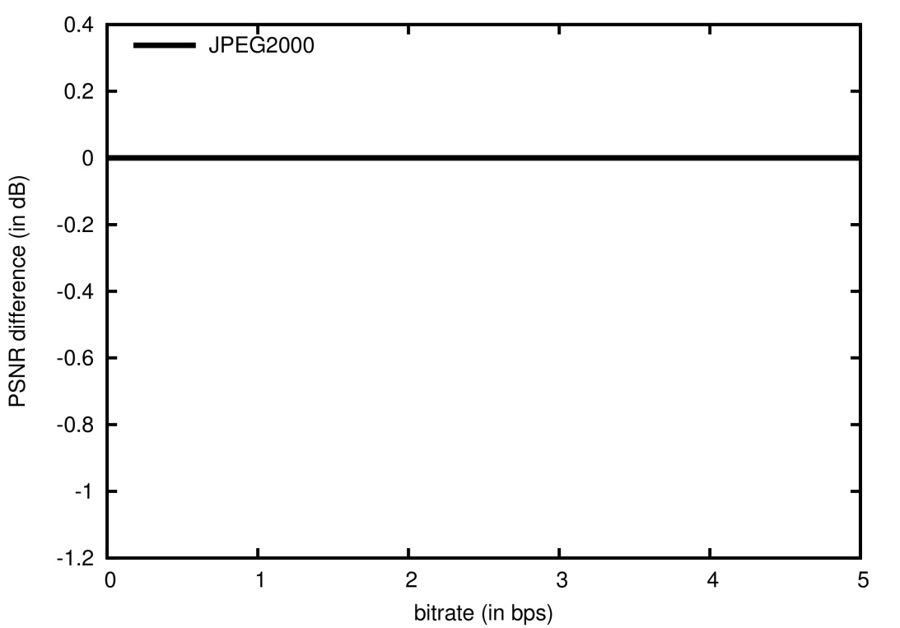
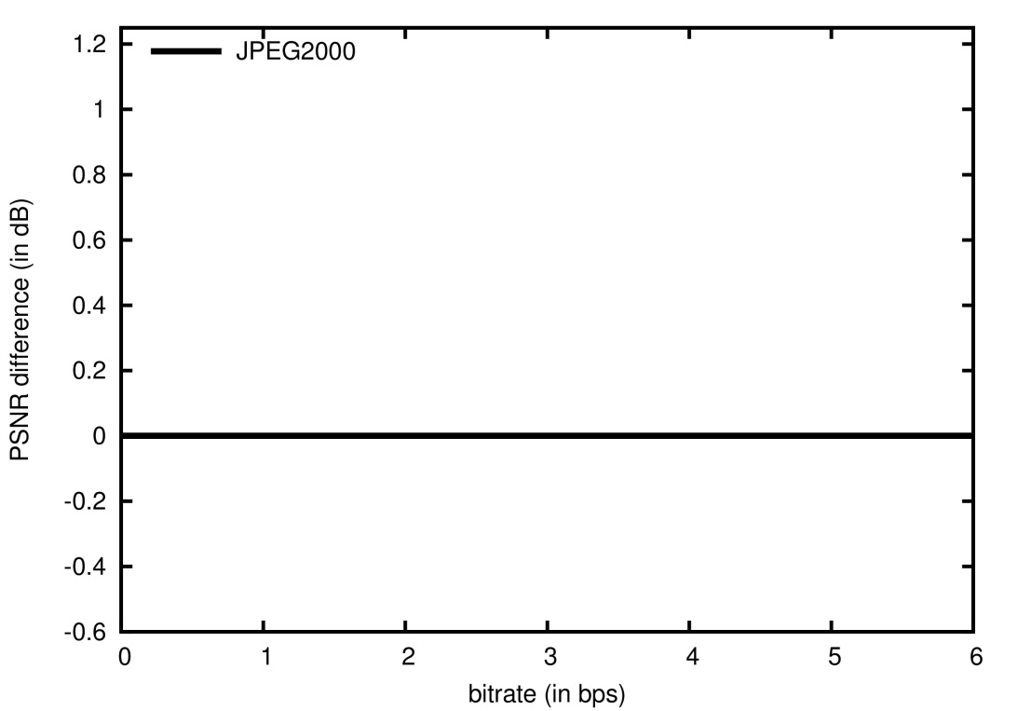
EXPERIMENTAL RESULTS
CODING PERFORMANCE EVALUATION
natural images
(2048x2560, 8 bps)
aerial images
(7200x4950, 8 bps)
21

Slide 54
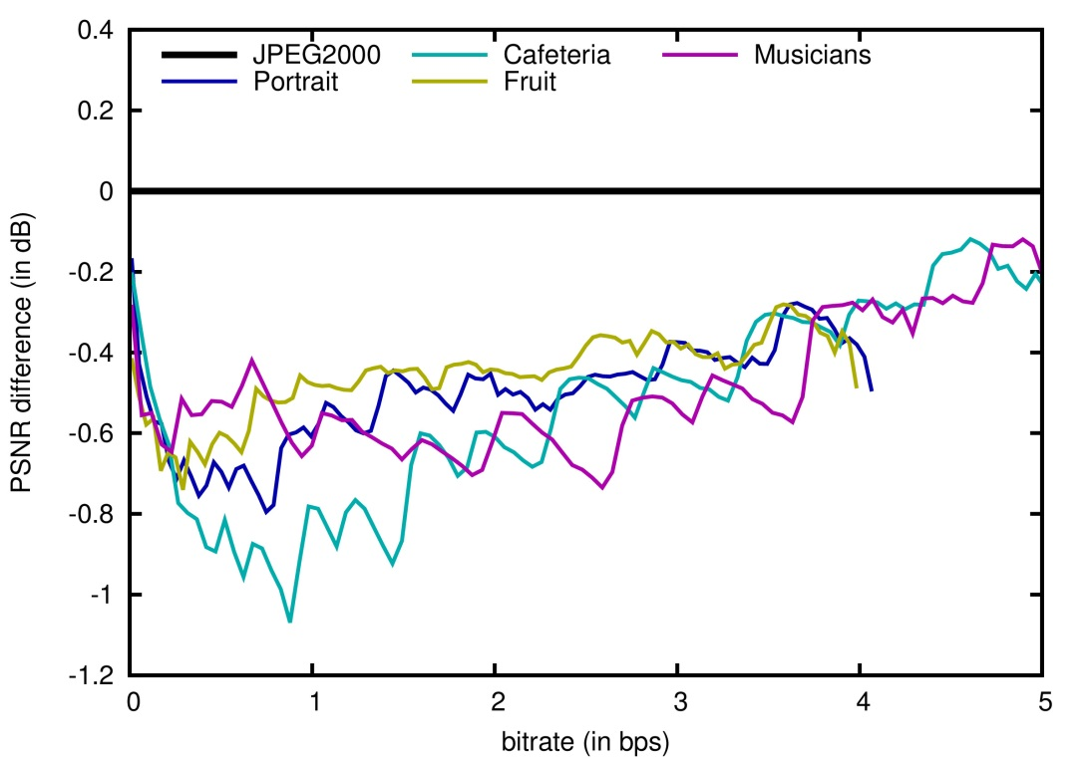
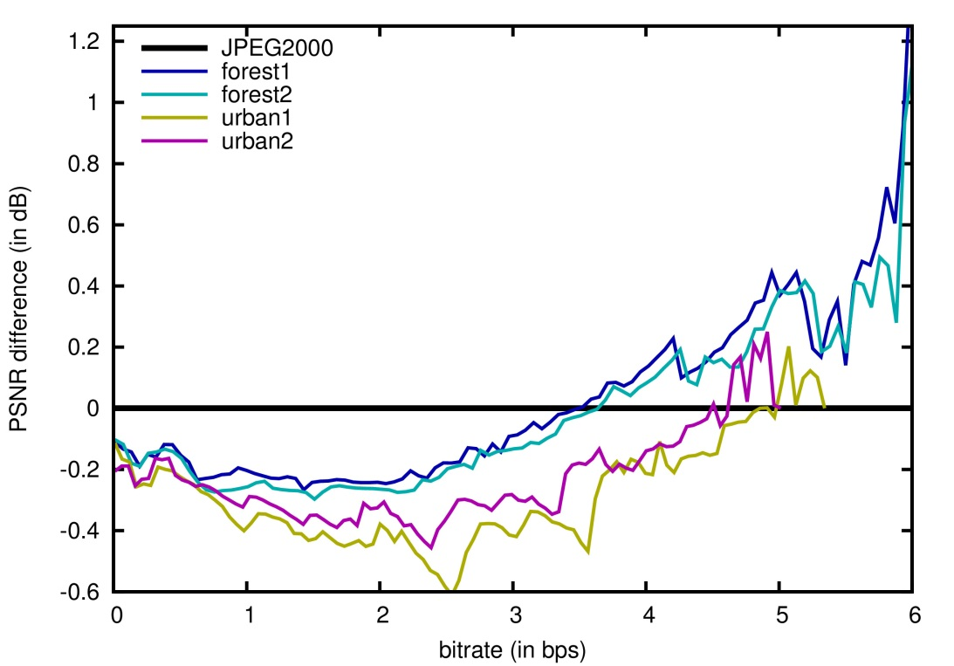
EXPERIMENTAL RESULTS
CODING PERFORMANCE EVALUATION
natural images
(2048x2560, 8 bps)
aerial images
(7200x4950, 8 bps)
21

Slide 55
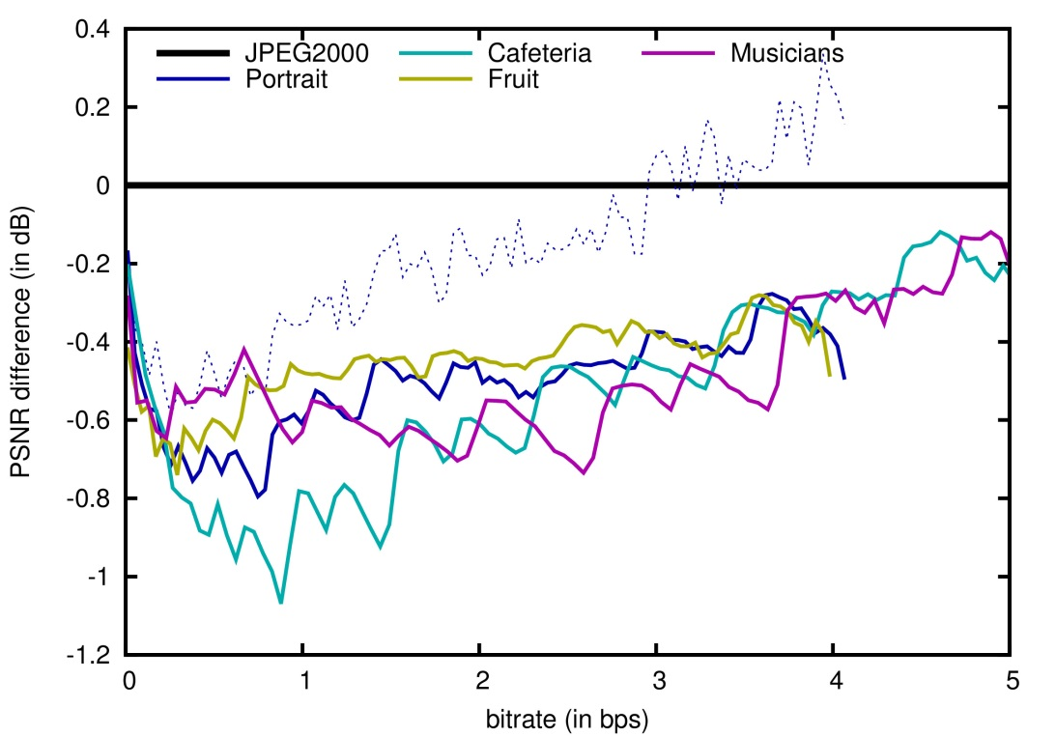
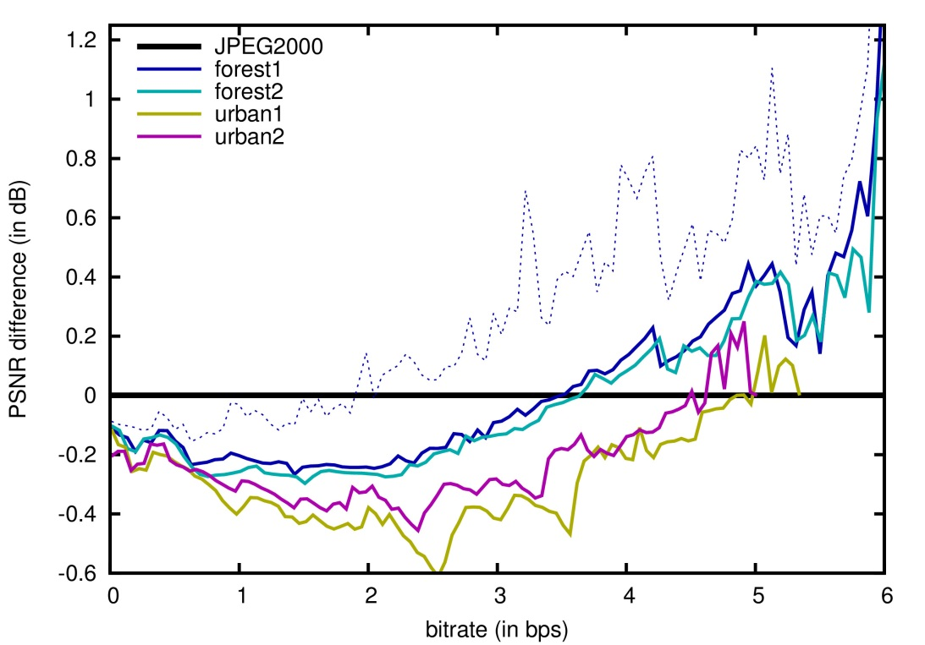
EXPERIMENTAL RESULTS
CODING PERFORMANCE EVALUATION
natural images
(2048x2560, 8 bps)
aerial images
(7200x4950, 8 bps)
21

Slide 56
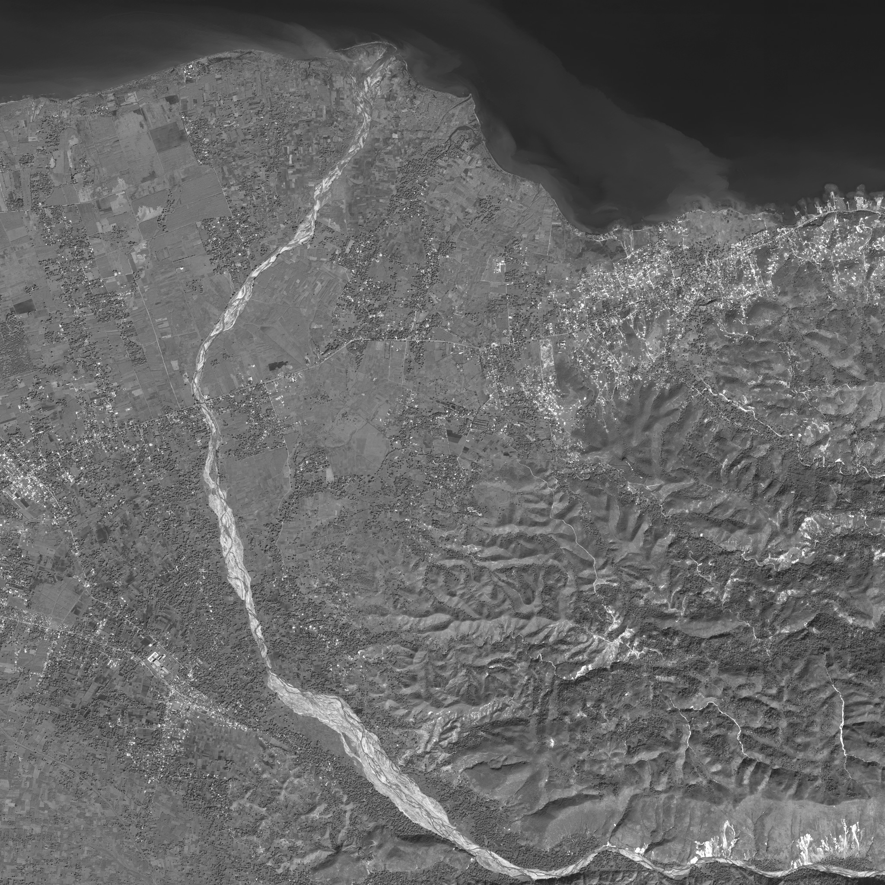
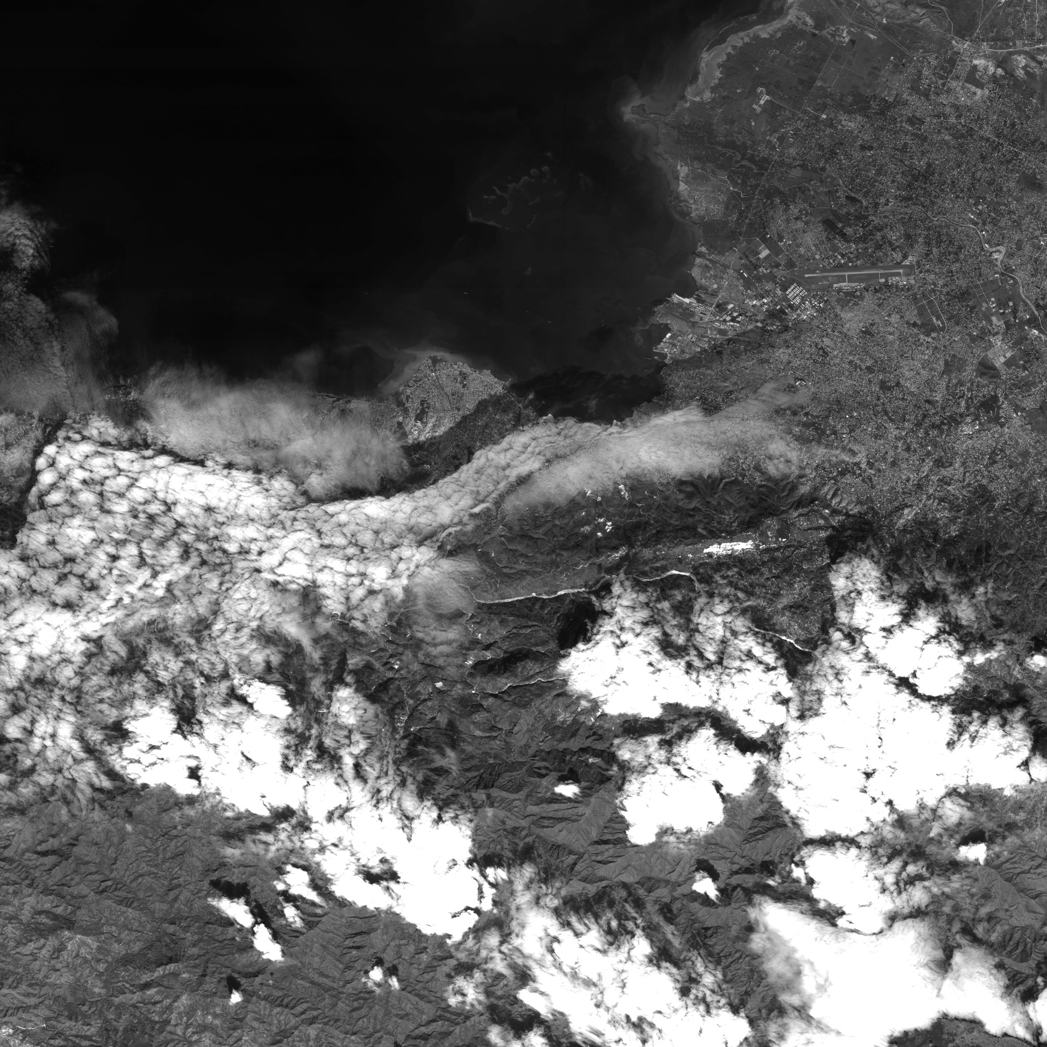
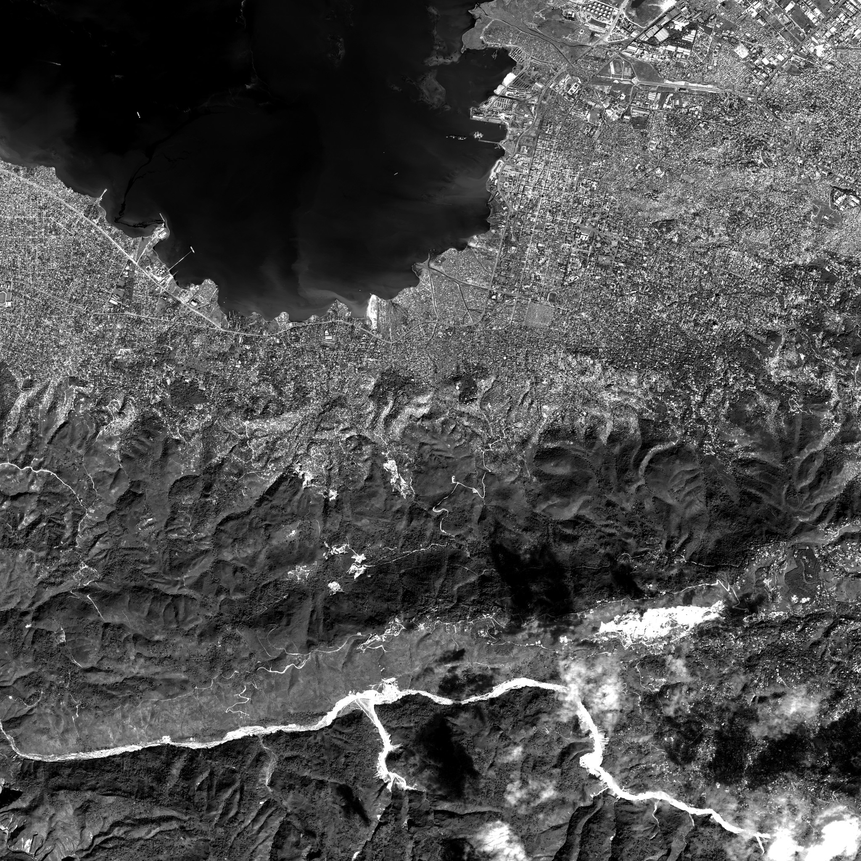
EXPERIMENTAL RESULTS
COMPUTATIONAL THROUGHPUT EVALUATION (preliminary)
satellite images
(10240x10240, 8 bps)
22

Slide 57
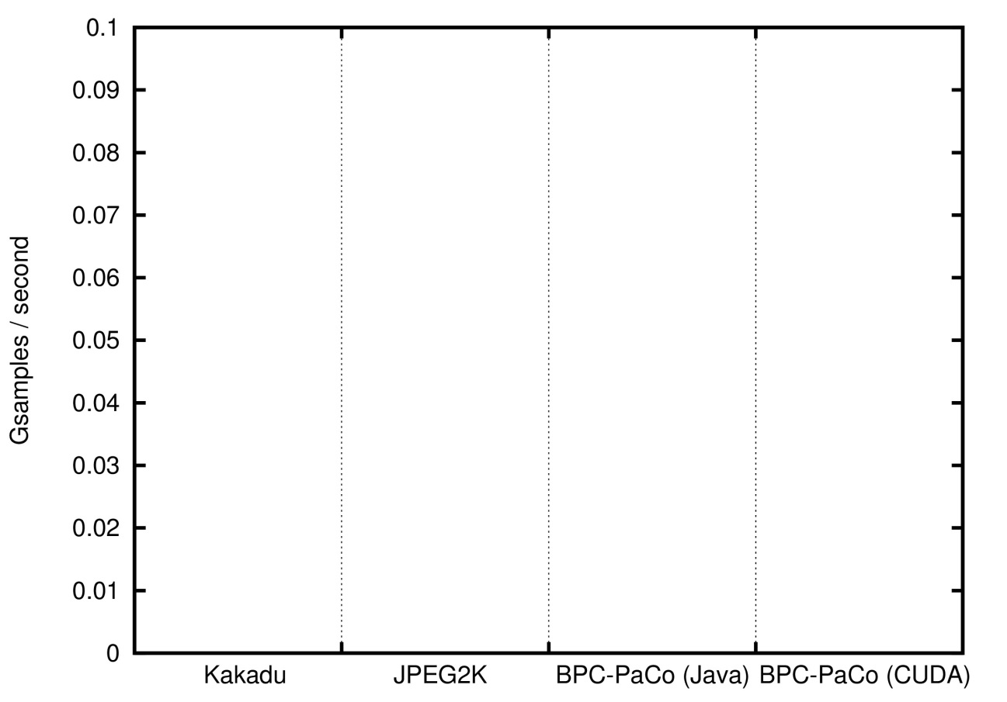
EXPERIMENTAL RESULTS
COMPUTATIONAL THROUGHPUT EVALUATION (preliminary)
CPU: Intel i7-3770 @ 3.40GHz
GPU: Nvidia GTX TITAN Black @ 980MHz
Coding parameters: codeblocks of 64x64, 5 levels of DWT
satellite images
(10240x10240, 8 bps)
22

Slide 58
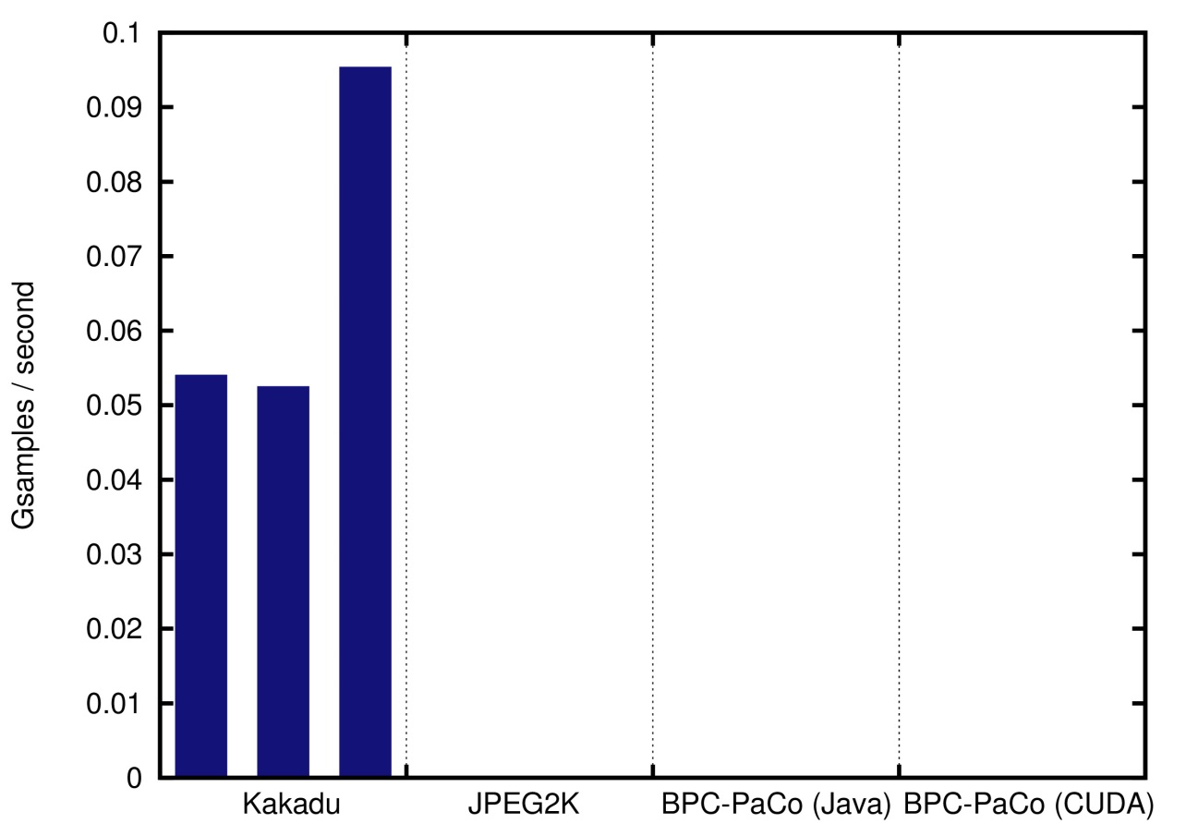
EXPERIMENTAL RESULTS
COMPUTATIONAL THROUGHPUT EVALUATION (preliminary)
CPU: Intel i7-3770 @ 3.40GHz
GPU: Nvidia GTX TITAN Black @ 980MHz
Coding parameters: codeblocks of 64x64, 5 levels of DWT
satellite images
(10240x10240, 8 bps)
22

Slide 59
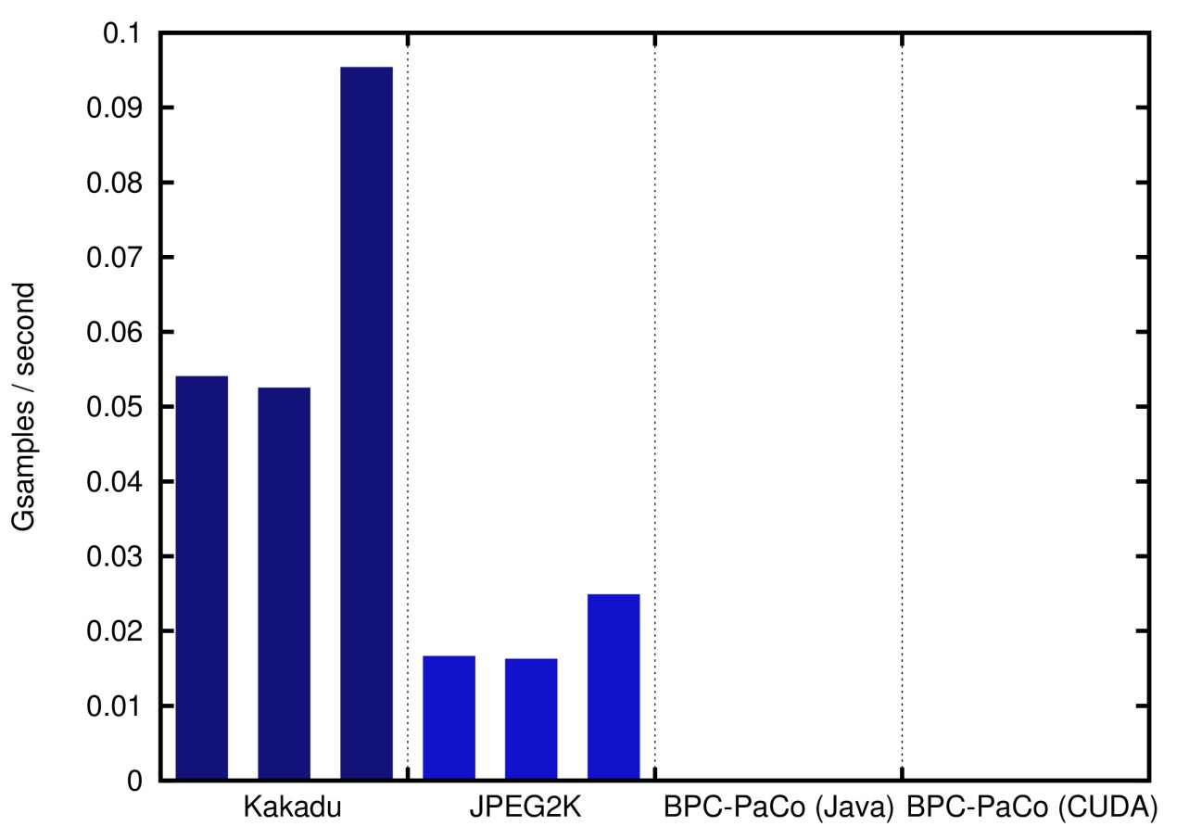
EXPERIMENTAL RESULTS
COMPUTATIONAL THROUGHPUT EVALUATION (preliminary)
CPU: Intel i7-3770 @ 3.40GHz
GPU: Nvidia GTX TITAN Black @ 980MHz
Coding parameters: codeblocks of 64x64, 5 levels of DWT
satellite images
(10240x10240, 8 bps)
22

Slide 60
EXPERIMENTAL RESULTS
COMPUTATIONAL THROUGHPUT EVALUATION (preliminary)
CPU: Intel i7-3770 @ 3.40GHz
GPU: Nvidia GTX TITAN Black @ 980MHz
Coding parameters: codeblocks of 64x64, 5 levels of DWT
satellite images
(10240x10240, 8 bps)
22

Slide 61
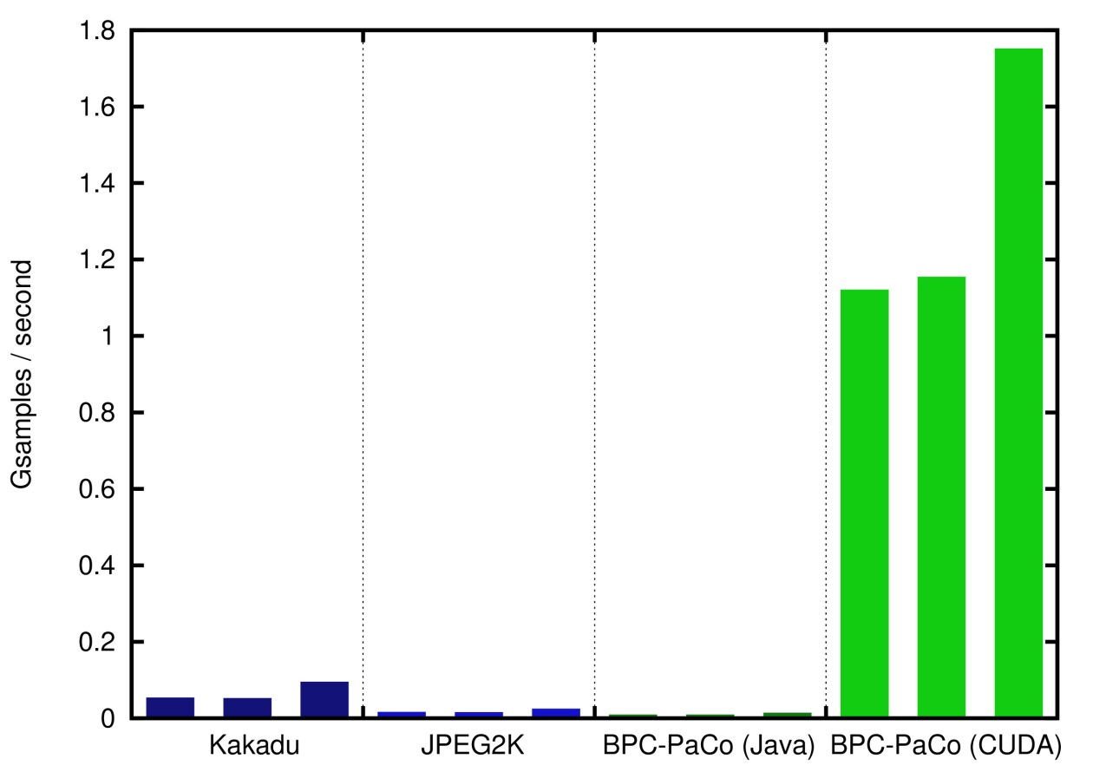
EXPERIMENTAL RESULTS
COMPUTATIONAL THROUGHPUT EVALUATION (preliminary)
CPU: Intel i7-3770 @ 3.40GHz
GPU: Nvidia GTX TITAN Black @ 980MHz
Coding parameters: codeblocks of 64x64, 5 levels of DWT
satellite images
(10240x10240, 8 bps)
22

Slide 62
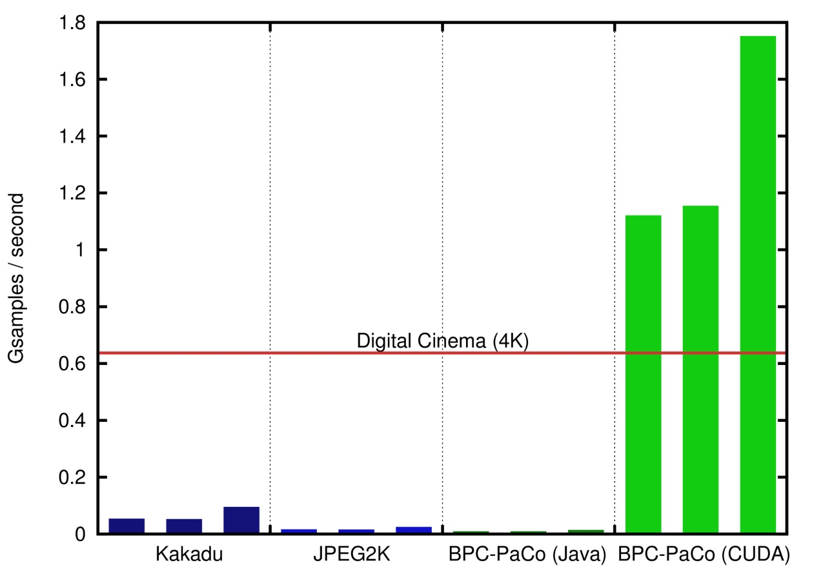
EXPERIMENTAL RESULTS
COMPUTATIONAL THROUGHPUT EVALUATION (preliminary)
CPU: Intel i7-3770 @ 3.40GHz
GPU: Nvidia GTX TITAN Black @ 980MHz
Coding parameters: codeblocks of 64x64, 5 levels of DWT
satellite images
(10240x10240, 8 bps)
22

Slide 63
TABLE OF CONTENTS
INTRODUCTION
TRADITIONAL SCHEMES
PROPOSED METHOD
EXPERIMENTAL RESULTS
CONCLUSIONS
Proposed method
Redevise mechanisms to allow SIMD computing
Scanning order: multiple stripes coded in parallel
Context formation: simplification without sacrifice in performance
Probability model: use of a stationary model via LUTs
Arithmetic coder: multiple coders and sorting technique

Slide 64
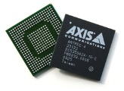
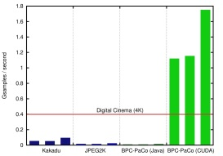
CONCLUSIONS
Motivation
Need of high performance image/video coding systems in real scenarios
Use of hardware solutions: fast but expensive
Upraising of SIMD computing via GPUs
Main issues
Current coding systems have algorithms that are inherently sequential
Mechanisms that prevent parallelism in bitplane image coding:
Scanning order
Context formation
Probability model
Arithmetic coder
Proposed method
Redevise mechanisms to allow SIMD computing
Scanning order: multiple stripes coded in parallel
Context formation: simplification without sacrifice in performance
Probability model: use of a stationary model via LUTs
Arithmetic coder: multiple coders and sorting technique
Experimental results
Coding performance: similar to that achieved by the international standard JPEG2000
Computational throughput: an order of magnitude superior to that achieved by state-of-the-art implementations
23

Slide 65
CONCLUSIONS
Motivation
Need of high performance image/video coding systems in real scenarios
Use of hardware solutions: fast but expensive
Upraising of SIMD computing via GPUs
Main issues
Current coding systems have algorithms that are inherently sequential
Mechanisms that prevent parallelism in bitplane image coding:
Scanning order
Context formation
Probability model
Arithmetic coder
Proposed method
Redevise mechanisms to allow SIMD computing
Scanning order: multiple stripes coded in parallel
Context formation: simplification without sacrifice in performance
Probability model: use of a stationary model via LUTs
Arithmetic coder: multiple coders and sorting technique
Experimental results
Coding performance: similar to that achieved by the international standard JPEG2000
Computational throughput: an order of magnitude superior to that achieved by state-of-the-art implementations
23

