Slide 1
LOW COMPLEXITY EMBEDDED QUANTIZATION SCHEME COMPATIBLE WITH BITPLANE IMAGE CODING
Francesc Aulí-Llinàs
Department of Information and Communications Engineering
Universitat Autònoma de Barcelona, Spain

Slide 2
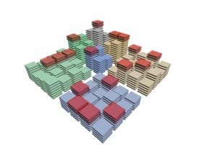
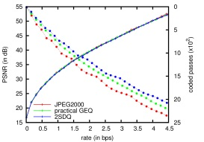
TABLE OF CONTENTS
INTRODUCTION
2-STEP SCALAR DEADZONE QUANTIZATION
αW
L
H
EXPERIMENTAL RESULTS
CONCLUSIONS

Slide 3
TABLE OF CONTENTS
INTRODUCTION
2-STEP SCALAR DEADZONE QUANTIZATION
αW
L
H
EXPERIMENTAL RESULTS
CONCLUSIONS

Slide 4
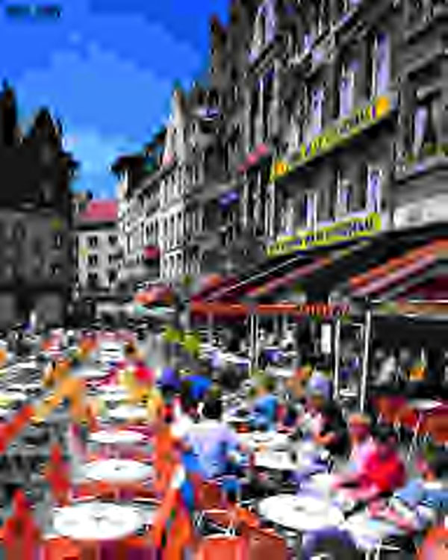
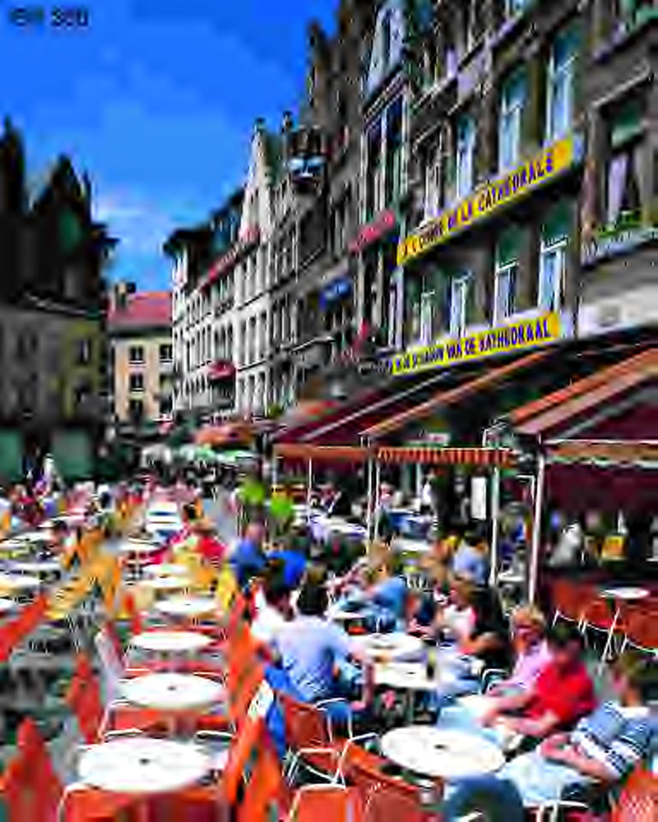
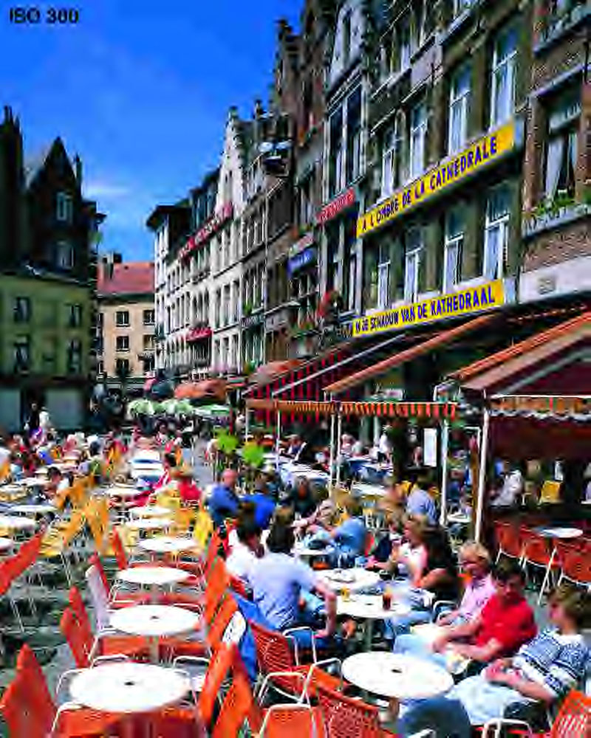
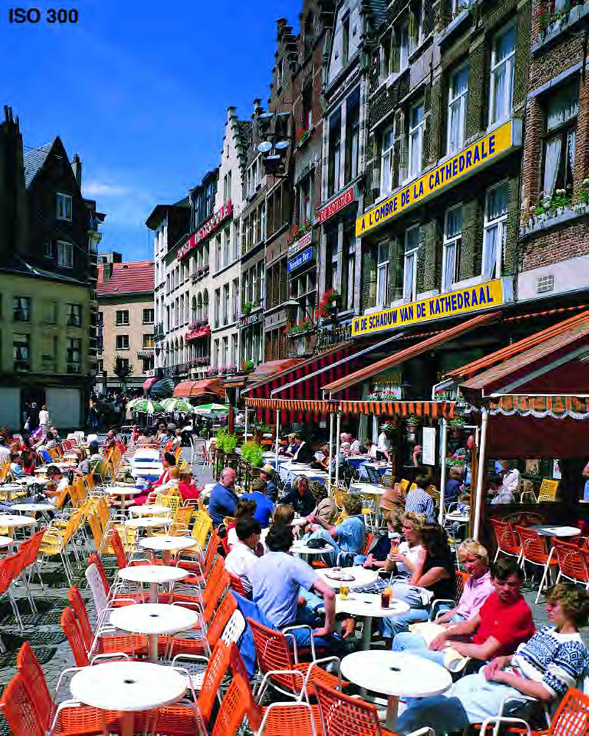
INTRODUCTION
QUALITY PROGRESSIVITY
compressed codestream
Progressive transmission
Interactive applications
Codestream truncation
Image transcoding
1

Slide 5
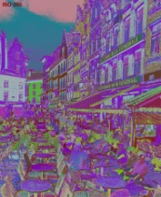
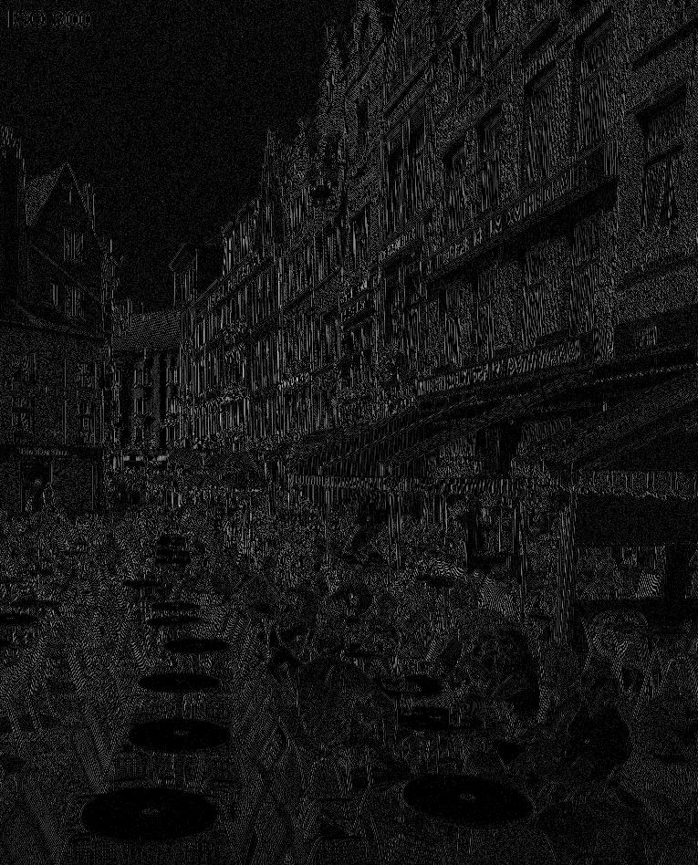
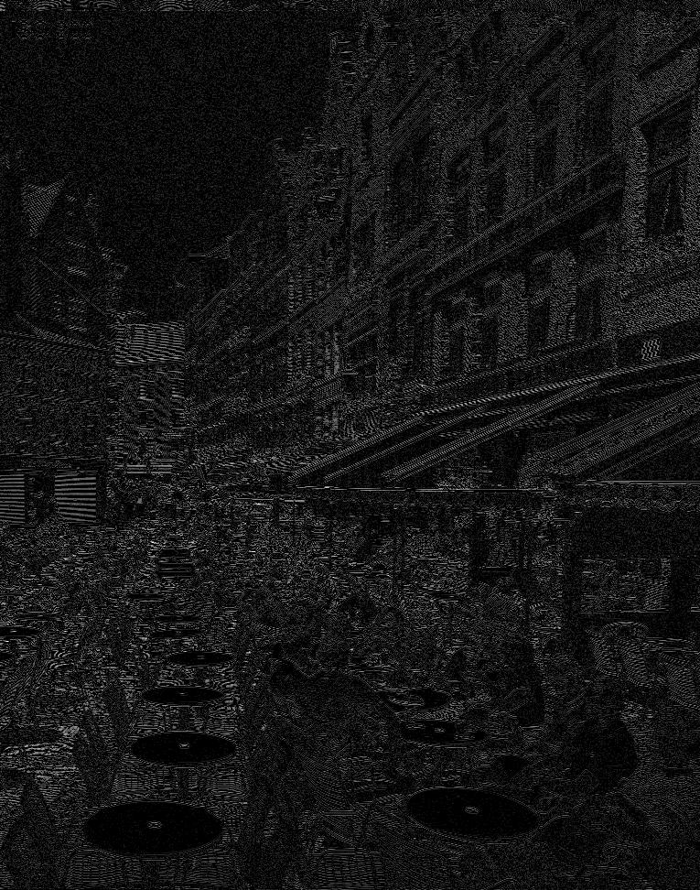
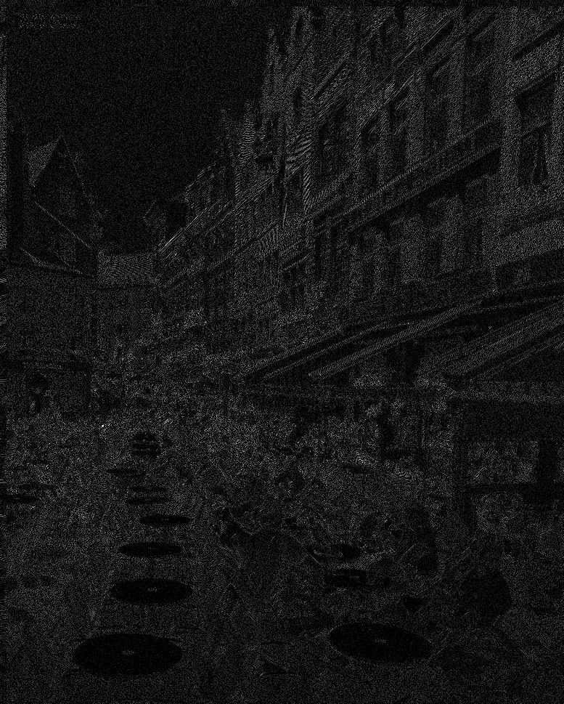
INTRODUCTION
CLASSIC SCHEME: USDQ+BPC
0
W = 2⁴
10
1

Slide 6
INTRODUCTION
CLASSIC SCHEME: USDQ+BPC
10₍₁₀
0
W = 2⁴
XXXX₍₂
emit 0
2³
emit 1
1XXX₍₂
0
2²
1
0
1
10XX₍₂
0
2¹
1
0
1
0
1
0
1
101X₍₂
2⁰
1010₍₂
= 10₍₁₀
2

Slide 7
INTRODUCTION
CLASSIC SCHEME: USDQ+BPC
10₍₁₀
0
W = 2⁴
XXXX₍₂
2³
1XXX₍₂
2²
10XX₍₂
2¹
101X₍₂
2⁰
1010₍₂
= 10₍₁₀
2

Slide 8
INTRODUCTION
CLASSIC SCHEME: USDQ+BPC
10₍₁₀
0
W = 2⁴
XXXX₍₂
2³
1XXX₍₂
2²
10XX₍₂
2¹
101X₍₂
2⁰
1010₍₂
= 10₍₁₀
IS USDQ+BPC OPTIMAL FOR
WAVELET-BASED LOSSY IMAGE CODING?
density
2

Slide 9
INTRODUCTION
GENERAL EMBEDDED QUANTIZATION (GEQ)
10₍₁₀
0
W = 2⁴
emit 0
T₁
emit 1
yes
1
> T₁ ?
no
emit 0
T₂
emit 1
0
T₃
1
0
T₄’
1
0
T₄’’
1
0
T₄’’’
1
> T₄’’’ ?
yes
T₅
no
0
0
1
T₆’
T₆’’
T₆’’’
T₆’’’’
T₆’’’’’
T₆’’’’’’
T₆’’’’’’’
yes
> T₆’’’’’’ ?
no
0
3

Slide 10
INTRODUCTION
GENERAL EMBEDDED QUANTIZATION (GEQ)
10₍₁₀
0
W = 2⁴
T₁
yes
1
> T₁ ?
no
T₂
T₃
RESEARCH PURPOSE:
ADAPT THE LOW-COMPLEXITY GEQ SCHEME TO BITPLANE CODING
T₄’
T₄’’
T₄’’’
> T₄’’’ ?
yes
T₅
no
0
T₆’
T₆’’
T₆’’’
T₆’’’’
T₆’’’’’
T₆’’’’’’
T₆’’’’’’’
yes
> T₆’’’’’’ ?
no
0
USDQ+BPC is optimal in terms of coding performance
GEQ schemes can achieve same coding performance as that of USDQ+BPC employing fewer quantization stages
GEQ schemes can help to reduce the computational costs of the codec in 20%
GEQ is not compatible with bitplane coding strategies
100 ≠ 10₍₁₀
3

Slide 11
TABLE OF CONTENTS
INTRODUCTION
2-STEP SCALAR DEADZONE QUANTIZATION
αW
L
H
EXPERIMENTAL RESULTS
CONCLUSIONS
1

Slide 12
2-STEP SCALAR DEADZONE QUANTIZATION
PROPOSED SCHEME
0
W
USDQ+BPC
GEQ
αW
2SDQ
L
H
1)
same number of subintervals
CONDITIONS
(1 - α)
2)
=
L
H
α
3) Each quantization stage halves the previous subintervals except
in the first stage
4

Slide 13
2-STEP SCALAR DEADZONE QUANTIZATION
PROPOSED SCHEME
10₍₁₀
0
W = 2⁴
XXXX
emit 0
αW
emit 1
1XXX
0
1
0
1
11XX
0
1
0
1
0
1
0
1
110X
1100
L
H
2SDQ(1010₍₂)=1100
5

Slide 14
2-STEP SCALAR DEADZONE QUANTIZATION
IMPLEMENTATION IN JPEG2000
ORIGINAL IMAGE
6

Slide 15
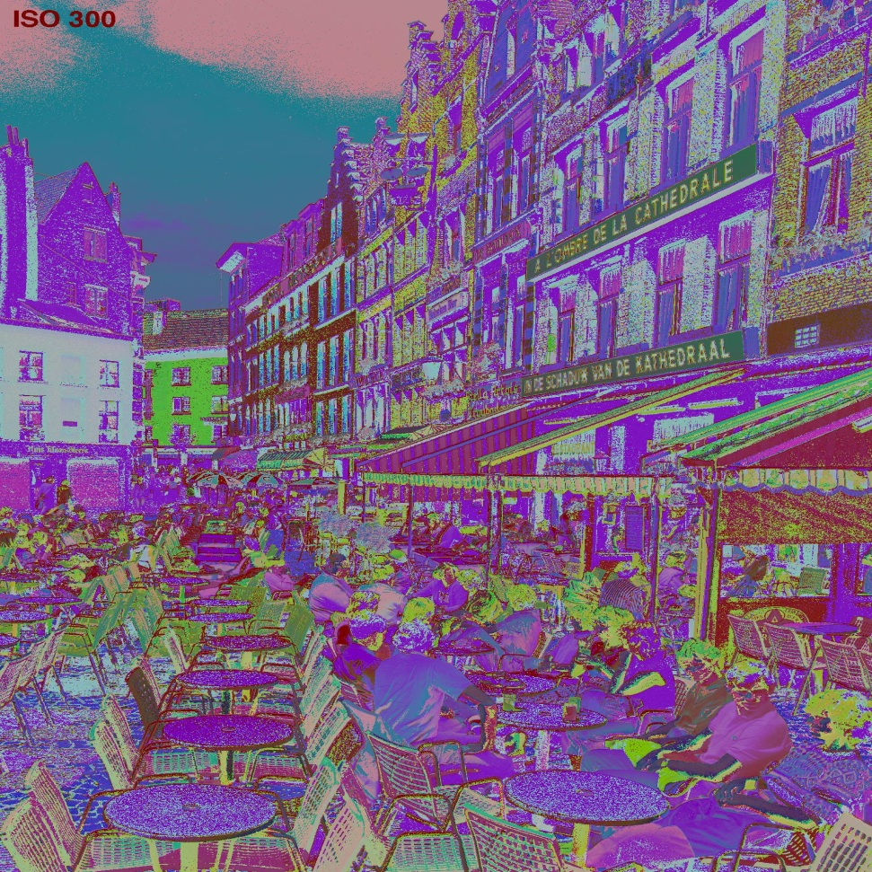
2-STEP SCALAR DEADZONE QUANTIZATION
IMPLEMENTATION IN JPEG2000
ORIGINAL IMAGE
MULTI-COMPONENT
TRANSFORM
6

Slide 16
2-STEP SCALAR DEADZONE QUANTIZATION
IMPLEMENTATION IN JPEG2000
ORIGINAL IMAGE
MULTI-COMPONENT
TRANSFORM
WAVELET
TRANSFORM
QUANTIZATION
6

Slide 17
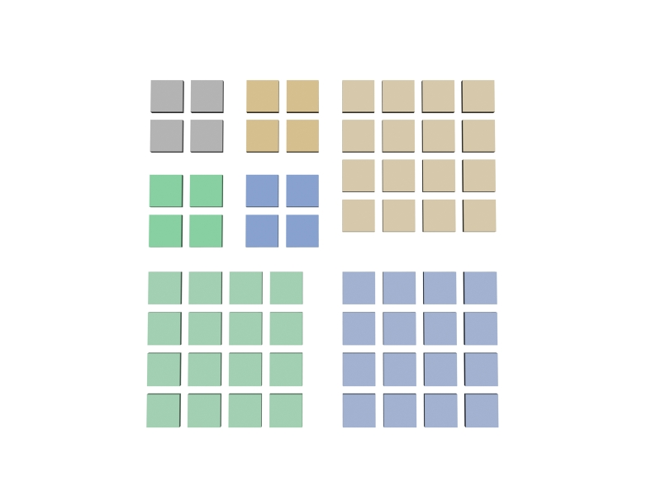
2-STEP SCALAR DEADZONE QUANTIZATION
IMPLEMENTATION IN JPEG2000
ORIGINAL IMAGE
MULTI-COMPONENT
TRANSFORM
WAVELET
TRANSFORM
QUANTIZATION
6

Slide 18
2-STEP SCALAR DEADZONE QUANTIZATION
IMPLEMENTATION IN JPEG2000
ORIGINAL IMAGE
MULTI-COMPONENT
TRANSFORM
WAVELET
TRANSFORM
QUANTIZATION
6

Slide 19
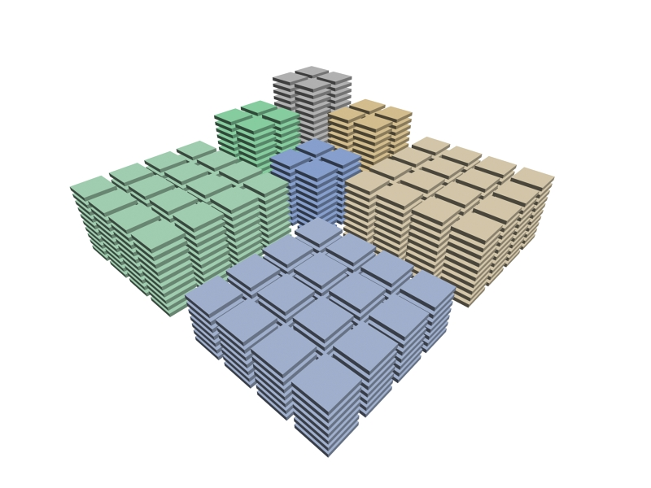
2-STEP SCALAR DEADZONE QUANTIZATION
IMPLEMENTATION IN JPEG2000
ORIGINAL IMAGE
MULTI-COMPONENT
TRANSFORM
WAVELET
TRANSFORM
QUANTIZATION
TIER-1
CODING
TIER-2
CODING
JP2 CODESTREAM
6

Slide 20
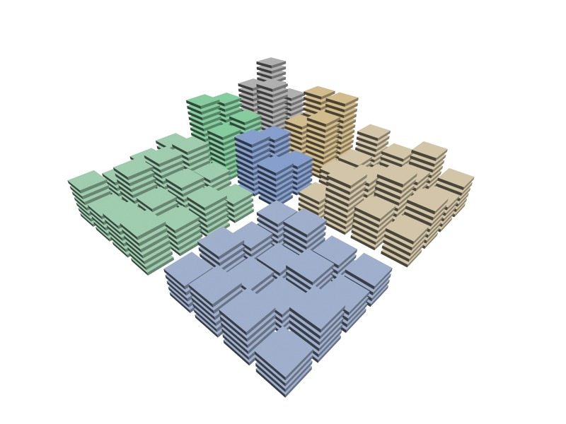
2-STEP SCALAR DEADZONE QUANTIZATION
IMPLEMENTATION IN JPEG2000
ORIGINAL IMAGE
MULTI-COMPONENT
TRANSFORM
WAVELET
TRANSFORM
QUANTIZATION
TIER-1
CODING
TIER-2
CODING
JP2 CODESTREAM
6

Slide 21
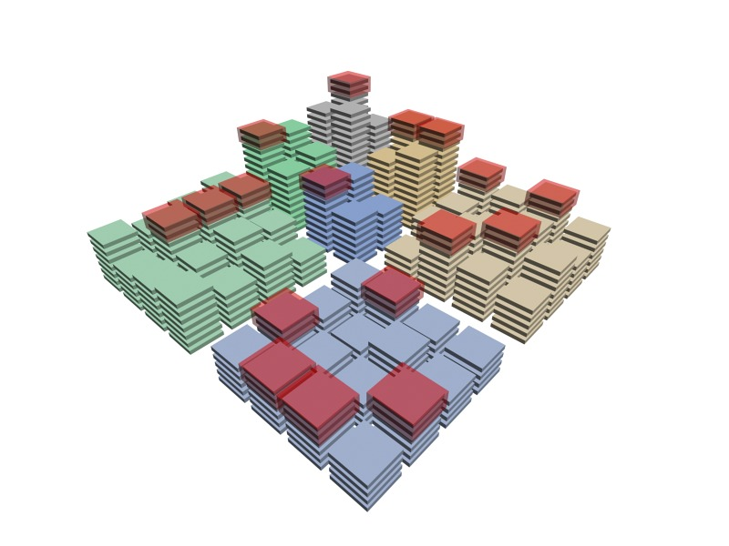
2-STEP SCALAR DEADZONE QUANTIZATION
IMPLEMENTATION IN JPEG2000
ORIGINAL IMAGE
MULTI-COMPONENT
TRANSFORM
WAVELET
TRANSFORM
QUANTIZATION
TIER-1
CODING
TIER-2
CODING
JP2 CODESTREAM
6

Slide 22
2-STEP SCALAR DEADZONE QUANTIZATION
IMPLEMENTATION IN JPEG2000
ORIGINAL IMAGE
MULTI-COMPONENT
TRANSFORM
WAVELET
TRANSFORM
QUANTIZATION
TIER-1
CODING
TIER-2
CODING
JP2 CODESTREAM
6

Slide 23
2-STEP SCALAR DEADZONE QUANTIZATION
IMPLEMENTATION IN JPEG2000
ORIGINAL IMAGE
MULTI-COMPONENT
TRANSFORM
WAVELET
TRANSFORM
QUANTIZATION
TIER-1
CODING
TIER-2
CODING
JP2 CODESTREAM
7

Slide 24
2-STEP SCALAR DEADZONE QUANTIZATION
IMPLEMENTATION IN JPEG2000
α2^{M}
ORIGINAL IMAGE
0
2^{M}
MULTI-COMPONENT
TRANSFORM
WAVELET
TRANSFORM
2^{M-1}
QUANTIZATION
TIER-1
CODING
TIER-2
CODING
JP2 CODESTREAM
7

Slide 25
2-STEP SCALAR DEADZONE QUANTIZATION
IMPLEMENTATION IN JPEG2000
α2^{M}
ORIGINAL IMAGE
0
L
H
2^{M}
MULTI-COMPONENT
TRANSFORM
WAVELET
TRANSFORM
2^{M-1}
QUANTIZATION
2SDQ
TIER-1
CODING
header
bit
TIER-2
CODING
JP2 CODESTREAM
7

Slide 26
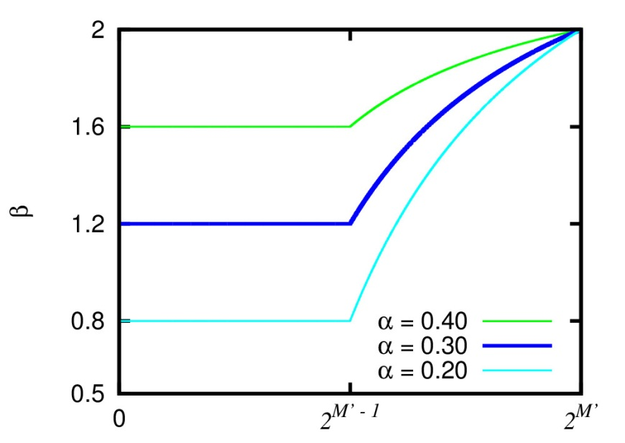
2-STEP SCALAR DEADZONE QUANTIZATION
IMPLEMENTATION IN JPEG2000
α2^{M}
ORIGINAL IMAGE
0
L
H
2^{M}
MULTI-COMPONENT
TRANSFORM
constant
variable
WAVELET
TRANSFORM
β_{L} = 4α
β_{H} = 4(2αln2 – α + 1 – ln2)
2^{M-1}
QUANTIZATION
2SDQ
TIER-1
CODING
header
bit
TIER-2
CODING
RD-opt
JP2 CODESTREAM
0
2^{M-2}
2^{M-1}
7

Slide 27
2-STEP SCALAR DEADZONE QUANTIZATION
IMPLEMENTATION IN JPEG2000
ORIGINAL IMAGE
MULTI-COMPONENT
TRANSFORM
WAVELET
TRANSFORM
QUANTIZATION
2SDQ
TIER-1
CODING
header
bit
TIER-2
CODING
RD-opt
JP2 CODESTREAM
8

Slide 28
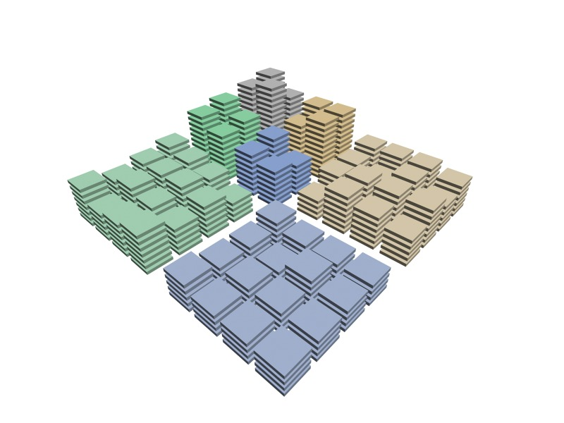
2-STEP SCALAR DEADZONE QUANTIZATION
IMPLEMENTATION IN JPEG2000
ORIGINAL IMAGE
MULTI-COMPONENT
TRANSFORM
WAVELET
TRANSFORM
QUANTIZATION
2SDQ
TIER-1
CODING
header
bit
TIER-2
CODING
RD-opt
JP2 CODESTREAM
8

Slide 29
TABLE OF CONTENTS
INTRODUCTION
2-STEP SCALAR DEADZONE QUANTIZATION
αW
L
H
EXPERIMENTAL RESULTS
CONCLUSIONS
1

Slide 30
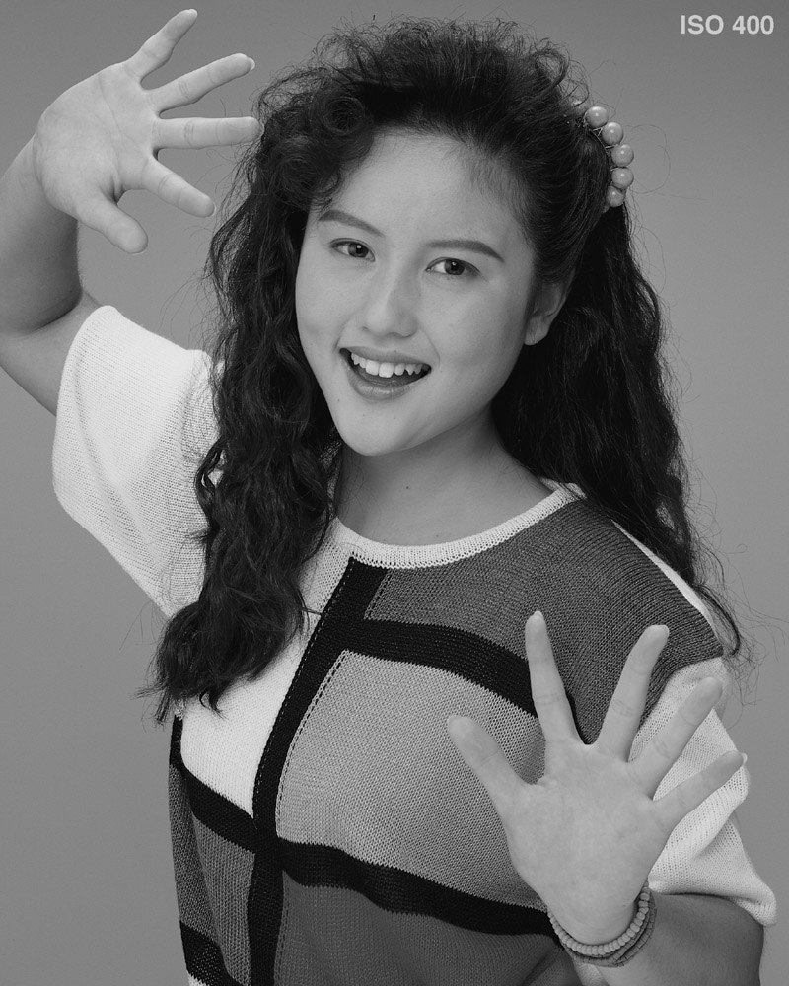
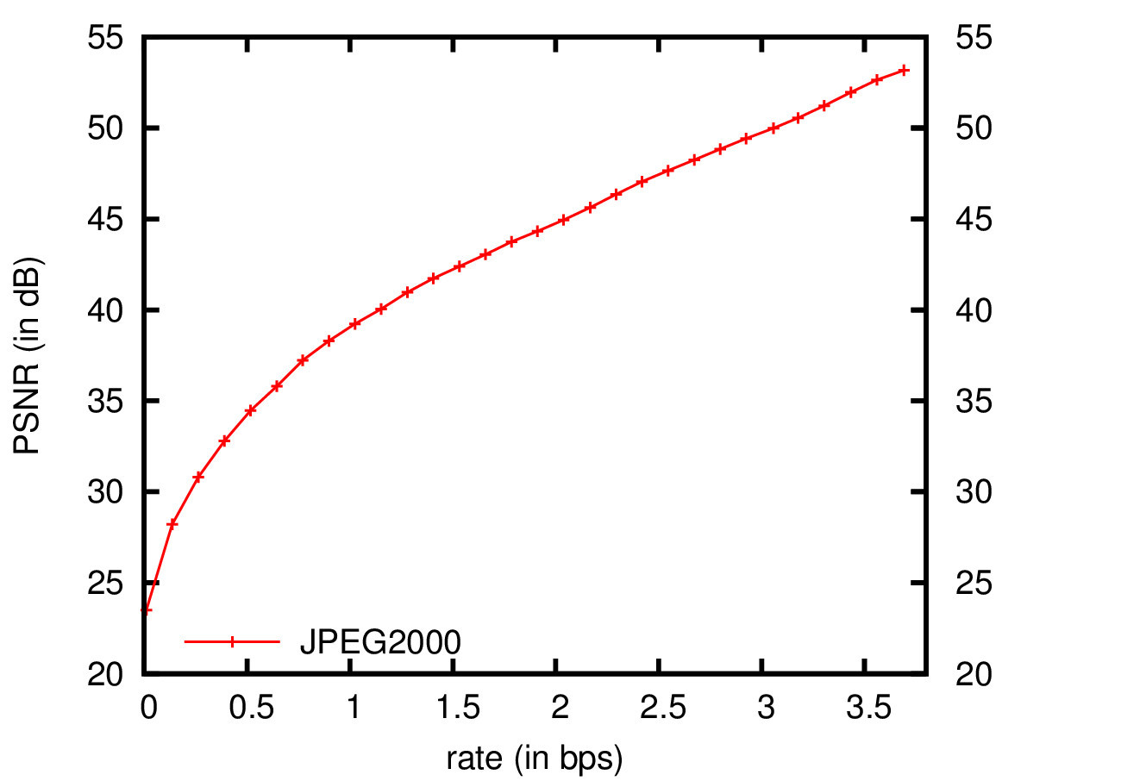
EXPERIMENTAL RESULTS
“Portrait” image (ISO 12640-1 corpus)
Codeblocks of 64x64
2SDQ is applied on codeblocks with
6 bitplanes or more removing 1 bitplane
9

Slide 31
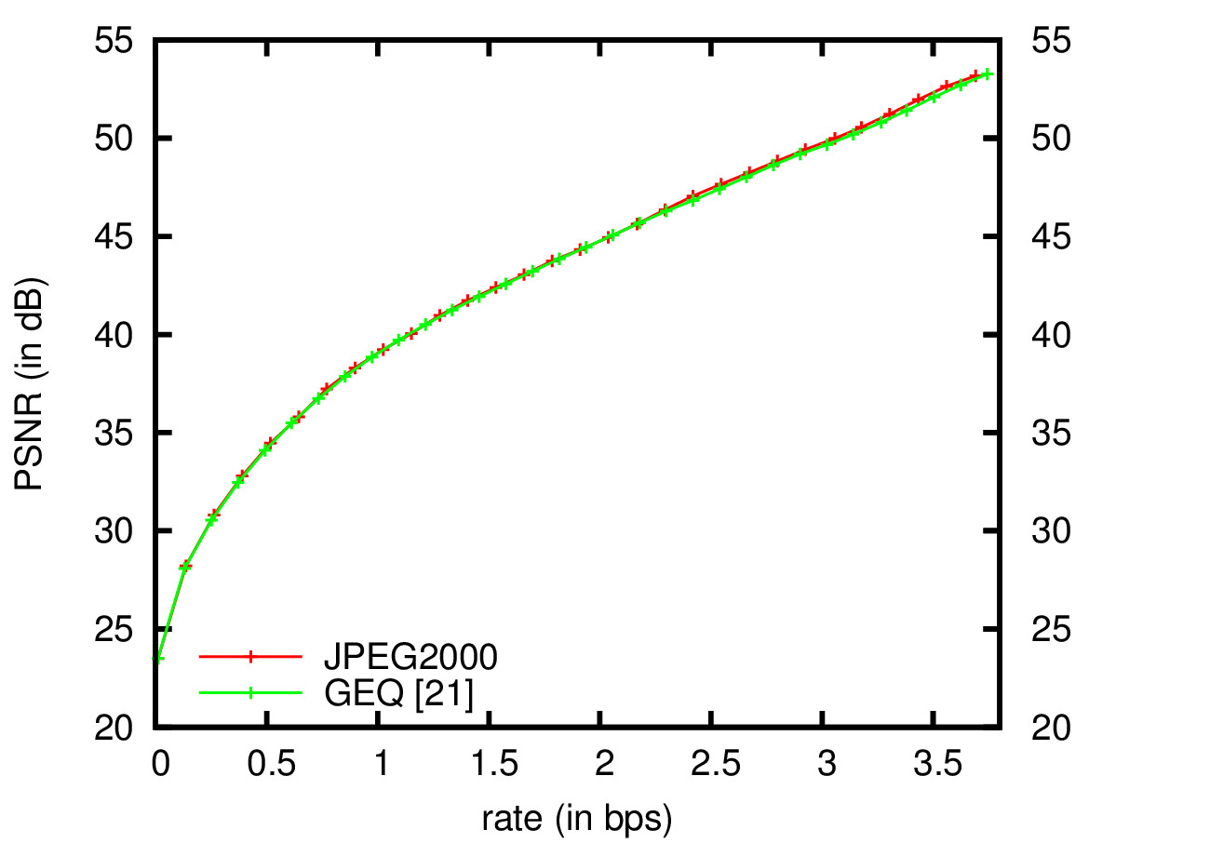
EXPERIMENTAL RESULTS
“Portrait” image (ISO 12640-1 corpus)
Codeblocks of 64x64
2SDQ is applied on codeblocks with
6 bitplanes or more removing 1 bitplane
9

Slide 32
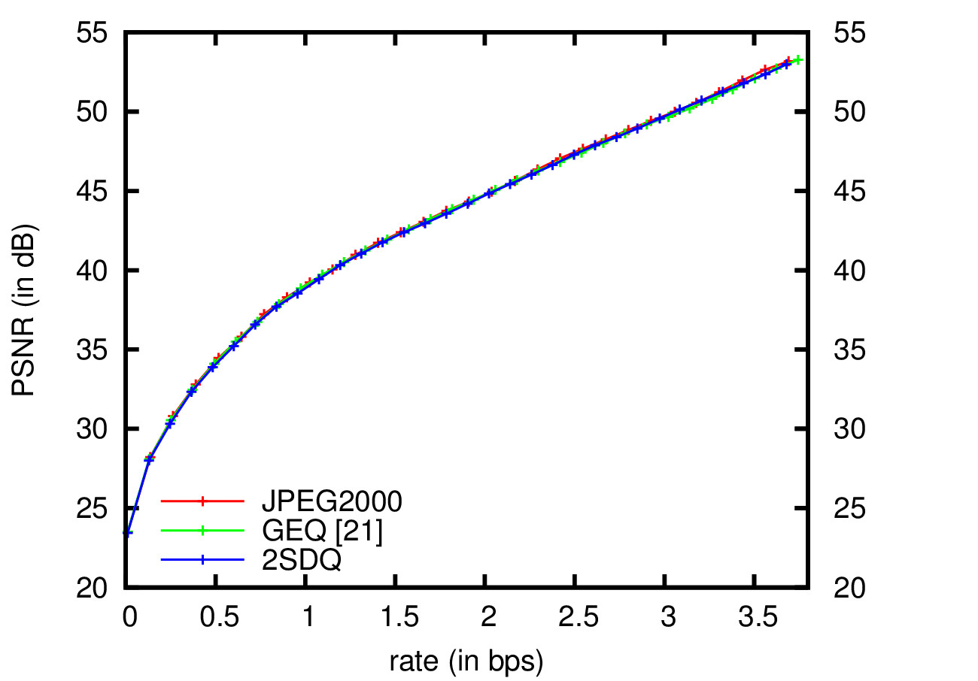
EXPERIMENTAL RESULTS
“Portrait” image (ISO 12640-1 corpus)
Codeblocks of 64x64
2SDQ is applied on codeblocks with
6 bitplanes or more removing 1 bitplane
9

Slide 33
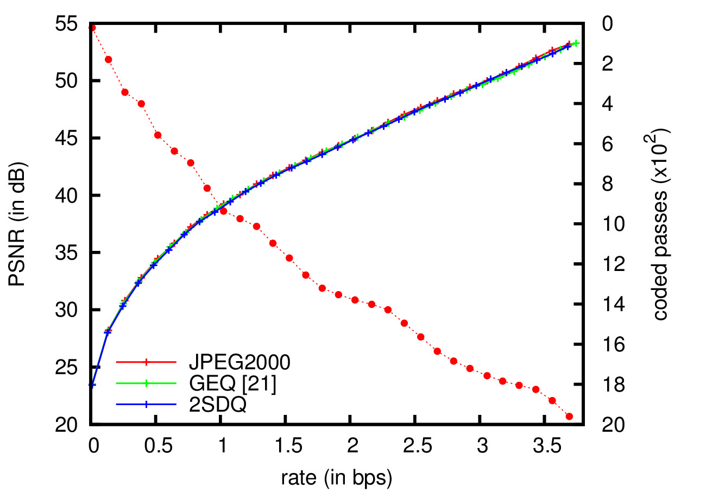
EXPERIMENTAL RESULTS
“Portrait” image (ISO 12640-1 corpus)
Codeblocks of 64x64
2SDQ is applied on codeblocks with
6 bitplanes or more removing 1 bitplane
9

Slide 34
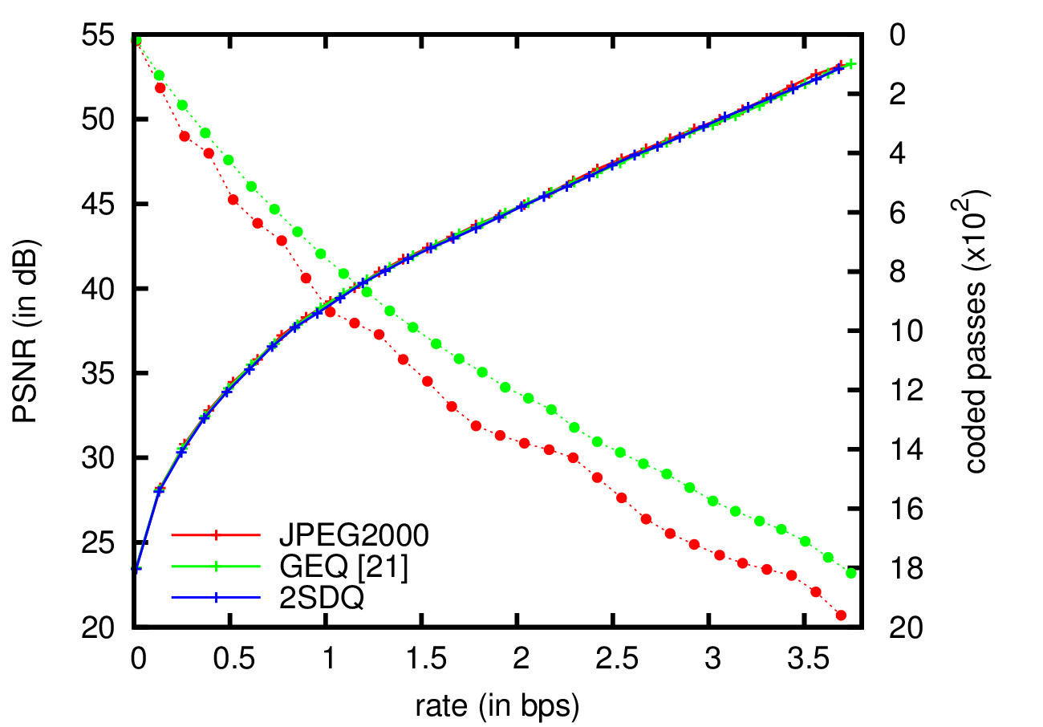
EXPERIMENTAL RESULTS
“Portrait” image (ISO 12640-1 corpus)
Codeblocks of 64x64
2SDQ is applied on codeblocks with
6 bitplanes or more removing 1 bitplane
9

Slide 35
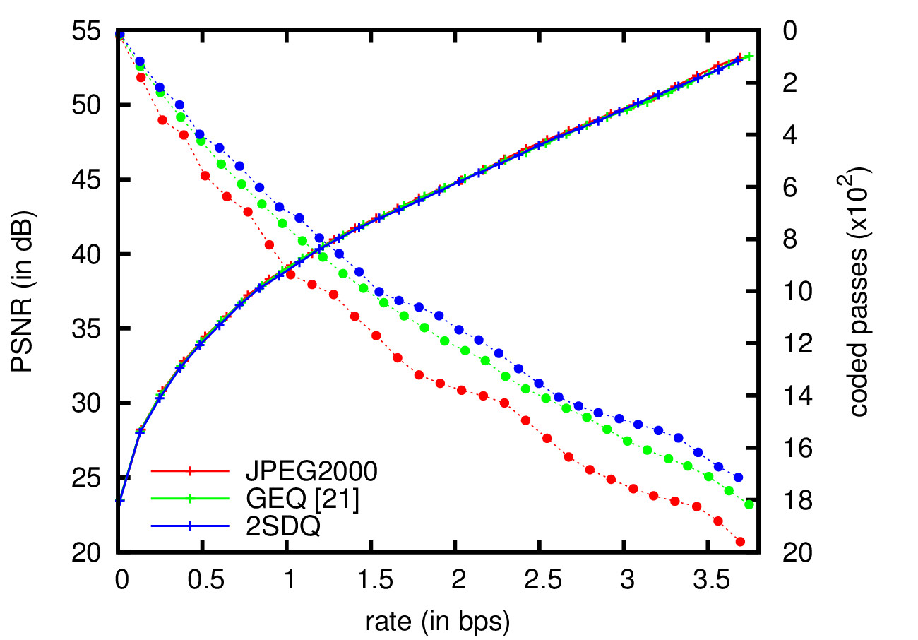
EXPERIMENTAL RESULTS
“Portrait” image (ISO 12640-1 corpus)
Codeblocks of 64x64
2SDQ is applied on codeblocks with
6 bitplanes or more removing 1 bitplane
9

Slide 36
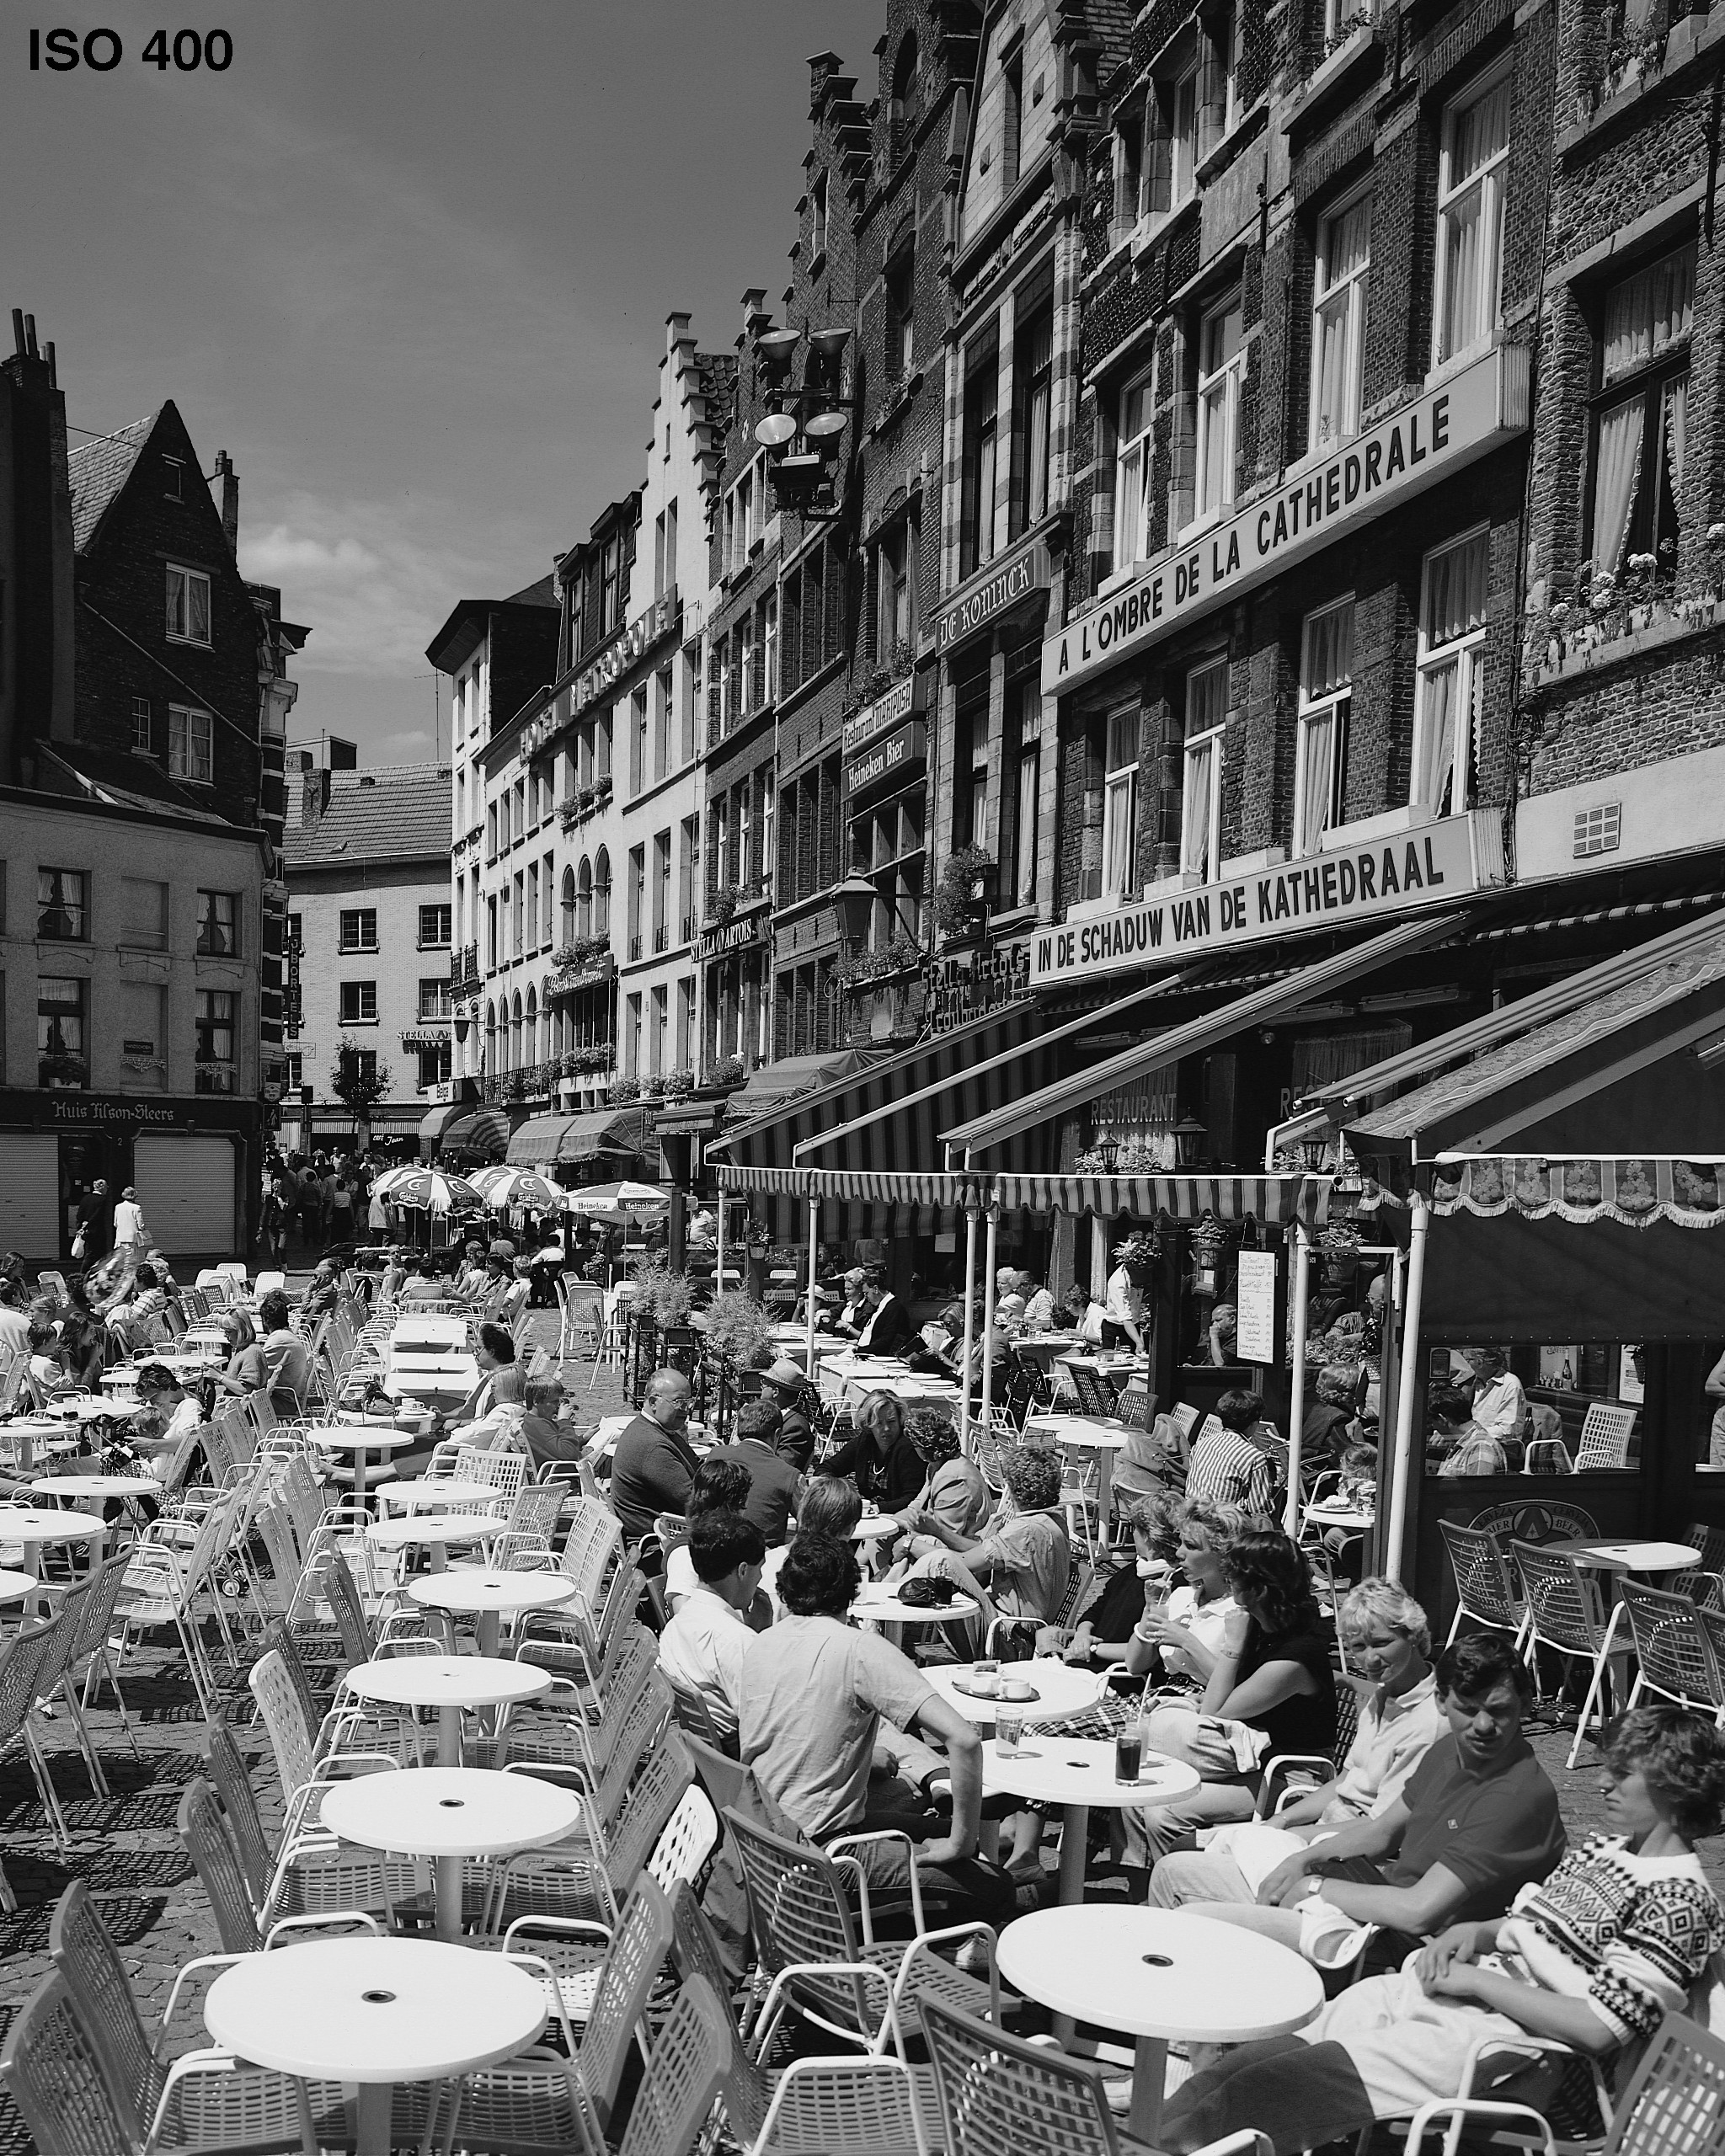
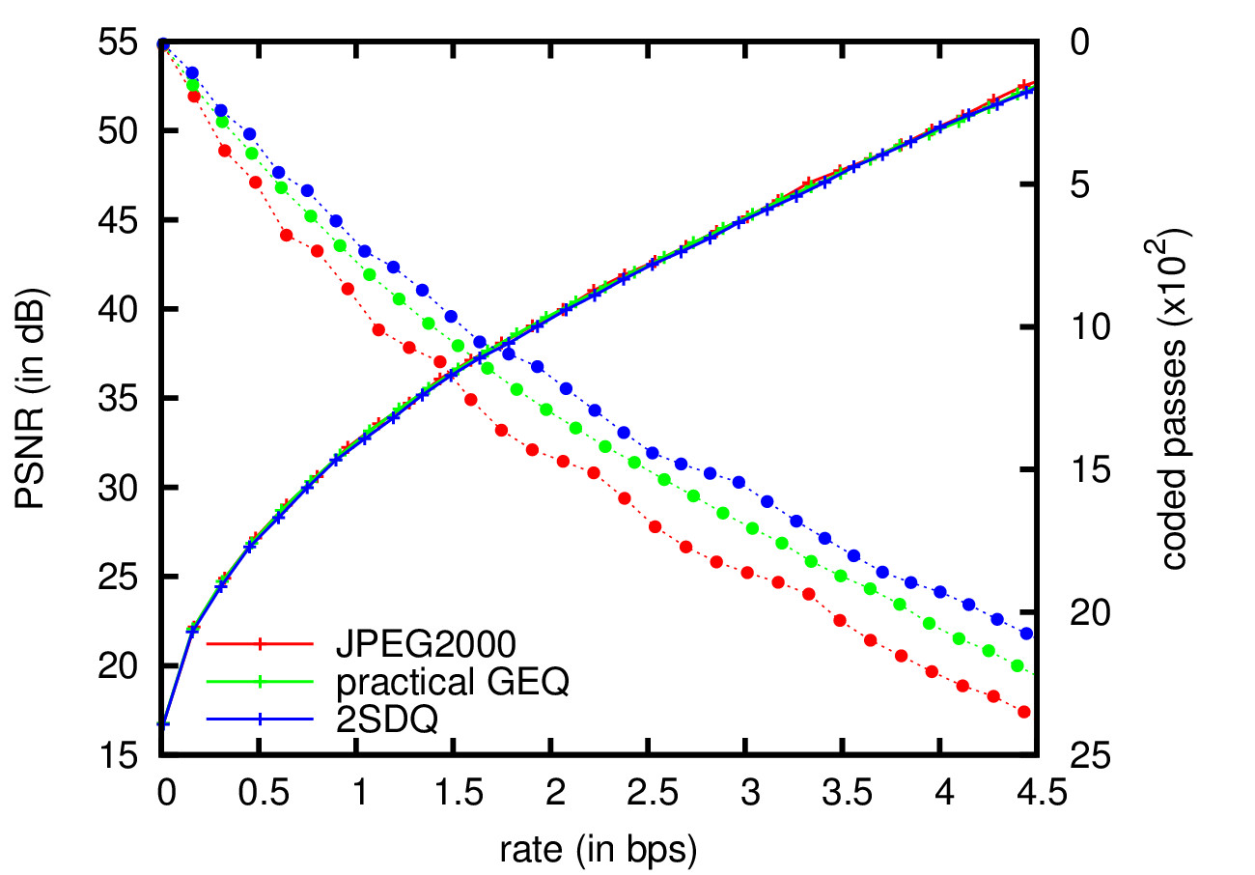
EXPERIMENTAL RESULTS
“Cafeteria” image (ISO 12640-1 corpus)
Codeblocks of 64x64
2SDQ is applied on codeblocks with
6 bitplanes or more removing 1 bitplane
10

Slide 37
TABLE OF CONTENTS
INTRODUCTION
2-STEP SCALAR DEADZONE QUANTIZATION
αW
L
H
EXPERIMENTAL RESULTS
CONCLUSIONS
1

Slide 38
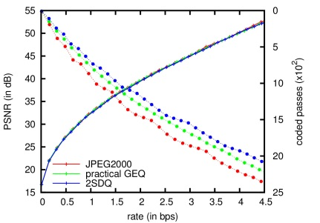
CONCLUSIONS
Motivation
explore new quantization schemes for wavelet-based image coding compatible with bitplane coding
2SDQ
quantization scheme with 2 step sizes adapted to the density of wavelet coefficients
αW
L
H
Implementation
replacement of USDQ quantization indices by 2SDQ indices
Adaptation in JPEG2000
introduction of three easy-to-implement steps in the coding pipeline
Results
reduction of coding passes without penalizing coding performance
11

Slide 39
CONCLUSIONS
CONCLUSIONS
Motivation
explore new quantization schemes for wavelet-based image coding compatible with bitplane coding
2SDQ
quantization scheme with 2 step sizes adapted to the density of wavelet coefficients
αW
L
H
Implementation
replacement of USDQ quantization indices by 2SDQ indices
Adaptation in JPEG2000
introduction of three easy-to-implement steps in the coding pipeline
Results
reduction of coding passes without penalizing coding performance
11

