Slide 1
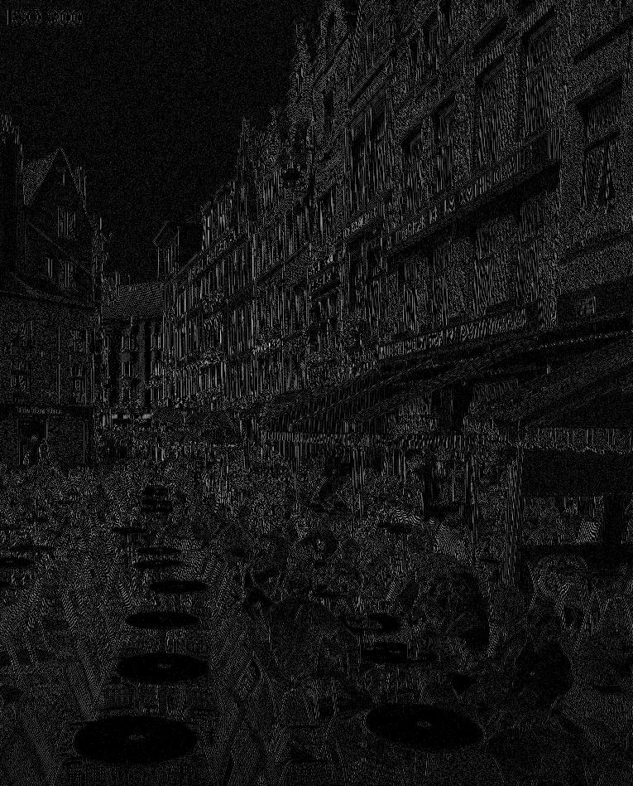
EMBEDDED QUANTIZATION
FOR LOSSY IMAGE CODING
Francesc Aulí-Llinàs
Department of Information and Communications Engineering
Universitat Autònoma de Barcelona, Spain

Slide 2
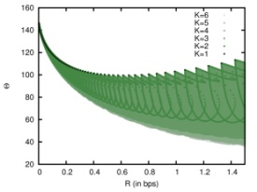
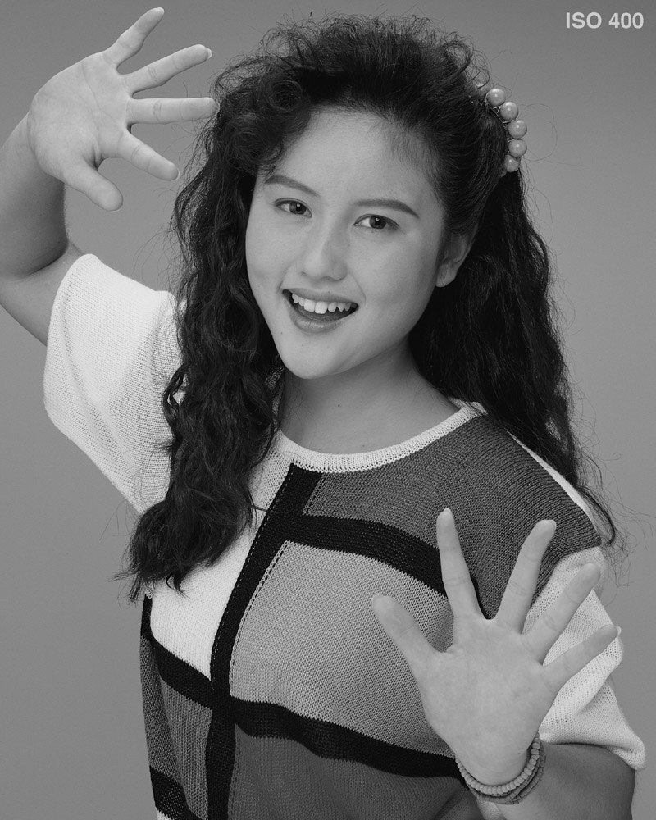
TABLE OF CONTENTS
INTRODUCTION
ANALYSIS & ALGORITHM
EXPERIMENTAL RESULTS
CONCLUSIONS
1) General embedded quantization (GEQ)
2) Exhaustive search
3) Low complexity algorithm

Slide 3
TABLE OF CONTENTS
INTRODUCTION
ANALYSIS & ALGORITHM
EXPERIMENTAL RESULTS
CONCLUSIONS
1) General embedded quantization (GEQ)
2) Exhaustive search
3) Low complexity algorithm

Slide 4
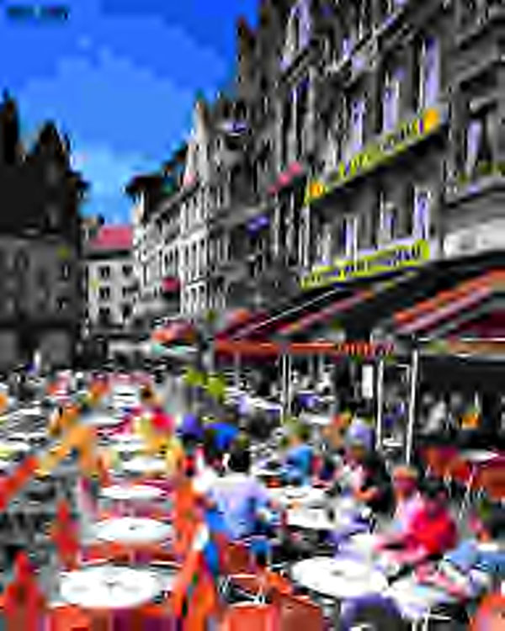
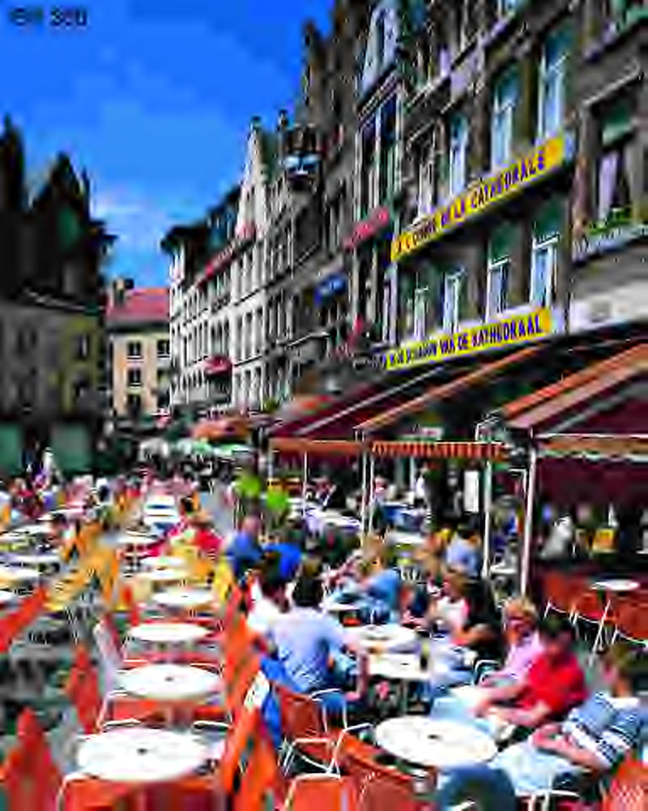
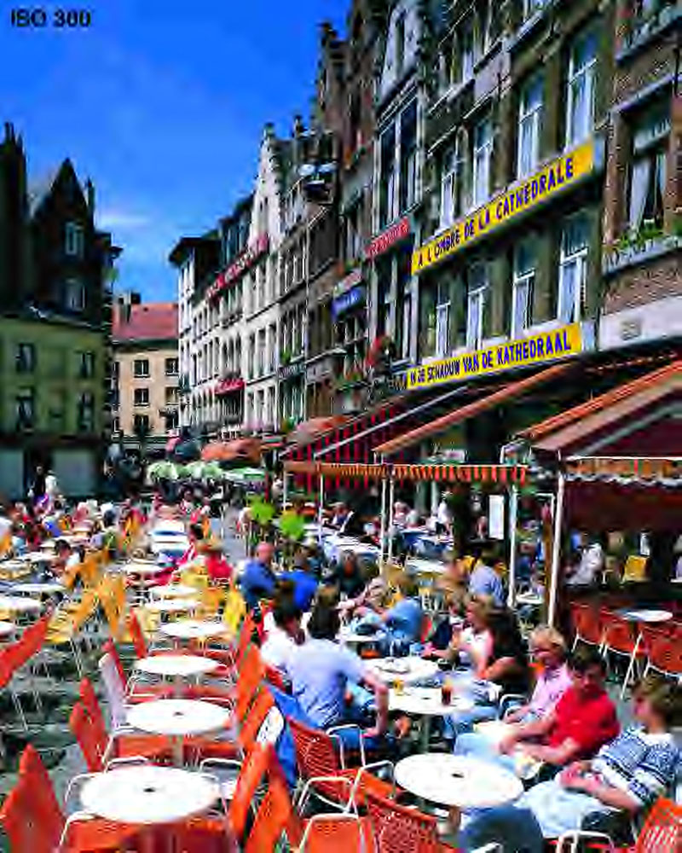
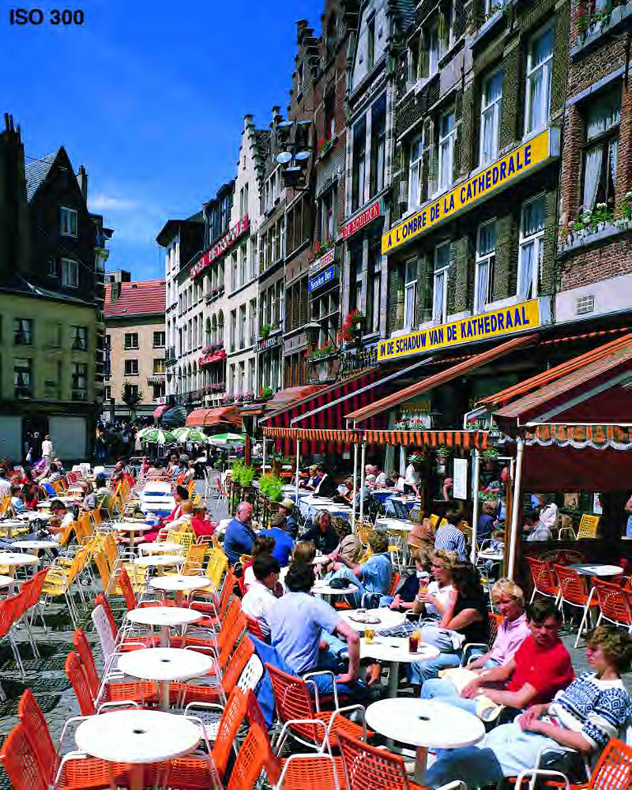
INTRODUCTION
QUALITY PROGRESSIVITY
COMPRESSED CODESTREAM
Applications:
Interactive image transmission
Codestream truncation
Image transcoding

Slide 5
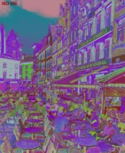
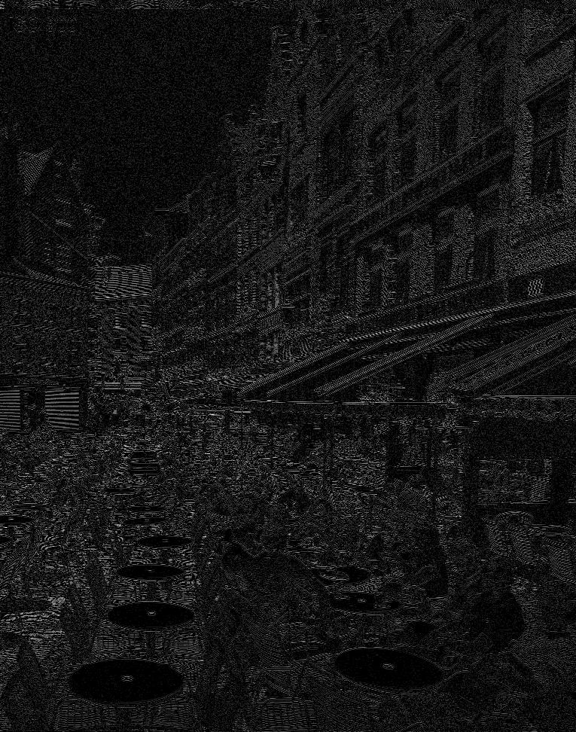
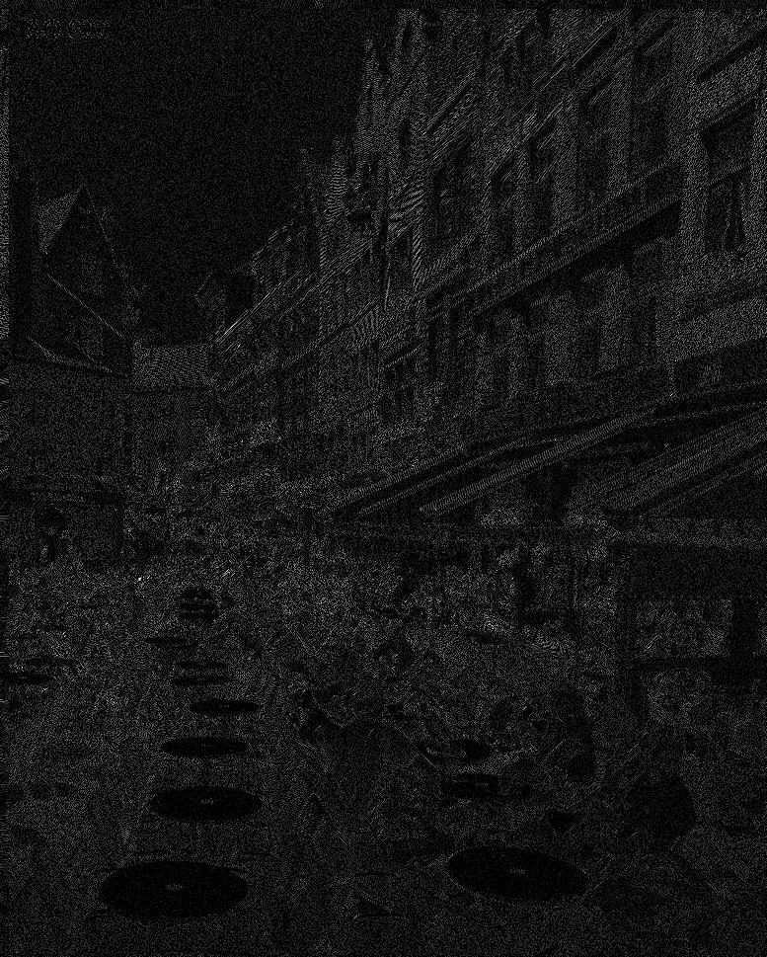
INTRODUCTION
USDQ+BPC SCHEME
0
W

Slide 6
INTRODUCTION
USDQ+BPC SCHEME
0
W
uniform scalar deadzone quantization (USDQ)

Slide 7
INTRODUCTION
USDQ+BPC SCHEME
emit 0
emit 1
0
W
bitplane coding (BPC)

Slide 8
INTRODUCTION
USDQ+BPC SCHEME
0
0
1
0
1
W
bitplane coding (BPC)

Slide 9
INTRODUCTION
USDQ+BPC SCHEME
0
0
1
0
1
0
1
0
1
W
bitplane coding (BPC)
WHY IS USDQ+BPC SO POPULAR ?
1) is convenient for current hardware
2) achieves competitive coding performance
3) many works aimed to improve efficiency
IS USDQ+BPC OPTIMAL FOR LOSSY IMAGE CODING ?

Slide 10
INTRODUCTION
USDQ+BPC SCHEME
0
W
GENERAL EMBEDDED QUANTIZATION (GEQ)
0
emit 0
emit 1
W
T₁

Slide 11
INTRODUCTION
USDQ+BPC SCHEME
0
W
GENERAL EMBEDDED QUANTIZATION (GEQ)
0
1
0
W
T₁
T₂

Slide 12
INTRODUCTION
USDQ+BPC SCHEME
0
W
GENERAL EMBEDDED QUANTIZATION (GEQ)
0
1
0
W
T₃
T₁
T₂

Slide 13
INTRODUCTION
USDQ+BPC SCHEME
0
W
GENERAL EMBEDDED QUANTIZATION (GEQ)
0
W

Slide 14
INTRODUCTION
USDQ+BPC SCHEME
0
W
GENERAL EMBEDDED QUANTIZATION (GEQ)
0
W
different thresholds:
quantizers with K stages:

Slide 15
INTRODUCTION
USDQ+BPC SCHEME
0
W
GENERAL EMBEDDED QUANTIZATION (GEQ)
0
W
different thresholds:
quantizers with K stages:
Example:

Slide 16
INTRODUCTION
USDQ+BPC SCHEME
0
W
GENERAL EMBEDDED QUANTIZATION (GEQ)
0
W
RESEARCH PURPOSES
1) Explore the efficiency of GEQ
2) Find a (near-)optimal quantizer design
3) Introduce a low-complexity algorithm
different thresholds:
quantizers with K stages:
Example:

Slide 17
TABLE OF CONTENTS
INTRODUCTION
ANALYSIS & ALGORITHM
EXPERIMENTAL RESULTS
CONCLUSIONS
1) General embedded quantization (GEQ)
2) Exhaustive search
3) Low complexity algorithm

Slide 18
ANALYSIS & ALGORITHM
EXPECTED MULTIRATE DISTORTION
0
W
T₃
T₁
T₄
T₂
JPEG2000-like codec
rate/distortion
estimates

Slide 19
ANALYSIS & ALGORITHM
EXPECTED MULTIRATE DISTORTION
0
W
T₃
T₁
T₄
T₂
JPEG2000-like codec
rate/distortion
estimates

Slide 20
ANALYSIS & ALGORITHM
EXHAUSTIVE SEARCH
“Portrait” image
0
W
HL₁ subband

Slide 21
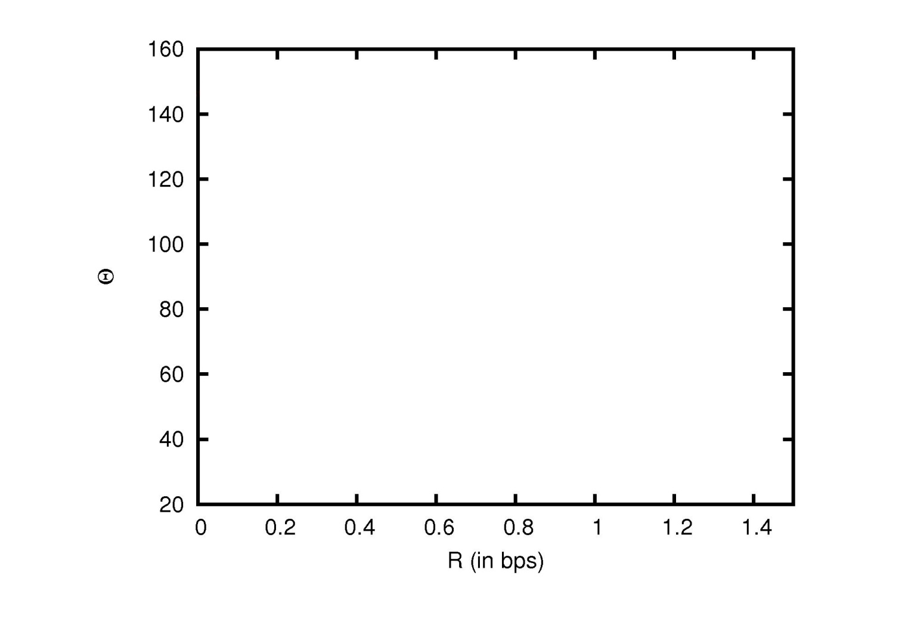
ANALYSIS & ALGORITHM
EXHAUSTIVE SEARCH
“Portrait” image
0
W
HL₁ subband
T₁

Slide 22
ANALYSIS & ALGORITHM
EXHAUSTIVE SEARCH
“Portrait” image
0
W
HL₁ subband

Slide 23
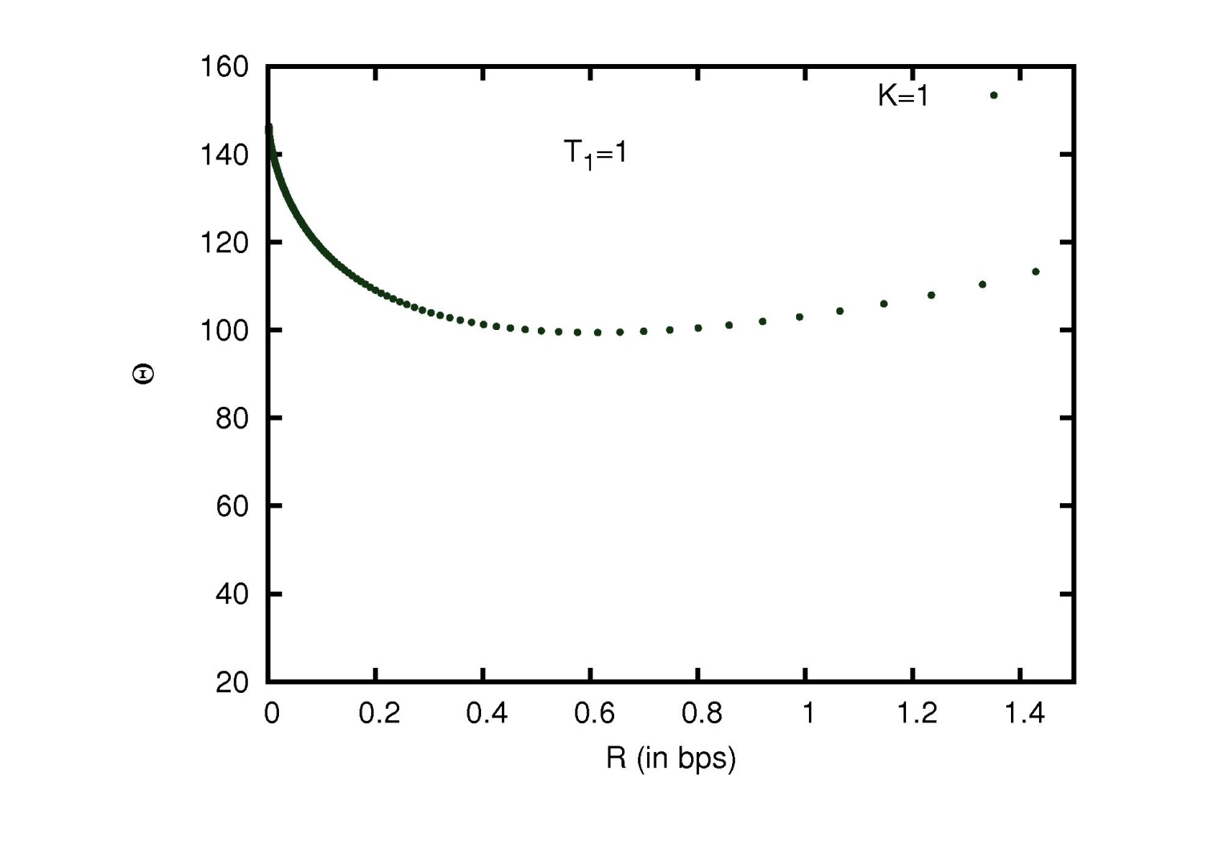
ANALYSIS & ALGORITHM
EXHAUSTIVE SEARCH
“Portrait” image
0
W
HL₁ subband
T₁=15
T₂

Slide 24
ANALYSIS & ALGORITHM
EXHAUSTIVE SEARCH
“Portrait” image
0
W
HL₁ subband
T₁=15

Slide 25
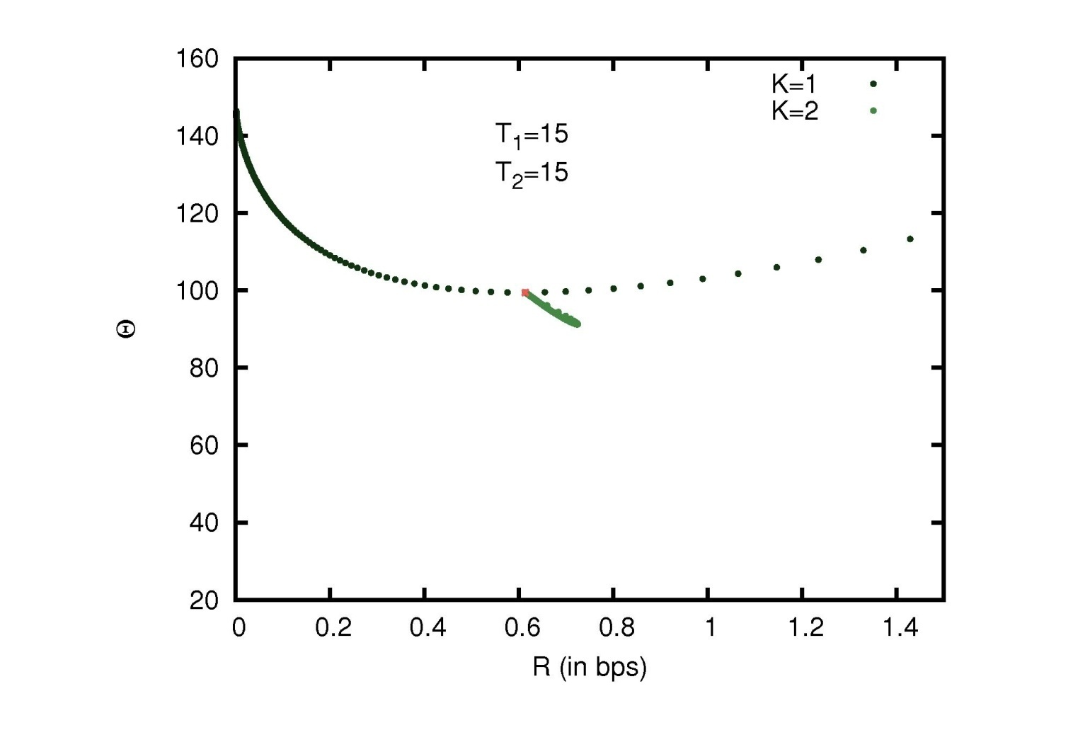
ANALYSIS & ALGORITHM
EXHAUSTIVE SEARCH
“Portrait” image
0
W
HL₁ subband
T₂
T₁=15

Slide 26
ANALYSIS & ALGORITHM
EXHAUSTIVE SEARCH
“Portrait” image
0
W
HL₁ subband
T₁=15

Slide 27
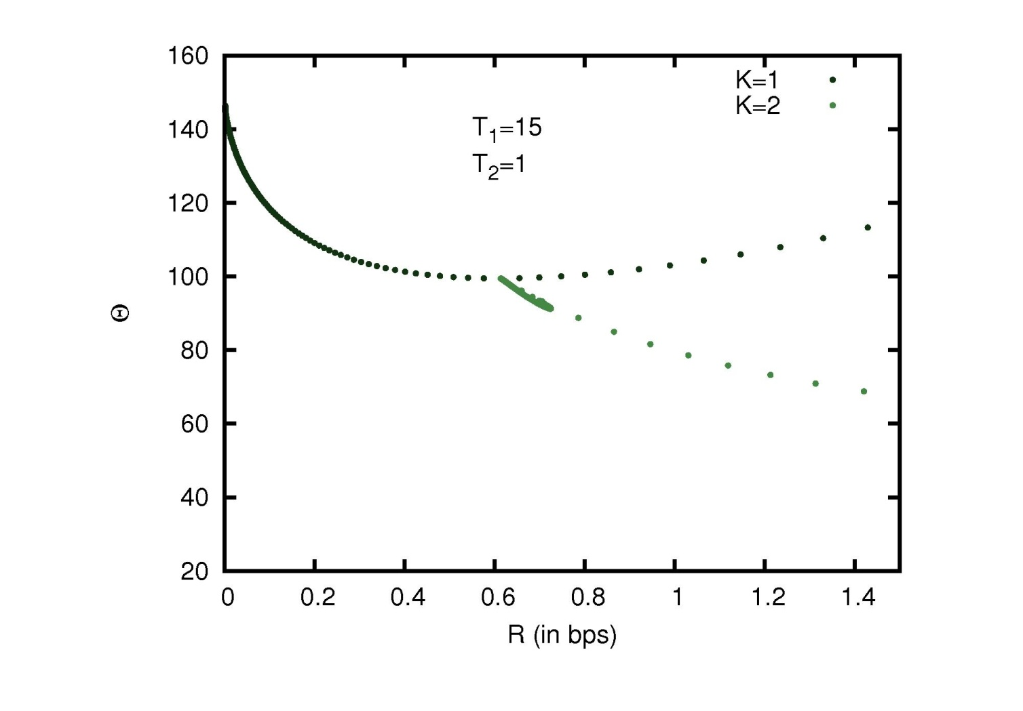
ANALYSIS & ALGORITHM
EXHAUSTIVE SEARCH
“Portrait” image
0
W
HL₁ subband
T₂=15
T₁
T₁=15

Slide 28
ANALYSIS & ALGORITHM
EXHAUSTIVE SEARCH
“Portrait” image
0
W
HL₁ subband
T₂=15

Slide 29
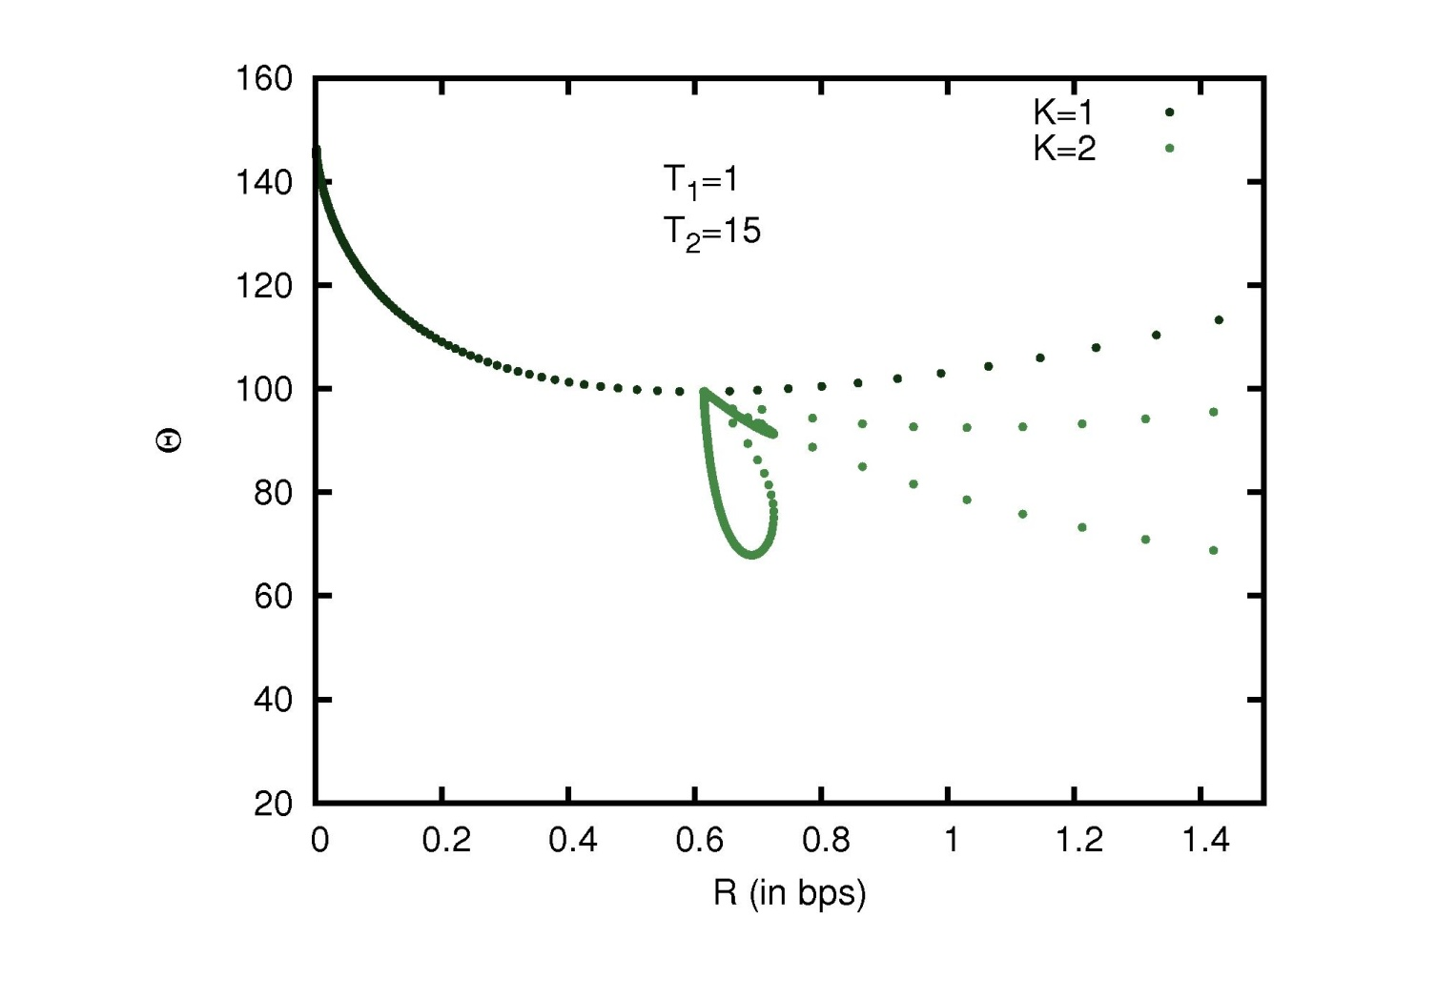
ANALYSIS & ALGORITHM
EXHAUSTIVE SEARCH
“Portrait” image
0
W
HL₁ subband
T₂=15
T₁=40
T₃

Slide 30
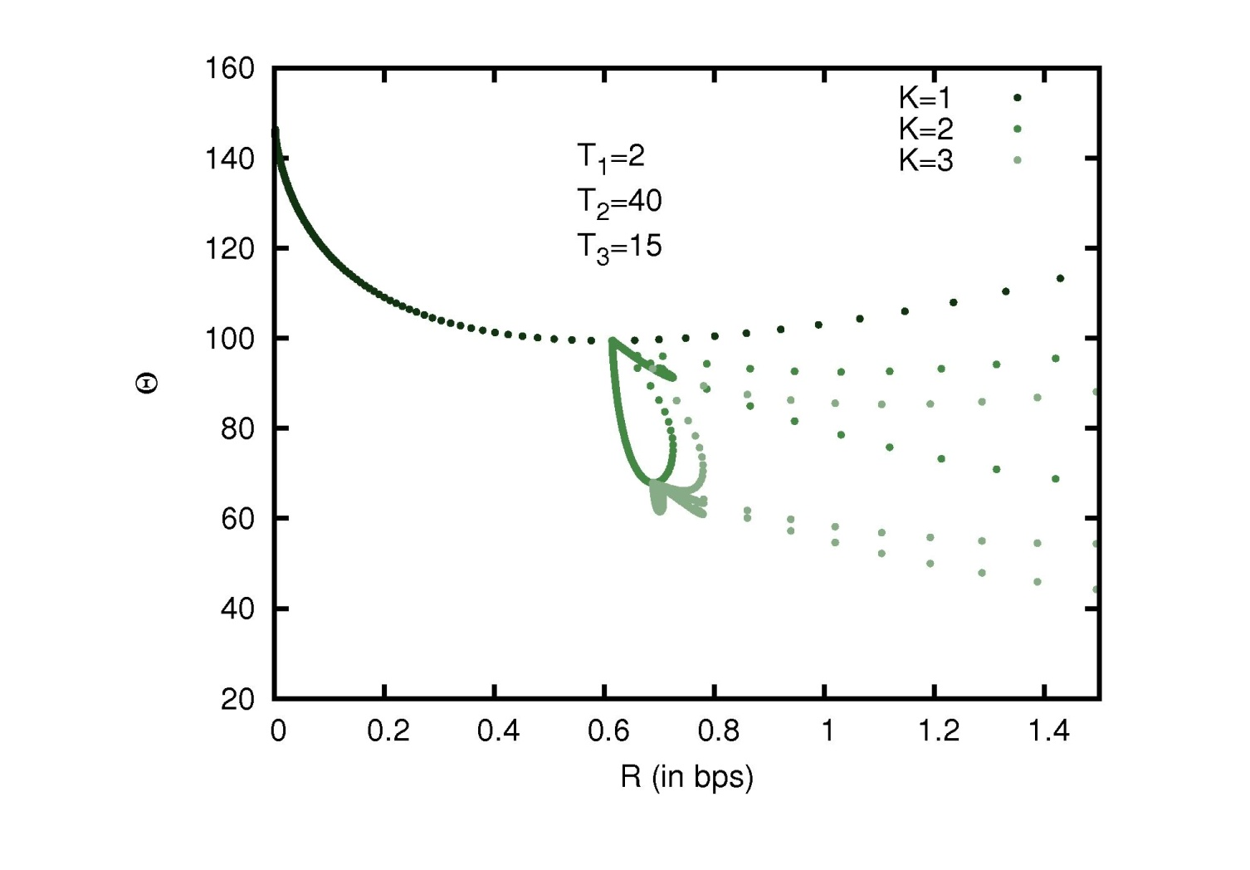
ANALYSIS & ALGORITHM
EXHAUSTIVE SEARCH
“Portrait” image
0
W
HL₁ subband
T₂=15
T₁=40

Slide 31
ANALYSIS & ALGORITHM
EXHAUSTIVE SEARCH
“Portrait” image
0
W
HL₁ subband

Slide 32
ANALYSIS & ALGORITHM
EXHAUSTIVE SEARCH
“Portrait” image
0
W
HL₁ subband

Slide 33
ANALYSIS & ALGORITHM
EXHAUSTIVE SEARCH
“Portrait” image
0
W
HL₁ subband

Slide 34
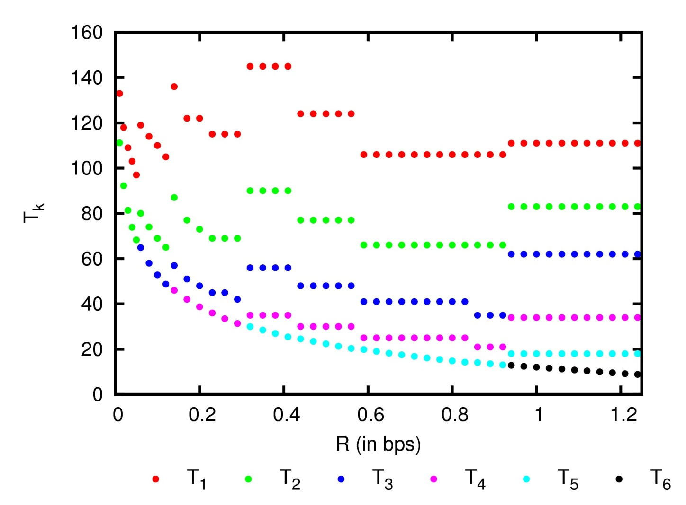
ANALYSIS & ALGORITHM
EXHAUSTIVE SEARCH
“Portrait” image
HL₁ subband

Slide 35
ANALYSIS & ALGORITHM
EXHAUSTIVE SEARCH
“Portrait” image
HL₁ subband

Slide 36
ANALYSIS & ALGORITHM
LOW-COMPLEXITY ALGORITHM
“Portrait” image
HL₁ subband

Slide 37
ANALYSIS & ALGORITHM
LOW-COMPLEXITY ALGORITHM
“Portrait” image
HL₁ subband

Slide 38
ANALYSIS & ALGORITHM
LOW-COMPLEXITY ALGORITHM
“Portrait” image
HL₁ subband

Slide 39
ANALYSIS & ALGORITHM
LOW-COMPLEXITY ALGORITHM
“Portrait” image
HL₁ subband

Slide 40
ANALYSIS & ALGORITHM
LOW-COMPLEXITY ALGORITHM
“Portrait” image
HL₁ subband

Slide 41
ANALYSIS & ALGORITHM
LOW-COMPLEXITY ALGORITHM
“Portrait” image
HL₁ subband

Slide 42
ANALYSIS & ALGORITHM
LOW-COMPLEXITY ALGORITHM
“Portrait” image
HL₁ subband
algorithm’s complexity:
exhaustive search:

Slide 43
TABLE OF CONTENTS
INTRODUCTION
ANALYSIS & ALGORITHM
EXPERIMENTAL RESULTS
CONCLUSIONS
1) General embedded quantization (GEQ)
2) Exhaustive search
3) Low complexity algorithm

Slide 44
EXPERIMENTAL RESULTS
PERFORMANCE EVALUATION
“Portrait” image
HL₁ subband
rate/distortion estimates
Low-complexity algorithm
for quantizers with

Slide 45
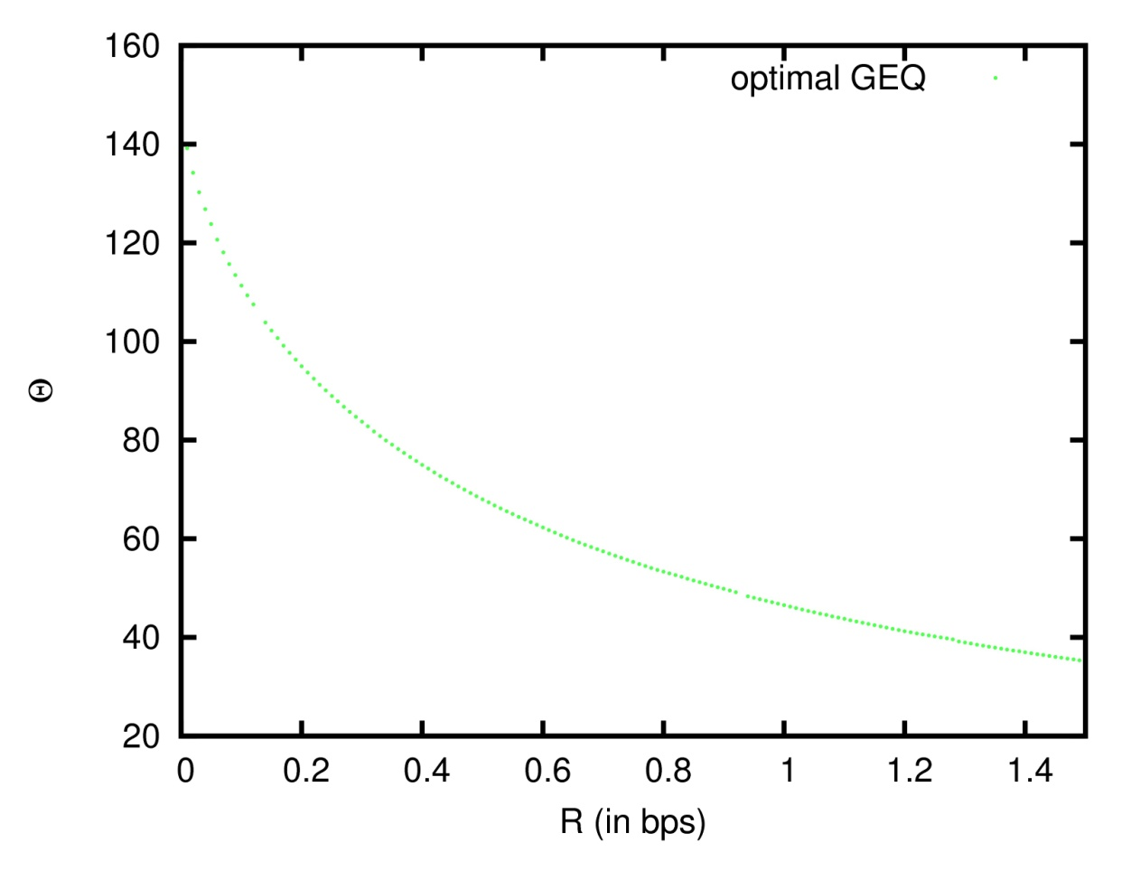
EXPERIMENTAL RESULTS
PERFORMANCE EVALUATION
“Portrait” image
HL₁ subband
rate/distortion estimates
Low-complexity algorithm
for quantizers with

Slide 46
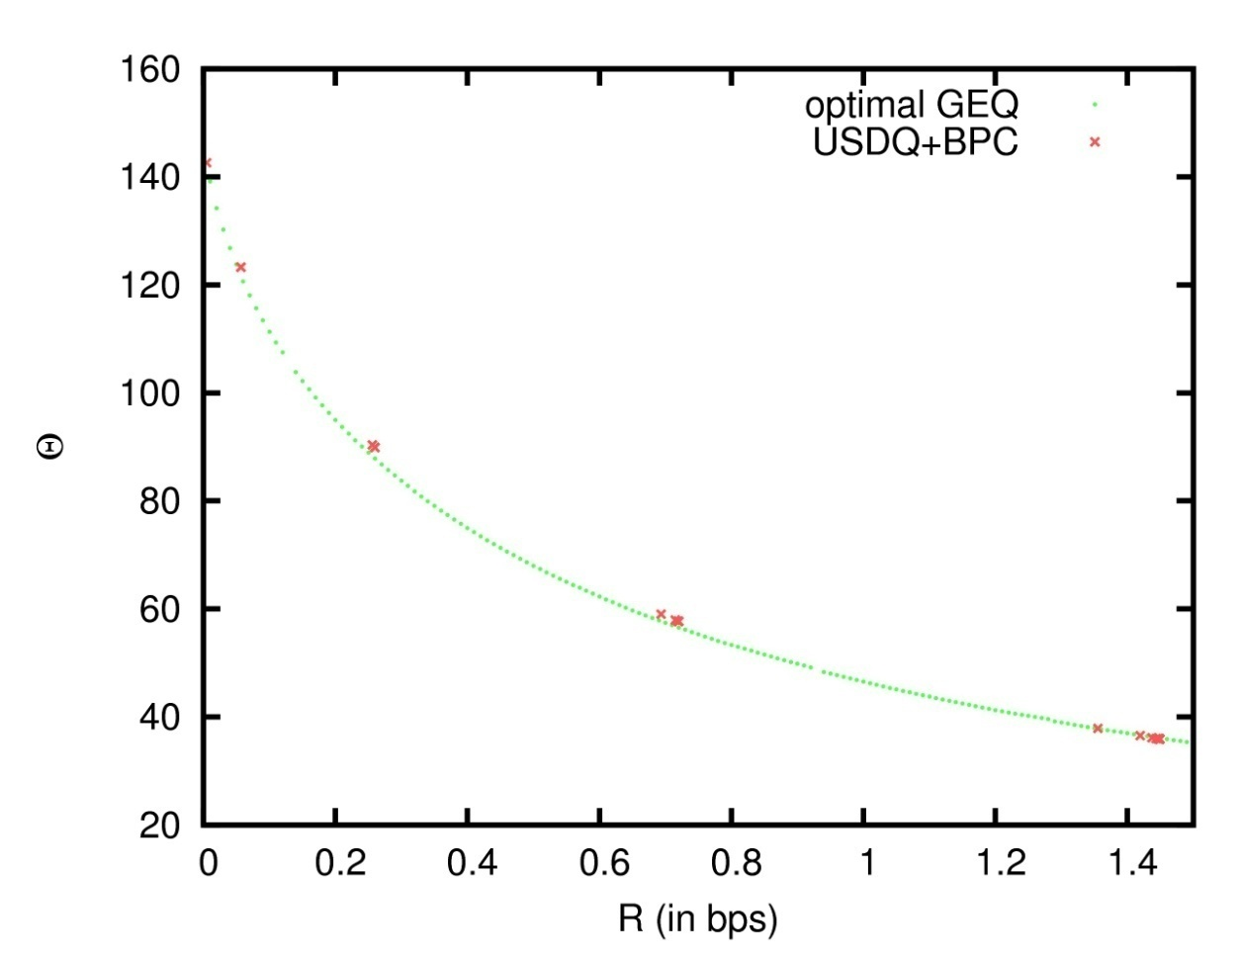
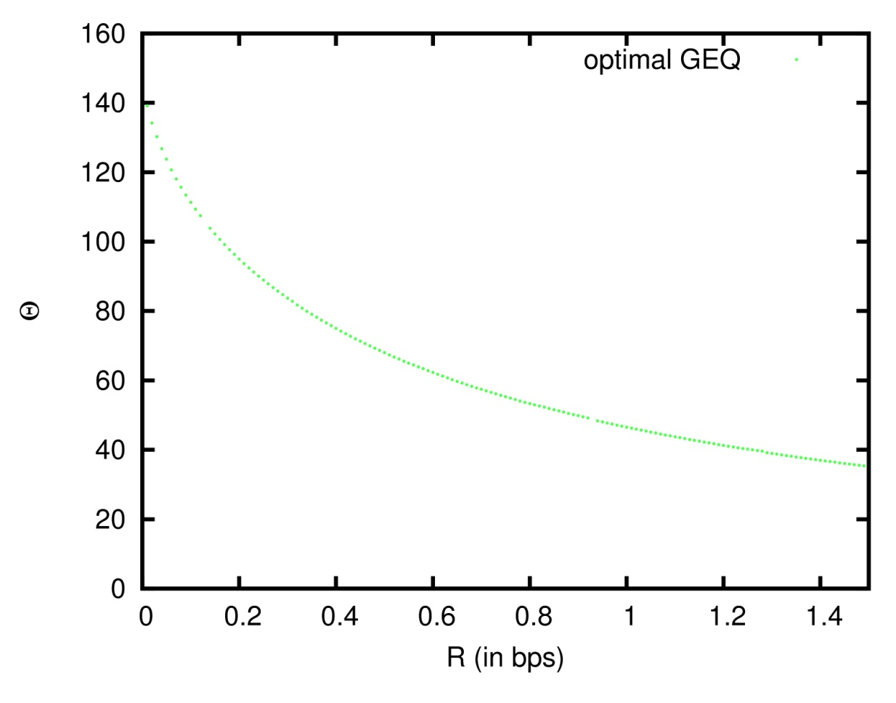
EXPERIMENTAL RESULTS
PERFORMANCE EVALUATION
“Portrait” image
HL₁ subband
rate/distortion estimates
Low-complexity algorithm
for quantizers with

Slide 47
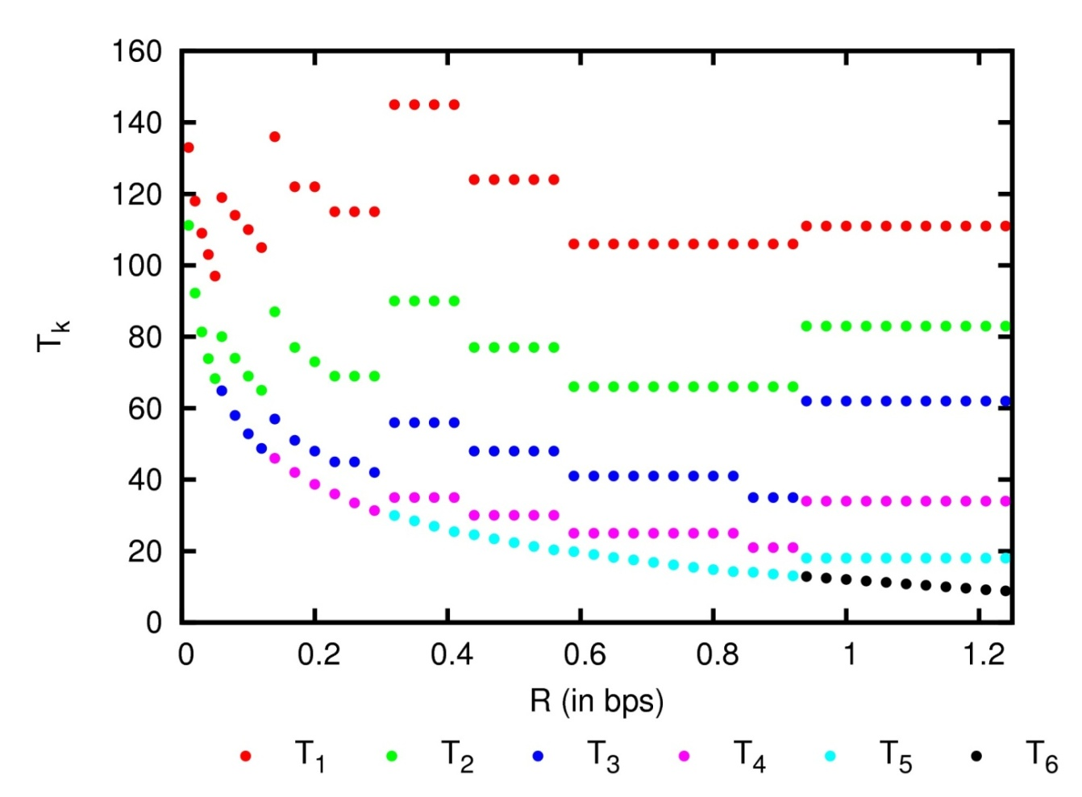
EXPERIMENTAL RESULTS
THRESHOLDS EVALUATION
“Portrait” image
HL₁ subband
rate/distortion estimates
Low-complexity algorithm
for quantizers with

Slide 48
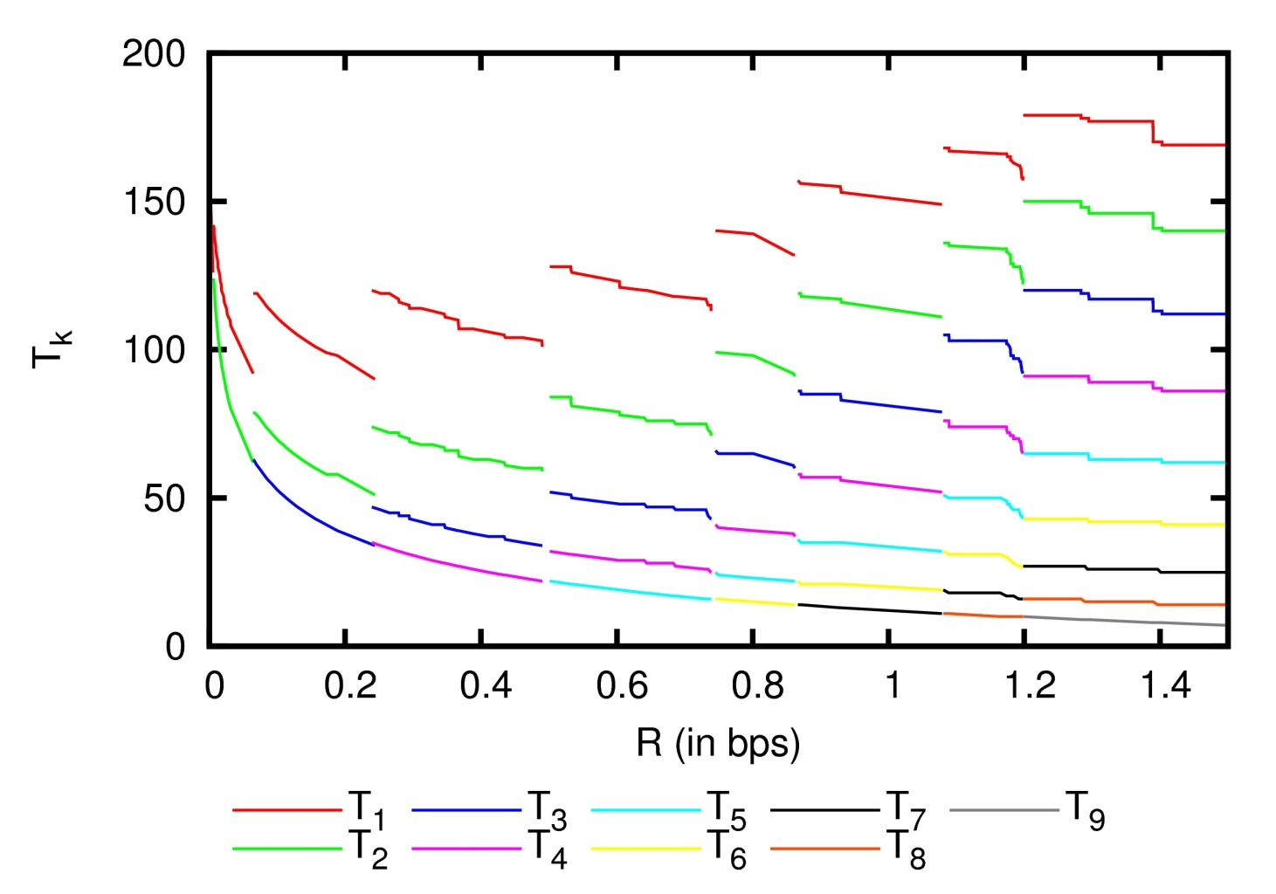
EXPERIMENTAL RESULTS
THRESHOLDS EVALUATION
“Portrait” image
HL₁ subband
rate/distortion estimates
Low-complexity algorithm
for quantizers with

Slide 49
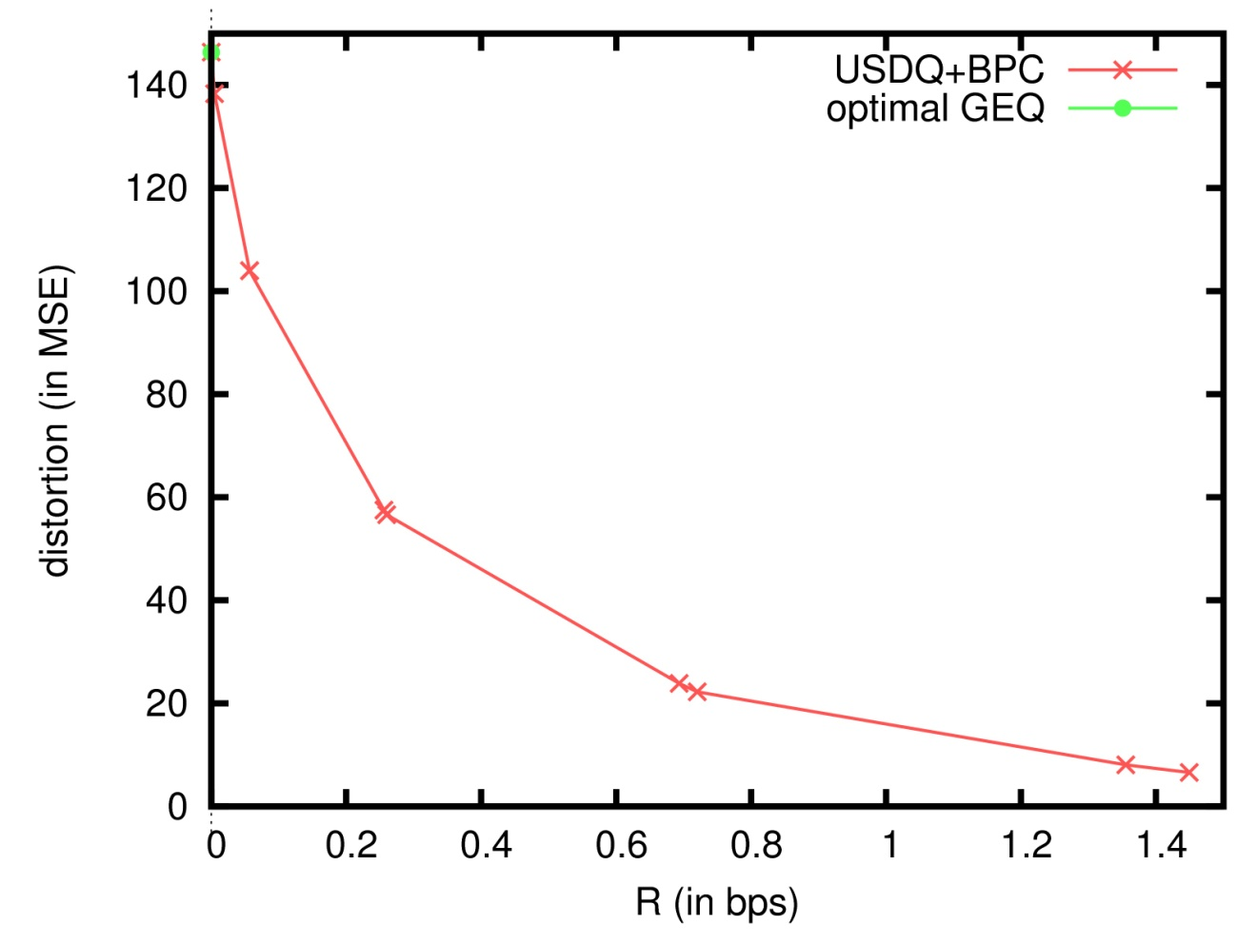
EXPERIMENTAL RESULTS
CODING PERFORMANCE
“Portrait” image
HL₁ subband
rate/distortion estimates
Low-complexity algorithm
for quantizers with

Slide 50
EXPERIMENTAL RESULTS
CODING PERFORMANCE
“Portrait” image
HL₁ subband
rate/distortion estimates
Low-complexity algorithm
for quantizers with

Slide 51
EXPERIMENTAL RESULTS
CODING PERFORMANCE
“Portrait” image
HL₁ subband
rate/distortion estimates
Low-complexity algorithm
for quantizers with

Slide 52
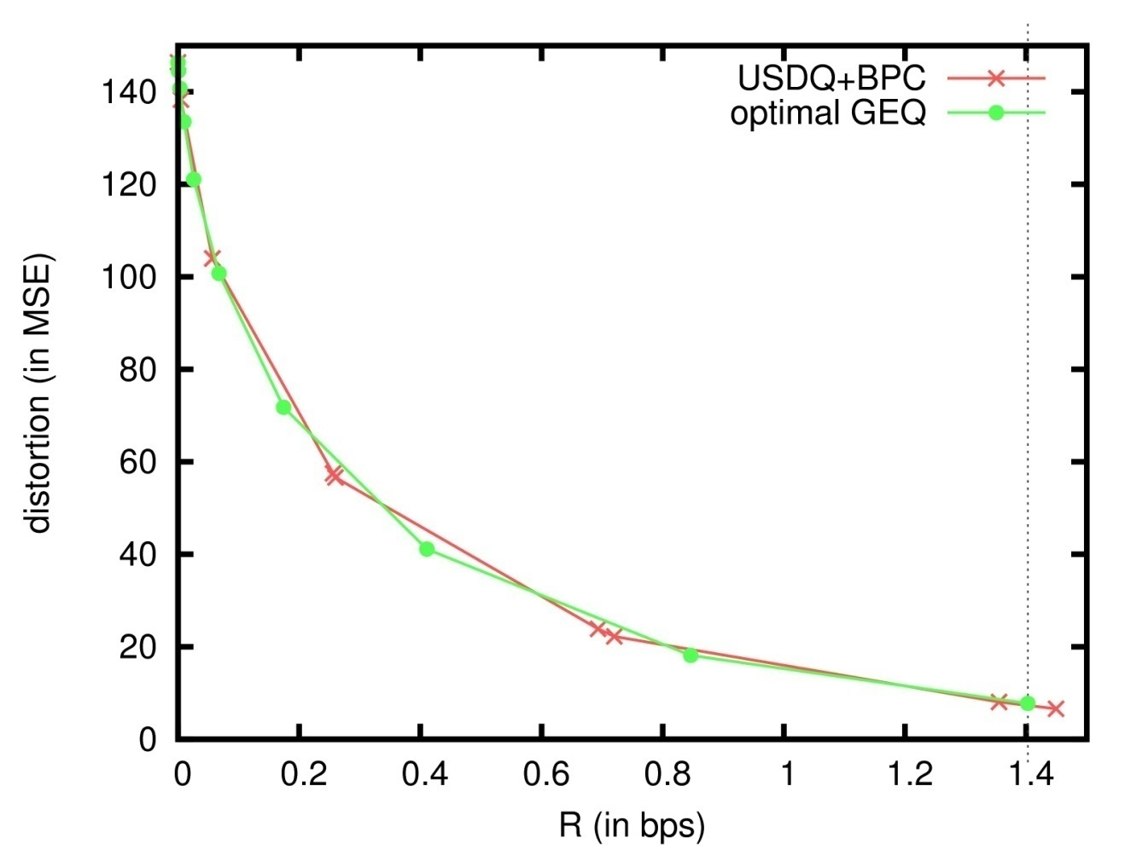
EXPERIMENTAL RESULTS
CODING PERFORMANCE
“Portrait” image
HL₁ subband
rate/distortion estimates
Low-complexity algorithm
for quantizers with

Slide 53
TABLE OF CONTENTS
INTRODUCTION
ANALYSIS & ALGORITHM
EXPERIMENTAL RESULTS
CONCLUSIONS
1) General embedded quantization (GEQ)
2) Exhaustive search
3) Low complexity algorithm

Slide 54
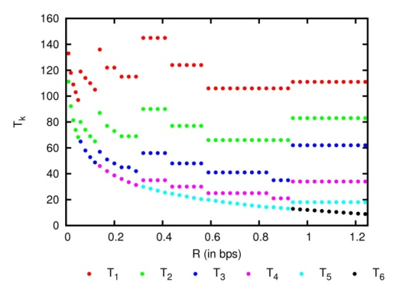
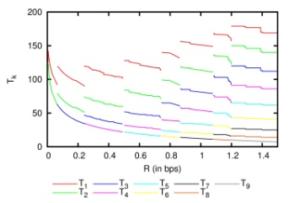
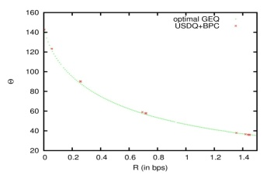
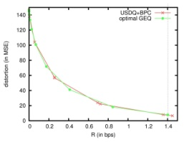
CONCLUSIONS
SUMMARY
1) General embedded quantization (GEQ)
0
W
T₃
T₁
T₂
2) Exhaustive search
3) Low-complexity algorithm

Slide 55
CONCLUSIONS
SUMMARY
1) General embedded quantization (GEQ)
0
W
T₃
T₁
T₂
2) Exhaustive search
3) Low-complexity algorithm

