Slide 1
POLICIES OF JPEG2000
VIDEO TRANSMISSION
Francesc Aulí-Llinàs
Department of Information and Communications Engineering
Universitat Autònoma de Barcelona, Spain

Slide 2
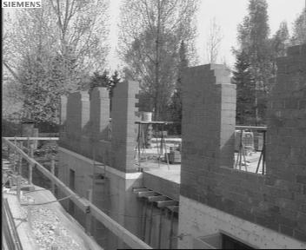
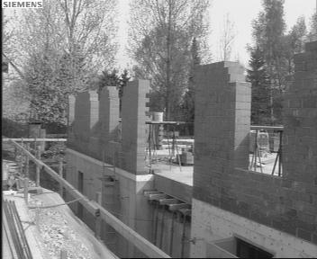
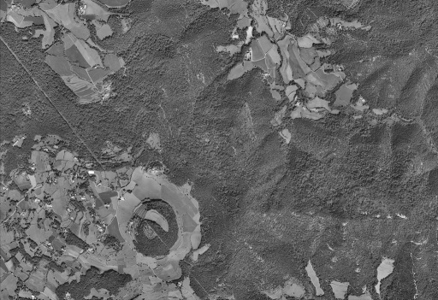
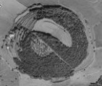
INTRODUCTION
PART 1: JPEG2000 core coding system
ORIGINAL
IMAGE
SAMPLE DATA
TRANSFORMATION
TIER-1
CODING
TIER-2
CODING
JPEG2000
codestream
PART 3: Motion JPEG2000
JP2
JP2
JP2
JP2
JP2
JP2
JP2
JP2
JP2
JP2
MJ2 FILE
PART 9: JPEG2000 interactive protocol
JPIP
SERVER
JPIP
CLIENT
JPEG2000 codestream

Slide 3
POLICIES OF VIDEO TRANSMISSION
1) Client-driven policy

Slide 4
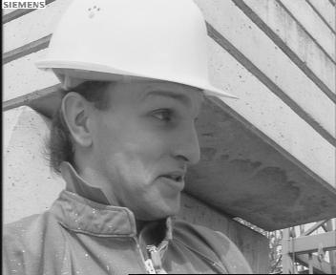
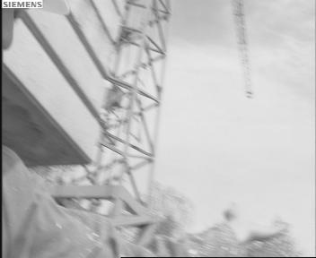
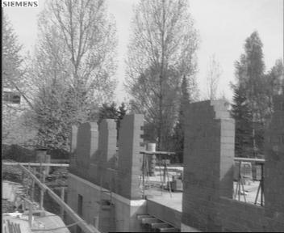
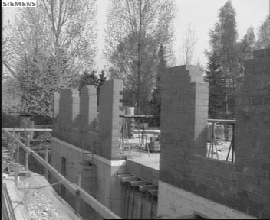
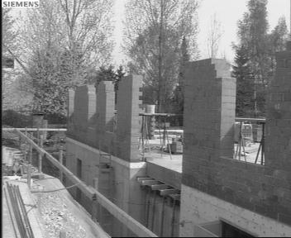
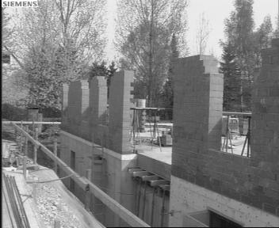
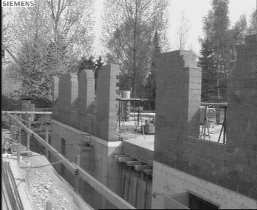
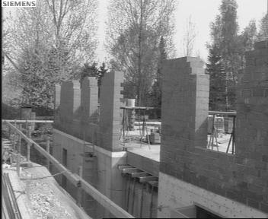
POLICIES OF VIDEO TRANSMISSION
1) Client-driven policy
JPIP
CLIENT
JPIP
SERVER

Slide 5
POLICIES OF VIDEO TRANSMISSION
1) Client-driven policy
JPIP
CLIENT
JPIP
SERVER

Slide 6
POLICIES OF VIDEO TRANSMISSION
1) Client-driven policy
JPIP
CLIENT
JPIP
SERVER

Slide 7
POLICIES OF VIDEO TRANSMISSION
1) Client-driven policy
JPIP
CLIENT
JPIP
SERVER

Slide 8
POLICIES OF VIDEO TRANSMISSION
1) Client-driven policy
JPIP
CLIENT
JPIP
SERVER

Slide 9
POLICIES OF VIDEO TRANSMISSION
1) Client-driven policy
JPIP
CLIENT
JPIP
SERVER

Slide 10
POLICIES OF VIDEO TRANSMISSION
1) Client-driven policy
JPIP
CLIENT
JPIP
SERVER

Slide 11
POLICIES OF VIDEO TRANSMISSION
1) Client-driven policy
JPIP
CLIENT
JPIP
SERVER

Slide 12
POLICIES OF VIDEO TRANSMISSION
1) Client-driven policy
JPIP
CLIENT
JPIP
SERVER

Slide 13
POLICIES OF VIDEO TRANSMISSION
1) Client-driven policy
synchronization
JPIP
CLIENT
JPIP
SERVER

Slide 14
POLICIES OF VIDEO TRANSMISSION
1) Client-driven policy
synchronization
2) Server-driven policy
a) Constant Bit-Rate (CBR)
JPIP
CLIENT
JPIP
SERVER

Slide 15
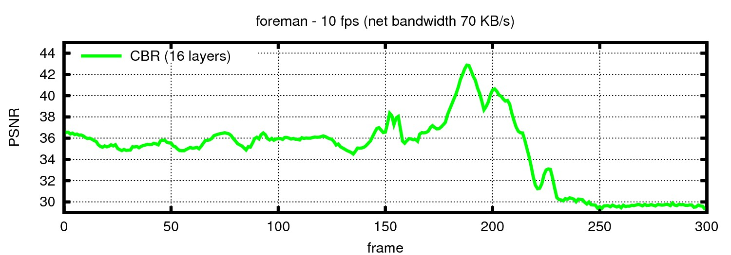
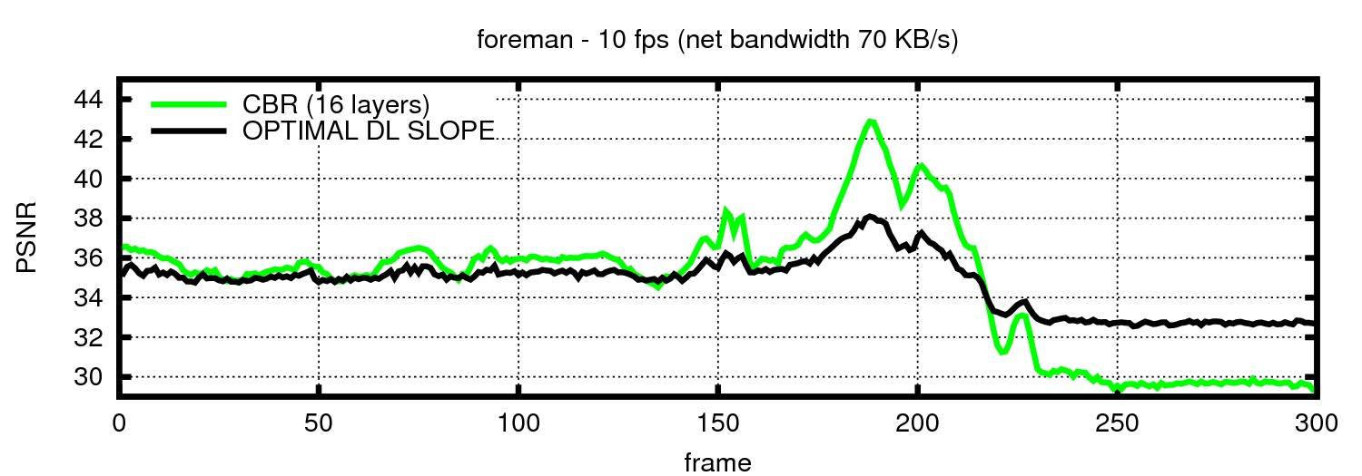
POLICIES OF VIDEO TRANSMISSION
1) Client-driven policy
synchronization
2) Server-driven policy
a) Constant Bit-Rate (CBR)
performance
JPIP
CLIENT
33.52 dB
JPIP
SERVER
34.55 dB

Slide 16
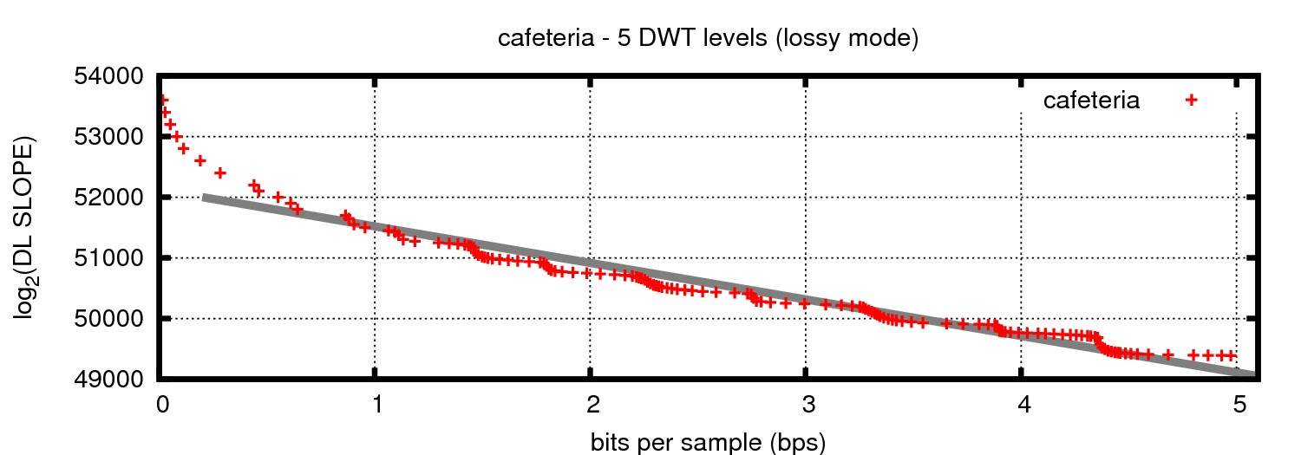
POLICIES OF VIDEO TRANSMISSION
1) Client-driven policy
synchronization
2) Server-driven policy
a) Constant Bit-Rate (CBR)
performance
b) Variable Bit-Rate (VBR)
minimize overall distortion – target DL slope
PREMISE 1: extrapolation between DL slope bitrate
DL slope thresholds of quality layers
33.52 dB
34.55 dB

Slide 17
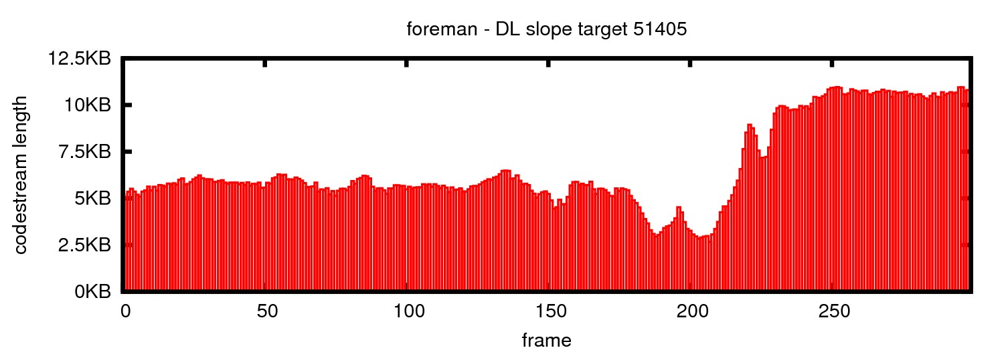
POLICIES OF VIDEO TRANSMISSION
1) Client-driven policy
synchronization
2) Server-driven policy
a) Constant Bit-Rate (CBR)
performance
b) Variable Bit-Rate (VBR)
minimize overall distortion – target DL slope
PREMISE 2: consecutive frames have similar characteristics
window size 2: 1.4%
window size 10: 4.3%

Slide 18
POLICIES OF VIDEO TRANSMISSION
1) Client-driven policy
synchronization
2) Server-driven policy
a) Constant Bit-Rate (CBR)
performance
b) Variable Bit-Rate (VBR)
minimize overall distortion – target DL slope
JPIP
CLIENT
buffer
JPIP
SERVER
targeting: DL SLOPE BIT-RATE
DL slope
frame

Slide 19
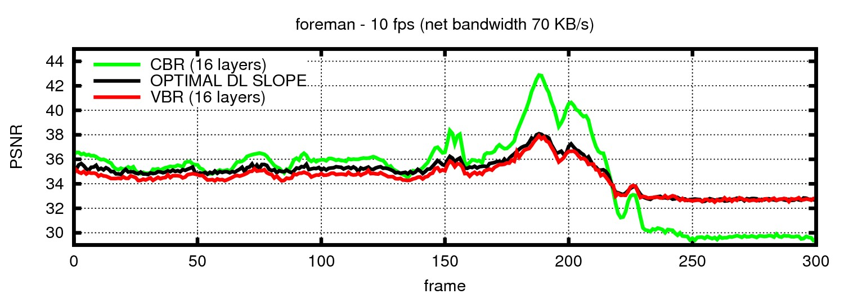
POLICIES OF VIDEO TRANSMISSION
1) Client-driven policy
synchronization
2) Server-driven policy
a) Constant Bit-Rate (CBR)
performance
b) Variable Bit-Rate (VBR)
minimize overall distortion – target DL slope
+ variable conditions channels
33.52 dB
34.55 dB
34.33 dB

