Slide 1
JPEG2000 BLOCK-WISE
LAYER TRUNCATION
Francesc Aulí-Llinàs
Department of Information and Communications Engineering
Universitat Autònoma de Barcelona, Spain

Slide 2
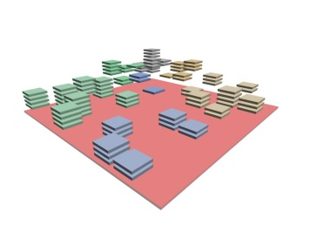
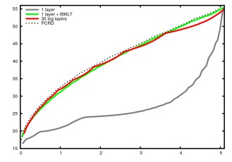
TABLE OF CONTENTS
1. INTRODUCTION
2. BLOCK-WISE TRUNCATION
OF QUALITY LAYERS
3. EXPERIMENTS
4. CONCLUSIONS
Interactive image transmission
Code-stream transcoding
Real-time video rendering
Client-server policies of video delivery
Applications

Slide 3
TABLE OF CONTENTS
1. INTRODUCTION
2. BLOCK-WISE TRUNCATION
OF QUALITY LAYERS
3. EXPERIMENTS
4. CONCLUSIONS
Interactive image transmission
Code-stream transcoding
Real-time video rendering
Client-server policies of video delivery
Applications

Slide 4
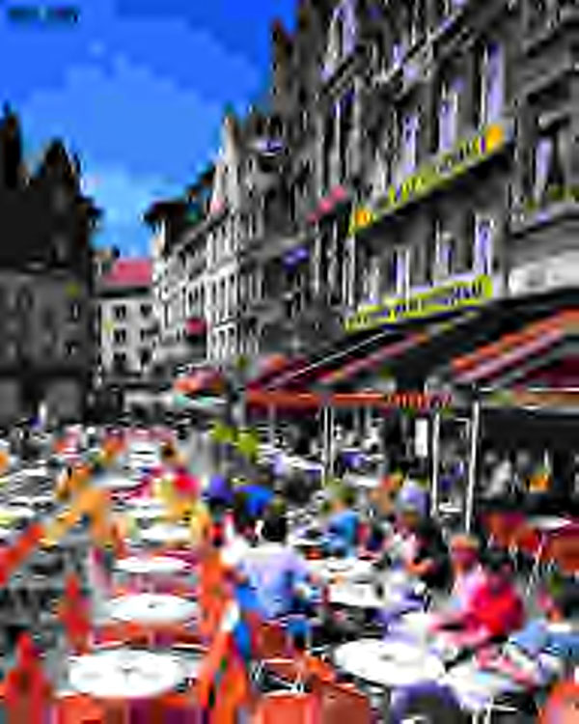
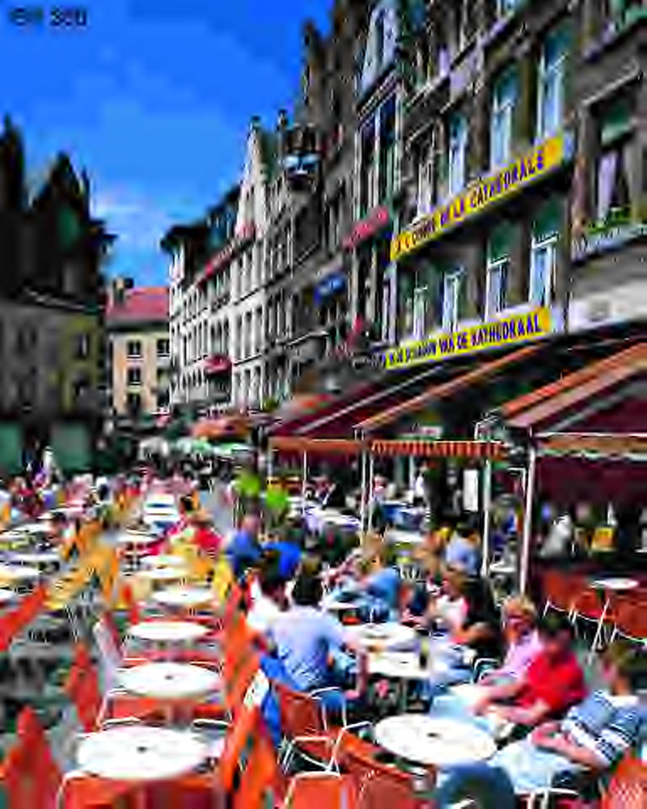
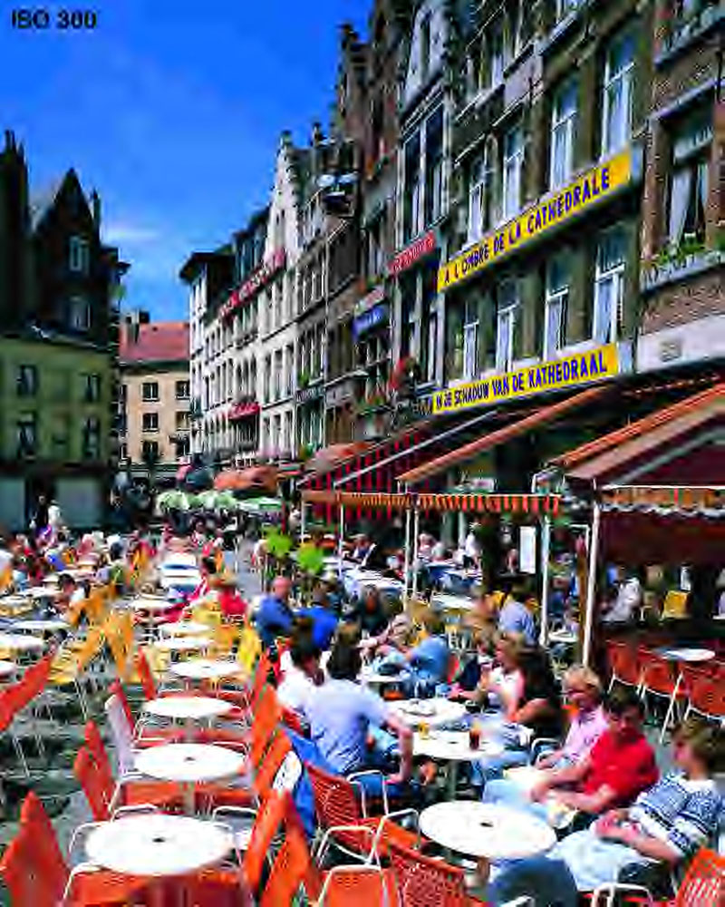
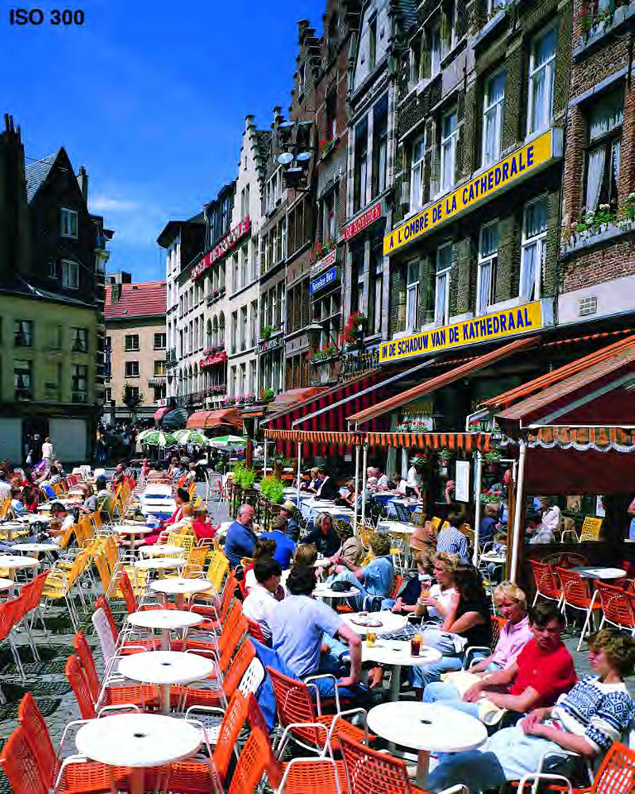
INTRODUCTION
JPEG2000 QUALITY SCALABILITY/PROGRESSION
ORIGINAL IMAGE
JPEG2000 CORE
CODING SYSTEM
JP2 code-stream
FORMATION OF
QUALITY LAYERS
MAX
QUALITY
MAX
QUALITY
MAX
QUALITY
MAX
QUALITY
MAX
QUALITY

Slide 5
INTRODUCTION
JPEG2000 QUALITY SCALABILITY/PROGRESSION
Quality layers
Optimal rate-distortion representations of the image
No penalization of the overall coding efficiency
Allow progressive transmission
Allow interactive image transmissions
Formed in the encoder
Truncation penalizes coding performance
SINGLE QUALITY LAYER CODE-STREAM
MULTIPLE QUALITY LAYERS CODE-STREAM

Slide 6
INTRODUCTION
JPEG2000 QUALITY SCALABILITY/PROGRESSION
1 layer – 13.95 dB
16 layers – 16.91 dB
Quality layers
Optimal rate-distortion representations of the image
No penalization of the overall coding efficiency
Allow progressive transmission
Allow interactive image transmissions
Formed in the encoder
Truncation penalizes coding performance
decompressed at 0.1 bps
SINGLE QUALITY LAYER CODE-STREAM
MULTIPLE QUALITY LAYERS CODE-STREAM

Slide 7
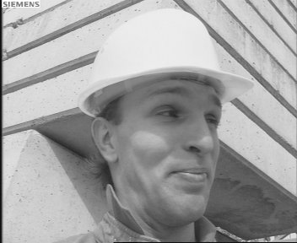
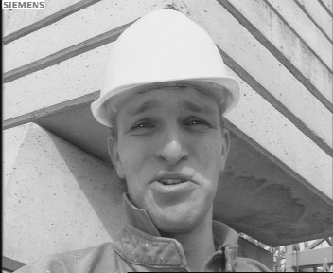
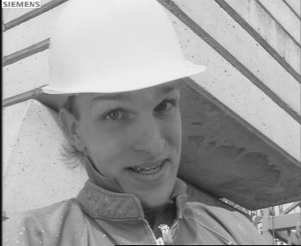
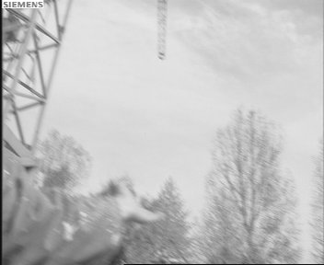
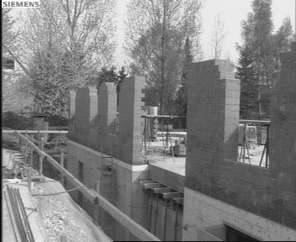
INTRODUCTION
RESEARCH PURPOSES
1) OPTIMIZED TRUNCATION OF QUALITY LAYERS
2) LOW COMPUTATIONAL COMPLEXITY (real-time applications)
real-time
video rendering
3) JPEG2000 COMPLIANCE

Slide 8
TABLE OF CONTENTS
1. INTRODUCTION
2. BLOCK-WISE TRUNCATION
OF QUALITY LAYERS
3. EXPERIMENTS
4. CONCLUSIONS
Interactive image transmission
Code-stream transcoding
Real-time video rendering
Client-server policies of video delivery
Applications

Slide 9
BLOCK-WISE LAYER TRUNCATION
JPEG2000 CORE CODING SYSTEM
ORIGINAL IMAGE

Slide 10
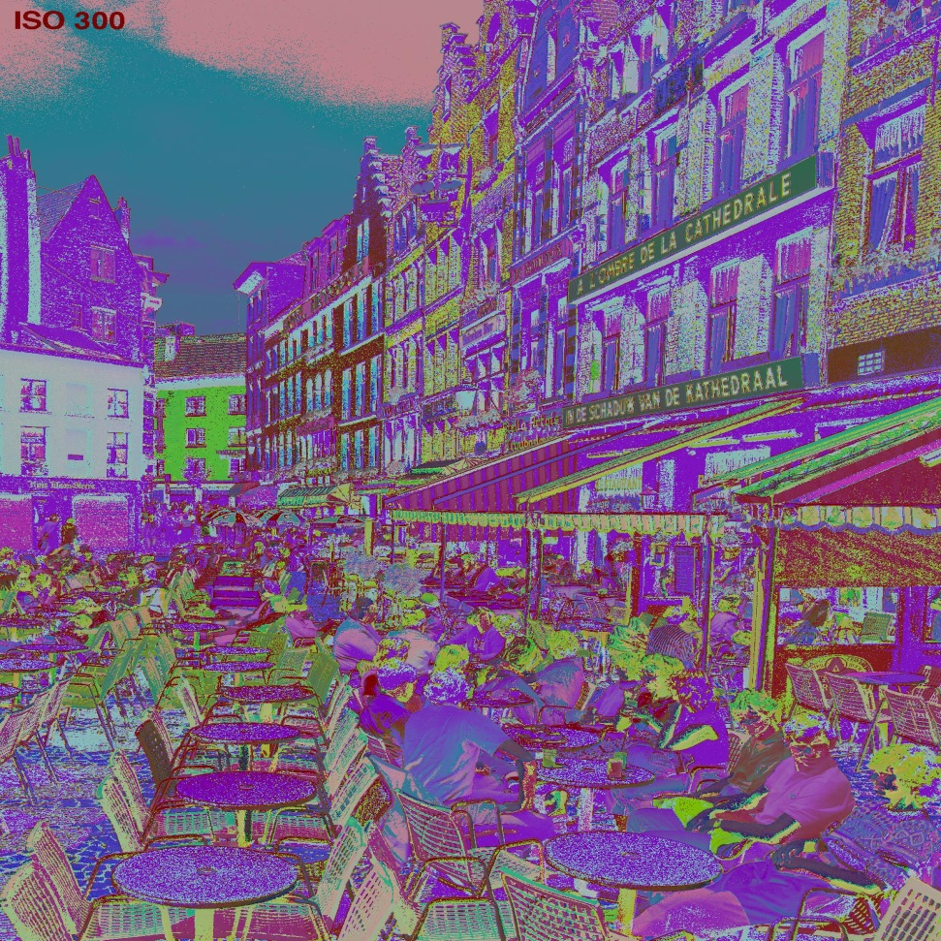
BLOCK-WISE LAYER TRUNCATION
JPEG2000 CORE CODING SYSTEM
ORIGINAL IMAGE
MULTI-COMPONENT
TRANSFORM

Slide 11
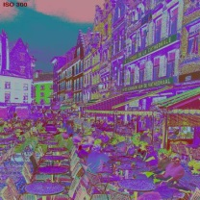
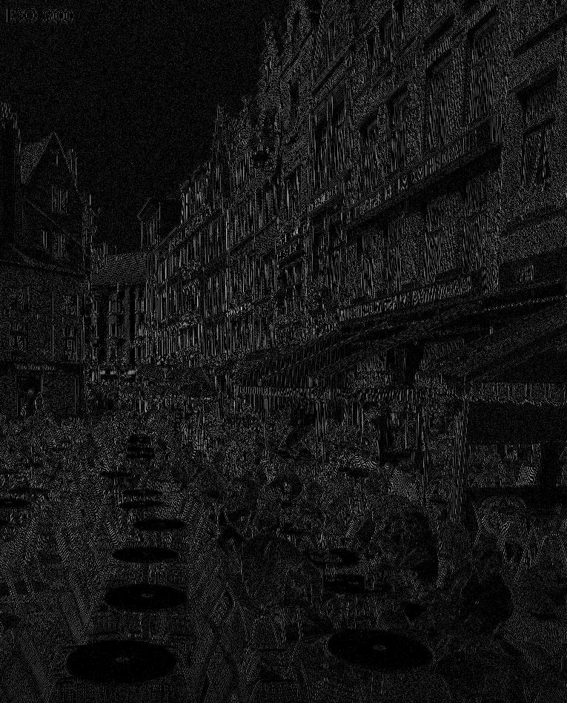
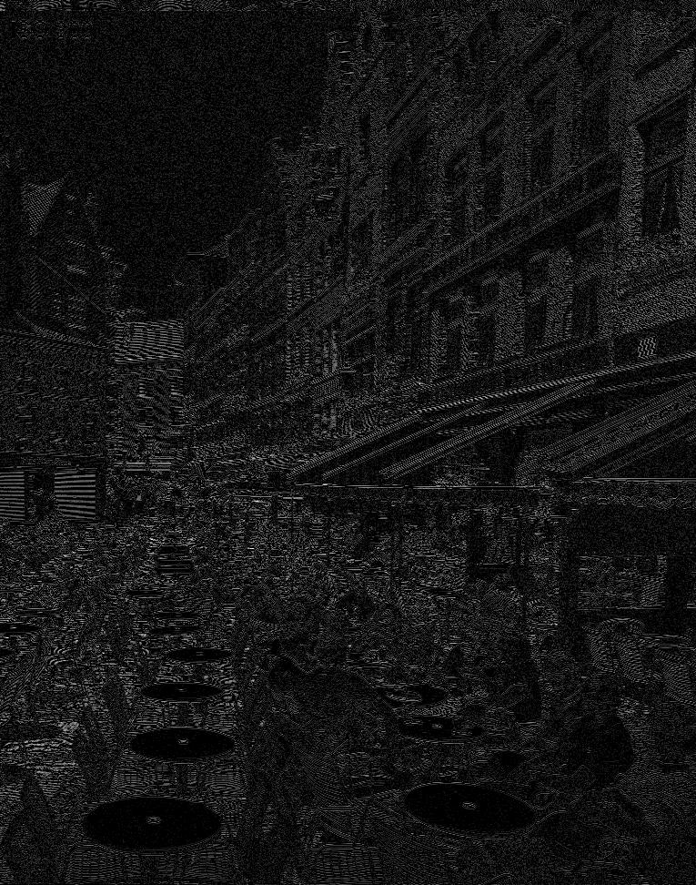
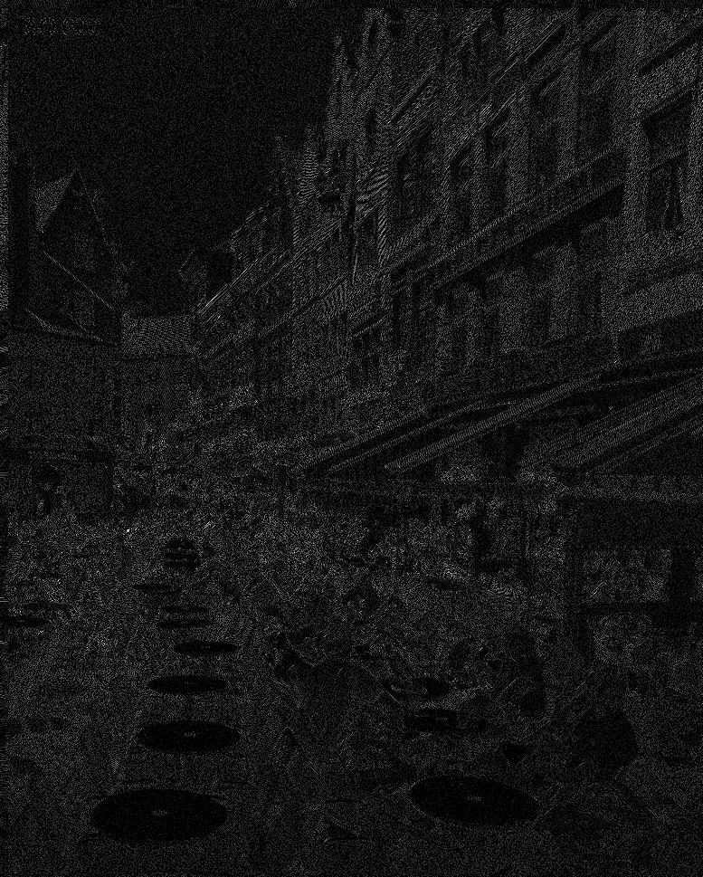
BLOCK-WISE LAYER TRUNCATION
JPEG2000 CORE CODING SYSTEM
ORIGINAL IMAGE
MULTI-COMPONENT
TRANSFORM
WAVELET
TRANSFORM
QUANTIZATION

Slide 12
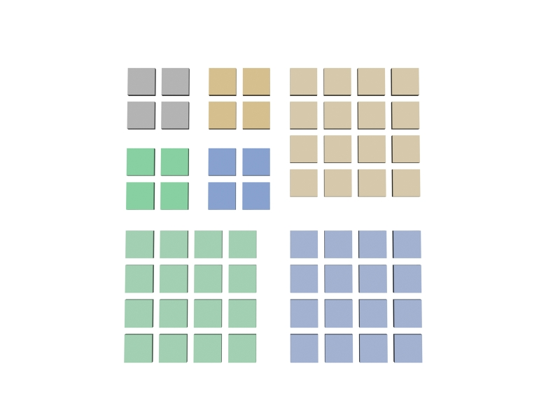
BLOCK-WISE LAYER TRUNCATION
JPEG2000 CORE CODING SYSTEM
ORIGINAL IMAGE
MULTI-COMPONENT
TRANSFORM
WAVELET
TRANSFORM
QUANTIZATION

Slide 13
BLOCK-WISE LAYER TRUNCATION
JPEG2000 CORE CODING SYSTEM
ORIGINAL IMAGE
MULTI-COMPONENT
TRANSFORM
WAVELET
TRANSFORM
QUANTIZATION

Slide 14
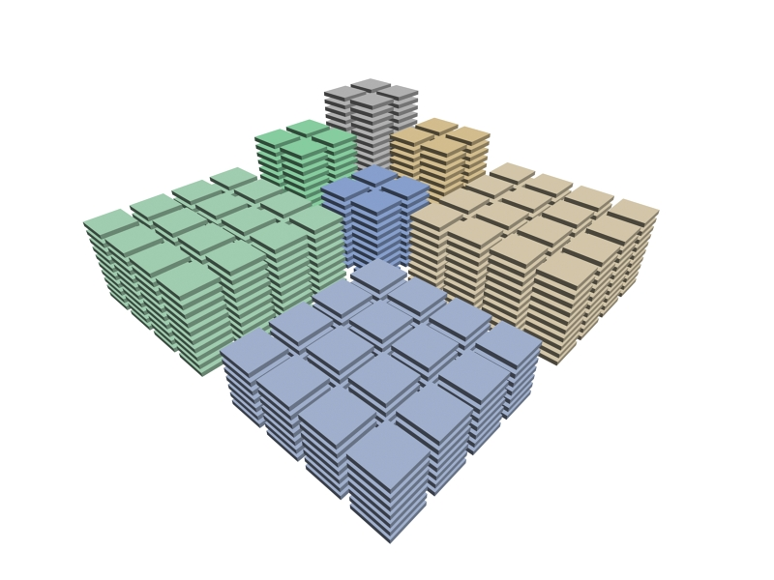
BLOCK-WISE LAYER TRUNCATION
JPEG2000 CORE CODING SYSTEM
ORIGINAL IMAGE
MULTI-COMPONENT
TRANSFORM
WAVELET
TRANSFORM
QUANTIZATION

Slide 15
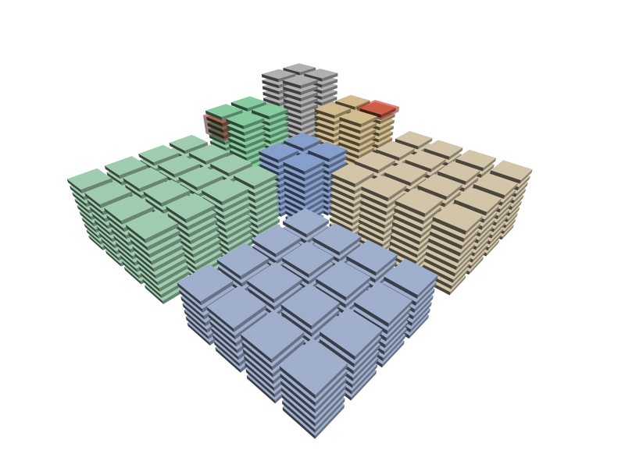
BLOCK-WISE LAYER TRUNCATION
JPEG2000 CORE CODING SYSTEM
ORIGINAL IMAGE
MULTI-COMPONENT
TRANSFORM
bit plane
coding pass
WAVELET
TRANSFORM
QUANTIZATION

Slide 16
BLOCK-WISE LAYER TRUNCATION
JPEG2000 CORE CODING SYSTEM
ORIGINAL IMAGE
MULTI-COMPONENT
TRANSFORM
WAVELET
TRANSFORM
QUANTIZATION
TIER-1 CODING

Slide 17
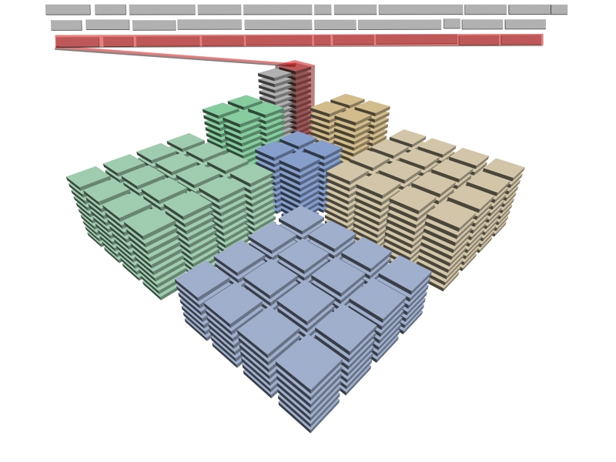
BLOCK-WISE LAYER TRUNCATION
JPEG2000 CORE CODING SYSTEM
ORIGINAL IMAGE
MULTI-COMPONENT
TRANSFORM
WAVELET
TRANSFORM
QUANTIZATION
TIER-1 CODING

Slide 18
BLOCK-WISE LAYER TRUNCATION
JPEG2000 CORE CODING SYSTEM
ORIGINAL IMAGE
MULTI-COMPONENT
TRANSFORM
WAVELET
TRANSFORM
QUANTIZATION
TIER-1 CODING
RATE-DISTORTION
OPTIMIZATION
TIER-2 CODING
JP2 code-stream
FORMATION OF
QUALITY LAYERS
LAYER TRUNCATION: LOSES SEGMENTS OF SOME CODE-BLOCKS

Slide 19
BLOCK-WISE LAYER TRUNCATION
JPEG2000 CORE CODING SYSTEM
ORIGINAL IMAGE
MULTI-COMPONENT
TRANSFORM
WAVELET
TRANSFORM
QUANTIZATION
TIER-1 CODING
RATE-DISTORTION
OPTIMIZATION
TIER-2 CODING
JP2 code-stream
MAIN INSIGHT:
BLOCK-WISE LAYER TRUNCATION
TO KEEP SEGMENTS OF ALL CODE-BLOCKS
FORMATION OF
QUALITY LAYERS
LAYER TRUNCATION: LOSES SEGMENTS OF SOME CODE-BLOCKS

Slide 20
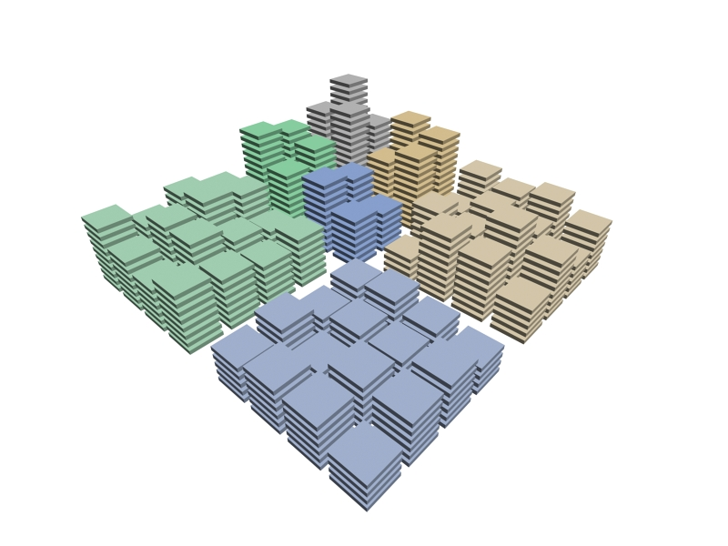
BLOCK-WISE LAYER TRUNCATION
LAYER CONTENTS
Available information
without decoding:

Slide 21
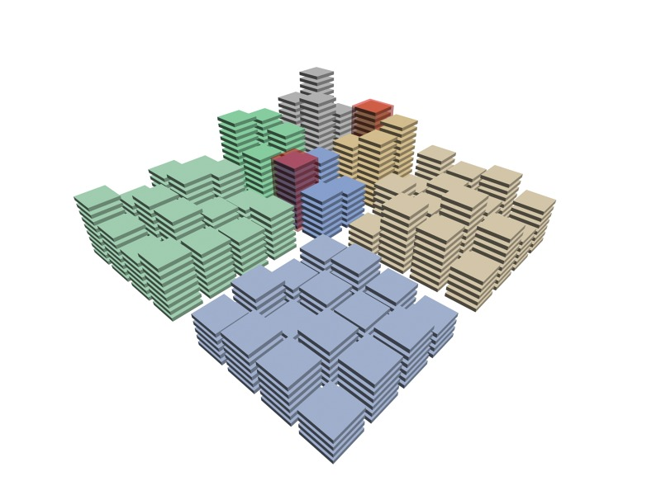
BLOCK-WISE LAYER TRUNCATION
LAYER CONTENTS
7 bit-planes
6 bit-planes
Available information
without decoding:
Magnitude bit-planes of code-blocks

Slide 22
BLOCK-WISE LAYER TRUNCATION
LAYER CONTENTS
Available information
without decoding:
Magnitude bit-planes of code-blocks
Length of bit-stream segments

Slide 23
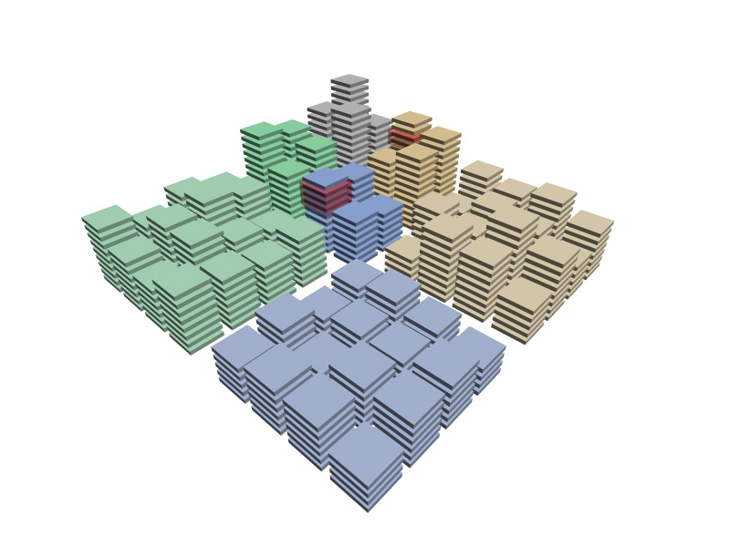
BLOCK-WISE LAYER TRUNCATION
LAYER CONTENTS
2 coding passes
Available information
without decoding:
4 coding passes
Magnitude bit-planes of code-blocks
Length of bit-stream segments
Number of coding passes

Slide 24
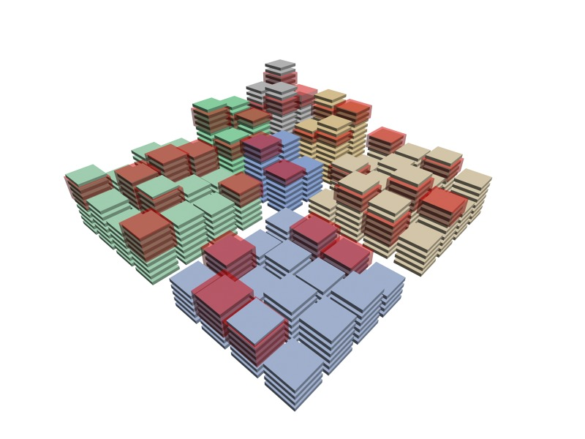
BLOCK-WISE LAYER TRUNCATION
LAYER CONTENTS
Quality layer
identification

Slide 25
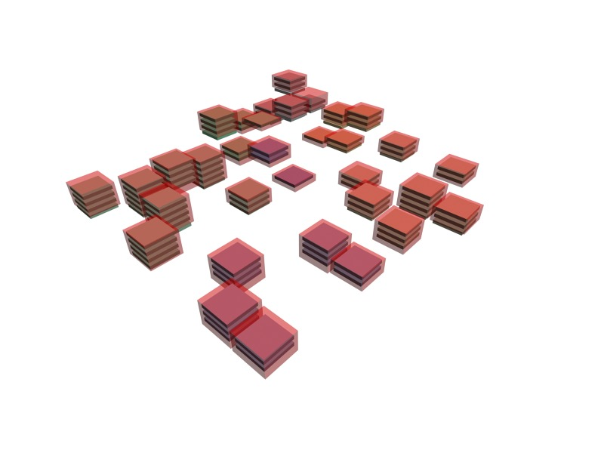
BLOCK-WISE LAYER TRUNCATION
LAYER CONTENTS
Quality layer
identification

Slide 26
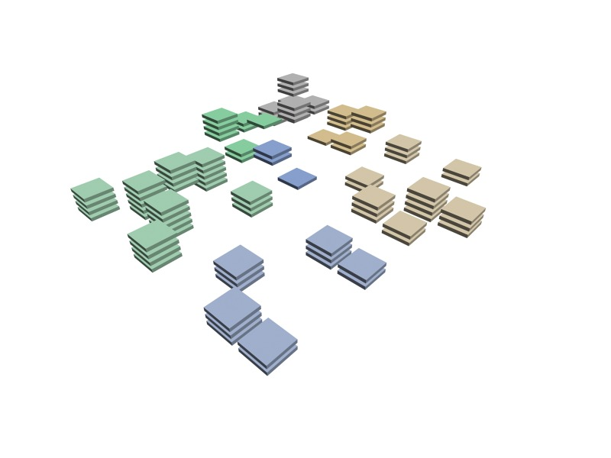
BLOCK-WISE LAYER TRUNCATION
LAYER CONTENTS
Quality layer
identification

Slide 27
BLOCK-WISE LAYER TRUNCATION
LAYER CONTENTS
Quality layer
identification

Slide 28
BLOCK-WISE LAYER TRUNCATION
OPTIMIZED TRUNCATION
Block-wise layer truncation
select layer’s coding
passes from the top to the bottom

Slide 29
BLOCK-WISE LAYER TRUNCATION
OPTIMIZED TRUNCATION

Slide 30
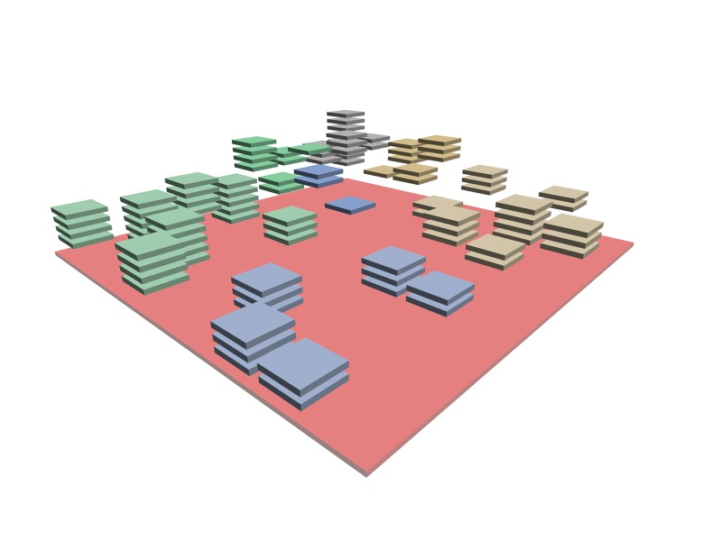
BLOCK-WISE LAYER TRUNCATION
OPTIMIZED TRUNCATION
segment length
available

Slide 31
BLOCK-WISE LAYER TRUNCATION
OPTIMIZED TRUNCATION
coding passes lengths
NOT available
NEED OF CODING PASSES
LENGTHS ESTIMATION

Slide 32
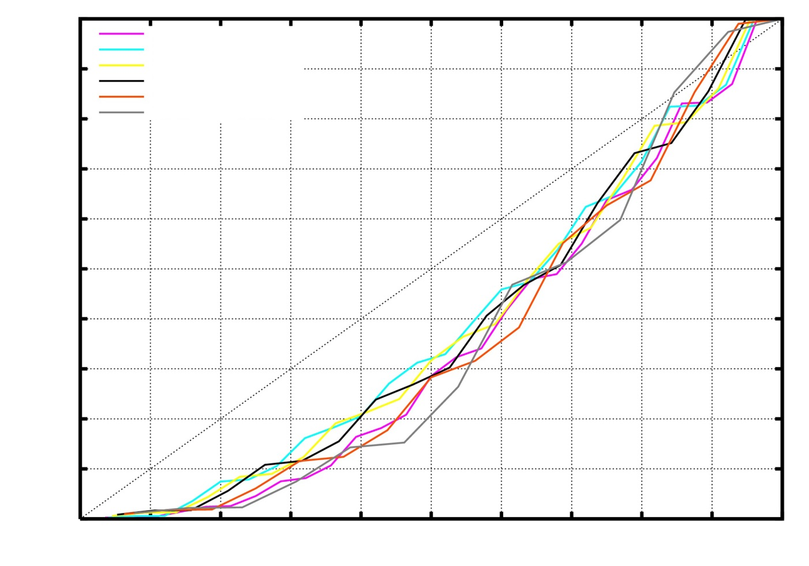
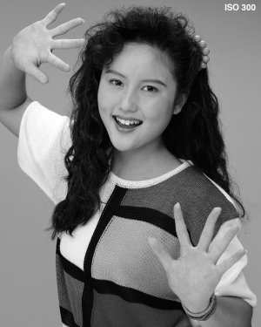
BLOCK-WISE LAYER TRUNCATION
ANALYSIS OF CODING PASSES LENGTHS
TIER-1
CODING
1
28 coding passes
25 coding passes
22 coding passes
19 coding passes
16 coding passes
13 coding passes
0.5
BIT-STREAM LENGTH
“Portait” image
5 DWT levels
lossy mode
64x64 code-blocks
b=3
0
0
0.5
1
BIT PLANE

Slide 33
BLOCK-WISE LAYER TRUNCATION
ANALYSIS OF CODING PASSES LENGTHS
TIER-1
CODING
1
28 coding passes
25 coding passes
22 coding passes
19 coding passes
16 coding passes
13 coding passes
0.5
BIT-STREAM LENGTH
“Portait” image
5 DWT levels
lossy mode
64x64 code-blocks
b=7
0
0
0.5
1
BIT PLANE

Slide 34
BLOCK-WISE LAYER TRUNCATION
ANALYSIS OF CODING PASSES LENGTHS
TIER-1
CODING
1
28 coding passes
25 coding passes
22 coding passes
19 coding passes
16 coding passes
13 coding passes
0.5
BIT-STREAM LENGTH
“Portait” image
5 DWT levels
lossy mode
64x64 code-blocks
b=11
0
0
0.5
1
BIT PLANE

Slide 35
BLOCK-WISE LAYER TRUNCATION
LAYER TRUNCATION
PLAIN
TRUNCATION

Slide 36
BLOCK-WISE LAYER TRUNCATION
OPTIMIZED TRUNCATION

Slide 37
BLOCK-WISE LAYER TRUNCATION
OPTIMIZED TRUNCATION
TOP-TO-BOTTOM
SELECTION
using
CODING PASSES
LENGTHS ESTIMATION
Needed operations:
Re-generation of packet headers
Stop decoding when the segment
ends
COMPUTATIONALLY INEXPENSIVE

Slide 38
TABLE OF CONTENTS
1. INTRODUCTION
2. BLOCK-WISE TRUNCATION
OF QUALITY LAYERS
3. EXPERIMENTS
4. CONCLUSIONS
Interactive image transmission
Code-stream transcoding
Real-time video rendering
Client-server policies of video delivery
Applications

Slide 39
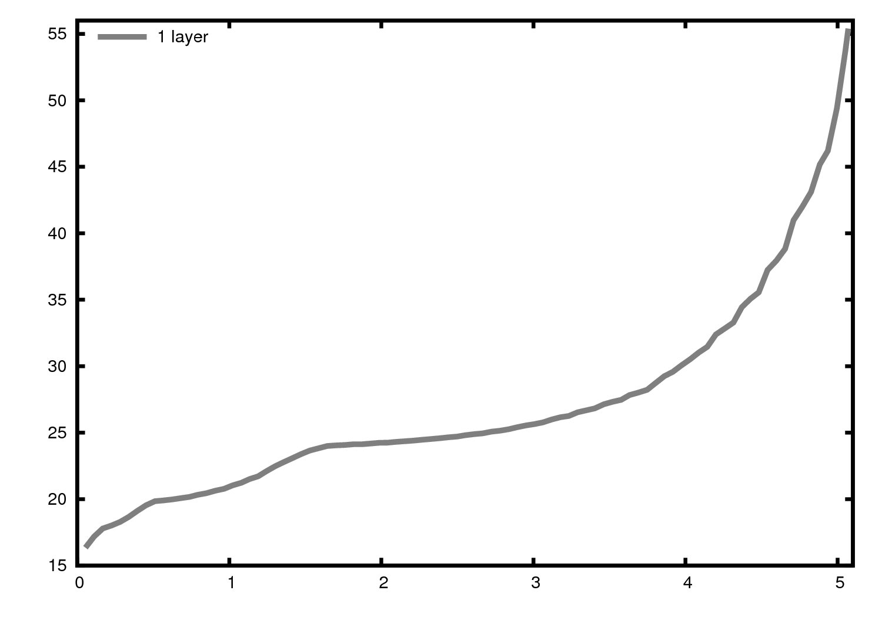
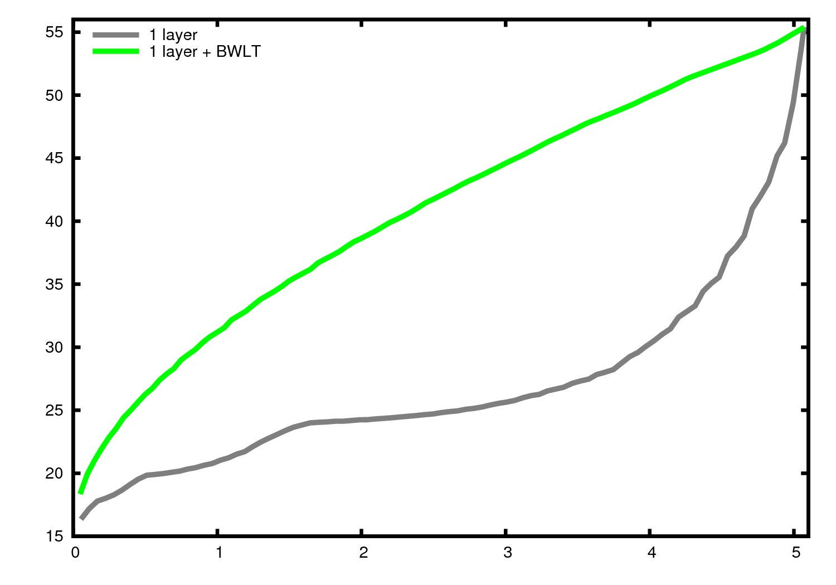
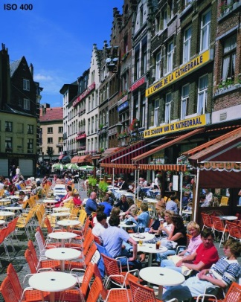
EXPERIMENTS
LOSSY MODE (1 layer)
PSNR (in dB)
> 10 dB
“Cafeteria” image
5 DWT levels
9/7 filter-taps
64x64 code-blocks
bits per sample (bps)
Notes:
-EXPLICAR BÉ COM S’HAN FET ELS EXPERIMENTS
-EL ROC NO NECESSITA CREAR QUALITY LAYERS

Slide 40
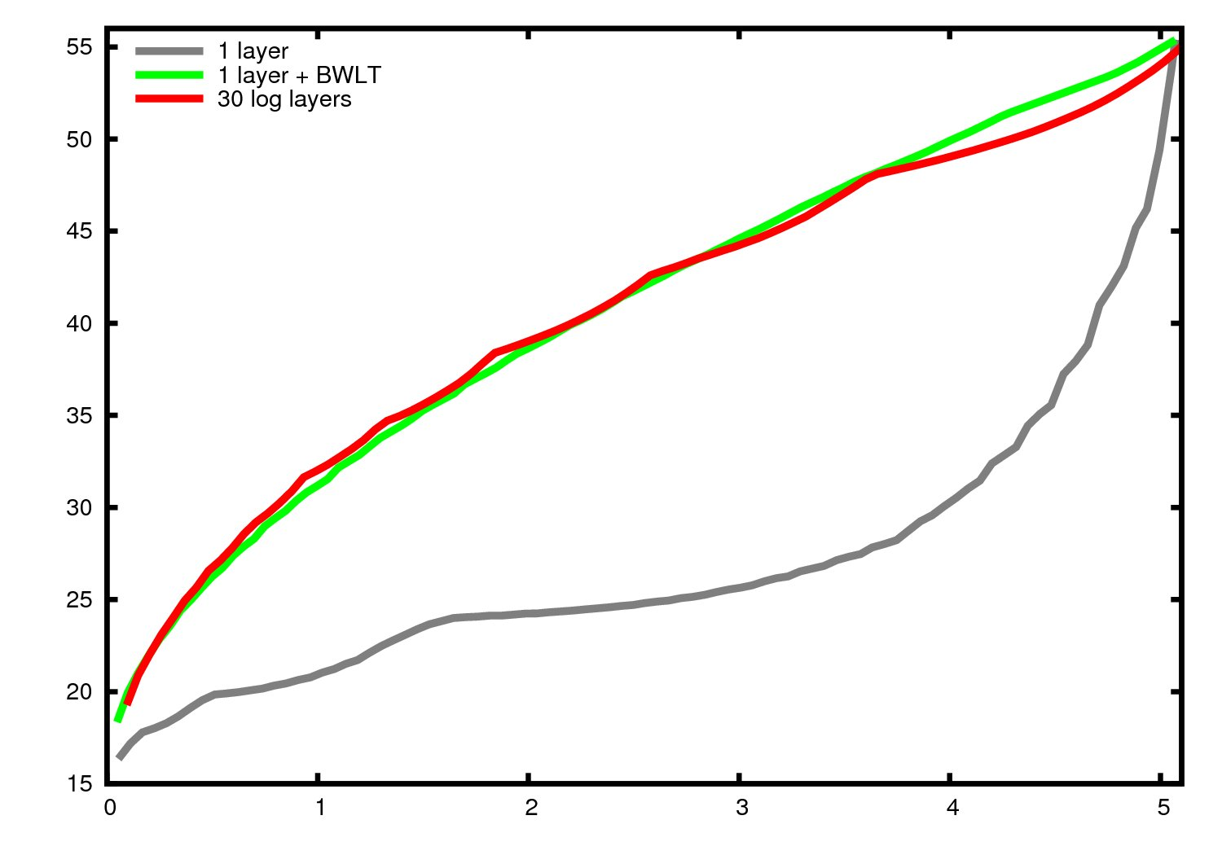
EXPERIMENTS
LOSSY MODE (1 layer)
PSNR (in dB)
“Cafeteria” image
5 DWT levels
9/7 filter-taps
64x64 code-blocks
bits per sample (bps)
Notes:
-EXPLICAR BÉ COM S’HAN FET ELS EXPERIMENTS
-EL ROC NO NECESSITA CREAR QUALITY LAYERS

Slide 41
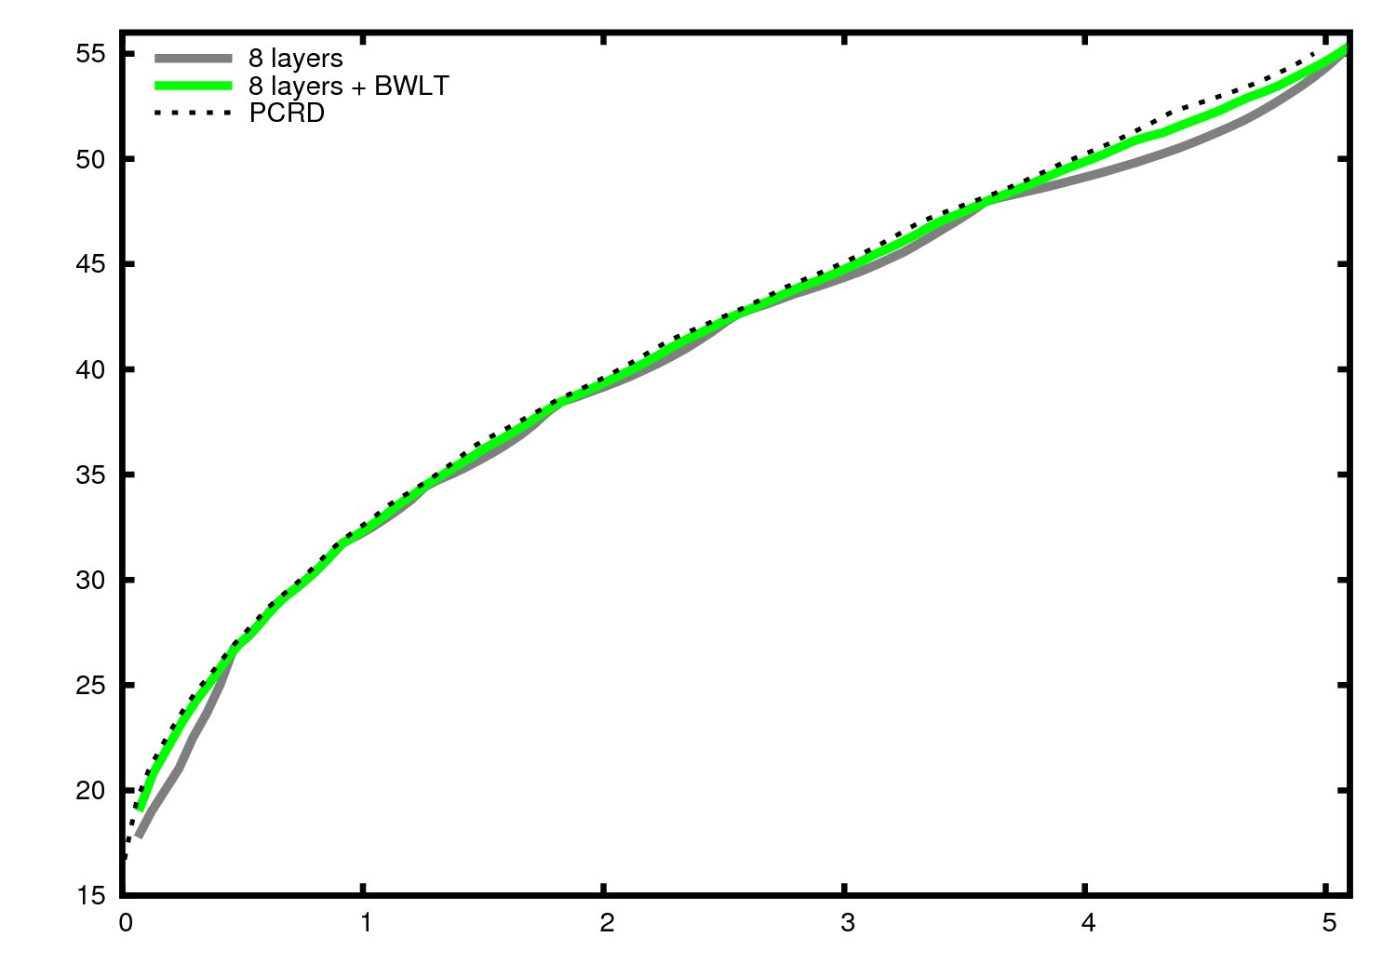
EXPERIMENTS
LOSSY MODE (8 layers)
PSNR (in dB)
“Cafeteria” image
5 DWT levels
9/7 filter-taps
64x64 code-blocks
bits per sample (bps)
Notes:
-EXPLICAR BÉ COM S’HAN FET ELS EXPERIMENTS
-EL ROC NO NECESSITA CREAR QUALITY LAYERS

Slide 42
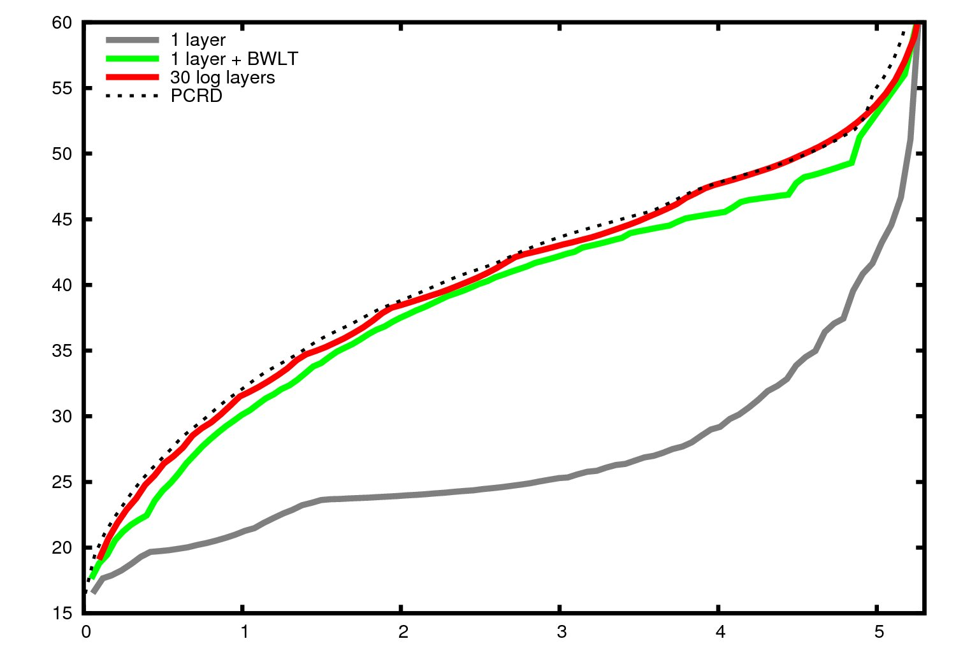
EXPERIMENTS
LOSSLESS MODE (1 layer)
PSNR (in dB)
“Cafeteria” image
5 DWT levels
5/3 filter-taps
64x64 code-blocks
bits per sample (bps)
Notes:
-EXPLICAR BÉ COM S’HAN FET ELS EXPERIMENTS
-EL ROC NO NECESSITA CREAR QUALITY LAYERS

Slide 43
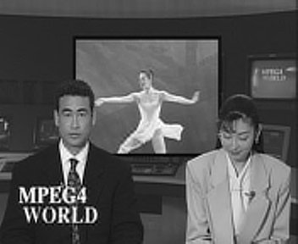
EXPERIMENTS
REAL-TIME VIDEO RENDERING
PSNR (in dB)
> 5 dB
time (in sec)
3 layers – 30.52 dB
3 layers + BWLT – 36.68 dB
“News” sequence
(size 352x288)
5 DWT levels
lossy mode
64x64 code-blocks
decoded data ≈ 7.5 kB
Notes:
-EXPLICAR BÉ COM S’HAN FET ELS EXPERIMENTS
-EL ROC NO NECESSITA CREAR QUALITY LAYERS

Slide 44
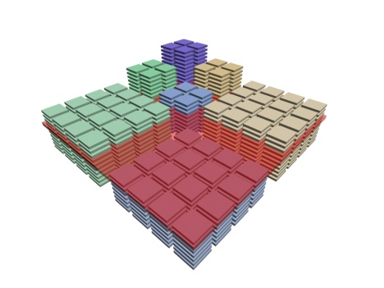
TABLE OF CONTENTS
1. OVERVIEW
CPI
ROC
CoRD
2. RATE CONTROL
METHODS
3. EXPERIMENTS
4. CONCLUSIONS
Interactive image transmission
Code-stream transcoding
Real-time video rendering
Client-server policies of video delivery
Applications

Slide 45
CONCLUSIONS
JPEG2000 QUALITY SCALABILITY/PROGRESSION
FORMATION OF
QUALITY LAYERS
Truncation: penalizes quality
RESEARCH PURPOSES:
1) OPTIMIZED TRUNCATION OF QUALITY LAYERS
2) LOW COMPUTATIONAL COMPLEXITY
3) JPEG2000 COMPLIANCE

Slide 46
CONCLUSIONS
BLOCK-WISE LAYER TRUNCATION
Include segments of all code-blocks
by selecting coding passes from
top to bottom
Estimate coding passes lengths through an exponential function

Slide 47
CONCLUSIONS
BLOCK-WISE LAYER TRUNCATION
Interactive image transmission
Code-stream transcoding
Real-time video rendering
Client-server policies of video delivery
Applications

