Slide 1
JPEG2000 RATE
CONTROL METHODS
Francesc Aulí-Llinàs
Department of Information and Communications Engineering
Universitat Autònoma de Barcelona, Spain

Slide 2
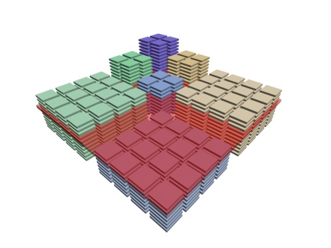
TABLE OF CONTENTS
1. OVERVIEW
CPI
ROC
CoRD
2. RATE CONTROL
METHODS
3. EXPERIMENTS
4. CONCLUSIONS
REDUCTION OF COMPUTATIONAL COMPLEXITY
MULTIPLE EXTRACTION
LAYERS REBUILDING
CONTROL INTERACTIVE TRANSMISSIONS

Slide 3
TABLE OF CONTENTS
1. OVERVIEW
CPI
ROC
CoRD
2. RATE CONTROL
METHODS
3. EXPERIMENTS
4. CONCLUSIONS
REDUCTION OF COMPUTATIONAL COMPLEXITY
MULTIPLE EXTRACTION
LAYERS REBUILDING
CONTROL INTERACTIVE TRANSMISSIONS

Slide 4
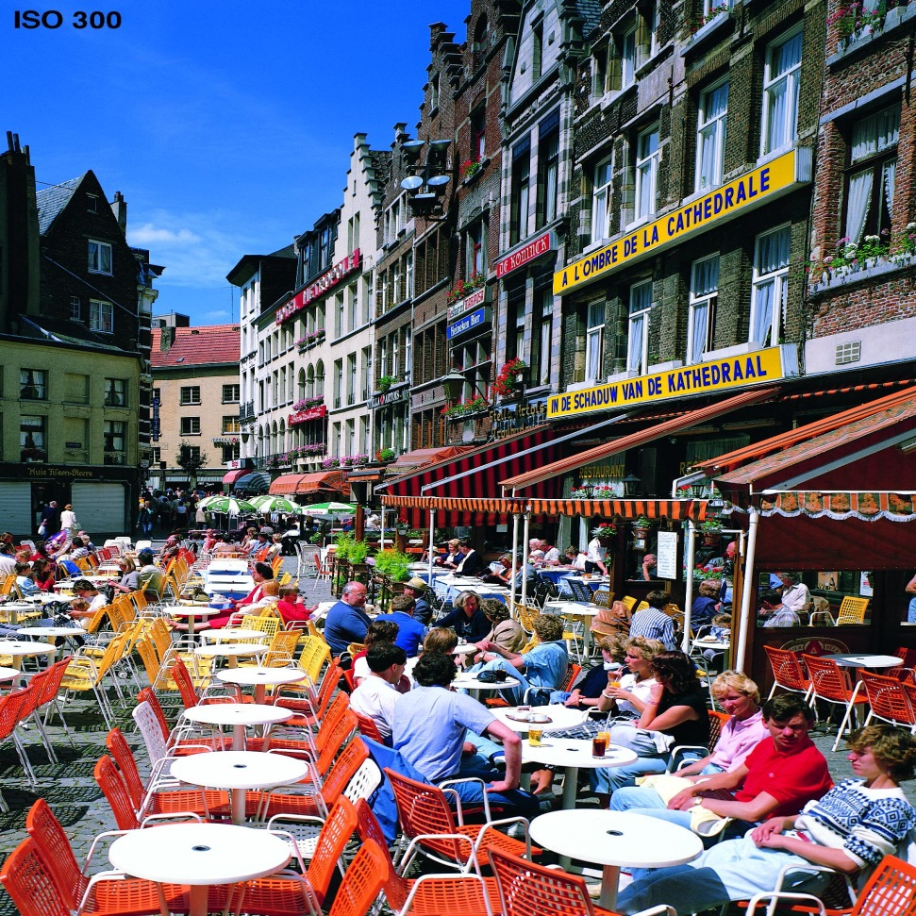
OVERVIEW
JPEG2000 CORE CODING SYSTEM
ORIGINAL IMAGE

Slide 5
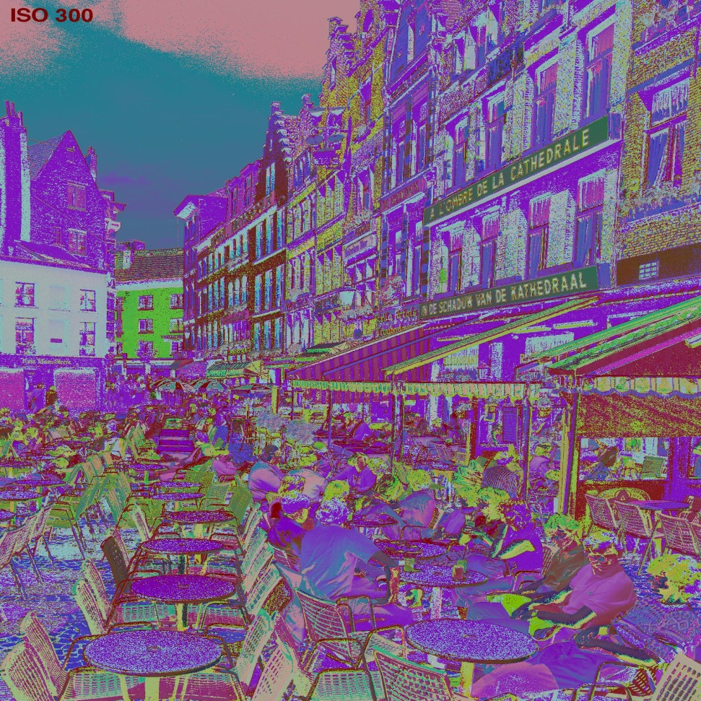
OVERVIEW
JPEG2000 CORE CODING SYSTEM
ORIGINAL IMAGE
MULTI-COMPONENT
TRANSFORM

Slide 6
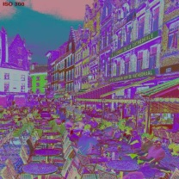
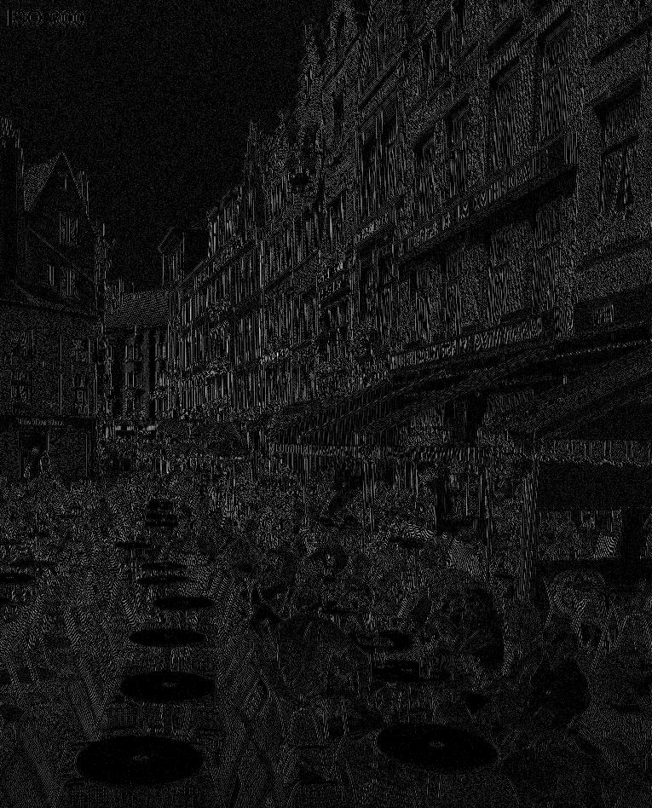
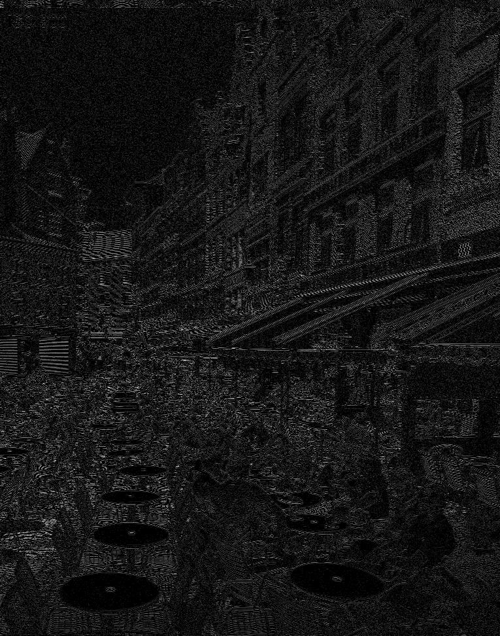
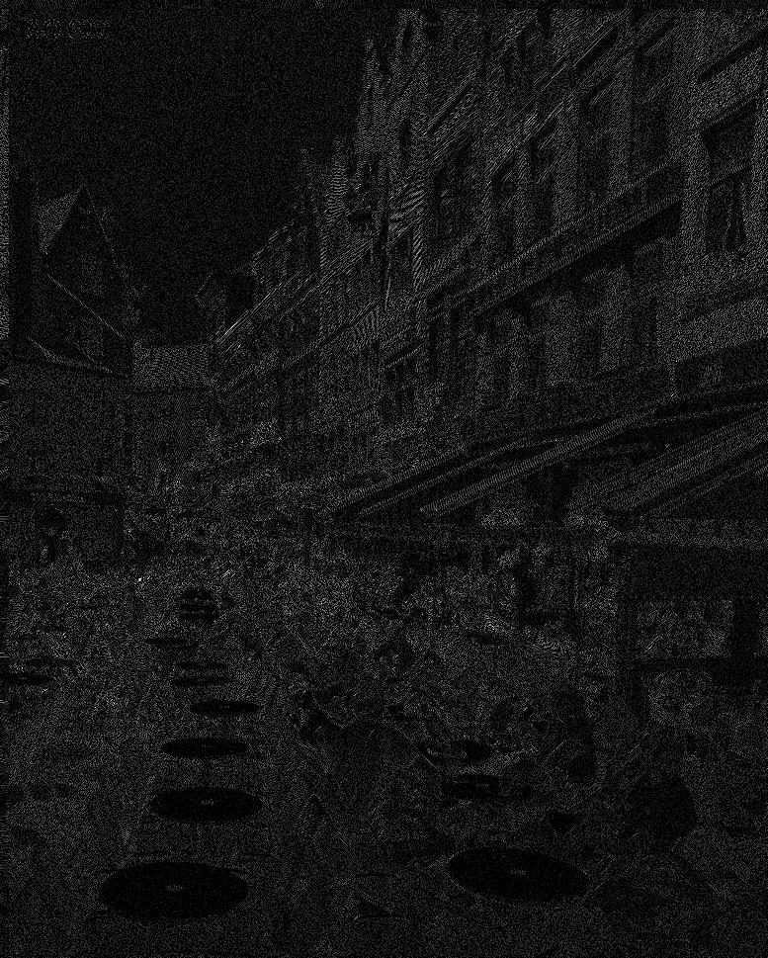
OVERVIEW
JPEG2000 CORE CODING SYSTEM
ORIGINAL IMAGE
MULTI-COMPONENT
TRANSFORM
WAVELET
TRANSFORM
QUANTIZATION

Slide 7
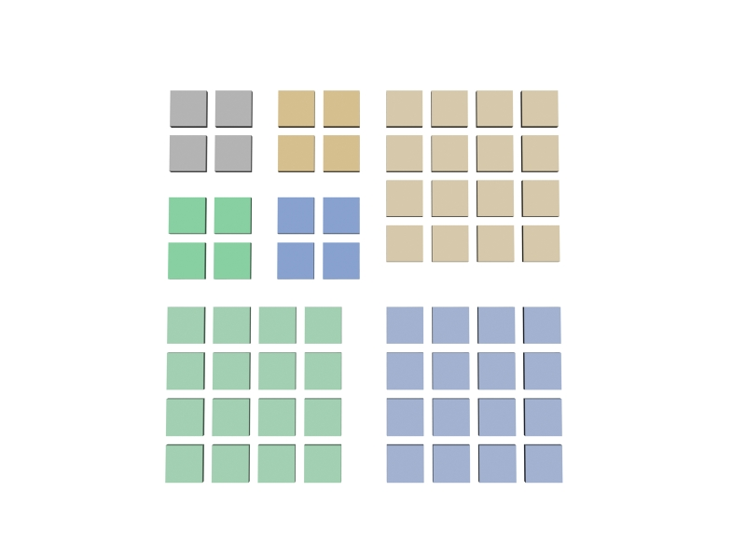
OVERVIEW
JPEG2000 CORE CODING SYSTEM
ORIGINAL IMAGE
MULTI-COMPONENT
TRANSFORM
WAVELET
TRANSFORM
QUANTIZATION

Slide 8
OVERVIEW
JPEG2000 CORE CODING SYSTEM
ORIGINAL IMAGE
MULTI-COMPONENT
TRANSFORM
WAVELET
TRANSFORM
QUANTIZATION

Slide 9
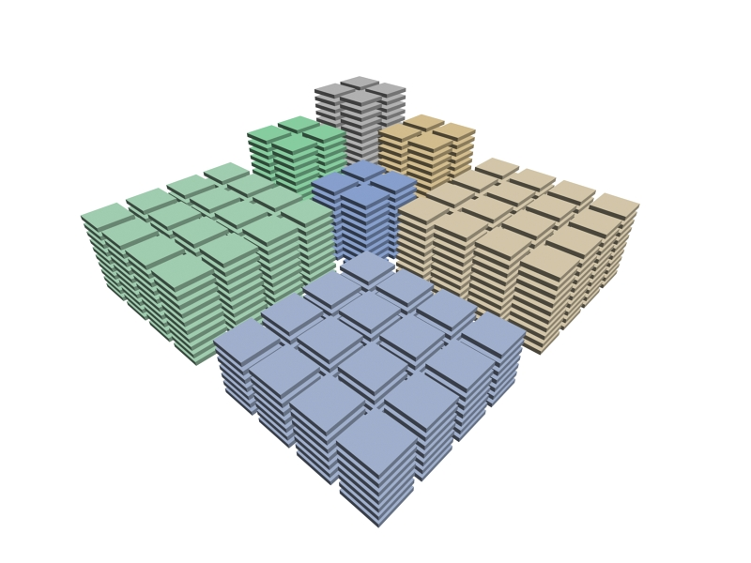
OVERVIEW
JPEG2000 CORE CODING SYSTEM
ORIGINAL IMAGE
MULTI-COMPONENT
TRANSFORM
WAVELET
TRANSFORM
QUANTIZATION

Slide 10
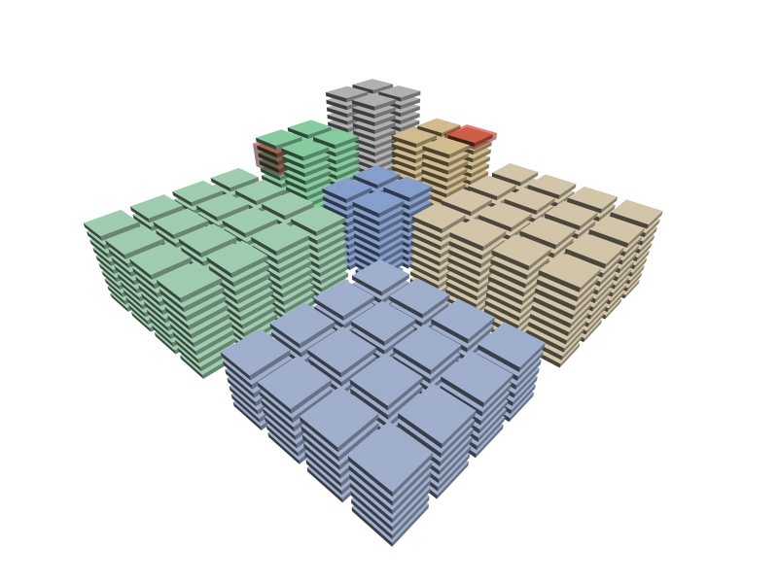
OVERVIEW
JPEG2000 CORE CODING SYSTEM
ORIGINAL IMAGE
MULTI-COMPONENT
TRANSFORM
bit plane
coding pass
WAVELET
TRANSFORM
QUANTIZATION

Slide 11
OVERVIEW
JPEG2000 CORE CODING SYSTEM
ORIGINAL IMAGE
MULTI-COMPONENT
TRANSFORM
bit plane
coding pass
WAVELET
TRANSFORM
coding pass type:
SPP - Significance Propagation
MRP - Magnitude Refinement
CP - Cleanup
QUANTIZATION
SPP
MRP
CP

Slide 12
OVERVIEW
JPEG2000 CORE CODING SYSTEM
ORIGINAL IMAGE
MULTI-COMPONENT
TRANSFORM
WAVELET
TRANSFORM
coding pass type:
SPP - Significance Propagation
MRP - Magnitude Refinement
CP - Cleanup
QUANTIZATION
SPP
MRP
CP

Slide 13
OVERVIEW
JPEG2000 CORE CODING SYSTEM
ORIGINAL IMAGE
MULTI-COMPONENT
TRANSFORM
WAVELET
TRANSFORM
QUANTIZATION
TIER-1 CODING

Slide 14
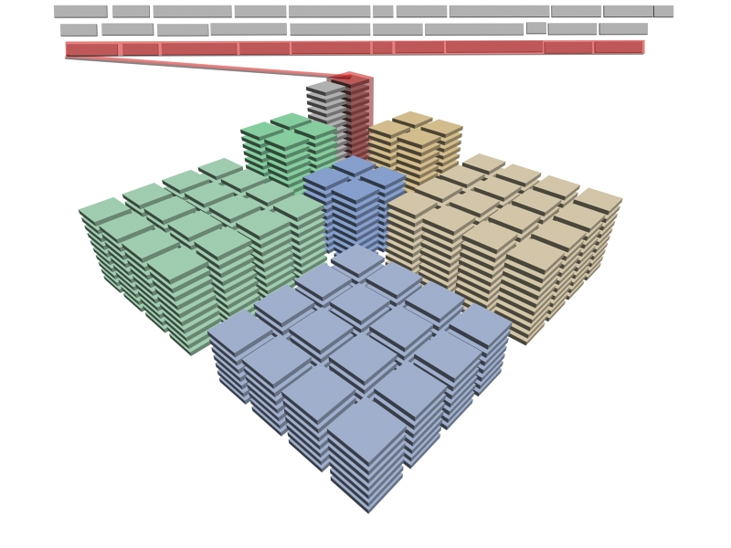
OVERVIEW
JPEG2000 CORE CODING SYSTEM
ORIGINAL IMAGE
MULTI-COMPONENT
TRANSFORM
WAVELET
TRANSFORM
QUANTIZATION
TIER-1 CODING

Slide 15
OVERVIEW
JPEG2000 CORE CODING SYSTEM
ORIGINAL IMAGE
MULTI-COMPONENT
TRANSFORM
WAVELET
TRANSFORM
QUANTIZATION
TIER-1 CODING

Slide 16
OVERVIEW
JPEG2000 CORE CODING SYSTEM
ORIGINAL IMAGE
MULTI-COMPONENT
TRANSFORM
WAVELET
TRANSFORM
QUANTIZATION
TIER-1 CODING
PCRD
TIER-2 CODING
1. TARGET BIT-RATE
JP2 code-stream
NEED OF RATE-DISTORTION
OPTIMIZATION
→ QUALITY OPTIMIZATION
2. TARGET QUALITY
→ BIT-RATE OPTIMIZATION

Slide 17
OVERVIEW
RATE-DISTORTION OPTIMIZATION
ORIGINAL IMAGE
R¹,D¹
R²,D²
R³,D³
R⁴,D⁴
R⁵,D⁵
MULTI-COMPONENT
TRANSFORM
D
WAVELET
TRANSFORM
1
2
QUANTIZATION
convex hull
3
4
TIER-1 CODING
5
PCRD
R
TIER-2 CODING
generalized Lagrange multiplier
1. TARGET BIT-RATE
min ( D + λR ) = min ( ( D_{i} + λR_{i} ))
JP2 code-stream
→ QUALITY OPTIMIZATION
2. TARGET QUALITY
min ( R + λD ) = min ( ( R_{i} + λD_{i} ))
→ BIT-RATE OPTIMIZATION

Slide 18
OVERVIEW
RATE-DISTORTION OPTIMIZATION
ORIGINAL IMAGE
25%
MULTI-COMPONENT
TRANSFORM
60%
WAVELET
TRANSFORM
QUANTIZATION
TIER-1 CODING
TIER-2 CODING
PCRD
15%
JP2 code-stream
ENCODING TIME OF THE
JPEG2000 CODING STAGES

Slide 19
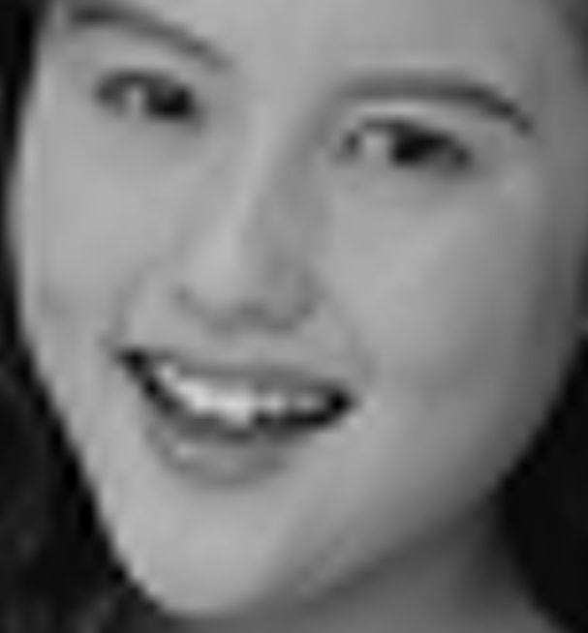
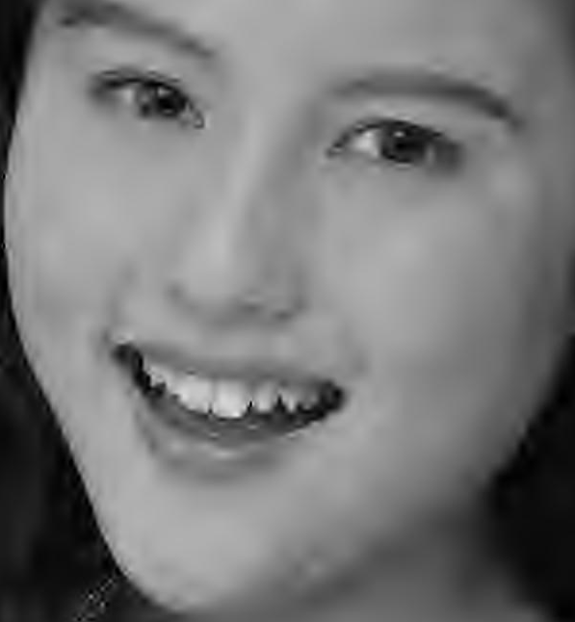
OVERVIEW
QUALITY SCALABILITY / PROGRESSION
SINGLE QUALITY LAYER CODE-STREAM
MULTIPLE QUALITY LAYERS CODE-STREAM
MAX
QUALITY
MAX
QUALITY
MAX
QUALITY
MAX
QUALITY
0.03125 bps
(256:1)
1 layer - 23.06 dB
40 layers - 24.7 dB

Slide 20
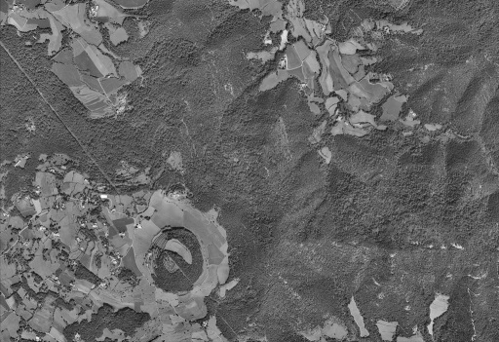
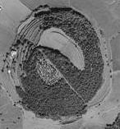
OVERVIEW
QUALITY SCALABILITY / PROGRESSION
SINGLE QUALITY LAYER CODE-STREAM
MULTIPLE QUALITY LAYERS CODE-STREAM
1) LACK OF QUALITY SCALABILITY
IN SINGLE QUALITY LAYERS
CODE-STREAMS
2) INADEQUATE RATE ALLOCATION OF
WINDOWS OF INTEREST (WOI)
THROUGHOUT THE QUALITY LAYERS
!
WOI
NONE OF THE STATE-OF-THE-ART RATE
CONTROL METHODS ADDRESSES THESE POINTS

Slide 21
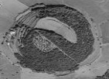
OVERVIEW
RESEARCH PURPOSES
1) TO PROVIDE QUALITY SCALABILITY TO ALREADY
ENCODED CODE-STREAMS
WOI
2) LOW COMPUTATIONAL COMPLEXITY - coder / decoder
interactive
transmission
3) JPEG2000 COMPLIANT

Slide 22
TABLE OF CONTENTS
1. OVERVIEW
CPI
ROC
CoRD
2. RATE CONTROL
METHODS
3. EXPERIMENTS
4. CONCLUSIONS
REDUCTION OF COMPUTATIONAL COMPLEXITY
MULTIPLE EXTRACTION
LAYERS REBUILDING
CONTROL INTERACTIVE TRANSMISSIONS

Slide 23
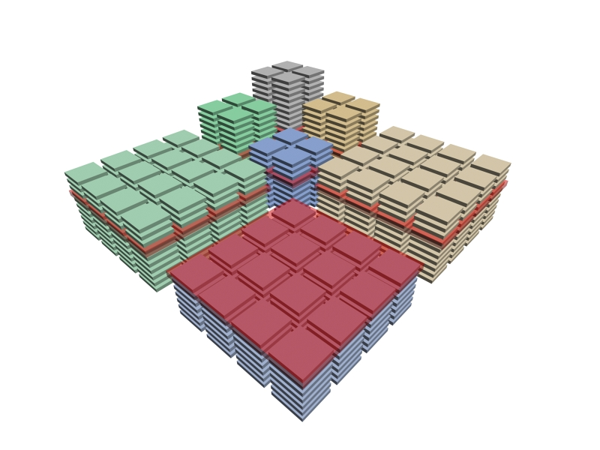
RATE CONTROL METHODS
CODING PASSES INTERLEAVING (CPI)
ORIGINAL IMAGE
MULTI-COMPONENT
TRANSFORM
WAVELET
TRANSFORM
QUANTIZATION
coding level:
coding passes of the
code-blocks selected by the transparent red boxes

Slide 24
RATE CONTROL METHODS
CODING PASSES INTERLEAVING (CPI)
ORIGINAL IMAGE
MULTI-COMPONENT
TRANSFORM
WAVELET
TRANSFORM
QUANTIZATION
CPI RATE CONTROL
TIER-1 CODING

Slide 25
RATE CONTROL METHODS
CODING PASSES INTERLEAVING (CPI)
ORIGINAL IMAGE
MULTI-COMPONENT
TRANSFORM
WAVELET
TRANSFORM
QUANTIZATION
CPI RATE CONTROL
TIER-1 CODING
11

Slide 26
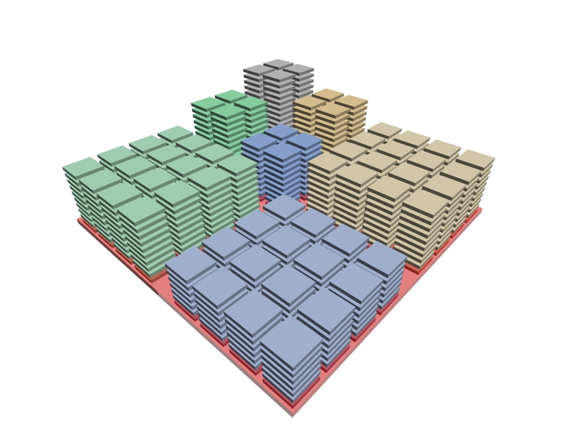
RATE CONTROL METHODS
CODING PASSES INTERLEAVING (CPI)
ORIGINAL IMAGE
MULTI-COMPONENT
TRANSFORM
WAVELET
TRANSFORM
QUANTIZATION
CPI RATE CONTROL
TIER-1 CODING

Slide 27
RATE CONTROL METHODS
CODING PASSES INTERLEAVING (CPI)
ORIGINAL IMAGE
MULTI-COMPONENT
TRANSFORM
1
2
WAVELET
TRANSFORM
5
3
4
QUANTIZATION
CPI RATE CONTROL
TIER-1 CODING
6
7

Slide 28
RATE CONTROL METHODS
CODING PASSES INTERLEAVING (CPI)
ORIGINAL IMAGE
SPP
MULTI-COMPONENT
TRANSFORM
1
2
WAVELET
TRANSFORM
5
3
4
QUANTIZATION
CPI RATE CONTROL
TIER-1 CODING
6
MRP+CP
7

Slide 29
RATE CONTROL METHODS
CODING PASSES INTERLEAVING (CPI)
SPP
1
2
5
3
4
6
MRP+CP
7

Slide 30
RATE CONTROL METHODS
REVERSE SUBBAND SCANNING ORDER, CODING PASSES CONCATENATION (ROC)
Changes to CPI from a particular bit-rate onward:
5
4
2
- Resolution level scanning order
- Subband scanning order
- Concatenation of MRP and CP of each code-block
4
3
2
1

Slide 31
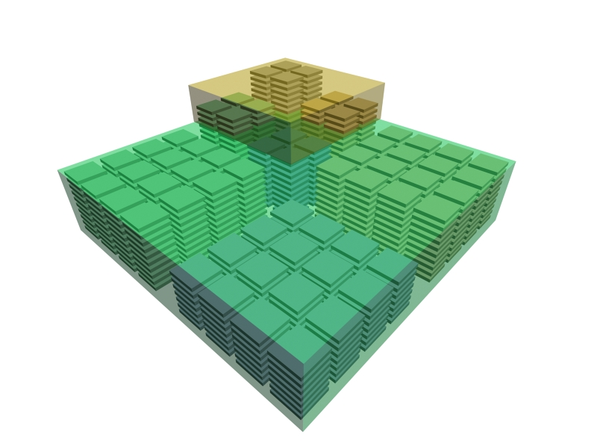
RATE CONTROL METHODS
REVERSE SUBBAND SCANNING ORDER, CODING PASSES CONCATENATION (ROC)
CPI
HIGH LEVELS: CPI
MEDIUM/LOW LEVELS: ROC
5
4
ROC
2
4
3
2
1

Slide 32
RATE CONTROL METHODS
REVERSE SUBBAND SCANNING ORDER, CODING PASSES CONCATENATION (ROC)
CPI
HIGH LEVELS: CPI
MEDIUM/LOW LEVELS: ROC
ROC

Slide 33
RATE CONTROL METHODS
REVERSE SUBBAND SCANNING ORDER, CODING PASSES CONCATENATION (ROC)
CPI
HIGH LEVELS: CPI
MEDIUM/LOW LEVELS: ROC
ROC

Slide 34
RATE CONTROL METHODS
CHARACTERIZATION OF THE RATE-DISTORTION
(CoRD)

Slide 35
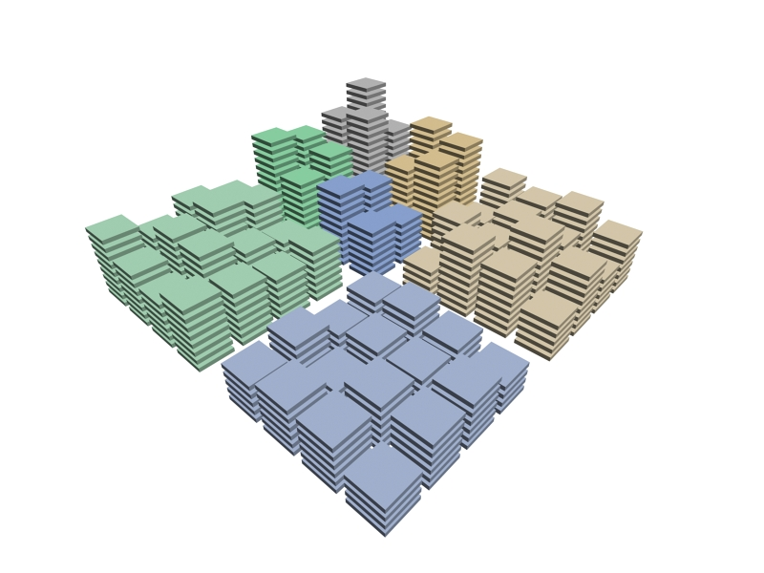
RATE CONTROL METHODS
CHARACTERIZATION OF THE RATE-DISTORTION
(CoRD)

Slide 36
RATE CONTROL METHODS
CHARACTERIZATION OF THE RATE-DISTORTION
(CoRD)

Slide 37
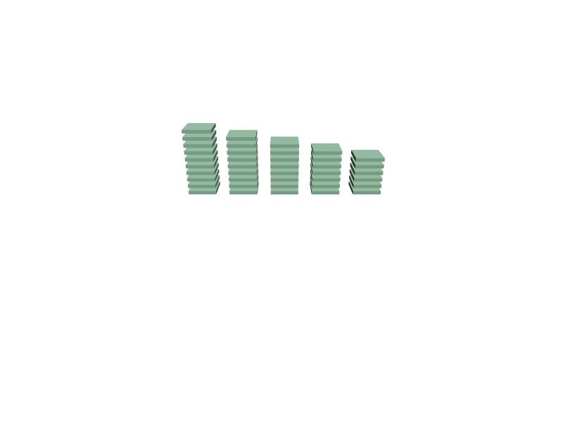
RATE CONTROL METHODS
CHARACTERIZATION OF THE RATE-DISTORTION
(CoRD)

Slide 38
RATE CONTROL METHODS
CHARACTERIZATION OF THE RATE-DISTORTION
(CoRD)
CP
SPP
MRP
CP
SPP
MRP
CP
SPP
MRP
CP
SPP
MRP
CP
SPP
MRP
CP
SPP
MRP
CP

Slide 39
RATE CONTROL METHODS
CHARACTERIZATION OF THE RATE-DISTORTION
(CoRD)
Vikram rate-distortion
model (2005)
CP
SPP
MRP
1) Concatenation of MRP
and CP of each
code-block
CP
SPP
MRP
CP
SPP
MRP
CP
SPP
MRP
CP
SPP
MRP
CP
SPP
MRP
CP

Slide 40
RATE CONTROL METHODS
CHARACTERIZATION OF THE RATE-DISTORTION
(CoRD)
Vikram rate-distortion
model (2005)
CP
SPP
MRP
1) Concatenation of MRP
and CP of each
code-block
CP
SPP
MRP
CP
SPP
2) Slope prediction based
on the number of
significant coefficients
MRP
CP
SPP
MRP
CP
balloon effect!
SPP
MRP
CP
SPP
MRP
CP

Slide 41
RATE CONTROL METHODS
CHARACTERIZATION OF THE RATE-DISTORTION
(CoRD)

Slide 42
RATE CONTROL METHODS
CHARACTERIZATION OF THE RATE-DISTORTION
(CoRD)

Slide 43
RATE CONTROL METHODS
CHARACTERIZATION OF THE RATE-DISTORTION
(CoRD)

Slide 44
RATE CONTROL METHODS
CHARACTERIZATION OF THE RATE-DISTORTION
(CoRD)

Slide 45
TABLE OF CONTENTS
1. OVERVIEW
CPI
ROC
CoRD
2. RATE CONTROL
METHODS
3. EXPERIMENTS
4. CONCLUSIONS
REDUCTION OF COMPUTATIONAL COMPLEXITY
MULTIPLE EXTRACTION
LAYERS REBUILDING
CONTROL INTERACTIVE TRANSMISSIONS

Slide 46
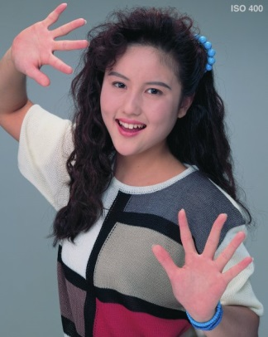
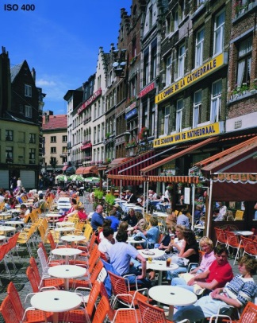
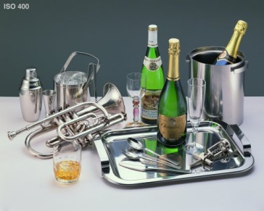
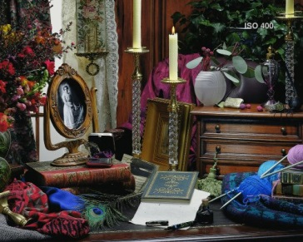
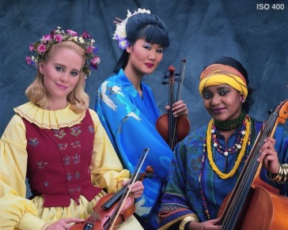
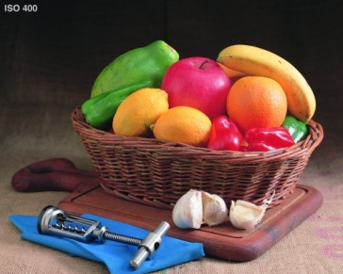
EXPERIMENTS
CODING PERFORMANCE
ISO 12640-1 corpus
JPEG2000 CODING PARAMETERS:
- 9/7 DWT 5 levels
- derived quantization
- code-block size 64x64
- no precincts
- RESTART coding variation
- LRCP progression
CORPUS FEATURES:
- 8 images
- size 2048x2560
- gray scaled to 8 bpp
Notes:
-EXPLICAR BÉ COM S’HAN FET ELS EXPERIMENTS
-EL ROC NO NECESSITA CREAR QUALITY LAYERS

Slide 47
EXPERIMENTS
CODING PERFORMANCE
AVERAGE PSNR DIFFERENCE
CPI
-0.122
ROC
-0.074
CoRD
-0.051
Notes:
-EXPLICAR BÉ COM S’HAN FET ELS EXPERIMENTS
-EL ROC NO NECESSITA CREAR QUALITY LAYERS

Slide 48
EXPERIMENTS
CODING PERFORMANCE
Notes:
-EXPLICAR BÉ COM S’HAN FET ELS EXPERIMENTS
-EL ROC NO NECESSITA CREAR QUALITY LAYERS

Slide 49
EXPERIMENTS
CODING PERFORMANCE
AVERAGE PSNR DIFFERENCE
20 layers
-0.638
40 layers
-0.058
CoRD
-0.051
Notes:
-EXPLICAR BÉ COM S’HAN FET ELS EXPERIMENTS
-EL ROC NO NECESSITA CREAR QUALITY LAYERS

Slide 50
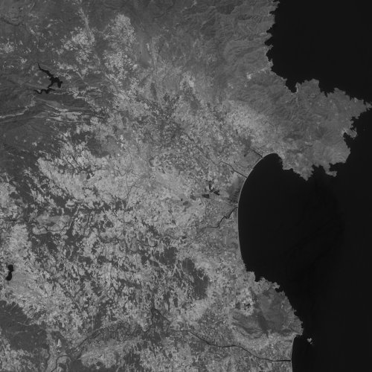
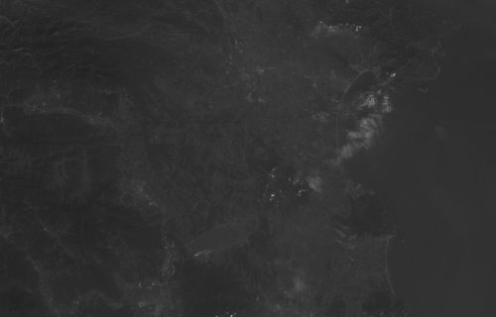
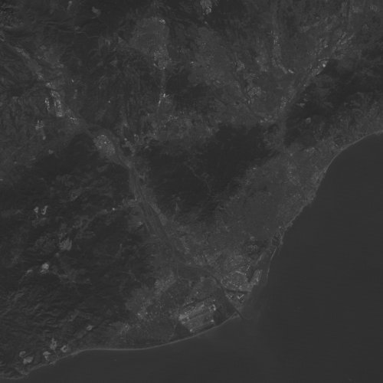
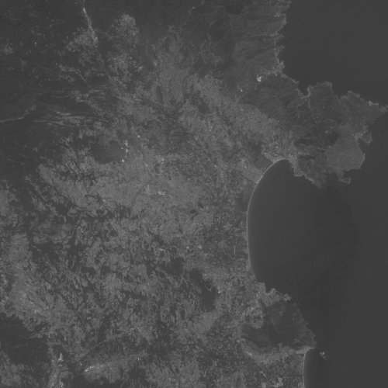
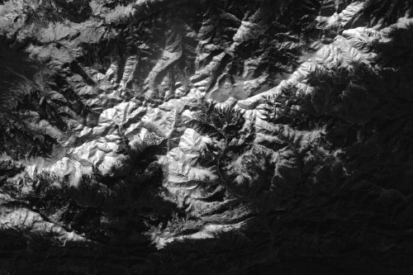
EXPERIMENTS
CODING PERFORMANCE
REMOTE SENSING corpus
JPEG2000 CODING PARAMETERS:
- 9/7 DWT 5 levels
- derived quantization
- code-block size 64x64
- no precincts
- RESTART coding variation
- LRCP progression
CORPUS FEATURES:
- 5 images
- Sensors: TM (Landsat), HRG (SPOT)
- different sizes
- gray scaled to 8 bpp
Notes:
-EXPLICAR BÉ COM S’HAN FET ELS EXPERIMENTS
-EL ROC NO NECESSITA CREAR QUALITY LAYERS

Slide 51
EXPERIMENTS
CODING PERFORMANCE
AVERAGE PSNR DIFFERENCE
CPI
-0.079
ROC
-0.090
CoRD
-0.039
Notes:
-EXPLICAR BÉ COM S’HAN FET ELS EXPERIMENTS
-EL ROC NO NECESSITA CREAR QUALITY LAYERS

Slide 52
EXPERIMENTS
CODING PERFORMANCE
Notes:
-EXPLICAR BÉ COM S’HAN FET ELS EXPERIMENTS
-EL ROC NO NECESSITA CREAR QUALITY LAYERS

Slide 53
EXPERIMENTS
CODING PERFORMANCE
AVERAGE PSNR DIFFERENCE
20 layers
-0.377
40 layers
-0.047
CoRD
-0.039
Notes:
-EXPLICAR BÉ COM S’HAN FET ELS EXPERIMENTS
-EL ROC NO NECESSITA CREAR QUALITY LAYERS

Slide 54
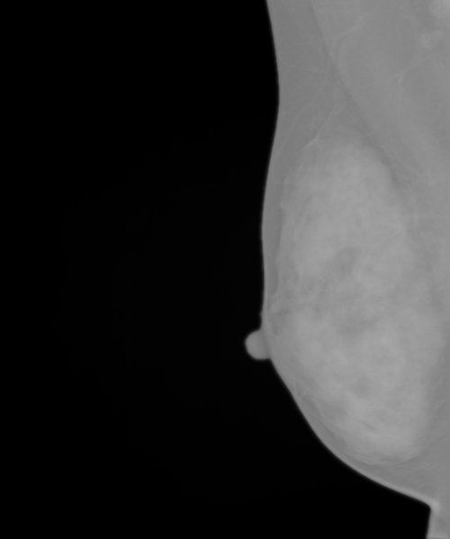
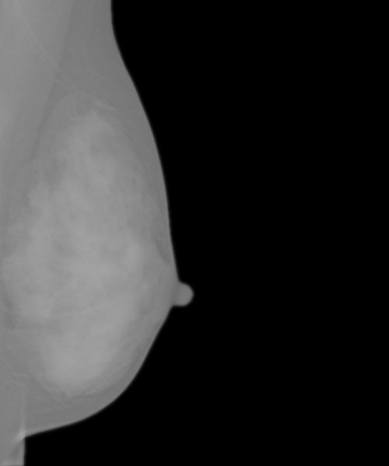
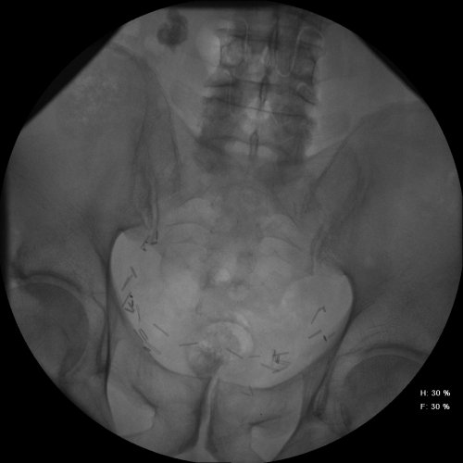
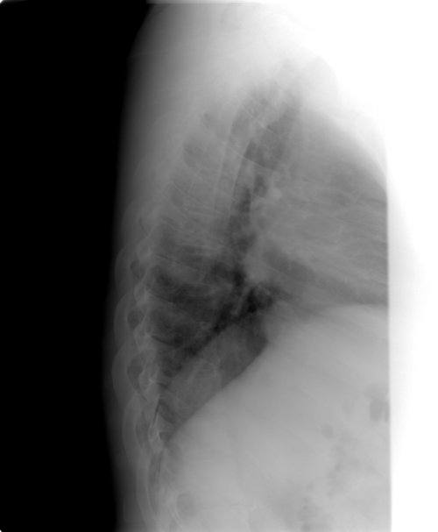
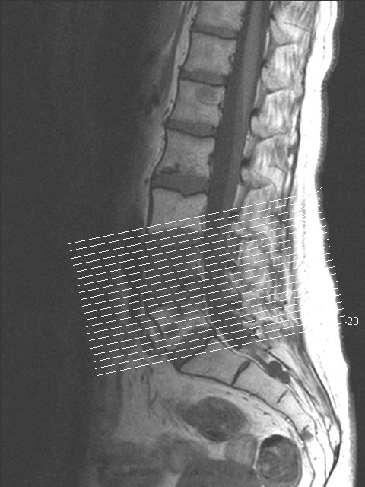
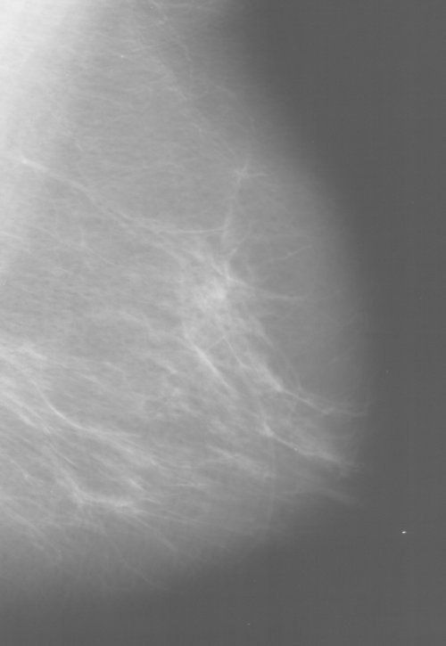
EXPERIMENTS
CODING PERFORMANCE
MEDICAL corpus
JPEG2000 CODING PARAMETERS:
- 9/7 DWT 5 levels
- derived quantization
- code-block size 64x64
- no precincts
- RESTART coding variation
- LRCP progression
CORPUS FEATURES:
- 6 images
- Type: CR, Mamo, Radio
- Different sizes
- gray scaled to 8 bpp
Notes:
-EXPLICAR BÉ COM S’HAN FET ELS EXPERIMENTS
-EL ROC NO NECESSITA CREAR QUALITY LAYERS

Slide 55
EXPERIMENTS
CODING PERFORMANCE
AVERAGE PSNR DIFFERENCE
CPI
-0.097
ROC
-0.104
CoRD
-0.053
Notes:
-EXPLICAR BÉ COM S’HAN FET ELS EXPERIMENTS
-EL ROC NO NECESSITA CREAR QUALITY LAYERS

Slide 56
EXPERIMENTS
CODING PERFORMANCE
Notes:
-EXPLICAR BÉ COM S’HAN FET ELS EXPERIMENTS
-EL ROC NO NECESSITA CREAR QUALITY LAYERS

Slide 57
EXPERIMENTS
CODING PERFORMANCE
AVERAGE PSNR DIFFERENCE
20 layers
-0.377
40 layers
-0.096
CoRD
-0.053
Notes:
-EXPLICAR BÉ COM S’HAN FET ELS EXPERIMENTS
-EL ROC NO NECESSITA CREAR QUALITY LAYERS

Slide 58
EXPERIMENTS
VISUAL COMPARISON
IMAGE: Portrait, gray scaled
COMPRESSION RATIO: 0.03125 bps (256:1)
1 layer
23.06 dB
40 layers
24.7 dB
1 layer + CoRD
24.7 dB
Notes:
-PER JPIP IMATGES AMB 1 LAYER VA MOLT MALAMENT
-ROC ES POT UTILITZAR AMB JPIP SENSE PROBLEMES

Slide 59
EXPERIMENTS
COMPUTATIONAL LOAD OF CoRD
 |  |  | #CODING PASSES
bps | CODING TIME (tier-1) | SPEED UP | CODED / INCLUDED
0.0625 | 6% | 16 | PCRD: 23307 / 1387
 |  |  | CoRD: 1431 / 1430
0.125 | 10% | 10 | PCRD: 23307 / 2550
 |  |  | CoRD: 2552 / 2551
0.25 | 15% | 6.6 | PCRD: 23307 / 4508
 |  |  | CoRD: 4309 / 4038
0.5 | 25% | 4 | PCRD: 23307 / 7136
 |  |  | CoRD: 6697 / 6696
1 | 35% | 2.9 | PCRD: 23307 / 10507
 |  |  | CoRD: 10205 / 10204
2 | 50% | 2 | PCRD: 23307 / 15126
 |  |  | CoRD: 14679 / 14678
ISO 12640-1 average
Notes:
-MOSTRAR UN EXEMPLE DE NOMBRE DE CODING PASSOS CODIFICATS / INCLOSOS

Slide 60
EXPERIMENTS
RATE CONTROL METHODS COMPARISON
coding performance
0.125 bps
0.5 bps
1 bps
V
i
k
r
a
m
K
a
k
a
d
u
K
a
k
a
d
u
V
i
k
r
a
m
P
S
R
A
C
o
R
D
K
a
k
a
d
u
V
i
k
r
a
m
I
R
E
C
P
C
R
D
M
S
D
P
S
O
T
P
C
R
D
M
S
D
I
R
E
C
P
S
O
T
P
S
R
A
C
o
R
D
P
C
R
D
M
S
D
I
R
E
C
P
S
O
T
P
S
R
A
C
o
R
D
D
u
D
u
D
u
0.125 bps
0.5 bps
1 bps
computational load
Notes:
-MOSTRAR UN EXEMPLE DE NOMBRE DE CODING PASSOS CODIFICATS / INCLOSOS

Slide 61
TABLE OF CONTENTS
1. OVERVIEW
CPI
ROC
CoRD
2. RATE CONTROL
METHODS
3. EXPERIMENTS
4. CONCLUSIONS
REDUCTION OF COMPUTATIONAL COMPLEXITY
MULTIPLE EXTRACTION
LAYERS REBUILDING
CONTROL INTERACTIVE TRANSMISSIONS

Slide 62
CONCLUSIONS
Interactive transmission
QUALITY SCALABILITY
Code-stream truncation
Single quality layer code-streams
JPEG2000
QUALITY LAYERS
WOI transmission
STATE-OF-THE-ART RATE CONTROL METHODS
coder computational complexity

Slide 63
CONCLUSIONS
Interactive transmission
QUALITY SCALABILITY
Code-stream truncation
Single quality layer code-streams
JPEG2000
QUALITY LAYERS
WOI transmission
RESEARCH PURPOSES:
1) TO PROVIDE QUALITY SCALABILITY TO ALREADY
ENCODED CODE-STREAMS
STATE-OF-THE-ART RATE CONTROL METHODS
coder computational complexity
2) LOW COMPUTATIONAL COMPLEXITY
3) JPEG2000 COMPLIANT

Slide 64
CONCLUSIONS
CPI - Coding Passes Interleaving
Implicit simple rate-distortion model
Coding performance penalization
ROC - Reverse subband Order & coding passes Concatenation
Improved coding performance
Unstable
CoRD - Characterization of the Rate-Distortion slope
Novel rate-distortion model
High coding performance

Slide 65
CONCLUSIONS
CPI / ROC / CoRD features
Quality scalability to single quality layer code-streams
code-stream truncation
layers rebuiliding
WOIs extraction
Model-based method with high coding performance
no distortion measures based on the original image
no decoding the code-stream
novel rate-distortion model
Low computational complexity (encoder)
computational complexity reduction
incremental encoding
Low computational complexity (decoder)
interactive image transmissions (JPIP)
JPEG2000 compliant
RESTART coding variation

Slide 66
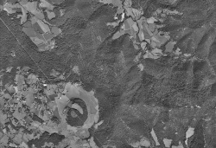
CONCLUSIONS
FUTURE RESEARCH
=
Lossless compression
3D data sets
Interactive image transmissions (JPIP)
Region of Interest Coding
Applications of CoRD
D
Flexible order of coding passes
Evaluation with other distortion measures
Related issues
R

