Slide 1
OVERVIEW OF JPEG2000
CORE CODING SYSTEM
Francesc Aulí-Llinàs
Department of Information and Communications Engineering
Universitat Autònoma de Barcelona, Spain

Slide 2
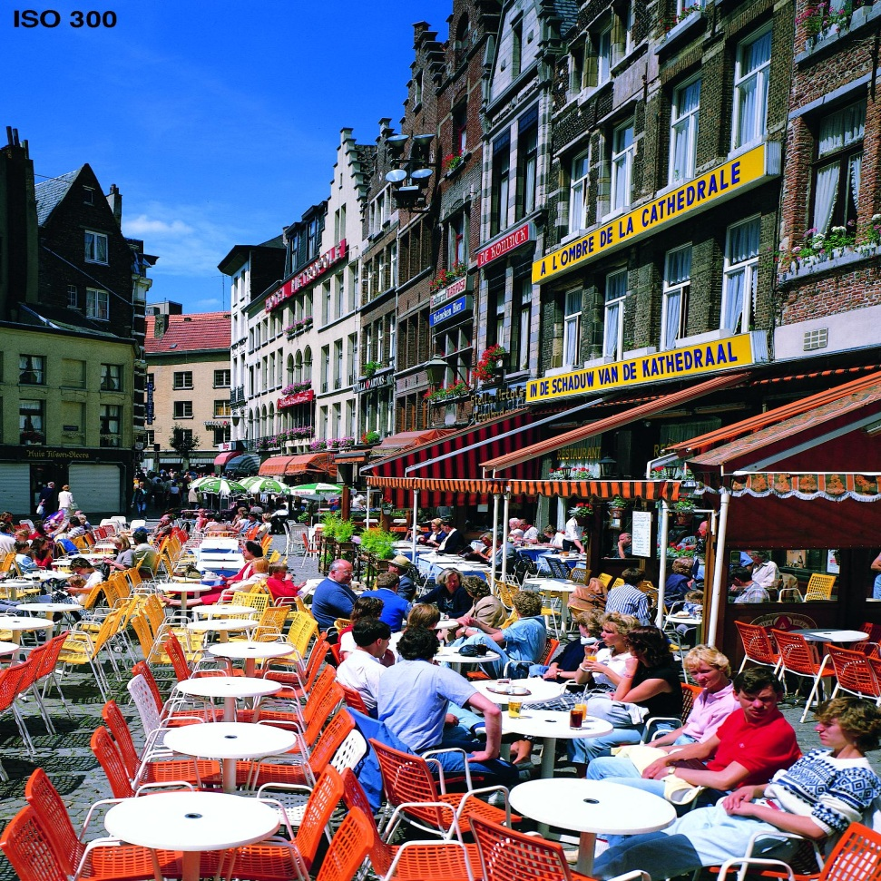
JPEG2000 CORE CODING SYSTEM
ORIGINAL IMAGE

Slide 3
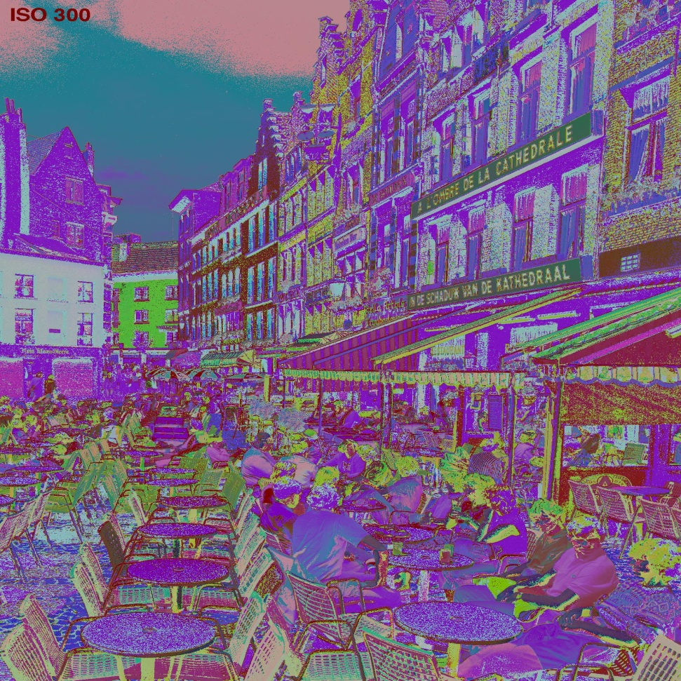
JPEG2000 CORE CODING SYSTEM
ORIGINAL IMAGE
MULTI-COMPONENT
TRANSFORM

Slide 4
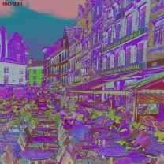
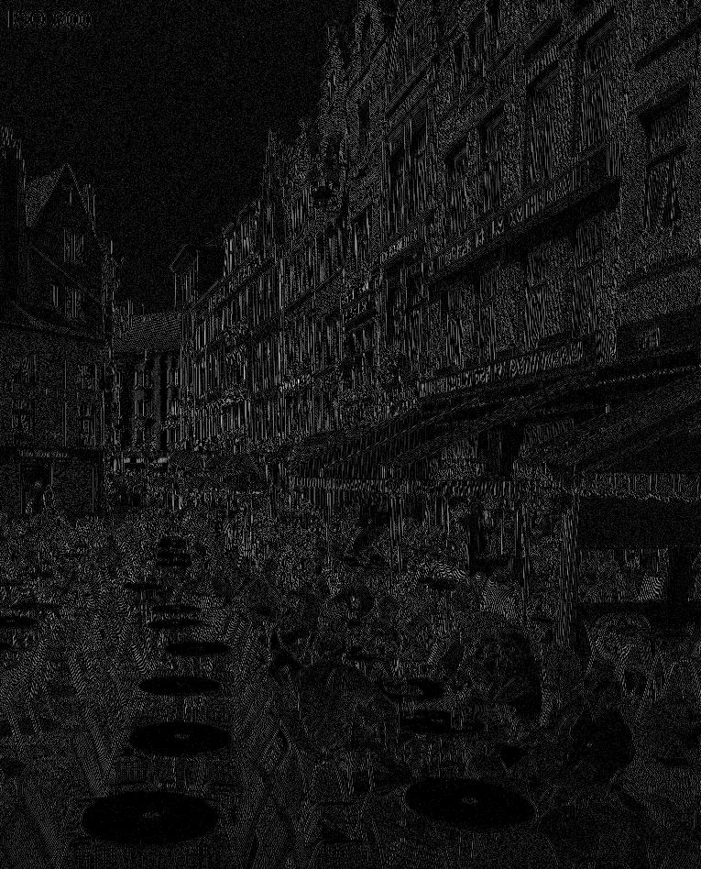
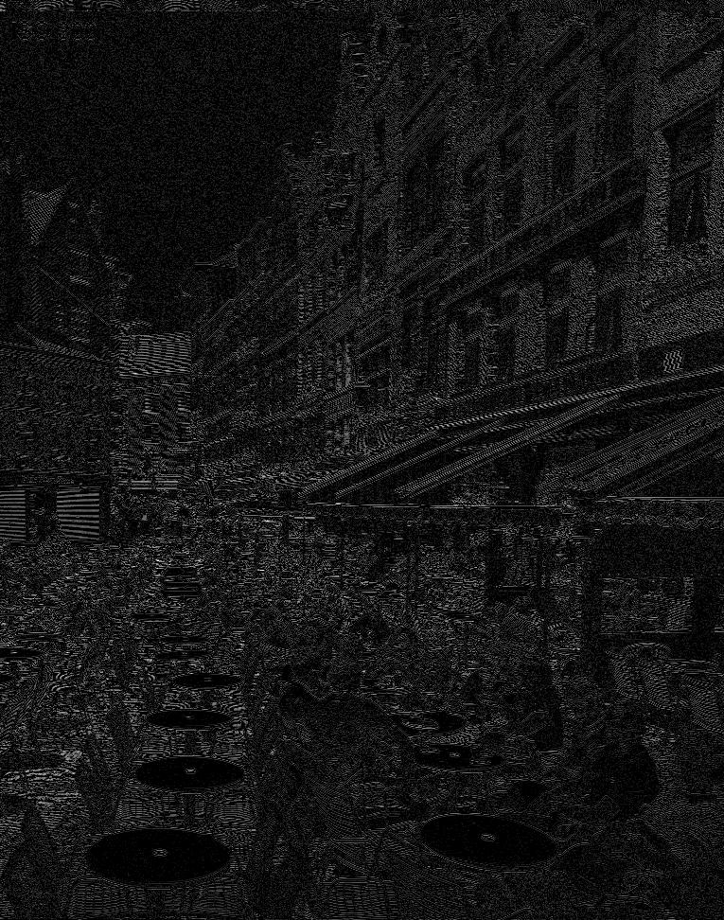
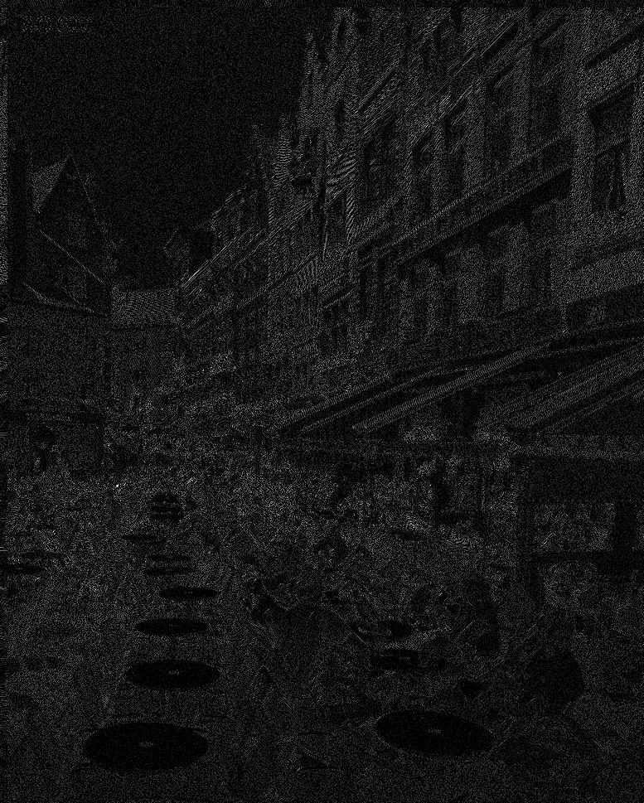
JPEG2000 CORE CODING SYSTEM
ORIGINAL IMAGE
MULTI-COMPONENT
TRANSFORM
WAVELET
TRANSFORM
QUANTIZATION

Slide 5
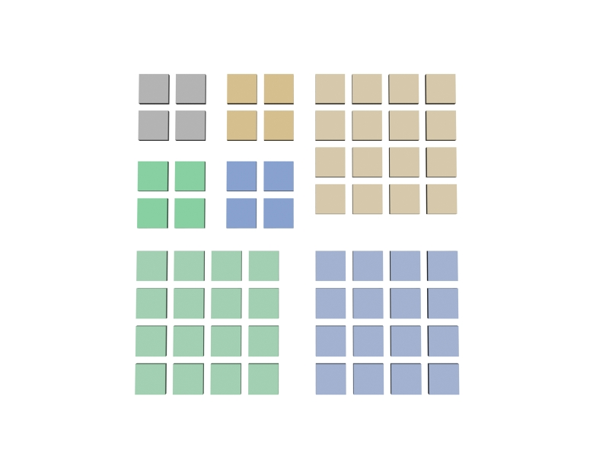
JPEG2000 CORE CODING SYSTEM
ORIGINAL IMAGE
MULTI-COMPONENT
TRANSFORM
WAVELET
TRANSFORM
QUANTIZATION

Slide 6
JPEG2000 CORE CODING SYSTEM
ORIGINAL IMAGE
MULTI-COMPONENT
TRANSFORM
WAVELET
TRANSFORM
QUANTIZATION

Slide 7
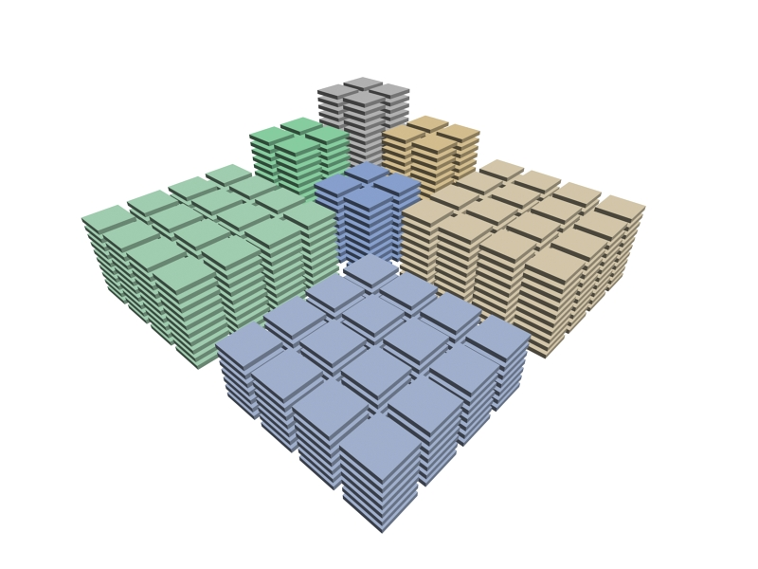
JPEG2000 CORE CODING SYSTEM
ORIGINAL IMAGE
MULTI-COMPONENT
TRANSFORM
WAVELET
TRANSFORM
QUANTIZATION

Slide 8
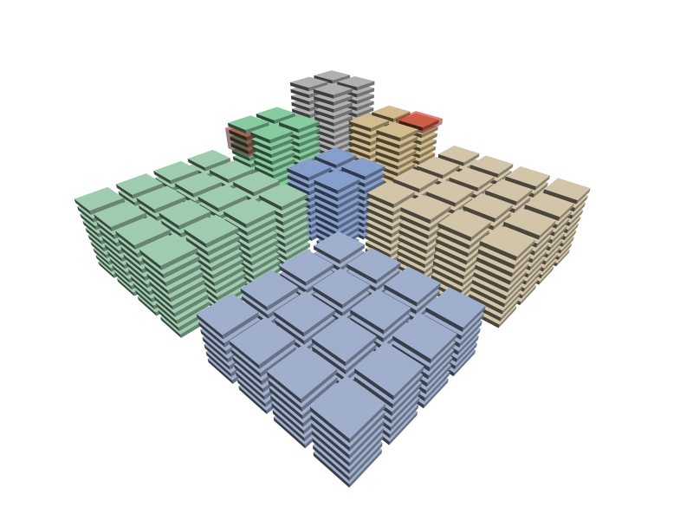
JPEG2000 CORE CODING SYSTEM
ORIGINAL IMAGE
coding pass
MULTI-COMPONENT
TRANSFORM
bitplane
WAVELET
TRANSFORM
QUANTIZATION

Slide 9
JPEG2000 CORE CODING SYSTEM
ORIGINAL IMAGE
coding pass
MULTI-COMPONENT
TRANSFORM
bitplane
WAVELET
TRANSFORM
Types of coding passes:
SPP - Significance Propagation
MRP - Magnitude Refinement
CP - Cleanup
QUANTIZATION
SPP
MRP
CP

Slide 10
JPEG2000 CORE CODING SYSTEM
ORIGINAL IMAGE
MULTI-COMPONENT
TRANSFORM
WAVELET
TRANSFORM
Types of coding passes:
SPP - Significance Propagation
MRP - Magnitude Refinement
CP - Cleanup
QUANTIZATION
SPP
MRP
CP

Slide 11
JPEG2000 CORE CODING SYSTEM
ORIGINAL IMAGE
MULTI-COMPONENT
TRANSFORM
WAVELET
TRANSFORM
QUANTIZATION
TIER-1
CODING

Slide 12
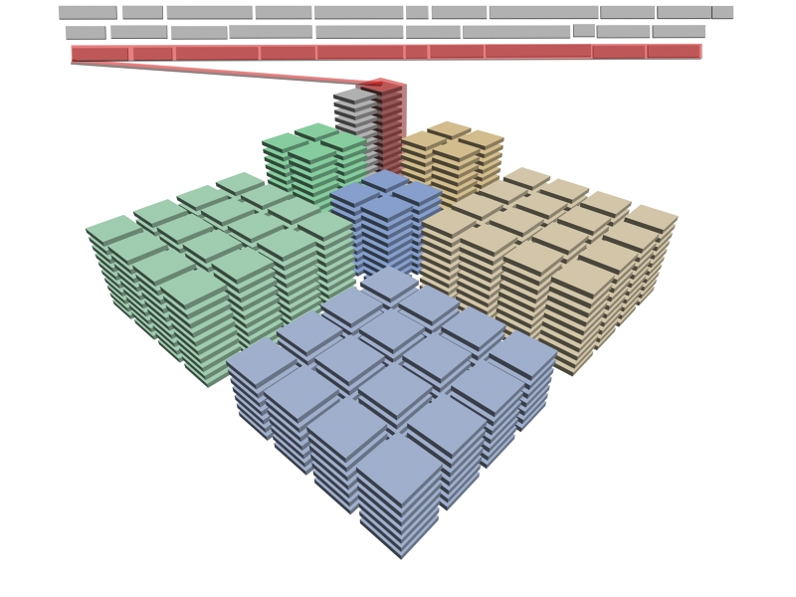
JPEG2000 CORE CODING SYSTEM
ORIGINAL IMAGE
MULTI-COMPONENT
TRANSFORM
WAVELET
TRANSFORM
QUANTIZATION
TIER-1
CODING

Slide 13
JPEG2000 CORE CODING SYSTEM
ORIGINAL IMAGE
MULTI-COMPONENT
TRANSFORM
WAVELET
TRANSFORM
QUANTIZATION
TIER-1
CODING

Slide 14
JPEG2000 CORE CODING SYSTEM
ORIGINAL IMAGE
MULTI-COMPONENT
TRANSFORM
WAVELET
TRANSFORM
QUANTIZATION
TIER-1
CODING
RD OPTIMIZATION
TIER-2
CODING
1. TARGET BITRATE
JP2 CODESTREAM
→ Quality maximization
2. TARGET QUALITY
→ Bitrate minimization

Slide 15
JPEG2000 CORE CODING SYSTEM
ORIGINAL IMAGE
R¹,D¹
R²,D²
R³,D³
R⁴,D⁴
R⁵,D⁵
MULTI-COMPONENT
TRANSFORM
D
1
WAVELET
TRANSFORM
2
QUANTIZATION
“convex hull”
3
4
TIER-1
CODING
5
RD OPTIMIZATION
R
TIER-2
CODING
1. TARGET BITRATE
JP2 CODESTREAM
→ Quality maximization
2. TARGET QUALITY
→ Bitrate minimization

Slide 16
JPEG2000 CORE CODING SYSTEM
ORIGINAL IMAGE
R¹,D¹
R²,D²
R³,D³
R⁴,D⁴
R⁵,D⁵
MULTI-COMPONENT
TRANSFORM
D
WAVELET
TRANSFORM
QUANTIZATION
TIER-1
CODING
RD OPTIMIZATION
R
TIER-2
CODING
Lagrange multiplier optimization:
Determine the ”convex hull” for all codeblocks
Compute the slope of all codestream segments on the convex hull
Select segments with highest slope until reaching the target bitrate or quality
JP2 CODESTREAM

Slide 17
JPEG2000 CORE CODING SYSTEM
ORIGINAL IMAGE
25%
MULTI-COMPONENT
TRANSFORM
60%
WAVELET
TRANSFORM
QUANTIZATION
TIER-1
CODING
TIER-2
CODING
15%
JP2 CODESTREAM
CODING TIME

Slide 18
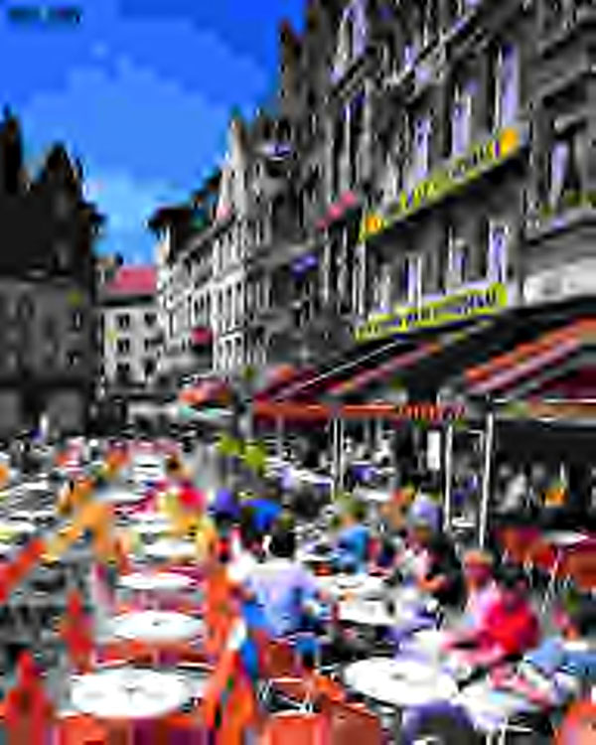
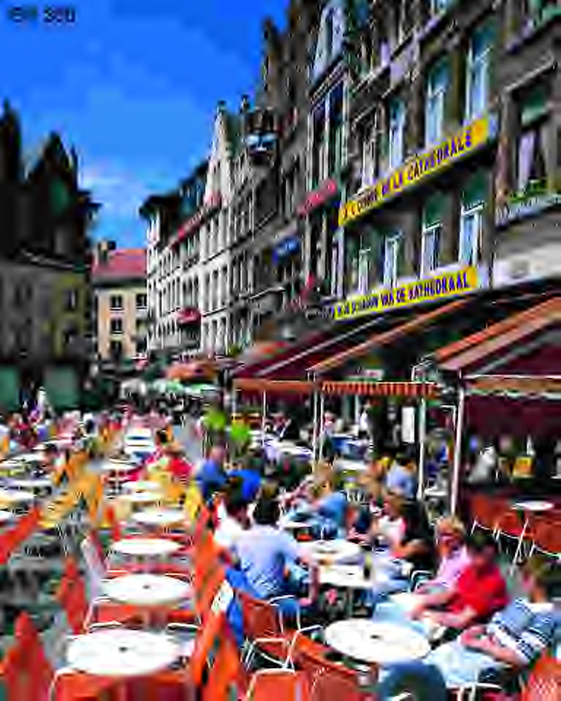
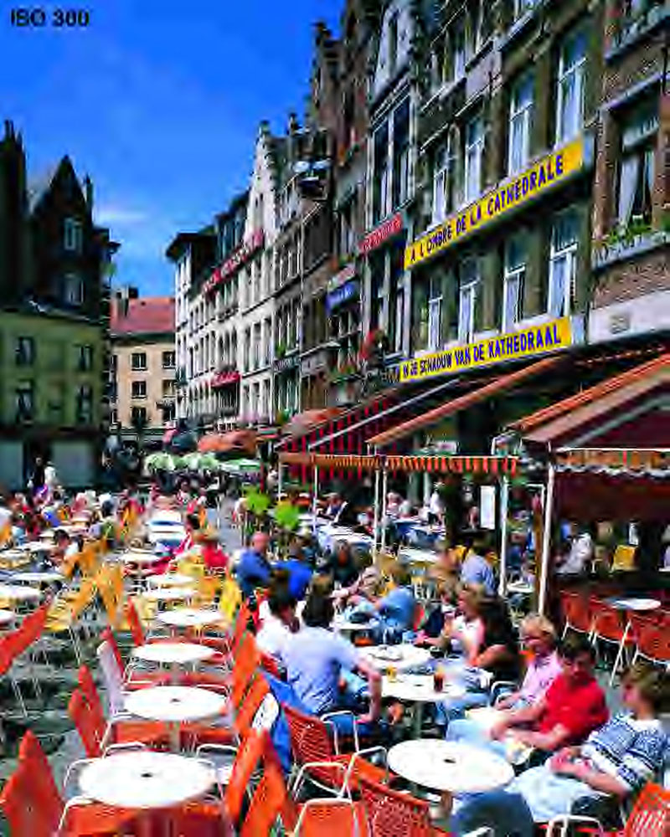
JPEG2000 CORE CODING SYSTEM
ORIGINAL IMAGE
MULTI-COMPONENT
TRANSFORM
WAVELET
TRANSFORM
QUANTIZATION
TIER-1
CODING
TIER-2
CODING
JP2 CODESTREAM
màxima
qualitat
màxima
qualitat
màxima
qualitat

Slide 19
JPEG2000 CORE CODING SYSTEM
resolució 1
resolució 2
resolució 3
ORIGINAL IMAGE
MULTI-COMPONENT
TRANSFORM
WAVELET
TRANSFORM
QUANTIZATION
TIER-1
CODING
TIER-2
CODING
JP2 CODESTREAM

Slide 20
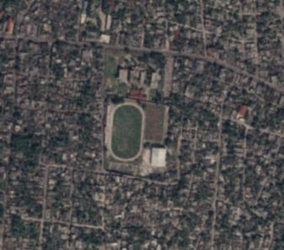
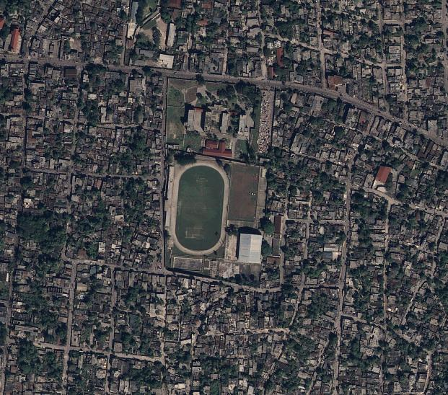
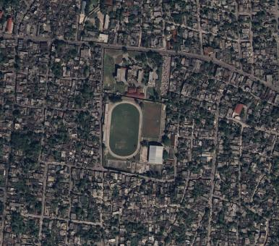
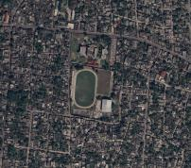
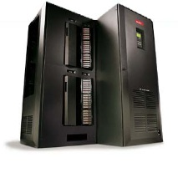
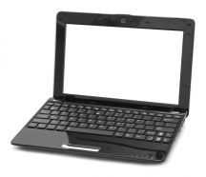
JPEG2000 CORE CODING SYSTEM
JPEG2000

Slide 21
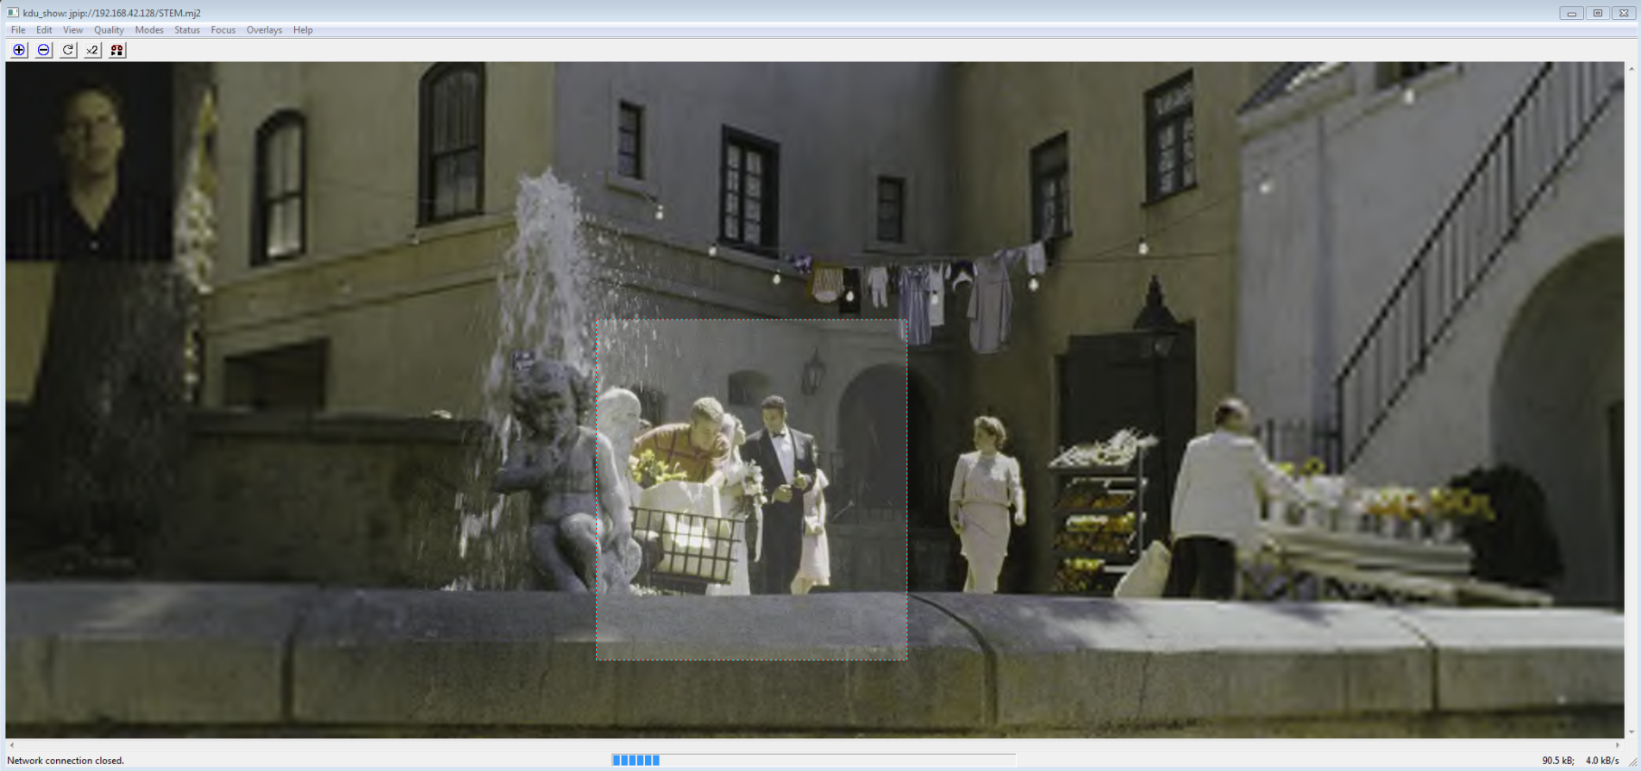
JPEG2000 CORE CODING SYSTEM

Slide 22
JPEG2000 CORE CODING SYSTEM

Slide 23
JPEG2000 CORE CODING SYSTEM

Slide 24
JPEG2000 CORE CODING SYSTEM

Slide 25
JPEG2000 CORE CODING SYSTEM
Significance propagation pass
Magnitude refinement pass
Cleanup pass
non significant coefficient
significant coefficient
coefficients to scan
Scanned coefficient
9 different contexts to code significance status (depending on the neighbors)‏
5 different contexts to code the sign (depending on the neighbors)‏

Slide 26
JPEG2000 CORE CODING SYSTEM
Significance propagation pass
Magnitude refinement pass
Cleanup pass
non significant coefficient
significant coefficient
(previous bit planes)‏
1
0
1
0
1
1
refinement in this bit plane: 0/1
3 different contexts to code refinement

Slide 27
JPEG2000 CORE CODING SYSTEM
Significance propagation pass
Magnitude refinement pass
Cleanup pass
non visited coefficients
visited coefficients
same coding contexts as the significance propagation pass
+ run mode (2 special contexts)

