Slide 1
Scanning order strategies for
bitplane image coding engines
Francesc Aulí-Llinàs
Department of Information and Communications Engineering
Universitat Autònoma de Barcelona, Spain

Slide 2
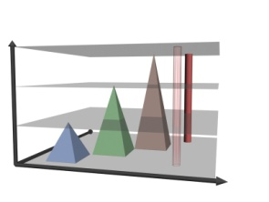
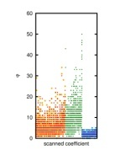
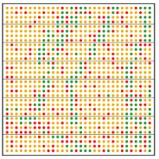
TABLE OF CONTENTS
INTRODUCTION
ADAPTIVE SCANNING ORDER
EXPERIMENTS
CONCLUSIONS
MOTIVATION:
-to assess the optimality of modern bitplane image coders
-design an optimal scanning order (not practical)
PROPOSED METHOD:
-adaptive scanning order
-analysis based on the local average

Slide 3
TABLE OF CONTENTS
INTRODUCTION
ADAPTIVE SCANNING ORDER
EXPERIMENTS
CONCLUSIONS
MOTIVATION:
-to assess the optimality of modern bitplane image coders
-design an optimal scanning order (not practical)
PROPOSED METHOD:
-adaptive scanning order
-analysis based on the local average

Slide 4
INTRODUCTION
REVIEW OF BITPLANE IMAGE CODING

Slide 5
INTRODUCTION
REVIEW OF BITPLANE IMAGE CODING

Slide 6
INTRODUCTION
REVIEW OF BITPLANE IMAGE CODING
COMPLEXITY
CODING PERFORMANCE

Slide 7
INTRODUCTION
REVIEW OF BITPLANE IMAGE CODING

Slide 8
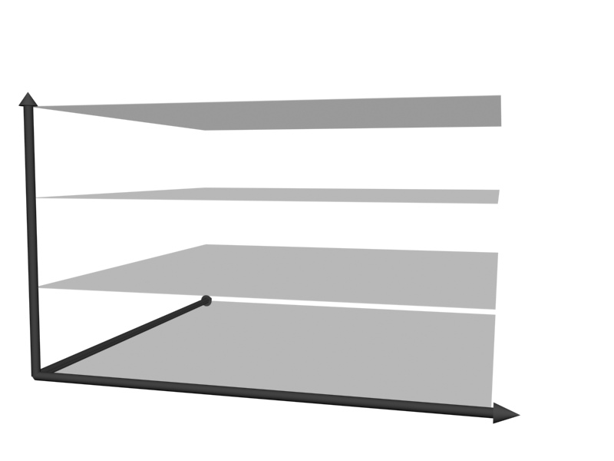
INTRODUCTION
REVIEW OF BITPLANE IMAGE CODING
SCALABILITY
COMPLEXITY
CODING PERFORMANCE

Slide 9
INTRODUCTION
REVIEW OF BITPLANE IMAGE CODING

Slide 10
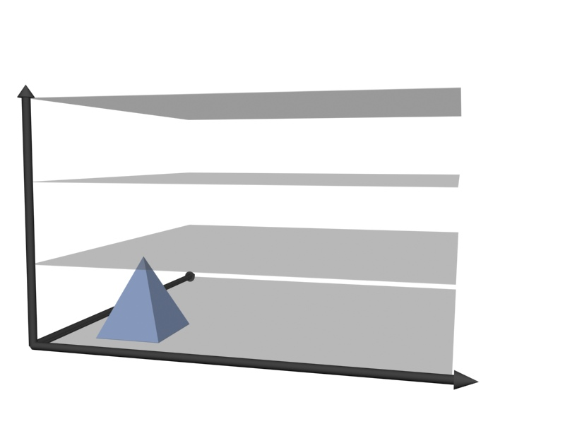
INTRODUCTION
REVIEW OF BITPLANE IMAGE CODING
SCALABILITY
COMPLEXITY
QUALITY
EZW, SPIHT,...
CODING PERFORMANCE

Slide 11
INTRODUCTION
REVIEW OF BITPLANE IMAGE CODING
EZW, SPIHT,...

Slide 12
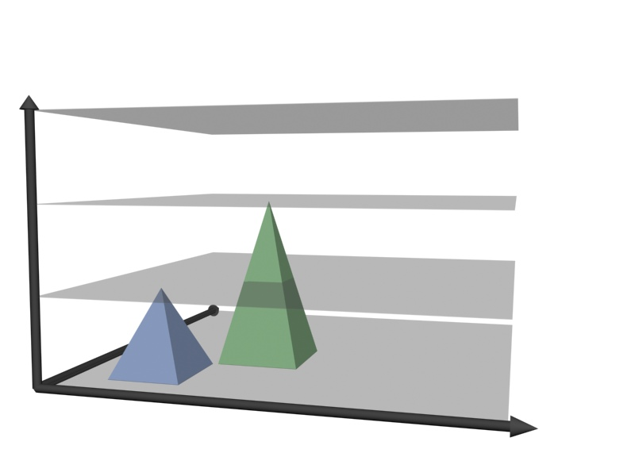
INTRODUCTION
REVIEW OF BITPLANE IMAGE CODING
RESOLUTION
SCALABILITY
QUALITY
CREW, EPWIC,
RDE,...
COMPLEXITY
EZW, SPIHT,...
CODING PERFORMANCE

Slide 13
INTRODUCTION
REVIEW OF BITPLANE IMAGE CODING
CREW, EPWIC,
RDE,...
EZW, SPIHT,...

Slide 14
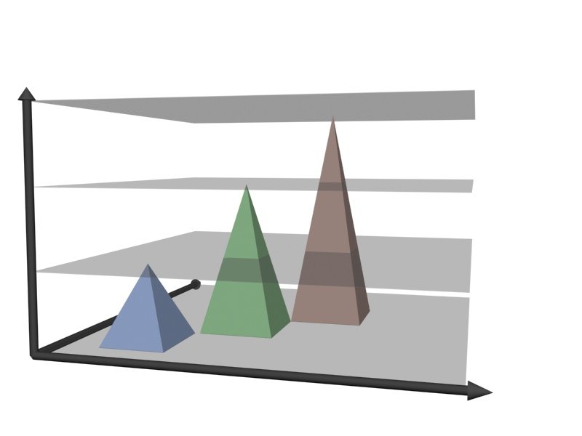
INTRODUCTION
REVIEW OF BITPLANE IMAGE CODING
SPATIAL
LOCATION
RESOLUTION
EBCOT, SBHP,
...
SCALABILITY
QUALITY
CREW, EPWIC,
RDE,...
COMPLEXITY
EZW, SPIHT,...
CODING PERFORMANCE

Slide 15
INTRODUCTION
REVIEW OF BITPLANE IMAGE CODING
EBCOT, SBHP,
...
CREW, EPWIC,
RDE,...
EZW, SPIHT,...

Slide 16
INTRODUCTION
REVIEW OF BITPLANE IMAGE CODING
SPATIAL
LOCATION
PROPOSED
RESOLUTION
EBCOT, SBHP,
...
SCALABILITY
QUALITY
CREW, EPWIC,
RDE,...
COMPLEXITY
EZW, SPIHT,...
CODING PERFORMANCE

Slide 17
INTRODUCTION
REVIEW OF BITPLANE IMAGE CODING
PROPOSED
EBCOT, SBHP,
...
CREW, EPWIC,
RDE,...
EZW, SPIHT,...

Slide 18
INTRODUCTION
REVIEW OF BITPLANE IMAGE CODING
FUTURE WORK
SPATIAL
LOCATION
PROPOSED
RESOLUTION
EBCOT, SBHP,
...
SCALABILITY
QUALITY
CREW, EPWIC,
RDE,...
COMPLEXITY
EZW, SPIHT,...
CODING PERFORMANCE

Slide 19
TABLE OF CONTENTS
INTRODUCTION
ADAPTIVE SCANNING ORDER
EXPERIMENTS
CONCLUSIONS
MOTIVATION:
-to assess the optimality of modern bitplane image coders
-design an optimal scanning order (not practical)
PROPOSED METHOD:
-adaptive scanning order
-analysis based on the local average

Slide 20
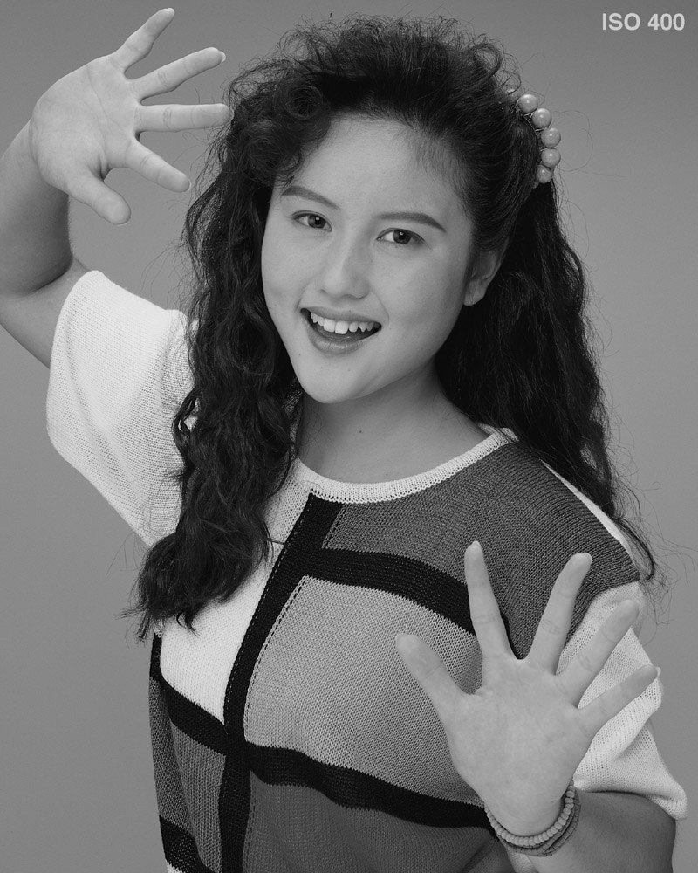
ADAPTIVE SCANNING ORDER
BITPLANE IMAGE CODING

Slide 21
ADAPTIVE SCANNING ORDER
BITPLANE IMAGE CODING

Slide 22
ADAPTIVE SCANNING ORDER
BITPLANE IMAGE CODING

Slide 23
ADAPTIVE SCANNING ORDER
BITPLANE IMAGE CODING

Slide 24
ADAPTIVE SCANNING ORDER
BITPLANE IMAGE CODING

Slide 25
ADAPTIVE SCANNING ORDER
BITPLANE IMAGE CODING

Slide 26
ADAPTIVE SCANNING ORDER
CLASSIC SCANNING ORDERS

Slide 27
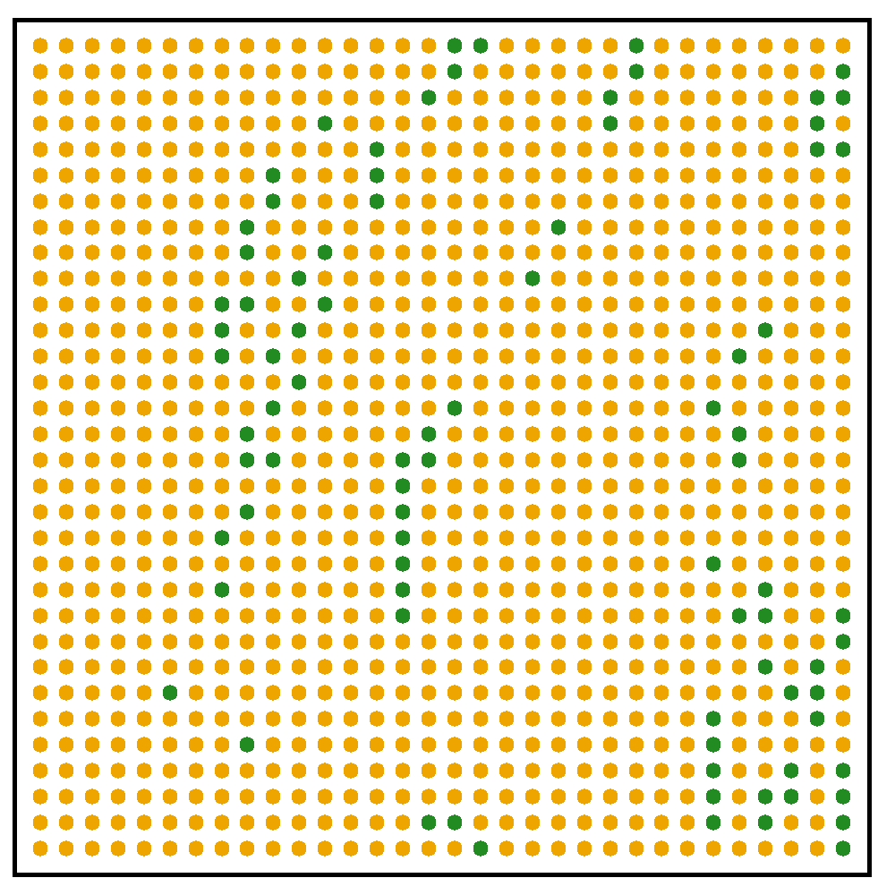
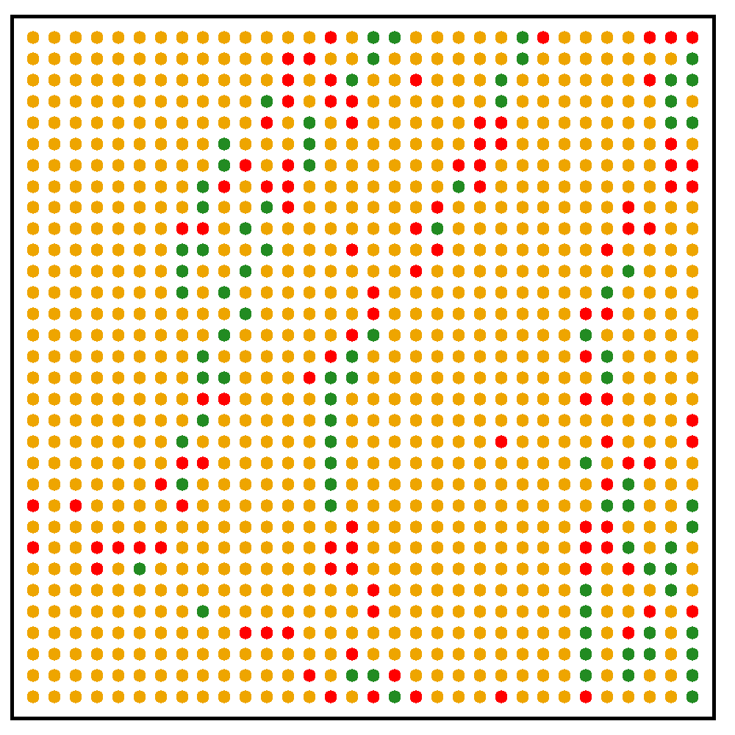
ADAPTIVE SCANNING ORDER
CLASSIC SCANNING ORDERS

Slide 28
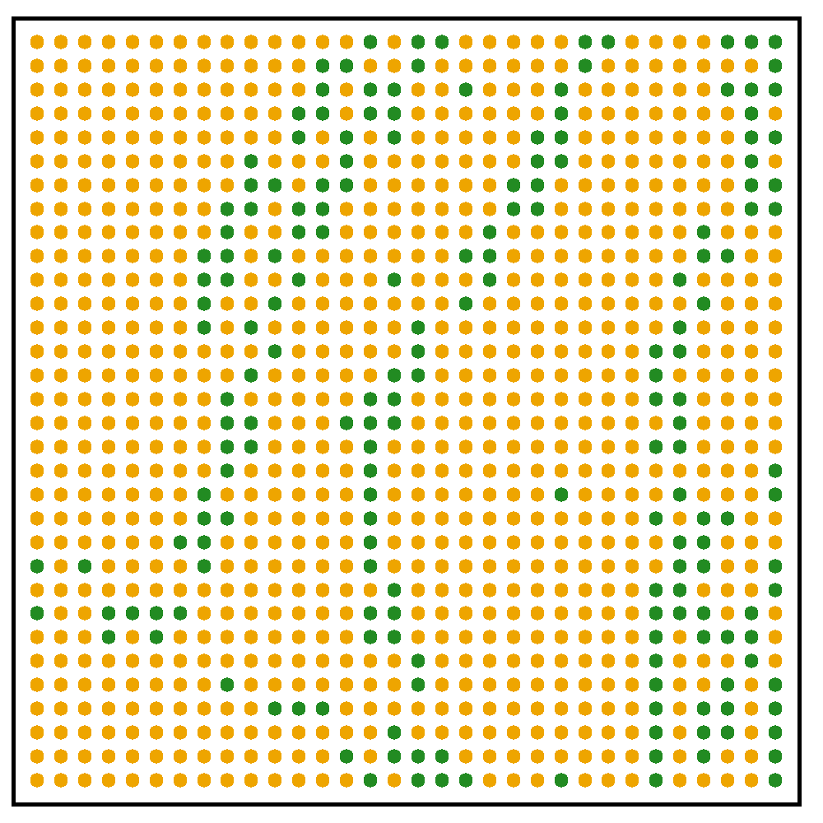
ADAPTIVE SCANNING ORDER
CLASSIC SCANNING ORDERS

Slide 29
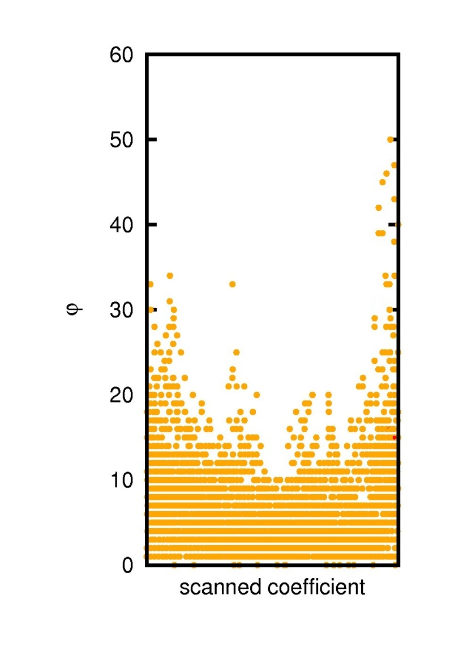
ADAPTIVE SCANNING ORDER
CLASSIC SCANNING ORDERS
SINGLE-PASS STRATEGY
arithmetic mean
of the neighbors’
magnitude
scanned coefficient

Slide 30
ADAPTIVE SCANNING ORDER
CLASSIC SCANNING ORDERS
SINGLE-PASS STRATEGY

Slide 31
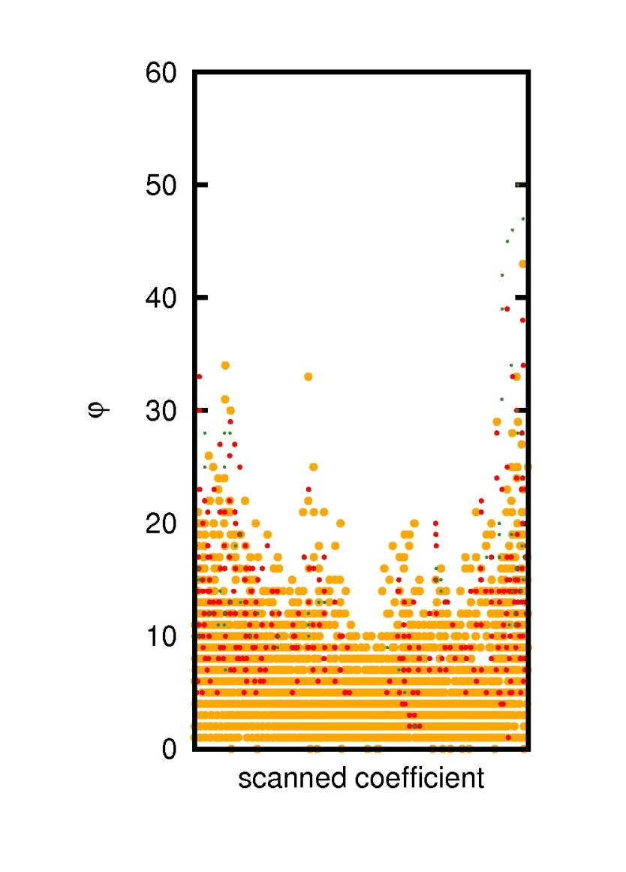
ADAPTIVE SCANNING ORDER
CLASSIC SCANNING ORDERS
SINGLE-PASS STRATEGY

Slide 32
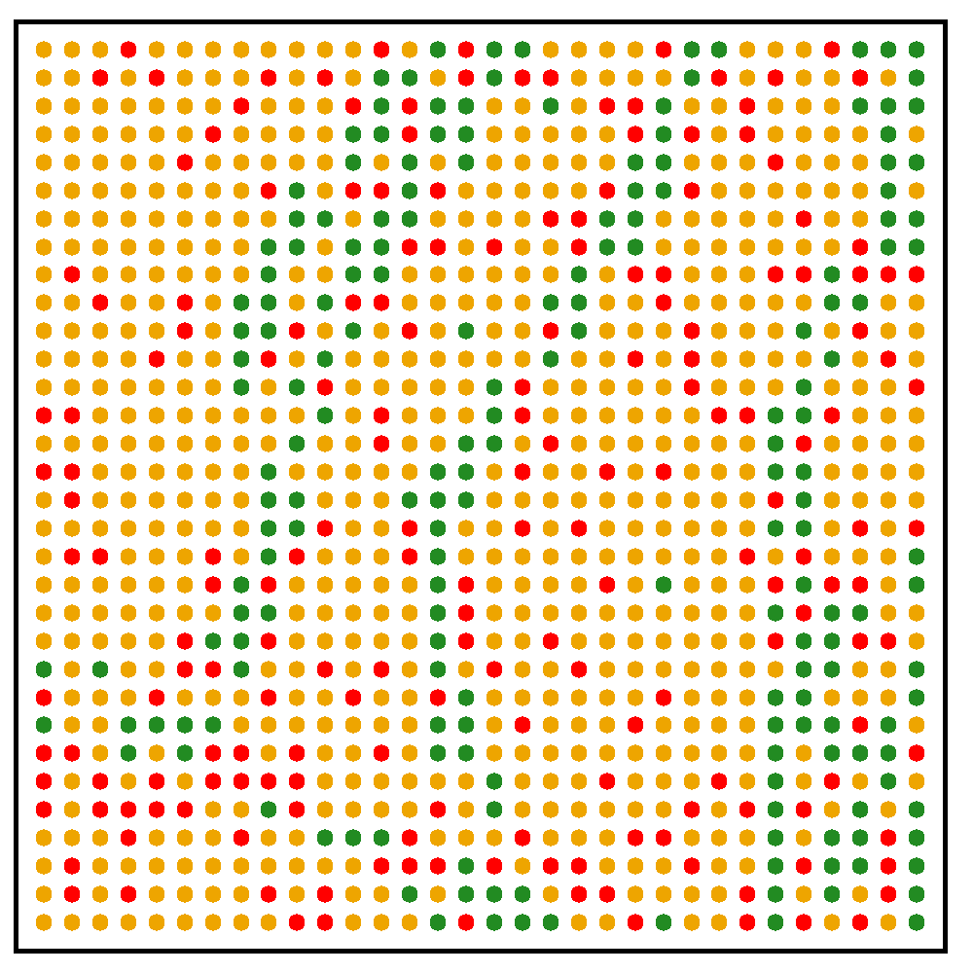
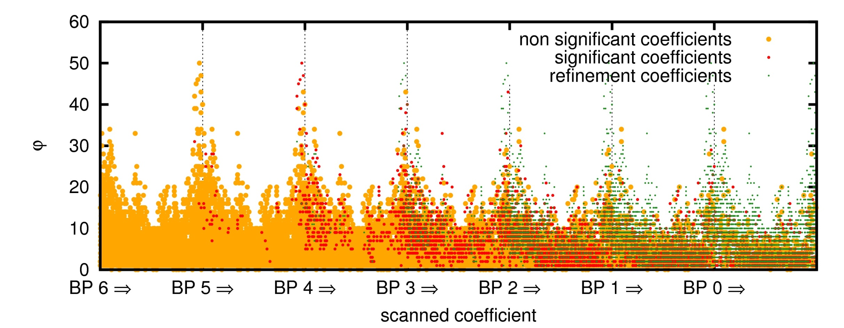
ADAPTIVE SCANNING ORDER
CLASSIC SCANNING ORDERS
SINGLE-PASS STRATEGY

Slide 33
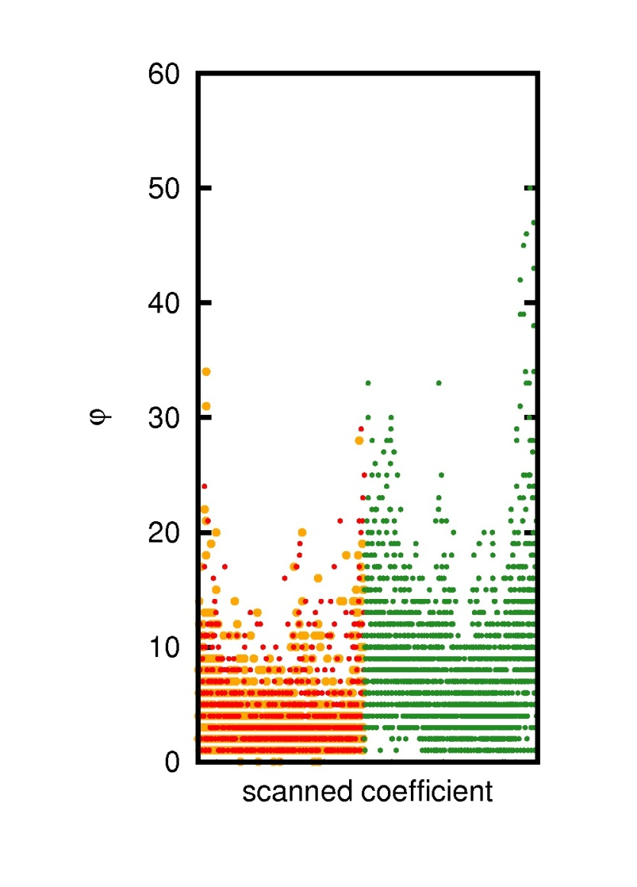
ADAPTIVE SCANNING ORDER
CLASSIC SCANNING ORDERS
TWO-PASS STRATEGY

Slide 34
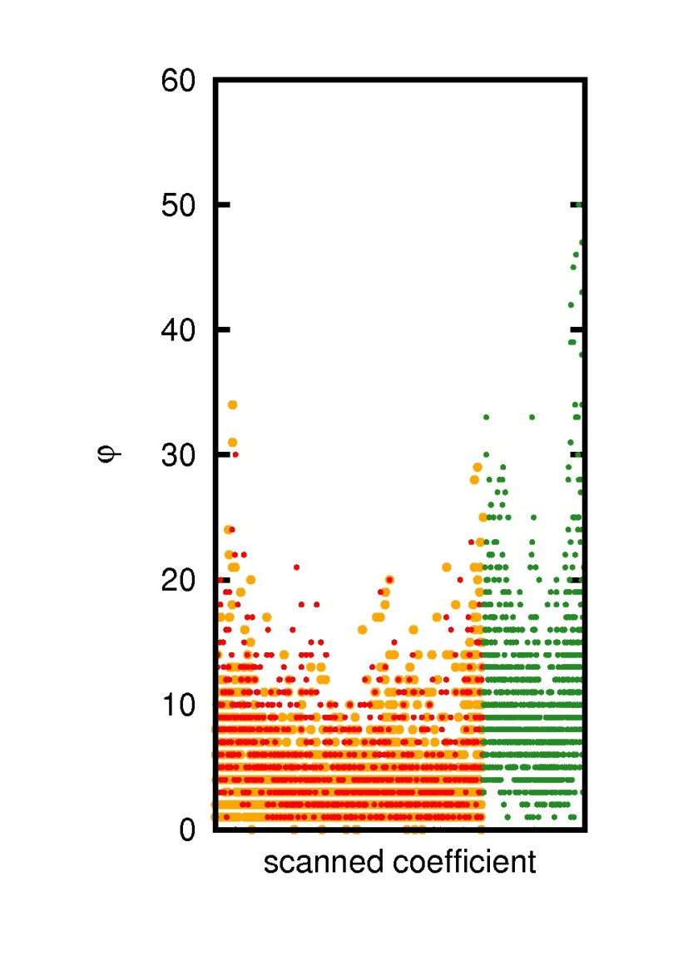
ADAPTIVE SCANNING ORDER
CLASSIC SCANNING ORDERS
TWO-PASS STRATEGY

Slide 35
ADAPTIVE SCANNING ORDER
CLASSIC SCANNING ORDERS
TWO-PASS STRATEGY

Slide 36
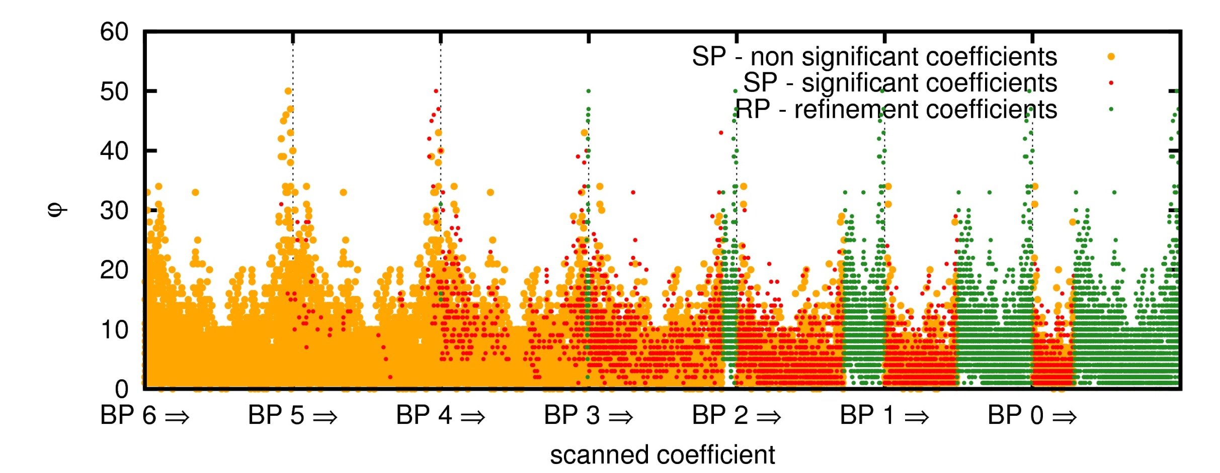
ADAPTIVE SCANNING ORDER
CLASSIC SCANNING ORDERS
TWO-PASS STRATEGY

Slide 37
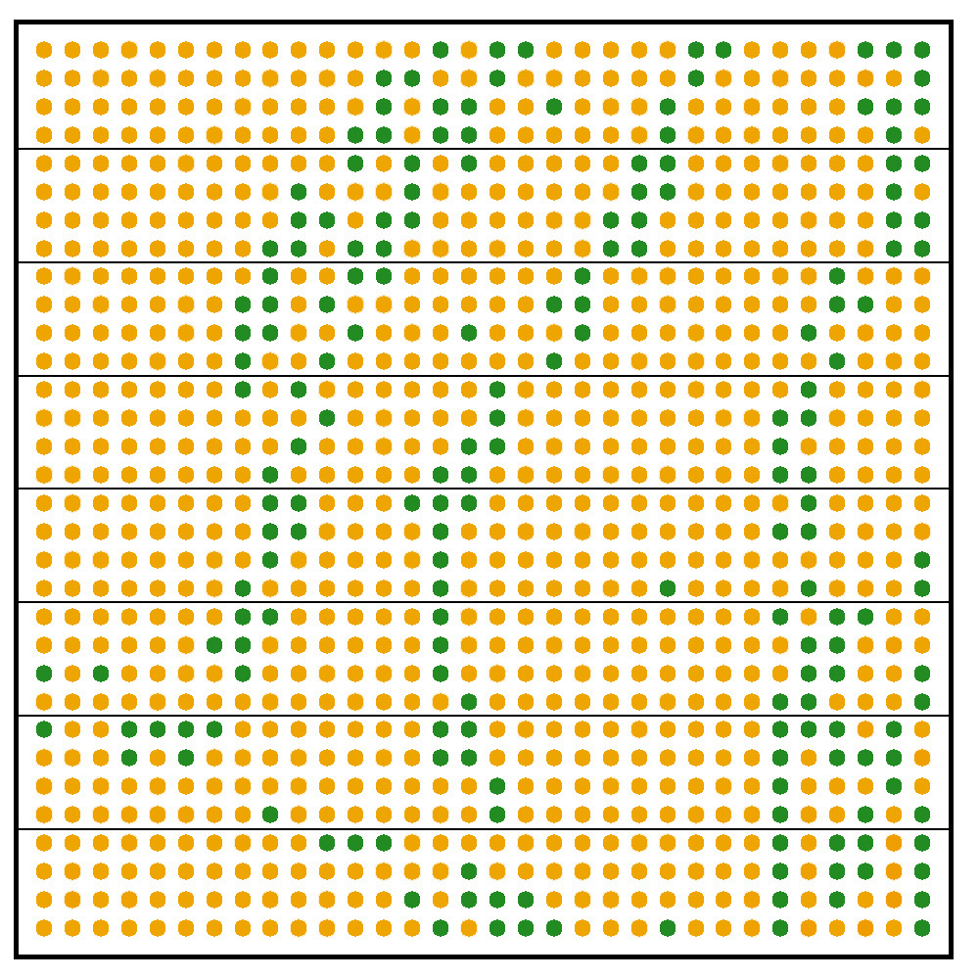
ADAPTIVE SCANNING ORDER
CLASSIC SCANNING ORDERS
3-PASS JPEG2000 STRATEGY

Slide 38
ADAPTIVE SCANNING ORDER
CLASSIC SCANNING ORDERS
3-PASS JPEG2000 STRATEGY

Slide 39
ADAPTIVE SCANNING ORDER
CLASSIC SCANNING ORDERS
3-PASS JPEG2000 STRATEGY

Slide 40
ADAPTIVE SCANNING ORDER
CLASSIC SCANNING ORDERS
3-PASS JPEG2000 STRATEGY

Slide 41
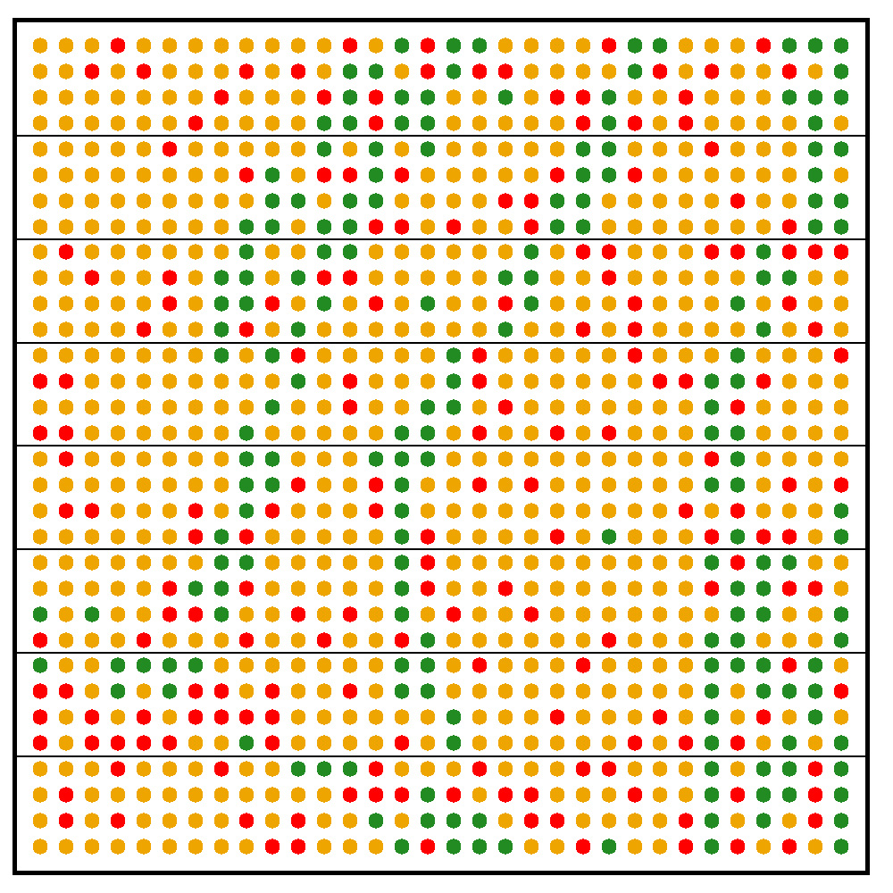
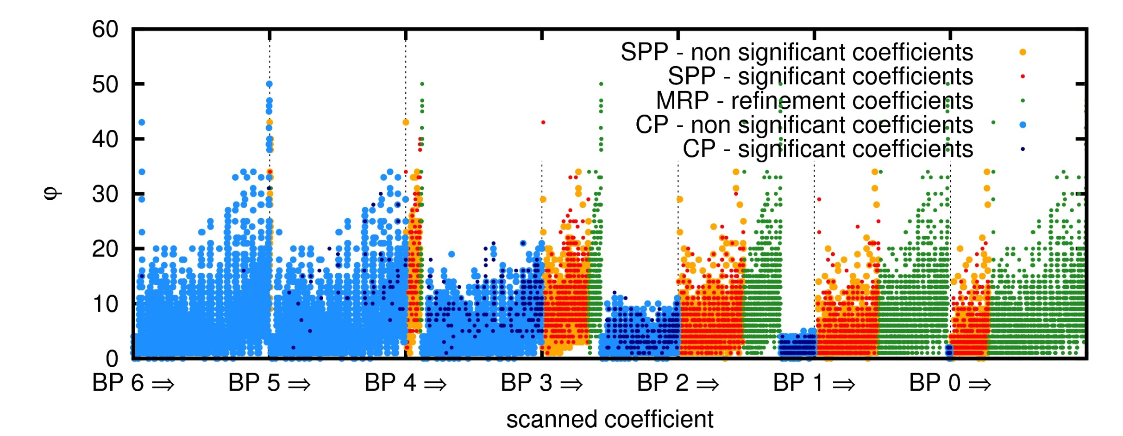
ADAPTIVE SCANNING ORDER
CLASSIC SCANNING ORDERS
3-PASS JPEG2000 STRATEGY

Slide 42
ADAPTIVE SCANNING ORDER
PROPOSED
ADAPTIVE SCANNING ORDER

Slide 43
ADAPTIVE SCANNING ORDER
PROPOSED
ADAPTIVE SCANNING ORDER

Slide 44
ADAPTIVE SCANNING ORDER
PROPOSED
ADAPTIVE SCANNING ORDER

Slide 45
ADAPTIVE SCANNING ORDER
PROPOSED
ADAPTIVE SCANNING ORDER

Slide 46
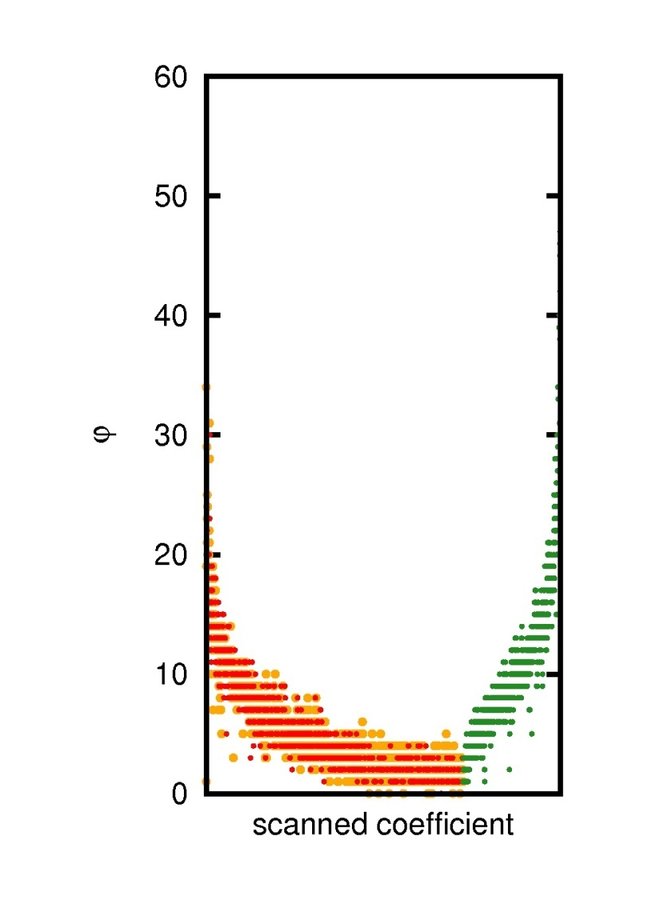
ADAPTIVE SCANNING ORDER
PROPOSED
ADAPTIVE SCANNING ORDER

Slide 47
ADAPTIVE SCANNING ORDER
PROPOSED
ADAPTIVE SCANNING ORDER

Slide 48
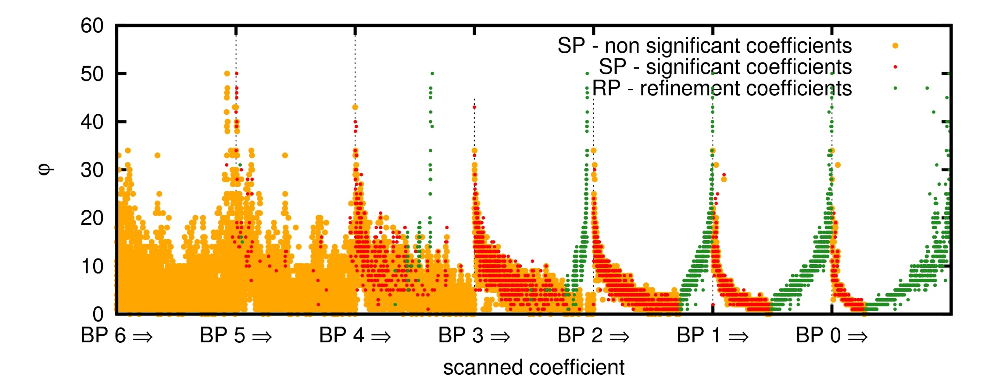
ADAPTIVE SCANNING ORDER
PROPOSED
ADAPTIVE SCANNING ORDER

Slide 49
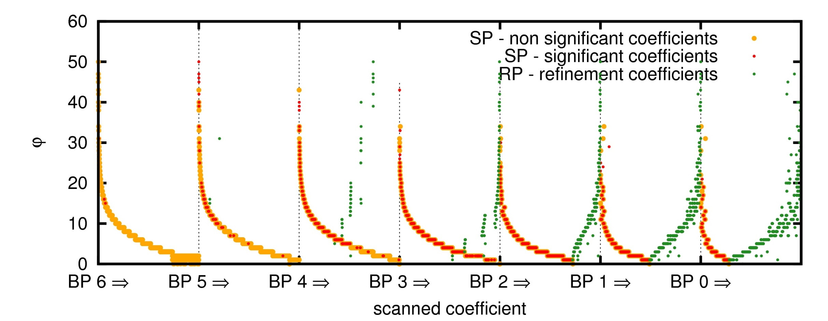
ADAPTIVE SCANNING ORDER
PROPOSED
ADAPTIVE SCANNING ORDER

Slide 50
TABLE OF CONTENTS
INTRODUCTION
ADAPTIVE SCANNING ORDER
EXPERIMENTS
CONCLUSIONS
MOTIVATION:
-to assess the optimality of modern bitplane image coders
-design an optimal scanning order (not practical)
PROPOSED METHOD:
-adaptive scanning order
-analysis based on the local average

Slide 51
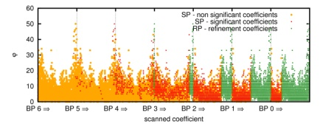
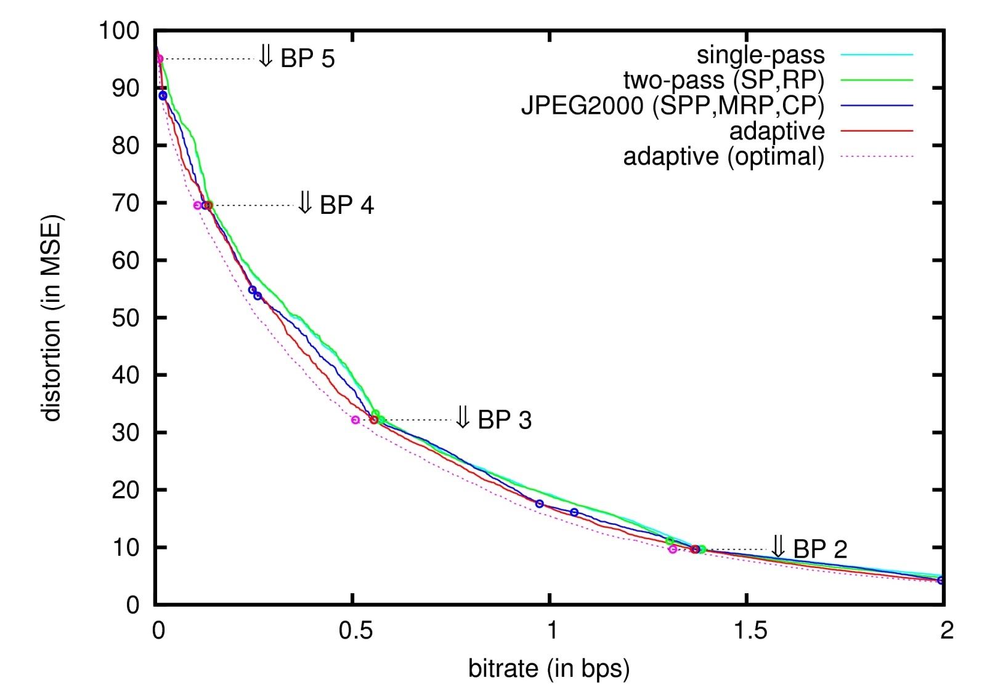
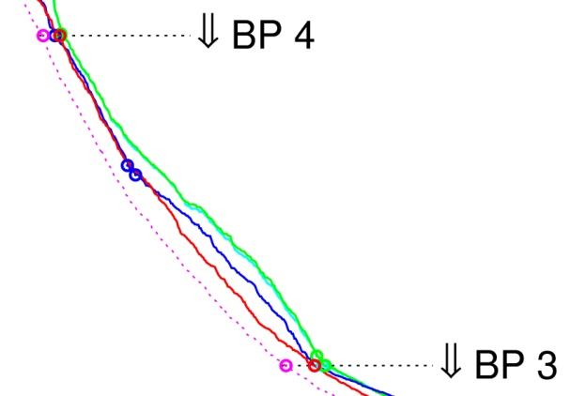
EXPERIMENTS
“Portrait” image
9/7 wav. transf.
HL₂ subband
64x64 codeblock
CODING PERFORMANCE
ADAPTIVE
(OPTIMAL)
ADAPTIVE
JPEG2000
TWO-PASS
SINGLE-PASS

Slide 52
EXPERIMENTS
“Portrait” image
9/7 wav. transf.
HL₂ subband
64x64 codeblock
CODING PERFORMANCE
ADAPTIVE
(OPTIMAL)
ADAPTIVE
JPEG2000
TWO-PASS
SINGLE-PASS

Slide 53
EXPERIMENTS
“Portrait” image
9/7 wav. transf.
HL₂ subband
64x64 codeblock
CODING PERFORMANCE
ADAPTIVE
(OPTIMAL)
ADAPTIVE
JPEG2000
TWO-PASS
SINGLE-PASS
0.6 dB

Slide 54
TABLE OF CONTENTS
INTRODUCTION
ADAPTIVE SCANNING ORDER
EXPERIMENTS
CONCLUSIONS
MOTIVATION:
-to assess the optimality of modern bitplane image coders
-design an optimal scanning order (not practical)
PROPOSED METHOD:
-adaptive scanning order
-analysis based on the local average

Slide 55
CONCLUSIONS
MOTIVATION:
-to assess the optimality of modern bitplane image coders
-design an optimal scanning order (not practical)
PROPOSED METHOD:
-adaptive scanning order
-analysis based on the local average
RESULTS:
-optimal coding performance
-end of coding passes are
optimal in terms of RD

Slide 56
CONCLUSIONS
MOTIVATION:
-to assess the optimality of modern bitplane image coders
-design an optimal scanning order (not practical)
PROPOSED METHOD:
-adaptive scanning order
-analysis based on the local average
RESULTS:
-optimal coding performance
-end of coding passes are
optimal in terms of RD

Slide 57
