Slide 1
Probability model for multi-component images through Prior-component Lookup Tables
Francesc Aulí-Llinàs
Department of Information and Communications Engineering
Universitat Autònoma de Barcelona, Spain

Slide 2
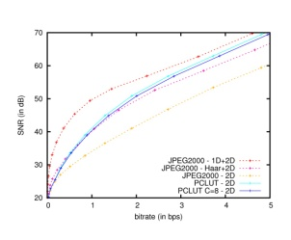
TABLE OF CONTENTS
INTRODUCTION
PCLUT METHOD
EXPERIMENTAL RESULTS
CONCLUSIONS
PCLUT ADVANTAGES
Memory requirements: only 2 components in memory
Computational costs: reduction in 1/3 (mainly due to the probability model)
Coding performance: equivalent to 1 level of Haar transform along the depth axis
Component scalability: equivalent to 1 level of Haar transform along the depth axis

Slide 3
TABLE OF CONTENTS
INTRODUCTION
PCLUT METHOD
EXPERIMENTAL RESULTS
CONCLUSIONS
PCLUT ADVANTAGES
Memory requirements: only 2 components in memory
Computational costs: reduction in 1/3 (mainly due to the probability model)
Coding performance: equivalent to 1 level of Haar transform along the depth axis
Component scalability: equivalent to 1 level of Haar transform along the depth axis

Slide 4
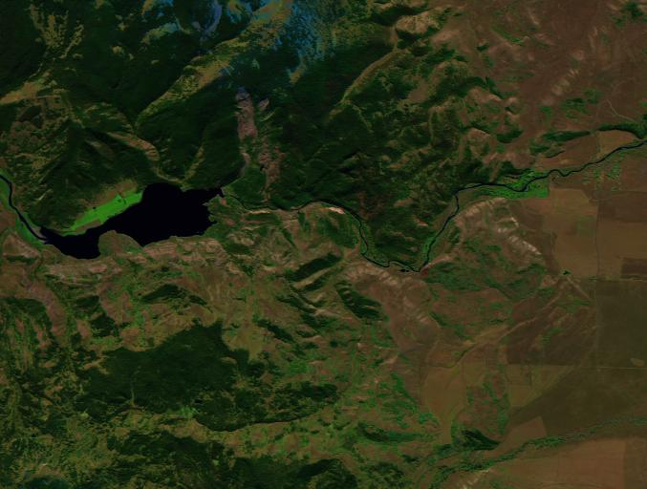
INTRODUCTION
HYPERSPECTRAL IMAGES

Slide 5
INTRODUCTION
TYPICAL CODING SCHEME

Slide 6
INTRODUCTION
TYPICAL CODING SCHEME

Slide 7
INTRODUCTION
TYPICAL CODING SCHEME

Slide 8
INTRODUCTION
TYPICAL CODING SCHEME

Slide 9
INTRODUCTION
TYPICAL CODING SCHEME

Slide 10
INTRODUCTION
TYPICAL CODING SCHEME
ARITHMETIC
CODER
CODESTREAM

Slide 11
INTRODUCTION
TYPICAL CODING SCHEME
DISADVANTAGES
High memory requirements
High computational costs
Poor component scalability
RESEARCH PURPOSE
Lossy coding scheme for hyper-spectral images
with low memory requirements, low computational
costs, and high component scalability
ARITHMETIC
CODER
CODESTREAM

Slide 12
TABLE OF CONTENTS
INTRODUCTION
PCLUT METHOD
EXPERIMENTAL RESULTS
CONCLUSIONS
PCLUT ADVANTAGES
Memory requirements: only 2 components in memory
Computational costs: reduction in 1/3 (mainly due to the probability model)
Coding performance: equivalent to 1 level of Haar transform along the depth axis
Component scalability: equivalent to 1 level of Haar transform along the depth axis

Slide 13
PCLUT METHOD
MAIN INSIGHTS
1) Wavelet transform only on the
spatial dimensions
reduces computational costs
reduces memory requirements
increases component scalability
reduces coding performance

Slide 14
PCLUT METHOD
MAIN INSIGHTS
1) Wavelet transform only on the
spatial dimensions
reduces computational costs
reduces memory requirements
increases component scalability
reduces coding performance

Slide 15
PCLUT METHOD
MAIN INSIGHTS
1) Wavelet transform only on the
spatial dimensions
reduces computational costs
reduces memory requirements
increases component scalability
reduces coding performance
2) Enhanced probability model
for emitted symbols
reduces computational costs
increases coding performance

Slide 16
PCLUT METHOD
PRIOR COEFFICIENT LOOKUP TABLES METHOD
LUT
ARITHMETIC
CODER
CODESTREAM

Slide 17
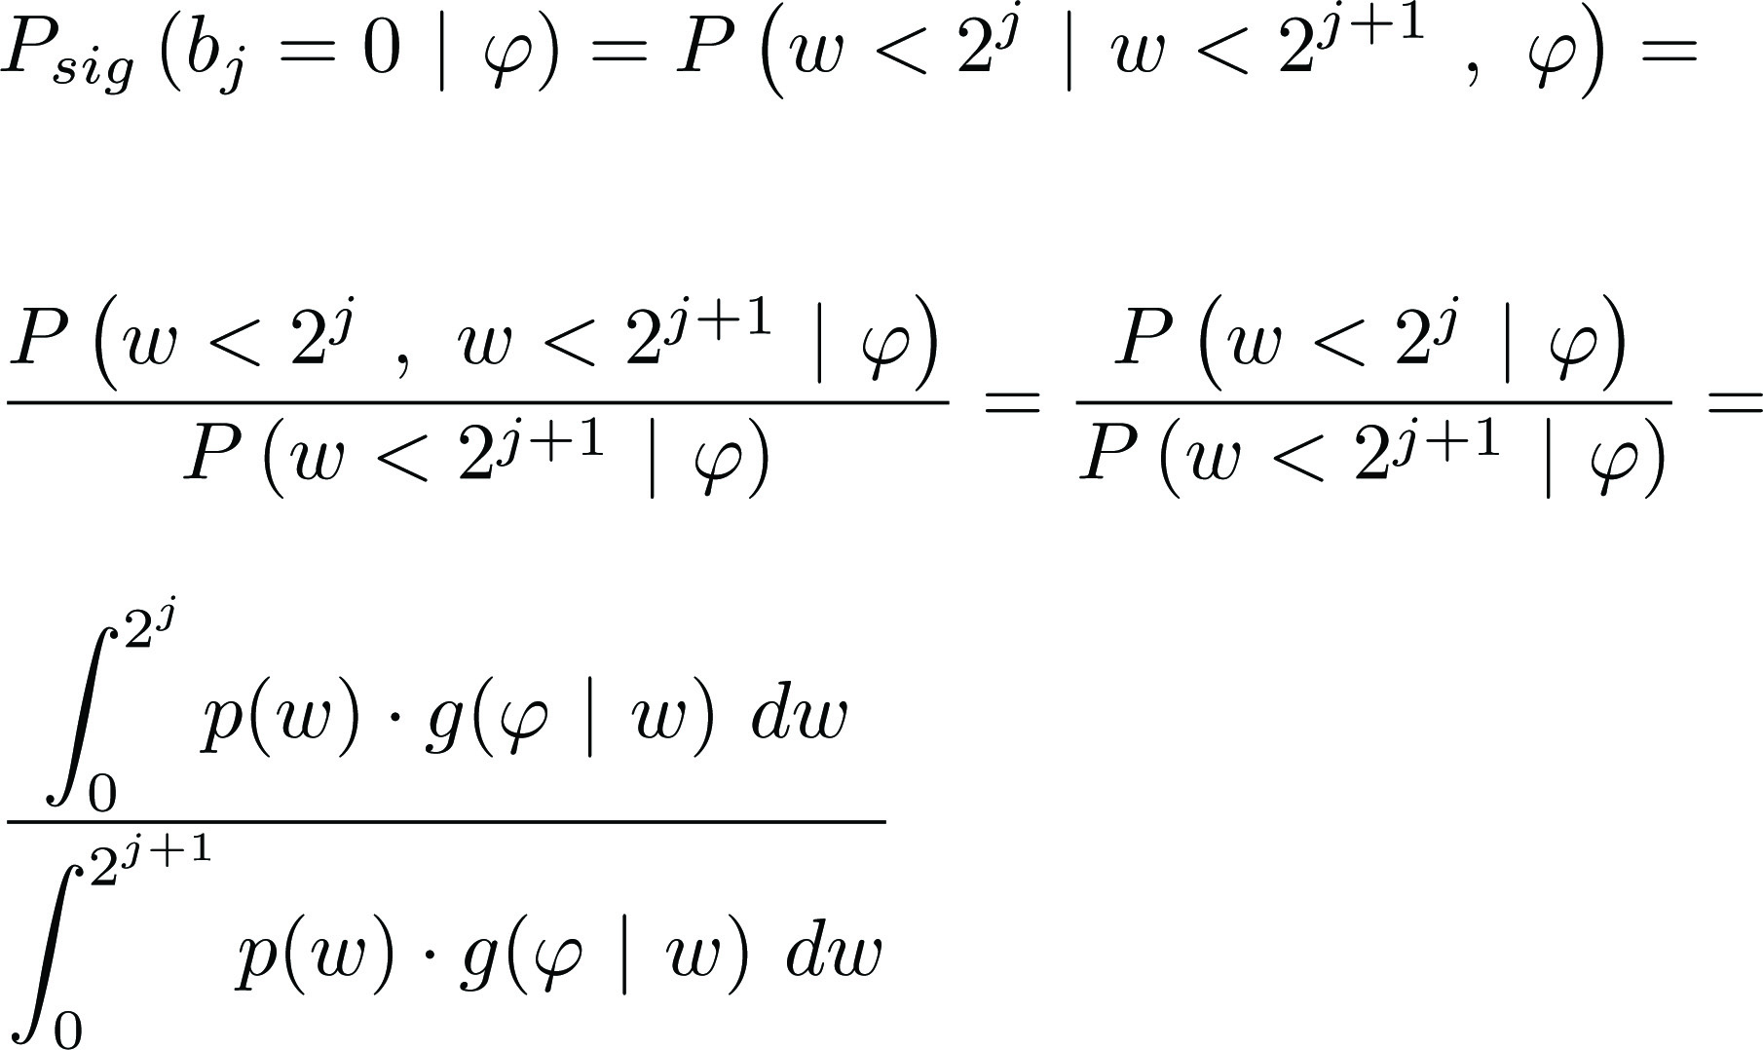
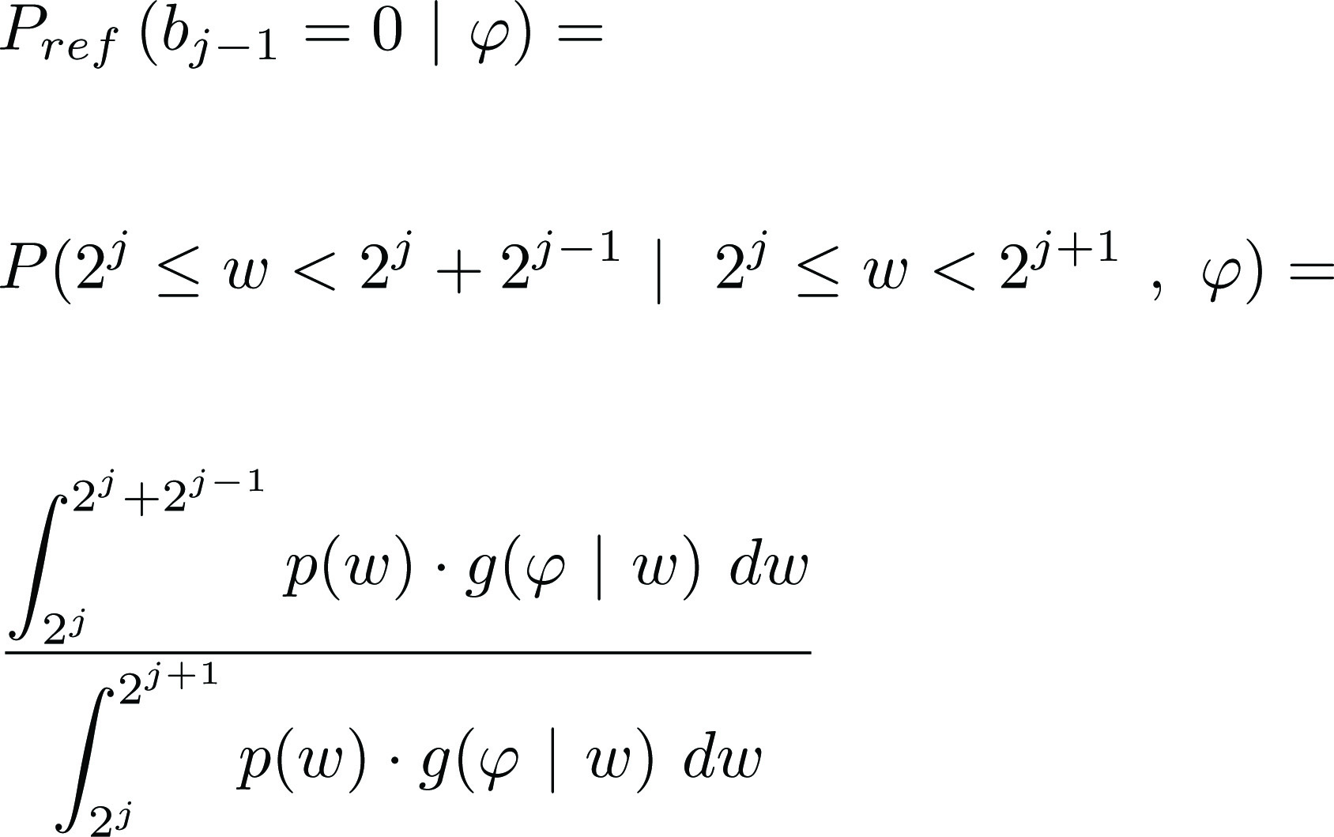
PCLUT METHOD
PRIOR COEFFICIENT LOOKUP TABLES METHOD
SIGNIFICANCE CODING
REFINEMENT CODING

Slide 18
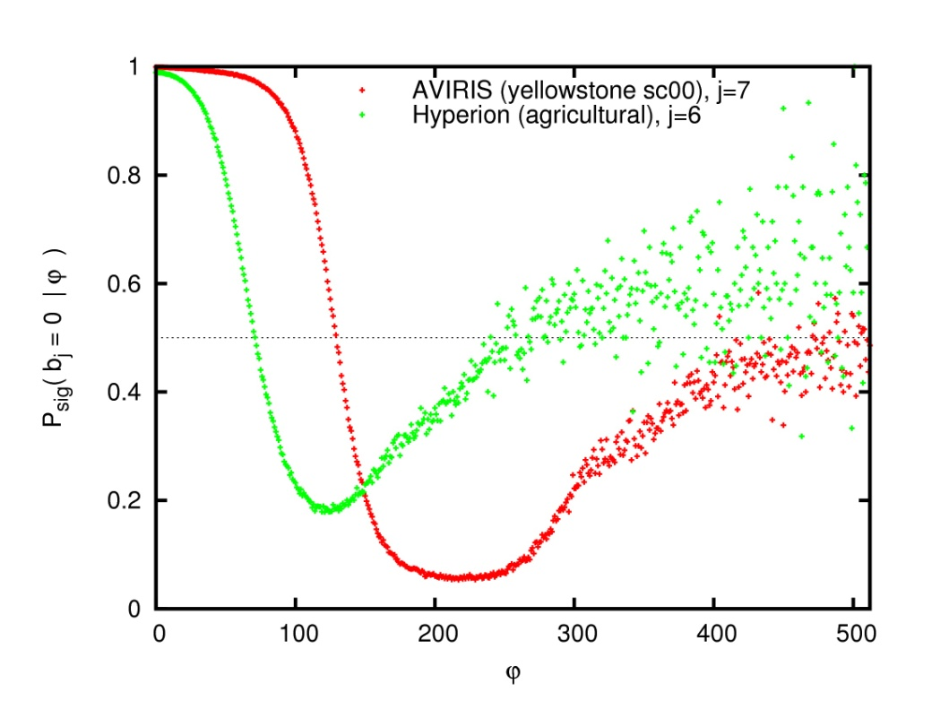
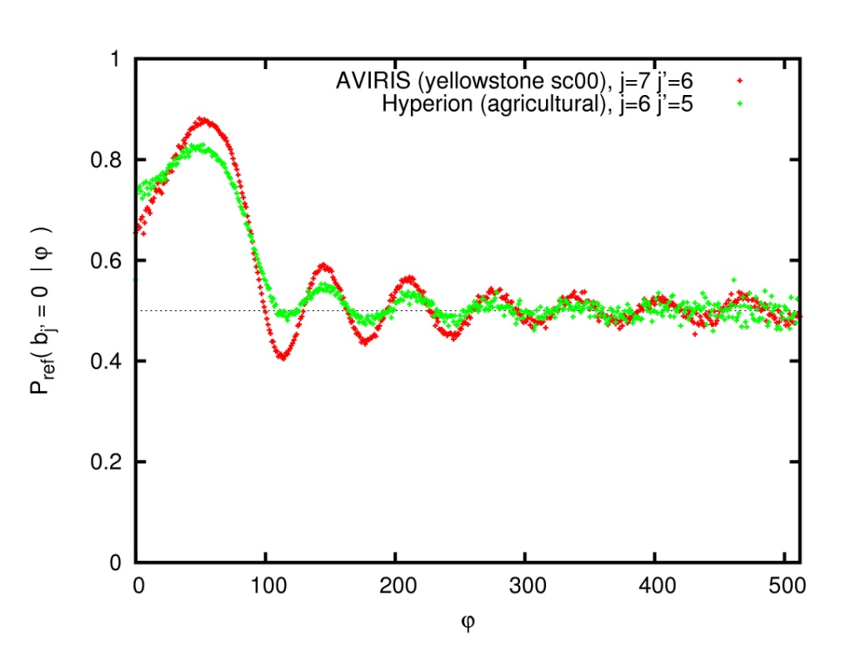
PCLUT METHOD
PRIOR COEFFICIENT LOOKUP TABLES METHOD
SIGNIFICANCE CODING
REFINEMENT CODING

Slide 19
TABLE OF CONTENTS
INTRODUCTION
PCLUT METHOD
EXPERIMENTAL RESULTS
CONCLUSIONS
PCLUT ADVANTAGES
Memory requirements: only 2 components in memory
Computational costs: reduction in 1/3 (mainly due to the probability model)
Coding performance: equivalent to 1 level of Haar transform along the depth axis
Component scalability: equivalent to 1 level of Haar transform along the depth axis

Slide 20
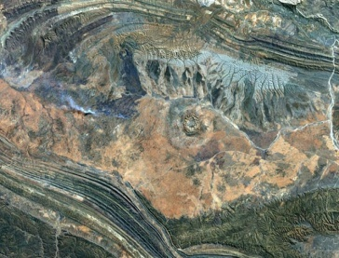
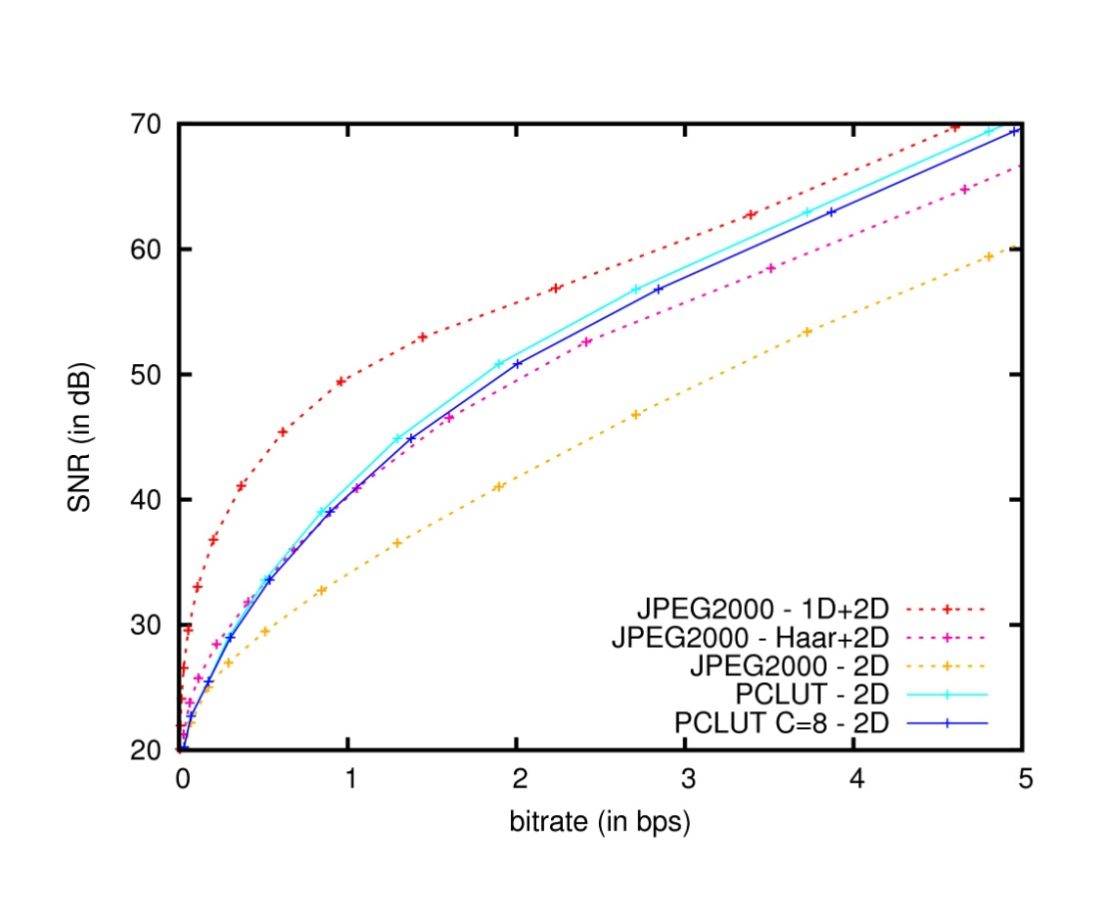
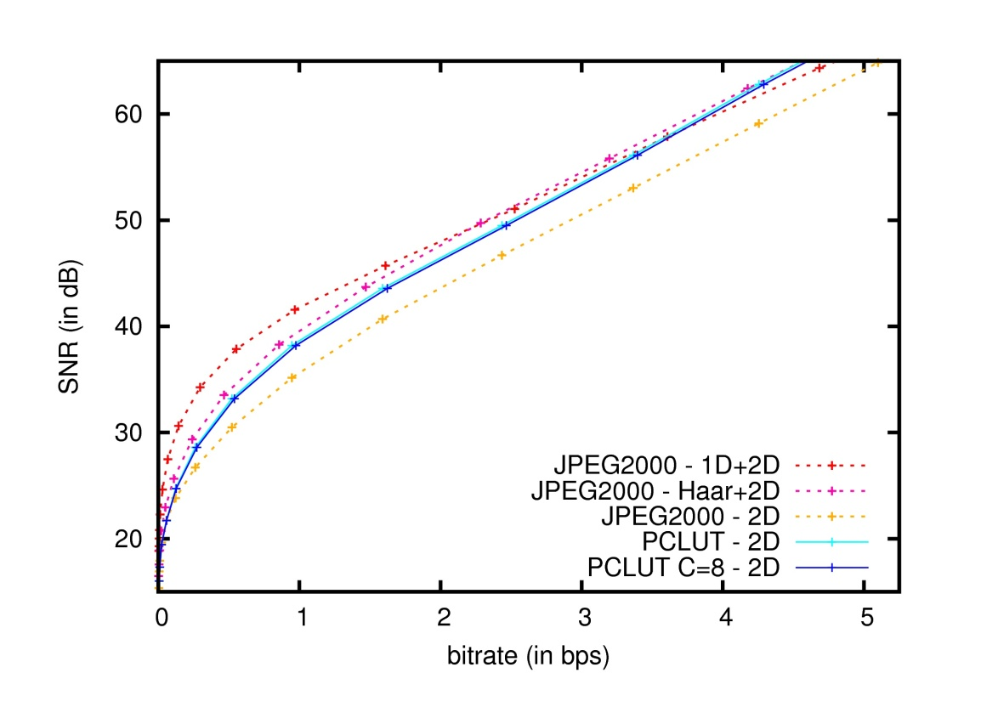
EXPERIMENTAL RESULTS
CODING PERFORMANCE
3 AVIRIS images
512x512x224 (16bps)
1 used to
generate LUTs
3 Hyperion images
768x256x242 (12bps)
1 used to
generate LUTs
AVIRIS – yellowstone sc01
Hyperion – flooding

Slide 21
EXPERIMENTAL RESULTS
COMPUTATIONAL COSTS
3 AVIRIS images
512x512x224 (16bps)
1 used to
generate LUTs
3 Hyperion images
768x256x242 (12bps)
1 used to
generate LUTs
THROUGHPUT (in seconds)
MEMORY REQUIREMENTS (in MB)

Slide 22
TABLE OF CONTENTS
INTRODUCTION
PCLUT METHOD
EXPERIMENTAL RESULTS
CONCLUSIONS
PCLUT ADVANTAGES
Memory requirements: only 2 components in memory
Computational costs: reduction in 1/3 (mainly due to the probability model)
Coding performance: equivalent to 1 level of Haar transform along the depth axis
Component scalability: equivalent to 1 level of Haar transform along the depth axis

Slide 23
CONCLUSIONS
TYPICAL CODING SCHEME
PRIOR COEFFICIENT LOOKUP TABLES
LUT
ARITHMETIC
CODER
ARITHMETIC
CODER
CODESTREAM
CODESTREAM
PCLUT ADVANTAGES
Memory requirements: only 2 components in memory
Computational costs: reduction in 1/3 (mainly due to the probability model)
Coding performance: equivalent to 1 level of Haar transform along the depth axis
Component scalability: equivalent to 1 level of Haar transform along the depth axis

Slide 24
CONCLUSIONS
TYPICAL CODING SCHEME
PRIOR COEFFICIENT LOOKUP TABLES
LUT
ARITHMETIC
CODER
ARITHMETIC
CODER
CODESTREAM
CODESTREAM
PCLUT ADVANTAGES
Memory requirements: only 2 components in memory
Computational costs: reduction in 1/3 (mainly due to the probability model)
Coding performance: equivalent to 1 level of Haar transform along the depth axis
Component scalability: equivalent to 1 level of Haar transform along the depth axis

