Slide 1
Local average-based model of
probabilities for bitplane image coding
Francesc Aulí-Llinàs
Department of Information and Communications Engineering
Universitat Autònoma de Barcelona, Spain

Slide 2
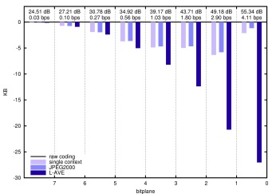
TABLE OF CONTENTS
INTRODUCTION
LOCAL AVERAGE-BASED
MODEL OF PROBABILITIES
EXPERIMENTS
CONCLUSIONS
FUTURE RESEARCH:
MATEMATICAL FRAMEWORK BEHIND THE MODEL
GENERALIZED ALGORITHM

Slide 3
TABLE OF CONTENTS
INTRODUCTION
LOCAL AVERAGE-BASED
MODEL OF PROBABILITIES
EXPERIMENTS
CONCLUSIONS
FUTURE RESEARCH:
MATEMATICAL FRAMEWORK BEHIND THE MODEL
GENERALIZED ALGORITHM

Slide 4
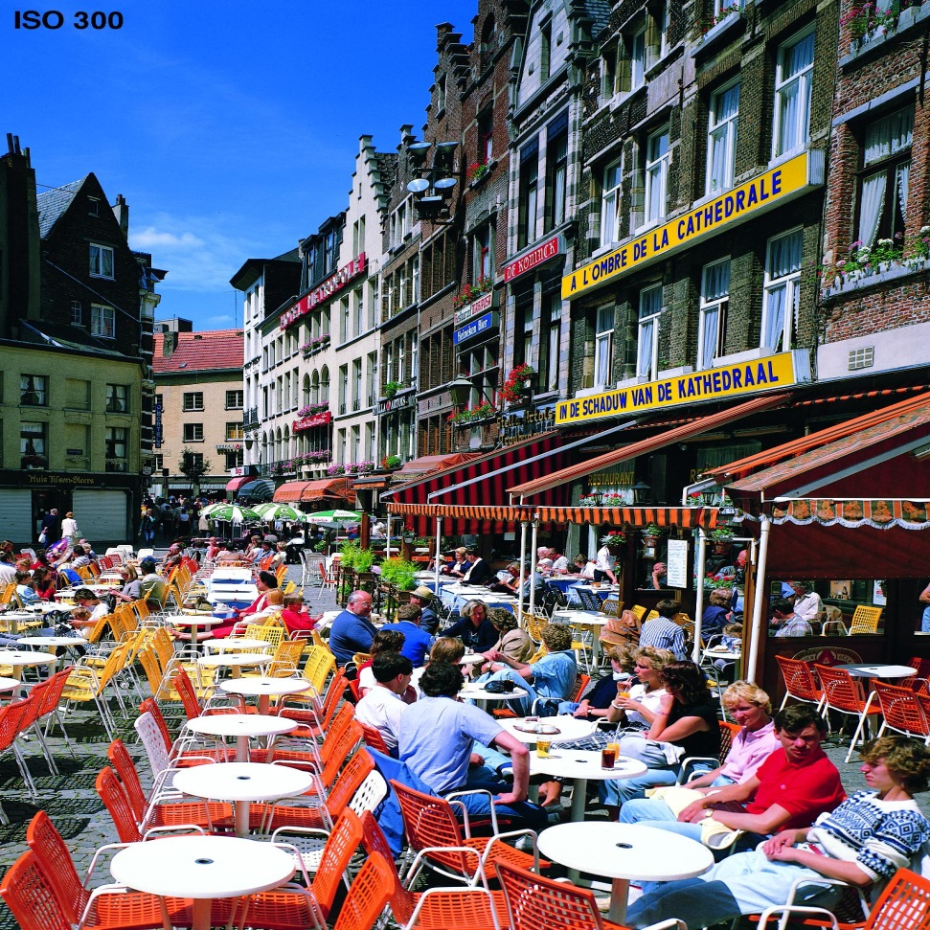
INTRODUCTION
LOSSY IMAGE CODING SYSTEM
ORIGINAL IMAGE

Slide 5
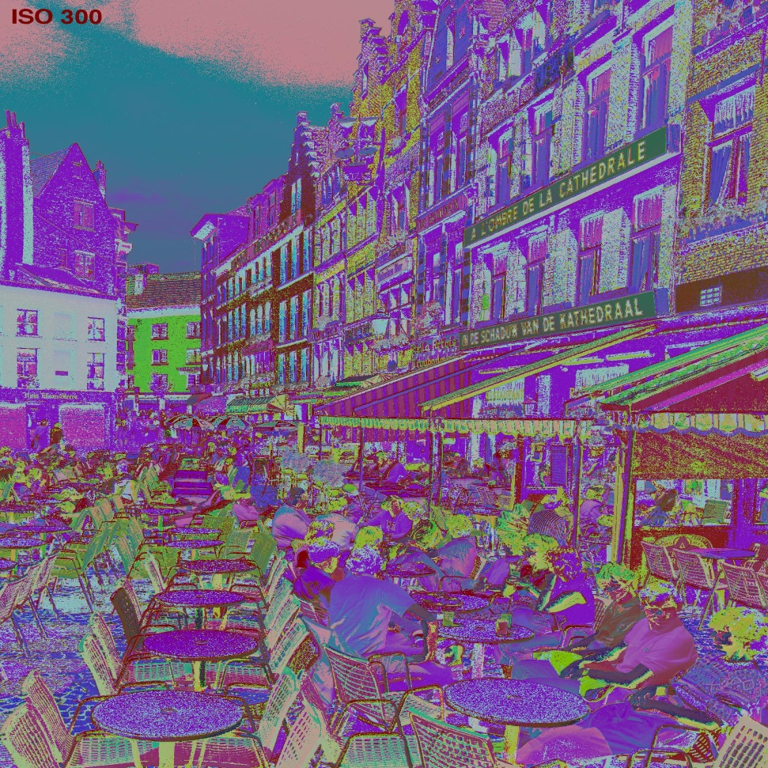
INTRODUCTION
LOSSY IMAGE CODING SYSTEM
ORIGINAL IMAGE
MULTI-COMPONENT
TRANSFORM

Slide 6
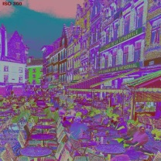
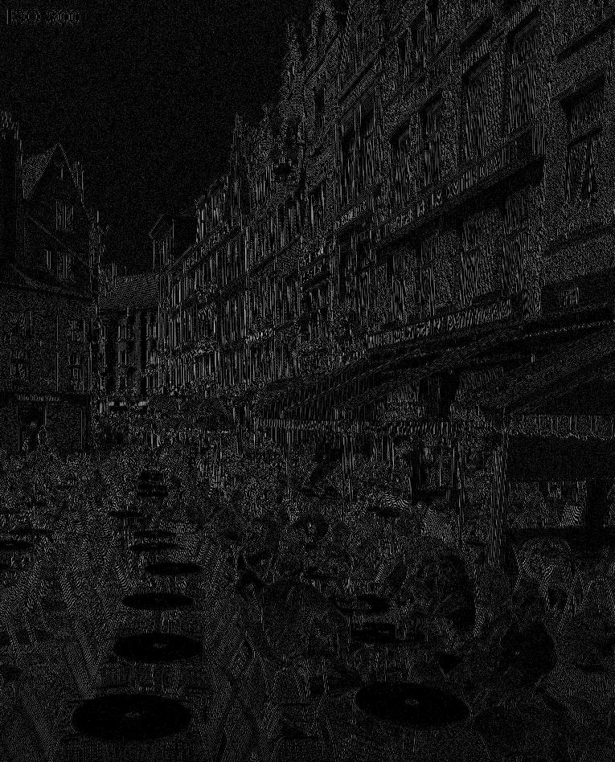
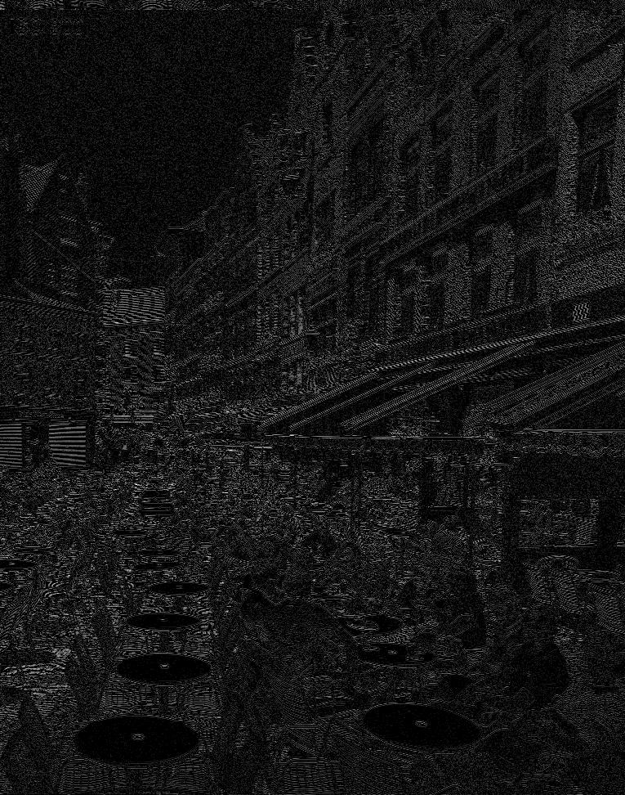
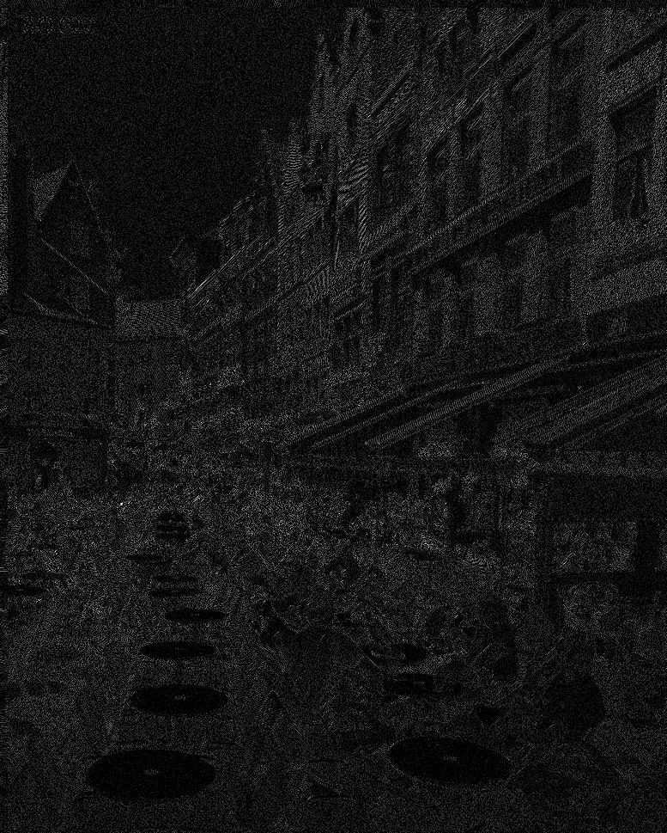
INTRODUCTION
LOSSY IMAGE CODING SYSTEM
ORIGINAL IMAGE
MULTI-COMPONENT
TRANSFORM
WAVELET
TRANSFORM
QUANTIZATION

Slide 7
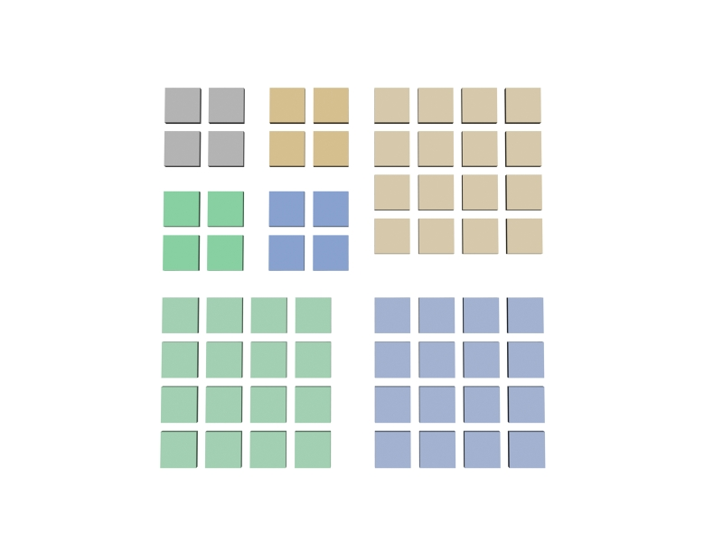
INTRODUCTION
LOSSY IMAGE CODING SYSTEM
ORIGINAL IMAGE
MULTI-COMPONENT
TRANSFORM
WAVELET
TRANSFORM
QUANTIZATION

Slide 8
INTRODUCTION
LOSSY IMAGE CODING SYSTEM
ORIGINAL IMAGE
MULTI-COMPONENT
TRANSFORM
WAVELET
TRANSFORM
QUANTIZATION

Slide 9
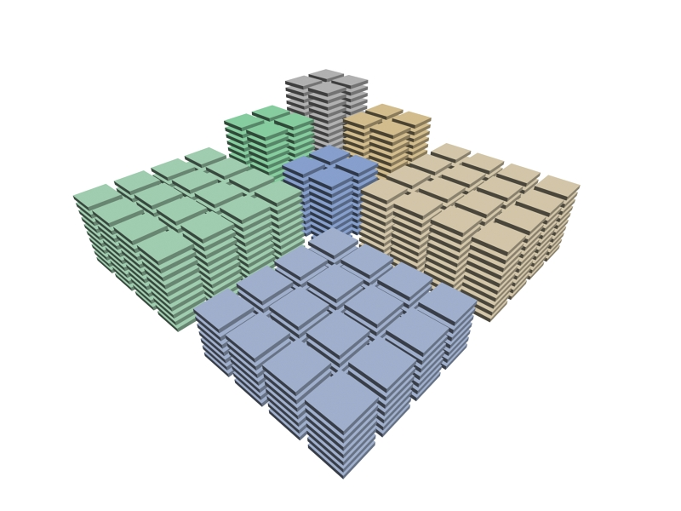
INTRODUCTION
LOSSY IMAGE CODING SYSTEM
ORIGINAL IMAGE
MULTI-COMPONENT
TRANSFORM
WAVELET
TRANSFORM
QUANTIZATION

Slide 10
INTRODUCTION
LOSSY IMAGE CODING SYSTEM
ORIGINAL IMAGE
MULTI-COMPONENT
TRANSFORM
WAVELET
TRANSFORM
QUANTIZATION
BITPLANE CODER
ARITHMETIC CODER

Slide 11
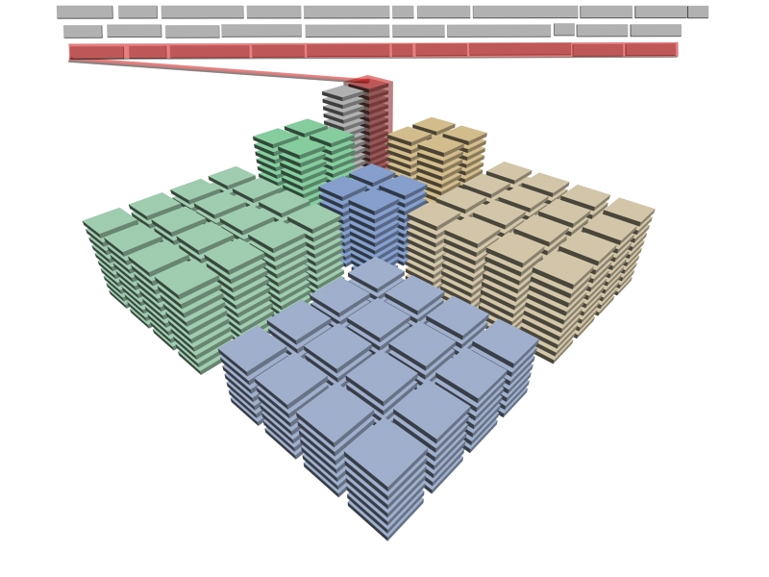
INTRODUCTION
LOSSY IMAGE CODING SYSTEM
ORIGINAL IMAGE
MULTI-COMPONENT
TRANSFORM
WAVELET
TRANSFORM
QUANTIZATION
BITPLANE CODER
ARITHMETIC CODER
RD-opt
CODESTREAM
REORGANIZATION
JP2 codestream

Slide 12
INTRODUCTION
CONTEXT-ADAPTIVE BINARY ARITHMETIC CODING
ORIGINAL IMAGE
MULTI-COMPONENT
TRANSFORM
WAVELET
TRANSFORM
QUANTIZATION
BITPLANE CODER
ARITHMETIC CODER
RD-opt
CODESTREAM
REORGANIZATION
JP2 codestream

Slide 13
INTRODUCTION
CONTEXT-ADAPTIVE BINARY ARITHMETIC CODING
BITPLANE CODER
significant
coefficients
ARITHMETIC
CODER

Slide 14
INTRODUCTION
CONTEXT-ADAPTIVE BINARY ARITHMETIC CODING
BITPLANE CODER
ARITHMETIC
CODER

Slide 15
INTRODUCTION
CONTEXT-ADAPTIVE BINARY ARITHMETIC CODING
BITPLANE CODER
ARITHMETIC
CODER

Slide 16
INTRODUCTION
CONTEXT-ADAPTIVE BINARY ARITHMETIC CODING
BITPLANE CODER
{0|1}
CONTEXT
MODELS
ARITHMETIC
CODER

Slide 17
INTRODUCTION
CONTEXT-ADAPTIVE BINARY ARITHMETIC CODING
BITPLANE CODER
{0|1}
CONTEXT
MODELS
probabilities
are adaptively
adjusted
ARITHMETIC
CODER

Slide 18
INTRODUCTION
CONTEXT-ADAPTIVE BINARY ARITHMETIC CODING
BITPLANE CODER
CONTEXT
MODELS
ARITHMETIC
CODER

Slide 19
INTRODUCTION
CONTEXT-ADAPTIVE BINARY ARITHMETIC CODING
HEURISTICS
STATISTICAL ANALYSIS
CONTEXT
FORMATION
MODELS
ENTROPY-BASED CONCEPTS
(MUTUAL INFORMATION)
DELAYED-DECISION ALGORITHMS
…
CONTEXT
MODELS
ARITHMETIC
CODER

Slide 20
INTRODUCTION
ELABORATE vs NON-ELABORATE MODELS
JPEG2000
CONTEXT MODEL:
AIMED TO CAPTURE
IMAGE FEATURES
EXPERIMENT:
SIGNIFICANCE COD.
SWAP CONTEXT
TABLES AMONG
SUBBANDS
REFINEMENT COD.
DO NOT USE
CONTEXTS

Slide 21
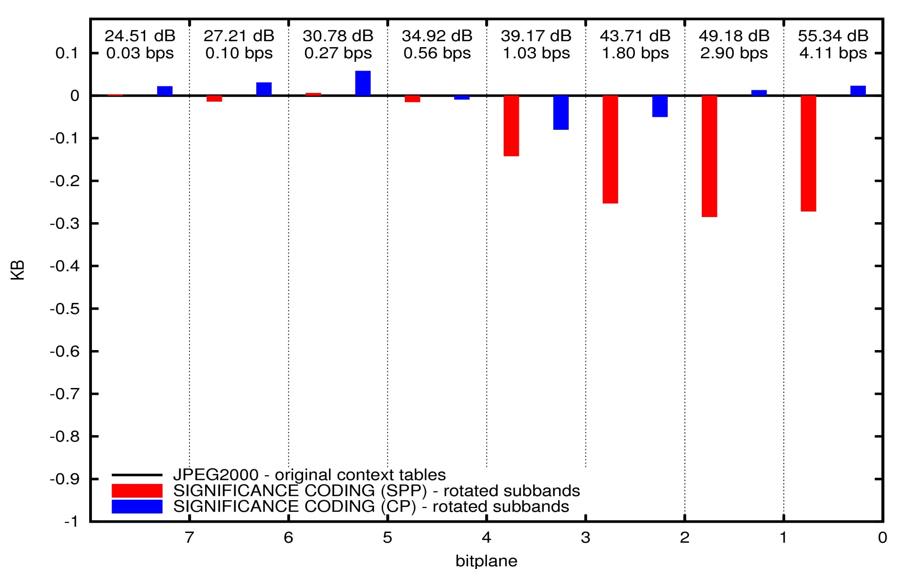
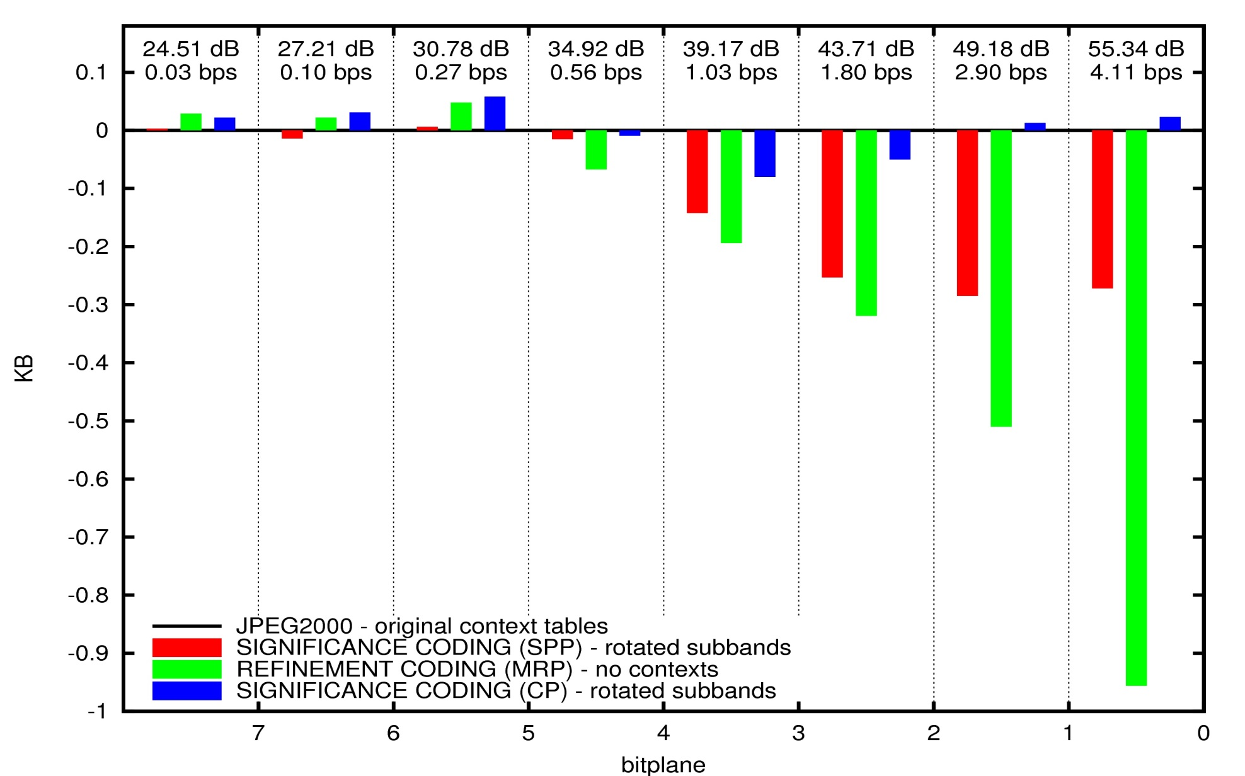
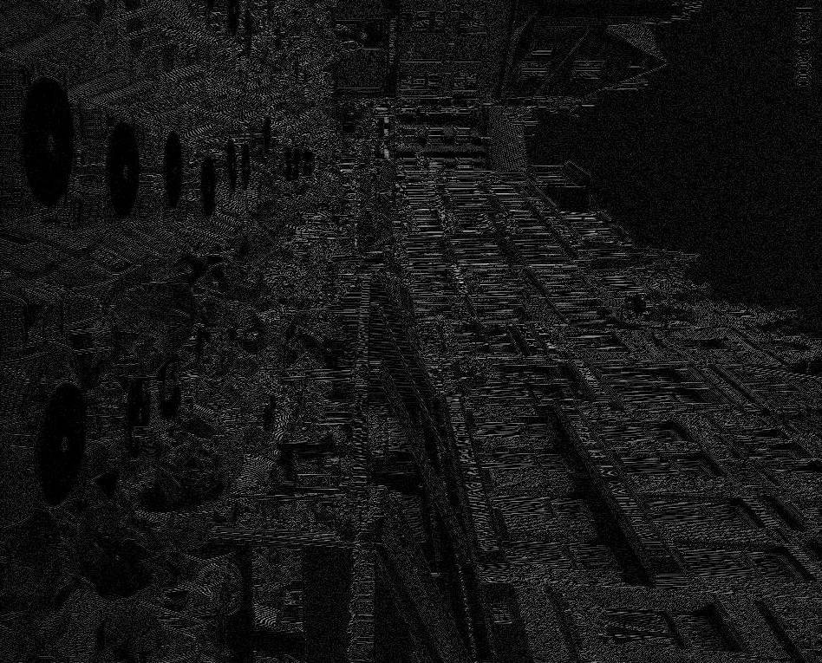
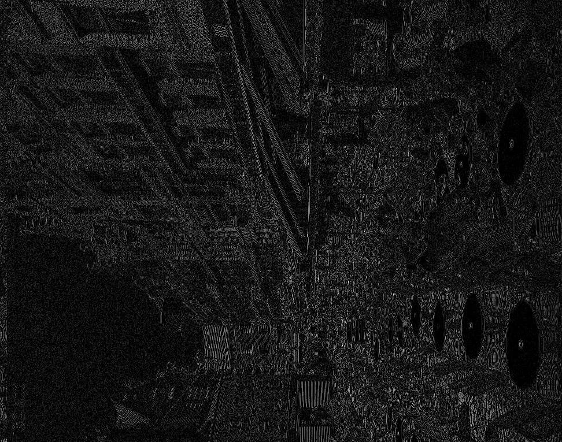
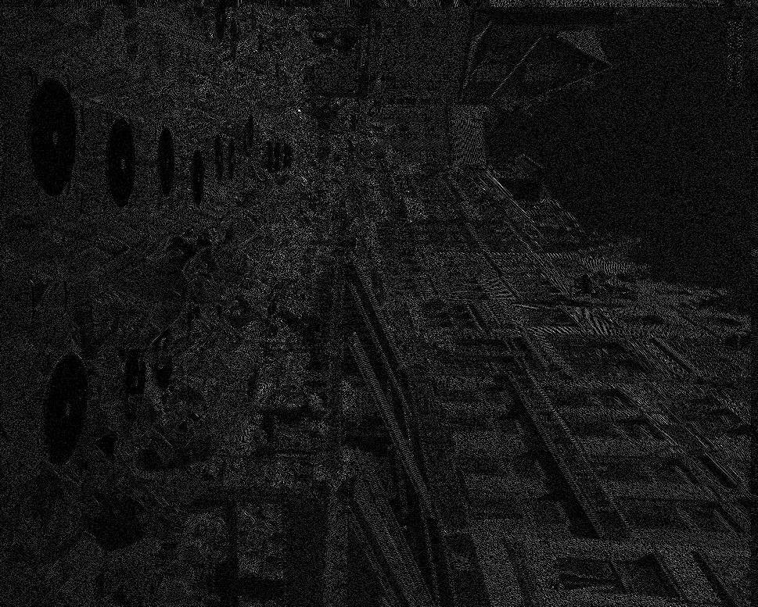
INTRODUCTION
ELABORATE vs NON-ELABORATE MODELS
JPEG2000
CONTEXT MODEL:
AIMED TO CAPTURE
IMAGE FEATURES
EXPERIMENT:
SIGNIFICANCE COD.
SWAP CONTEXT
TABLES AMONG
SUBBANDS
REFINEMENT COD.
DO NOT USE
CONTEXTS

Slide 22
INTRODUCTION
RESEARCH PURPOSE
EXPLORE MODELS OF PROBABILITIES FOR
BITPLANE IMAGE CODING THAT ARE NOT
BASED ON CONTEXT-ADAPTIVE CODING
Application to JPEG2000 core coding system
EQ-CODER
EPWIC
TARP-FILTER, TCE
DCC 1997
ICIP 1997
DCC 2002, ICASSP 2004

Slide 23
TABLE OF CONTENTS
INTRODUCTION
LOCAL AVERAGE-BASED
MODEL OF PROBABILITIES
EXPERIMENTS
CONCLUSIONS
FUTURE RESEARCH:
MATEMATICAL FRAMEWORK BEHIND THE MODEL
GENERALIZED ALGORITHM

Slide 24
MODEL OF PROBABILITIES
LOCAL AVERAGE
CONTEXT-ADAPTIVE CODING:
ONLY USES SIGNIFICANCE STATE
SIGNIFICANCE BITPLANE, REFINEMENT BITS:
NOT USED TO DETERMINE PROBABILITIES

Slide 25
MODEL OF PROBABILITIES
LOCAL AVERAGE

Slide 26
MODEL OF PROBABILITIES
LOCAL AVERAGE
predicted magnitude
of the currently coded
coefficient
LOCAL AVERAGE:
ARITHMETIC MEAN OF THE
NEIGHBORS’ MAGNITUDE
SIMILAR TECHNIQUES:
LOSSLESS:
Ruedin 2010, Wang 2007, Weinberger 2000, Wu 1998,…
LOSSY:
Liu 2001, Buccigrossi 1999, Yoo 1999, Chrysafis 1997,…
6

Slide 27
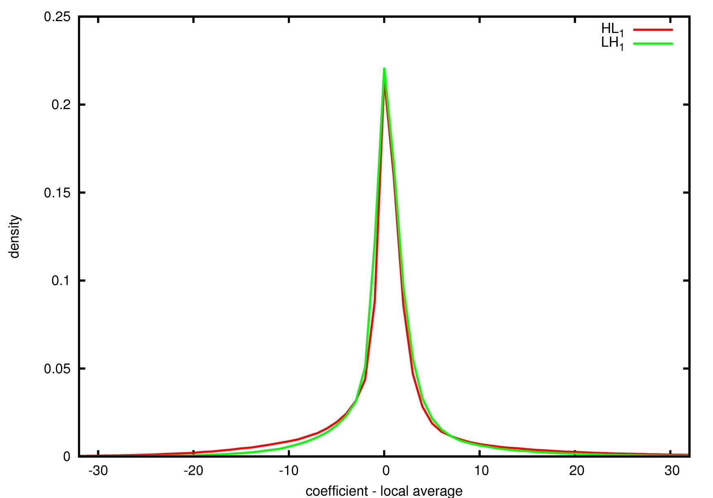
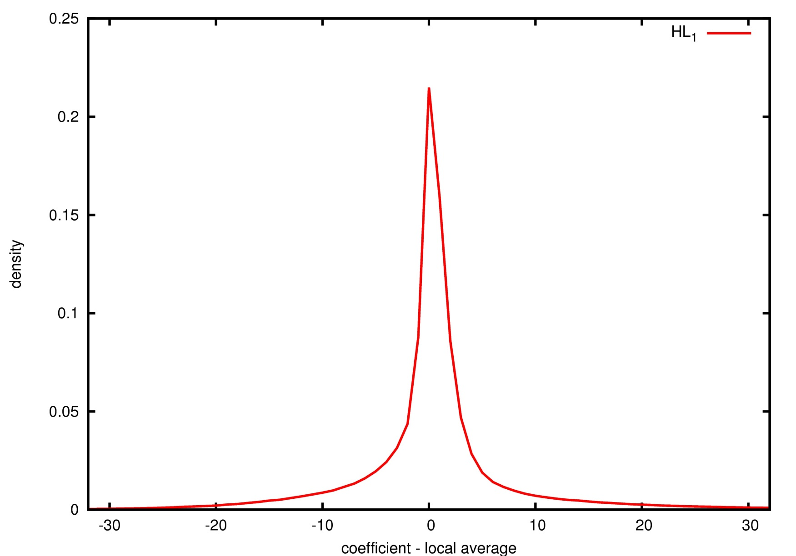
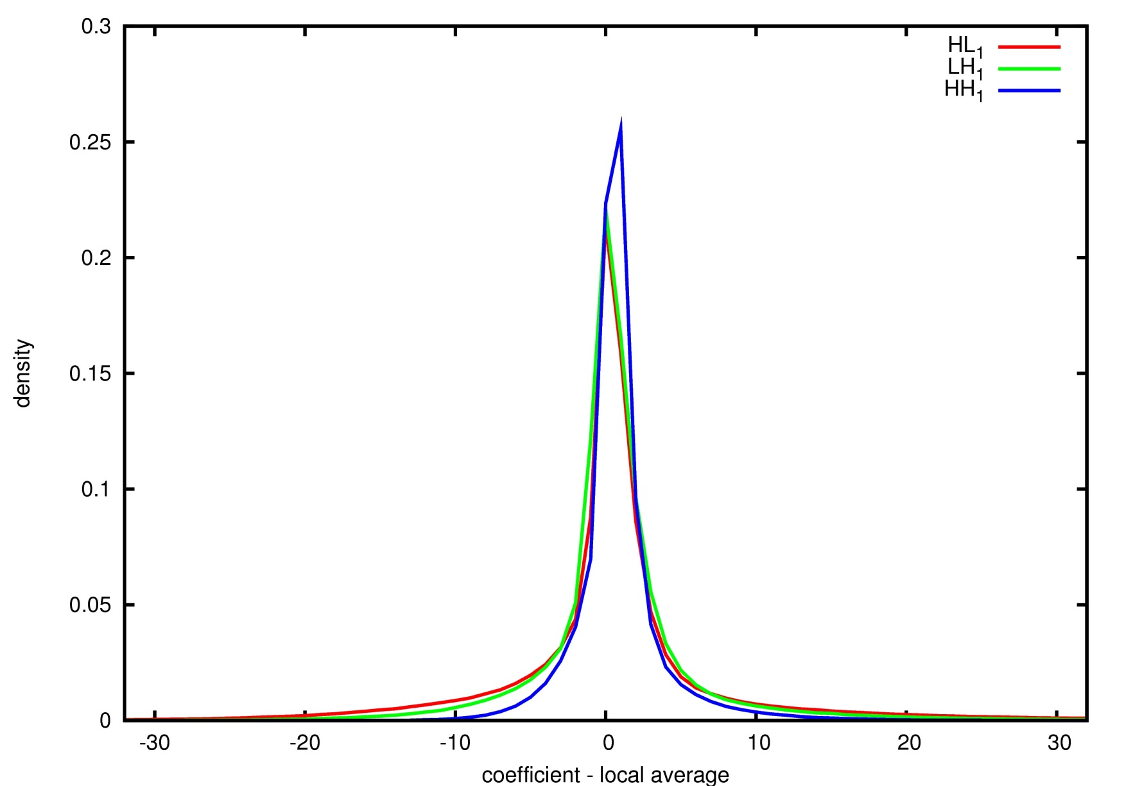
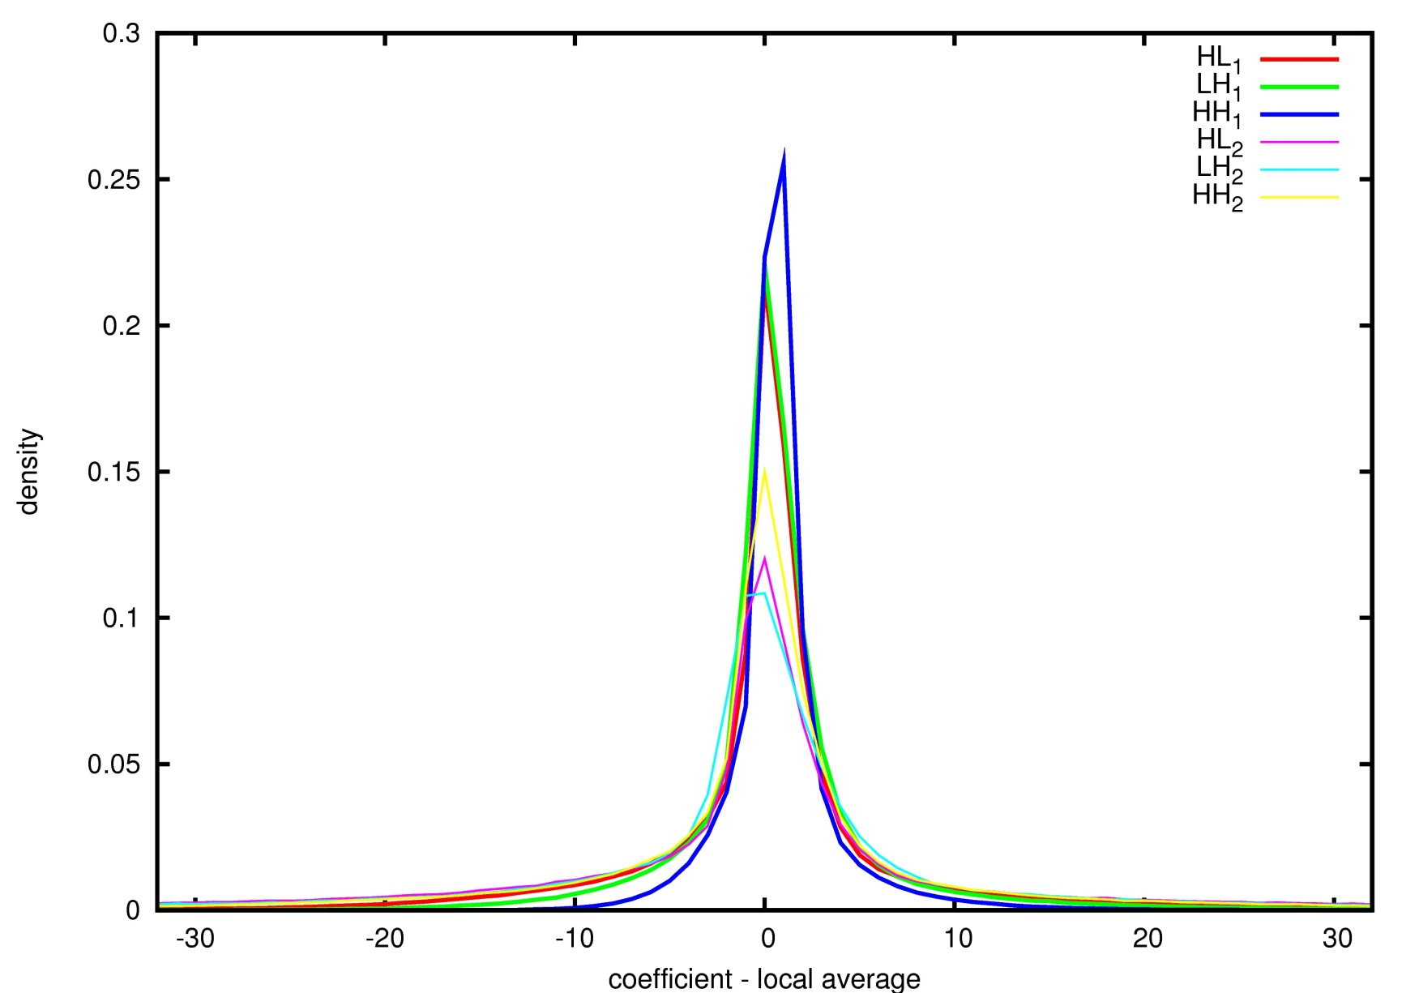
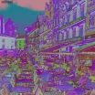
MODEL OF PROBABILITIES
LOCAL AVERAGE IN WAVELET SUBBANDS

Slide 28
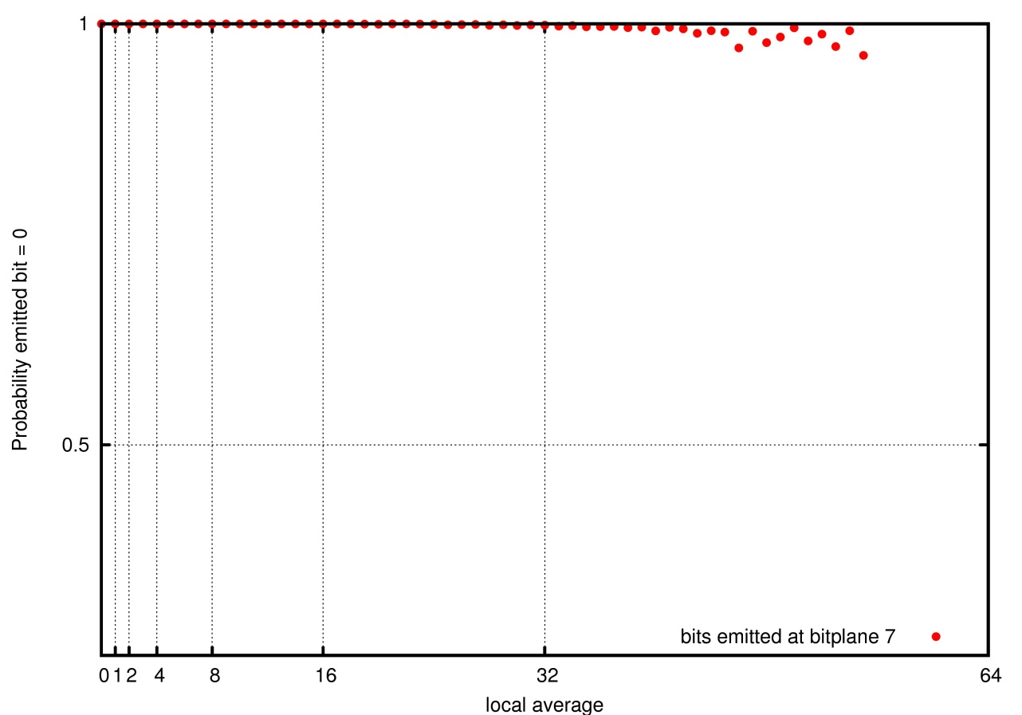
INTRODUCTION
LOCAL AVERAGE IN BITPLANE CODING

Slide 29
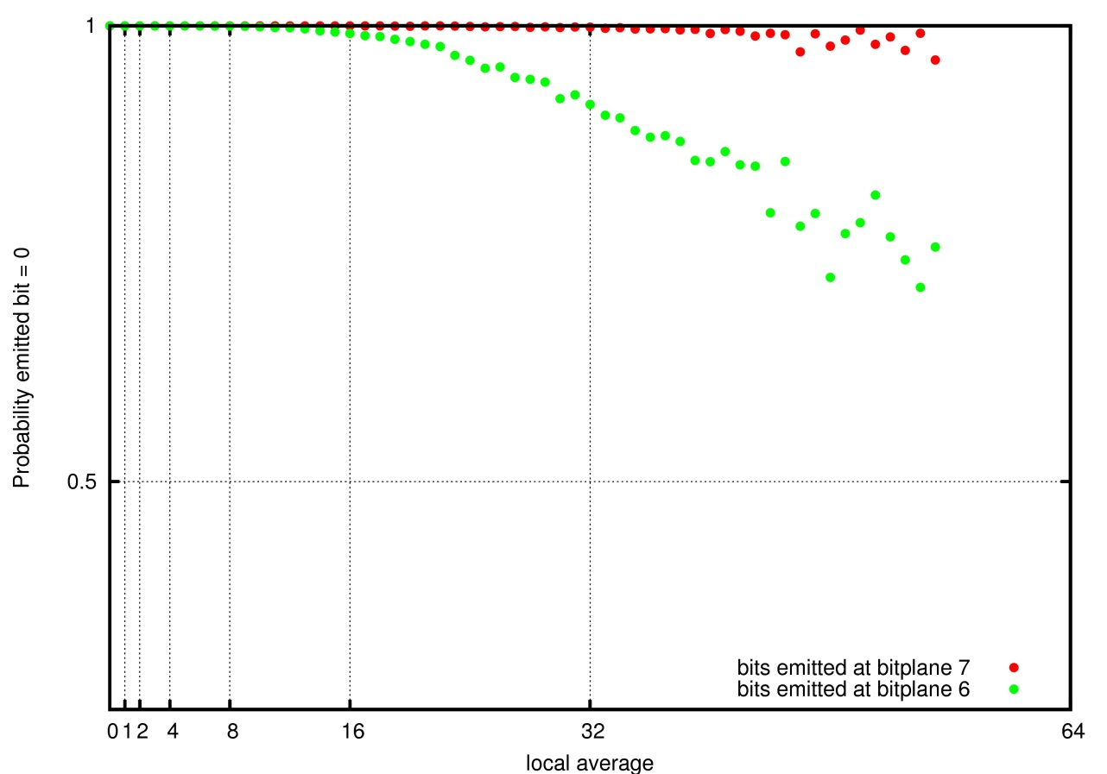
INTRODUCTION
LOCAL AVERAGE IN BITPLANE CODING

Slide 30
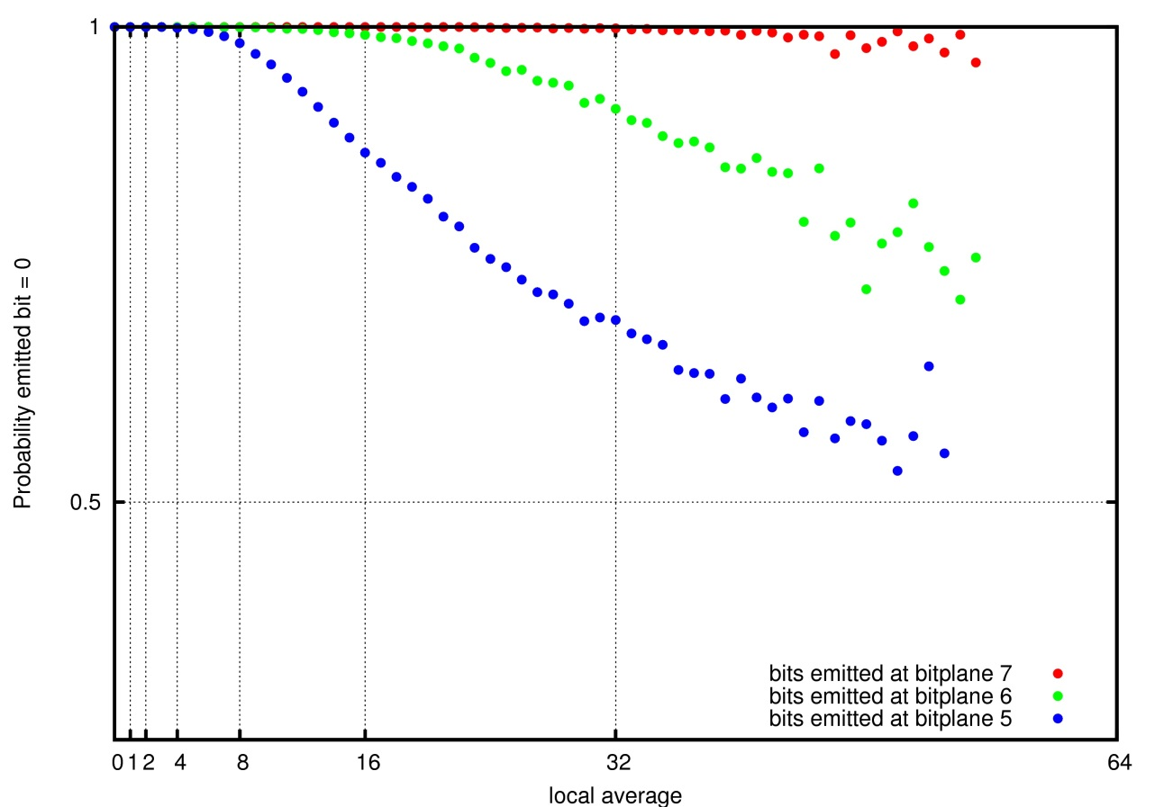
INTRODUCTION
LOCAL AVERAGE IN BITPLANE CODING

Slide 31
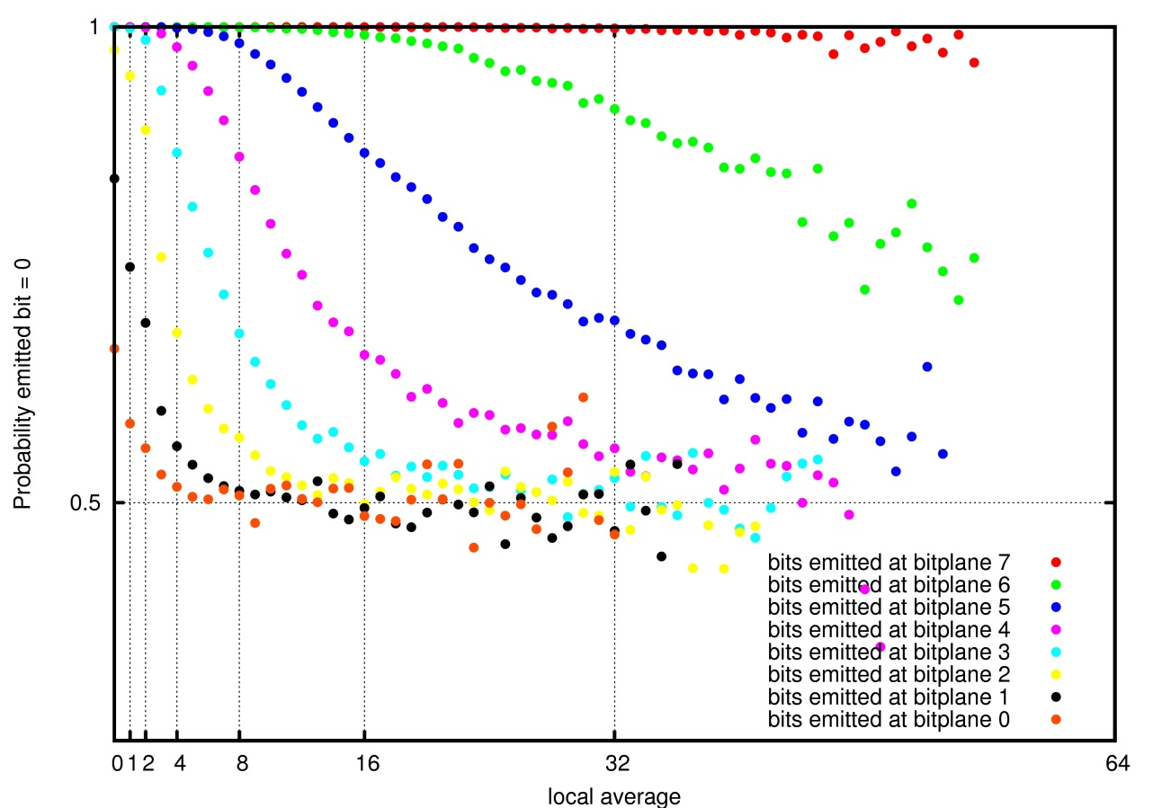
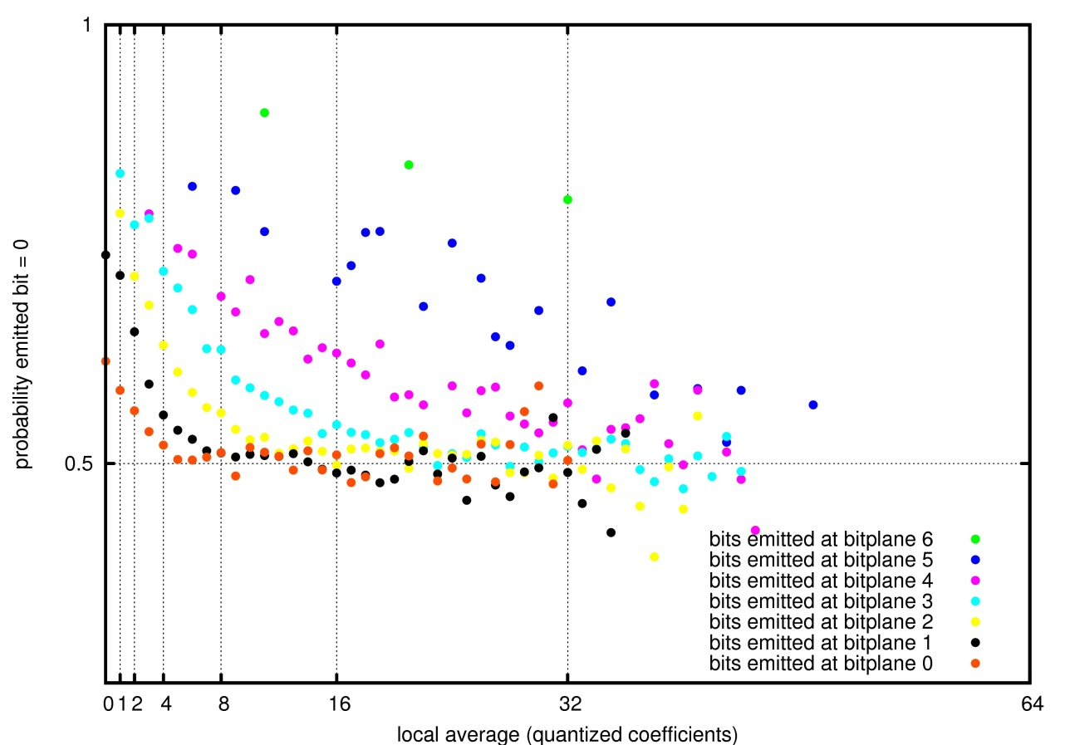
INTRODUCTION
LOCAL AVERAGE IN BITPLANE CODING
LOCAL AVERAGE
COMPUTED WITH
QUANTIZED
COEFFICIENTS

Slide 32
INTRODUCTION
MODEL OF PROBABILITIES FOR JPEG2000
SIGNIFICANCE
CODING PASS (SPP)
REFINEMENT
CODING PASS (MRP)
CLEANUP PASS (CP)
– 2 CONTEXTS –
0.77
0.8
0.75
BP=4
BP=5
BP=3
0.5
0.5
0.5

Slide 33
TABLE OF CONTENTS
INTRODUCTION
LOCAL AVERAGE-BASED
MODEL OF PROBABILITIES
EXPERIMENTS
CONCLUSIONS
FUTURE RESEARCH:
MATEMATICAL FRAMEWORK BEHIND THE MODEL
GENERALIZED ALGORITHM

Slide 34
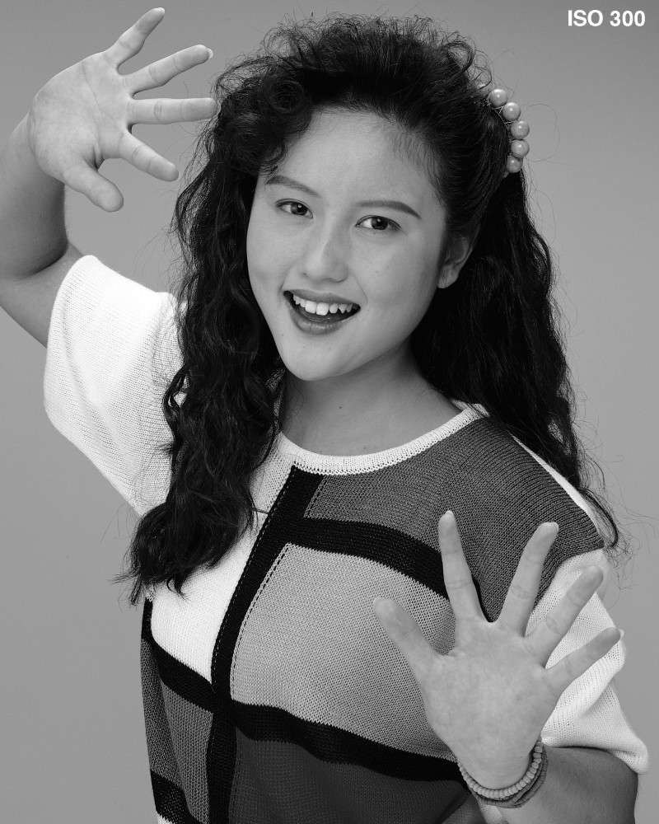
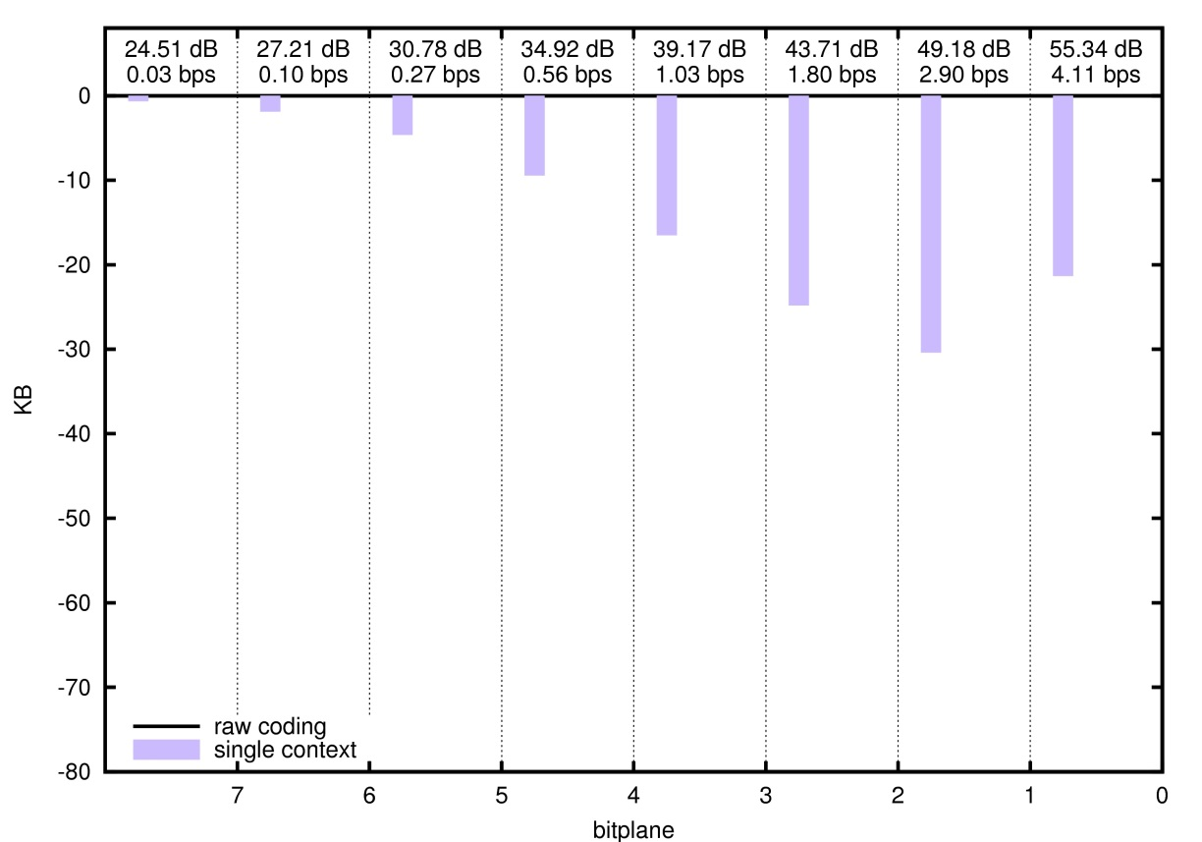
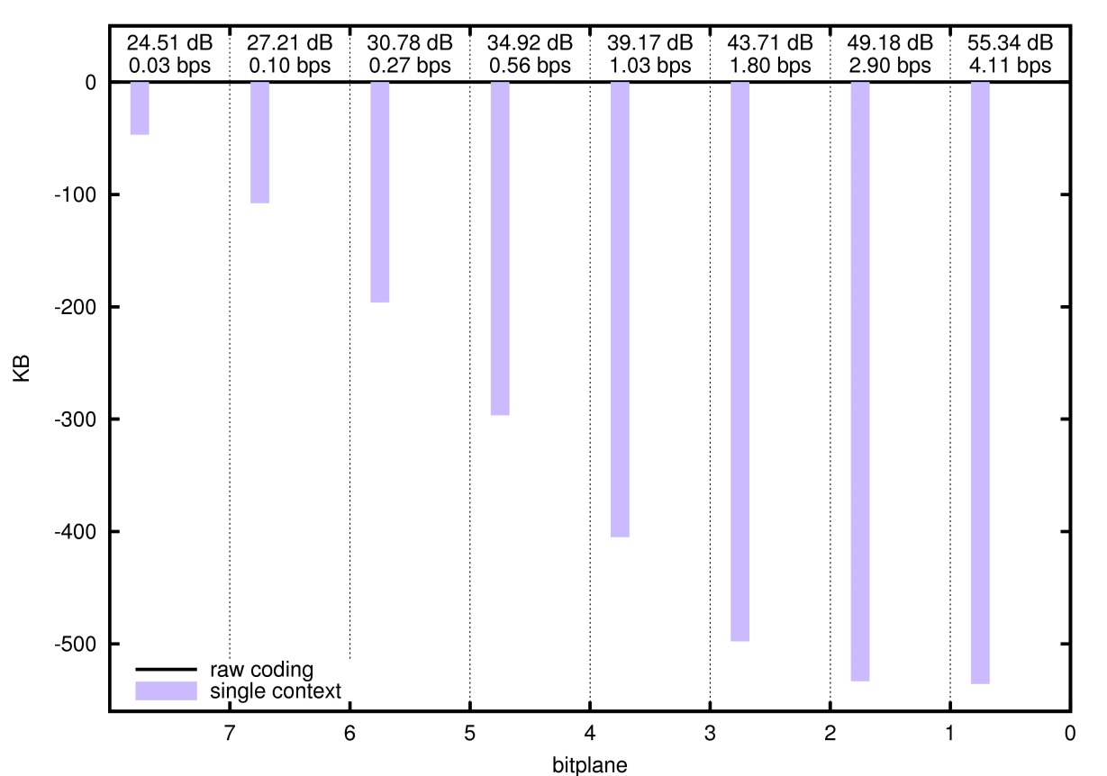
EXPERIMENTS
SIGNIFICANCE CODING
“Portrait” image
5 DWT levels
9/7 filter-taps
64x64 codeblocks
SIGNIFICANCE PROPAGATION PASS
CLEANUP PASS

Slide 35
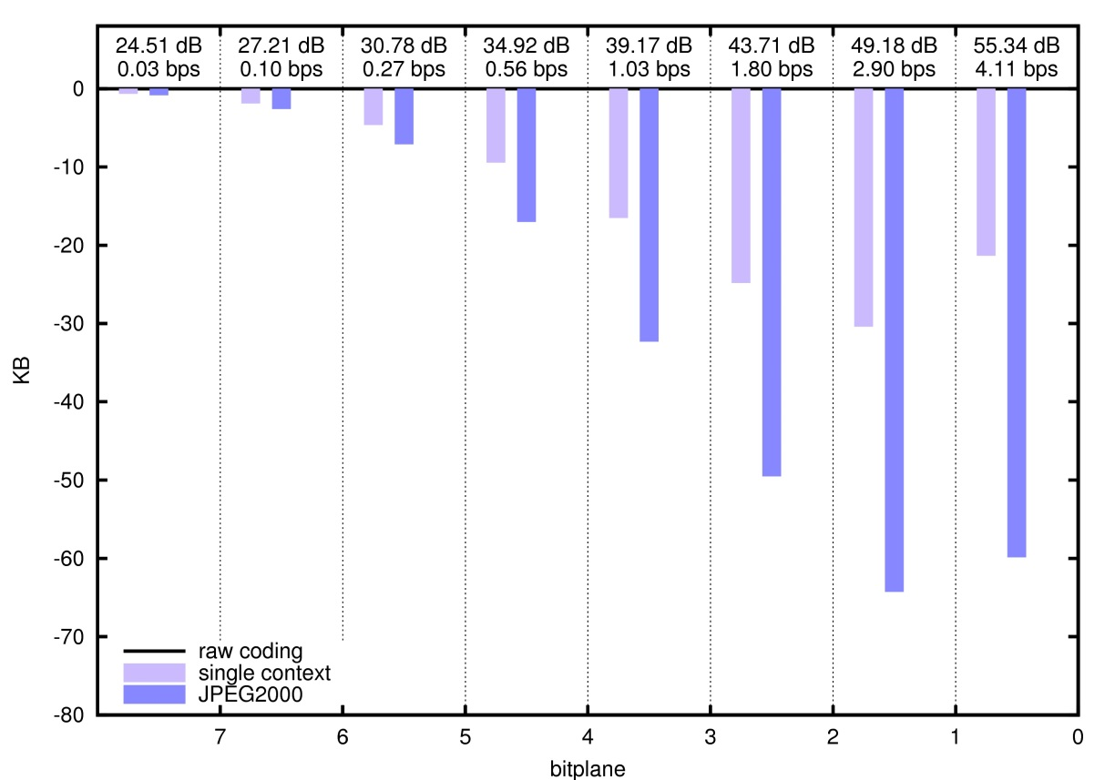
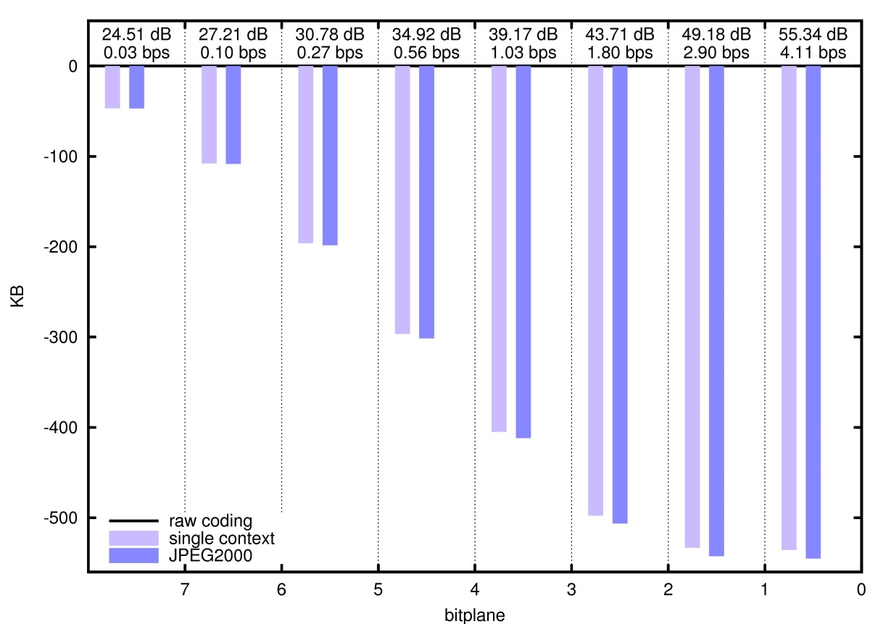
EXPERIMENTS
SIGNIFICANCE CODING
“Portrait” image
5 DWT levels
9/7 filter-taps
64x64 codeblocks
SIGNIFICANCE PROPAGATION PASS
CLEANUP PASS

Slide 36
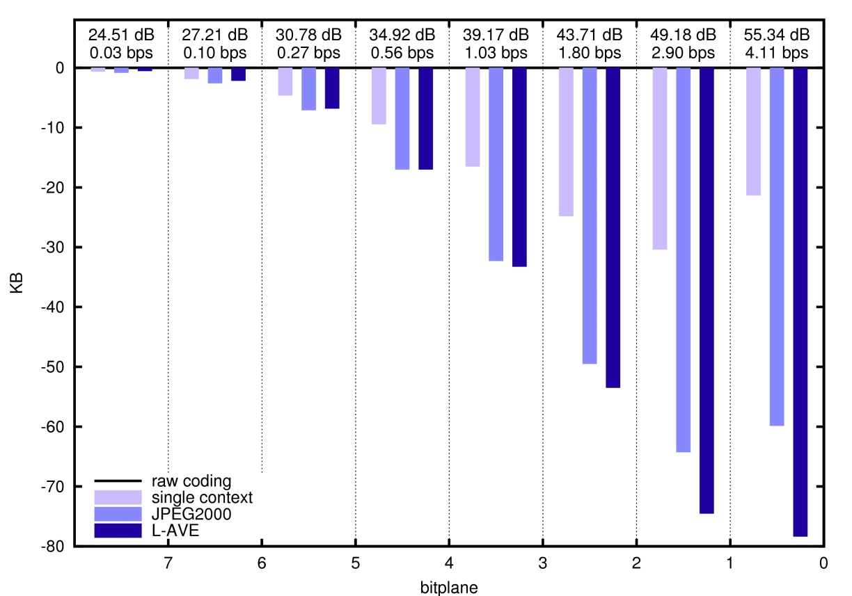
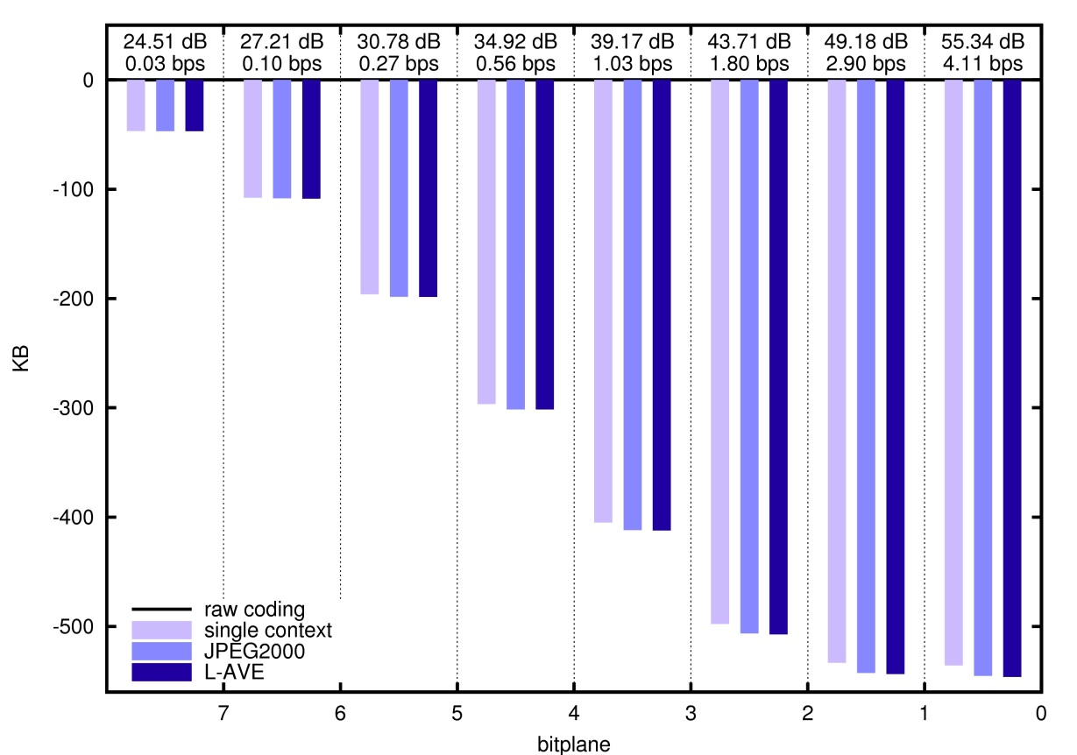
EXPERIMENTS
SIGNIFICANCE CODING
“Portrait” image
5 DWT levels
9/7 filter-taps
64x64 codeblocks
SIGNIFICANCE PROPAGATION PASS
CLEANUP PASS

Slide 37
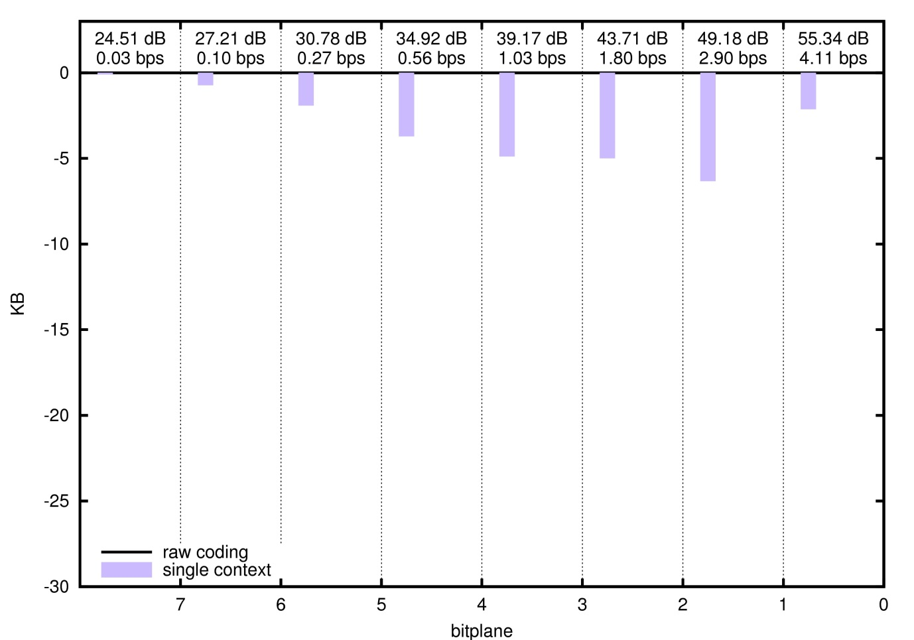
EXPERIMENTS
REFINEMENT CODING
“Portrait” image
5 DWT levels
9/7 filter-taps
64x64 codeblocks
MAGNITUDE REFINEMENT PASS

Slide 38
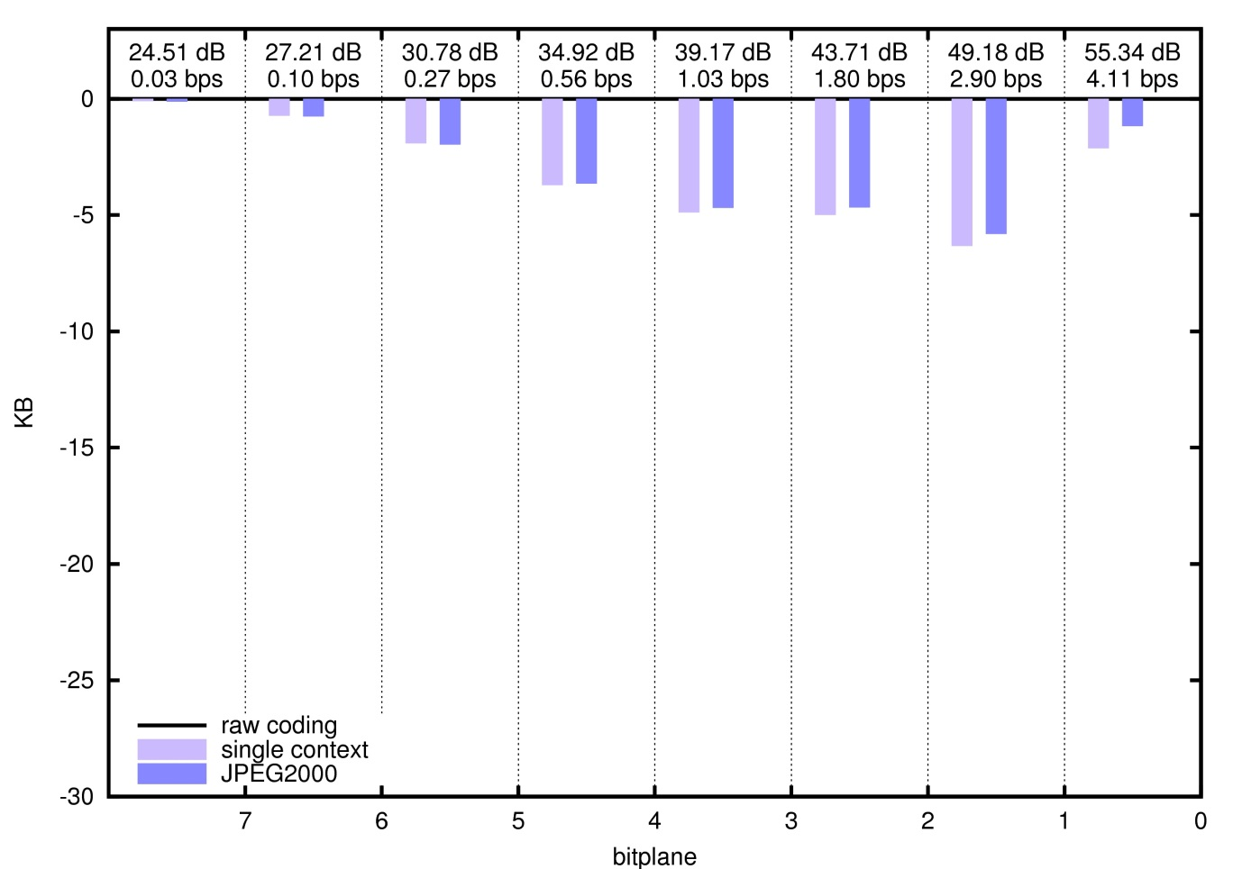
EXPERIMENTS
REFINEMENT CODING
“Portrait” image
5 DWT levels
9/7 filter-taps
64x64 codeblocks
MAGNITUDE REFINEMENT PASS

Slide 39
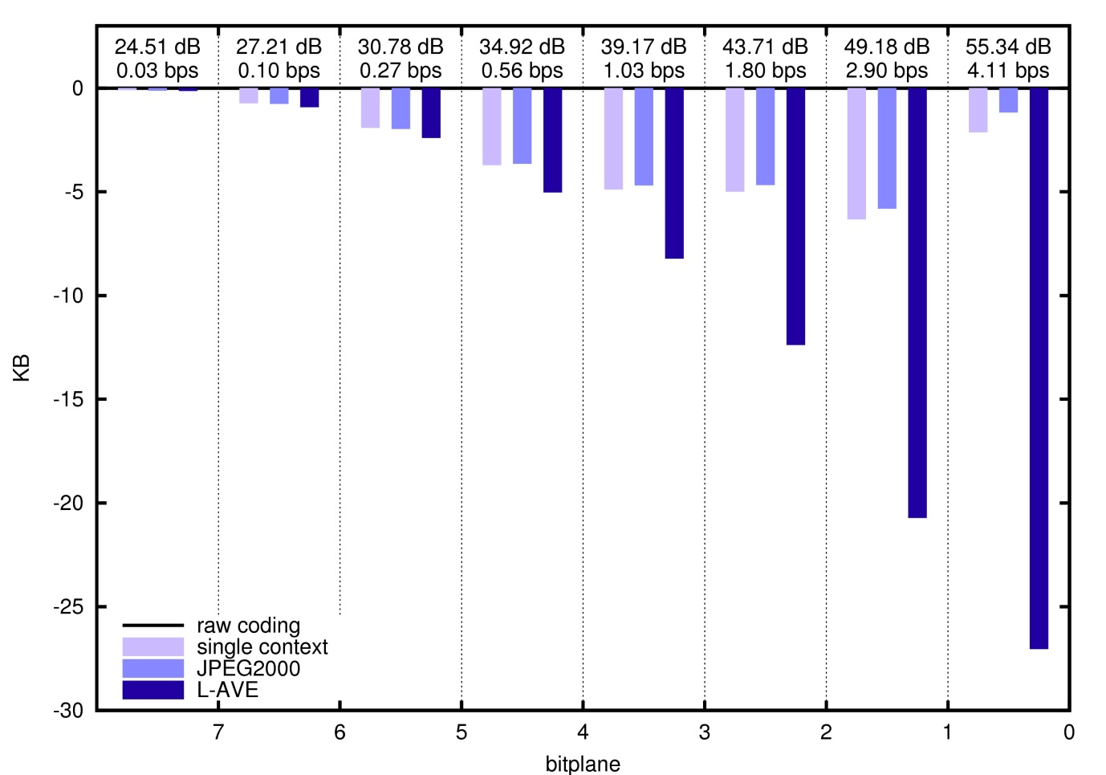
EXPERIMENTS
REFINEMENT CODING
“Portrait” image
5 DWT levels
9/7 filter-taps
64x64 codeblocks
MAGNITUDE REFINEMENT PASS

Slide 40
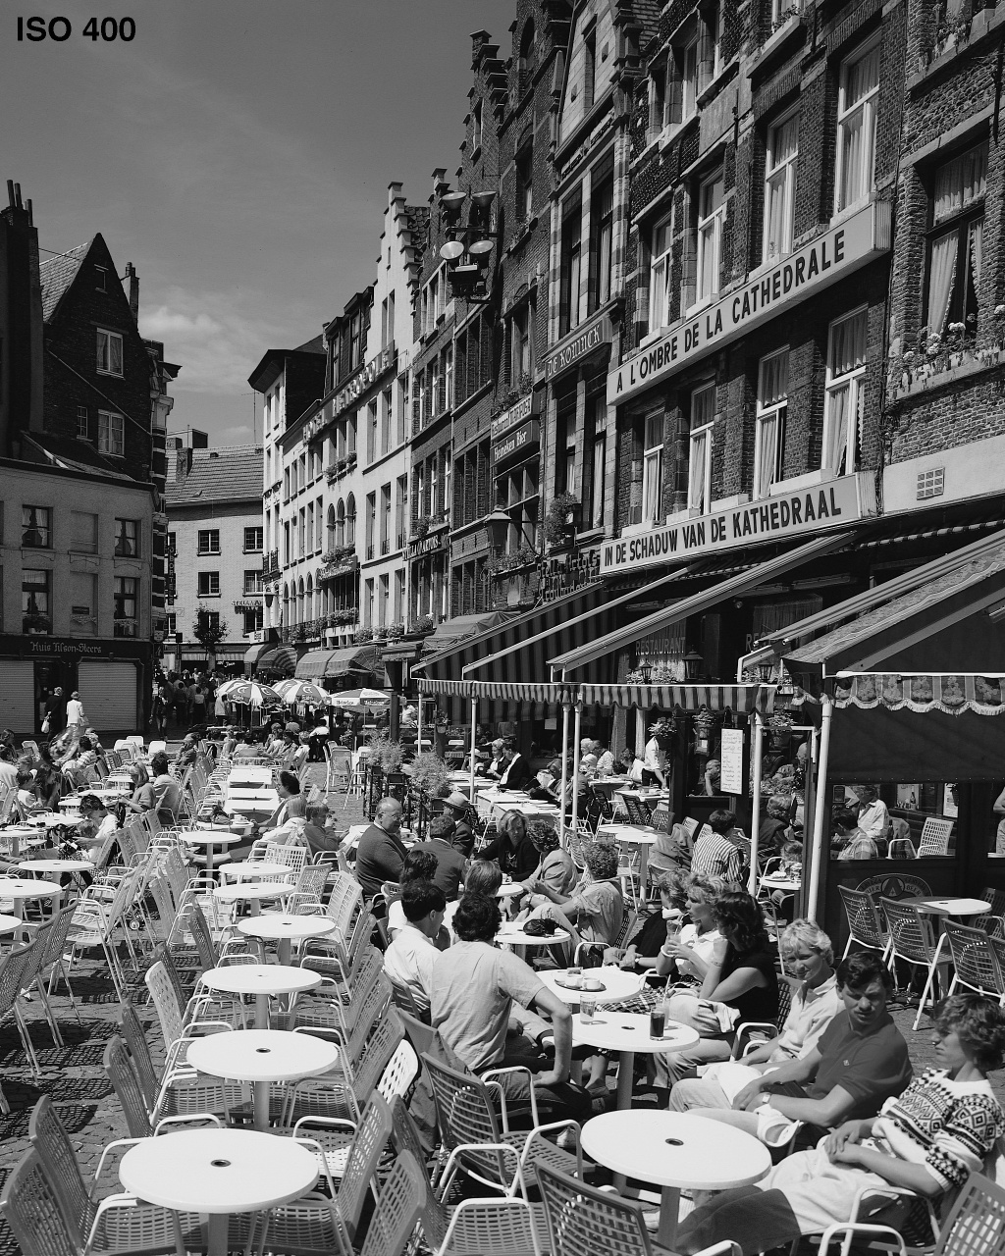
EXPERIMENTS
CODING EFFICIENCY
PSNR (in dB) | 27.21 | 34.92 | 43.71 | 55.34 | 24.47 | 33.64 | 43.98 | 56.05
raw coding | 0.27 | 1.06 | 2.65 | 5.04 | 0.66 | 1.94 | 3.89 | 6.20
single context | 0.10 | 0.58 | 1.85 | 4.18 | 0.32 | 1.21 | 2.90 | 5.23
JPEG2000 | 0.10 | 0.56 | 1.80 | 4.11 | 0.30 | 1.14 | 2.80 | 5.12
L-AVE | 0.10 | 0.56 | 1.78 | 4.04 | 0.30 | 1.15 | 2.78 | 5.03
results reported in bits per sample (bps)

Slide 41
EXPERIMENTS
CODING EFFICIENCY
PSNR (in dB) | 27.21 | 34.92 | 43.71 | 55.34 | 24.47 | 33.64 | 43.98 | 56.05
raw coding | 0.27 | 1.06 | 2.65 | 5.04 | 0.66 | 1.94 | 3.89 | 6.20
single context | 0.10 | 0.58 | 1.85 | 4.18 | 0.32 | 1.21 | 2.90 | 5.23
JPEG2000 | 0.10 | 0.56 | 1.80 | 4.11 | 0.30 | 1.14 | 2.80 | 5.12
L-AVE | 0.10 | 0.56 | 1.78 | 4.04 | 0.30 | 1.15 | 2.78 | 5.03
0.07
0.11
0.07
0.09
results reported in bits per sample (bps)

Slide 42
TABLE OF CONTENTS
INTRODUCTION
LOCAL AVERAGE-BASED
MODEL OF PROBABILITIES
EXPERIMENTS
CONCLUSIONS
FUTURE RESEARCH:
MATEMATICAL FRAMEWORK BEHIND THE MODEL
GENERALIZED ALGORITHM

Slide 43
CONCLUSIONS
NON-ELABORATE CONTEXT MODELS
ACHIEVE SIMILAR CODING EFFICIENCY
AS ELABORATE CONTEXT MODELS
ARITHMETIC
CODER
RESEARCH PURPOSE:
MODEL OF PROBABILITIES FOR BITPLANE IMAGE CODING
THAT IS NOT BASED ON CONTEXT-ADAPTIVE CODING

Slide 44
CONCLUSIONS
NON-ELABORATE CONTEXT MODELS
ACHIEVE SIMILAR CODING EFFICIENCY
AS ELBORATE CONTEXT MODELS
ARITHMETIC
CODER
RESEARCH PURPOSE:
MODEL OF PROBABILITIES FOR BITPLANE IMAGE CODING
THAT IS NOT BASED ON CONTEXT-ADAPTIVE CODING

Slide 45
CONCLUSIONS
{0|1}
ARITHMETIC
CODER
LOCAL AVERAGE-BASED MODEL OF PROBABILITIES:
ASSUMES STATIONARY STATISTICAL BEHAVIOR
AVOIDS CONTEXT-ADAPTIVE CODING
SIMPLE & FAST IMPLEMENTATION

Slide 46
CONCLUSIONS
{0|1}
ARITHMETIC
CODER
FUTURE RESEARCH:
MATHEMATICAL FRAMEWORK BEHIND THE MODEL (ICIP 2010)
GENERALIZED ALGORITHM (to be submitted)

Slide 47
CONCLUSIONS
{0|1}
ARITHMETIC
CODER
FUTURE RESEARCH:
MATHEMATICAL FRAMEWORK BEHIND THE MODEL (ICIP 2010)
GENERALIZED ALGORITHM (to be submitted)

