Slide 1
EVALUATION OF CONTEXT MODELS TO CODE WAVELET-TRANSFORMED HYPERSPECTRAL IMAGES
Francesc Aulí-Llinàs
Department of Information and Communications Engineering
Universitat Autònoma de Barcelona, Spain

Slide 2
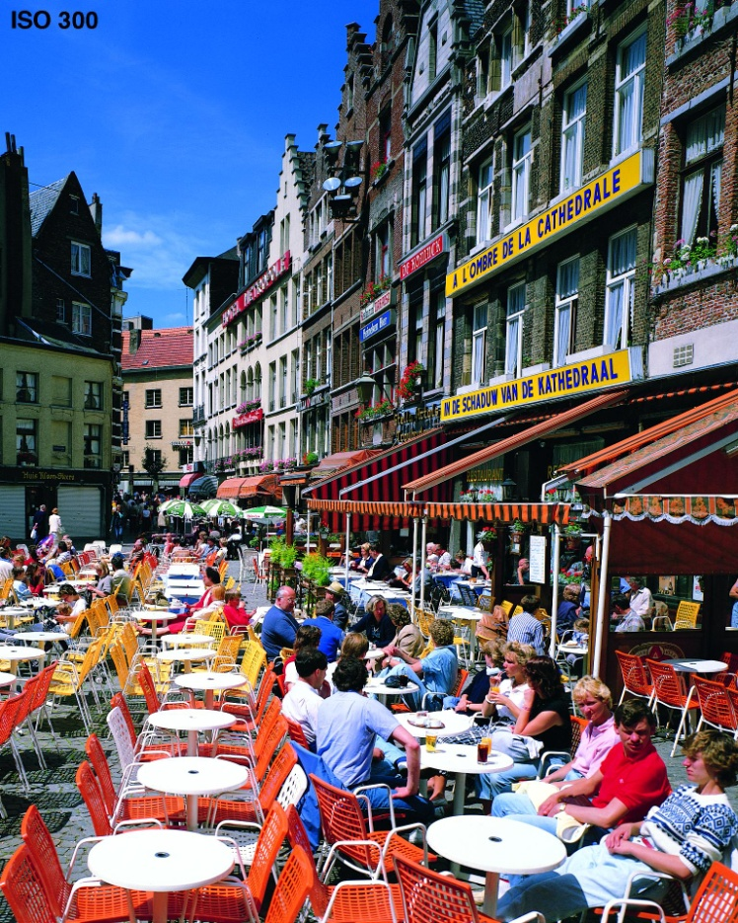
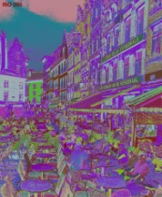
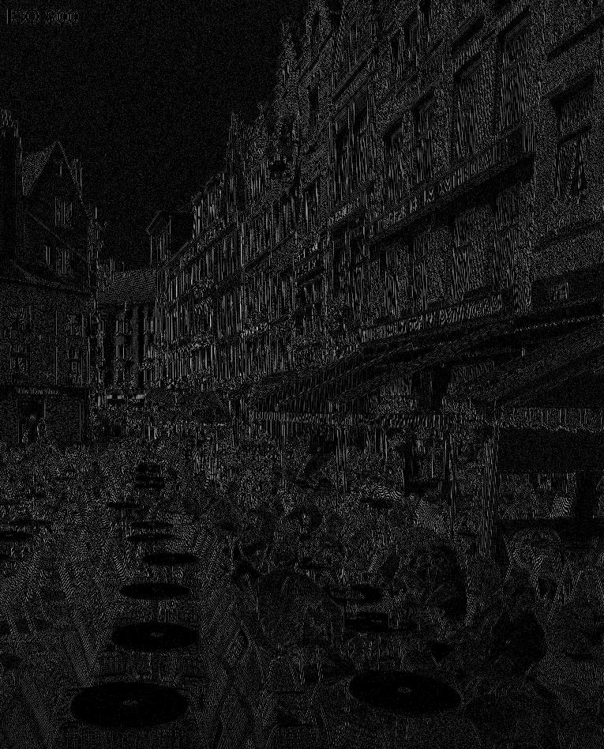
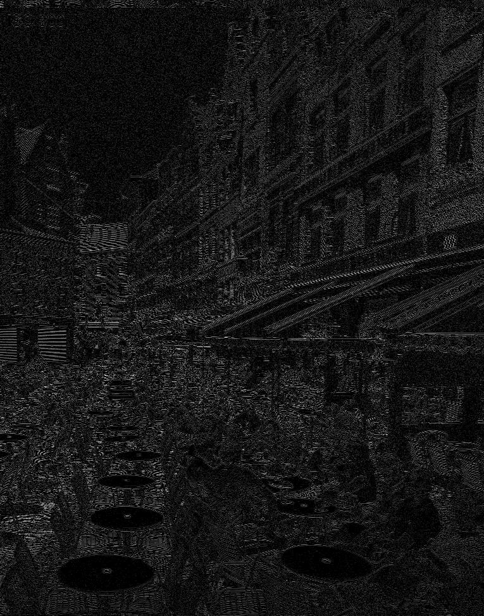
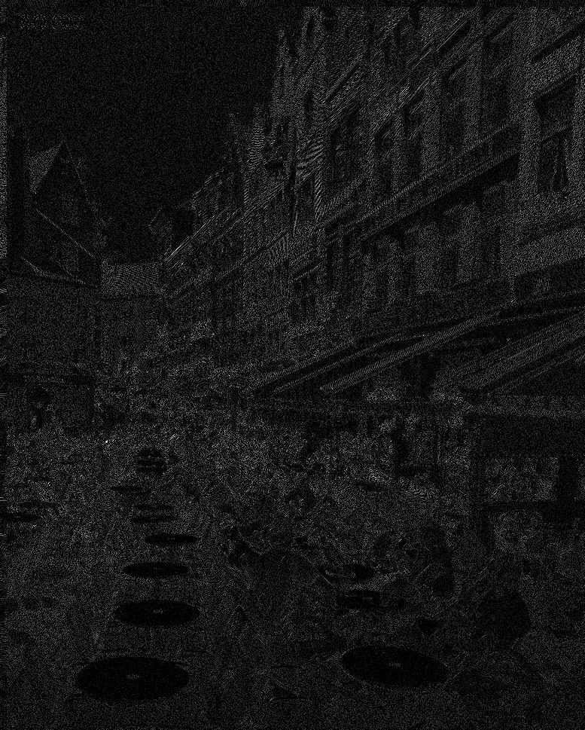
TABLE OF CONTENTS
INTRODUCTION
ENTROPY-BASED MEASURE FOR
CONTEXT EVALUATION
EXPERIMENTAL RESULTS
CONCLUSIONS
Motivation
evaluate context models for different image types
in a general framework
ENTIMA
entropy-based measure that considers wavelet-transformed images

Slide 3
TABLE OF CONTENTS
INTRODUCTION
ENTROPY-BASED MEASURE FOR
CONTEXT EVALUATION
EXPERIMENTAL RESULTS
CONCLUSIONS
Motivation
evaluate context models for different image types
in a general framework
ENTIMA
entropy-based measure that considers wavelet-transformed images

Slide 4
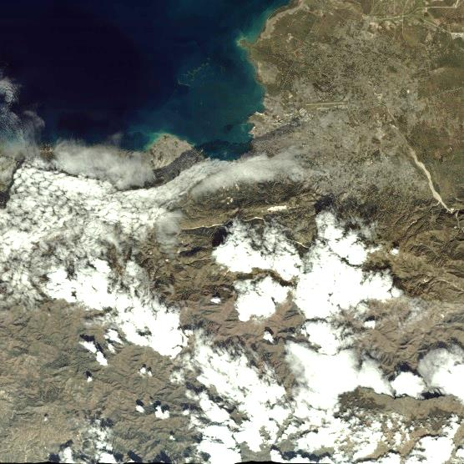
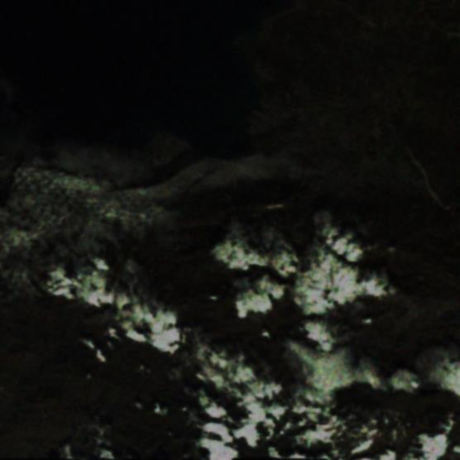
INTRODUCTION
WAVELET-BASED CODING SCHEMES
ORIGINAL IMAGE
WAVELET TRANSFORM
+ QUANTIZATION
BITPLANE CODING
+ ENTROPY CODING
removes visual
redundancies
removes statistical
redundancies
ARITHMETIC
CODER
removes spatial
redundancies
CODESTREAM
1

Slide 5
INTRODUCTION
WAVELET-BASED CODING SCHEMES
2

Slide 6
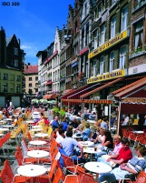
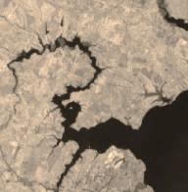
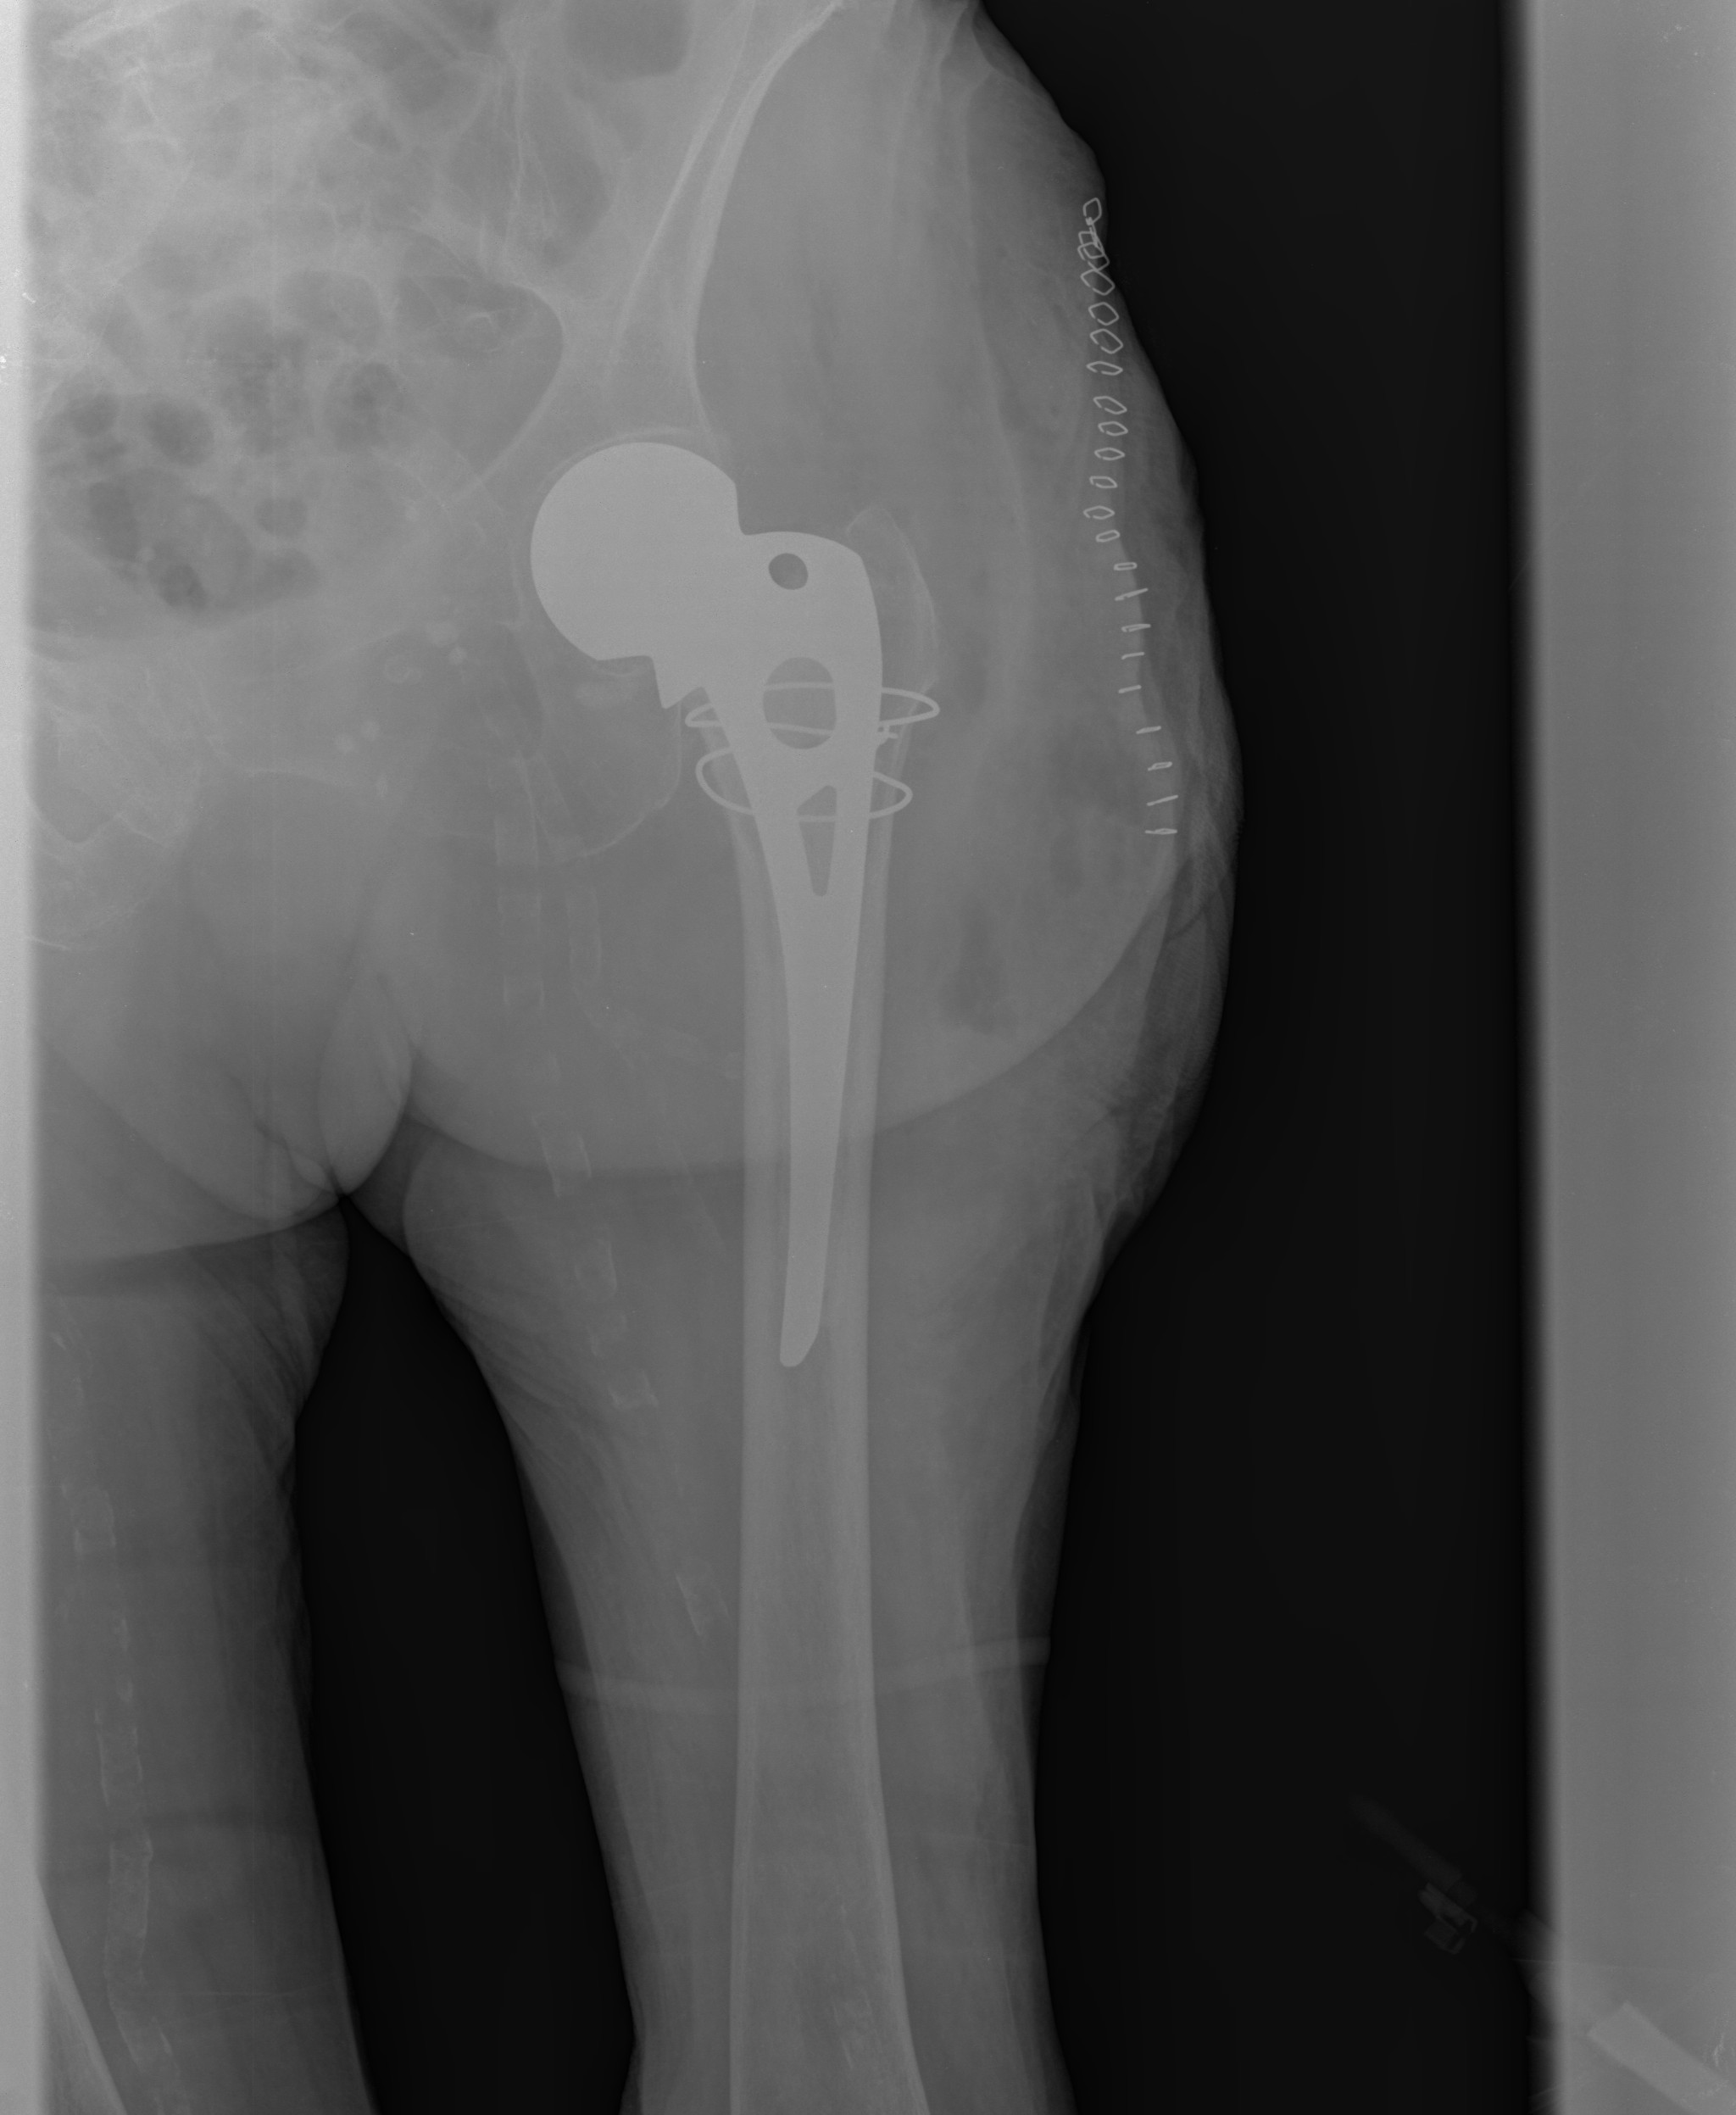
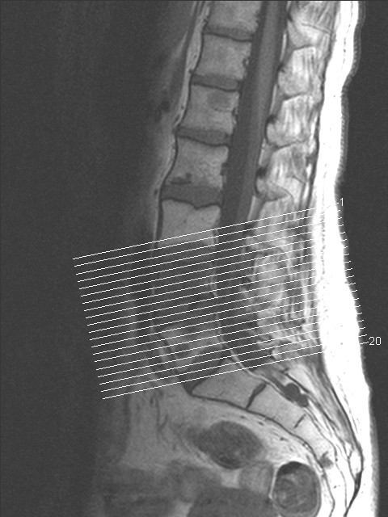
INTRODUCTION
CONTEXT MODELS
how are they determined?
how are they applied?
HEURISTICS
STATISTICAL ANALYSIS
SINGLE CODING SYSTEM
CONTEXT MODEL
ENTROPY-BASED CONCEPTS
(MUTUAL INFORMATION)
MANY IMAGE TYPES
DELAYED-DECISION ALGORITHMS
…
natural
IS THE CONTEXT MODEL SUITED TO A SINGLE CODING SYSTEM OR IMAGE TYPE?
remote sensing
medical
2

Slide 7
INTRODUCTION
RESEARCH PURPOSES
Evaluation of context models independently of the coding system
1) Simple model
2) JPEG2000-like (based on the significance state)
3) Local average approach
Use of different neighbors to compute the context
1) Intra-subband
2) Inter-subband
3) Inter-component
Focus on hyperspectral AVIRIS images
1) transformed via a 2D strategy
2) transformed via a 1D+2D strategy
3

Slide 8
TABLE OF CONTENTS
INTRODUCTION
ENTROPY-BASED MEASURE FOR
CONTEXT EVALUATION
EXPERIMENTAL RESULTS
CONCLUSIONS
Motivation
evaluate context models for different image types
in a general framework
ENTIMA
entropy-based measure that considers wavelet-transformed images
1

Slide 9
ENTROPY-BASED MEASURE FOR CONTEXT EVALUATION
PROPOSED MEASURE
4

Slide 10
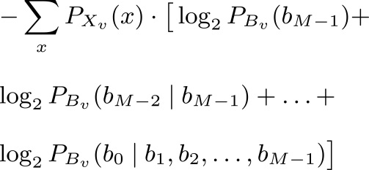
ENTROPY-BASED MEASURE FOR CONTEXT EVALUATION
PROPOSED MEASURE
order-zero entropy
magnitude of
quantized coefficients
sign of coefficients
✓
?
=
4

Slide 11
ENTROPY-BASED MEASURE FOR CONTEXT EVALUATION
PROPOSED MEASURE
4

Slide 12
ENTROPY-BASED MEASURE FOR CONTEXT EVALUATION
PROPOSED MEASURE
probability mass
function (pmf)
4

Slide 13
ENTROPY-BASED MEASURE FOR CONTEXT EVALUATION
PROPOSED MEASURE
5

Slide 14
ENTROPY-BASED MEASURE FOR CONTEXT EVALUATION
CONTEXT MODELS EVALUATED
MAGNITUDES
SIGNS
left coefficient
5

Slide 15
ENTROPY-BASED MEASURE FOR CONTEXT EVALUATION
CONTEXT MODELS EVALUATED
MAGNITUDES
SIGNS
left coefficient
5

Slide 16
ENTROPY-BASED MEASURE FOR CONTEXT EVALUATION
CONTEXT MODELS EVALUATED
MAGNITUDES
SIGNS
left coefficient
5

Slide 17
ENTROPY-BASED MEASURE FOR CONTEXT EVALUATION
CONTEXT MODELS EVALUATED
MAGNITUDES
SIGNS
left coefficient
5

Slide 18
ENTROPY-BASED MEASURE FOR CONTEXT EVALUATION
CONTEXT MODELS EVALUATED
MAGNITUDES
SIGNS
left coefficient
5

Slide 19
ENTROPY-BASED MEASURE FOR CONTEXT EVALUATION
CONTEXT MODELS EVALUATED
MAGNITUDES
SIGNS
left coefficient
significance state (JPEG2000-like)
5

Slide 20
ENTROPY-BASED MEASURE FOR CONTEXT EVALUATION
CONTEXT MODELS EVALUATED
MAGNITUDES
SIGNS
left coefficient
significance state (JPEG2000-like)
5

Slide 21
ENTROPY-BASED MEASURE FOR CONTEXT EVALUATION
CONTEXT MODELS EVALUATED
MAGNITUDES
SIGNS
left coefficient
significance state (JPEG2000-like)
local average
5

Slide 22
ENTROPY-BASED MEASURE FOR CONTEXT EVALUATION
CONTEXT MODELS EVALUATED
MAGNITUDES
SIGNS
left coefficient
significance state (JPEG2000-like)
local average
5

Slide 23
ENTROPY-BASED MEASURE FOR CONTEXT EVALUATION
CONTEXT MODELS EVALUATED
MAGNITUDES
SIGNS
left coefficient
significance state (JPEG2000-like)
local average
5

Slide 24
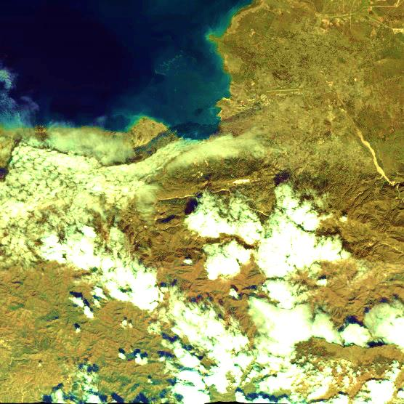
ENTROPY-BASED MEASURE FOR CONTEXT EVALUATION
DEPENDENCIES EMPLOYED IN THE CONTEXT
6

Slide 25
ENTROPY-BASED MEASURE FOR CONTEXT EVALUATION
DEPENDENCIES EMPLOYED IN THE CONTEXT
6

Slide 26
ENTROPY-BASED MEASURE FOR CONTEXT EVALUATION
DEPENDENCIES EMPLOYED IN THE CONTEXT
6

Slide 27
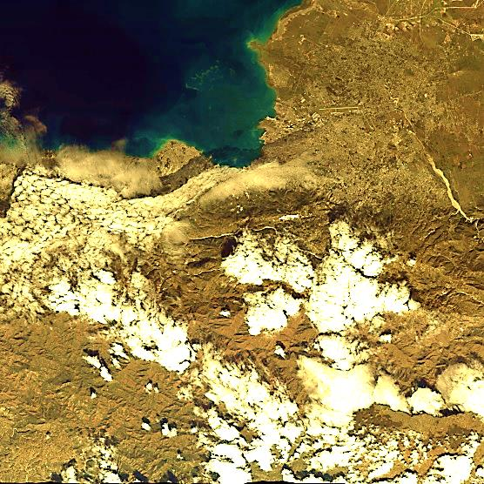
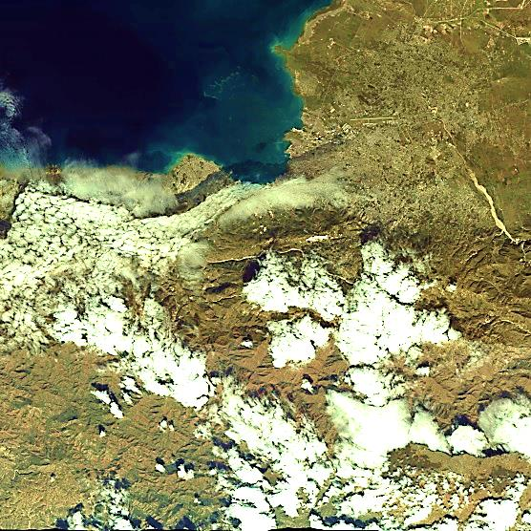
ENTROPY-BASED MEASURE FOR CONTEXT EVALUATION
DEPENDENCIES EMPLOYED IN THE CONTEXT
intra-scale
3D (inter-component)
inter-scale
6

Slide 28
ENTROPY-BASED MEASURE FOR CONTEXT EVALUATION
SUMMARY
intra-scale
inter-scale
3D (inter-component)
left coefficient
✓
✓
significance state
(JPEG2000-like)
✓
✓
✓
local average
✓
✓
✓
7

Slide 29
TABLE OF CONTENTS
INTRODUCTION
ENTROPY-BASED MEASURE FOR
CONTEXT EVALUATION
EXPERIMENTAL RESULTS
CONCLUSIONS
Motivation
evaluate context models for different image types
in a general framework
ENTIMA
entropy-based measure that considers wavelet-transformed images
1

Slide 30
EXPERIMENTAL RESULTS
8

Slide 31
EXPERIMENTAL RESULTS
Airborne Visible/Infrared Imaging Spectrometer (AVIRIS)
3 images (cuprite, jasper, lunarLake)
512x512, 224 components, 16 bits per sample
8

Slide 32
EXPERIMENTAL RESULTS
Airborne Visible/Infrared Imaging Spectrometer (AVIRIS)
3 images (cuprite, jasper, lunarLake)
512x512, 224 components, 16 bits per sample
8

Slide 33
EXPERIMENTAL RESULTS
Airborne Visible/Infrared Imaging Spectrometer (AVIRIS)
3 images (cuprite, jasper, lunarLake)
512x512, 224 components, 16 bits per sample
8

Slide 34
EXPERIMENTAL RESULTS
Airborne Visible/Infrared Imaging Spectrometer (AVIRIS)
3 images (cuprite, jasper, lunarLake)
512x512, 224 components, 16 bits per sample
8

Slide 35
EXPERIMENTAL RESULTS
Airborne Visible/Infrared Imaging Spectrometer (AVIRIS)
3 images (cuprite, jasper, lunarLake)
512x512, 224 components, 16 bits per sample
8

Slide 36
EXPERIMENTAL RESULTS
Airborne Visible/Infrared Imaging Spectrometer (AVIRIS)
3 images (cuprite, jasper, lunarLake)
512x512, 224 components, 16 bits per sample
8

Slide 37
EXPERIMENTAL RESULTS
Airborne Visible/Infrared Imaging Spectrometer (AVIRIS)
3 images (cuprite, jasper, lunarLake)
512x512, 224 components, 16 bits per sample
8

Slide 38
EXPERIMENTAL RESULTS
Airborne Visible/Infrared Imaging Spectrometer (AVIRIS)
3 images (cuprite, jasper, lunarLake)
512x512, 224 components, 16 bits per sample
8

Slide 39
EXPERIMENTAL RESULTS
Airbone Visible/Infrared Imaging Spectrometer (AVIRIS)
3 images (cuprite, jasper, lunarLake)
512x512, 224 components, 16 bits per sample
2D
1D+2D
8

Slide 40
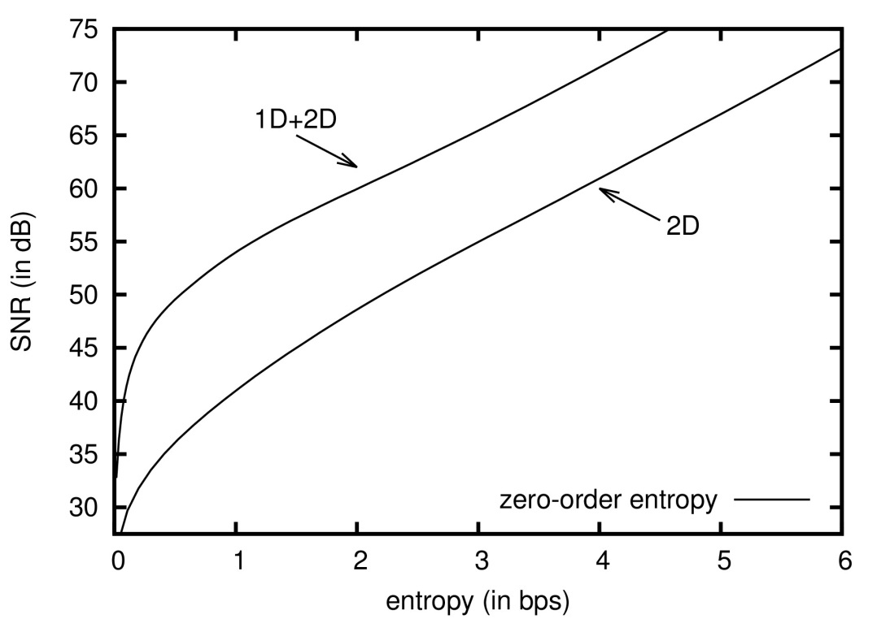
EXPERIMENTAL RESULTS
Airborne Visible/Infrared Imaging Spectrometer (AVIRIS)
3 images (cuprite, jasper, lunarLake)
512x512, 224 components, 16 bits per sample
2D
1D+2D
9

Slide 41
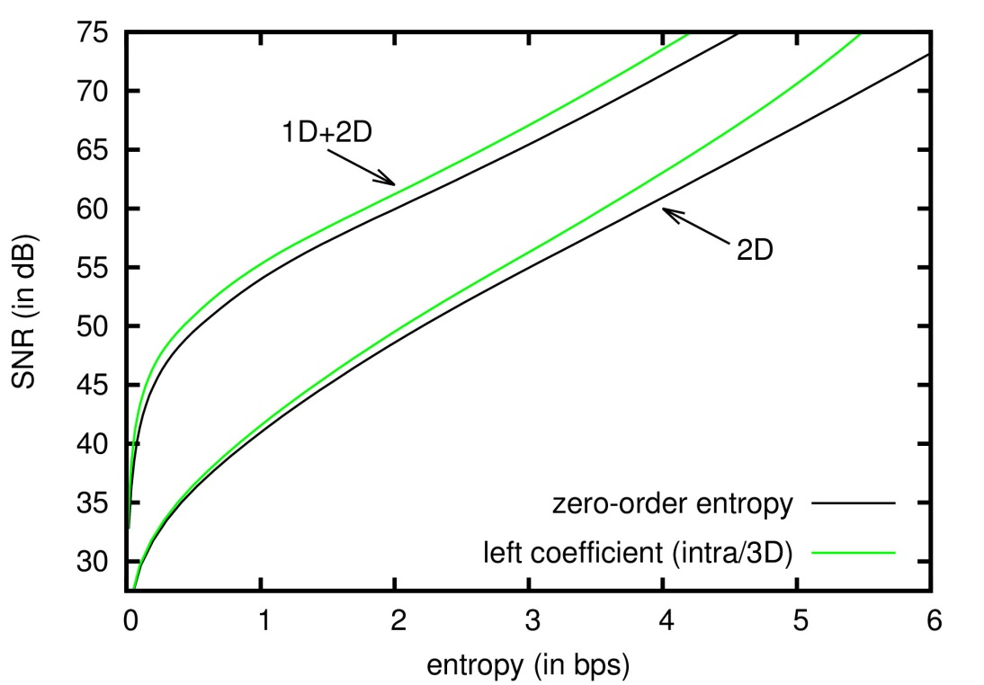
EXPERIMENTAL RESULTS
Airborne Visible/Infrared Imaging Spectrometer (AVIRIS)
3 images (cuprite, jasper, lunarLake)
512x512, 224 components, 16 bits per sample
2D
1D+2D
9

Slide 42
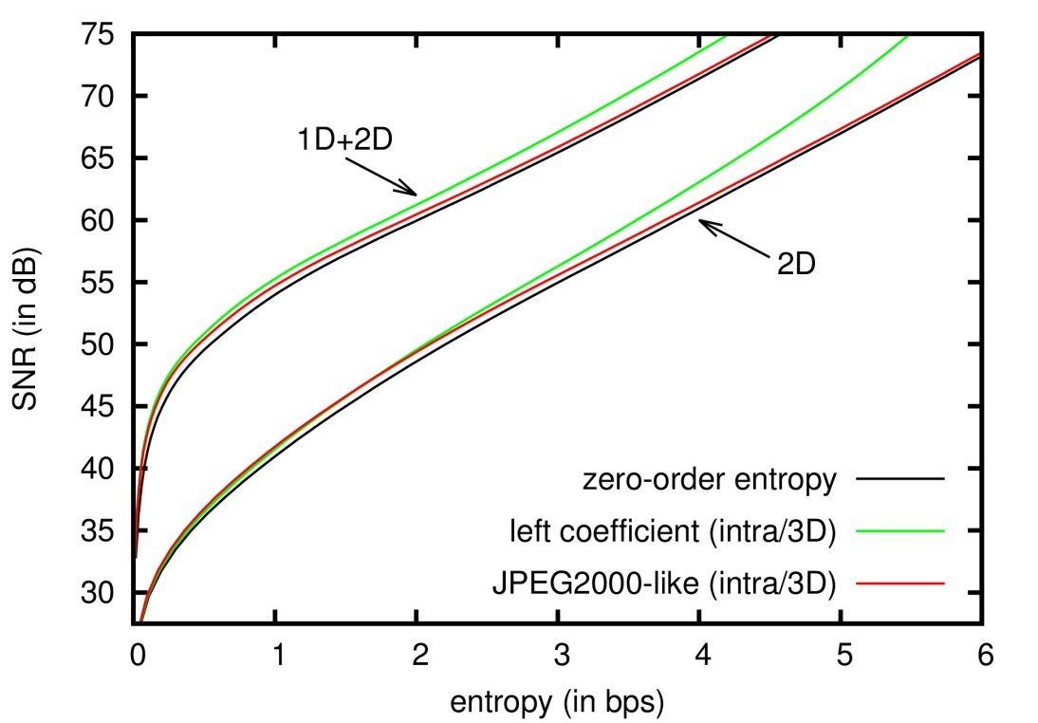
EXPERIMENTAL RESULTS
Airborne Visible/Infrared Imaging Spectrometer (AVIRIS)
3 images (cuprite, jasper, lunarLake)
512x512, 224 components, 16 bits per sample
2D
1D+2D
9

Slide 43
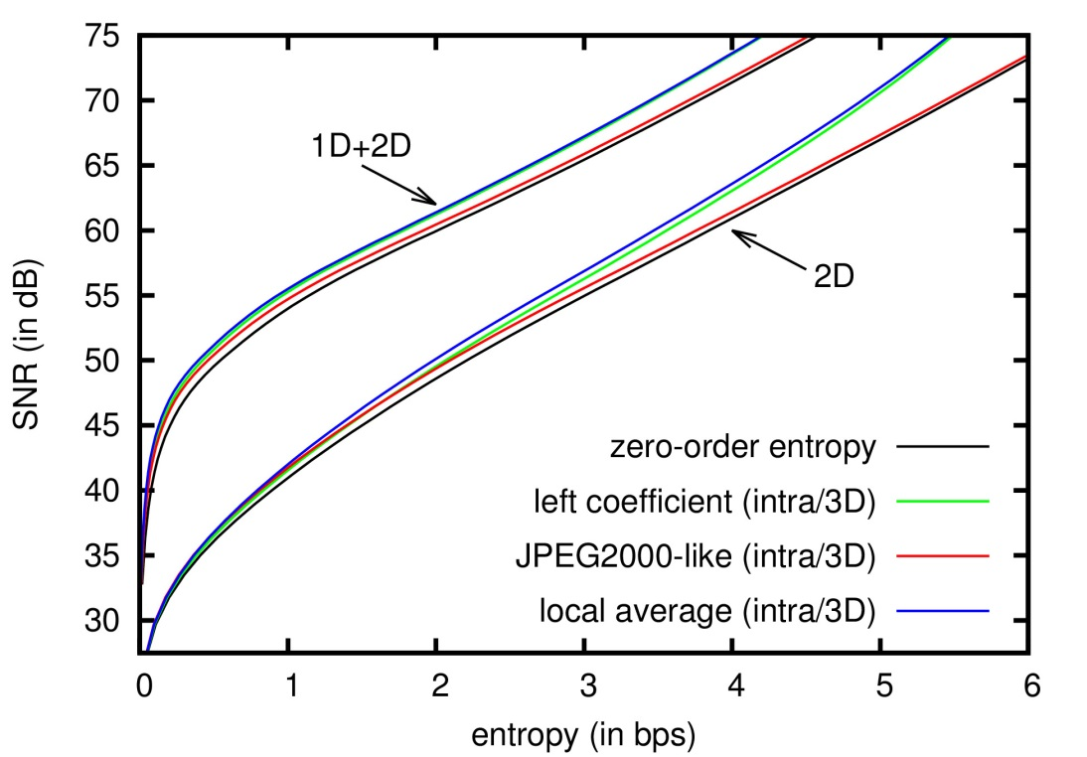
EXPERIMENTAL RESULTS
Airborne Visible/Infrared Imaging Spectrometer (AVIRIS)
3 images (cuprite, jasper, lunarLake)
512x512, 224 components, 16 bits per sample
2D
1D+2D
9

Slide 44
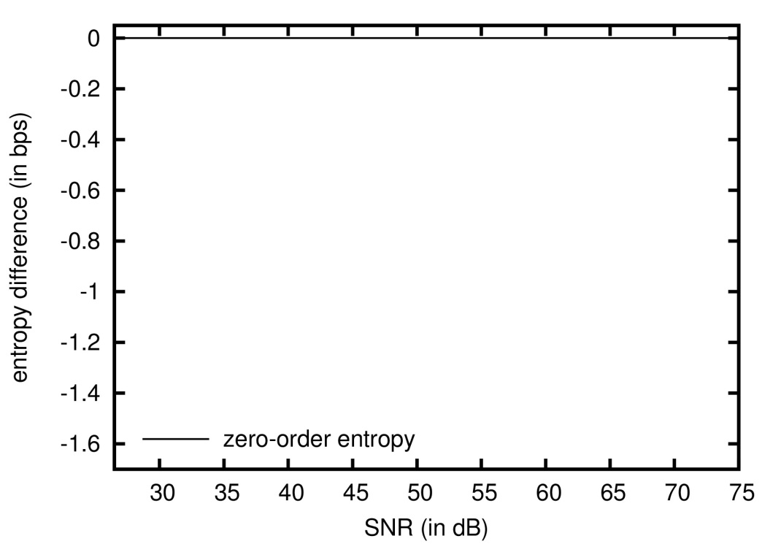
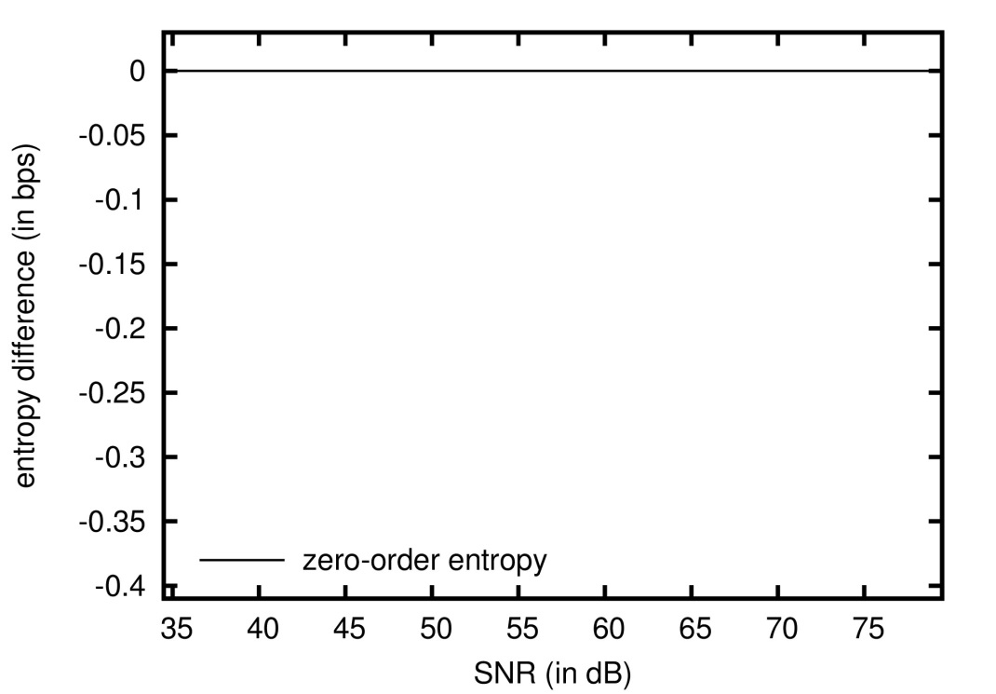
EXPERIMENTAL RESULTS
Airborne Visible/Infrared Imaging Spectrometer (AVIRIS)
3 images (cuprite, jasper, lunarLake)
512x512, 224 components, 16 bits per sample
2D
1D+2D
10

Slide 45
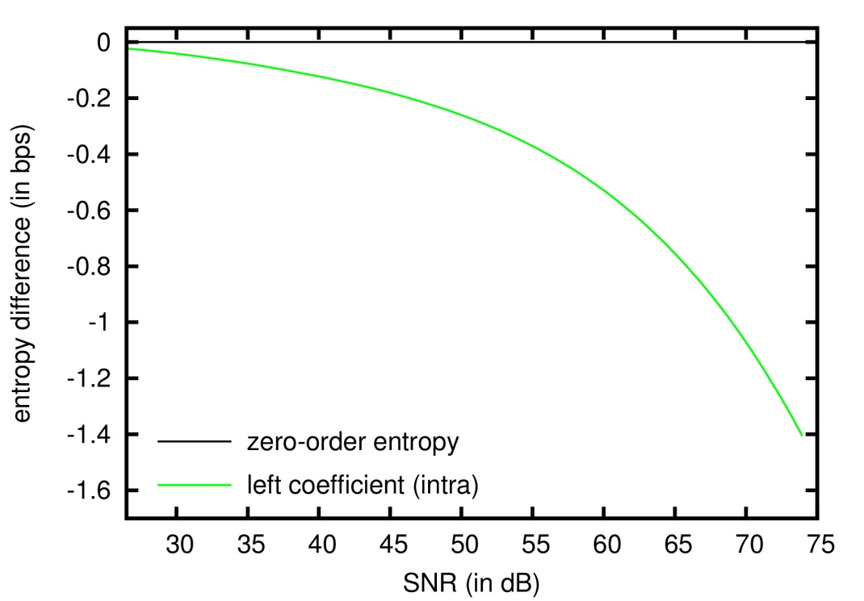
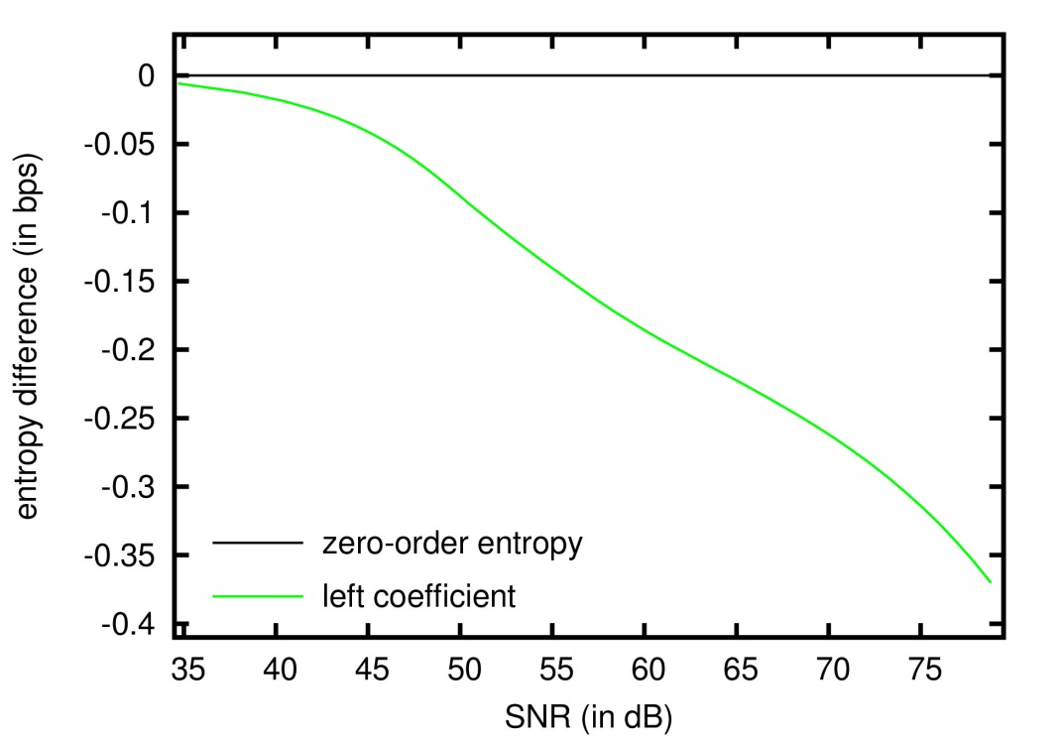
EXPERIMENTAL RESULTS
Airborne Visible/Infrared Imaging Spectrometer (AVIRIS)
3 images (cuprite, jasper, lunarLake)
512x512, 224 components, 16 bits per sample
2D
1D+2D
10

Slide 46
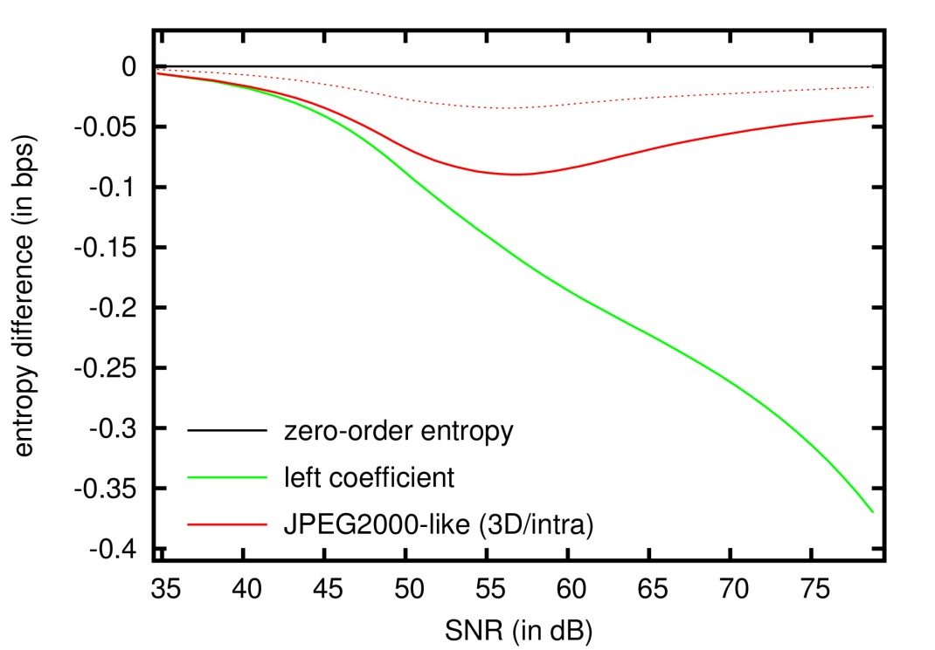
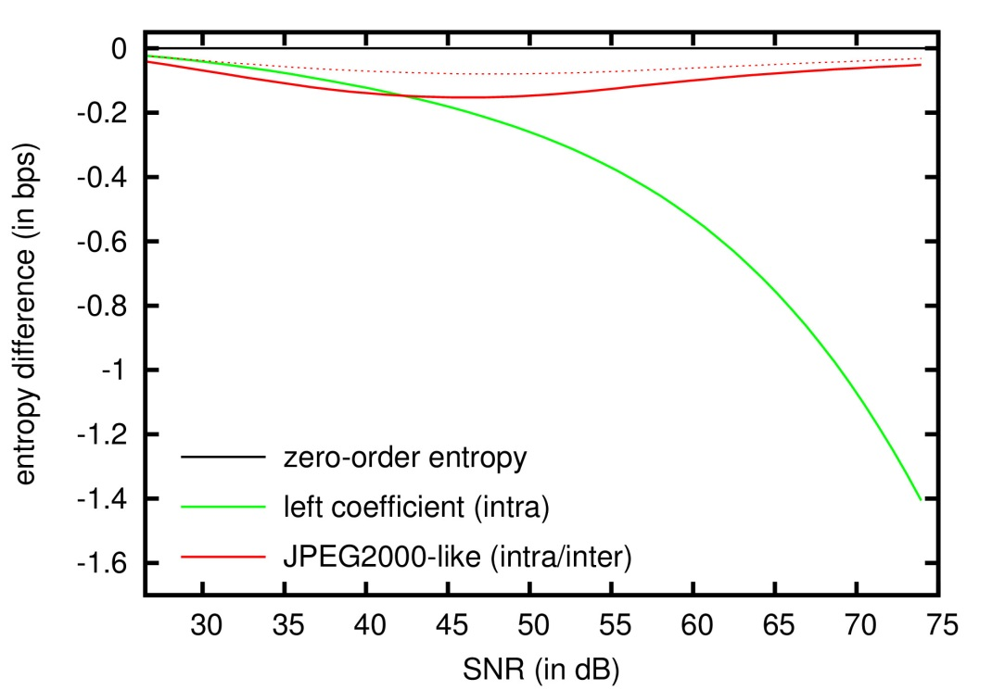
EXPERIMENTAL RESULTS
Airborne Visible/Infrared Imaging Spectrometer (AVIRIS)
3 images (cuprite, jasper, lunarLake)
512x512, 224 components, 16 bits per sample
2D
1D+2D
10

Slide 47
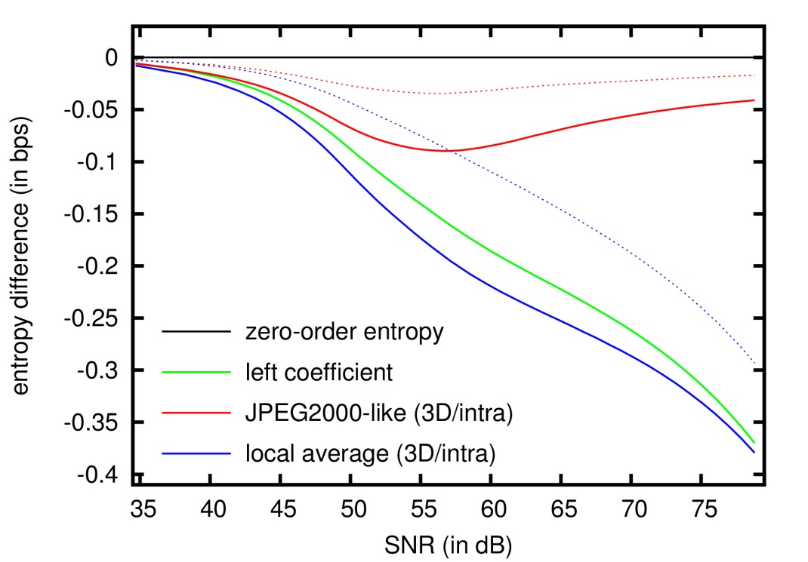
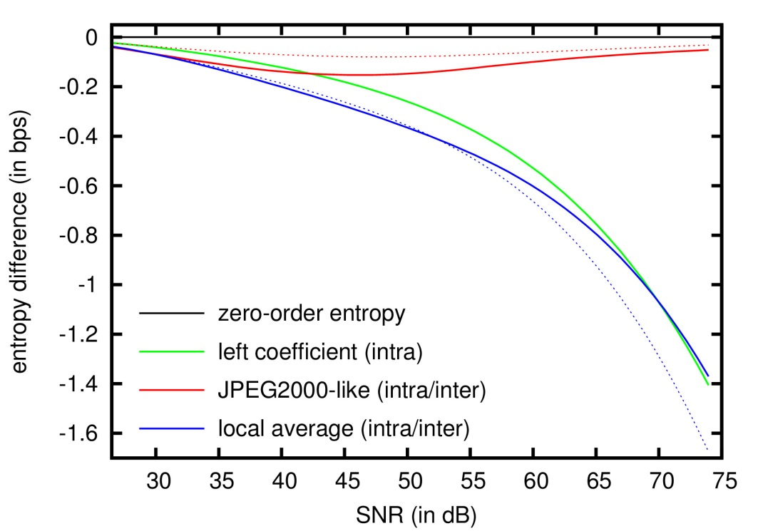
EXPERIMENTAL RESULTS
Airborne Visible/Infrared Imaging Spectrometer (AVIRIS)
3 images (cuprite, jasper, lunarLake)
512x512, 224 components, 16 bits per sample
2D
1D+2D
10

Slide 48
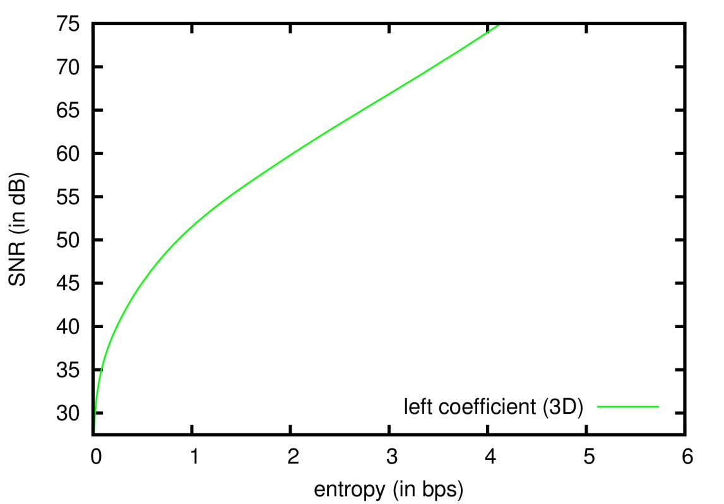
EXPERIMENTAL RESULTS
Airborne Visible/Infrared Imaging Spectrometer (AVIRIS)
3 images (cuprite, jasper, lunarLake)
512x512, 224 components, 16 bits per sample
2D
1D+2D
11

Slide 49
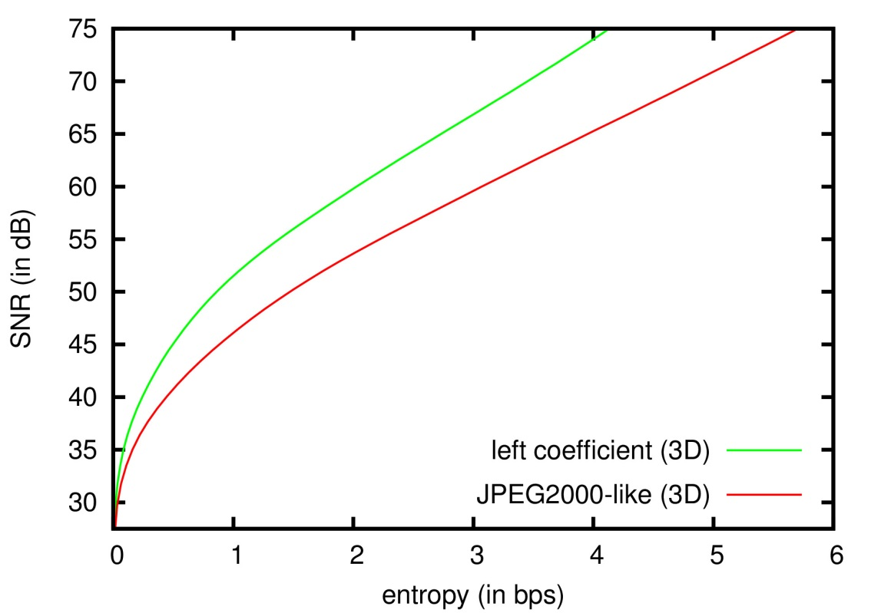
EXPERIMENTAL RESULTS
Airborne Visible/Infrared Imaging Spectrometer (AVIRIS)
3 images (cuprite, jasper, lunarLake)
512x512, 224 components, 16 bits per sample
2D
1D+2D
11

Slide 50
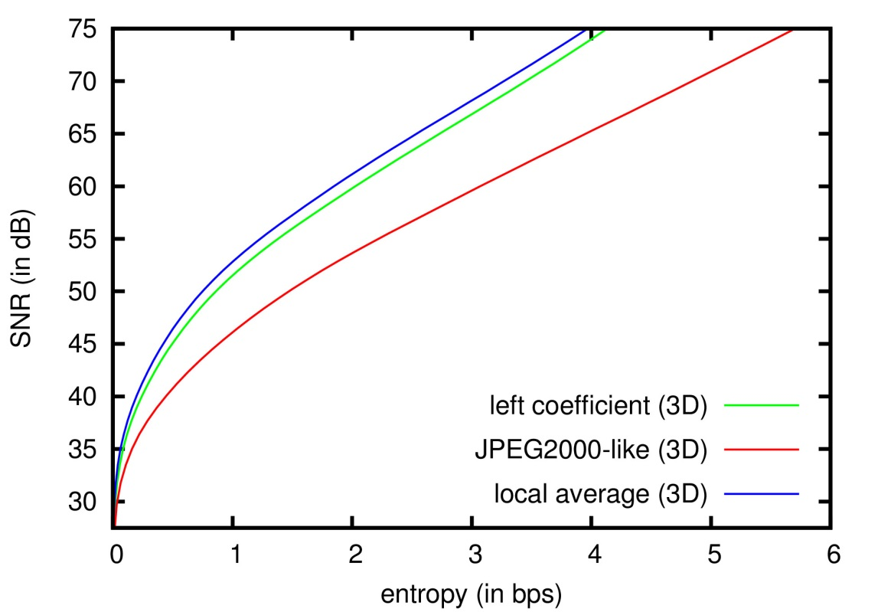
EXPERIMENTAL RESULTS
Airborne Visible/Infrared Imaging Spectrometer (AVIRIS)
3 images (cuprite, jasper, lunarLake)
512x512, 224 components, 16 bits per sample
2D
1D+2D
11

Slide 51
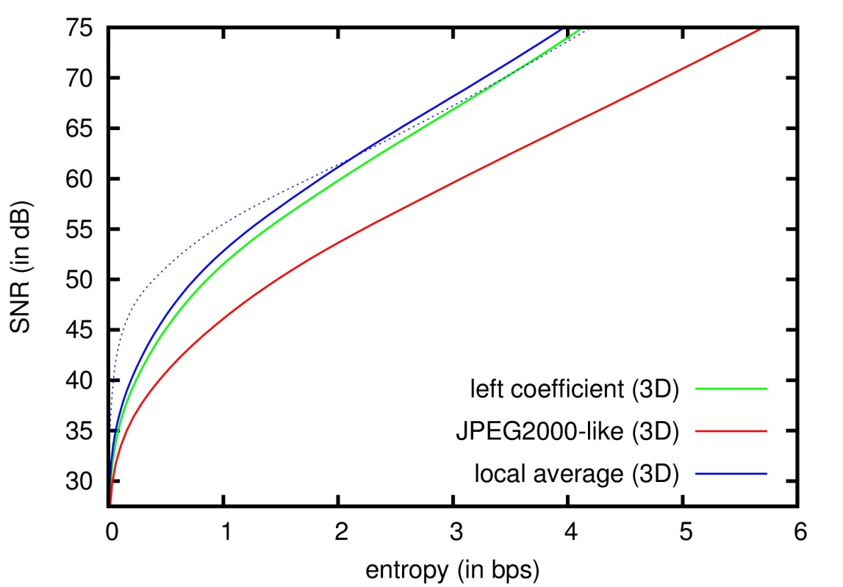
EXPERIMENTAL RESULTS
Airborne Visible/Infrared Imaging Spectrometer (AVIRIS)
3 images (cuprite, jasper, lunarLake)
512x512, 224 components, 16 bits per sample
2D
1D+2D
11

Slide 52
TABLE OF CONTENTS
INTRODUCTION
ENTROPY-BASED MEASURE FOR
CONTEXT EVALUATION
EXPERIMENTAL RESULTS
CONCLUSIONS
Motivation
evaluate context models for different image types
in a general framework
ENTIMA
entropy-based measure that considers wavelet-transformed images
1

Slide 53
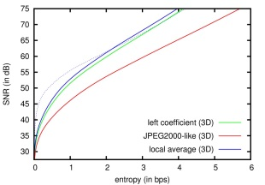
CONCLUSIONS
Motivation
evaluate context models for different image types
in a general framework
ENTIMA
entropy-based measure that considers wavelet-transformed images
Context models
evaluation of three well-known context models in the literature
Hyper-spectral images
application of the proposed measure to AVIRIS images
the significance state is not appropriate
the local average approach with inter-scale and 3D dependencies is effective for the 2D strategy
the 1D+2D strategy should be used with 3D dependencies
Results
12

Slide 54
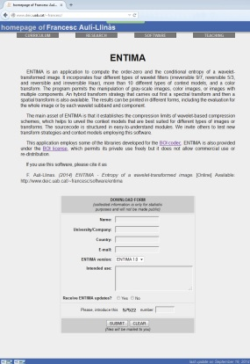
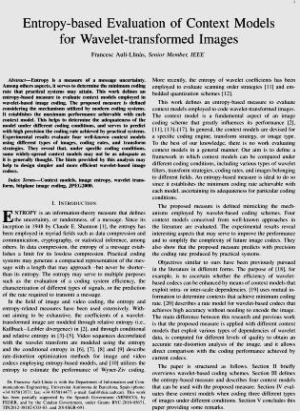
CONCLUSIONS
SOFTWARE TOOL
http://www.deic.uab.cat/~francesc/software/entima
10 different types of context models
4 wavelet filter banks (reversible 5/3, irreversible 9/7,
reversible Haar, irreversible Haar)
1 color transform
2D and 1D+2D transform strategies
IEEE TRANSACTIONS ON IMAGE PROCESSING
Entropy-based evaluation of context models for
wavelet-transformed images
13

