Slide 1
Distortion estimators
for bitplane image coding
Francesc Aulí-Llinàs
Department of Information and Communications Engineering
Universitat Autònoma de Barcelona, Spain

Slide 2
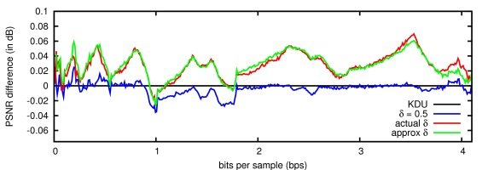
TABLE OF CONTENTS
1. INTRODUCTION
2. PDF-BASED DISTORTION
ESTIMATORS
3. EXPERIMENTS
4. CONCLUSIONS
Distortion estimation
Code-stream transcoding
Interactive image and video transmission
Applications

Slide 3
TABLE OF CONTENTS
1. INTRODUCTION
2. PDF-BASED DISTORTION
ESTIMATORS
3. EXPERIMENTS
4. CONCLUSIONS
Distortion estimation
Code-stream transcoding
Interactive image and video transmission
Applications

Slide 4
INTRODUCTION
BITPLANE CODING STRATEGY
MOST SIGNIFICANT BITPLANE (MSB)
significance coding
mid-point reconstruction
1
1 1
0 0 0
0 0 0 0
…
original coefficients
recovered coefficients

Slide 5
INTRODUCTION
BITPLANE CODING STRATEGY
MSB - 1
significance coding
1
1
0 0 0 0
…
original coefficients
recovered coefficients

Slide 6
INTRODUCTION
BITPLANE CODING STRATEGY
MSB - 1
refinement coding
1
0 0 0
original coefficients
recovered coefficients

Slide 7
INTRODUCTION
BITPLANE CODING STRATEGY
original coefficients
recovered coefficients
Progressive refinement of image distortion
Lossy-to-lossless coding
Well-suited digital representation for computers
Mid-point reconstruction does NOT correspond with the nature of the signal

Slide 8
INTRODUCTION
DISTRIBUTION OF WAVELET COEFFICIENTS
wavelet coefficients
in a subband
distribution

Slide 9
INTRODUCTION
DISTRIBUTION OF WAVELET COEFFICIENTS

Slide 10
INTRODUCTION
DISTRIBUTION OF WAVELET COEFFICIENTS
Common model:
generalized Laplacian
distribution
number of coefficients
-
0
+

Slide 11
INTRODUCTION
DISTRIBUTION OF WAVELET COEFFICIENTS
Common model:
generalized Laplacian
distribution
number of coefficients
-
0
+

Slide 12
INTRODUCTION
MID-POINT RECONSTRUCTION
1) RECONSTRUCTION PROCEDURE CARRIED
OUT IN THE DECODER
2) DETERMINATION OF DISTORTION DECREASES
IN THE ENCODER
FAST COMPUTATION
OF DISTORTION DECREASES
3) DISTORTION
ESTIMATORS
TRANSCODING OPERATIONS
DISTORTION ESTIMATION
1 1 1
0 0 0 0
ΔD

Slide 13
INTRODUCTION
MID-POINT RECONSTRUCTION
1) RECONSTRUCTION PROCEDURE CARRIED
OUT IN THE DECODER
2) DETERMINATION OF DISTORTION DECREASES
IN THE ENCODER
FAST COMPUTATION
OF DISTORTION DECREASES
3) DISTORTION
ESTIMATORS
TRANSCODING OPERATIONS
DISTORTION ESTIMATION
RESEARCH PURPOSE:
DETERMINATION OF DISTORTION ESTIMATORS
THAT BETTER CAPTURE THE SIGNAL’S NATURE
Application to the PCRD process of JPEG2000

Slide 14
TABLE OF CONTENTS
1. INTRODUCTION
2. PDF-BASED DISTORTION
ESTIMATORS
3. EXPERIMENTS
4. CONCLUSIONS
Distortion estimation
Code-stream transcoding
Interactive image and video transmission
Applications

Slide 15
PDF-BASED DISTORTION ESTIMATORS
DETERMINATION OF THE ESTIMATORS
coefficients
distribution
within a subband
2^{P*}
2^{P*+1}
δ_{P*}= 0.5
probability density function (pdf)
2^{P*+1}
[
]
p(x)
(
( 2^{P*} + δ_{P*}· 2^{P*} )
)²
dx
ΔDsig_{P*} =
∫
x² -
x -
2^{P*}
ΔDref_{P*} = …

Slide 16
PDF-BASED DISTORTION ESTIMATORS
DETERMINATION OF THE ESTIMATORS
to minimize the average distortion
coefficients have to be reconstructed as the
centroid of the quantization interval
transmitted
bitplane P*
1
1
1
1
1
1
1
1
1
0
1
0
0
1
0
1
0
1
1
0
1
1
0
1
1
1
0
ζ_{P*}
0
0
1
0
1
0
0
0
0
0
1
0
1
1
1
1
0
1
0
0
0
1
0
1
0
0
0
mean of non-
transmitted bits
δ_{P*}= ζ_{P*} / 2^{P*}
2^{P*+1}
[
]
p(x)
(
( 2^{P*} + δ_{P*}· 2^{P*} )
)²
dx
ΔDsig_{P*} =
∫
x² -
x -
2^{P*}

Slide 17
PDF-BASED DISTORTION ESTIMATORS
DETERMINATION OF THE ESTIMATORS
to minimize the average distortion
coefficients have to be reconstructed as the
centroid of the quantization interval
p(x)
2^{P*}
2^{P*+1}
2^{P*+1}
[
]
p(x)
(
( 2^{P*} + δ_{P*}· 2^{P*} )
)²
dx
ΔDsig_{P*} =
∫
x² -
x -
2^{P*}

Slide 18
PDF-BASED DISTORTION ESTIMATORS
DETERMINATION OF THE ESTIMATORS
to minimize the average distortion
coefficients have to be reconstructed as the
centroid of the quantization interval
p(x)
2^{P*}
ζ_{P*}
2^{P*+1}
accumulated probability = 0.5
2^{P*+1}
[
]
p(x)
(
( 2^{P*} + δ_{P*}· 2^{P*} )
)²
dx
ΔDsig_{P*} =
∫
x² -
x -
2^{P*}

Slide 19
PDF-BASED DISTORTION ESTIMATORS
DETERMINATION OF THE ESTIMATORS
to minimize the average distortion
coefficients have to be reconstructed as the
centroid of the quantization interval
p(x)
2^{P*}
ζ_{P*}
2^{P*+1}
2^{P*+1}
[
]
p(x)
(
( 2^{P*} + δ_{P*}· 2^{P*} )
)²
dx
ΔDsig_{P*} =
∫
x² -
x -
2^{P*}

Slide 20
PDF-BASED DISTORTION ESTIMATORS
DETERMINATION OF THE ESTIMATORS
to minimize the average distortion
coefficients have to be reconstructed as the
centroid of the quantization interval
p(x)
2^{P*}
ζ_{P*}
2^{P*+1}
2^{P*+1}
[
]
p(x)
(
( 2^{P*} + δ_{P*}· 2^{P*} )
)²
dx
ΔDsig_{P*} =
∫
x² -
x -
2^{P*}

Slide 21
PDF-BASED DISTORTION ESTIMATORS
DETERMINATION OF THE ESTIMATORS
to minimize the average distortion
coefficients have to be reconstructed as the
centroid of the quantization interval
p(x)
2^{P*}
ζ_{P*}
2^{P*+1}
2^{P*+1}
[
]
p(x)
(
( 2^{P*} + δ_{P*}· 2^{P*} )
)²
dx
ΔDsig_{P*} =
∫
x² -
x -
2^{P*}

Slide 22
PDF-BASED DISTORTION ESTIMATORS
DETERMINATION OF THE ESTIMATORS
to minimize the average distortion
coefficients have to be reconstructed as the
centroid of the quantization interval
p(x)
2^{P*}
ζ_{P*}
2^{P*+1}
2^{P*+1}
[
]
p(x)
(
( 2^{P*} + δ_{P*}· 2^{P*} )
)²
dx
ΔDsig_{P*} =
∫
x² -
x -
2^{P*}

Slide 23
PDF-BASED DISTORTION ESTIMATORS
DETERMINATION OF THE ESTIMATORS
to minimize the average distortion
coefficients have to be reconstructed as the
centroid of the quantization interval
p(x)
CENTROIDS ARE NOT COMMONLY
AVAILABLE IN PRACTICE
2^{P*}
ζ_{P*}
2^{P*+1}
2^{P*+1}
[
]
p(x)
(
( 2^{P*} + δ_{P*}· 2^{P*} )
)²
dx
ΔDsig_{P*} =
∫
x² -
x -
2^{P*}

Slide 24
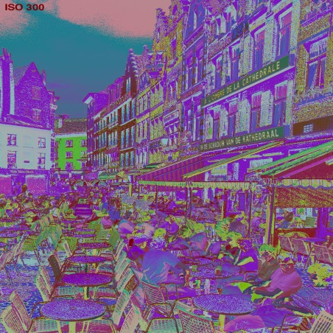
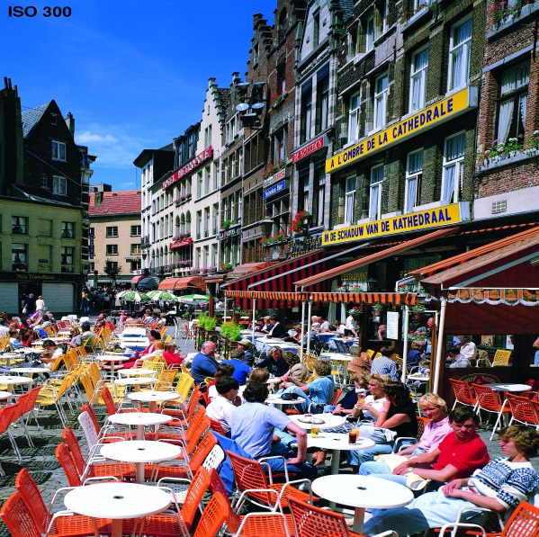
PDF-BASED DISTORTION ESTIMATORS
CENTROIDS ESTIMATION
dyadic wavelet decomposition

Slide 25
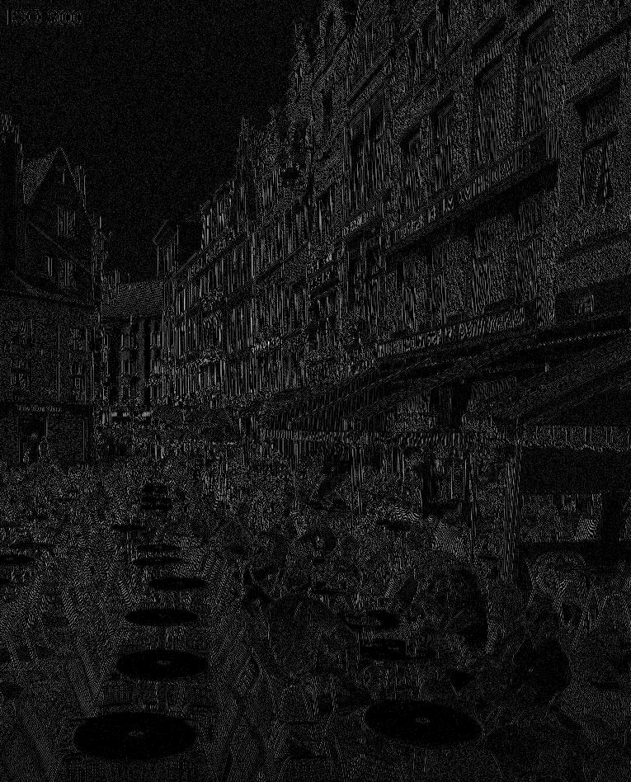
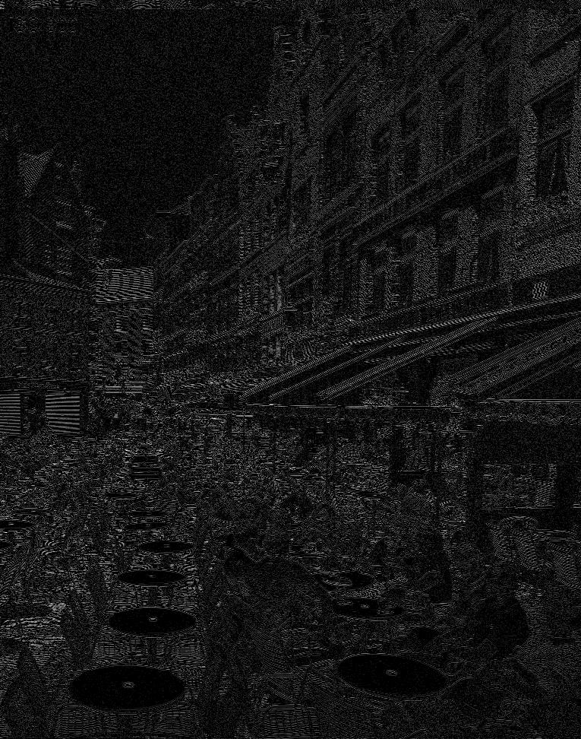
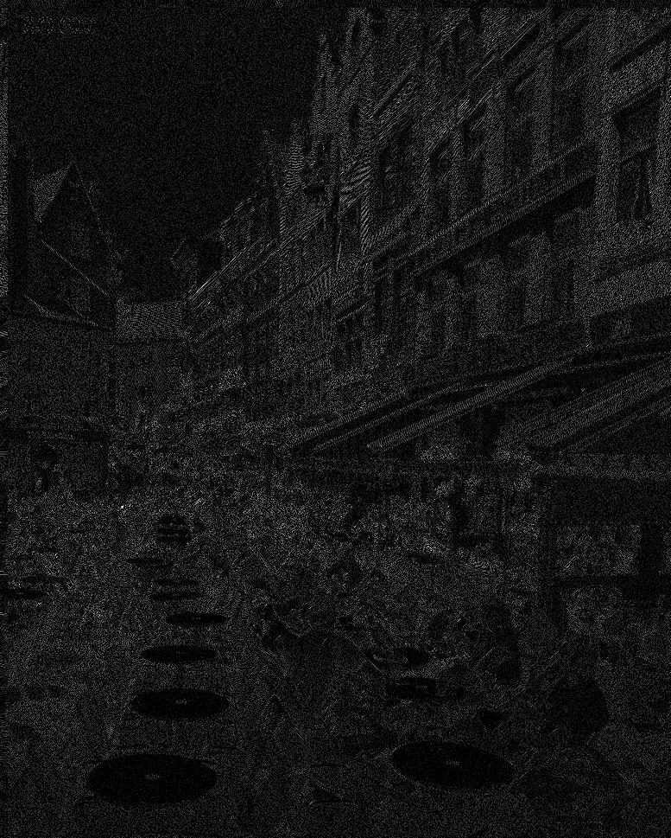
PDF-BASED DISTORTION ESTIMATORS
CENTROIDS ESTIMATION
dyadic wavelet decomposition
HL₁
LH₁
HH₁

Slide 26
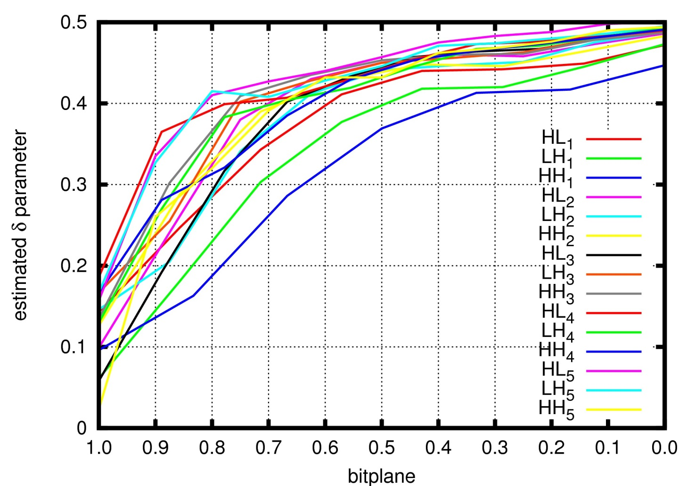
PDF-BASED DISTORTION ESTIMATORS
CENTROIDS ESTIMATION
dyadic wavelet decomposition
Portrait image - 5 wavelet levels (9/7 DWT)
LL₂
HL₂
HL₁
LH₂
HH₂
LH₁
HH₁

Slide 27
PDF-BASED DISTORTION ESTIMATORS
CENTROIDS ESTIMATION
dyadic wavelet decomposition
Portrait image - 5 wavelet levels (9/7 DWT)
LL₂
HL₂
HL₁
LH₂
HH₂
LH₁
HH₁

Slide 28
PDF-BASED DISTORTION ESTIMATORS
CENTROIDS ESTIMATION
dyadic wavelet decomposition
Portrait image - 5 wavelet levels (9/7 DWT)
LL₂
HL₂
HL₁
LH₂
HH₂
LH₁
HH₁

Slide 29
PDF-BASED DISTORTION ESTIMATORS
CENTROIDS ESTIMATION
dyadic wavelet decomposition
Portrait image - 5 wavelet levels (9/7 DWT)
LL₂
HL₂
HL₁
LH₂
HH₂
LH₁
HH₁
(
)
K_{b} – P
log₁₀
K_{b}
Practical advantage:
implementations can use pre-computed lookup tables for and
δ_{P,b} =
+ 0.475
5
ΔDsig_{P}
ΔDref_{P}

Slide 30
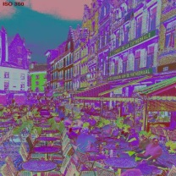
PDF-BASED DISTORTION ESTIMATORS
APPLICATION TO JPEG2000
core coding system
ORIGINAL IMAGE
MULTI-COMPONENT
TRANSFORM
WAVELET
TRANSFORM
QUANTIZATION
TIER-1 CODING
TIER-2 CODING
JP2 codestream

Slide 31
PDF-BASED DISTORTION ESTIMATORS
APPLICATION TO JPEG2000
core coding system
ORIGINAL IMAGE
MULTI-COMPONENT
TRANSFORM
WAVELET
TRANSFORM
QUANTIZATION
TIER-1 CODING
TIER-2 CODING
JP2 codestream

Slide 32
PDF-BASED DISTORTION ESTIMATORS
APPLICATION TO JPEG2000
core coding system
ORIGINAL IMAGE
MULTI-COMPONENT
TRANSFORM
WAVELET
TRANSFORM
QUANTIZATION
TIER-1 CODING
TIER-2 CODING
JP2 codestream

Slide 33
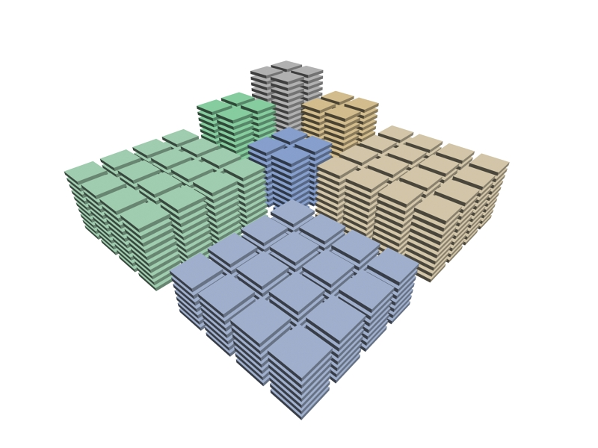
PDF-BASED DISTORTION ESTIMATORS
APPLICATION TO JPEG2000
core coding system
ORIGINAL IMAGE
MULTI-COMPONENT
TRANSFORM
WAVELET
TRANSFORM
QUANTIZATION
TIER-1 CODING
TIER-2 CODING
JP2 codestream

Slide 34
PDF-BASED DISTORTION ESTIMATORS
APPLICATION TO JPEG2000
core coding system
ORIGINAL IMAGE
MULTI-COMPONENT
TRANSFORM
WAVELET
TRANSFORM
QUANTIZATION
TIER-1 CODING
TIER-2 CODING
JP2 codestream

Slide 35
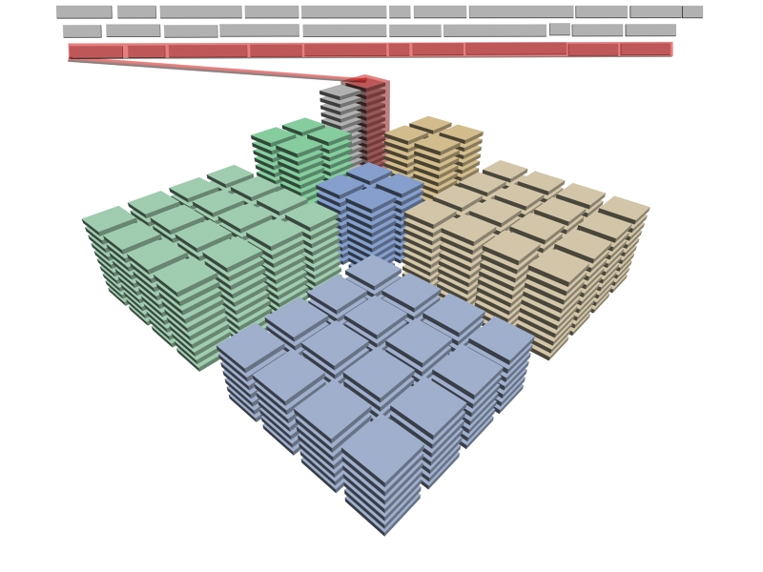
PDF-BASED DISTORTION ESTIMATORS
APPLICATION TO JPEG2000
core coding system
ORIGINAL IMAGE
MULTI-COMPONENT
TRANSFORM
WAVELET
TRANSFORM
QUANTIZATION
TIER-1 CODING
TIER-2 CODING
JP2 codestream

Slide 36
PDF-BASED DISTORTION ESTIMATORS
APPLICATION TO JPEG2000
core coding system
ORIGINAL IMAGE
MULTI-COMPONENT
TRANSFORM
WAVELET
TRANSFORM
QUANTIZATION
TIER-1 CODING
TIER-2 CODING
JP2 codestream

Slide 37
PDF-BASED DISTORTION ESTIMATORS
APPLICATION TO JPEG2000
core coding system
ORIGINAL IMAGE
MULTI-COMPONENT
TRANSFORM
WAVELET
TRANSFORM
QUANTIZATION
TIER-1 CODING
PCRD
TIER-2 CODING
JP2 codestream
final codestream

Slide 38
PDF-BASED DISTORTION ESTIMATORS
APPLICATION TO JPEG2000
core coding system
ORIGINAL IMAGE
R¹,D¹
R²,D²
R³,D³
R⁴,D⁴
R⁵,D⁵
MULTI-COMPONENT
TRANSFORM
D
WAVELET
TRANSFORM
1
2
QUANTIZATION
convex hull
3
4
TIER-1 CODING
5
PCRD
R
TIER-2 CODING
generalized Lagrange multiplier
JP2 codestream

Slide 39
PDF-BASED DISTORTION ESTIMATORS
APPLICATION TO JPEG2000
core coding system
ORIGINAL IMAGE
R¹,D¹
R²,D²
R³,D³
R⁴,D⁴
R⁵,D⁵
MULTI-COMPONENT
TRANSFORM
D
WAVELET
TRANSFORM
1
2
QUANTIZATION
convex hull
3
4
TIER-1 CODING
5
PCRD
R
TIER-2 CODING
generalized Lagrange multiplier
JP2 codestream
D = ΔDsig_{P} · #S + ΔDref_{P} · #R

Slide 40
TABLE OF CONTENTS
1. INTRODUCTION
2. PDF-BASED DISTORTION
ESTIMATORS
3. EXPERIMENTS
4. CONCLUSIONS
Distortion estimation
Code-stream transcoding
Interactive image and video transmission
Applications

Slide 41
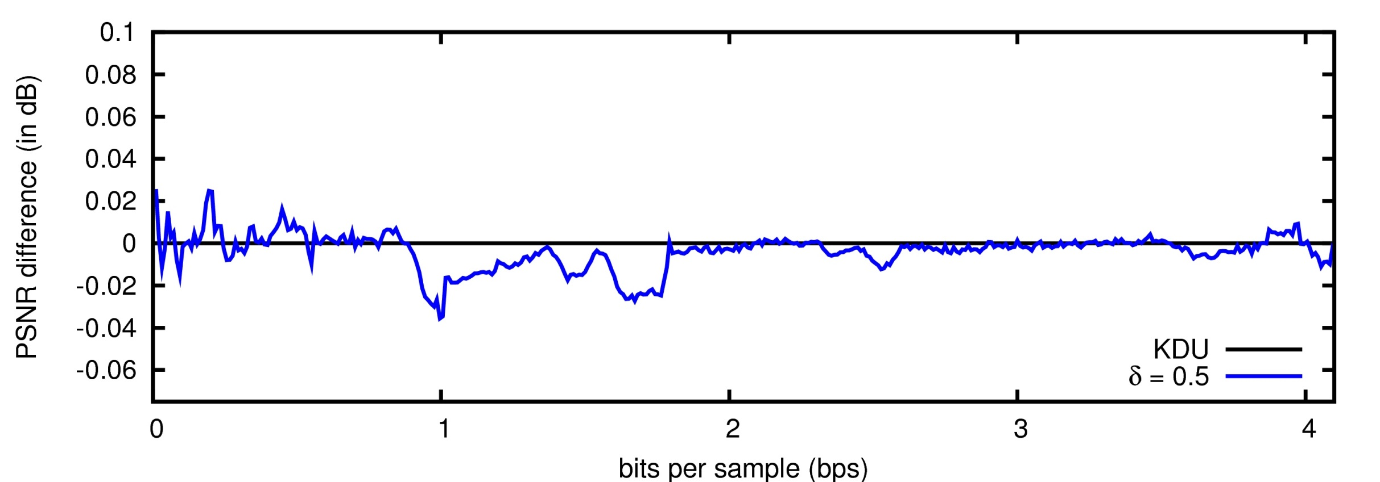
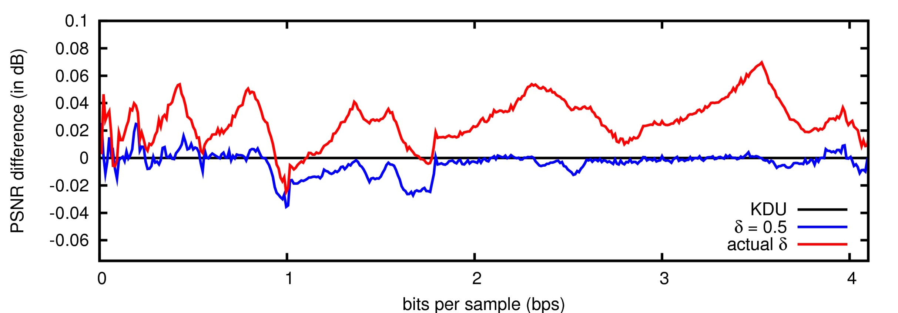
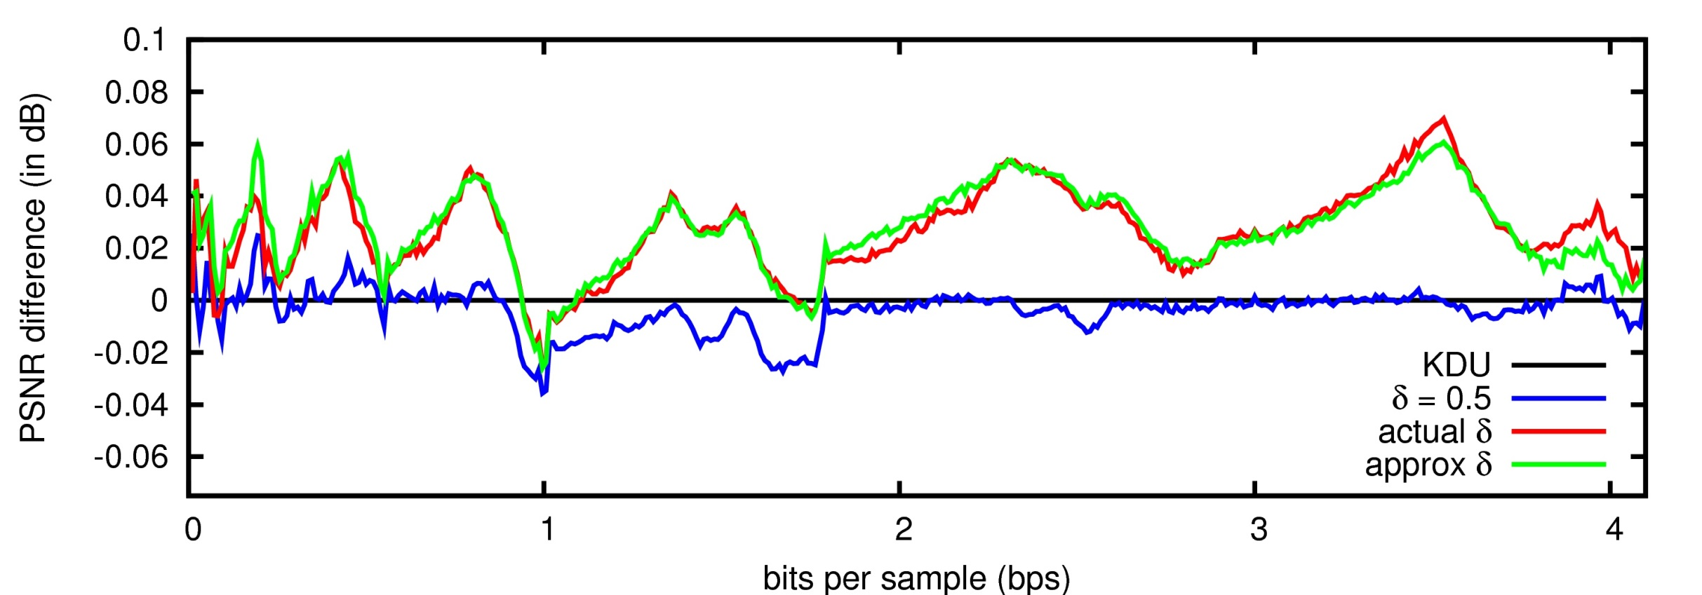
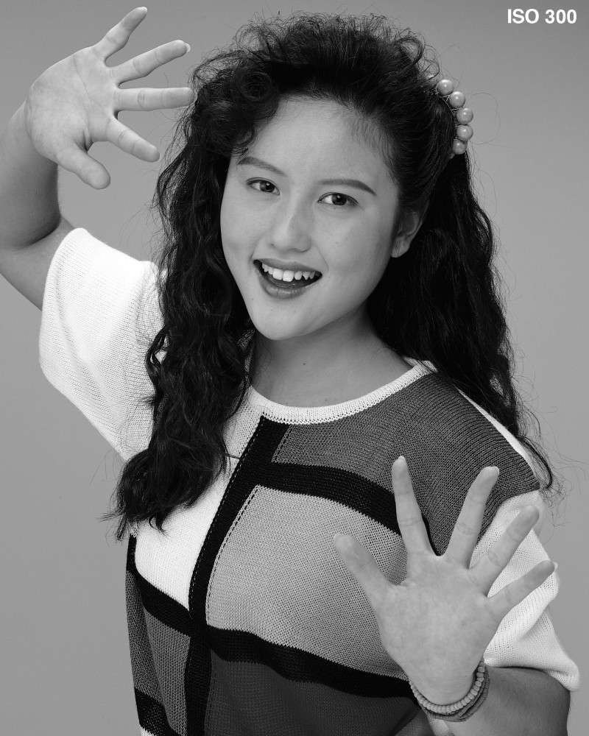
EXPERIMENTS
LOSSY MODE
 | CODER | DECODER
KDU | 0.5 ~ actual | 0.5
δ=0.5 | 0.5 ~ ΔDsig ΔDref | 0.5
actual δ | actual ~ ΔDsig ΔDref | actual
approx δ | approx ~ ΔDsig ΔDref | approx
“Portrait” image
5 DWT levels
9/7 filter-taps
64x64 codeblocks

Slide 42
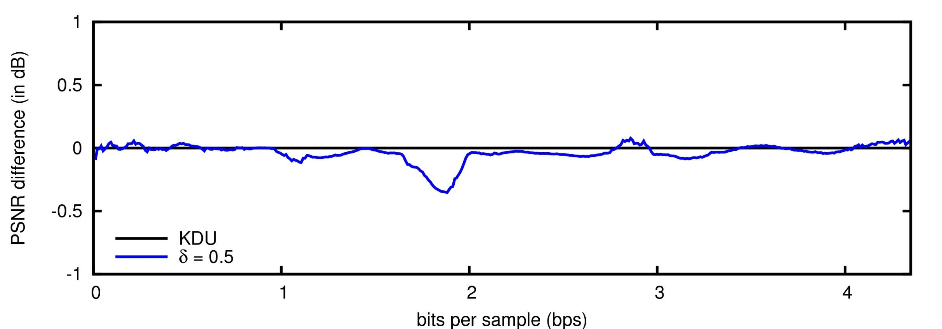
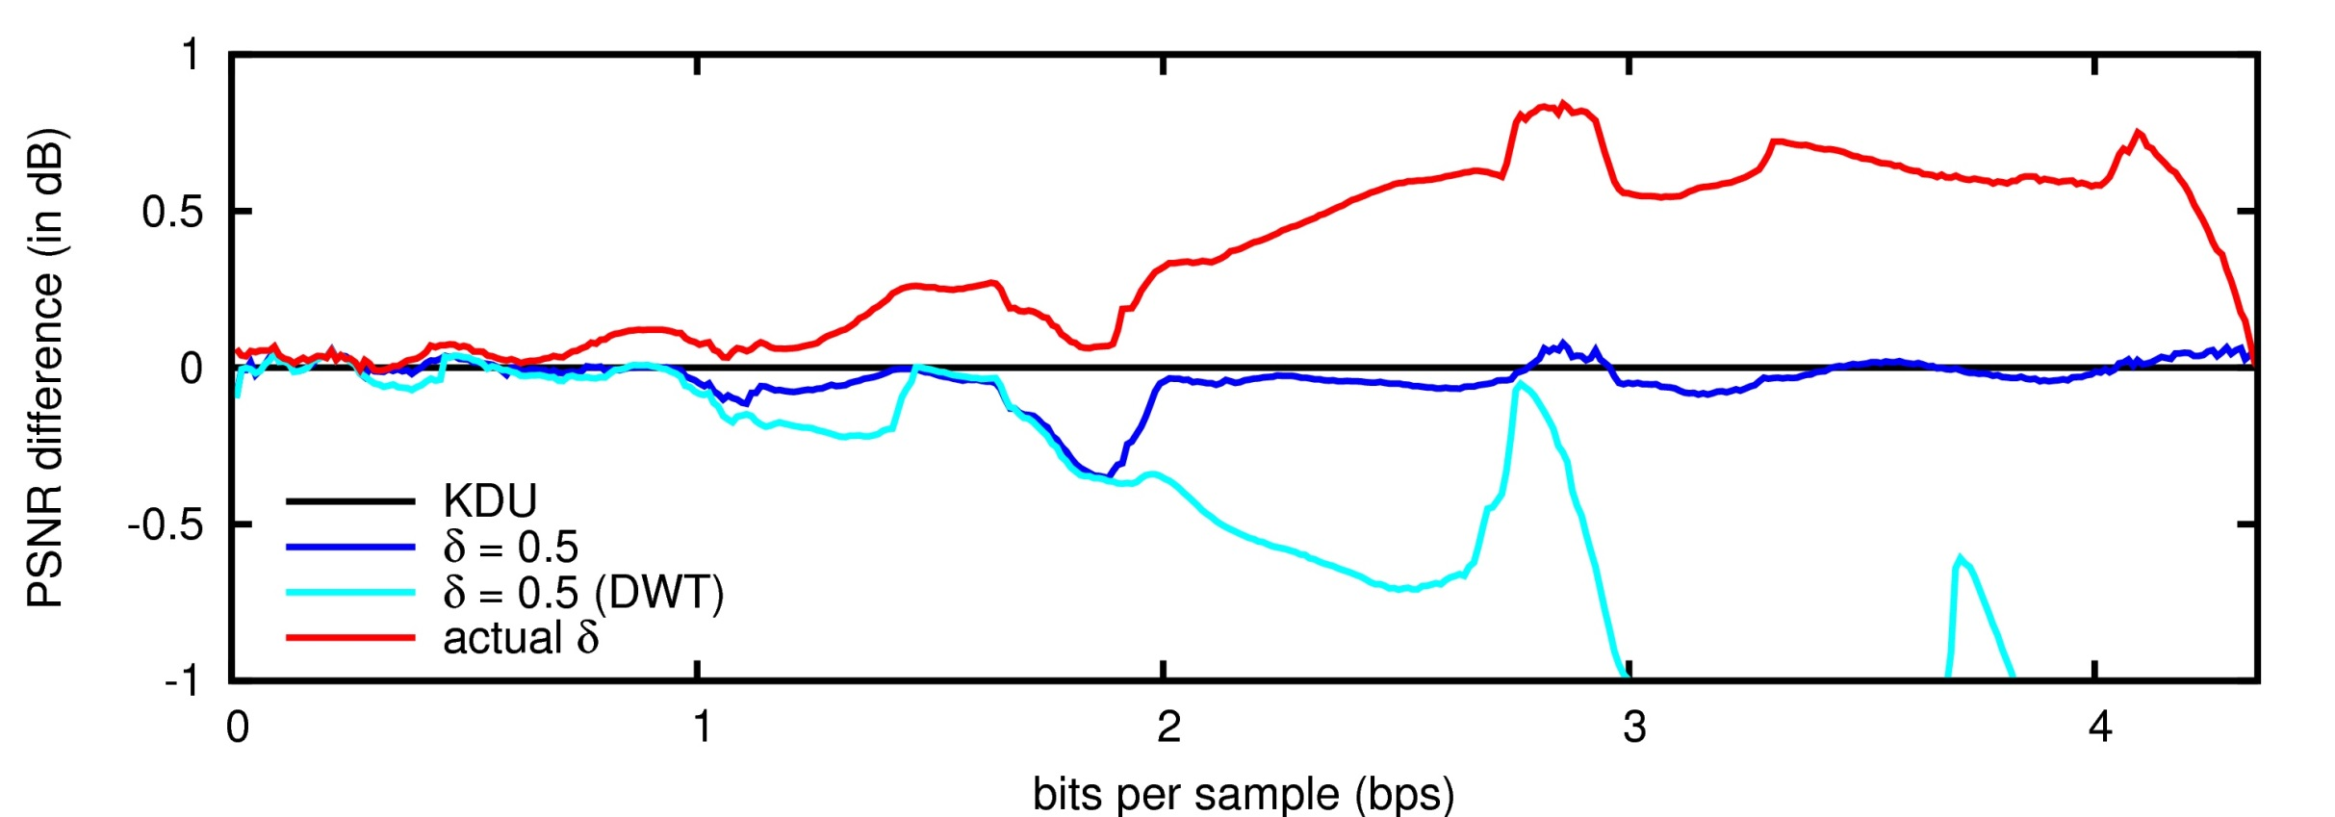
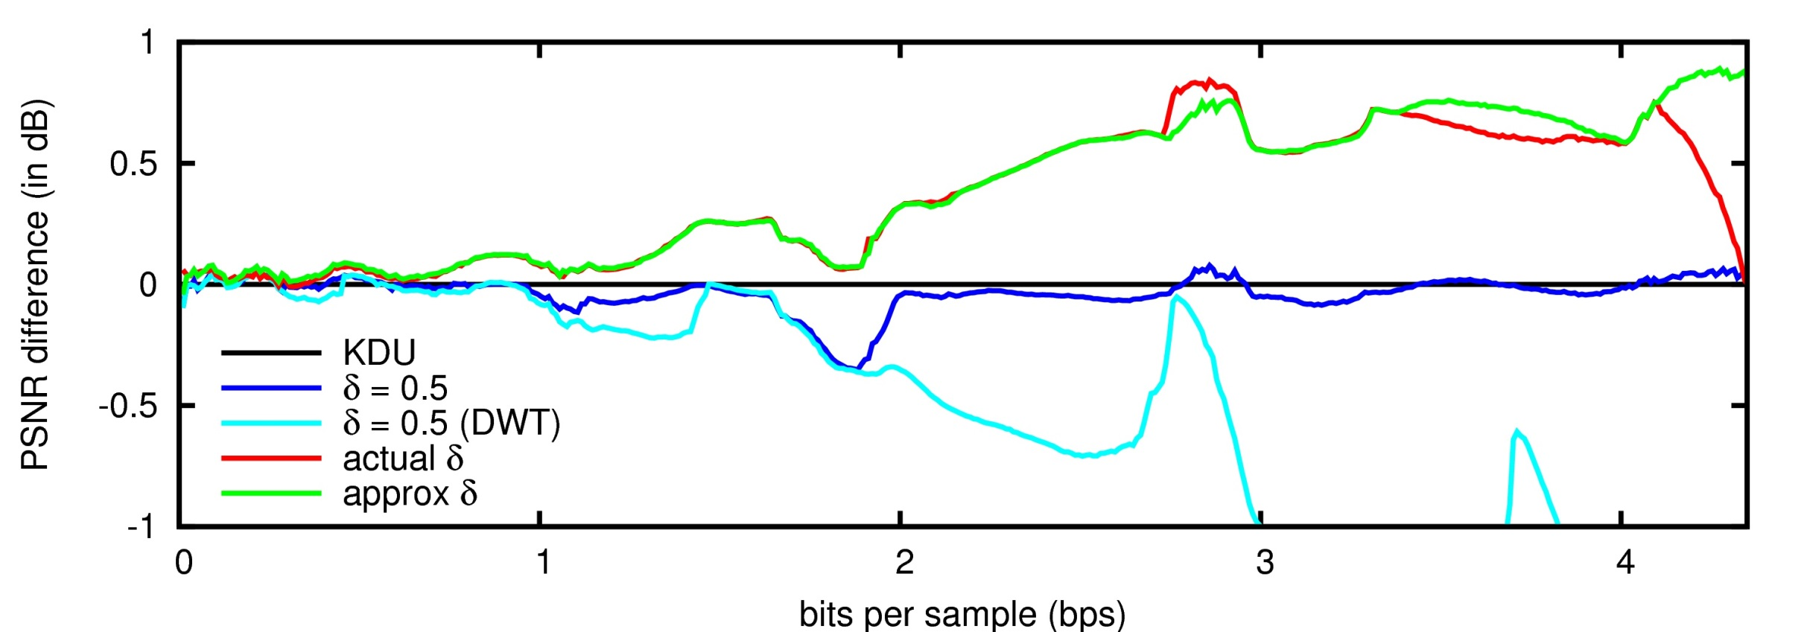
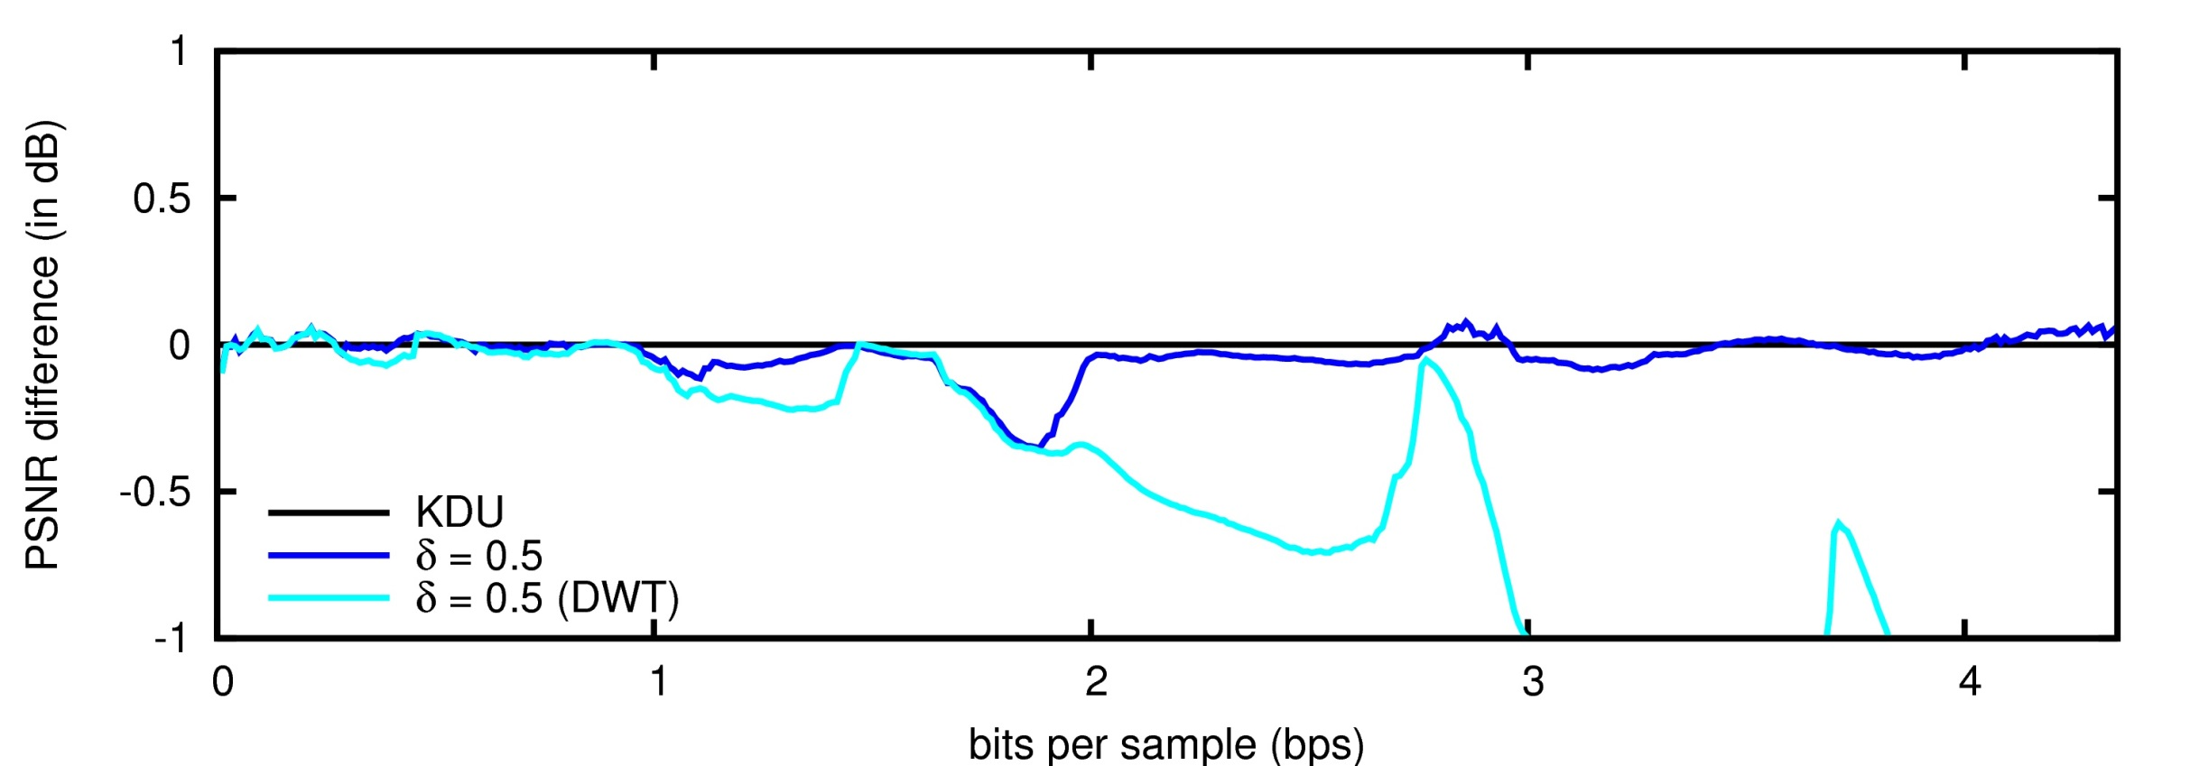
EXPERIMENTS
LOSSLESS MODE
 | CODER | DECODER
KDU | 0.5 ~ actual | 0.5
δ=0.5 | 0.5 ~ ΔDsig ΔDref | 0.5
actual δ | actual ~ ΔDsig ΔDref | actual
approx δ | approx ~ ΔDsig ΔDref | approx
“Portrait” image
5 IWT levels
5/3 filter-taps
64x64 codeblocks

Slide 43
TABLE OF CONTENTS
1. INTRODUCTION
2. PDF-BASED DISTORTION
ESTIMATORS
3. EXPERIMENTS
4. CONCLUSIONS
Distortion estimation
Code-stream transcoding
Interactive image and video transmission
Applications

Slide 44
CONCLUSIONS
MID-POINT RECONSTRUCTION DOES NOT
CORRESPOND WITH THE NATURE OF THE SIGNAL
Penalization on
the performance of distortion estimators
RESEARCH PURPOSE:
DETERMINATION OF DISTORTION ESTIMATORS
THAT BETTER CAPTURE THE SIGNAL’S NATURE

Slide 45
CONCLUSIONS
2^{P*+1}
[
]
p(x)
(
( 2^{P*} + δ_{P*}· 2^{P*} )
)²
dx
ΔDsig_{P*} =
∫
x² -
x -
2^{P*}
2^{P*}
ζ_{P*}
2^{P*+1}
centroid
APPLICATION TO THE PCRD PROCESS OF JPEG2000
When both the coder and decoder use pdf-based reconstruction, gains of 1 dB are achieved in the lossless mode

Slide 46
CONCLUSIONS
FUTURE RESEARCH
Distortion estimation
Codestream transcoding
Interactive image and video transmission
Applications

Slide 47
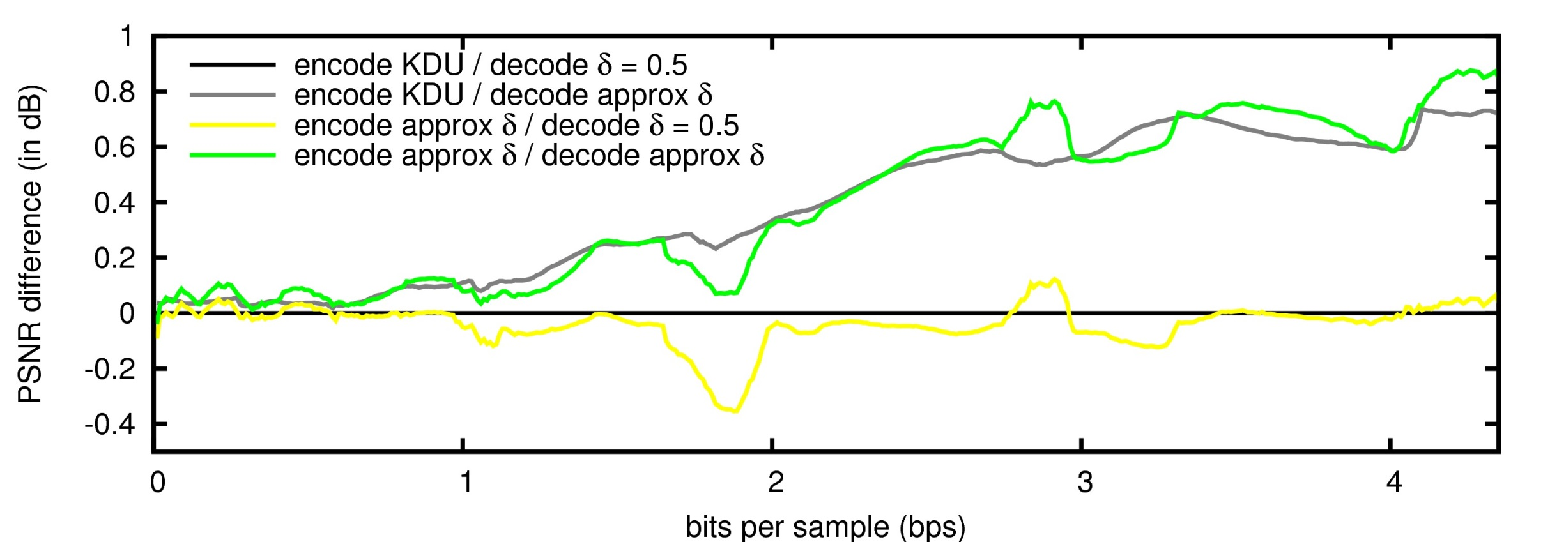
EXPERIMENTS
LOSSLESS MODE
“Portrait” image
5 IWT levels
5/3 filter-taps
64x64 codeblocks

