Slide 1
Reverse Engineering for Privacy-Preserving
Validation of GWAS Outcomes
Yuzhou Jiang
yxj466@case.edu
Case Western Reserve University
Tina Xu
yxx914@case.edu
Case Western Reserve University
Erman Ayday
exa208@case.edu
Case Western Reserve University
Notes:
Hi everyone, my name is Yuzhou Jiang, and today I'll be presenting my paper "PROVGEN: A Privacy-Preserving Approach for Outcome Validation in Genomic Research"

Slide 2
Research outcomes should be verifiable
However, reproducibility can be challenging
Data sharing is often restricted due to privacy risks
  Especially true for genomic area
Why is reproducibility still worth fighting for?
What could go wrong if we skip it?
Notes:
Reproducibility is a critical factor we must consider when sharing research findings.
They should be verifiable, and others should be able to check and confirm findings.
However, achieving reproducibility can be challenging in practice.
In many cases, the datasets used in the research cannot be shared due to privacy risks, which is especially true for genomic data
Given the challenges we just discussed, you might ask:
[CLICK]
Why is reproducibility still worth fighting for? And what could go wrong if we skip it?
Let me walk through a simplified example about cancer to illustrate the risk of not having reproducibility.

Slide 3


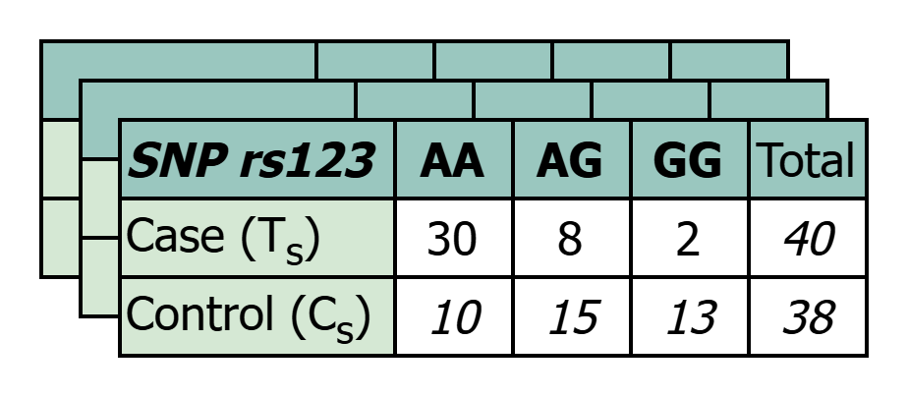

Reproducibility – Cancer Example
Researcher wants to know which part of DNA is associated with breast cancer.
Breast Cancer Patient Data
Genome-Wide
Association Studies
GWAS outcome for SNP rs123:
AA ~ 50% develop breast cancer
AG ~ 10% develop breast cancer
GG ~ <0.1% develop breast cancer
Pre-Processing
Contingency Tables
Notes:
Suppose a researcher is trying to find which part of DNA is associated with breast cancer.
[CLICK]
First, they collect genomic data from breast cancer patients, along with data from individuals who do not have breast cancer, to serve as a reference group.
[CLICK]
After preprocessing, the data is formatted into a more structured, easy-to-analyze form—such as contingency tables, which count how often each genetic variant appears across different groups.
[CLICK]
The researcher then performs a genome-wide association study, or GWAS, which applies statistical tests to identify DNA positions that are significantly associated with the disease.
In this study, the researcher identifies a specific SNP—a single nucleotide polymorphism, which is a common type of DNA variation across individuals. (We’ll cover SNPs in more detail shortly.)
Let’s say the SNP is rs123. According to the analysis:
If a patient has the genotype AA, they have a 50% chance of developing breast cancer.
With AG, the risk drops to 10%,
and with GG, it's less than 0.1%.

Slide 4
Reproducibility – Cancer Example Cont.
GWAS outcome for SNP rs123:
AA ~ 50% develop breast cancer
AG ~ 10% develop breast cancer
GG ~ <0.1% develop breast cancer
E.g., different populations/environments
What we can do:
Warn AA patients about potential risks
Recommend preventive measures
Regular screenings (detect in early stages)
But what if the research is wrong or misapplied?
E.g., rs234’s CC patients ~ 50% breast cancer instead
High-risk individuals get no warning
Low-risk people panic unnecessarily
Misleading future research directions
It already happened!
⚠️ Alzheimer’s study with fabricated images [1]
⚠️ Longevity gene study misled due to sequencing errors [2]
⚠️ …
[1] Piller, C. (2022). Blots on a field? Science, 377(6604), 358–363.
[2] Ledford, H. (2011). Paper on genetics of longevity retracted. Nature. https://www.nature.com/articles/news.2011.429
Notes:
So, given the GWAS findings we just discussed, we can see that AA patients are under very high risk.
What actions can we take to help them?
[CLICK]
First, we can warn them about the risk, ensuring they are aware and informed.
[CLICK]
Second, we can recommend preventive measures, based on prior medical research or clinical guidelines for reducing breast cancer risk.
[CLICK]
Third, we can advise the patient to undergo regular screenings, which aims to detect early-stage developments and enable early intervention.
[CLICK]
But this raises a critical question: what if the research is wrong—or misapplied?
[CLICK]
Please note this doesn’t necessarily mean that the researcher made a mistake.
Sometimes, the study population and the real-world application context differ in terms of demographics, environment, or other biological factors.
For example, a researcher may attempt to apply the findings, but they may not hold true in their target population or use case.
[CLICK]
Suppose that, in reality, it is patients with CC genotype for SNP rs234, and not rs123, that is truly associated with breast cancer risk.
In this case:
[CLICK]
High-risk individuals with rs234 CC patients will receive no warning at all
[CLICK]
Meanwhile, AA patients with rs123 might panic unnecessarily, although they are actually low-risk
[CLICK]
And the worst thing is that, these findings—if published and trusted—could mislead future research directions, wasting years of effort and resources
Unfortunately, this kind of scenario has already happened.
[CLICK]
For example, in 2006, a high-profile Alzheimer’s study was published using fabricated image data.
The issue wasn’t discovered until 2022, meaning it misled the field for over 15 years.
Similarly, another well-known longevity gene study had to be retracted after a sequencing error was found—again, long after it had already influenced follow-up research.
These examples highlight the critical need for reproducibility in genomic research

Slide 5
⚠️ Alzheimer’s study with fabricated images
⚠️ Misleading longevity gene study due to sequencing errors
⚠️ …
Why not just share the data for reproducibility?
It enables re-identification if not protected properly.
If re-identified
  Insurance bias and medical discrimination
  Family linkage
  …
Problem
Can we verify GWAS outcome without exposing privacy risks?
Notes:
[CLICK]
So, why not just share the original genomic dataset to ensure reproducibility?
While that might sound straightforward, in practice it can be extremely dangerous.
[CLICK]
If the data is not properly protected, it becomes vulnerable to re-identification attacks.
In such attacks, an adversary can match anonymized records to specific individuals using auxiliary information.
[CLICK]
Once re-identified, a person’s sensitive information may be exposed, and the consequences can be serious.
For example:
[CLICK]
It could lead to insurance bias and medical discrimination, such as increased premiums or even denial of coverage when medical care is most needed.
[CLICK]
Additionally, family members may be indirectly exposed through genetic linkage.
[CLICK]
Therefore, while reproducibility is important, we must balance it with privacy protection, especially in sensitive domains like genomics.
[CLICK]
So, can we verify GWAS outcomes without exposing individuals to privacy risks?
To address this, we propose a solution to share genomic data in a privacy-preserving manner.
Before we dive into the methodology, I’d like to briefly expand on some background in genomics.

Slide 6
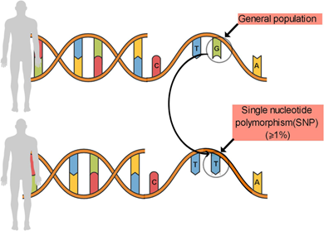
Background
Single Nucleotide Polymorphism (SNP)
SNP Value (A major, G minor): # of minor alleles
AA 0: homozygous for the major allele
AG 1: heterozygous, carrying one copy of the minor allele
GG 2: homozygous for the minor allele
Lima, L. S., Galiciolli, M. E. A., Pereira, M. E., Felisbino, K., Machado-Souza, C., de Oliveira, C. S., & Guiloski, I. C. (2022). Modification by genetic polymorphism of lead-induced IQ alteration: a systematic review. Environmental Science and Pollution Research, 29(29), 43435-43447.
Notes:
A Single Nucleotide Polymorphisms, or a SNP, is a location in the genome where a single nucleotide—A, T, C, or G—varies between individuals.
To be classified as a SNP, this variation must occur in at least 1% of the population.
At each SNP position, there are typically two versions of the nucleotide:
The more common one is called the major allele, and the less frequent one is the minor allele
[CLICK]
Every individual has two copies of each SNP—one from each parent—so their genotype at a SNP might be:
AA, AG, and GG
For computational purposes, we often represent these genotypes numerically by counting the number of minor alleles:
0 for AA, 1 for AG, and 2 for GG

Slide 7
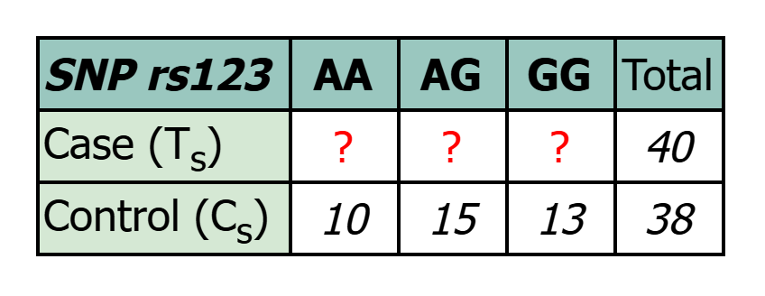

Modeling GWAS Reproducibility
What we have
The control row in the contingency table for each SNP
MAFs for each SNP from the research findings
Number of samples in the case row
What if we
Try to find the case row that generates the reported GWAS statistic?
$$χ^{2}=8.36$$
Notes:
Let us first revisit the problem of GWAS reproducibility, but from a new angle.
[CLICK]
In our setting, we assume access to three key pieces of information:
[CLICK]
First, the control row in the contingency table for each SNP
[CLICK]
Second, the MAF values for the SNP
[CLICK]
Also, we have the sample sizes for both the case and control groups
[CLICK]
All these information can typically be found in the research findings, which forms a situation as illustrated in the figure on the right.
With this setup, the only missing component for computing a GWAS statistic is the case row.
[CLICK]
So we ask:
What if we try to recover the case row that would reproduce the reported GWAS statistic?

Slide 8
A Brute Force Solution to Find Case Row
Try all possible combos for each SNP
  Time complexity is an issue for large-sample datasets
Can we speed up?
Notes:
To recover the missing case row, a natural solution is to use brute-force grid search
[CLICK]
For each SNP, we try all possible combos of genotype counts in the case row and see if we can find a combo that produces the same GWAS statistic from the research findings.
[CLICK]
However, it becomes computationally expensive for datasets with a large number of samples.
This leads to a new question:
[CLICK]
Can we speed this up?

Slide 9
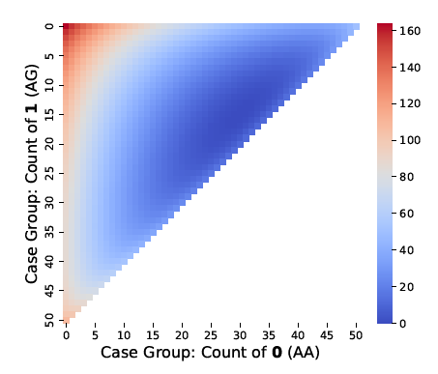
A Visualization of Chi-Square Statistic
Observations:
Statistically significant outcomes (in dark blue) are regional
Almost concave (with slight local fluctuations)
Optimizations
Monte Carlo Sampling
Divide and Refine
Notes:
To address the challenge, let’s take a look at the heatmap of the chi-square statistic.
[CLICK]
In this heatmap, the x-axis represents the count of genotype 0, and the y-axis represents the count of genotype 1.
[CLICK]
From this figure, we can make two key observations:
[CLICK]
First, the statistically significant outcomes, which is in dark blue, appear regionally.
[CLICK]
Second, the overall heatmap surface is approximately concave.
While there may be small local fluctuations, they are not obvious in the figure and generally do not disrupt the global structure.
[CLICK]
Based on these two observations, we propose two optimizations to accelerate the search process:
[CLICK]
Monte Carlo Sampling
[CLICK]
and Divide and Refine Strategy.

Slide 10


Monte Carlo Sampling
Starting Search Space
$χ^{2}≤$ Target
$χ^{2}≤$ Target + d
Tolerance Factor
Notes:
Let’s start with Monte Carlo sampling.
Instead of evaluating the entire search space exhaustively, we use a sampling-based approach to efficiently locate highly possible regions that may contain the target chi-square value.
Here’s how it works:
[CLICK]
First, we uniformly sample points across the entire search space and calculate the chi-square statistic for each combo.
[CLICK]
Then, we identify a region that includes all points where the chi-square value is less than or equal to the target value,
[CLICK]
plus a small tolerance margin by d.
[CLICK]
Once this region is located, we slightly expand its boundaries to form a rectangular search space.
This rectangle serves as the starting region for the later divide and refine search strategy.

Slide 11
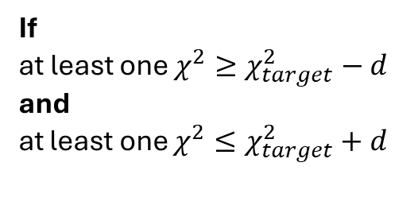
Divide and Refine
Exhaustive Grid Search
If small enough
If any vertex invalid
If
at least one $χ^{2}≥χ_{target}^{2}−d$
and
at least one $χ^{2}≤χ_{target}^{2}+d$
Divide into 4
Search Region
Check 4 vertices
Skip
Otherwise
Notes:
Given the rectangular subspace obtained from Monte Carlo sampling, we apply our second optimization: the Divide and Refine strategy.
[CLICK]
In a generally concave region, we don’t need to evaluate every single point in the space.
Instead, we want to determine whether the region is likely to contain any point with a chi-square value that meets the target.
[CLICK]
To do this, we only evaluate the four vertisees of the rectangle and make decisions based on those.
Here's how the process works:
[CLICK]
If the rectangle is small enough, we check all possible combinations in the area exhaustively to see if any match the target value.
If the rectangle is not small enough, we evaluate whether we should
[CLICK]
subdivide
[CLICK]
or skip it.
[CLICK]
If any vertex is invalid (i.e., it lies outside the feasible region,
[CLICK]
such as the example above), we must go deeper. This is because the internal area might still contain valid and matching combinations.
[CLICK]
If all vertisees are valid, we go deeper only if at least one vertex has a chi-square value greater than or equal to the target, and at least one vertex has a value less than or equal to the target, both with a tolerance factor.
[CLICK]
If none of these conditions are met, we skip it entirely because it is not likely to contain the target value.
Following this strategy, we can finally find all combos that generates the target values.

Slide 12
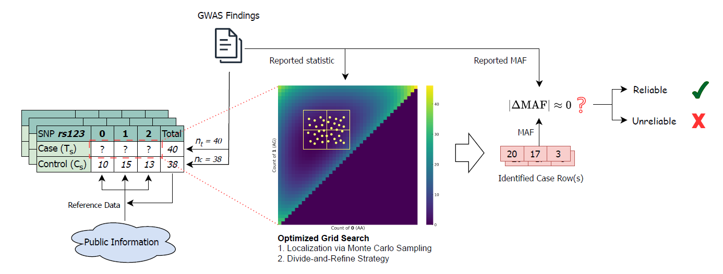
REGenOV Workflow
Notes:
Once we’ve found the candidate case rows, the next step is to perform validation.
Here is the workflow for our proposed approach, called REGenOV.
As mentioned earlier, we assume access to the control rows, the sample sizes for the case and control groups, plus the reported statistic and MAF values from the research findings.
For each SNP, we get all possible case rows that generate the target statistic using grid search with the two previously mentioned optimizations.
From each candidate case row, we compute its MAF value and compare it to the reported MAF.
If at least one of the candidate rows matches the reported MAF, we consider that SNP validated.
If all SNPs under validation pass this MAF check, we believe the overall research outcome to be trusted.
On the other hand, if one or more SNPs fail to produce a matching MAF, we flag the outcome as potentially incorrect, and recommend that it be investigated further.

Slide 13
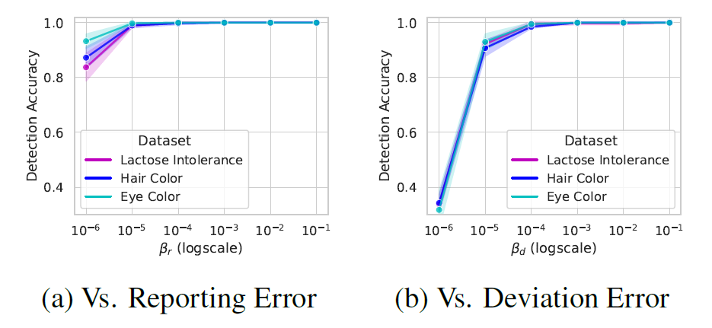
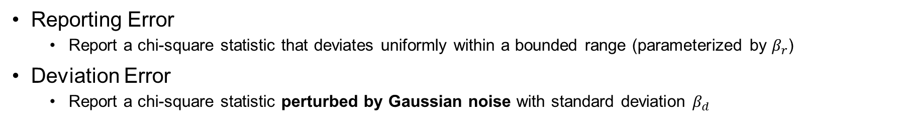
Performance: Detecting Errors During GWAS
Reporting Error
  Report a chi-square statistic that deviates uniformly within a bounded range (parameterized by $β_{r}$)
Deviation Error
  Report a chi-square statistic perturbed by Gaussian noise with standard deviation $β_{d}$
Notes:
We evaluated the performance of our reverse-engineering scheme (REGenOV) in detecting errors during GWAS.
We modeled two types of errors:
[CLICK]
Reporting error, where the reported chi-square statistic is intentionally deviated within a bounded range.
[CLICK]
The other is deviation error, where the reported chi-square value is perturbed by Gaussian noise, simulating systemic reporting distortion.
[CLICK]
As shown in the figure, as long as the error rate is at least 10⁻⁵ for reporting error and 10⁻⁴ for deviation error, which is very small, our method maintains close to 100% accuracy for all three datasets.
These results demonstrate that our scheme has very high sensitivity, and can capture even minor deviations in GWAS outcomes.

Slide 14
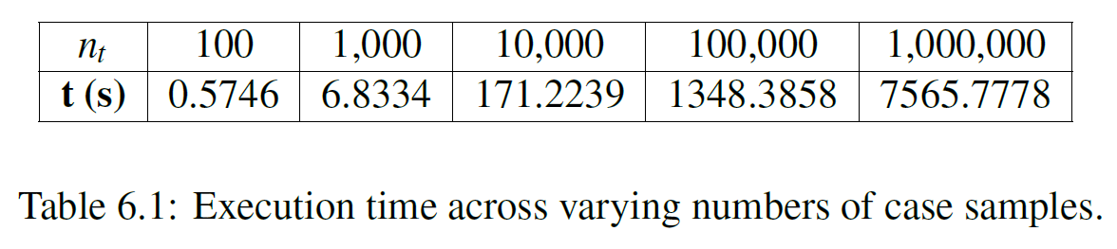
Performance: Time Complexity
Notes:
In addition to accuracy, we also evaluated the time cost of our scheme to understand its scalability.
[CLICK]
As shown in the figure, the execution time increases almost linearly. When there are 1M samples in the case group, which is close to max number of real-world dataset sizes in genomic research, our scheme can also handle it.
This proves that our method is a practical solution while also efficient and scalable.

Slide 15
Future Directions
  Expand to more types of errors in more GWAS stages
  Leverage Zero-Knowledge Proof (ZKP) to validate outcomes
Notes:
As next steps, we plan to:
[CLICK]
Expand our error modeling and also extend validation across more gwas stages to support end-to-end reproducibility, including data collection and preprocessing.
[CLICK]
Additionally, we aim to leverage Zero knowledge proof to perform the validation. We plan to verify a subset of key SNPs in the research findings and then propagate the validation through correlationst between the SNPs, making it efficient and reliable.

Slide 16
Thank You!

