Slide 1
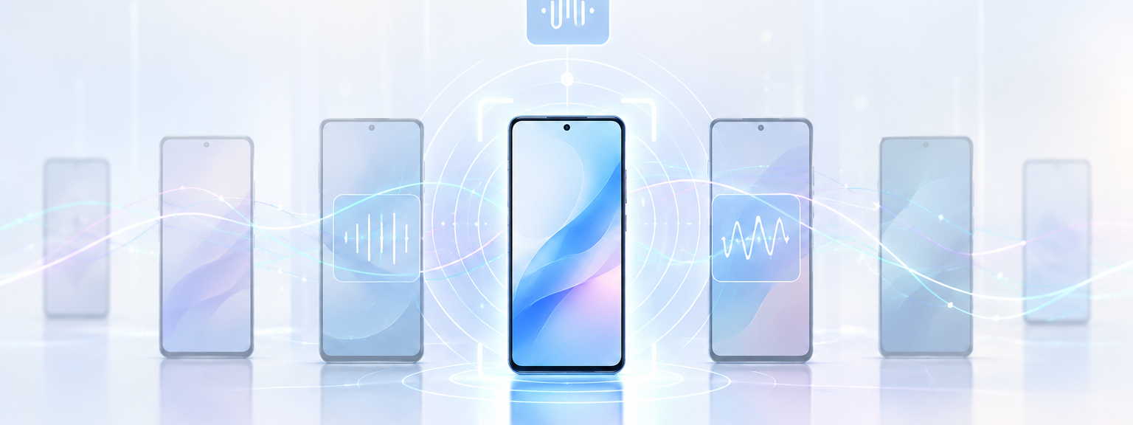

Hidden Figures
Fingerprinting Mobile Phones Through Passive Background App Traffic
Shiva Azizzadeh, Gunes Acar

Slide 2



One traveler, three open networks
07:58
12:34
18:40
onboard Wi-Fi, open
56 min on the network
guest Wi-Fi, open
31 min on the network
free Wi-Fi, open
63 min on the network
Three strangers — or one person?
Three operators. Three randomized MAC addresses. Nothing that ties them together.
Notes:
Lets start with thinking about a traveller
The traveler doesn’t touch the phone at these times. The screen stays off, no app is opened, nothing is typed.
Three different operators
Three different randomized MAC addresses.
To anyone watching those three networks, these look like three strangers. But can they be related? We will answer this question!

Slide 3



Fingerprinting
Actions & apps
Encrypted traffic still reveals user actions and the app.
Routines
Daily activity patterns can be inferred from metadata.
Devices
Transmission characteristics can survive the encryption.
Almost every one of these attacks needs the user to do something.
Notes:
Traffic analysis has been used for over two decades to extract sensitive information from network communications, and we know that encryption could not stop that;
From encrypted traffic you can infer which app is running and what the user is doing. From metadata you can infer daily routines. And transmission characteristics, like frame timing or clock skew, can identify a device model through the encryption.
But look at what these have in common: they need the user to do something — an app to be opened, a page to be loaded, or anything else

Slide 4



Research Question
Can two captures, recorded at different times and places, be linked to the same phone?
No Payload Content
No Persistent Identifiers
No User Interaction
Notes:
So here is the question we want to answer
Can we still tell that both captures came from the same device?
what phones actually do. They sync, update and send telemetry with the screen off. That traffic is shaped by which applications are installed rather than by behavior of the user,
background traffic is lower in volume and variability, than user-generated traffic.
so it must be harder to exploit.

Slide 5

Attack Setting
Location 1
open Wi-Fi, first visit
The attacker:
Sniffs an open network or runs a rogue AP.
Uses network-layer metadata only.
MAC a2:4f:… (randomized)
same device?
Location 2
Our implementation needs:
Generating realistic user profiles
Phone connected to the access point
open Wi-Fi, another time
MAC 7e:c1:… (different)
Notes:
This is the threat model.
The adversary is passive.
To implement this we needed two things. First, realistic user profiles
Second, a phone actually connected to the access point and left alone, no interaction at all.
So the adversary ends up with two sets of traces, everything seen at the first location, everything seen at the second; and the whole attack is deciding which pairs belong together. We show two locations for clarity of notation; more locations simply mean more pairwise comparisons.

Slide 6

User Profiles
Google Play Store popular apps and categories
Random selection from weighted categories
Random number of apps (mean=75)
Average overlap of 16 apps between profiles
Factory reset and disable pre-installed apps
Enable current profile’s apps via adb
Launch each app once so it completes a cold start
Close everything, screen off, record for one hour
40p * 10r * 1h
POCO F2 Pro
Samsung Galaxy A14 5G
Notes:
A user profile, in our setup, is a set of installed applications.
We generate realistic user profiles, prepare the phone and the access point, passively record the traffic each profile produces, and repeat the recording with a different application launch order each time, to mimic real users opening their apps in different orders.

Slide 7
The Representation of a Trace
Raw capture
Every packet reaching the AP during the capturing window
Endpoints
Each destination IP resolved to its AS via the MaxMind database
Filtered set
Filtered Ases considering the volume and uniqueness
Final representation
Unique ASes stay, non-unique ones are combined with the ports
Notes:
IP addresses are the obvious candidate but the weakest one. They indicate the connection endpoints, but load balancing, distributed infrastructure and address changes over time mean the same host answers from different addresses.
Autonomous systems fix that. We map the ip addresses to their AS number using maxmind database
Third, filtering. We drop very low-volume endpoints with the standard Tukey rule, then score how unique each remaining AS is. Uniqueness averages three things: how many profiles contact that AS, how many ports they use, and how varied its packet sizes are. An AS everyone contacts, on many ports, tells you nothing.
Finally the representation. A unique AS is kept as it is. A common one is not thrown away — it is extended with the informative ports it was contacted on,
The result is a set of strings. That is our trace.

Slide 8
Comparison of Two Traces
Trace A
Trace B
AS1
AS4
AS3:5222
AS6:123
AS9
AS11
AS1
AS4
AS3:5222
AS6:8883
AS9
AS11
shared
endpoints
AS1
AS3:5222
AS4
AS6:123
AS6:8883
AS9
AS11
1
1
1
1
0
1
1
1
1
1
0
1
1
1
Jaccard distance = 1 − |A ∩ B| / |A ∪ B|
|A ∩ B| = 5 |A ∪ B| = 7 Jac.Dist = 0.29
Notes:
no classifier and no retraining schedule. The decision is only a distance metric and one threshold
Jaccard : These vectors are sparse, and two phones both not contacting some obscure AS have nothing in common

Slide 9
Decision Threshold
High and low threshold:
Too low, too strict:
  Real matches rejected
Too high: too relaxed:
  Unrelated traces accepted
Chosen threshold = 0.3
Notes:
We have a distance. To make a decision we need a threshold: below it, we say same user.
We divide the Jaccard range into ten equal intervals and keep the candidate that maximises F1 against the ground truth on the training split.
Either side tells you why. Lower is too strict: you demand near-perfect overlap and reject real matches. Higher is too relaxed: almost any two traces pass. From 0.6 up the score is flat at 0.12, which is what saying yes to everything gives you.

Slide 10
Capture Duration
Higher success rate when:
Using AS+Port combination
Longer capture
Notes:
The second parameter is how long the attacker has to listen.
Second, representation matters. Raw IP addresses are the weakest, because the same service resolves to a different address elsewhere. Autonomous systems survive that, and adding AS-port strings gives the best curve at the long end: 0.72 at an hour.

Slide 11
Evaluation Results
Poco Phone
Android 10
≈ 141 related pairs
≈ 2 360 unrelated pairs
Notes:
So look at the other three metrics, and at how they move from left to right.
Two things worth saying about that. Precision 0.85 means that when this attack claims two traces are the same user, it is right roughly six times out of seven, against a base rate of six per cent. And recall 0.63 means it finds about two thirds of the real links.

Slide 12
Poco vs Samsung
Higher success rate in Samsung
More background traffic
More distinct endpoints in a trace
Longer capture
Notes:
Everything so far was one handset, so the question is whether this is a property of that phone. We repeated the experiment on a Samsung Galaxy A14 on Android 14 — different vendor, four Android versions later.
This is what each phone emits while idle as the window grows: distinct autonomous systems, distinct IP addresses, and packets. Each metric is scaled to its own largest value, so 1.0 is the Samsung at a full hour.
Every curve rises, which is the same mechanism as before. The important part is the gap: the Samsung sits far above the Poco everywhere. At a full hour the Poco reaches about a third of the Samsung's autonomous systems, and under a fifth of its packets.
More background traffic, more distinct endpoints, more rare items in a trace, and so an easier device to link. The attack works on both — but the newer Android was the chattier one, not the safer one.

Slide 13
Limitations
Link-layer encryption
  The attack cannot run on a WPA2- or WPA3-protected network; but a large share of public Wi-Fi is still open.
Number of generated profiles
  With millions of apps available, many real app sets are likely unique.
Number of tested phones and OSes
  Shared Android behavior suggests the result carries over, but iOS is not tested.
Notes:
Three limitations, and I want to name them before you do.
First, link-layer encryption. The attack reads IP and AS metadata off the air, so on a WPA2 or WPA3 network there is nothing to read. That is a real boundary — but a large share of public Wi-Fi is still open, and those are the networks people join in transit.
Second, forty synthetic profiles is not thousands of real users, so our numbers may be optimistic. Although with millions of apps available, a real person's app set is if anything more distinctive than ours.
Third, two Android phones. Android devices share much of this background behaviour, but iOS is untested.

Slide 14
Conclusion
Metadata alone is enough to distinguish the device and link the traces across locations.
No interaction needed
Time affects the success
Not tied to one phone
Notes:
To close.
We showed a passive fingerprinting attack that uses only the traffic a phone sends on its own — no payload, no persistent identifier, no user interaction. Metadata alone is enough to tell devices apart and link their traces across locations.
Three things drive it. It needs no interaction, so it does not depend on modelling what a user does. Observation time matters: the longer the capture, the higher the success. And it is not tied to one phone — it held across two vendors, two Android versions and two independent app sets.
The uncomfortable part is that encryption and MAC randomisation are the two protections users are told to rely on, and neither closes this gap. It has to be addressed at the network level.

Slide 15
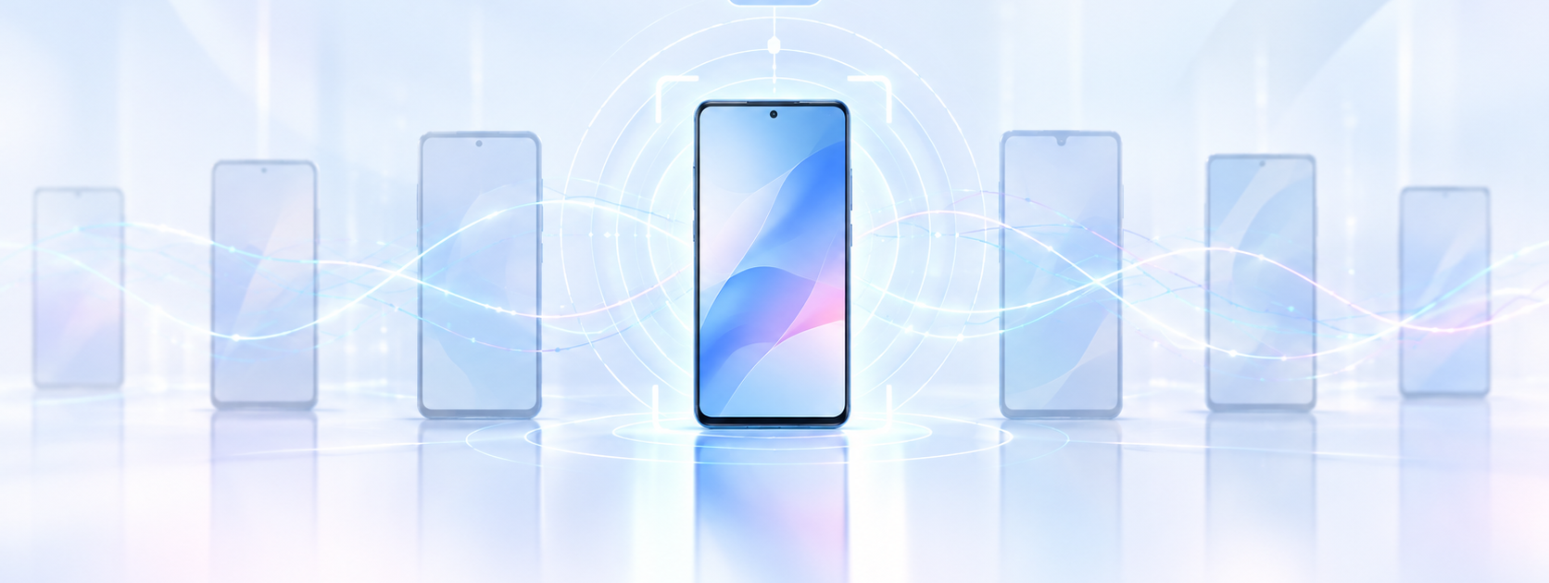
Thank you!
Questions?
Shiva.Azizzadeh@ru.nl

