Slide 1



21st International Workshop on Data Privacy Management
A Privacy-Preserving Architecture for Secure
Appliance-Level Demand Response
in Virtual Power Plants
DPM 2026
Joan Ferré-Queralt · Jordi Castellà-Roca · Alexandre Viejo
Nicolás Orduz Álvarez · Takao Tsuji
Universitat Rovira i Virgili, Spain
Yokohama National University, Japan
Presenter
Joan Ferré-Queralt
Notes:
Hello everyone. I’m Joan Ferré-Queralt, from Universitat Rovira i Virgili. Today I’ll present our work with colleagues at Yokohama National University on secure, privacy-preserving demand response.
We investigate how household appliances can help balance the electricity grid while protecting information about their users and ensuring that remote control and rewards follow the agreed rules.

Slide 2
PRESENTATION ROADMAP
From grid need to trusted appliance-level response
The argument follows the research question from motivation to guarantees.
1
INTRODUCTION
2
SYSTEM OVERVIEW
3
EVALUATION
4
CONCLUSIONS
Why the grid needs distributed demand flexibility
Who participates, what is stored, and how the protocol runs
Functional coverage, privacy, and security
What the architecture establishes—and what remains
Need
Design
Assess
Takeaway
Can small appliances provide flexibility without exposing or misusing user behavior?
Joan Ferré-Queralt et al. | Roadmap
1
Notes:
I’ll begin with the motivation, then explain the architecture and its protocol. After that, I’ll discuss the privacy and security properties and the remaining work.
The central question is: how can small appliances provide useful flexibility without exposing or misusing information about their users?

Slide 3
INTRODUCTION
The grid must continuously balance supply and demand
Most expected demand is balanced one day ahead—but the forecast is never exact.
1
DAY AHEAD
2
REAL TIME
3
CORRECTION
Forecast demand
Actual ≠ forecast
Demand response
Schedule generation
Renewables + demand vary
Adjust flexible load
Most expected load is balanced before delivery.
Residual imbalances remain—and are becoming harder to predict.
Reduce or shift consumption when the system needs support.
More renewables + rising consumption → greater need for responsive demand-side flexibility
See Kundur et al. (2007), Njoka et al. (2024), and Yolcan (2023).
Joan Ferré-Queralt et al. | Introduction
2
Notes:
Electricity systems must continuously balance generation and consumption.
Operators forecast demand and schedule generation in advance, but actual conditions always differ from those forecasts. Demand changes, and renewable generation varies with conditions such as wind and sunlight. The system therefore needs ways to correct the remaining imbalance.
Demand response contributes by adjusting consumption. For example, a flexible appliance can temporarily reduce its power demand when the grid needs support.
Here, flexibility means that some consumption can change within acceptable operating limits. The challenge is to make that flexibility available when needed while respecting the appliance’s constraints and the user’s comfort.

Slide 4
INTRODUCTION
Traditional demand response is effective—but coarse-grained
TRADITIONAL MODEL
APPLIANCE-LEVEL MODEL
HVAC
EV
WATER
HEATER
RECENT
DIRECTION
FRIDGE
PUMP
A few large industrial loads
Many small flexible loads
The grid can interrupt contracted processes when needed and compensate the participant—but control is available only in large blocks.
HVAC and other user appliances can briefly curtail consumption when extra balancing is required.
The opportunity shifts from a few MW-scale sites to many kW-scale resources.
Joan Ferré-Queralt et al. | Introduction
3
Notes:
Traditional demand response often relies on a limited number of large industrial consumers. Under agreed conditions, they reduce consumption and receive compensation. This provides substantial capacity, but adjustments come in relatively large blocks.
Residential appliances offer smaller contributions. A single water heater or air-conditioning unit has limited capacity, but many devices together can provide a useful resource.
A Virtual Power Plant, or VPP, coordinates these distributed resources and represents their combined flexibility in electricity markets.
Aggregation also addresses a practical barrier: individual appliances generally cannot meet market participation thresholds. The VPP combines them into a resource large enough to participate.

Slide 5
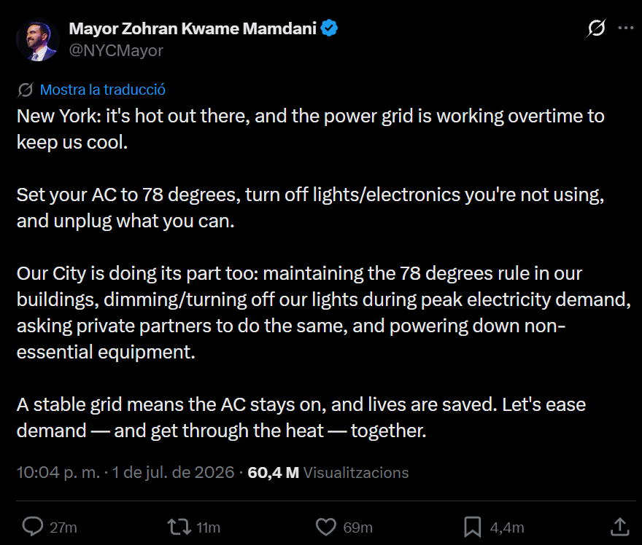
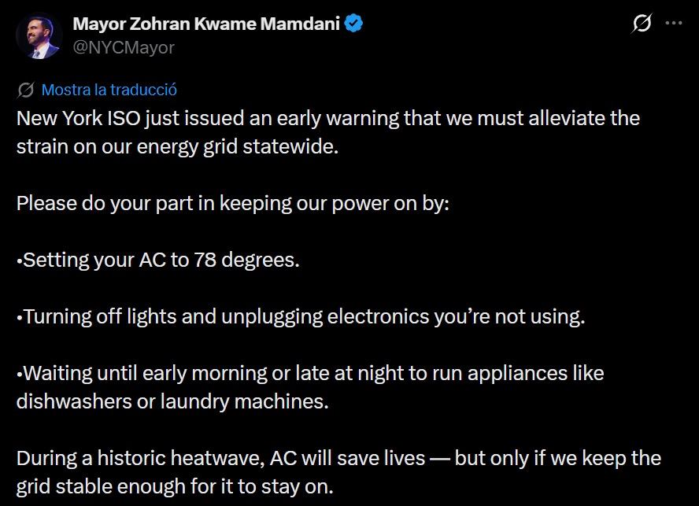
INTRODUCTION
Does appliance-level demand response sound far-fetched?
Public calls to reduce air-conditioning during peak demand already happen.
During an extreme heat event, millions of users were asked to change consumption at the same time to protect the grid.
Joan Ferré-Queralt et al. | Introduction
4
Notes:
The posts on this slide illustrate the idea. They ask people to adjust air-conditioning settings and delay some appliance use during high demand.
[Briefly point to the examples.]
Our architecture supports a more structured form of participation: users specify when appliances may respond, the VPP coordinates activation, and successful participation produces evidence for compensation.
That coordination introduces the privacy and security questions addressed in this work.

Slide 6
21st International Workshop on Data Privacy Management
SECTION 02
System Overview
02
Actors, components, and the end-to-end protocol lifecycle
1
INTRODUCTION
2
SYSTEM OVERVIEW
3
EVALUATION
4
CONCLUSIONS
Joan Ferré-Queralt et al. | System Overview
5
Notes:
Let’s look at the actors and components, then follow an appliance through the protocol.

Slide 7
SYSTEM OVERVIEW
Five actors separate ownership, coordination, and trust
Each role sees and controls only the information needed for its function.
U
USERS
RA
REGISTRATION AUTHORITY
Choose availability and comfort limits.
Verifies devices, assigns clusters, and manages pseudonyms.
VPP
VIRTUAL POWER PLANT
Aggregates flexibility, schedules events, and acts as OpenADR VTN.
A
APPLIANCES
M
MANUFACTURER
Act as OpenADR VENs; curtail and sign with an HSM.
Provisions trusted hardware and certified appliance credentials.
The VPP coordinates operations; the RA retains the identity-to-pseudonym mapping.
Joan Ferré-Queralt et al. | Actors
7
Notes:
The architecture separates five roles.
Users choose availability and comfort limits. Their appliances execute accepted requests and produce delivery evidence using a hardware security module, or HSM.
The VPP aggregates flexibility and schedules events. It communicates through OpenADR, acting as the Virtual Top Node. Each appliance acts as a Virtual End Node that receives the events.
The Registration Authority, or RA, verifies appliances, assigns clusters, and manages operational pseudonyms. Manufacturers provision the trusted hardware and certified appliance credentials.
The separation between the VPP and the RA is central to privacy: the VPP coordinates pseudonymous resources, while the RA retains the mapping between users and pseudonyms.

Slide 8
SYSTEM OVERVIEW
A complete privacy-preserving DR workflow
The design connects registration, scheduling, activation, verification, and remuneration.
1
2
3
Availability
Activation
Evidence & payment
Routines and occupancy may be inferred.
Forged commands can disrupt operation.
Forged or reused claims can misdirect rewards.
Encrypt reports and use pseudonyms.
Authenticate each scheduled event.
Verify signed delivery before payment.
Goal: coordinate every DR stage while limiting disclosure of user-specific information.
Paper: §§1.1–1.2 and §2.3. Prior work is summarized qualitatively.
Joan Ferré-Queralt et al. | System overview
6
Notes:
Privacy and security concerns appear throughout the workflow.
Availability reports can reveal routines or occupancy patterns. We therefore encrypt their contents and associate submissions with pseudonyms.
Activation introduces a control risk: a forged command could interrupt an appliance without authorization. Devices must authenticate requests and check them against the schedule.
Finally, evidence and payment introduce the possibility of fabricated claims or repeated rewards. The contract verifies signed evidence before authorizing compensation.
The contribution is an architecture connecting these stages. The paper identifies a gap in earlier work, which often addresses individual parts of this process rather than their combined requirements.

Slide 9
SYSTEM OVERVIEW
Four components turn private appliance choices into schedulable flexibility
Encrypted detail stays off-chain; verifiable coordination stays on-chain.
FLEXIBILITY CLUSTER
θc = (Pc, maxc, recc)
CLUSTER SMART CONTRACT
CSC₍c₎
Groups appliances with compatible power and operating constraints.
Stores authorized pseudonyms, CIDs, schedules, event hashes, and payment state.
OPERATIONAL PSEUDONYM
(Addr, pkᵒᵖ)
IPFS
Encrypted availability
Lets each appliance participate without publishing its owner’s identity.
Stores encrypted reports while only their content identifiers appear on-chain.
Together: appliance-level privacy with cluster-level scheduling and event-level accountability.
Joan Ferré-Queralt et al. | Components
8
Notes:
Four components support the design.
A flexibility cluster groups appliances with compatible power and operating constraints. Its profile describes guaranteed power per appliance, the maximum permitted OFF duration, and the recovery time before another activation. Conservative values make the profile compatible with every member.
Each cluster has a smart contract. It records authorized pseudonyms, report references, schedules, activation hashes, and payment state.
An operational pseudonym consists of a blockchain address and an operational public key. The appliance uses these credentials without placing its owner’s identity in the public records.
Finally, IPFS stores encrypted availability reports. The blockchain stores their content identifiers, which allow the VPP to retrieve them.
The encryption protects the report contents. IPFS supplies storage, while the contract maintains the records needed for coordination and verification.

Slide 10
SETUP & REGISTRATION
Setup and registration
One-time system setup is followed by registration of each appliance.
1
SYSTEM SETUP
2
APPLIANCE REGISTRATION
3
REGISTRATION AUTHORITY
Deployment
Create a pseudonym
Authorize its use
VPP + RA
Create an address and key pair.
Verify
Keys and certificates
Certified appliance + signature
VPP
Blockchain address
Assign
Clusters and smart contracts
+ operational public key
A compatible flexibility cluster
Manufacturer
Register
HSM + certified appliance key
Private signing key stays
inside the appliance’s HSM.
Address + public key in the
cluster smart contract
RA keeps the user ↔ pseudonym mapping. The VPP operates with the pseudonym.
Joan Ferré-Queralt et al. | Setup & registration
9
Notes:
Setup establishes the cryptographic infrastructure. The VPP defines clusters and deploys their contracts, while manufacturers equip appliances with trusted hardware and certified keys.
During registration, the user configures the appliance’s operating limits through the mobile application.
The appliance generates a fresh operational key pair inside its HSM and creates a blockchain address. It sends the RA its profile and operational credentials in a registration message signed with its certified appliance key.
The RA verifies the certificate and signature, checks that the credentials are fresh, and assigns a compatible cluster. It then registers the operational address and public key in that cluster’s contract.
The appliance can now participate under its pseudonym, with its private operational key remaining inside the HSM.

Slide 11
PROTOCOL • AVAILABILITY AND SCHEDULING
Encrypted reports
Illustrative example: the VPP counts available appliances in each time slot.
APPLIANCE AVAILABILITY
VPP DECRYPTS + COUNTS
t1
t2
t3
t4
t5
t6
t7
t8
ENCRYPT
for the VPP
a1
a2
IPFS: ciphertext
a3
a4
Contract:
day + CID¹
available
unavailable
Available cluster power: A_{c,d}[t] = N_{c,d}[t] × P_{c}
¹ CID = content identifier. Records use operational addresses. Slot durations are unspecified in this illustration.
Joan Ferré-Queralt et al. | Protocol • availability and scheduling
10
Notes:
The recurring process starts with the user selecting daily availability.
Each appliance represents this as a bitmap: one means available for curtailment in that slot, and zero means unavailable. It keeps a local copy, encrypts the bitmap with the VPP’s public key, and uploads the ciphertext to IPFS. It then submits the day and content identifier to the contract under its operational address.
The VPP retrieves and decrypts the reports, then counts available appliances in each time slot.
[Point from the availability grid to the bar chart.]
In this illustration, two appliances are available in the first slot and four in the fourth. Multiplying each count by the cluster’s guaranteed per-appliance power gives the available cluster capacity.
The scheduler uses that capacity and the operational constraints to select activation intervals. The contract records addresses available throughout each selected interval. The optimization algorithm itself is outside this paper’s scope.
Notice that the VPP reads individual availability reports. Privacy here depends on keeping the real-user mapping separate and protecting the reports from public disclosure.

Slide 12
PROTOCOL
A scheduled event becomes signed proof of delivery
Each transition is authenticated, bound to the schedule, and checked for freshness.
1
DR ACTIVATION
2
ON-CHAIN RECORD
3
VERIFY + CURTAIL
4
DELIVERY EVIDENCE
The VPP creates an OpenADR event and sends it as VTN.
The event hash is committed to the cluster smart contract.
The VEN checks eventID, cluster, schedule, and local availability.
After full-interval curtailment, the HSM signs the evidence.
VPP certificate
hash(event)
all checks pass
πᵈᵉˡ signed
No evidence exists without trusted control; no activation is accepted without schedule-bound checks.
Joan Ferré-Queralt et al. | Activation & evidence
11
Notes:
When scheduled flexibility is needed, the VPP creates an OpenADR event with a fresh identifier and sends it to the appliance endpoints. It also records the activation and a hash of the event in the cluster contract.
Before acting, an appliance authenticates the VPP through its certificate and checks the event against the recorded hash. It also rejects an identifier it has already processed.
The appliance checks the target cluster, confirms that its operational address belongs to the scheduled set, and verifies compatibility with its local availability. Only after these checks does it curtail consumption for the requested interval.
Afterwards, the trusted control and measurement component checks that curtailment lasted for the full interval. The HSM then signs delivery evidence tied to the event, day, interval, and operational address.
This hardware assumption matters. The contract can verify a signature and its connection to an authorized event. The connection between that signature and physical curtailment depends on trusted appliance control and measurement. A signature alone cannot establish what happened electrically.

Slide 13
PROTOCOL
One accepted proof authorizes one reward—and a fresh identity
Payment and credential rotation are bound to the same verified delivery.
1
SUBMIT
2
VERIFY
3
PAY
4
ROTATE
Send signed delivery evidence to CSC₍c₎.
Check activation, schedule membership, signature, and replay state.
Credit the scheduled operational address exactly once.
Authorize the next address and key; retire the old credential.
evidence
authorization
reward
unlinkability
The RA processes rotation without publishing an explicit old-address ↔ new-address link.
Joan Ferré-Queralt et al. | Payment & rotation
12
Notes:
The appliance submits its signed delivery evidence to the cluster contract.
The contract checks that the activation exists, that the address was scheduled, and that the evidence matches the expected event. It checks the evidence digest and signature against the registered operational key, and confirms that this address has not already received payment for that event.
Successful verification authorizes the reward and marks the address as paid, preventing duplicate remuneration.
The evidence also carries a request for the next operational pseudonym. The appliance encrypts the new address and public key for the RA.
The RA processes valid rotation requests in batches, authorizes fresh credentials, and retires the previous credentials for future scheduling epochs. It publishes no explicit mapping between old and new addresses.
Batching helps reduce correlation through rotation timing, while changing pseudonyms reduces the accumulation of a persistent public participation history.

Slide 14
21st International Workshop on Data Privacy Management
SECTION 03
Evaluation
03
Functional feasibility, privacy properties, and security requirements
1
INTRODUCTION
2
SYSTEM OVERVIEW
3
EVALUATION
4
CONCLUSIONS
Joan Ferré-Queralt et al. | Evaluation
13
Notes:
We evaluate the design qualitatively by tracing each requirement to the protocol mechanism that supports it.

Slide 15
EVALUATION
The protocol covers the complete demand-response workflow
The functional assessment traces each required operation to a concrete mechanism.
F1
REGISTRATION + CLUSTERING
F2
SCHEDULING
The RA authenticates each appliance and assigns it to a compatible flexibility cluster.
The VPP decrypts reports, aggregates availability by slot, and computes cluster-level flexibility.
COMPLETE WORKFLOW
✓
✓
✓
✓
✓
✓
✓
Register
Cluster
Report
Schedule
Activate
Verify
Pay
Functional feasibility: every stage from registration to remuneration has an explicit protocol path.
Joan Ferré-Queralt et al. | Functional evaluation
14
Notes:
The functional evaluation considers two requirements.
First, registration and clustering: the RA authenticates appliances and assigns them to compatible clusters.
Second, scheduling: the VPP retrieves availability reports and derives the cluster capacity needed by a scheduler.
The remaining protocol steps connect these capabilities to activation, delivery verification, and payment, giving each stage an explicit path through the architecture.
This establishes functional coverage at the design level. Implementation and performance measurements remain future work.

Slide 16
EVALUATION
Privacy limits disclosure; security binds actions to authorization
The guarantees are qualitative and depend on the stated trust model.
PRIVACY REQUIREMENTS
SECURITY REQUIREMENTS
P1
Availability confidentiality
S1
Authentic activation
VPP certificate + event hash
Encrypt before storage in IPFS.
S2
Replay protection
Fresh event IDs + one-payment state
P2
User–availability unlinkability
Use operational pseudonyms, not real identities.
S3
Valid evidence
Registered key + signed evidence
P3
Activation privacy
Record pseudonyms and rotate them periodically.
S4
Authorized payment
Scheduled address + valid proof
TRUST MODEL • RA trusted • VPP honest-but-curious • no RA–VPP collusion • appliance HSMs trusted
Joan Ferré-Queralt et al. | Privacy & security evaluation
15
Notes:
For privacy, P1 protects availability contents from external observers through encryption.
P2 concerns linking an availability report to a real user. Operational pseudonyms and the separation of the identity mapping from the VPP support this property.
P3 concerns linking activations to users. Public records use pseudonyms, and periodic rotation reduces long-term linkability. Observers can still see that a particular pseudonym participated.
For security, S1 combines VPP authentication with event integrity and schedule checks. S2 prevents replay through event identifiers and payment state. S3 requires evidence signed by an authorized appliance key and bound to a scheduled event. S4 permits payment only after those checks and only once per address and event.
[Point to the trust-model line.]
These arguments depend on the stated assumptions. The RA is trusted. The VPP follows the protocol but may try to infer user behavior, and it must not collude with the RA. Manufacturers, certificate authorities, and appliance hardware are also trusted.
The guarantees concern application-layer information. Network addresses and communication timing may still enable correlation. Resistance to global traffic analysis and denial of service is outside the scope of this work.

Slide 17
21st International Workshop on Data Privacy Management
SECTION 04
Conclusions and Future Work
04
What the architecture establishes—and what still needs implementation
1
INTRODUCTION
2
SYSTEM OVERVIEW
3
EVALUATION
4
CONCLUSIONS
Joan Ferré-Queralt et al. | Conclusions and Future Work
16
Notes:
I’ll finish with the contribution of the architecture and the next steps toward implementation.

Slide 18
CONCLUSION
Private flexibility, secure control, verifiable reward
One architecture connects the complete appliance-level demand-response lifecycle.
1
2
3
PRIVATE
FLEXIBILITY
AUTHENTICATED
CONTROL
VERIFIABLE
REWARD
Encrypted availability
Operational pseudonyms
OpenADR authentication
Schedule-bound activation
HSM-backed evidence
One-time contract payment
Next: implement the architecture, measure its cost, and integrate VPP schedulers.
Paper: §5 Conclusions. Research support: SAFE/DATA PID2024-156914OB-C42; FPU23/01275.
Joan Ferré-Queralt et al. | Conclusion
17
Notes:
This work connects the complete appliance-level demand-response lifecycle within one architecture.
Encrypted reports and operational pseudonyms limit disclosure. Authenticated events and schedule checks constrain remote activation. Signed delivery evidence allows the contract to verify claims and authorize rewards.
The next steps are to implement the architecture, measure computational and communication costs, and integrate concrete VPP scheduling algorithms.
The overall aim is to make small appliances usable as coordinated flexibility resources while respecting user choices and the stated privacy and security requirements.

Slide 19
Thank you
Questions?
A Privacy-Preserving Architecture for Secure
Appliance-Level Demand Response in Virtual Power Plants
joan.ferreq@urv.cat
SAFE/DATA · PID2024-156914OB-C42
FPU23/01275
Notes:
QUESTIONS | after the 15-minute talk
Likely questions and concise answers:
Who sees the availability? The VPP decrypts individual bitmaps under operational pseudonyms. Public observers see ciphertext and pseudonymous metadata.
Who links a pseudonym to the user? The RA maintains that mapping; privacy assumes the RA and VPP do not collude.
Does the blockchain prove physical curtailment? It verifies event-bound signed evidence. Physical truth depends on the trusted control and measurement component linked to the HSM.
Does rotation guarantee complete anonymity? No. Batching avoids an explicit old-to-new mapping and reduces linkage; network metadata and other correlations remain relevant.
Does on-chain processing scale? Per-transaction mapping checks have constant storage-access complexity, while total storage and transaction volume grow. The paper suggests a Merkle-root commitment for scheduled sets as a possible optimization, without evaluating it.
What has been evaluated? Qualitative satisfaction of requirements under the stated model. Implementation, performance measurement, and concrete scheduling integration are future work.
PRESENTATION CUE: Keep this slide visible during discussion. Acknowledge project support if time permits.
SOURCE: Paper: §§2.1, 2.3, 4–5. Full acknowledgment: SAFE/DATA funded by MICIU/AEI/10.13039/501100011033 and FEDER, UE; FPU23/01275. Alexandre Viejo is a Serra-Húnter Fellow.

