Slide 1


The Privacy Peak
Non-Monotonic Leakage in Federated Learning
WORKSHOP ON DATA PRIVACY MANAGEMENT · DPM 2026
A reproducible, post-hoc reconstruction study of privacy leakage across federated heterogeneity regimes
Hamza Sajjad, Xavier Lessage, Gabriele Costa, Philippe Massonet
IMT School for Advanced Studies Lucca, Italy · CETIC asbl, Belgium
hamza.sajjadahmed@imtlucca.it
DPM 2026
co-located with ESORICS 2026 · Rome, Italy

Slide 2
OVERVIEW
Agenda
01
Motivation
02
Threat model
Why FL privacy is not solved by design
Post-hoc, white-box, model-only adversary
03
Method
04
Setup
Anchor-guided reconstruction framework
CIFAR-10 across four heterogeneity regimes
05
Results
06
Discussion
The non-monotonic “privacy peak” at E3
Why moderate skew is the risky regime
DPM 2026 · Co-located with ESORICS 2026, Rome
1

Slide 3
MOTIVATION
Federated Learning Was Supposed to Protect Privacy
The promise
The catch
Clients keep raw data local; only model updates are shared with a central server
Widely adopted for healthcare, mobile, and personalized services precisely because it avoids centralizing sensitive data
Federated Averaging (FedAvg) aggregates client updates into one global model
Model updates and the final trained model still encode information about the data that produced them
Membership inference, attribute inference, and reconstruction attacks all show FL alone is not privacy
Most prior reconstruction work assumes access to gradients or client updates — rarely the deployed model alone
This paper asks: does FL alone protect privacy once training is done — with only the final model in an adversary's hands?
DPM 2026 · Co-located with ESORICS 2026, Rome
2

Slide 4
PROBLEM
An Open Question: Does Heterogeneity Help or Hurt Privacy?
Client data is rarely IID in practice. Data heterogeneity is known to affect accuracy and convergence — but its effect on privacy leakage is far less understood.
1
2
3
Limited heterogeneity ranges
Optimization-success bias
Training-time assumptions
Most studies test only IID or one non-IID level, not a full spectrum
Reconstruction quality is judged by convergence, not semantic consistency or stability
Few works consider a strictly post-hoc adversary with only the final global model
Our goal: systematically measure post-hoc reconstruction leakage across the full IID → extreme non-IID spectrum.
DPM 2026 · Co-located with ESORICS 2026, Rome
3

Slide 5
CONTRIBUTIONS
Research Questions & Contributions
RQ1
How does data heterogeneity affect the vulnerability of a federated model to post-hoc reconstruction?
RQ2
Can anchor-guided initialization improve inversion without gradients, updates, or training dynamics?
RQ3
Is the heterogeneity – privacy relationship monotonic, as commonly assumed?
Contributions
A systematic study of leakage across IID → extreme non-IID regimes, revealing a non-monotonic reconstruction trend
An anchor-guided reconstruction framework using only the final global model (no gradients, updates, or training dynamics)
Statistical validation, ablations, and class-wise analysis showing federated models retain recoverable information even under strong distribution shift
DPM 2026 · Co-located with ESORICS 2026, Rome
4

Slide 6
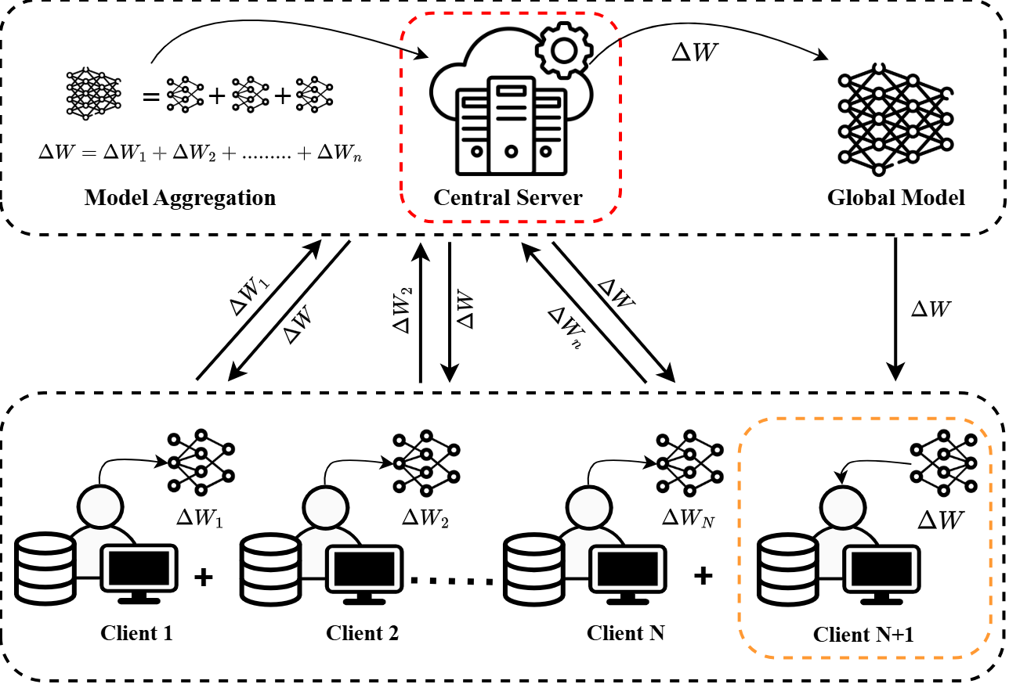
THREAT MODEL
A Strictly Post-Hoc, Model-Only Adversary
Adversary knows
Final trained global model fθ — all parameters, BatchNorm statistics
Can query the model for output logits on arbitrary inputs
Adversary does NOT know
Client datasets, gradients, local updates, or optimizer states
Any intermediate training-time information
DPM 2026 · Co-located with ESORICS 2026, Rome
5

Slide 7
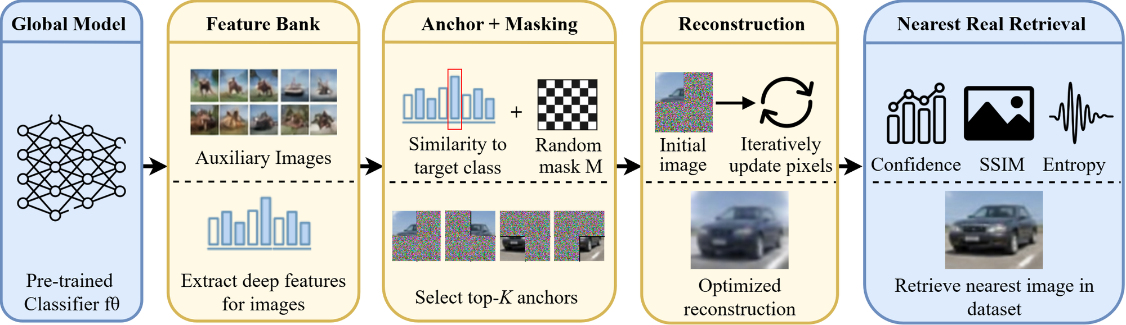
METHOD
Anchor-Guided Reconstruction Framework
How the Pipeline Works
Why This Matters
Feature bank → anchor + masking → iterative reconstruction → nearest-real check
Touches only the frozen global model fθ — the exact post-hoc adversary from the threat model
This anchor-guided attack is the paper's core technical contribution
Every result in the rest of this talk comes from running this exact pipeline
DPM 2026 · Co-located with ESORICS 2026, Rome
6

Slide 8
METHOD
Partial-Anchor Initialization & Multi-Objective Loss
Partial-anchor initialization
Multi-objective loss
x0 = M ⊙ xa + (1−M) ⊙ xn — anchor xa preserves partial semantic content, mask M and noise xn add diversity
Optimize a reparameterized variable u with x = σ(u), mapping the latent variable into valid image space
Multiple random restarts mitigate sensitivity to local minima
L = Lce + λbn·Lbn + λf·Lfeat + λp·Lperc + λtv·Ltv + λc·Lcolor + λa·Lanchor
Enforces classification alignment, BatchNorm-statistic matching, feature consistency, perceptual similarity, smoothness, color regularity, and anchor preservation
Final reconstruction per sample = restart with maximum target-class confidence under fθ
From equation to pixels
xₐ
⊙
+
=
→
iterate
T steps
→
x*
anchor
mask
noise
initial x₀
reconstruction
DPM 2026 · Co-located with ESORICS 2026, Rome
7

Slide 9
SETUP
Experimental Setup
Heterogeneity regimes & global-model accuracy
Design
E1
IID
94.11%
Dataset: CIFAR-10, identical architecture/optimization across all settings
Heterogeneity via Dirichlet partitioning (α = ∞, 0.5, 0.3, 0.1)
100 reconstructions per experiment (10 classes × multiple anchors)
E2
Mild non-IID
93.18%
E3
Strong non-IID
89.51%
Metrics
Pixel-level: MSE, SSIM
Semantic: penultimate-layer feature distance
Privacy proxy: unique nearest-neighbour training images retrieved
E4
Extreme non-IID
65.39%
accuracy ↓ sharply only at E4 (extreme skew)
DPM 2026 · Co-located with ESORICS 2026, Rome
8

Slide 10
RESULTS
Reconstruction Fidelity Peaks at Strong Non-IID (E3)
DPM 2026 · Co-located with ESORICS 2026, Rome
9

Slide 11
RESULTS
Leakage-Level Classification Across Settings
Reading the peak
E3 (strong non-IID): 66% high-leakage, 0% low — the most concentrated, stable reconstructions
E4 (extreme non-IID): only 10% high-leakage; shifts to medium/low as optimization becomes unstable
Thresholds (SSIM, unique-NN, feature distance) applied uniformly across settings for comparability
DPM 2026 · Co-located with ESORICS 2026, Rome
10

Slide 12
RESULTS
E3’s Advantage Is Statistically Significant
Welch's t-test on per-sample SSIM and feature distance (N = 100 per setting, α = 0.05)
Comparison
Metric
p-value
E3 vs E1
SSIM
0.004
E3 vs E1
Feature Distance
< 0.001
E3 vs E2
SSIM
0.018
E3 vs E2
Feature Distance
< 0.001
All differences are significant (p < 0.05): E3’s higher SSIM and lower feature distance are unlikely to be sampling noise.
DPM 2026 · Co-located with ESORICS 2026, Rome
11

Slide 13
RESULTS
Vulnerability Is Also Class-Dependent
Setting
Hardest class
Feat. dist.
Easiest class
Feat. dist.
E1 — IID
bird
0.4145
ship
0.2561
E2 — Mild non-IID
dog
0.6890
cat
0.2609
E3 — Strong non-IID
airplane
0.3012
horse
0.1664
E4 — Extreme non-IID
bird
0.3046
frog
0.0873
Structurally complex classes (airplane, deer, bird) are more variable; simple, prototypical classes (horse) stay stable
Under extreme non-IID (E4), visually complex classes (bird, dog) degrade most — heterogeneity amplifies existing disparities
DPM 2026 · Co-located with ESORICS 2026, Rome
12

Slide 14
RESULTS
Ablation: Every Component Contributes
Setting
Method
SSIM
Feat. Dist.
E3
Random Init
0.0907
1.4547
E3
No Feature Bank
0.1794
2.5508
E3
Full Method
0.6385
1.4755
Takeaways (consistent across all four settings E1–E4)
Random-noise initialization is a weak baseline — SSIM stays below 0.11 everywhere
Removing the feature bank hurts fidelity and inflates feature distance, despite similar SSIM to random init
The full anchor-guided method with feature-bank guidance gives the largest, most consistent gains
DPM 2026 · Co-located with ESORICS 2026, Rome
13

Slide 15
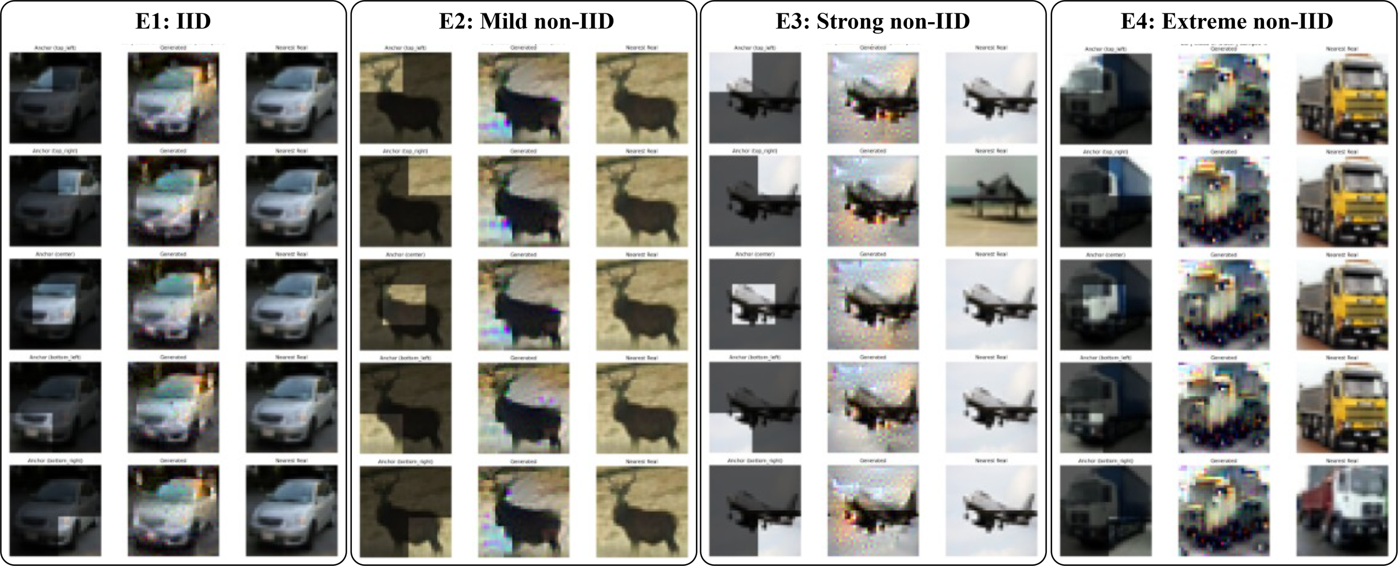
RESULTS
Qualitative Reconstructions Across Heterogeneity
Each panel: anchor → reconstruction → nearest real CIFAR-10 image. Reconstructions stay class-consistent and stable across anchor positions, especially at E3.
DPM 2026 · Co-located with ESORICS 2026, Rome
14

Slide 16
DISCUSSION
Why a “Privacy Peak” at Moderate Skew?
Representation stability drives leakage
Extreme skew is not better privacy
At E3, the global model learns smooth, class-consistent representations — ideal gradients for reconstruction
Leakage tracks representation stability and concentration, not heterogeneity magnitude itself
E4's weaker reconstructions come from degraded model utility (65.39% accuracy), not from stronger privacy
Feature-space similarity remains relatively strong even at E4 — semantic information is still partly recoverable
Neither extreme keeps you safe: privacy risk is a curve, not a straight line — and its peak sits in the middle.
DPM 2026 · Co-located with ESORICS 2026, Rome
15

Slide 17
CONCLUSION
Conclusion
“
Federated models retain semantically meaningful, recoverable information about their training data — even under strong distribution shift and even when adversaries never see a single gradient or client update.
1
What We Found
2
What It Means
3
What's Next
Reconstruction fidelity peaks at strong — not extreme — non-IID conditions: a non-monotonic “privacy peak.”
Holds even for the strictest adversary: no gradients, no client updates, only the final deployed model.
Benchmarking privacy only at IID or extreme skew can underestimate real-world risk.
A vulnerable “moderate skew” regime deserves explicit attention in FL privacy evaluations.
Testing generalization beyond CIFAR-10 — CIFAR-100, Tiny-ImageNet, and other domains.
Exploring data-free variants and extending the framework to other model families.
DPM 2026 · Co-located with ESORICS 2026, Rome
16

Slide 18
Thank You
Questions & Discussion
Hamza Sajjad
hamza.sajjadahmed@imtlucca.it
github.com/imhamzasajjad/anchor_guided_fl_reconstruction
Supported by RDS PTR 25–27 (Cybersecurity) and SPF BOSA project AIDE

