Slide 1

Fast Simulation Algorithms for OLH using Binomial Modeling
Berkay Kemal Balioglu, Alireza Khodaie, M. Emre Gürsoy
Department of Computer Engineering
Koç University, Istanbul, Türkiye
Notes:
Fast simulation algorithms for OLH. Joint work with Alireza Khodaie and Emre Gursoy at Koc University.

Slide 2
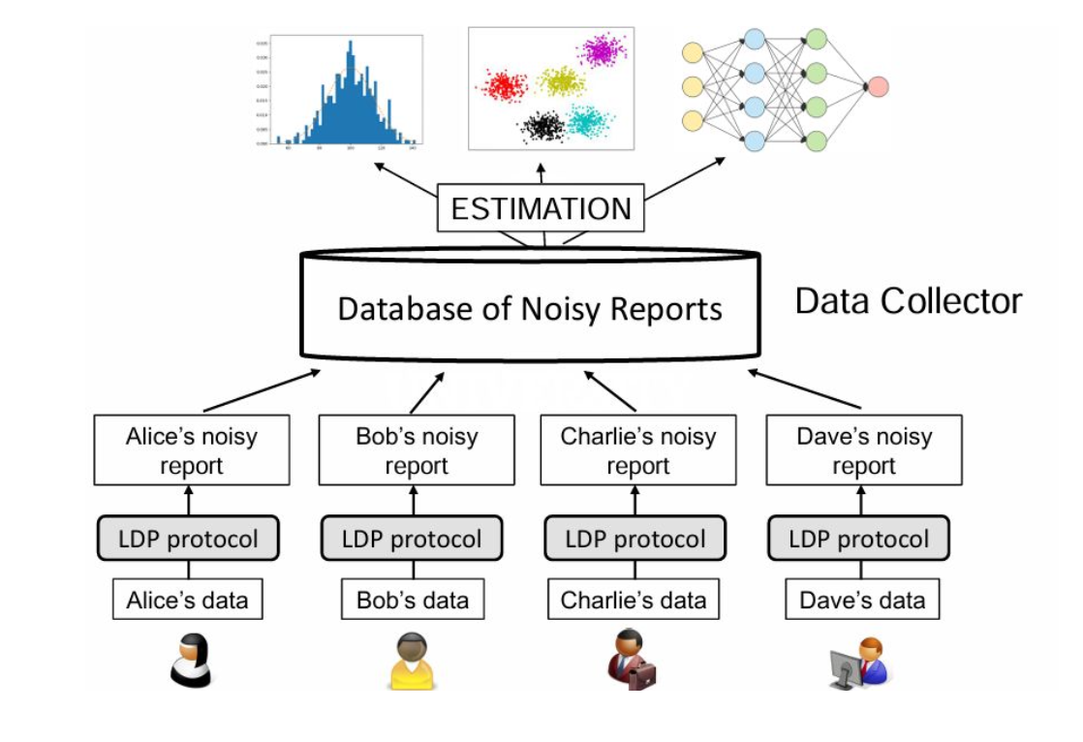
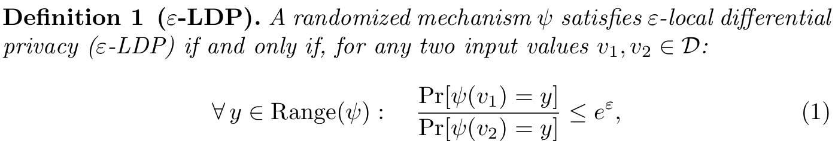
Local Differential Privacy
Modern analytics relies heavily on data collection, much of which involves privacy-sensitive information such as health, financial, and location data.
In Local Differential Privacy (LDP):
Each user perturbs their value locally
The server applies estimation to recover aggregate statistics such as frequencies
Lower 𝜺 yields stronger privacy, higher 𝜺 yields higher utility

Slide 3
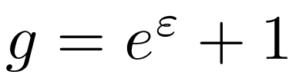
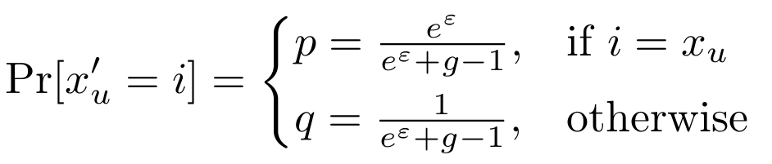
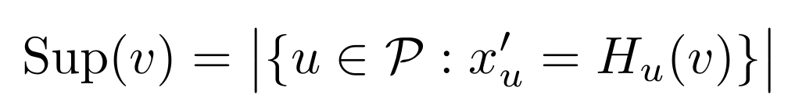
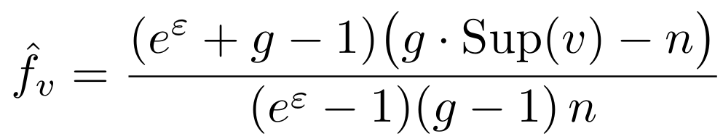
Optimized Local Hashing
Each user randomly selects a hash function from a hash family and uses it to encode their true value to an integer in [0, g-1], where
User-Side Perturbation:
Server-side support and frequency estimation:
Encode
map v_{u} to x_{u} = H_{u}(v_{u}) in [0,...,g-1]
Perturb
Keep x_{u} with probability p; otherwise, sample uniformly from [0,...,g-1]\{x_{u}}
Report
Send <H_{u}, x'_{u}> to the server
→
→

Slide 4
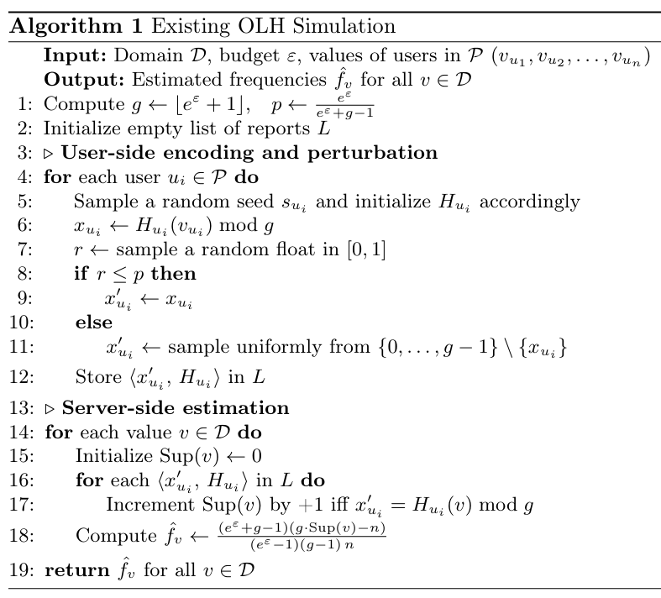
Simulating OLH
In research, we run simulations of OLH on one machine: every user, then the server
User phase: O(n)
Server phase: recomputes H_{u}(v) for every report-value pair
Bottleneck: Line 17 executes O(nd) hash calls, which dominate runtime
O(nd) complexity: with n in the millions and d in the hundreds, a single simulation takes minutes.

Slide 5
Contributions
We propose two simulation algorithms (2-Binom and 3-Binom) for OLH to capture the collective behavior of n users using Binomial sampling, avoiding per-user simulation
We formally prove that 2-Binom and 3-Binom yield unbiased frequency estimates with variances equal to original OLH
We empirically validate 2-Binom and 3-Binom on multiple datasets
  Orders-of-magnitude reductions in runtime and memory
  Estimates are statistically indistinguishable from OLH

Slide 6
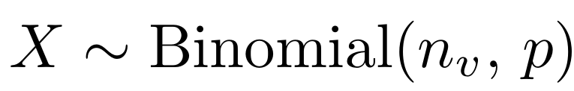
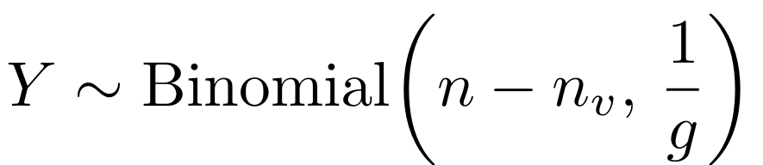
The Binomial Insight
Each user contributes 0 or 1 to Sup(v).
Partition the population by their true value:
Group 1: User’s value v_{u} = v (n_{v} such users)
Contributes iff the perturbation keeps the hashed value, w.p. p.
Group 2: User’s value v_{u} ≠ v (n - n_{v} users)
A. hash collision, value kept: p / g
B. no collision, flips onto H_{u}(v): (g-1)q/g
Total Sup(v) is:
Sup(v) = X + Y

Slide 7
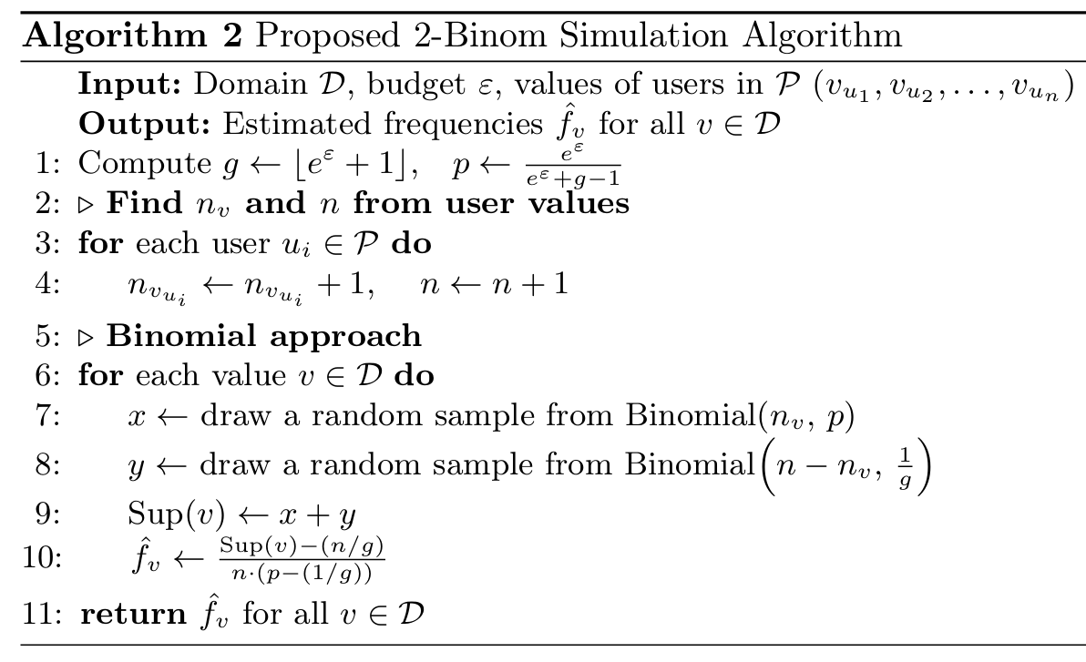
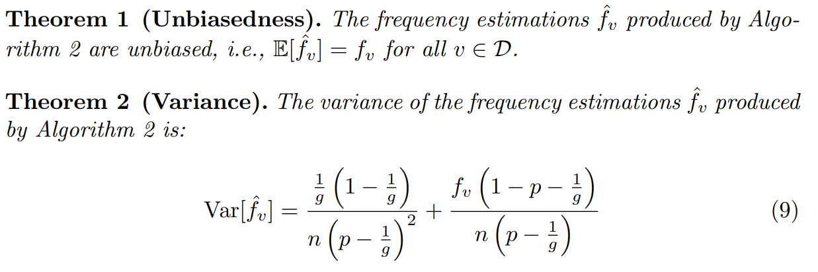
2-Binom Algorithm
No reports are stored and no hash is ever computed
Total complexity O(n+d), down from O(nd)
When the same dataset is reused (repetitions, or a sweep over 𝜺) the count phase runs once, so each further run is O(d)

Slide 8
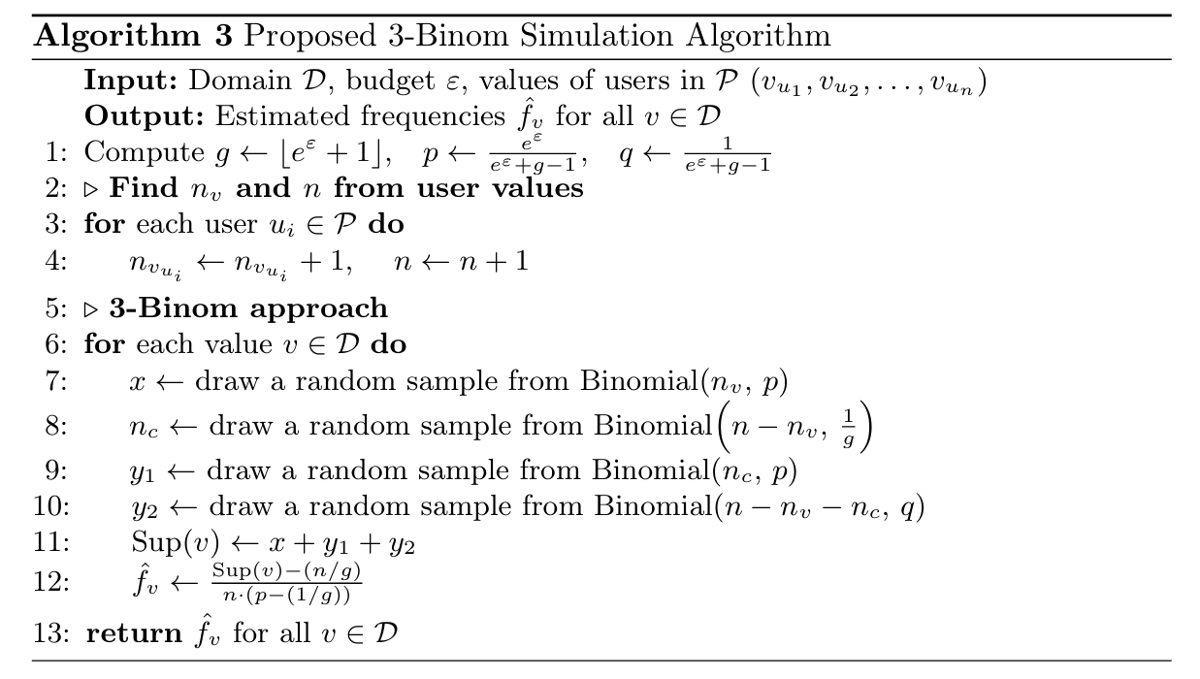
3-Binom Algorithm
Instead of merging the two sub-cases of Group 2, draw the number of colliding users n_{c} first and condition on it.
Three Binomial draws:
  X: true (v), survives perturbation
  Y₁: colliding users, kept by perturbation
  Y₂: non-colliding users, flip to H_{u}(v) by chance
Result: three draws per value; complexity remains O(n+d)
Theorems 3-4 in our paper show 3-Binom produces unbiased estimates with variance identical to 2-Binom: The two decompositions are statistically equivalent.

Slide 9
Experiment Setup
Datasets:
Adult: 45K records, 14 attributes; Age as private value (d=74)
MSNBC: User browsing activity logs (d=17)
Kosarak: Click-stream data; top 128 URLs (d=128)
BMS-POS: 516K transactions, 1.7K items; top 256 items (d=256)
Experimental Settings:
𝜺 ∈ {0.5, 1.0, …, 4.0}
Runtime: 10 repetitions
Error & variance: 5,000 repetitions
Metrics:
Execution time & peak memory
ℓ₁ and ℓ₂ estimation error
Per-value empirical variance

Slide 10
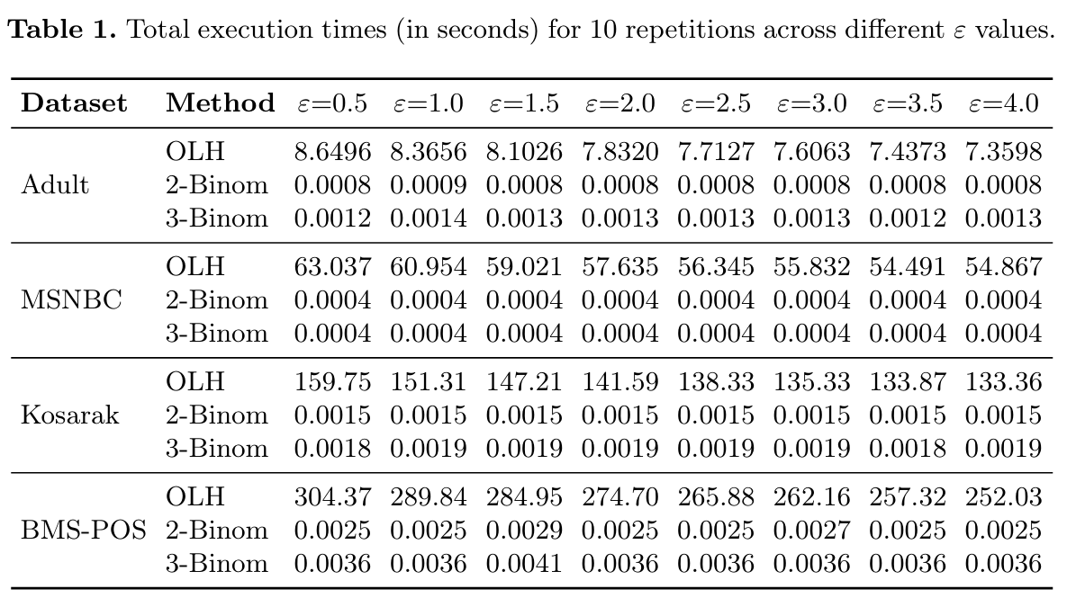
Execution Time Results
Binomial methods: Have run time <5 ms across all configurations
OLH: Scales with both n and d, reaching several minutes
3-Binom: Slight overhead from the additional draw per v, but negligible in practice

Slide 11
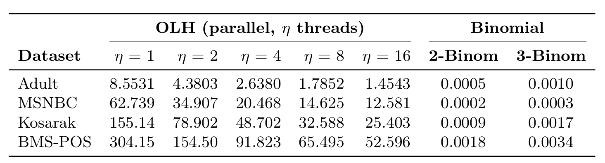
Effect of Multi-Threading
Parallel OLH with 𝜂 threads against single-threaded Binomial methods, 𝜺 = 1
Multithreading accelerates OLH, but speedup is sublinear as threads increase
Even with 16 threads, OLH remains orders of magnitude slower than single-threaded Binomial
The bottleneck remains: parallelization reduces runtime but does not remove the O(nd) computation

Slide 12
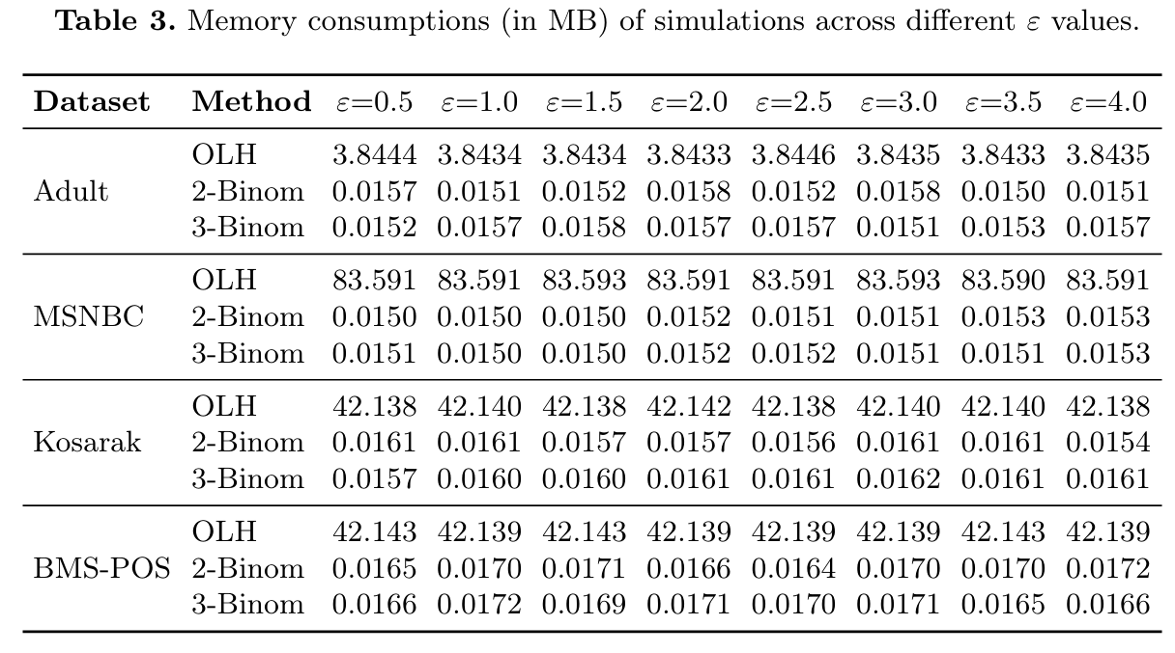
Memory Consumption
2-Binom and 3-Binom cut memory usage by orders of magnitude (from megabytes down to tens of kilobytes)
Population-independent: Binomial methods scale as O(d) vs OLH’s O(n+d)
2-Binom ≈ 3-Binom: Both have a negligible memory footprint

Slide 13
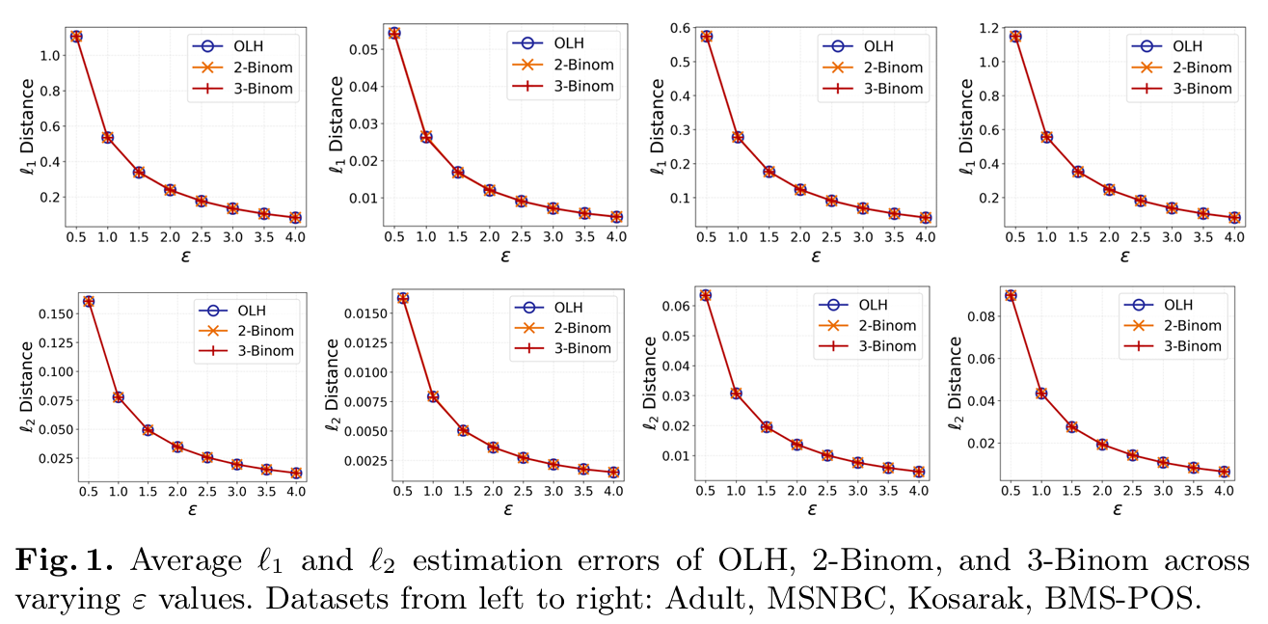
ℓ₁ and ℓ₂ Errors
Error curves of OLH, 2-Binom and 3-Binom closely overlap across all 𝜺 values
All three decrease monotonically as 𝜺 grows
Residual differences are within the sampling noise of 5,000 repetitions

Slide 14
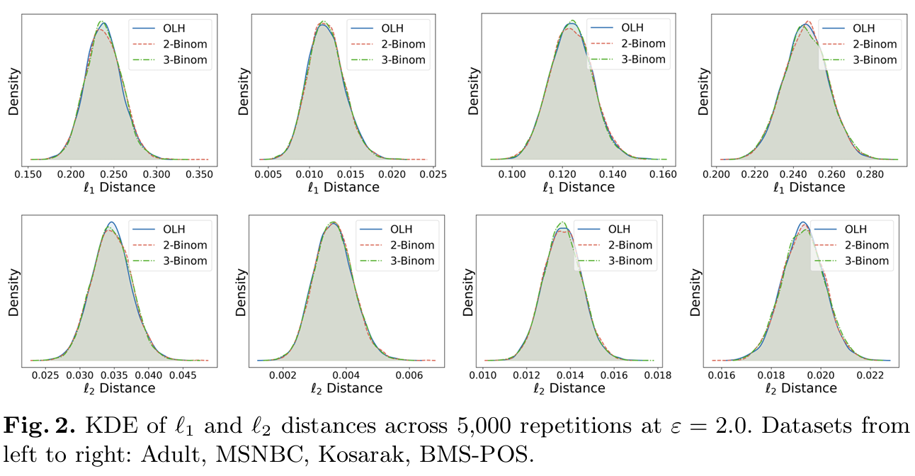
Error Distributions (KDE)
The KDE curves overlap closely and are bell-shaped, sharing the same center and the same spread
Agreement is tightest on the smallest domain (MSNBC, d = 17)
Binomial methods match OLH not only in mean error, but in the full error distribution

Slide 15
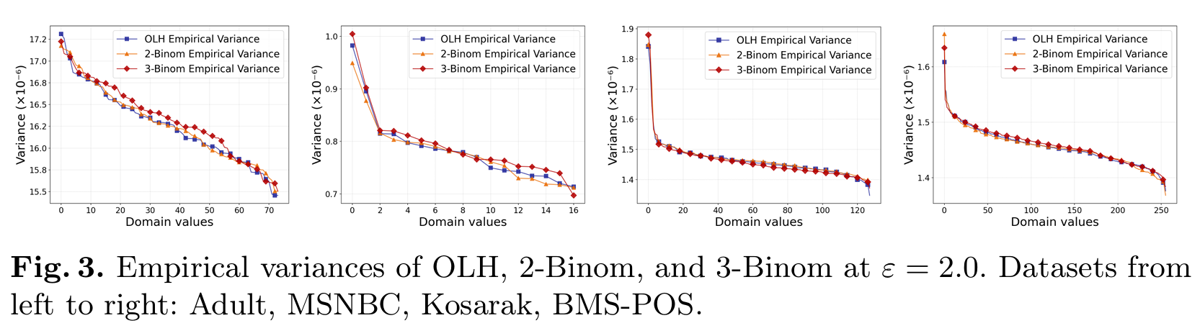
Per-Value Variance
Per-value variances of the three methods track one another across the whole domain
Variance decreases with f_{v} , the behaviour predicted analytically by Theorems 2 and 4
Together with the error results, this establishes the Binomial methods as empirically equivalent to OLH

Slide 16
Conclusion
2-Binom & 3-Binom: Replace per-user OLH simulation with Binomial sampling to improve simulation efficiency
Complexity drops from O(nd) to O(n+d), or O(d) with cached counts, while unbiasedness and variance are provably preserved
Execution times fall from minutes to milliseconds and memory from megabytes to kilobytes, with no change in utility
Future work:
  Integrate the proposed methods into LDP benchmarking platforms
  Accelerate downstream OLH-based applications

Slide 17



Thank You!
Berkay Kemal Balioglu
bbalioglu23@ku.edu.tr
Alireza Khodaie
akhodaie22@ku.edu.tr
M. Emre Gürsoy
emregursoy@ku.edu.tr

