Slide 1

Harmless Opening for Continuous-Valued
Local Differential Privacy
Hiroaki Kikuchi
Meiji University, Japan
DPM 2026, Roma

Slide 2





Issue of LDP: Poisoning
ε
$v_{1}$=2
LDP
algorithm
$z_{1}$ = 3
User 1
ε
S
ε
$v_{2}$=2
LDP
algorithm
$z_{2}$ = 1
MLE
User 2
manipulation
of statistics
LDP
algorithm
$z_{3}$ = -100
User 3
poisoning
malicious

Slide 3
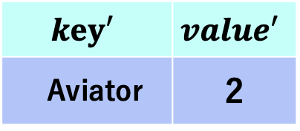
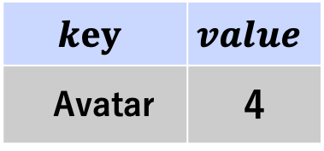
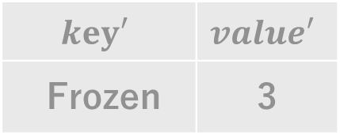
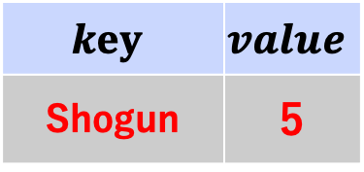
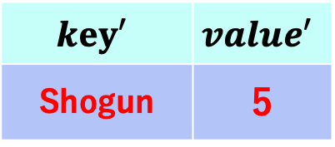
Poisoning attacks
[Y.Wu, et al., 2022]
Input Poisoning (IPA)
Output Poisoning (OPA)
1. M2GA
$$key′$$ | $$value′$$
Shogun | 5
original
perturbed
$$key$$ | $$value$$
Avatar | 4
Randomized
Response
$$key′$$ | $$value′$$
Aviator | 2
3. RKVA
2. RMA
$$key$$ | $$value$$
Shogun | 5
$$key′$$ | $$value′$$
Frozen | 3

Slide 4
Related Works
Poisonings
  [7] Cheu S&P21
  [8] Cao Usenix 21
  [9] Wu Usenix 22
Robust LDP protocols
  [10] Zhao, S&P 25, RobustLDP
  Ye, S&P 25, Subset Counting Query
Cryptographical approach
  [6] Kato, DBSec 2021
  [1] Song, IEEE Trans. IFS 2023.

Slide 5
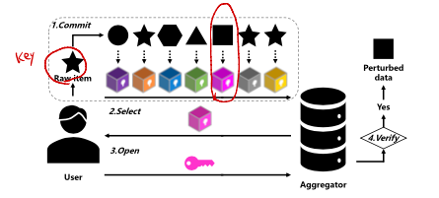
[1] Song+23
S. Song, L. Xu and L. Zhu, "Efficient Defenses Against Output Poisoning Attacks on Local Differential Privacy," in IEEE Transactions on Information Forensics and Security, vol. 18, pp. 5506-5521, 2023
Interactive Perturbation
  Cryptographic approach
    Commit: User sends commitment of his input value and fake input values
    Select: Aggregator uniformly choose one
    Open: Users opens it with some of fake values
    Verify : Aggregator verifies user follows protocol.

Slide 6
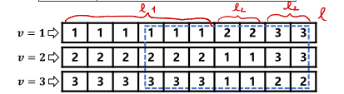
“Harmless Opening”
VGRR (Verifiable GRR)
  Commit ℓ₁ true value and ℓ₂ fake values
  ℓ= ℓ₁ + (d-1)ℓ₂
  Example ℓ=10, d = 3
    Pr[x = 1] = 6/10
    Pr[x = 2] = Pr[x = 3] = 2/10
    Aggregator can not distinguish x = 1 and x = 2,3

Slide 7

VGRR (Verified GRR)
Pros:
  VGRR is ( )-LDP
  VGRR is robust against OPA
    robust iff Pｒ[S_{max} = S_{in}] > 1 – negl(k)
    S_{in} = IPA, S_{max} = OPA
  VGRR is lightweight (no ZK proof)
Cons:
  deals with only discrete values (frequency estimation)

Slide 8
Our work
Goal
  Robust LDP for continuous value
Task | LDP | Poisoning | Mitigation
 |  |  | probabilistic | cryptographical
Frequency estimation (categorical value) | GRR, OUE, OLH, Rappor | [7] Cheu [8] Cao [9] Wu | [8], [12] | [1] Song, [6] Kato
Mean estimation (continuous value) | [3] SR [4] PM | [10] Zhao | [10] Zhao | Our work

Slide 9
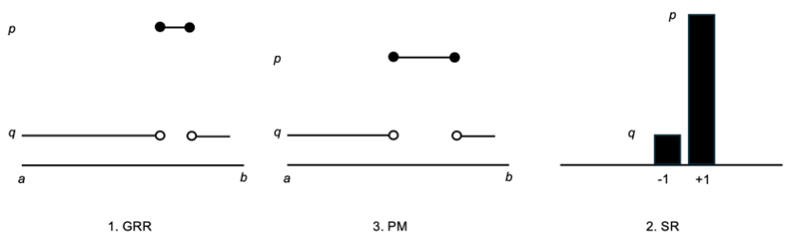
Continuous-valued LDP
LDP
  [2] GRR (Generalized Randomized Response)
  [3] SR (Stochastic Rounding)
  [4] PM (Pricewise Mechanism)

Slide 10



SR (Stochastic Rounding)
Input: x
  x in [a,b] → x~ in [-1,1]
    x~ = -1 + (x-a)*2/(b-a)
Perturbation: x’
Unbiased estimator

Slide 11
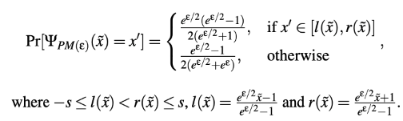
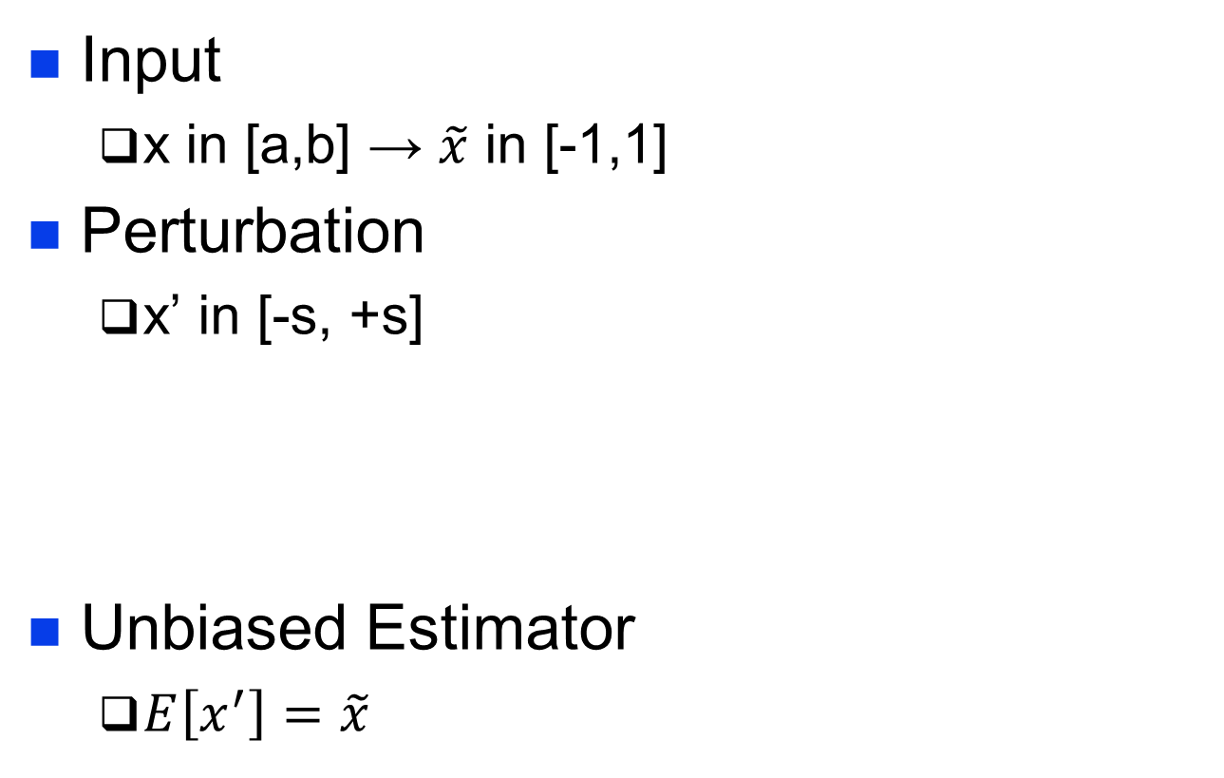
PM (Piecewise Mechanism)
Input
  x in [a,b] → $\tilde{x}$ in [-1,1]
Perturbation
  x’ in [-s, +s]
Unbiased Estimator
  $E\left[x^{′}\right]=\tilde{x}$

Slide 12
Threat model
n honest users
m malicious users
  rate β = m/(n+m)
  gain = target mean (max) – true mean
  IPA (input = targeted value, with LDP)
  OPA (output = targeted value, without LDP, leaves if x < θ）

Slide 13
Proposed Method
Idea
  binning (making into discrete bins) and applies Harmless Opening (VGRR)
base |  | Harmless Opening
LDP | encoding | Binning
GRR | D→D | D →d values {0,…,d-1} | VGRR-HO
SR | [a,b]→{-1,+1} | [a,b] → d values | SR-HO
PM | [a,b] →[-s, +s] | [-s,+s] → d values | PM-HO

Slide 14
Example 1) GRR
1. Commit
  d = 5, x in {1,2,3,4,5}, x~ in {-1, -1/2, 0, ½, 1},
  ε = log 2
  x = 4, x~ = 1/2, p = e^{ε}/(e^{ε}+d-1) =2/6, q = 1/6
2. A picks j = 2 in {1,..,6}
3. U opens c(1) c(2) c(3) c(4) c(5)
4. A checks C and c(1) c(2) c(3) c(4) c(5)
1 | 2 | 2 | 3 | 4 | 5
C(1) | C(2) | C(2) | C(3) | C(4) | C(5)

Slide 15
Example 2) SR-HO
D = {0,1,2,3,4}, d = 5, ε =ln 2, ℓ = 12
  HO proves that 4/12 ≦ p* ≦ 8/12 for all cases
x | ~x | P* | ℓ-₁ | ℓ₁
0 | -1 | 1/3 | 4 | 8
1 | -1/2 | 5/12 | 5 | 7
2 | 0 | 1/2 | 6 | 6
3 | 1/2 | 7/12 | 7 | 5
4 | 1 | 2/3 | 8 | 4
x | 1 | 2 | 3 | 4 | 5 | 6 | 7 | 8 | 9 | 10 | 11 | 12
0 | C(-1) | C(-1) | C(-1) | C(-1) | C(1) | C(1) | C(1) | C(1) | C(1) | C(1) | C(1) | C(1)
1 | C(-1) | C(-1) | C(-1) | C(-1) | C(-1) | C(1) | C(1) | C(1) | C(1) | C(1) | C(1) | C(1)

Slide 16
Example 3) PM-HO
Commit
  d = 5, x in {0,1,2,3,4}, ~x in {-1, -1/2, 0, ½, 1}, ε = log 2,
  x = 3, x~ = 1/2, s = (e^{ε/2}+1)/(e^{ε/2} -1) = 5.8
  ℓ(x) = 2x -1 /(2-1) = -0.7, r(x) = 4.1
0.121
0.060
-5.8
-0.7
4.1
+5.8

Slide 17

Questions
RQ1. Does Harmless Opening mitigates poisoning attacks?
RQ2. How much accuracy reduction does come with the binning?
RQ3. Which is the best LDP scheme in terms of accuracy and computational costs?

Slide 18
Security Analysis
Privacy
  GRR-HO, SR-HO and PM-HO satisfies
  ε-LDP.
Robustness
  Theorem 1 GRR-HO is robust
    Pr[S_{max} = S_{in}] > 1 – negl (k)
  Proposition SR-HO is semi-robust?
    Pr[S_{max} > S_{in}] > 1 – negl (k)
bogus

Slide 19

Security of SR-HO
Lemma 1. Any report accepted by the Harmless opening satisfies
for mean-maximizing attack.
  Mean-maximizing adversary would like to commit +1 value, which is limited at most ℓ₂ (ℓ₋₁) times in HO verification process.
Theorem 2. SR-HO is robust for mean estimation, i.e., gain G_{max} = G_{IPA}.

Slide 20
Evaluation
Dataset
  UCI Adult dataset , Age [a = 17, b = 90]
Taks
  Mean estimation
Metrics
  Accuracy: MSE
  Robustness: gain
  gain = estimate with poisoning – estimate

Slide 21
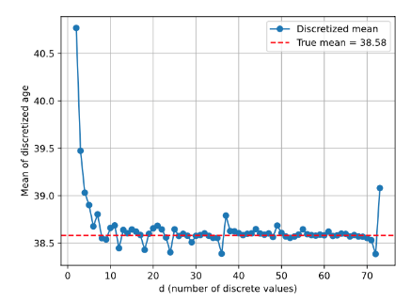
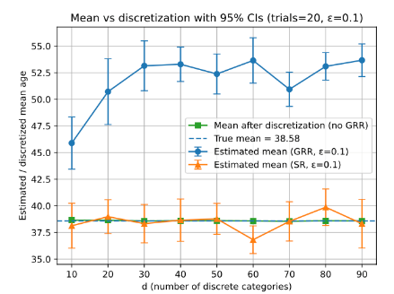
Result 1. binning
Without perturbation
LDP (GRR, SR)
Estimated mean
True mean
d (# values)
d (# values)

Slide 22
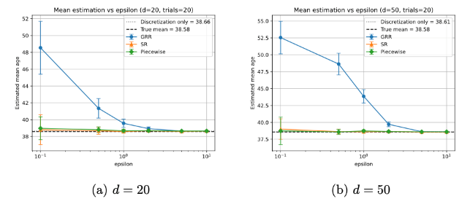
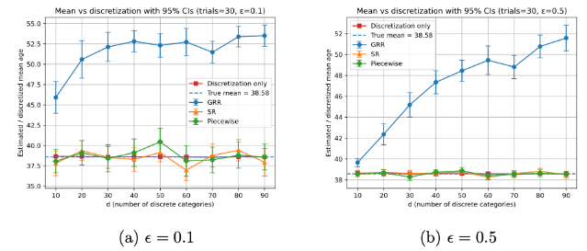
Result 2. Estimated Mean
Estimated mean
(age)
Privacy budget ε
ε
Estimated mean
(age)
d (# values)
d

Slide 23
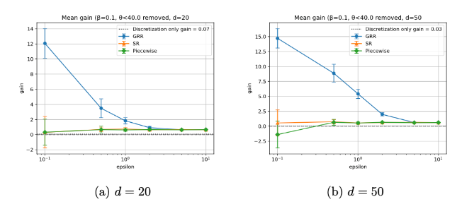
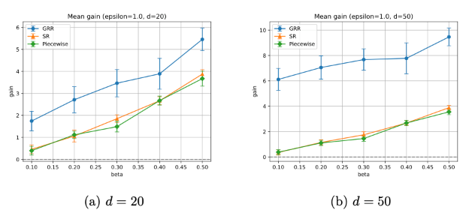
Result 3. Gain (=vulnerability)
Gain
vulnerable
Robust
Privacy budget ε
ε
Vulnerable
robust
Malicious user rate β
d = 20
β
d = 50

Slide 24
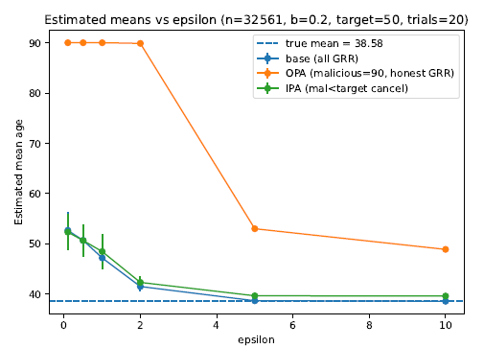
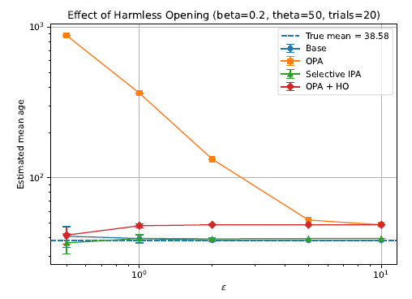
Result 3. Gain (=vulnerability)
Gain
vulnerable
OPA
OPA+HO
Robust
Privacy budget ε
ε

Slide 25
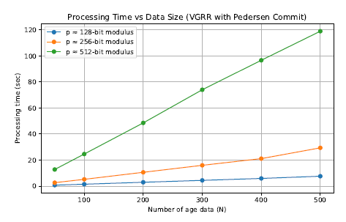
Result 4 processing time
512 bit
Total time used for Pedersen Commitment
d = 73, ℓ = 200
Per user time is very small.
E.g. 75 s / 300 (N ) = 0.25 sec/user
256 bit
レコード数 N

Slide 26
Conclusions
RQ1. does HO mitigate poisoning?
  Yes. GRR and SM are robust.
RQ2. Accuracy reduction? small
RQ3. Best scheme? SR is robust and lightweighted
Future work： robustness for PM and work with Robust LDP [Zhao 25]
 | GRR | SR | PM
Robustness | Frequency | Mean | Mean
security | Robust | Robust | (open)
ℓ | ℓ₁+(d-1) ℓ₂ | ℓ₁+ℓ₂ | ℓ₁s + ℓ₂s
Cost | High | Low | High
Accuracy | Low | High | High
Gain | High | Low | Low

Slide 27
Pedersen Commitment
情報理論的安全性を保証したコミット
  Z1, Z2: 有限群 (DLP仮定)
  公開鍵: (g, h) Z1, Z2の生成元
  コミットする値: ρ
  コミット： C(ρ) = g^{ρ}h^{τ}
  準同型性

Slide 28
準同型性を用いたランダムサンプリング
初期値
  A: x, B: y
  A→B: C(x,r1)
  B→A: C(y,r2)
  C’ = C(x,r1)*C(y,r2) = C(x+y, r1+r2)を求めて，x, y をopen

Slide 29
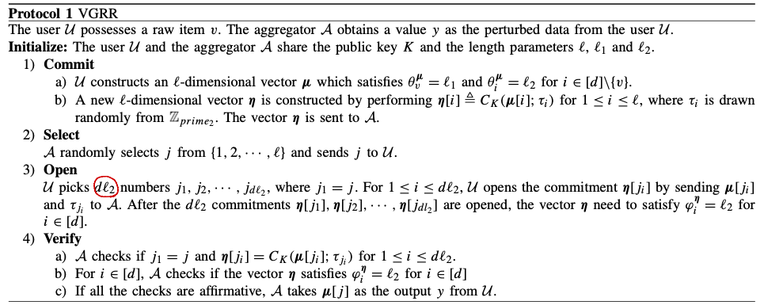
VGRR

Slide 30
robustの定義
定義2 (識別不能性)
  A* (真のアイテムを推測するアルゴリズム）
  view (Aが観測する情報）
  Pr(A*(view;y) = v) – Pr[A*(y) = v] < nelg(k)
  である時，Mは識別不能．
定義3 (ロバスト）
  Smax = Overall scoreの最大値．
  Pr[Smax = Sin] > 1 – nelg(k) である時，Mはrobust.
定義4 (semi-robust)
  Pr[Sout > Smax > Sin] > 1 – nelg(k)

Slide 31
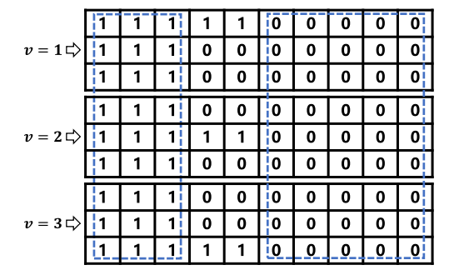
VOUE
VGRRのOUEバージョン
  ℓ = 2ℓ₁, ℓ₁> ℓ₂
  d個のそれぞれについて，jを選ぶ．

Slide 32
VOUEの性質
定理4 (LDP)
  LDPを満たす．
定理5 (識別不能性)
定理6 (安全性，少し弱い）
  VOUEは semi-robust である．
    Sout = r ℓ₁ > Smax = r/2

Slide 33
VOUE+
集合への所属のZKIPの導入
  [36, Kato], [40, Benarroh 2021]
  未開示のエレメントが正しく所定の集合に属していることを証明する．
定理9 (頑強性)
  VOUE+はrobustである．

