Slide 1

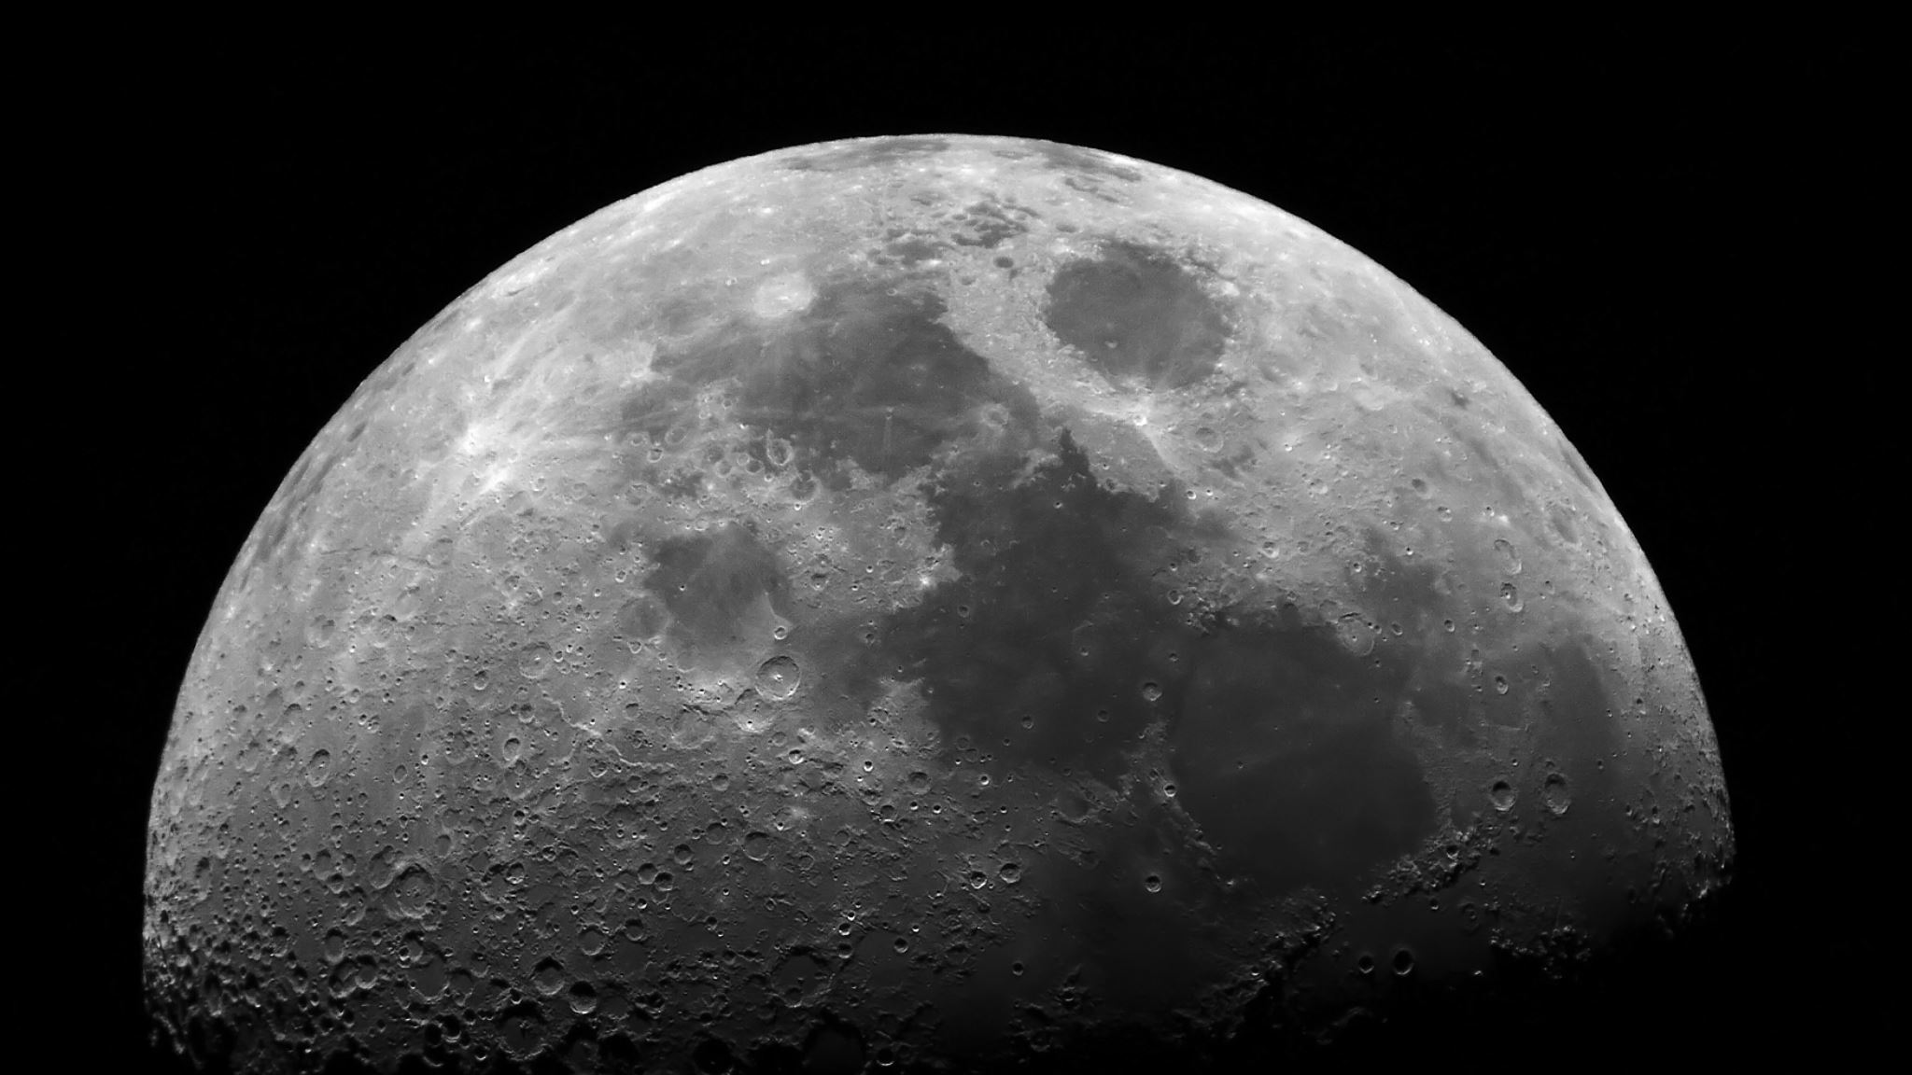
PLUTO
Privacy-preserving benchmarking for Local and Unbiased Triangle Obfuscation
Long Pham and Stacey Truex

Slide 2
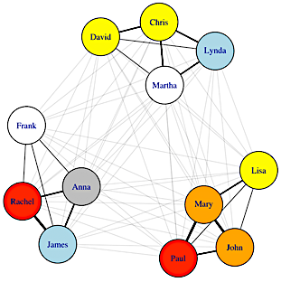
Triangle Counting
Chris
David
Lynda
Fundamental tool in graph analysis
Applications:
clustering behavior
network transitivity
community discovery
link prediction
spam filtering
Martha
Frank
Lisa
Anna
Rachel
Mary
James
John
Paul

Slide 3
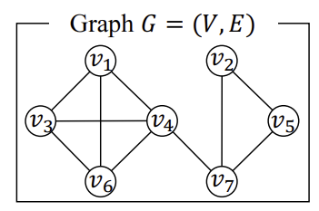
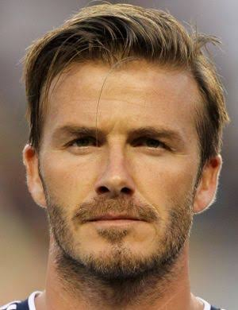

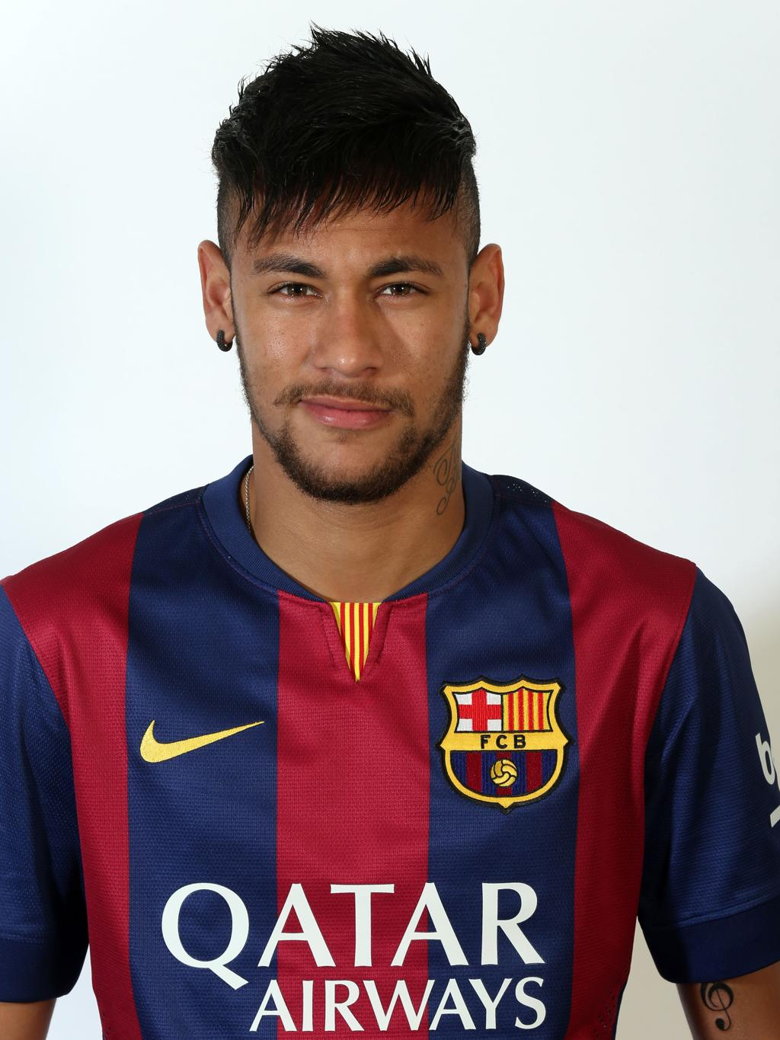

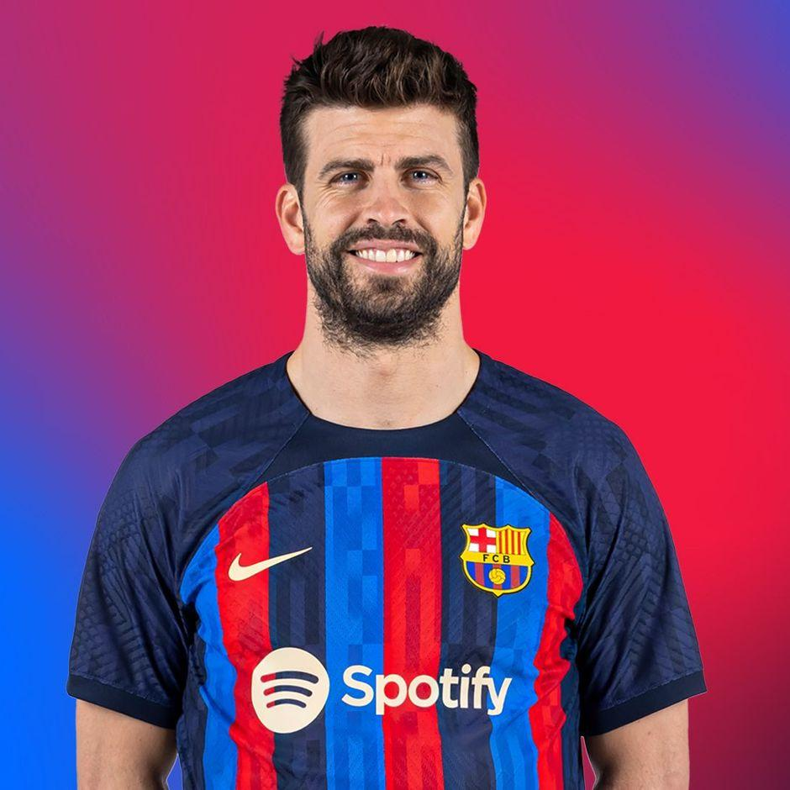


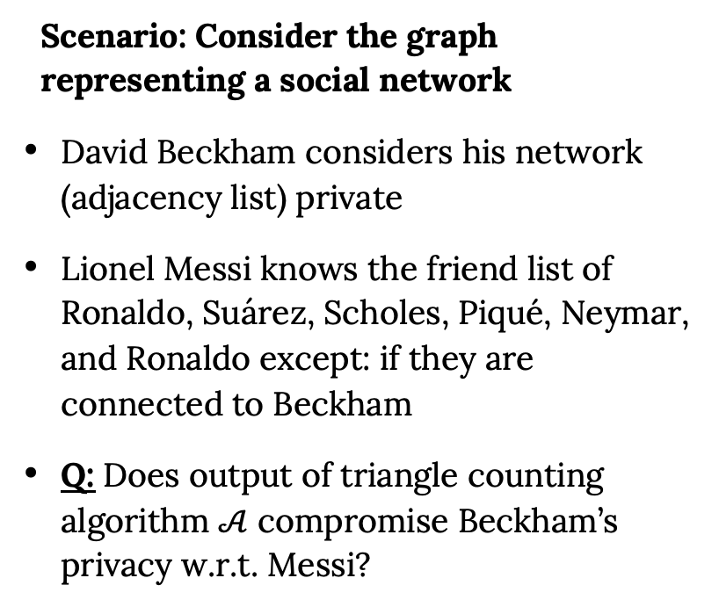
Privacy in Triangle Counting
Scenario: Consider the graph representing a social network
David Beckham considers his network (adjacency list) private
Lionel Messi knows the friend list of Ronaldo, Suárez, Scholes, Piqué, Neymar, and Ronaldo except: if they are connected to Beckham
Q: Does output of triangle counting algorithm $𝒜$ compromise Beckham’s privacy w.r.t. Messi?

Slide 4
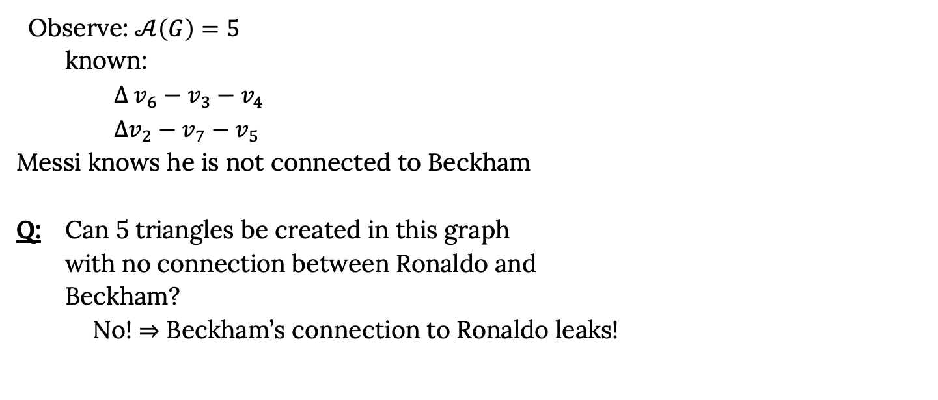
Privacy in Triangle Counting
Observe: $𝒜\left(G\right)=5$
known:
$Δ v_{6}−v_{3}−v_{4}$
$Δv_{2}−v_{7}−v_{5}$
Messi knows he is not connected to Beckham
Q: Can 5 triangles be created in this graph
with no connection between Ronaldo and
Beckham?
No! $⇒$ Beckham’s connection to Ronaldo leaks!

Slide 5

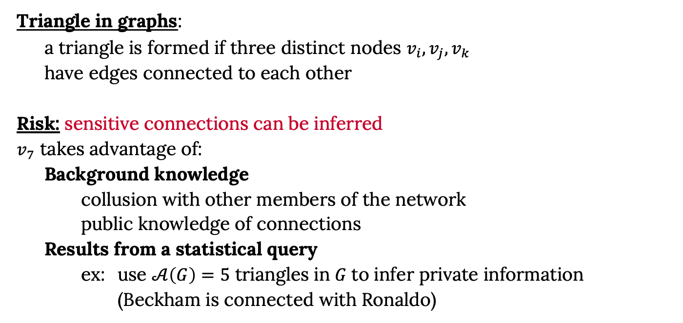


Privacy in Triangle Counting
Triangle in graphs:
a triangle is formed if three distinct nodes $v_{i}, v_{j}, v_{k}$
have edges connected to each other
Risk: sensitive connections can be inferred
$v_{7}$ takes advantage of:
Background knowledge
collusion with other members of the network
public knowledge of connections
Results from a statistical query
ex: use $𝒜\left(G\right)=5$ triangles in $G$to infer private information
(Beckham is connected with Ronaldo)
$${ v}_{i}$$
$${ v}_{j}$$
$$v_{k}$$

Slide 6
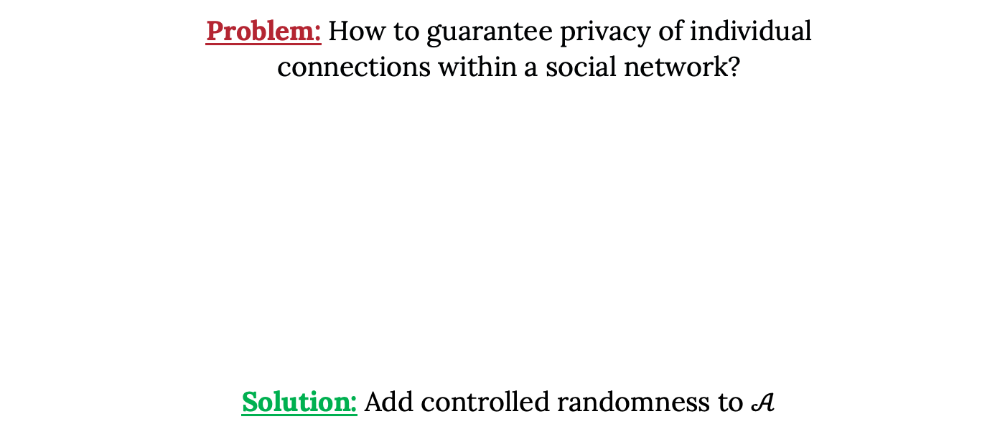
Privacy in Triangle Counting
Problem: How to guarantee privacy of individual
connections within a social network?
Solution: Add controlled randomness to $𝒜$

Slide 7
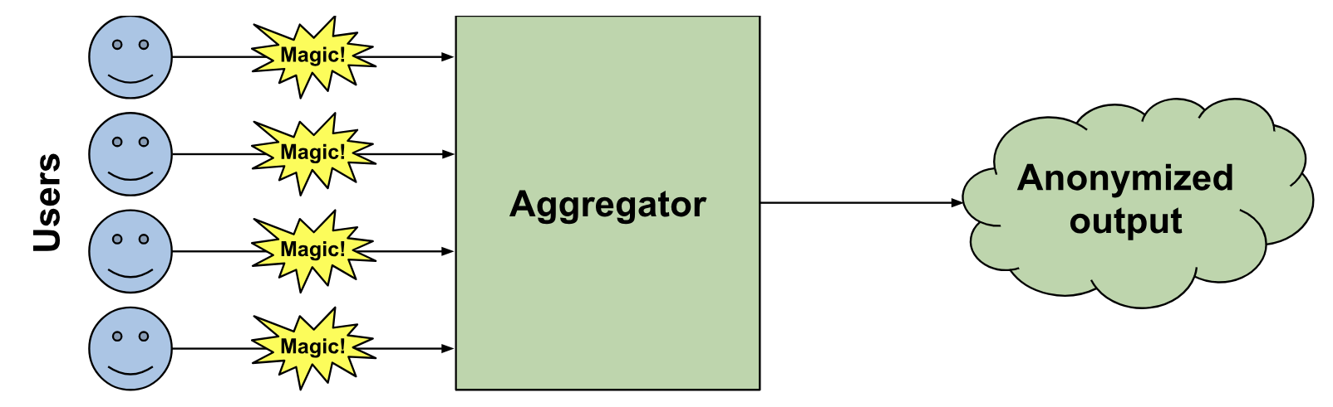
Local Differential Privacy (LDP)
Users perturb sensitive data
Users transmit
noisy data
Server aggregates noisy reports
Statistical estimation recovers patterns

Slide 8
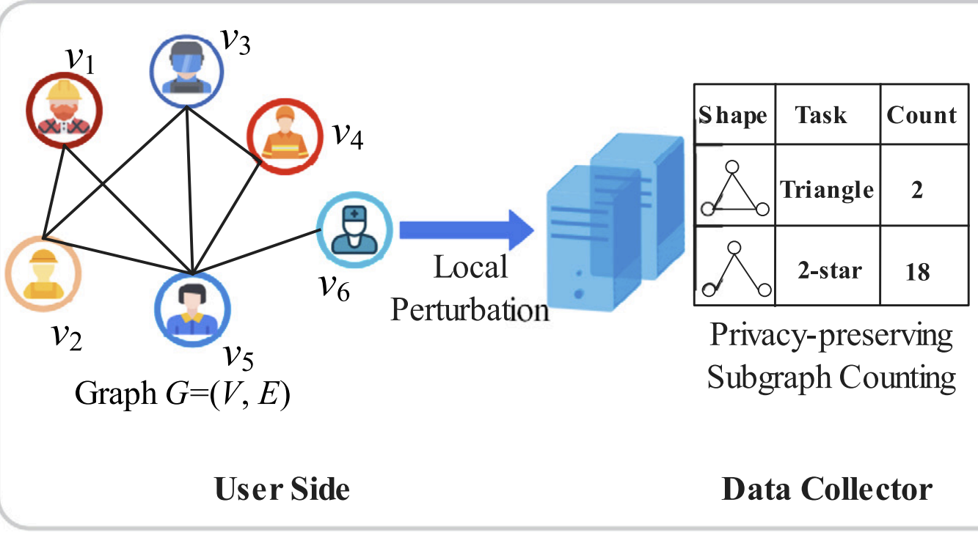
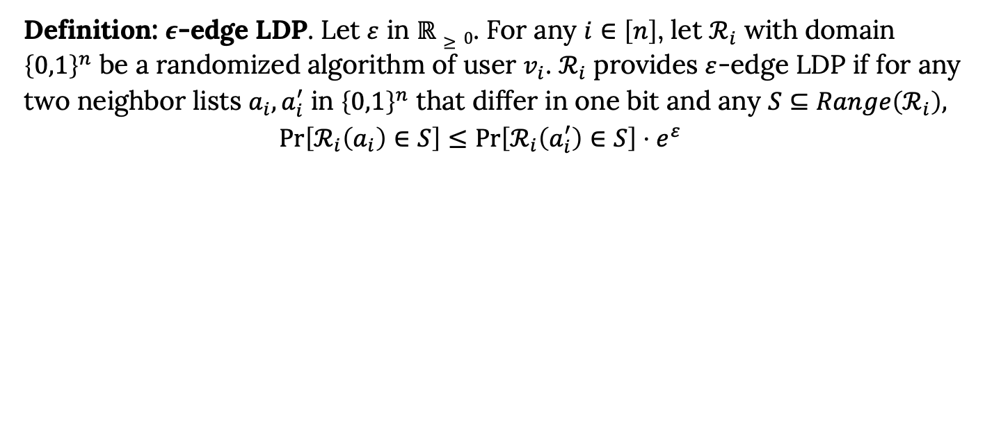
Applying LDP to Graph Analysis
Definition: $ε$-edge LDP. Let $ε$ in $ℝ≥0$. For any $i∈\left[n\right]$, let $ℛ_{i}$ with domain ${\left\{0,1\right\}}^{n}$ be a randomized algorithm of user $v_{i}$. $ℛ_{i}$ provides $ε$-edge LDP if for any two neighbor lists $a_{i}, a_{i}^{′}$ in ${\left\{0,1\right\}}^{n}$ that differ in one bit and any $S⊆Range\left(ℛ_{i}\right),$
$$\operatorname{Pr}\left[ℛ_{i}\left(a_{i}\right)∈S\right]≤\operatorname{Pr}\left[ℛ_{i}\left(a_{i}^{′}\right)∈S\right]⋅e^{ε}$$

Slide 9
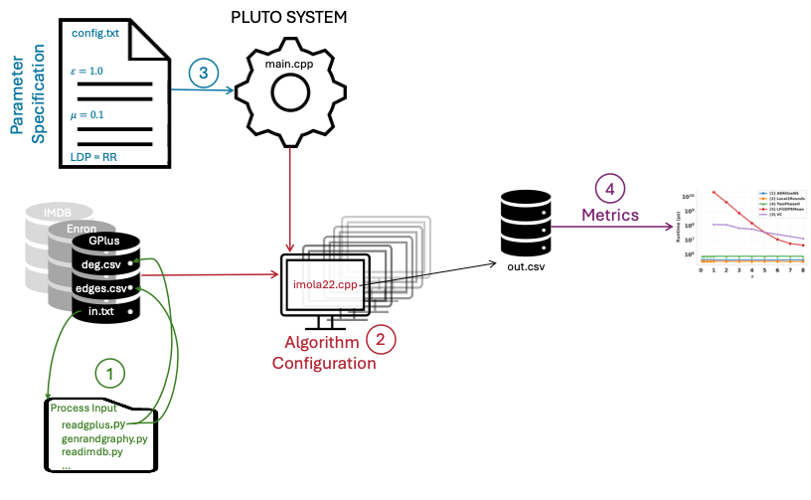
PLUTO System
Addresses the lack of a standardized experimental pipeline
Provides a unified & extensible benchmarking framework for evaluating LDP triangle counting algorithms

Slide 10
PLUTO System
1. Data Processing
SNAP networks
Synthetic graphs: Erdös-Rényi & Barabási-Albert
2. Algorithm Configuration
Each algorithm is implemented as a self-contained module
Add self-contained module & update build configurations

Slide 11
PLUTO System
3. Parameter Specification
General parameters:
Algorithm-specific tuning parameters:
4. Metric Evaluation
Accuracy: Relative Error & L2-Loss
Runtime in microseconds
$ε$: controlling privacy budget, $n$: number of nodes control input size
𝜀: controlling privacy budget, 𝑛: number of nodes control input size
$μ$: edge sampling to reduce noise
𝜇: edge sampling to reduce noise
privacy-budget allocation: allocate$ε$non-uniformly across steps
privacy-budget allocation: allocate 𝜀 non-uniformly across steps
Choice of LDP mechanism: RR, OUE
Communication overhead: upload & download cost

Slide 12
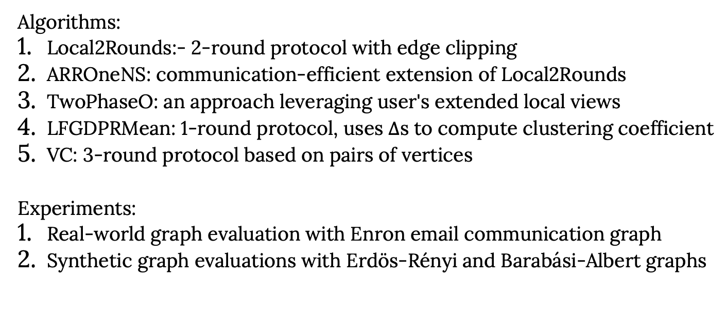
Empirical Evaluations
Algorithms:
Local2Rounds:- 2-round protocol with edge clipping
ARROneNS: communication-efficient extension of Local2Rounds
TwoPhaseO: an approach leveraging user's extended local views
LFGDPRMean: 1-round protocol, uses $Δ$s to compute clustering coefficient
VC: 3-round protocol based on pairs of vertices
Experiments:
Real-world graph evaluation with Enron email communication graph
Synthetic graph evaluations with Erdös-Rényi and Barabási-Albert graphs

Slide 13
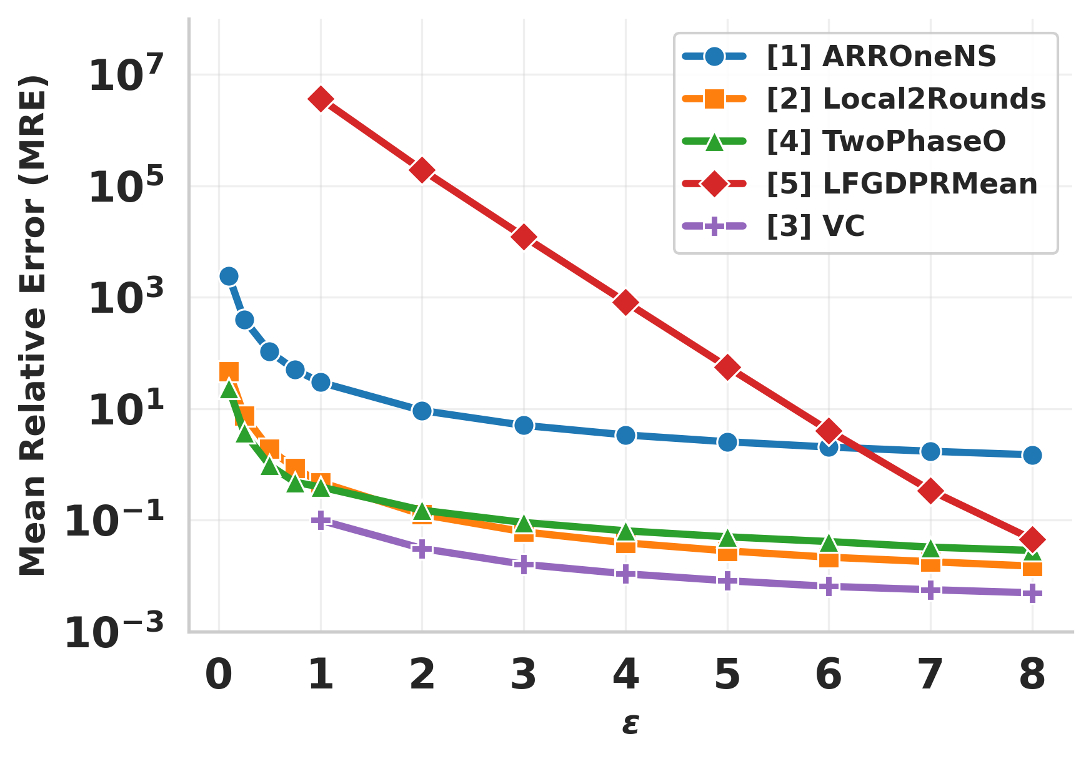
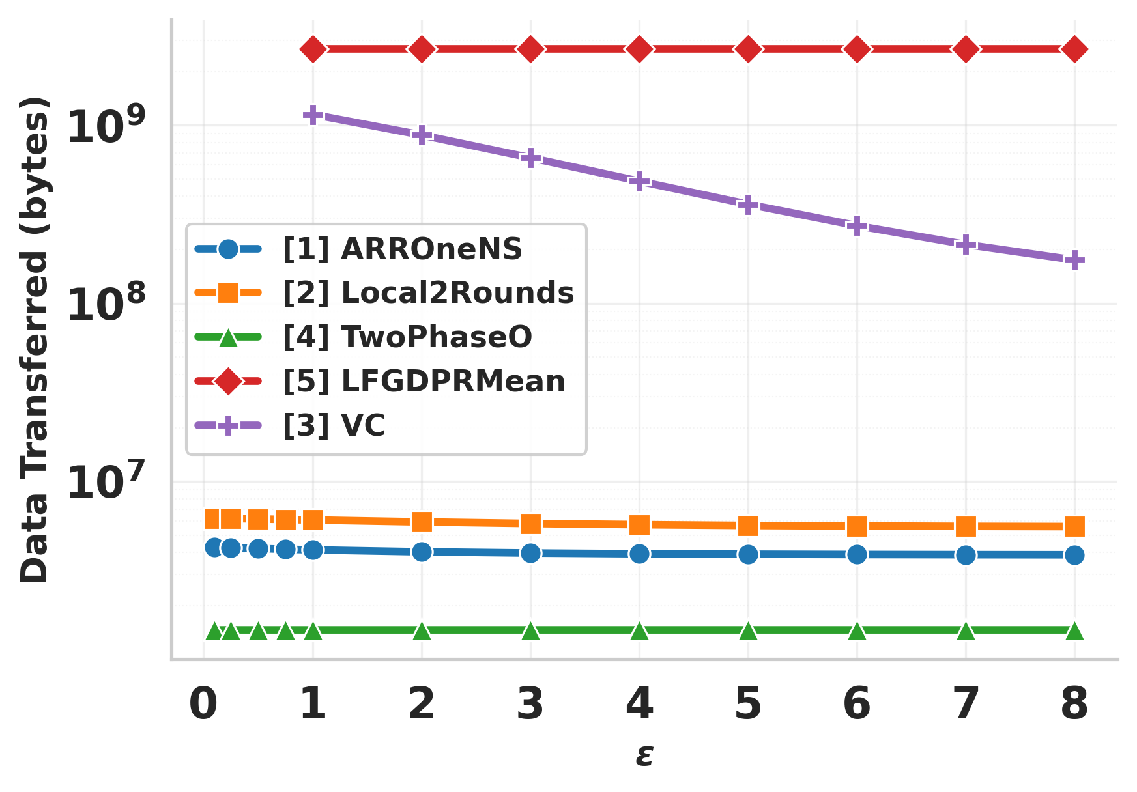
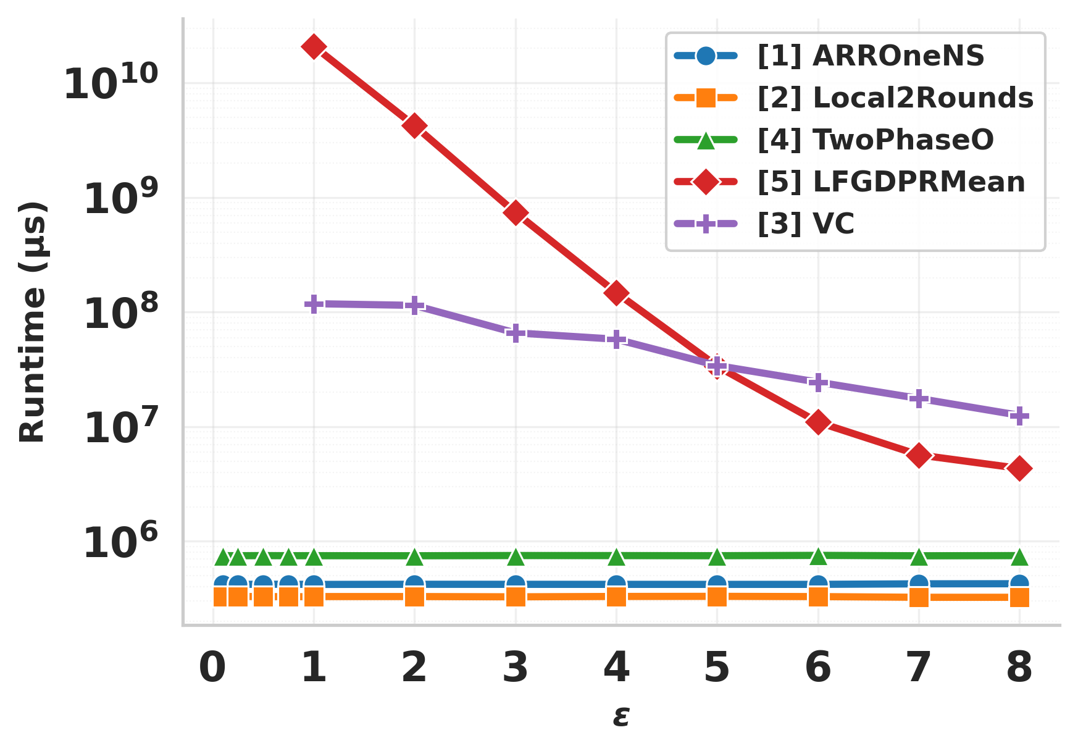
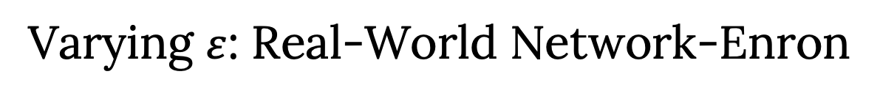
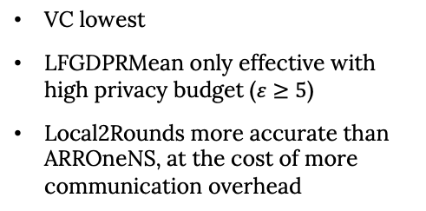
Varying $ε$: Real-World Network-Enron
VC lowest
LFGDPRMean only effective with high privacy budget ($ε≥5$)
Local2Rounds more accurate than ARROneNS, at the cost of more communication overhead
LFGDPRMean incurs high computation because triangle counting is performed over the entire noisy graph.
VC limits computation scope to the local neighborhood
ARROneNS and Local2Rounds have low complexity
TwoPhaseO lowest: avoid transferring adjacency vectors, count triangle on unperturbed graph
LFGDPRMean highest: each participant transmits roughly half of an adjacency bit vector
The other three saw decreasing runtime at different rates

Slide 14
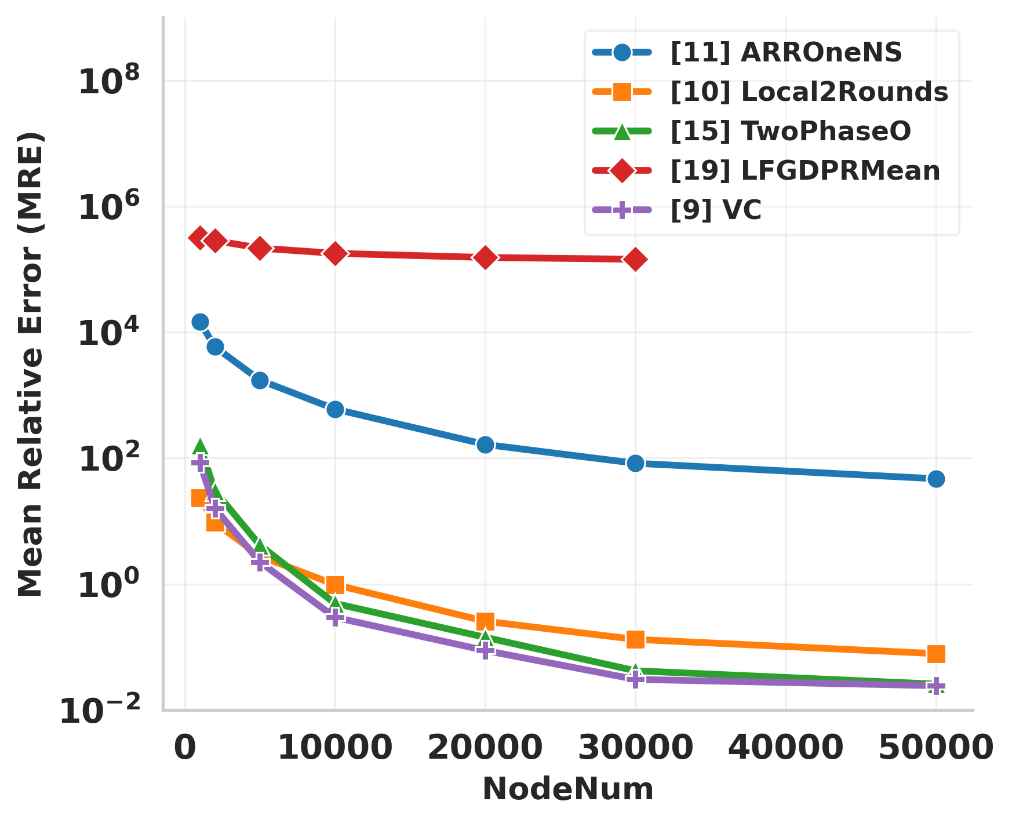
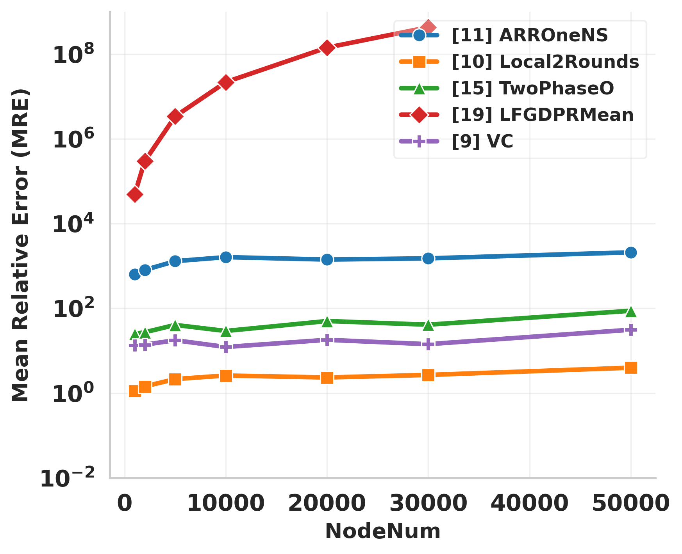
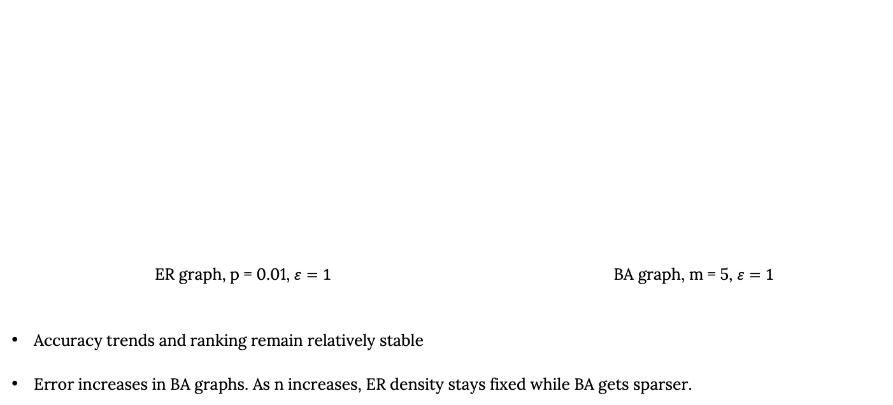
Varying Num Nodes: Synthetic Graphs
ER graph, p = 0.01, $ε=1$ BA graph, m = 5, $ε=1$
Accuracy trends and ranking remain relatively stable
Error increases in BA graphs. As n increases, ER density stays fixed while BA gets sparser.

Slide 15
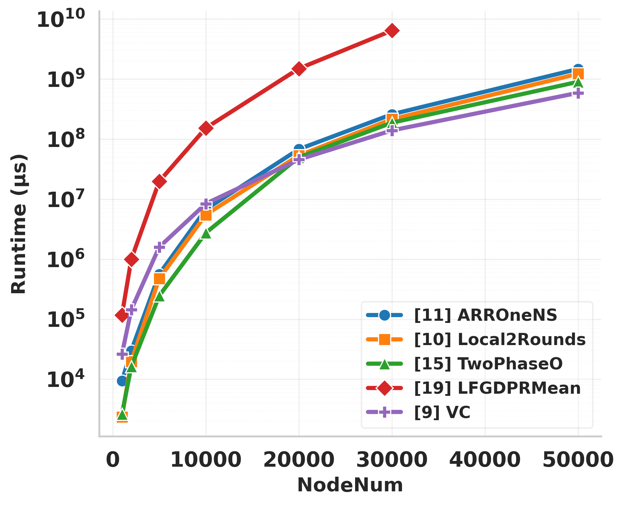
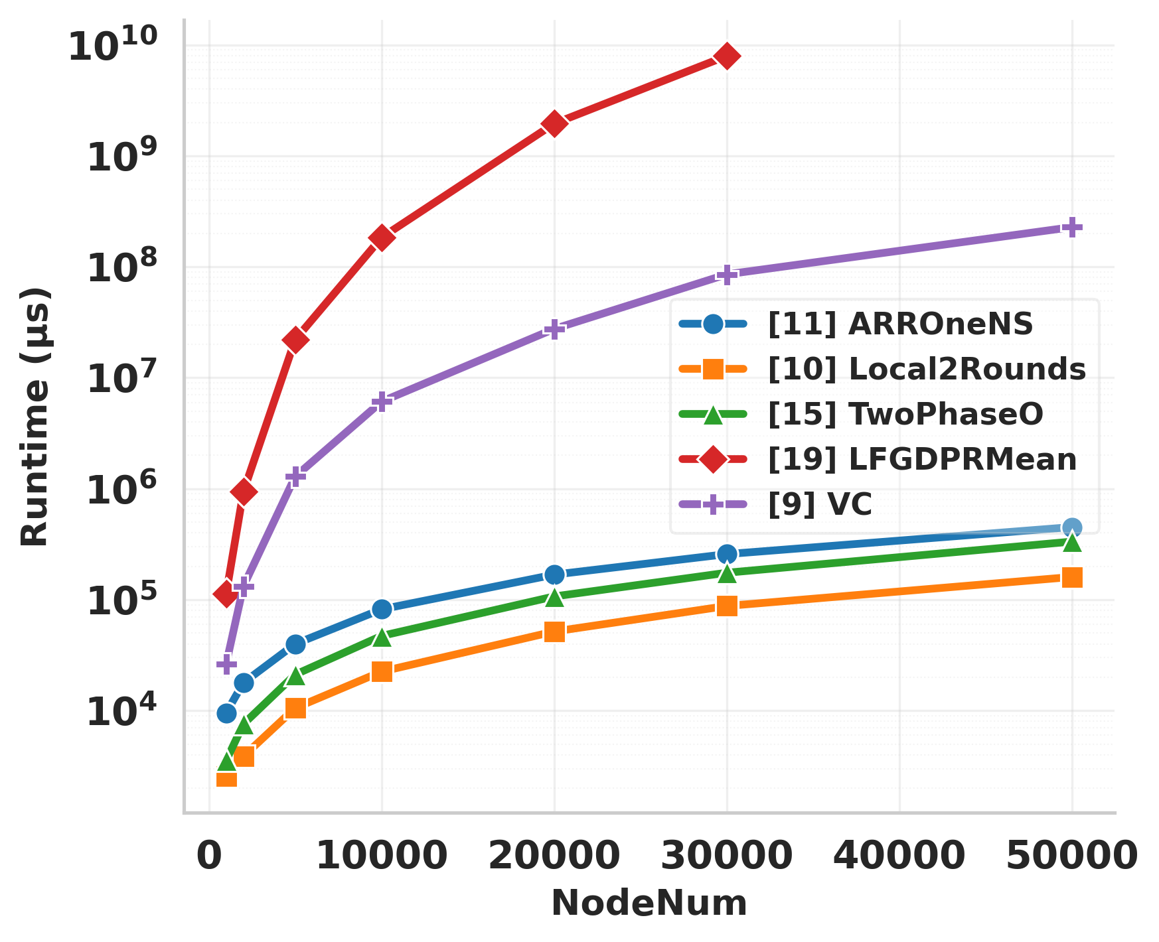
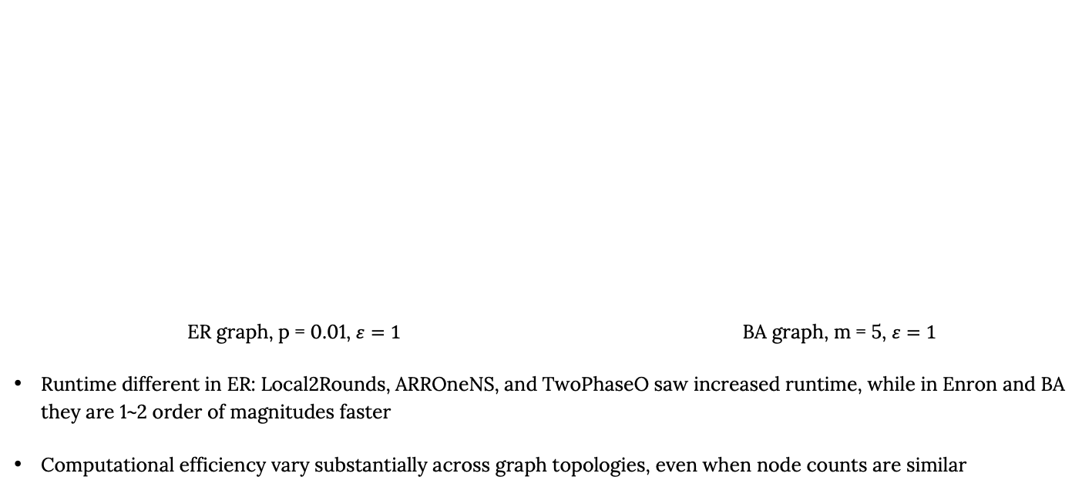
Varying Num Nodes: Synthetic Graphs
ER graph, p = 0.01, $ε=1$ BA graph, m = 5, $ε=1$
Runtime different in ER: Local2Rounds, ARROneNS, and TwoPhaseO saw increased runtime, while in Enron and BA they are 1~2 order of magnitudes faster
Computational efficiency vary substantially across graph topologies, even when node counts are similar

Slide 16
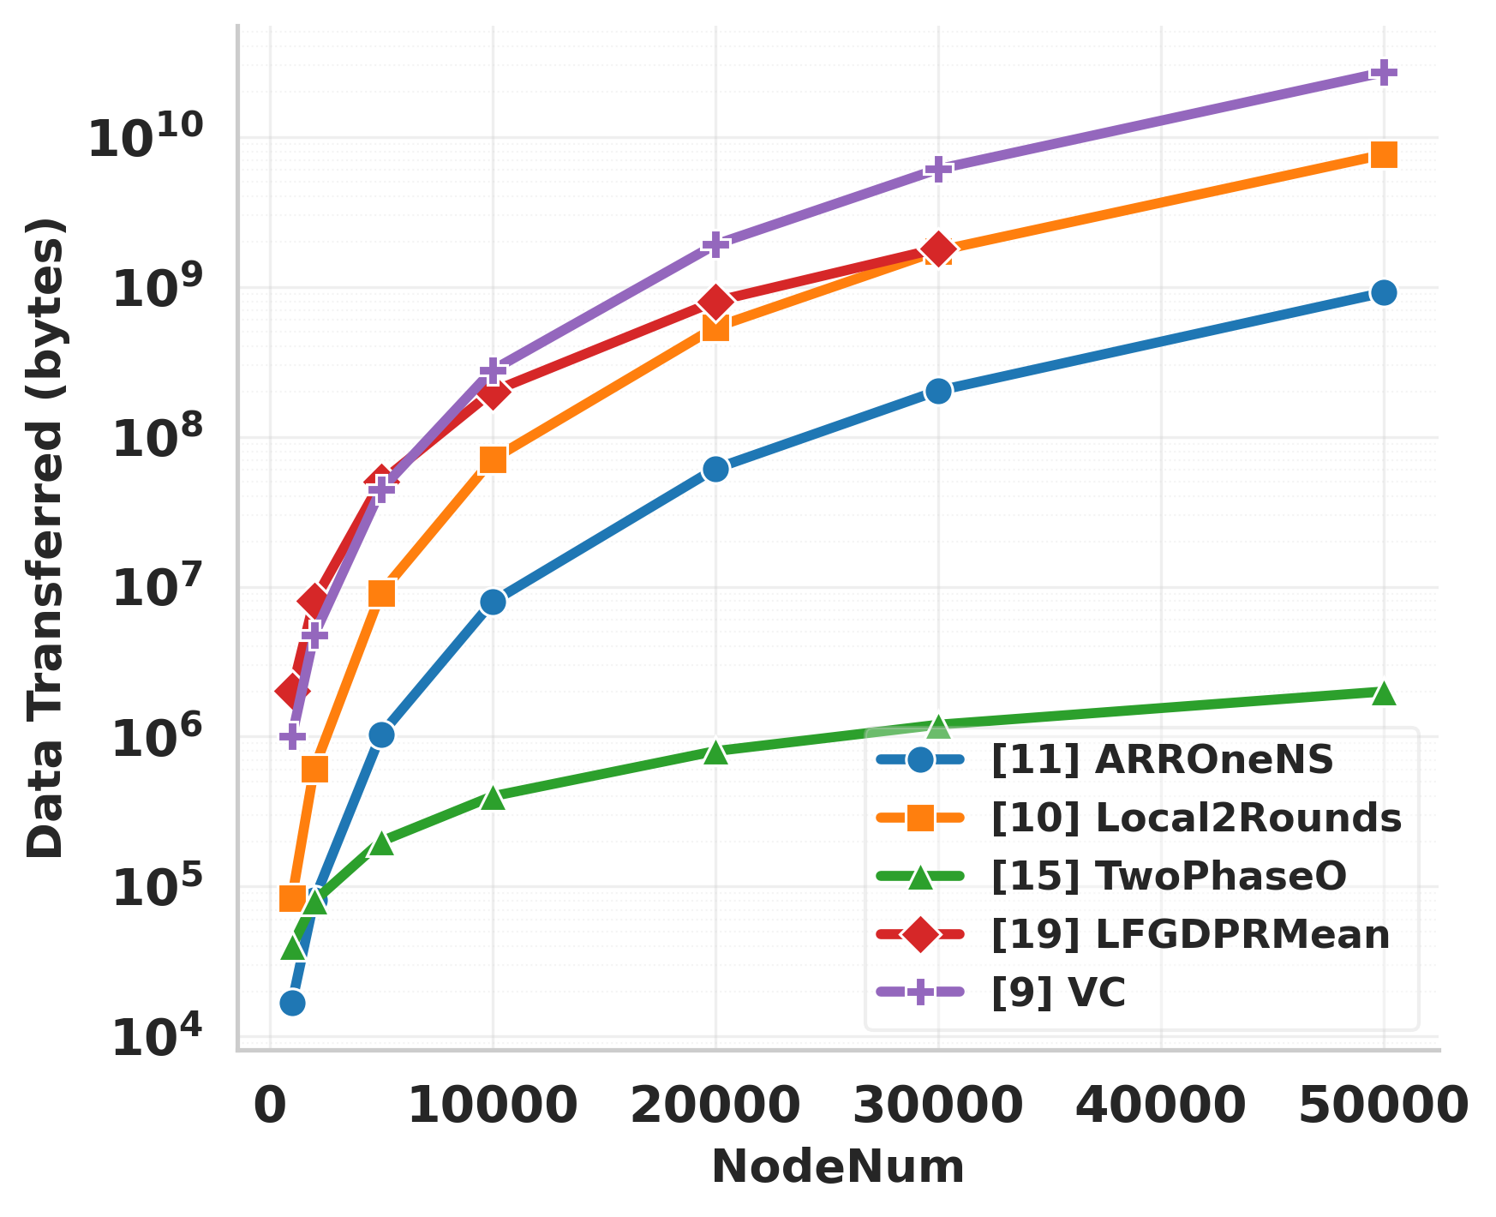
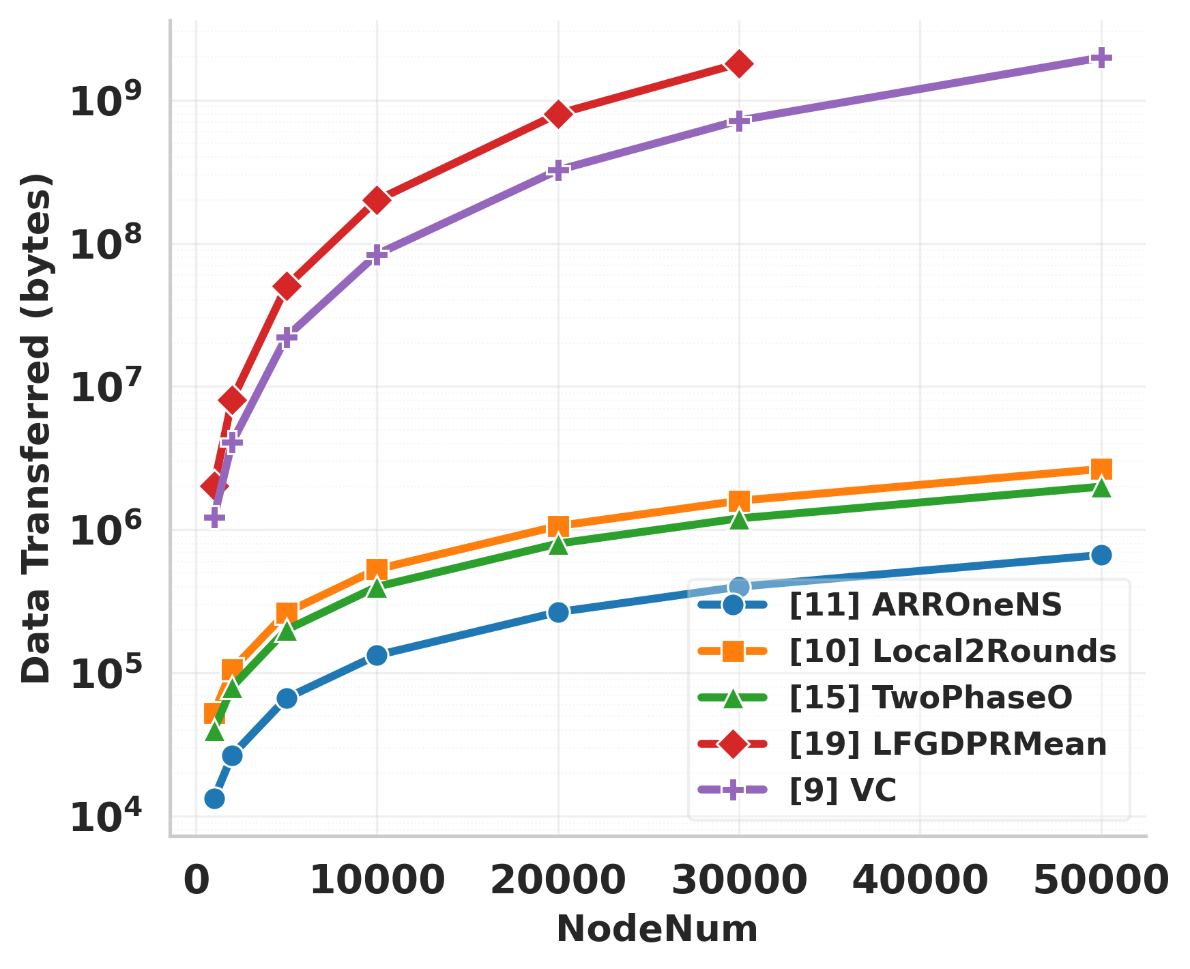
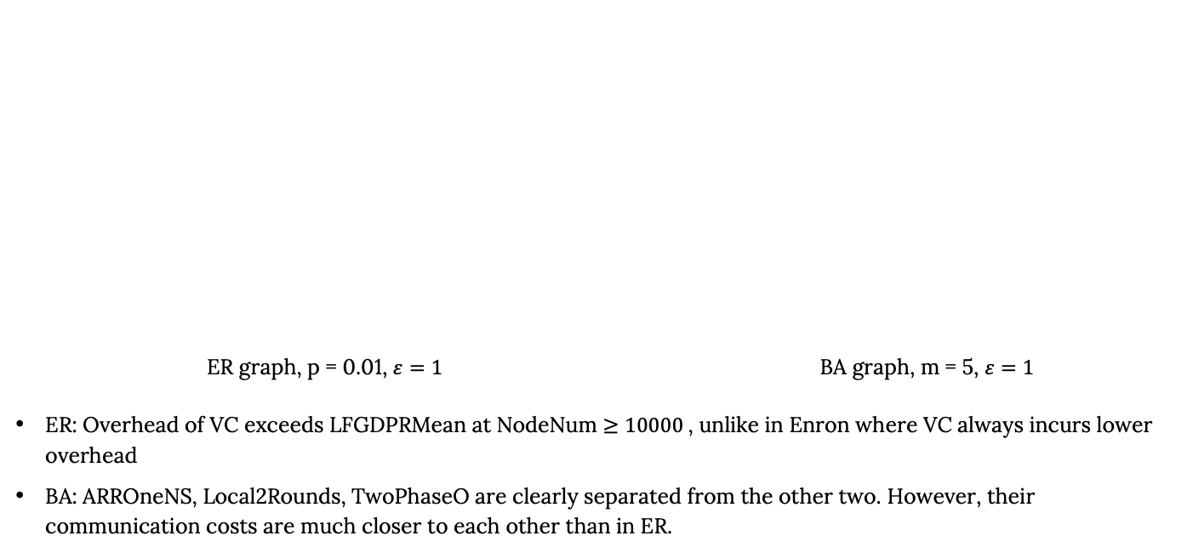
Varying Num Nodes: Synthetic Graphs
ER graph, p = 0.01, $ε=1$ BA graph, m = 5, $ε=1$
ER: Overhead of VC exceeds LFGDPRMean at NodeNum $≥10000$, unlike in Enron where VC always incurs lower overhead
BA: ARROneNS, Local2Rounds, TwoPhaseO are clearly separated from the other two. However, their communication costs are much closer to each other than in ER.

Slide 17
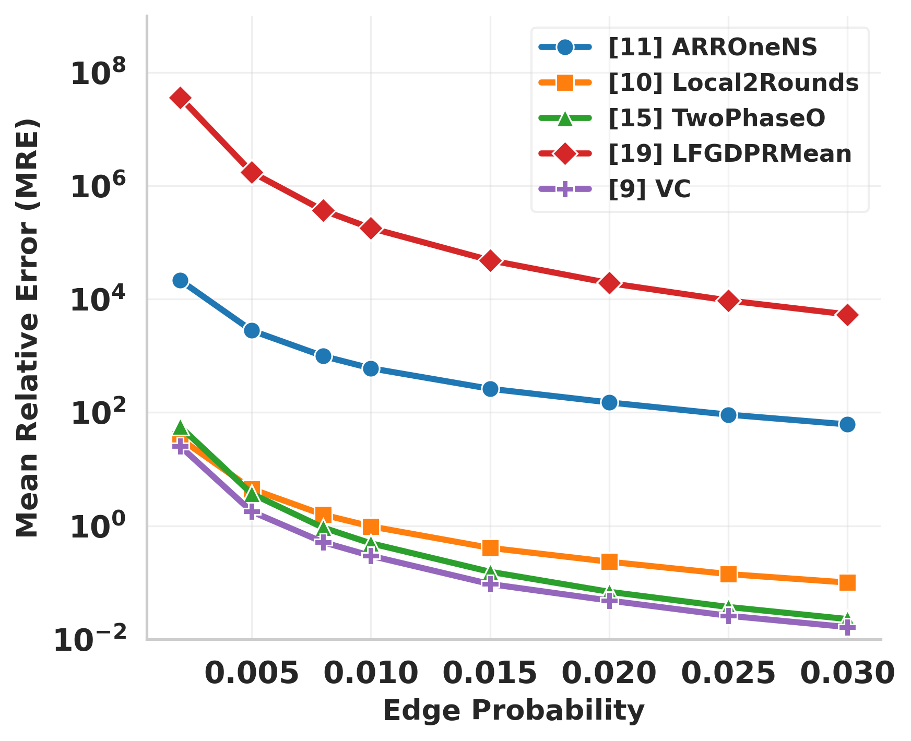
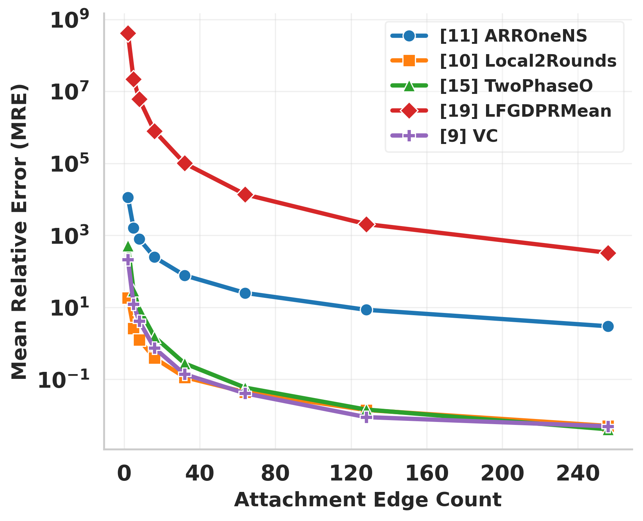
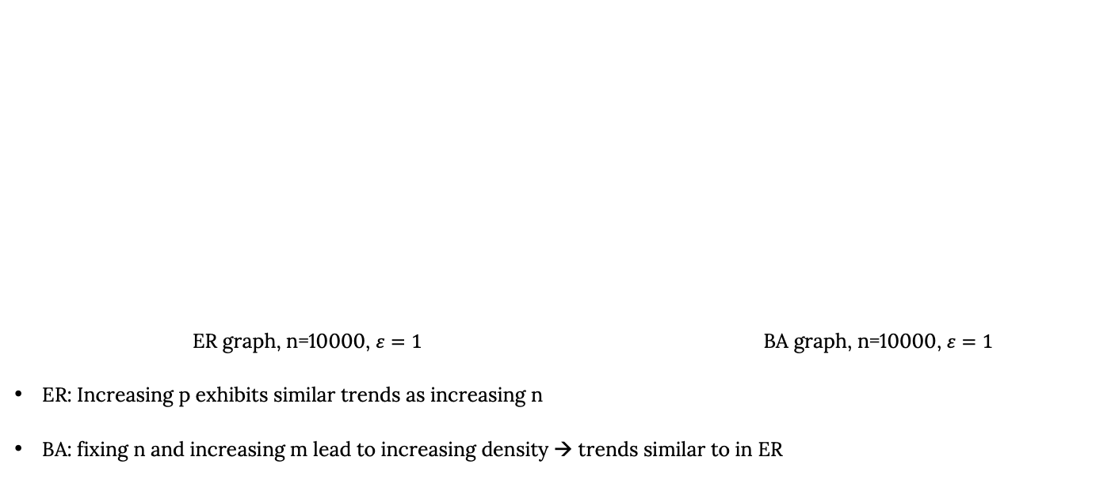
Varying Density: Synthetic Graphs
ER graph, n=10000, $ε=1$ BA graph, n=10000, $ε=1$
ER: Increasing p exhibits similar trends as increasing n
BA: fixing n and increasing m lead to increasing density → trends similar to in ER

Slide 18
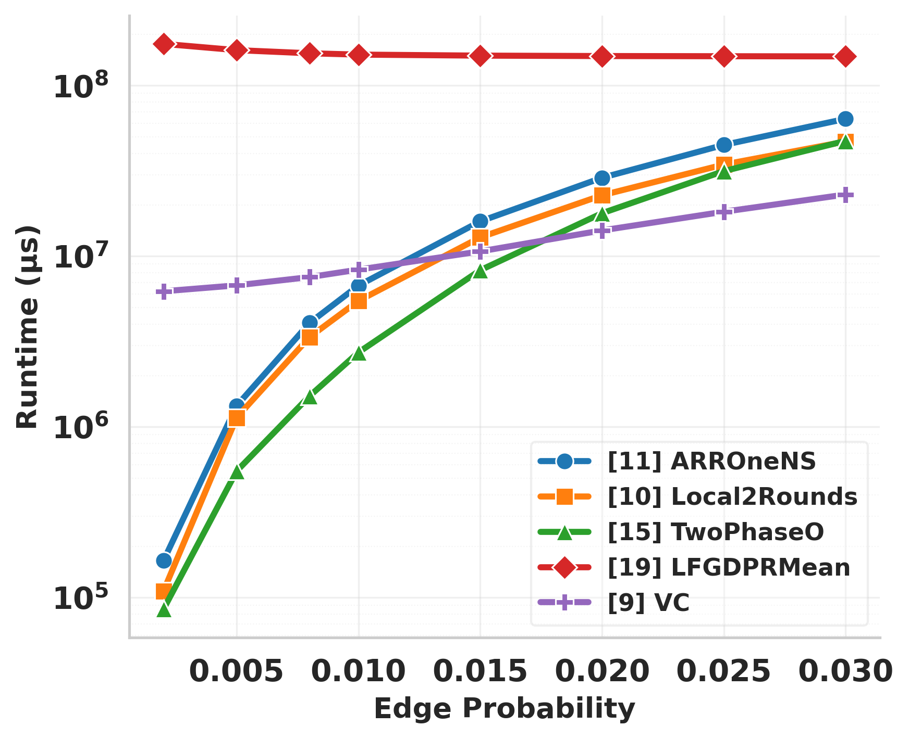
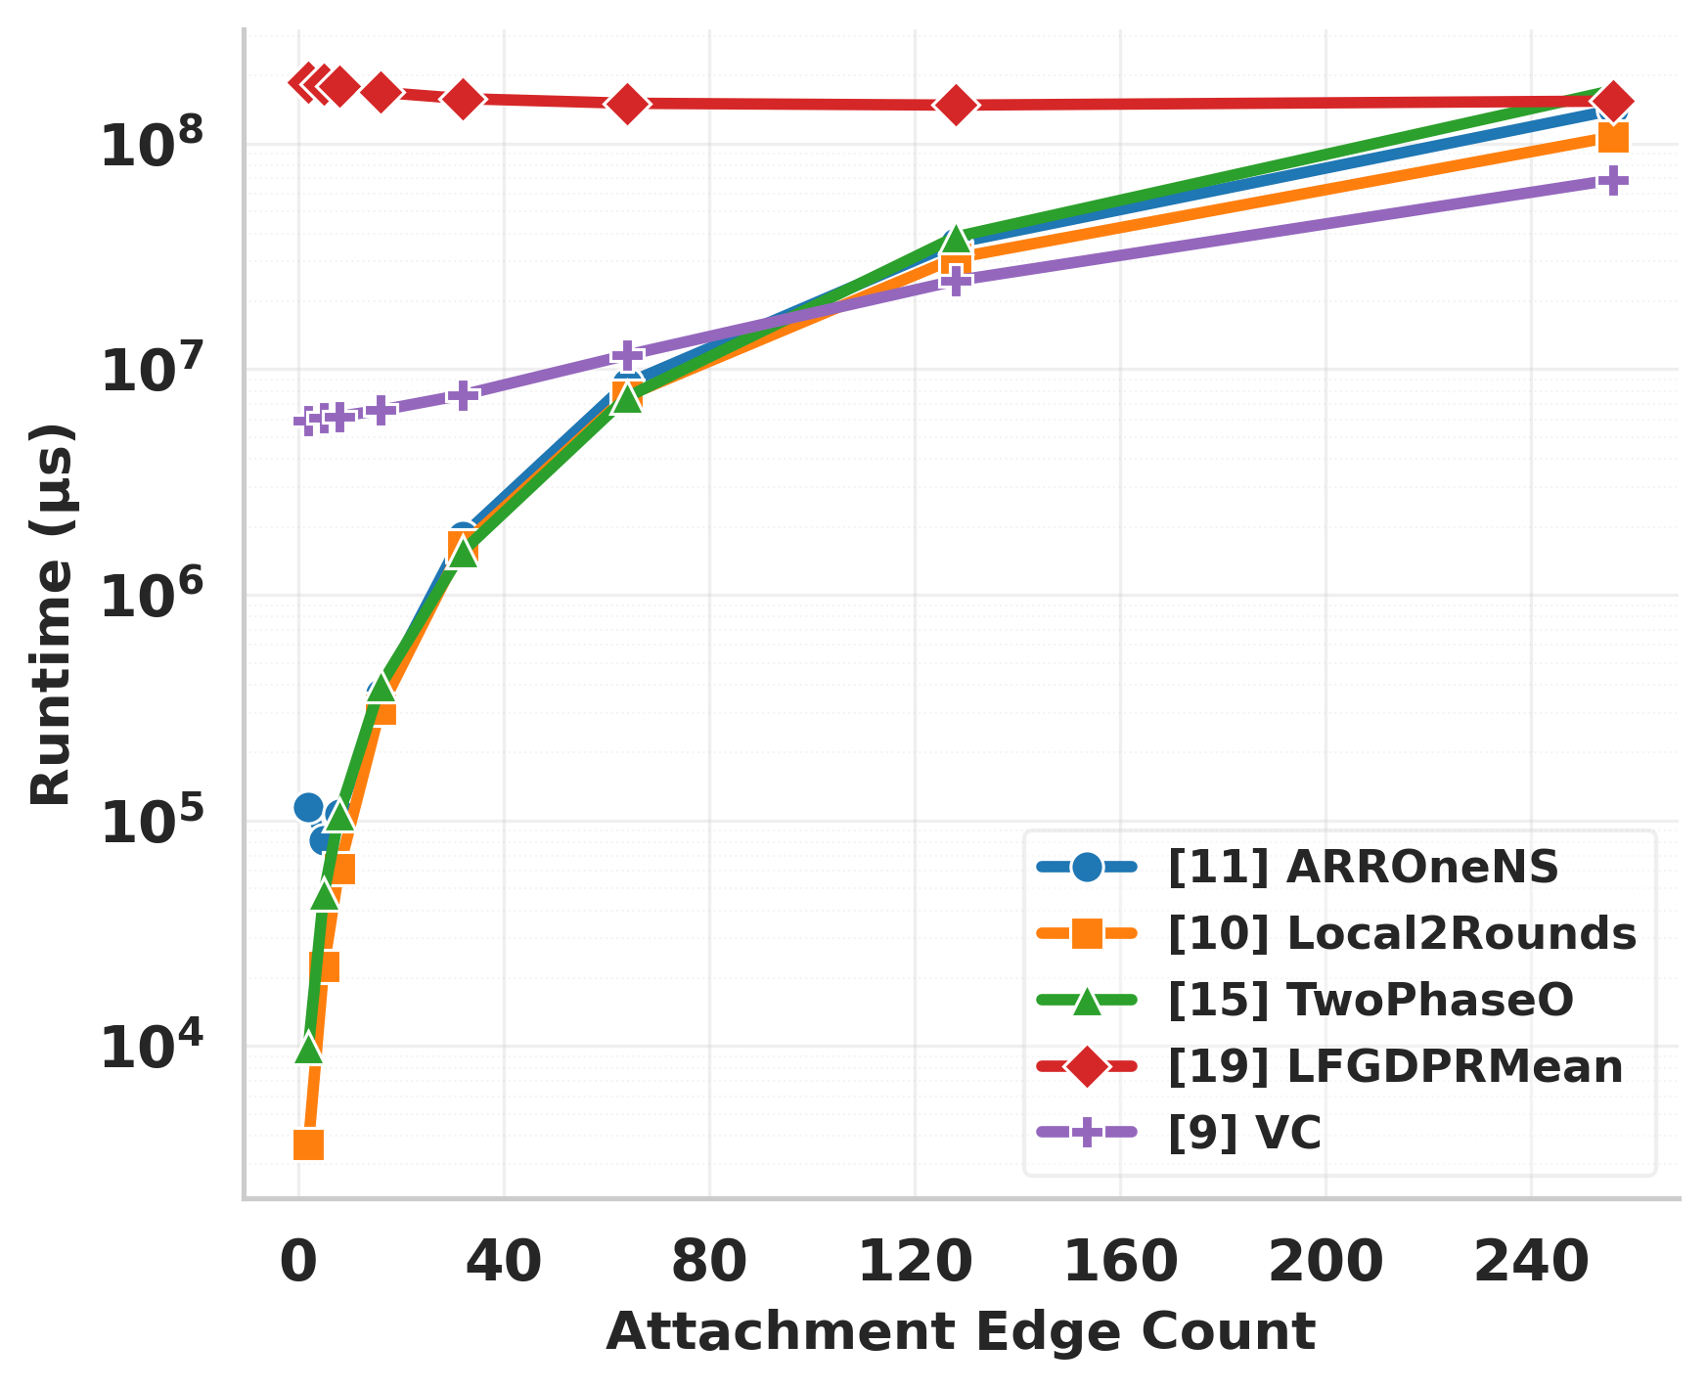
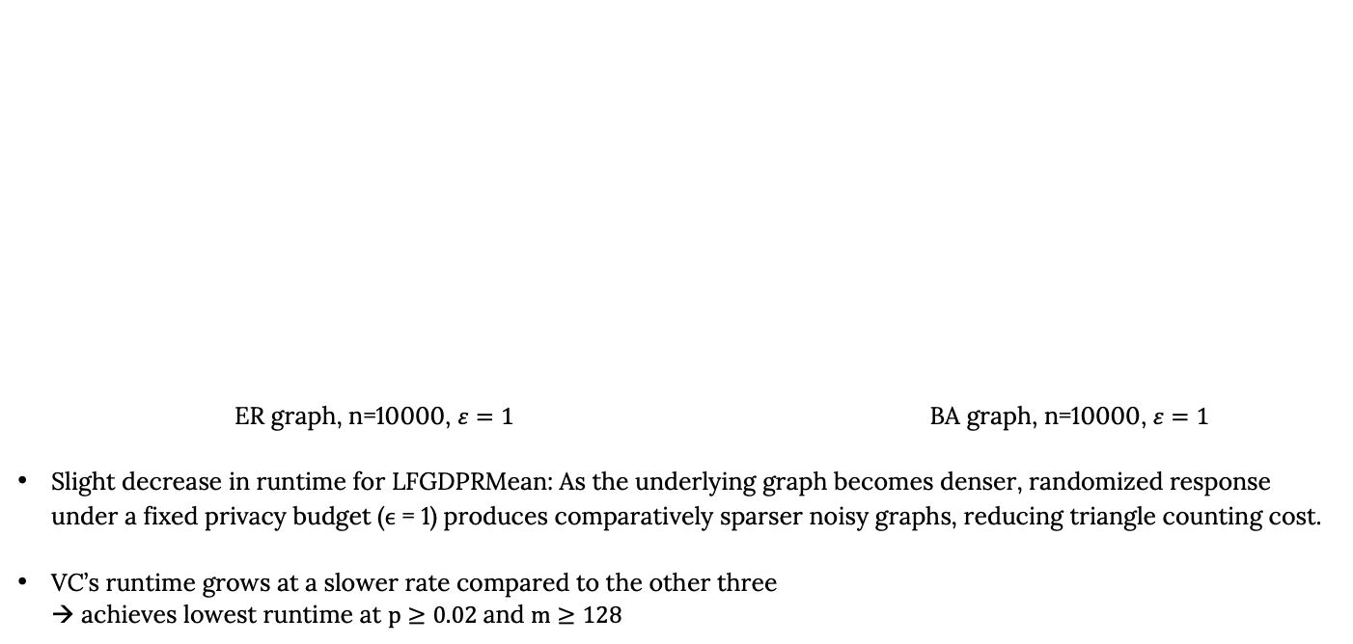
Varying Density: Synthetic Graphs
ER graph, n=10000, $ε=1$ BA graph, n=10000, $ε=1$
Slight decrease in runtime for LFGDPRMean: As the underlying graph becomes denser, randomized response under a fixed privacy budget (ϵ = 1) produces comparatively sparser noisy graphs, reducing triangle counting cost.
VC’s runtime grows at a slower rate compared to the other three
→ achieves lowest runtime at $p≥0.02$and $m≥128$

Slide 19
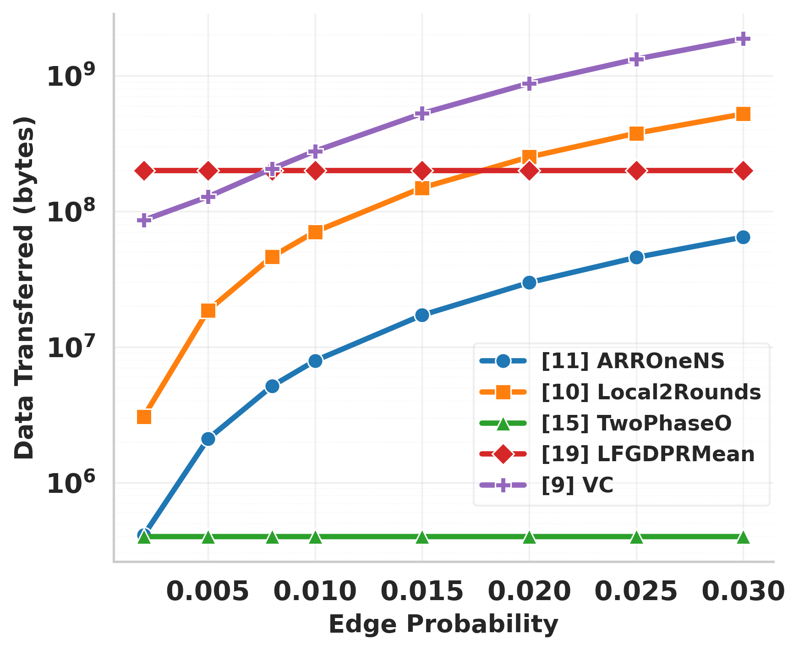
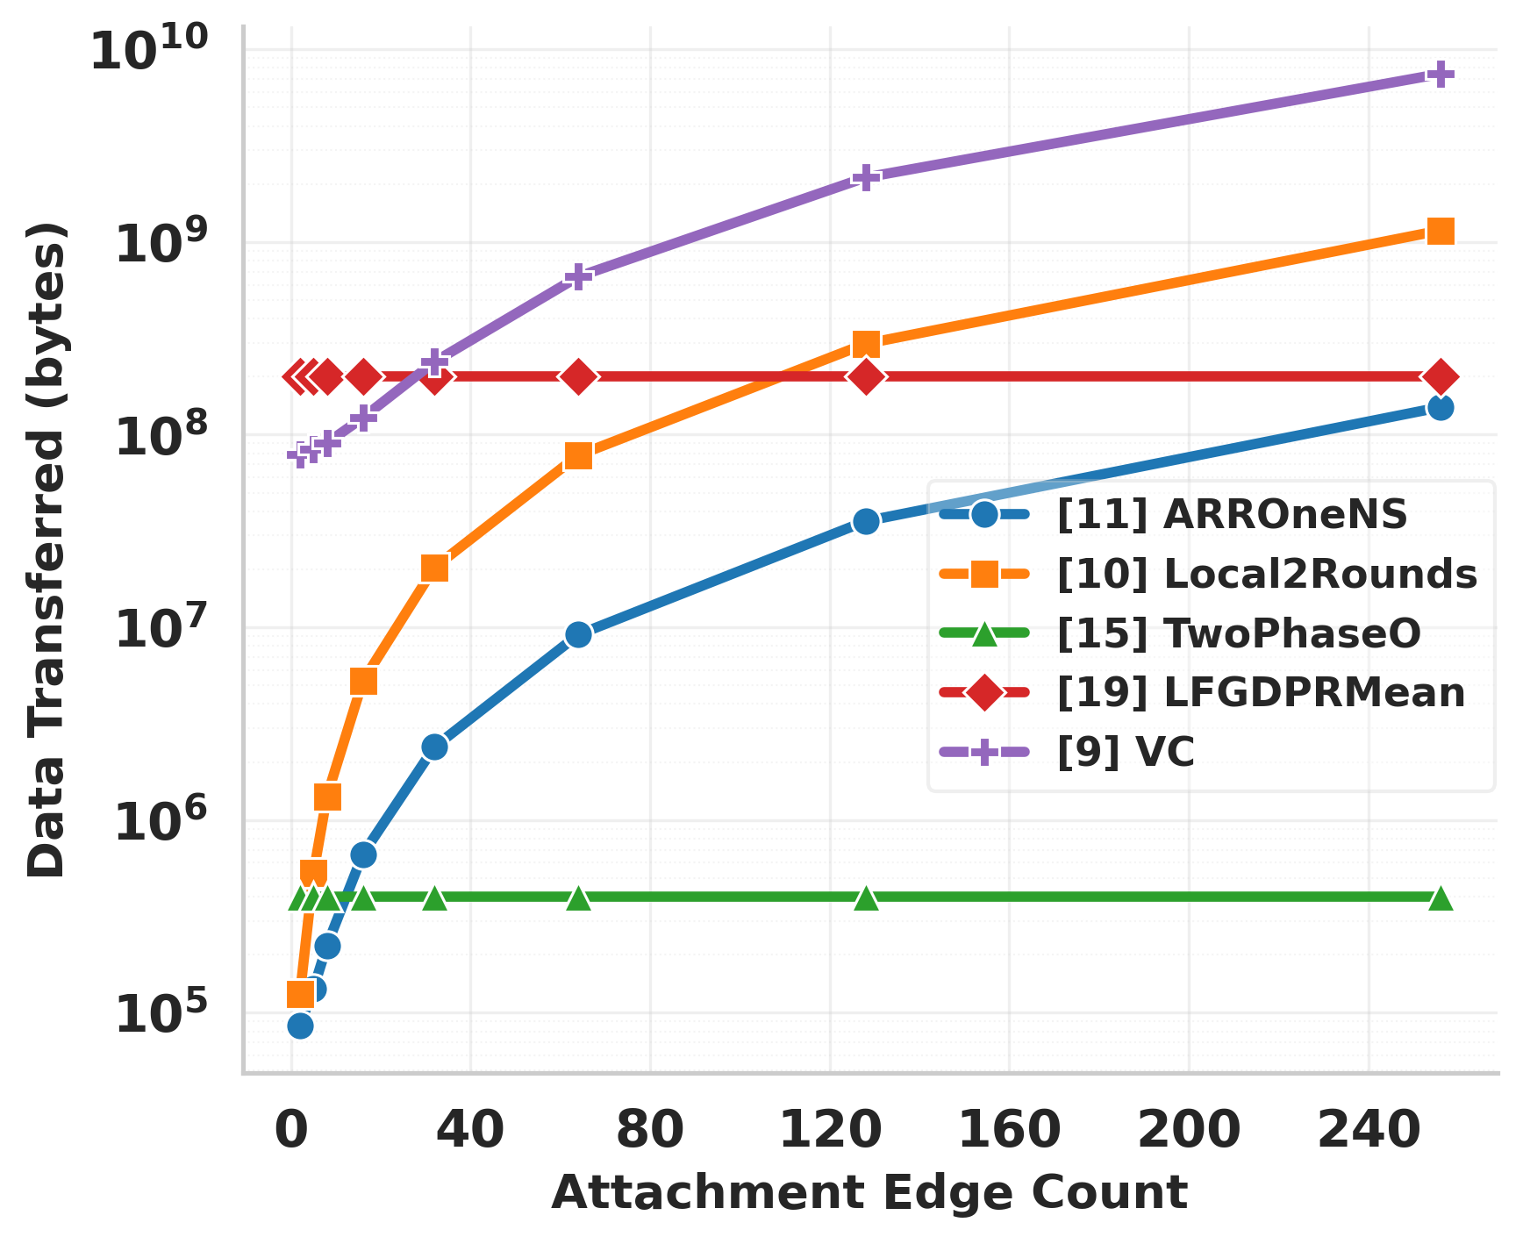
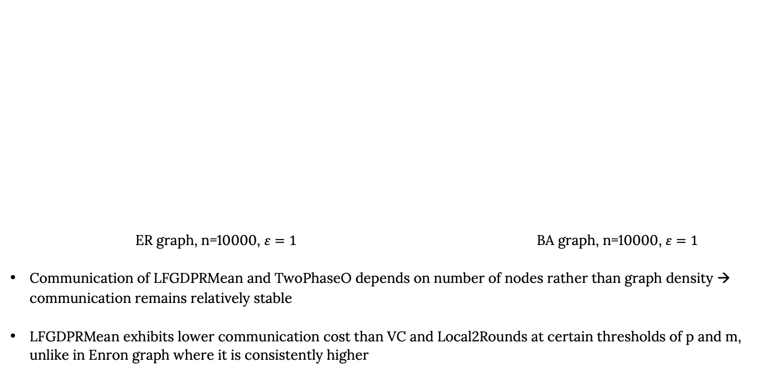
Varying Density: Synthetic Graphs
ER graph, n=10000, $ε=1$ BA graph, n=10000, $ε=1$
Communication of LFGDPRMean and TwoPhaseO depends on number of nodes rather than graph density → communication remains relatively stable
LFGDPRMean exhibits lower communication cost than VC and Local2Rounds at certain thresholds of p and m, unlike in Enron graph where it is consistently higher

Slide 20
Insights
Graph topology substantially influences algorithm behavior
Algorithm rankings are not invariant to graph structure, even if the
graph sizes are similar
Communication-efficient methods incur predictable utility trade-offs
Reducing communication overhead leads to increased error.
Runtime difference between these ARROneNS and Local2Rounds
remains mostly unchanged
→ accuracy-communication tradeoff can be tuned independently of
computational cost.
TwoPhaseO is effective under permissive privacy assumptions
Effective when exposing neighbor lists is acceptable and
communication budgets are limited
(transmission cost only scales with n)

Slide 21
Insights
LFGDPRMean performs best under weaker privacy requirements
Low accuracy and high runtime except at large ϵ
Overhead is only dependent on n
VC consistently achieves the strongest accuracy
Highest accuracy among evaluated methods
at relatively high communication cost
Extra round to report noisy degrees contributes to communication overhead

Slide 22
References
Al Hasan, M., Dave, V.S.: Triangle counting in large networks: a review. WIREs Data Mining and Knowledge Discovery 8(2), e1226 (2018). https://doi.org/https://doi.org/10.1002/widm.1226, https://wires. onlinelibrary.wiley.com/doi/abs/10.1002/widm.1226
Albert, R., Barabási, A.L.: Statistical mechanics of complex networks. Reviews of Modern Physics 74(1), 47–97 (Jan 2002). https://doi.org/10.1103/revmodphys.74.47
Dwork, C., Roth, A.: The algorithmic foundations of differential privacy. Found. Trends Theor. Comput. Sci. 9(3–4), 211–407 (Aug 2014). https://doi.org/10.1561/0400000042, https://doi.org/10.1561/0400000042
Erdős, P., Rényi, A., et al.: On the evolution of random graphs. Publications of the (1960)
Erlingsson, U., Pihur, V., Korolova, A.: Rappor: Randomized aggregatable privacypreserving ordinal response. In: Proceedings of the 2014 ACM SIGSAC Conference on Computer and Communications Security. pp. 1054–1067. CCS ’14, ACM (Nov 2014). https://doi.org/10.1145/2660267.2660348
Gursoy, M.E., Tamersoy, A., Truex, S., Wei, W., Liu, L.: Secure and utility-aware data collection with condensed local differential privacy. IEEE Trans. Dependable Secur. Comput. 18(5), 2365–2378 (Sep 2021). https://doi.org/10.1109/TDSC.2019.2949041
Hay, M., Machanavajjhala, A., Miklau, G., Chen, Y., Zhang, D.: Principled evaluation of differentially private algorithms using dpbench (2015), https://arxiv. org/abs/1512.04817
Hay, M., Machanavajjhala, A., Miklau, G., Chen, Y., Zhang, D., Bissias, G.: Exploring privacy-accuracy tradeoffs using dpcomp. In: Proceedings of the 2016 International Conference on Management of Data. p. 2101–2104. SIGMOD ’16, Association for Computing Machinery, New York, NY, USA (2016). https://doi.org/10.1145/2882903.2899387, https://doi.org/ 10.1145/2882903.2899387
He, Y., Wang, K., Zhang, W., Lin, X., Zhang, Y., Ni, W.: Robust privacy-preserving triangle counting under edge local differential privacy. Proc. ACM Manag. Data 3(3) (Jun 2025). https://doi.org/10.1145/3725348
Imola, J., Murakami, T., Chaudhuri, K.: Locally differentially private analysis of graph statistics. In: 30th USENIX Security Symposium (USENIX Security 21). pp. 983–1000. USENIX Association (Aug 2021)
Imola, J., Murakami, T., Chaudhuri, K.: Communication-Efficient triangle counting under local differential privacy. In: 31st USENIX Security Symposium (USENIX Security 22). pp. 537–554. USENIX Association, Boston, MA (Aug 2022)
Leskovec, J., Krevl, A.: SNAP Datasets: Stanford large network dataset collection. http://snap.stanford.edu/data (Jun 2014)
Leskovec, J., Mcauley, J.: Learning to discover social circles in ego networks. In: Pereira, F., Burges, C., Bottou, L., Weinberger, K. (eds.) Advances in Neural Information Processing Systems. vol. 25. Curran Associates, Inc. (2012)
Liu, S., Du, H., Cao, Y., Yan, B., Liu, J., Yoshikawa, M.: Pgb: Benchmarking differentially private synthetic graph generation algorithms (2024), https: //arxiv.org/abs/2408.02928
Sun, H., Xiao, X., Khalil, I., Yang, Y., Qin, Z., Wang, H.W., Yu, T.: Analyzing subgraph statistics from extended local views with decentralized differential privacy. In: Proceedings of the 2019 ACM SIGSAC Conference on Computer and Communications Security. pp. 703–717. CCS ’19, Association for Computing Machinery, New York, NY, USA (2019). https://doi.org/10.1145/3319535.3354253
Wang, T., Blocki, J., Li, N., Jha, S.: Locally differentially private protocols for frequency estimation. In: 26th USENIX Security Symposium (USENIX Security 17). pp. 729–745. USENIX Association, Vancouver, BC (Aug 2017)
Warner, S.L.: Randomized response: A survey technique for eliminating evasive answer bias. Journal of the American statistical association 60(309), 63–69 (1965)
Xia, S., Chang, B., Knopf, K., He, Y., Tao, Y., He, X.: Dpgraph: A benchmark platform for differentially private graph analysis. In: Proceedings of the 2021 International Conference on Management of Data. p. 2808–2812. SIGMOD ’21, Association for Computing Machinery, New York, NY, USA (2021). https://doi.org/10.1145/3448016.3452756, https://doi.org/ 10.1145/3448016.3452756
Ye, Q., Hu, H., Au, M.H., Meng, X., Xiao, X.: Lf-gdpr: A framework for estimating graph metrics with local differential privacy. IEEE Transactions on Knowledge and Data Engineering 34(10), 4905–4920 (2022). https://doi.org/10.1109/TKDE.2020.3047124
Anon.Retrieved September 10, 2026 from https://acumenresearch.io/using-social-network-analysis-to-explore-and-enhance-team-effectiveness/

Slide 23
THANK YOU!
truexs@denison.edu

